Slide 1
Realising the in-sessional dream?
Forging a successful collaboration with Engineering on jointly assessed summative assignments for Masters students.
Neil Adam Tibbetts

Slide 2

Introduction
Collaboration CALD + 2 departments in Engineering
In-sessional EAP context
= Successful collaboration?

Slide 3
Realising the in-sessional dream?
2 questions
Is this the in-sessional dream?
How close is this collaboration?

Slide 4
ISEAP and assessment What role should we have?
In-sessional language provision - ‘Fully inclusive: part of regular teaching, learning and assessment’ (Wingate, 2016: 60)
Co marking with content lecturers? Can be an ‘eye –opener’ e.g. AR in - Carr et al. (2021: 166)
Working with lecturers- raising genre awareness while writing assignment briefs (McGrath et al., 2019)
Boundaries between ‘language’ and ‘content’? (Bond, 2017) Value of having feedback from both language practitioners and content lecturers? (e.g. Caulton et al., 2017)
Possibilities for content lecturers to share marking workload with language practitioners, (Wingate, 2016: 62).
Possibly more common for language practitioners to have a stake in assessment practices in Australian contexts? (Tibbetts & Chapman, 2023: 206-207).

Slide 5
CONTEXT Academic language and literacy (ALL)
All levels (UG/PG) potentially up to 10000 students
40+ courses across all faculties at PG level
ALL for all
Embedded –CEM model (Sloan and Porter, 2010) but beyond this- integrated (Hanson et al., BALEAP 2023)
In timetables, involved in the unit teaching pattern, CALD not seen as a separate ‘provider’
Summative assessment set up in collaboration with Engineering lecturers on 2 programmes – over 3 + year period, both courses Int’l + home, 100-150 ss.

Slide 6
CONTEXT 2 ALL provisions
PG ALL COMP SCI- co-marking group presentations on the MSc Computer science programme (in TB1* unit Introduction to Computer Science)
PG ALL EEE – co-marking individual research review reports on MSc Electrical and electronic Engineering (EEE) pathways (in TB2 unit Engineering Research skills)
*TB = Teaching block

Slide 7
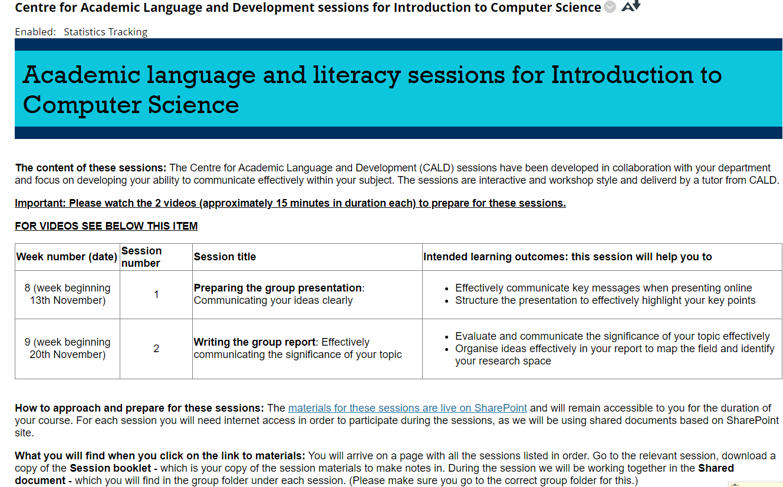
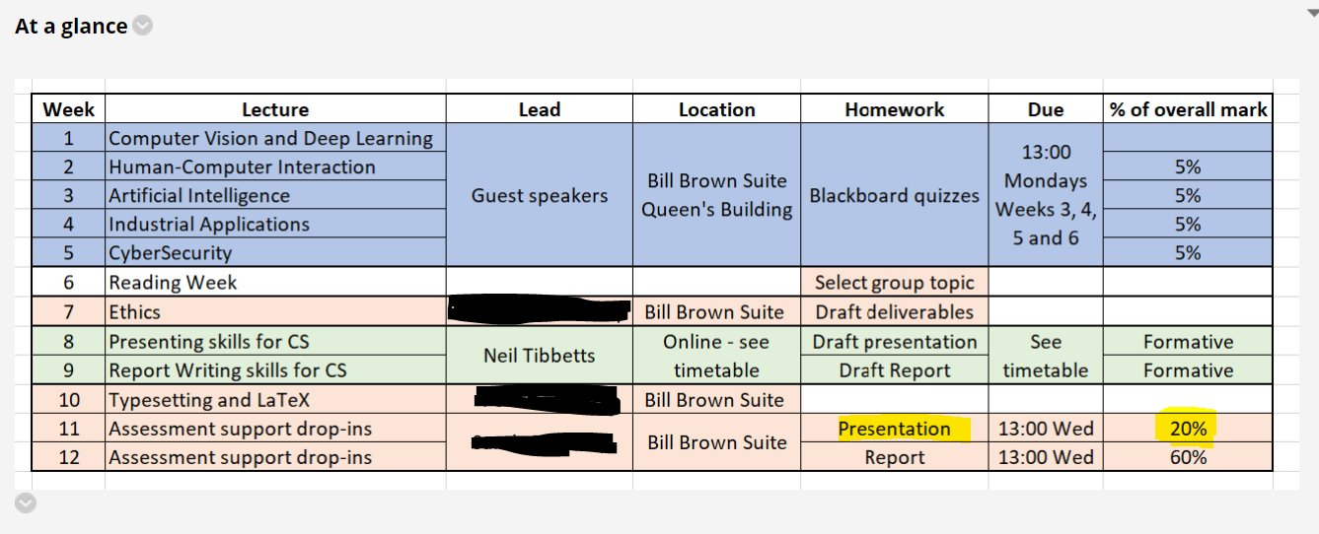
PG ALL COMP SCI- What we did
Screenshots from COMSM0084 Introduction to Computer Science unit 2023-24 Blackboard

Slide 8
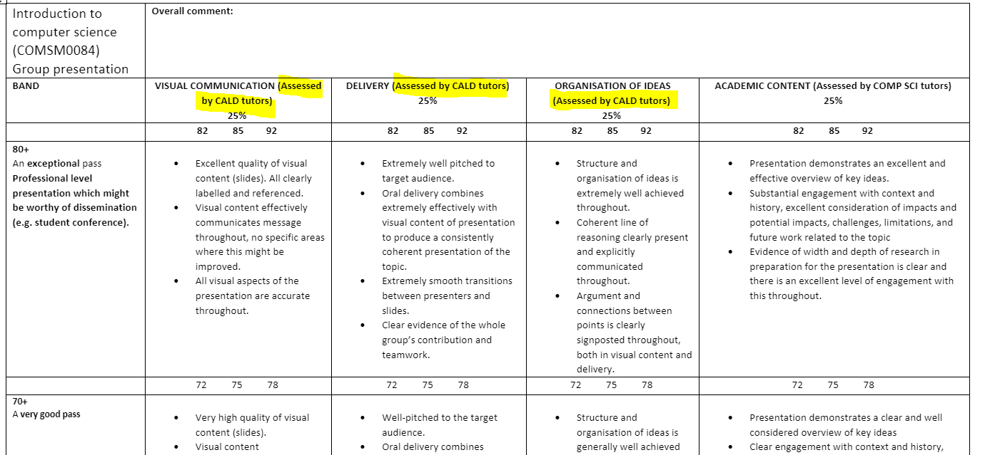
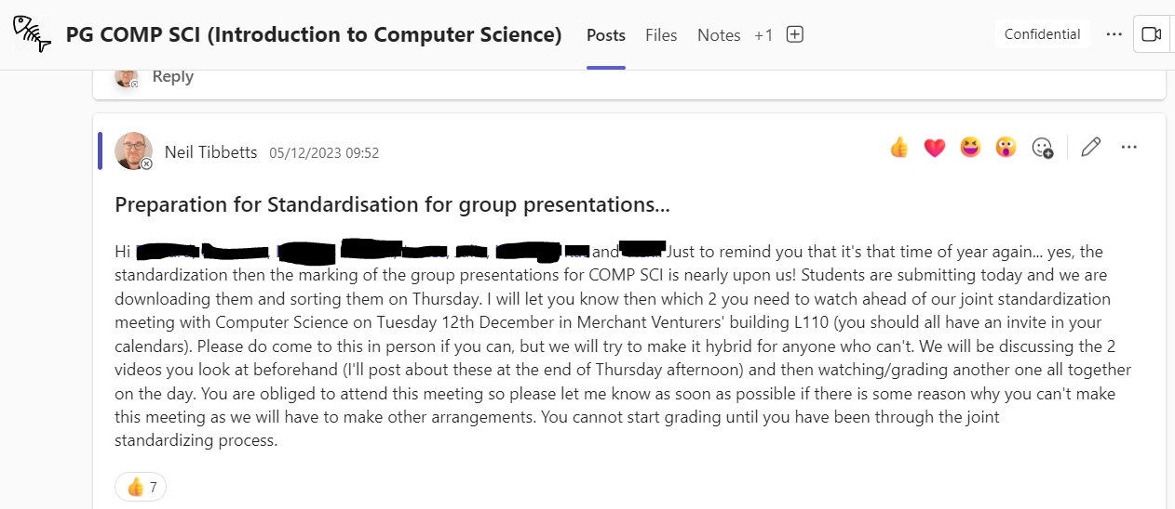
PG ALL COMP SCI- Processes

Slide 9
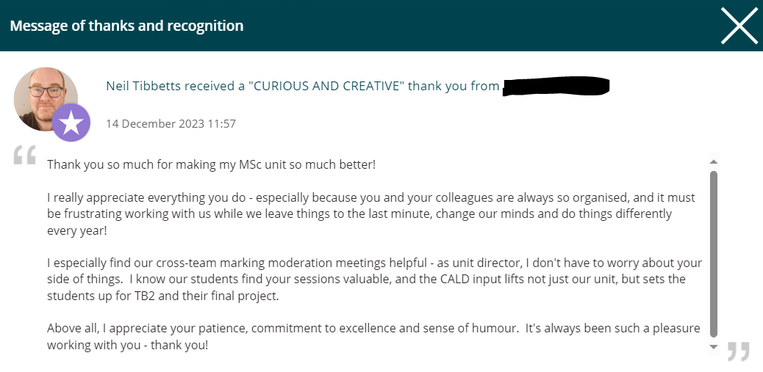
PG ALL COMP SCI- Impact
From UoB staff Thanks and Recognition ‘wall’ Dec 2023

Slide 10
PG ALL COMP SCI- Reflections
History of working on collaboration on assessment. Grading of group presentations over 3 years
Co-written (but not acknowledged) marking criteria
Shared standardization and moderation processes CS/CALD
Input on literacy- slide design/presentation skills
Only involved in the presentation, not in the group written report
Chance to meet lecturers as equals for CALD
Positive reputational impact (personal)
Intro to CS Unit disappearing in 2024-25
Issues…
L1/non L1 English cohort - Facilitating group dynamics?
Lecturers treating EAP markers as equals?
Who decides the mark?

Slide 11
PG ALL EEE- What we did
Feedback on drafts*
Co-created marking criteria (2020, reviewed 2022)
IPP (Interim project plan), RRR (Research review report)
Grading 30% of IPP (15% of the unit mark)*
Grading 20% of the RRR (85% of the unit mark)
*2020 and 2021 only, 2022-2023 RRR marking only.

Slide 12
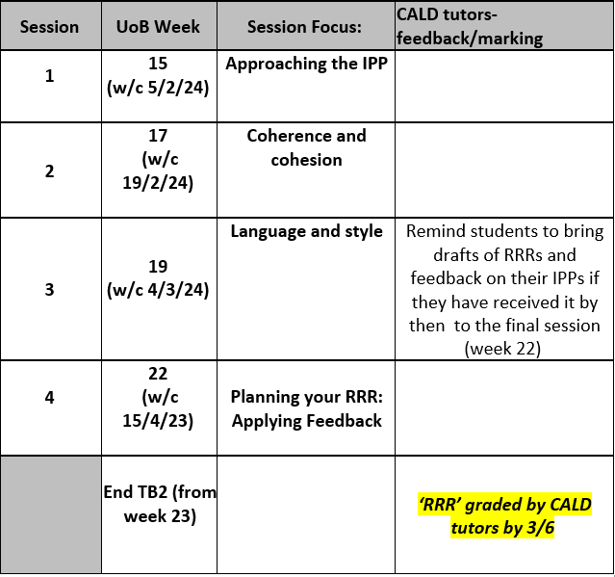
PG ALL EEE- Collaboration
We have involvement in welcome week lecture
Introduced as equals
‘Dr. Neil Tibbetts’
‘CALD sessions’, ‘CALD tutors’

Slide 13
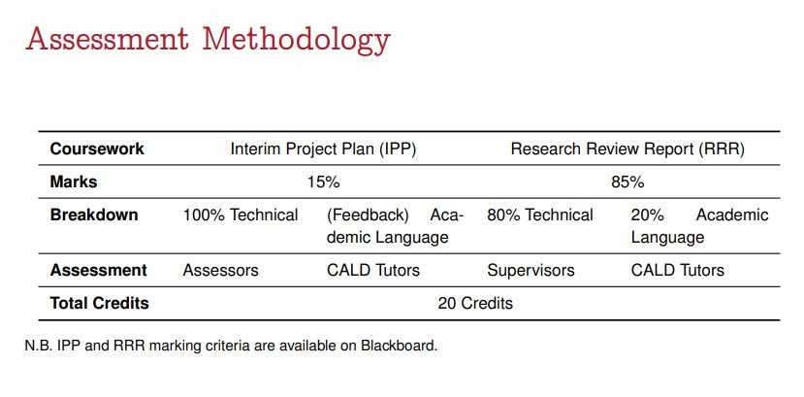
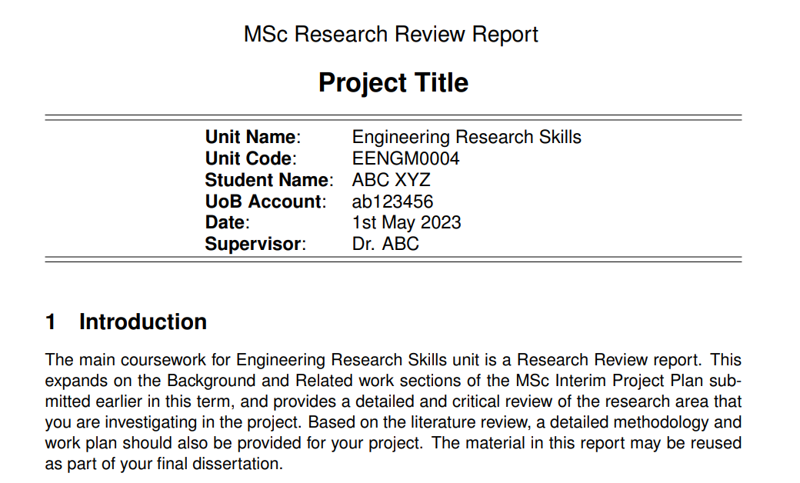
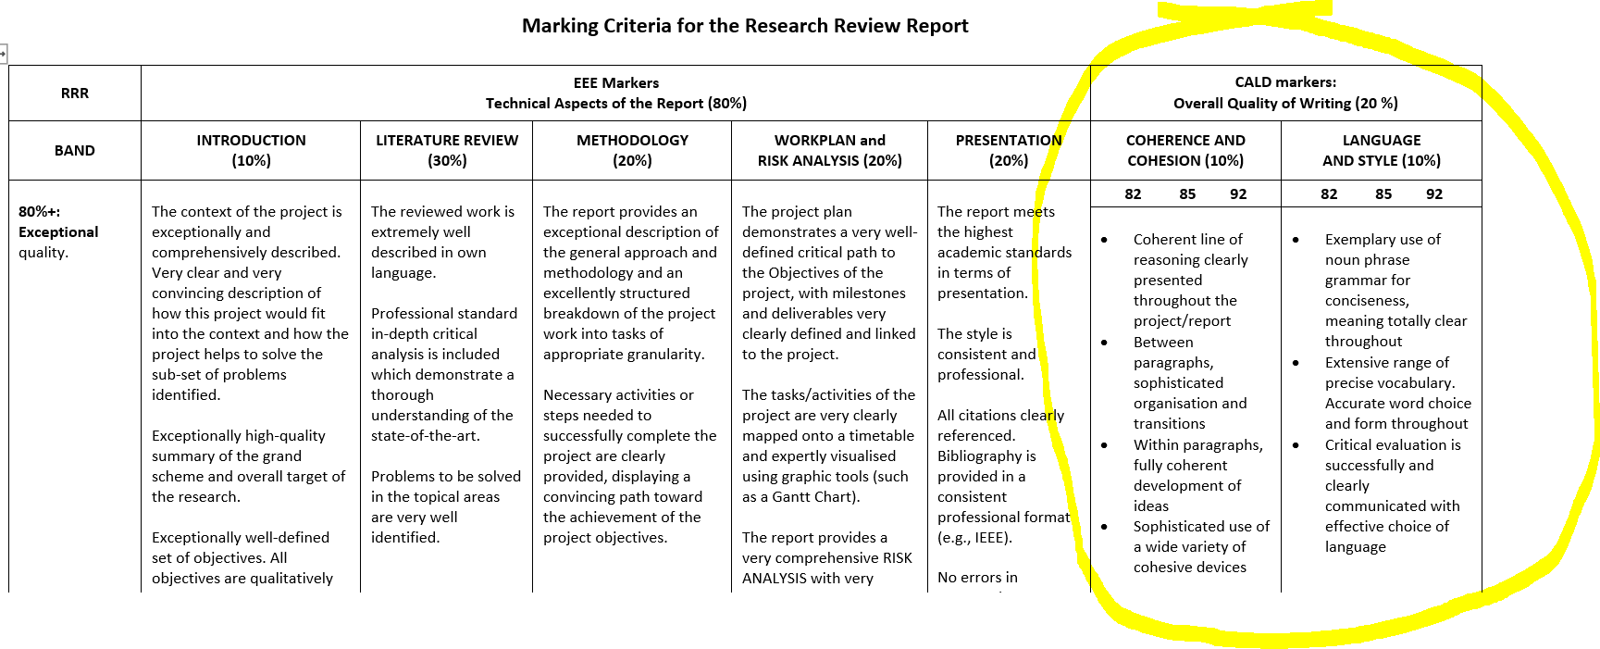
PG ALL EEE- Processes
EENGM0004 Engineering Research Skills unit 2023-24 Blackboard

Slide 14
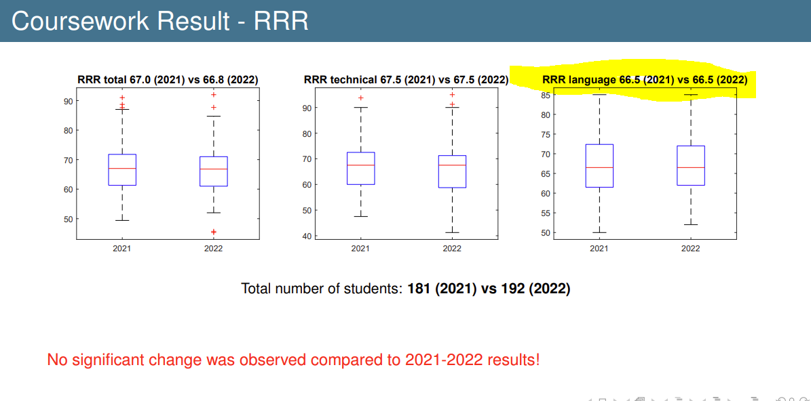
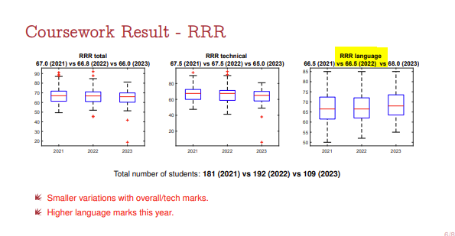
PG ALL EEE- Impact

Slide 15
PG ALL EEE - Reflections
Repeated over 4 years
Joint Development of marking criteria- our section – IPP and RRR
Included as equals in opening lecture
Not joint practices such as moderation/standardization (unlike Comp Sci)
Not invited to the exam board
ERS Unit being revised- moving to group project
Issues…
Treated as separate providers within the unit
Impact- Status of ALL with Engineering faculty
Benefit to CALD teaching staff
Language + Content

Slide 16
Summary- criteria for successful in-sessional assessment collaboration?
Involvement in procedures (marking criteria, assignment briefs, set up, standardization, marking, moderation)
Experience and expertise for us - involvement in Masters level summative marking
Reputation/visibility/impact for EAP centre
Sustainability of collaborative assessment practices
Collaboration and advisory role
Our positioning with lecturers
Literacy development, advocacy for language + content together

Slide 17
2 questions
Is this the in-sessional dream?
What type of collaboration do we seek in in-sessional EAP? Is assessment part of it and if so, what should be our involvement?

Slide 18
Any questions?
Any other experiences of collaboration in in-sessional + assessment?

Slide 19
References
Bond, B. (2020) Making Language Visible in the University: English for Academic Purposes and Internationalisation. Bristol: Multilingual Matters.
Carr, C., Maxwell, C., Rolinska, A. and Sizer, J. (2021) EAP Teachers Working in, with and through the Creative Arts. In MacDiarmid, C. and MacDonald, J. (Eds.) Pedagogies in English for Academic Purposes: Teaching and Learning in International Contexts. London: Bloomsbury Academic, 153-168.
Caulton, D., Northcott, J. and Gillies, P. (2019) EAP and subject specialist academic writing feedback collaboration In Gillway, M. (ed.) Proceedings of the 2017 BALEAP Conference Addressing the state of the union: Working together = learning together. Reading: Garnet education.
Hanson, L., Hendrie, P., High, K. , Jones, D. and Tibbetts, N.A. (2023) Deconstructing in-sessional: Underpinning theories and practical implications to define our EAP practice. (Conference presentation) In: BALEAP 2023 Caution! EAP under Deconstruction, University of Warwick, 21 April 2023.
McGrath, L., Negretti, R. and Nicholls, K. (2019) Hidden expectations: Scaffolding specialists’ genre knowledge of the assignment they set. Higher education research and development, (78) 835-853.
Sloan, D. and Porter, E. (2010) ‘Changing international student and business staff perceptions of in-sessional EAP: using the CEM model’ JEAP, 9:3, pp. 198-210.
Tibbetts, N. A. and Chapman, T. (2023) A guide to in-sessional EAP: Paradigms and practices. Abingdon: Routledge.
Wingate (2016) Academic Literacy and Student Diversity: The Case for Inclusive Practice. Bristol: Multilingual Matters.

