Slide 1
The contexts of collaboration
Rob Playfair, rplayf01@student.bbk.ac.uk / @RobPlayfair (X)
Queen Mary & Birkbeck College, University of London
BALEAP PIM, Kings College London, 7th March 2024

Slide 2
Overview
Professional vision as political
How we define and use collaboration in EAP:
  Specificity
  Relevance
An alternative: contexts of collaboration
My study:
  Ethnography as counter-hegemony
  Early analysis - a more complex picture of collaboration
EAP professional vision

Slide 3
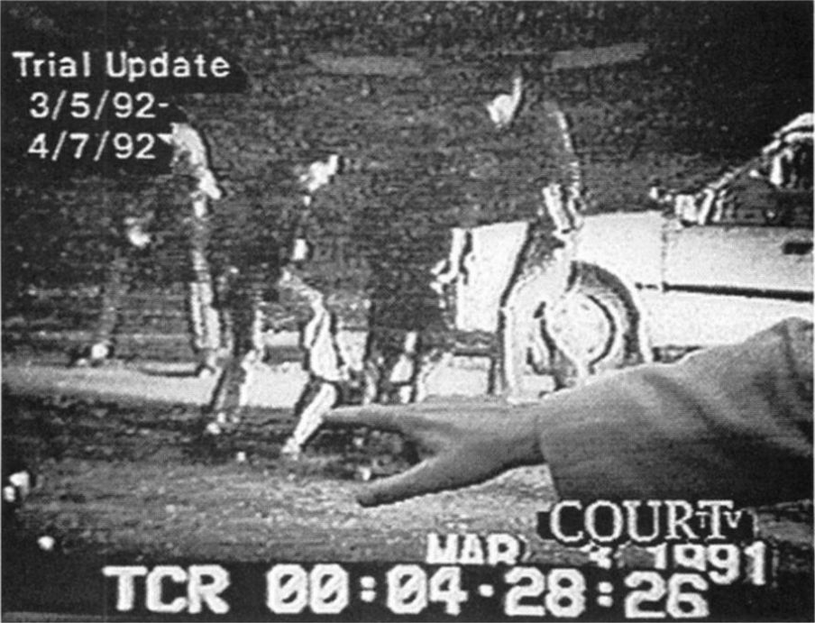
Professional vision as political
In any profession, participants “build and contest professional vision – socially organised ways of seeing and understanding events that are answerable to the distinctive interests of a particular social group.”
(Goodwin, 1994: 606)

Slide 4


Definitions of collaboration
“…the direct working together of language and subject teacher outside the classroom” (Hyland, 2006: 87)
Co-operation → collaboration → team teaching (Dudley-Evans, 2001)
Collaboration:
  None →
  some input from subject lecturers →
  equal contribution to design and delivery →
  input/advice from EAP teachers
  (Wingate, 2015)

Slide 5
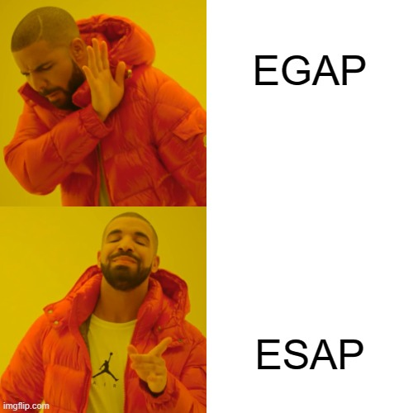
Conceptual uses of collaboration
= specificity (Hyland, 2006, 2016)
= relevance (Wingate, 2015:60)
Collaboration with subject specialists

Slide 6
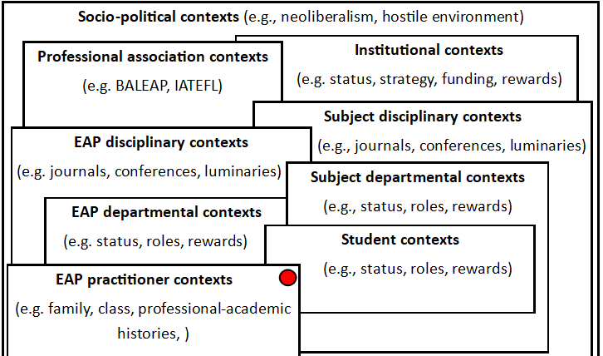
Contexts of collaboration
Fig 1. Suggested EAP contexts, adapted from Holliday’s culture-complex (1994: 29)

Slide 7
My study

Slide 8
Ethnography
“[Ethnography] is capable of constructing a discourse on social uses of language and social dimensions of meaningful behavior which differs strongly from established norms and expectations… as starting points for questioning them.”
(Blommaert, 2015: 10)

Slide 9
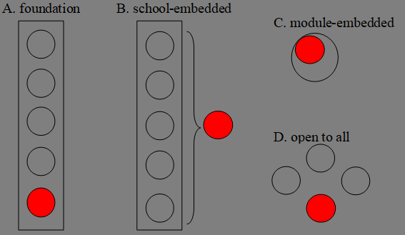
EAP positionings

Slide 10
Data collection
Pre course:
Professional – academic history interviews
During course:
Lesson observations
Document collection
Talk around text interviews
Field notes
Post-course:
Reflective interviews

Slide 11
The many contexts of collaboration
Institutional Status
Collaboration within EAP
Professional targets
EAP teachers’ own academic practices
Multi-directional learning

Slide 12
The many contexts of collaboration
Institutional Status
Collaboration within EAP
Professional targets
EAP teachers’ own academic practices
Multi-directional learning

Slide 13
The many contexts of collaboration
“…the undergraduates [staff] look down on the foundation and they're not interested… [foundation students] are not even being taught a lot of the time by the people that they will see in faculty. They're taught by hourly paid people who come in”
Institutional Status
Collaboration within EAP
Professional targets
EAP teachers’ own academic practices
Multi-directional learning

Slide 14
The many contexts of collaboration
“…it's that very fortunate position… that I'm part of a team as opposed to an added thing... Weirdly though, we're paid as sundries [laughing]…
We're basically there with the cakes.”
Institutional Status
Collaboration within EAP
Professional targets
EAP teachers’ own academic practices
Multi-directional learning

Slide 15
The many contexts of collaboration
Institutional Status
Collaboration within EAP
Professional targets
EAP teachers’ own academic practices
Multi-directional learning

Slide 16
The many contexts of collaboration
Institutional Status
Collaboration within EAP
Professional targets
EAP teachers’ own academic practices
Multi-directional learning
“And I also have the most teachers, new teachers. So that also has a lot that comes with that because it's not just helping teachers come from the pre-sessional, they're going into science as well. But they're also new to like an in-sessional environment a lot of the time… it always takes six years, you just have to be very patient…”

Slide 17
The many contexts of collaboration
Institutional Status
Collaboration within EAP
Professional targets
EAP teachers’ own academic practices
Multi-directional learning

Slide 18
The many contexts of collaboration
Institutional Status
Collaboration within EAP
Professional targets
EAP teachers’ own academic practices
Multi-directional learning

Slide 19
The many contexts of collaboration
Institutional Status
Collaboration within EAP
Professional targets
EAP teachers’ own academic practices
Multi-directional learning
“… many of [EAP colleagues] were talking about academic writing, but none of them was actually doing academic writing… To teach about something that you don't do is difficult”.

Slide 20
The many contexts of collaboration
Institutional Status
Collaboration within EAP
Professional targets
EAP teachers’ own academic practices
Multi-directional learning
“So I'm now doing my PhD in a STEM department. I'm actually… it's not in an education department… So I've gone completely in this time.”

Slide 21
The many contexts of collaboration
Institutional Status
Collaboration within EAP
Professional targets
EAP teachers’ own academic practices
Multi-directional learning

Slide 22
A more complex picture of collaboration!

Slide 23
EAP professional vision
Participants [in EAP]: “build and contest professional vision – socially organised ways of seeing and understanding events that are answerable to distinctive interests of a particular social group.” (Goodwin, 1994: 606)
In EAP…
  Who organises the ‘ways of seeing and understanding’ collaboration?
  Who are the social groups that our work is answerable to?
  What ‘distinctive interests’ do these groups have?
  How are these interests built and contested through collaboration?
  Who benefits and who loses out?

Slide 24
References
Blommaert, J. (2001). Context is/as Critique. Critique of Anthropology, 21(1), 13–32.
Blommaert, J. (2015). Dialogues with Ethnography. Tilburg University.
Bodin-Galvez, J., & Ding, A. (2019). Interdisciplinary EAP: Moving beyond aporetic English for general academic purposes. The Language Scholar, 78–88.
Dudley-Evans, T. (2001). Team-teaching in EAP: Changes and adaptation in the Birmingham approach. In J. Flowerdew & M. Peacock (Eds.), Research Perspectives on English for Academic Purposes (pp. 225–238). Cambridge University Press.
Goodwin, C. (1994). Professional Vision. American Anthropologist, 96(3), 606–633.
Hyland, K. (2006). English for Academic Purposes: An Advanced Resource Book. Routledge.
Hyland, K. (2016). General and Specific EAP. In P. Shaw & K. Hyland (Eds.), The Routledge Handbook of English for Academic Purposes (pp. 17–29). Routledge.
Wingate, U. (2015). Academic literacy and student diversity: The case for inclusive practice. Multilingual Matters.

