Slide 1


DET Primer & Q&A
March 2024

Slide 2





DET UK team
Michael Lynas
Country Lead
(DET UK)
Tamsin Thomas
Senior Stakeholder
Engagement Manager (DET UK)
Lee Harris
Senior Stakeholder
Engagement Manager (DET UK)

Slide 3

Our mission is to develop
the best education in the world and
make it universally available.
Use technology to lower barriers to assessment and increase opportunities for English language learners everywhere.

Slide 4








Duolingo
Founded in 2011 by Luis von Ahn and Severin Hacker at Carnegie Mellon University.
The Duolingo app launched in 2012 and has since become the most popular way to learn a language and is the most downloaded education app in the world.

Slide 5
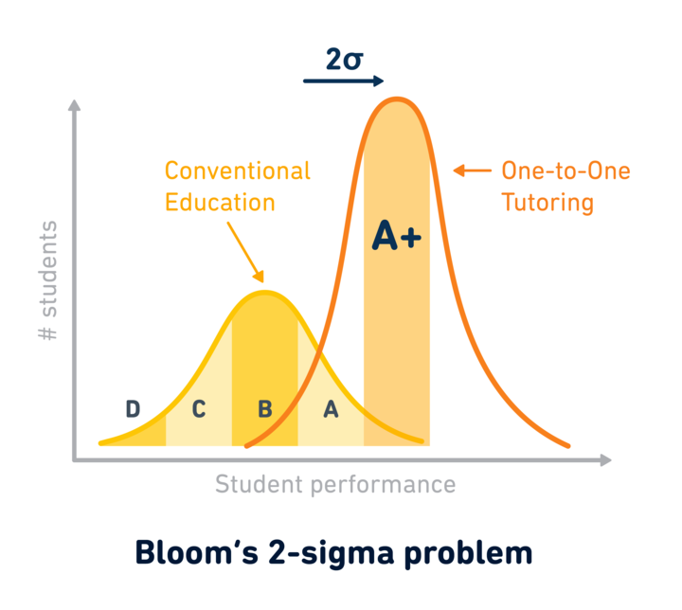

AI is helping to enhance our offer

Slide 6

Our access program
The Access Program is the DET’s social impact initiative that supports international students from the most fragile contexts. It includes…
A comprehensive fee waiver program
Duolingo x UNHCR
Access Scholars Program
UK partners include Chevening, Cara, Universities of Sanctuary, World Jewish Relief and more
Discussions with local authorities
Notes:
Quick overview here

Slide 7




Overcoming traditional high-stakes testing
Book a date
Pay >$220
Go to test-center or even travel to a different city/country
+3 hours to take a test
Legacy model is not equitable, accessible, reliable or affordable
A need to utilise technology to find a better solution
Notes:
Tamsin

Slide 8

Built on innovation
In 2016, Duolingo launched the world’s first digital-first high stakes proficiency test. Powered by the latest assessment science, psychometrics, and human-in-the-loop AI.
The test had a mandate to achieve 4 key goals:
Accessible (No testing centres, no appointments)
Efficient (1 hour maximum length)
Economical ($59 USD)
Psychometric quality (Precise & reliable for high-stakes uses / Aligned to CEFR)
Notes:
The Duolingo English Test uses technology to lower barriers to assessment and increase opportunities for English language learners everywhere
Clear evidence based scoring interpretations - That could be used for high stakes decision making (university admissions)
High levels of score reliability and precision.
The Duolingo English Test (DET) was researched and developed to achieve multiple goals. The primary goal was to develop a test that provides an efficient, convenient, and economical means of demonstrating language proficiency.
In addition, the designers wanted the test to have equivalent psychometric quality to other language tests used for high-stakes decision making. Psychometric quality was defined as having clear evidence-based score interpretations supporting users (e.g., admissions decisions), while also having high levels of score reliability/precision.
Develop and support the best possible English language proficiency test
Take advantage of the latest developments in technology, applied linguistics, psychometrics, and assessment science to produce a modern test that equally fits the needs of both test takers and the institutions accepting our test
Constantly measure, iterate, and improve all aspects of our assessment R&D processes to continually improve the test
The designers defined efficiency, convenience, and economy as;
enabling test takers to test anywhere on their personal computers at any time
making travelling to a test centre unnecessary
reducing test time to one hour or less
providing scores to test takers in approximately two days
pricing the test so that it was within reach of nearly any motivated student (e.g., having the price point well below the cost of alternative tests)
Achieving these five ambitious goals required the DET developers to move beyond traditional test development processes and embrace leading research and developments in machine learning and natural language processing, computer-adaptive testing and to develop an automated item generation process, which not only developed items, but provided item difficulty estimates. Please refer to the Duolingo English Test research and efficacy page to view a large repository of peer-reviewed journal articles and explore these research accomplishments in greater detail.
Underpinning all of these achievements is a world class research team, led by Alina Von Davier, President of the International Association of Computer Adaptive Testing and Board Director for the Association of Test Publishers.

Slide 9




Digital-first innovation
∞
+
+
=
CAT
Use Artificial Intelligence to build and monitor a massive item bank
Use Computer Adaptive Testing
for tailoring, accuracy and efficiency
Use asynchronous AI-assisted human proctoring
Notes:
BEN
Mention digital-first vs digitally-assisted: In contrast, the DET was born digital. It’s not only that the constructs measured are digitally mediated, but that all items were generated automatically and their psychometric properties were derived from computational models. In other words, the test was created with no test data, on the basis of models that predict language learning levels from item characteristics. Since then testing data has been used to updated these models and predictions, but this gives you a sense of the contrast with usual ways of developing an assessment.
In addition, the DET has an unusual level of integration in its infrastructure: theoretical, computational, psychometric and physical infrastructures are tightly integrated.
And finally, all this supports a view of TTX that is also unusual with other tests…
Born digital
Digitally-mediated constructs
Designed with computational models & AI-algorithms in mind
Theory-based & evidence-centered
Integrated
Fluid infrastructure
Integrative theoretical frameworks
Integrated (automatic) tools & databases
Superior test taker experience (TTX)
Available on demand, anytime, anywhere
Online testing with remote proctoring

Slide 10
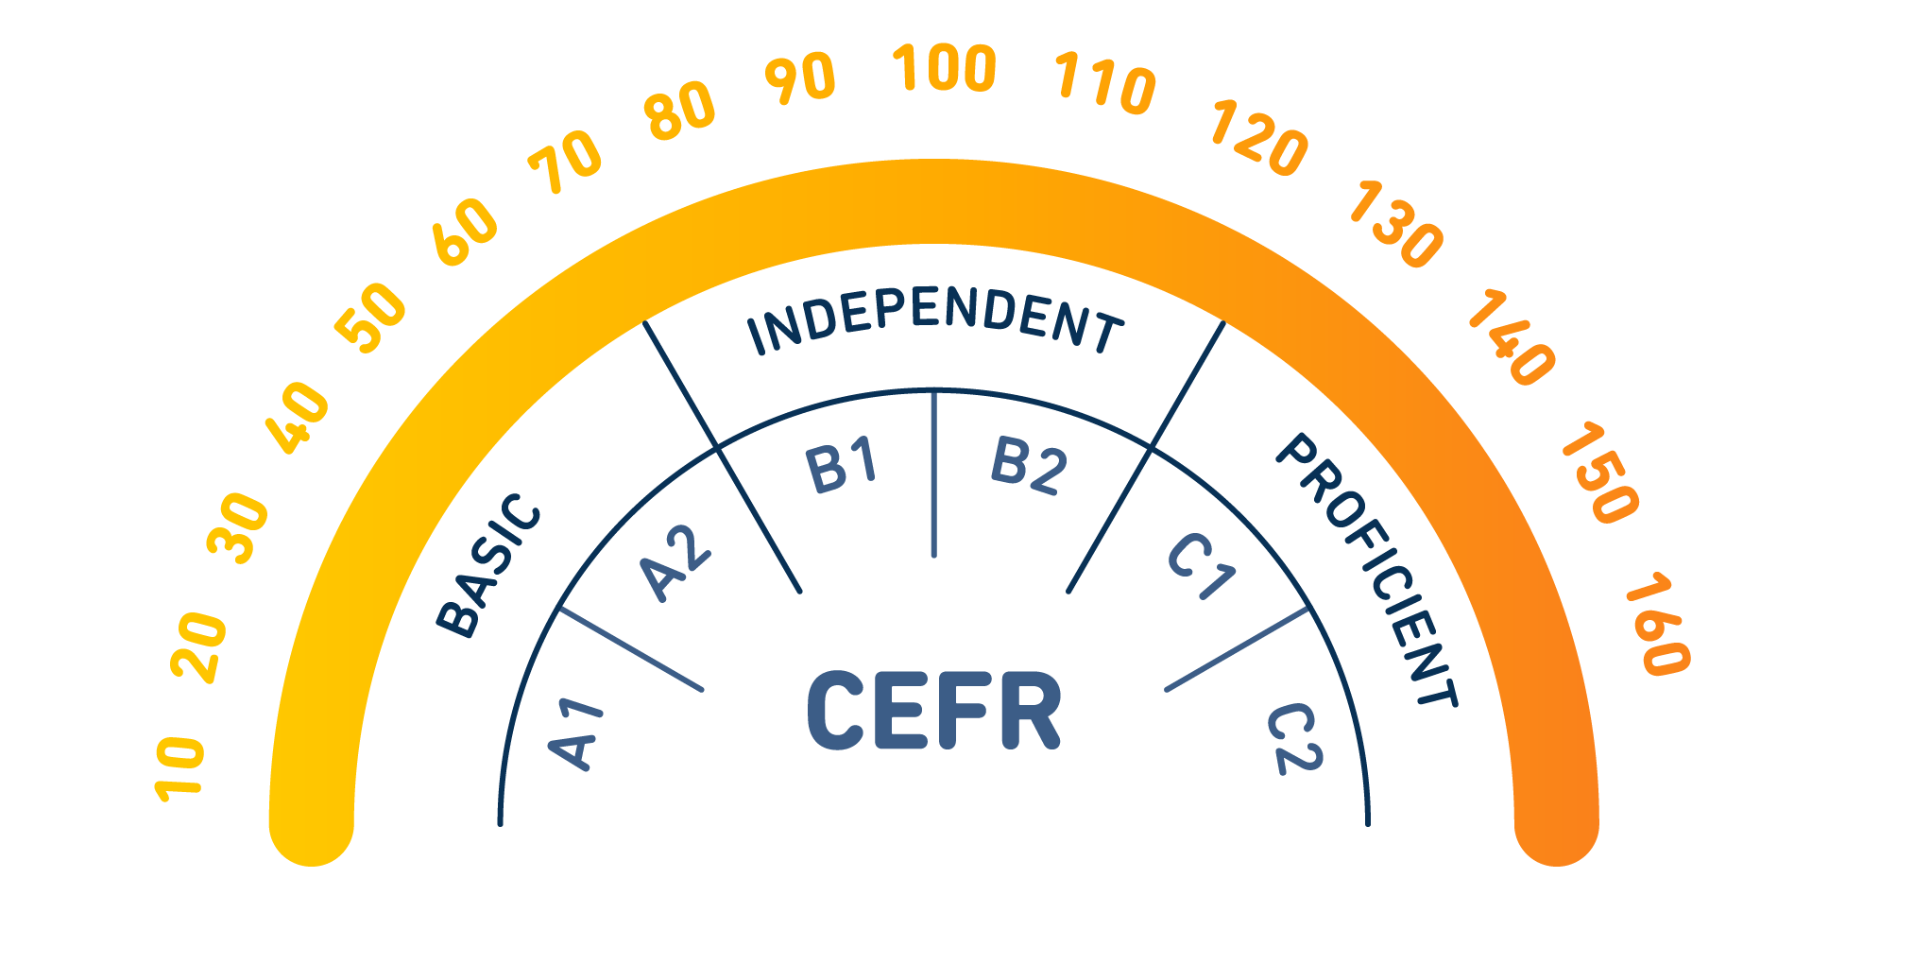
Meeting the standard
CEFR aligned from Beginner to Advanced
Notes:
Ra
The 10-160 point scale is different in its range and units from other large scale test; it also moves reporting away from the 0-100 point scale, which was often interpreted as % scores (which it was not)

Slide 11

Subscores: Integrated language use
Reading and writing English from basic informational text to advanced expository/persuasive texts
Producing spoken and written English from basic informational discourse (paragraphs) to advanced discourse (persuasive arguments)
Understanding spoken and written English from basic informational discourse (mini-talks) to advanced discourse (extended monologues)
Listening and producing spoken English from basic discourse (informational) to advanced discourse (lectures)

Slide 12

Computer-adaptive test design
10,000+
items
Number of unique test items
(No two tests are the same)
Adaptive engine draws items as test is being taken
📄

Slide 13
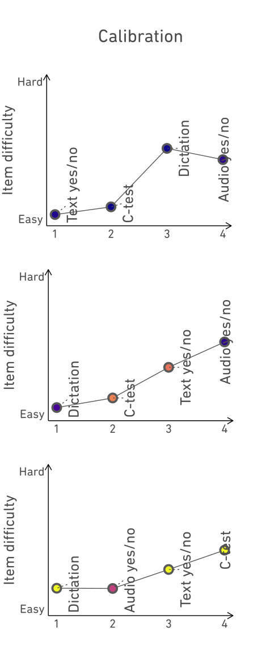
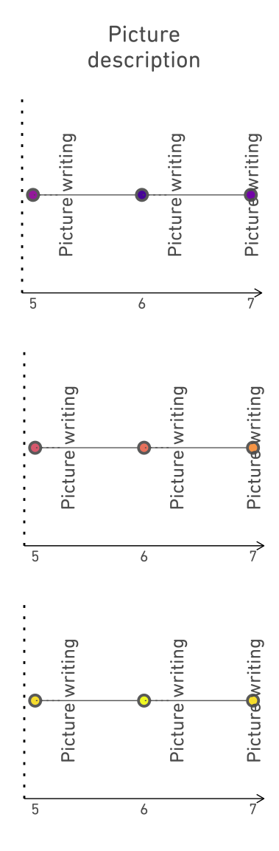
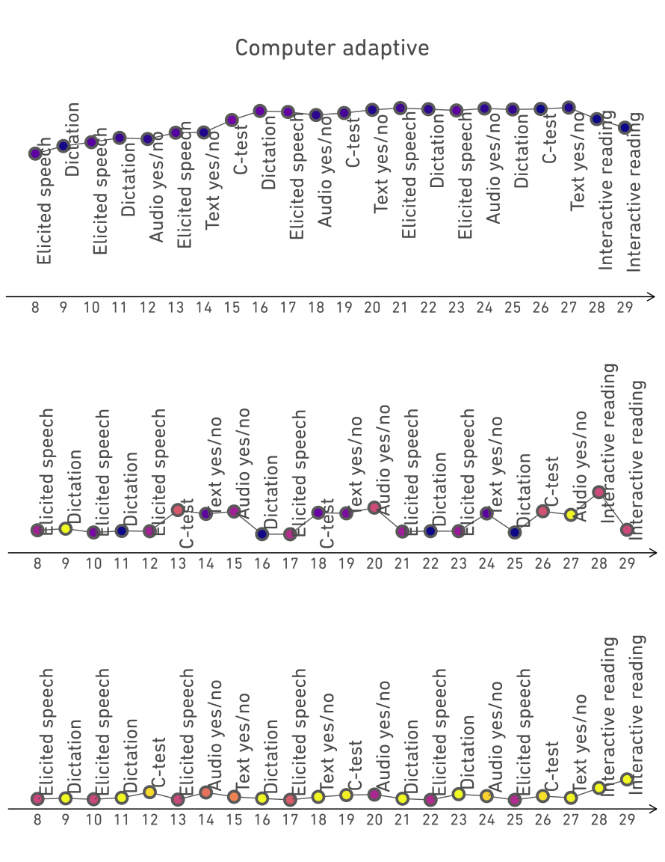
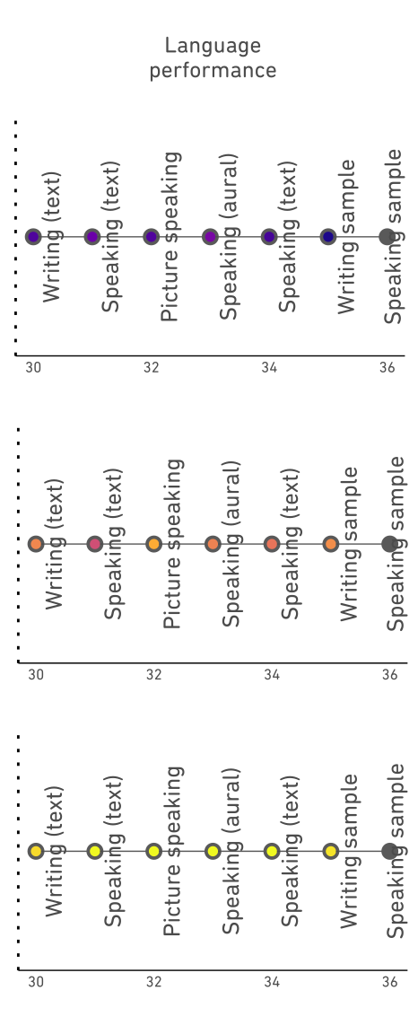
Computer adaptive administration
160
80
15
📄
Notes:
There are four stages to the test's administration:
The y-axis represents the difficulty of the item (for the calibration and the CAT phase). The dashed lines on the other two indicate that those tasks are randomly sampled.
The color of the points represents how well the test taker did on the item. The darker the color, the higher the score they received. The lighter the color the lower the score.
Calibration: Four items of roughly increasing difficulty. After the four items and provisional estimate of ability is created
Picture description (writing)
CAT: each item is selected to best match the provisional estimate of ability, which is updated after the response to the item (repeats until the end of the stage)
Language performance stage: 7 writing and speaking tasks (six of which are scored, the seventh is the speaking sample and is actually gray to indicate no score). Randomly selected
The major takeaway from this slide is that test takers have different "journeys" of item difficulty through the test, which is demonstrated by the path and color of the CAT section.
160: The test taker stays at the upper end of the difficulty spectrum in the CAT phase (and gets high scores on the items)
15: The test taker stays at the lower end of the difficulty spectrum in the CAT phase (and performs poorly on the items)
80: The person bounces around a little (reflected in the slightly higher variability in the difficulty range in the CAT section and the greater mix of darker (high scores on items) and lighter (low scores on items) points

Slide 14
Research, scoring and concordance
Duolingo reports an overall score of 10-160, plus integrated subscores.
Duolingo’s 2022 concordance study against IELTS and TOEFL, involving more than 5,000 student results, has been peer reviewed and published in the leading journal Language Testing in September 2023.
Duolingo continues to publish significant amounts of research to demonstrate its validity and reliability
DET | IELTS Academic
160 | 8.5–9
150–155 | 8
140–145 | 7.5
130–135 | 7
120–125 | 6.5
105–115 | 6
95–100 | 5.5
80–90 | 5
65–75 | 4.5
10–60 | 0–4
- englishtest.duolingo.com/scores
englishtest.duolingo.com/research
Notes:
Steven
These tables along with more information and documentation around the research supporting them can be found on our website: englishtest.duolingo.com/scores. We strongly encourage you to take a more in-depth look there, familiarize yourself with the latest concordance data, and please reach out to your Duolingo engagement manager if you have any questions.
Steven
For future concordance updates:
-We are continuously working to improve the test.
-We have improved the process for updating concordances.
-We will update the concordance periodically as needed.
Last thing to say:
“I will now hand it off to Mancy to talk about AQuAA.”

Slide 15
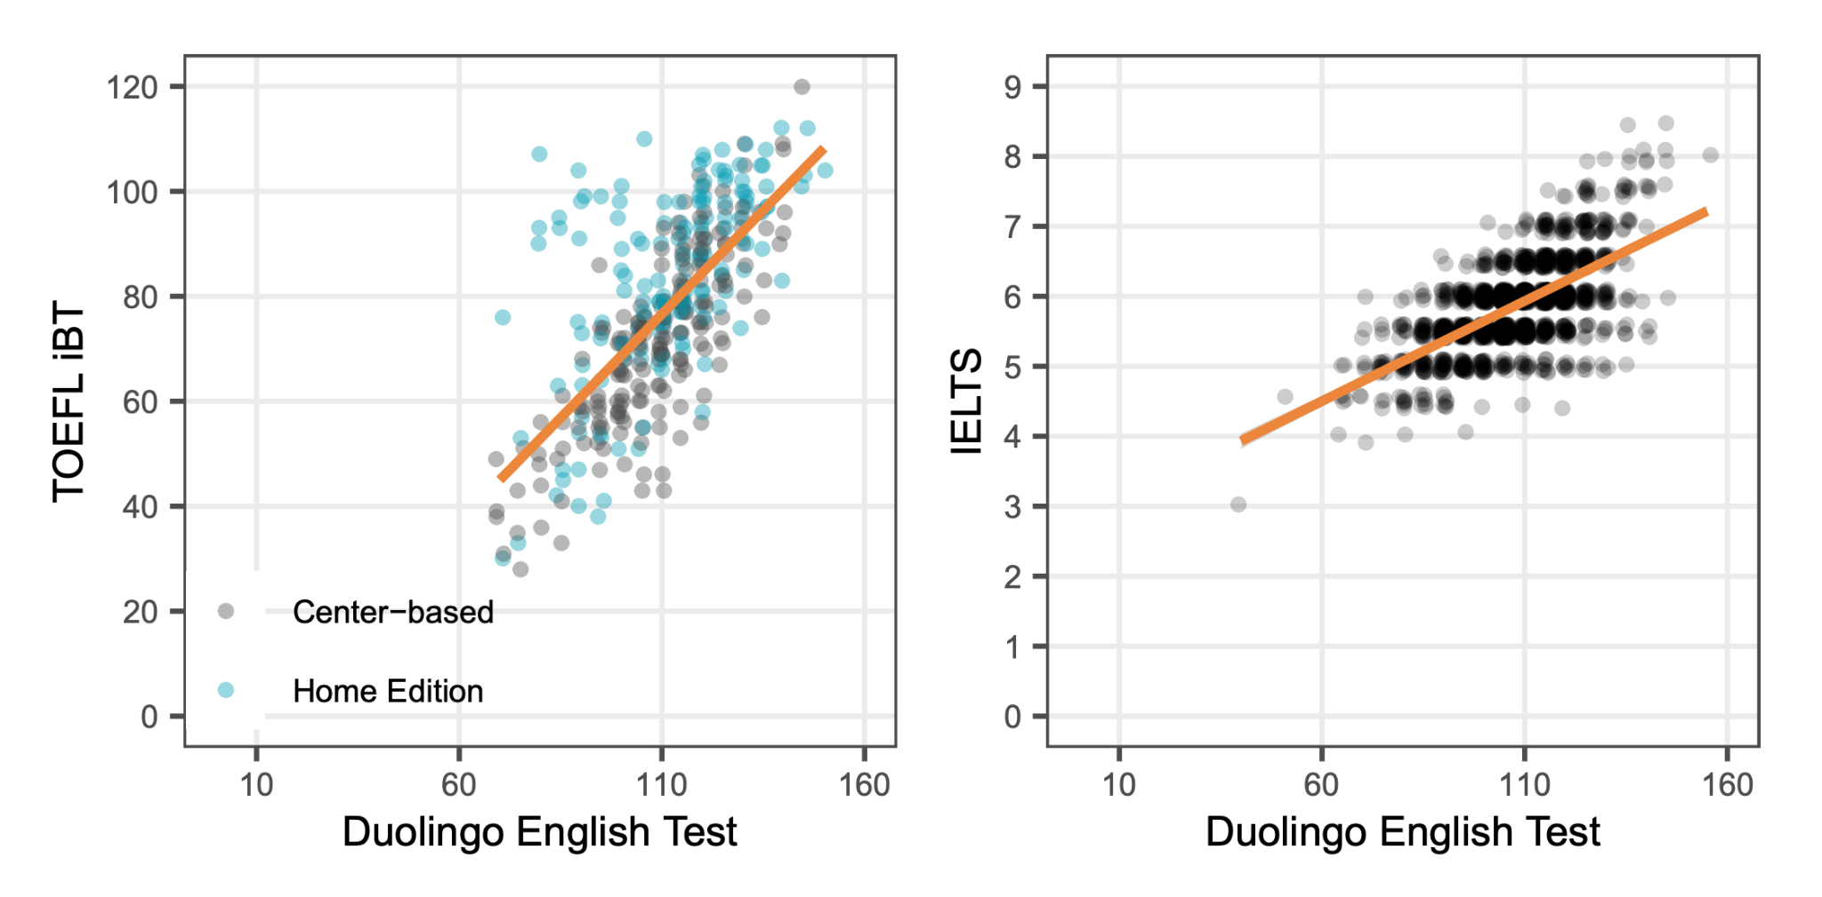
DET to IELTS & TOEFL concordance
r = 0.82
r = 0.65
r = 0.61
📄

Slide 16
Security benefits
Secure by design - no two tests are ever alike
Individual invigilation
Human certification with AI review
Data record of each test session
Reduced supply chain risk
Rapid response & bug fix deployment
Notes:
Steve
Digital-first involves a lot of automation in levels that (I think) are unusual in large scale assessment.

Slide 17
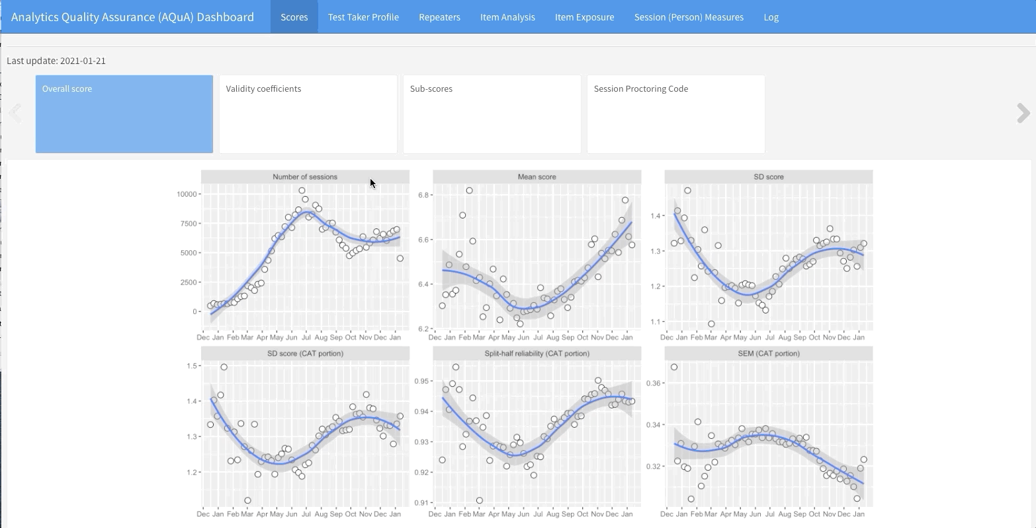
Digital Quality Control
Analytics for Quality Assurance in Assessment
tracks and reports on all validity-related metrics of our test in real time
Provides context and evidence for when certain test adjustments are recommended or required.
Improves our test score validity for high-stakes assessment
Notes:
Mancy
AQuAA stands for Analytics for Quality assurance in assessment. It is a tool designed for evaluating score comparability and test quality. This tool was first developed in December 2020, and we keep improving it over time
Essentially, AQuAA is a set of internally developed dashboards that help us track and report on all validity-related metrics of our test daily across the globe
In the demo animation on the right, AQuAA consists of a set of regularly updated dashboards that track the various metrics of the duolingo English test, such as the score distribution, test taker population composition, scores summarized by test taker subgroups and score reliability and validity coefficients.
Whenever anomalies are detected in the metrics, alerts will be sent to the test developers
Every week, the test developers meet as a group and review the metrics in AQuAA.
If an alert is raised by AQuAA, we would systematically investigate the causes of the alerts and determine if the alert signals any score validity issue. If we suspect that there is a potential issue that threatens the score validity, we will promptly react to fix the issue.

Slide 18
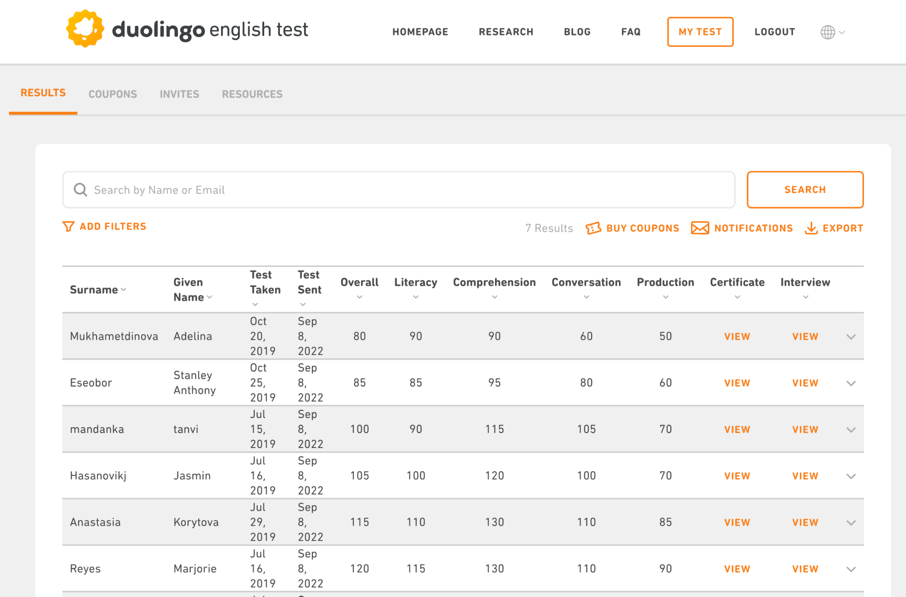
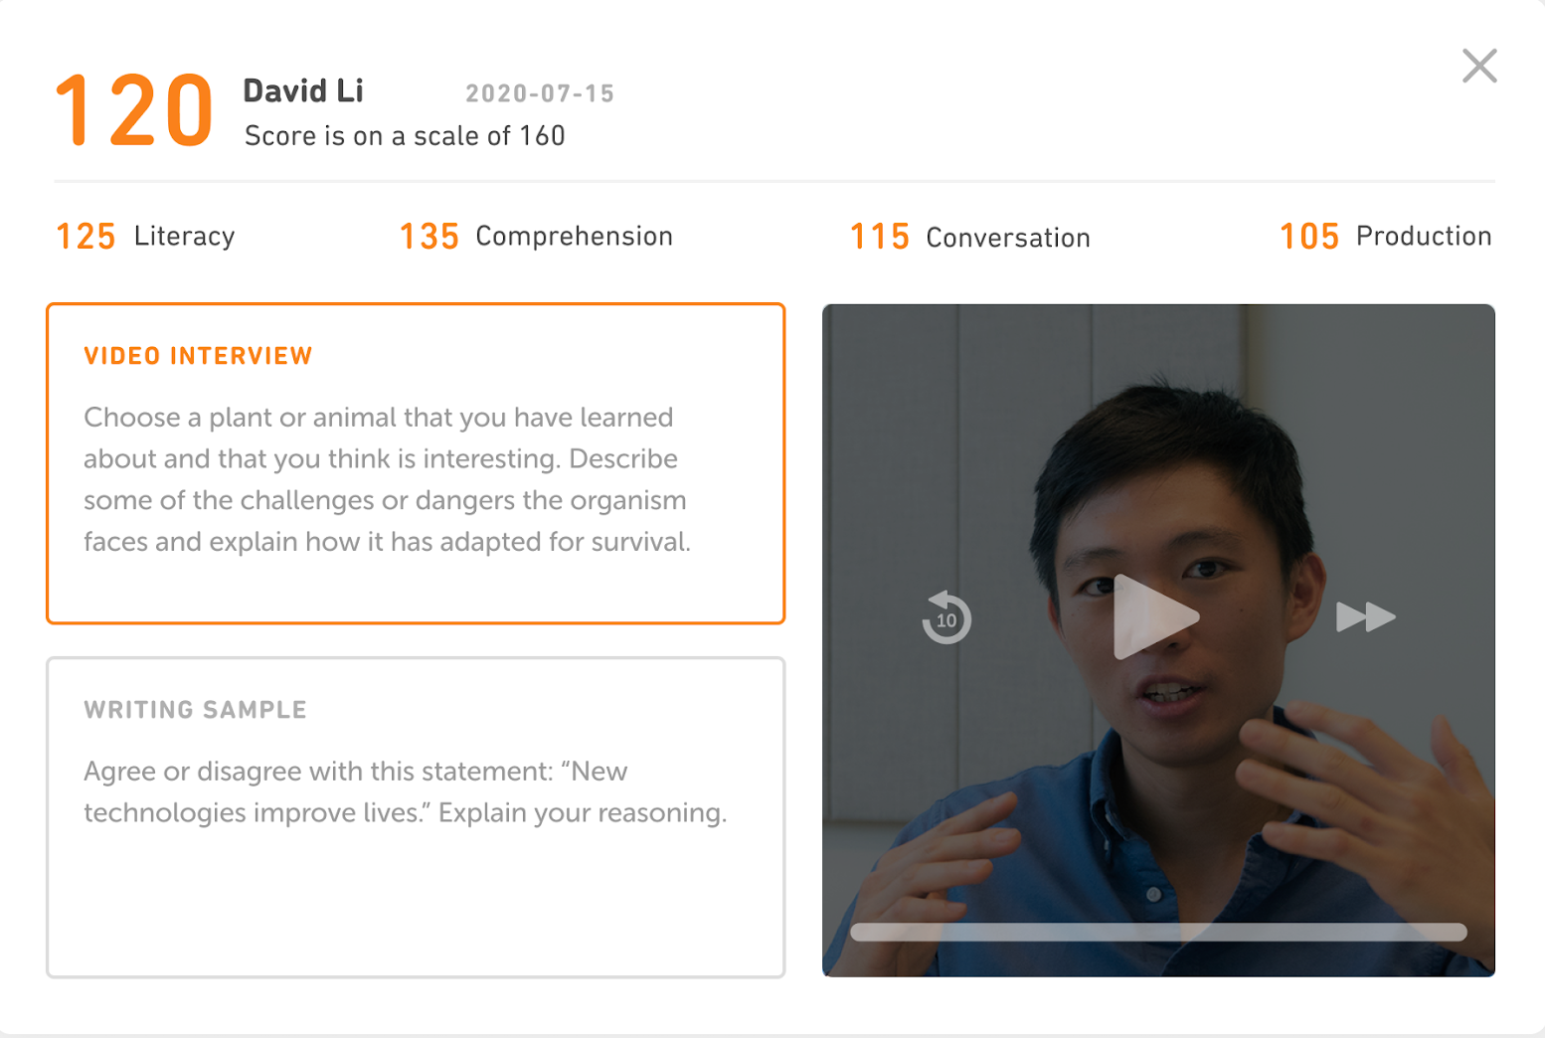
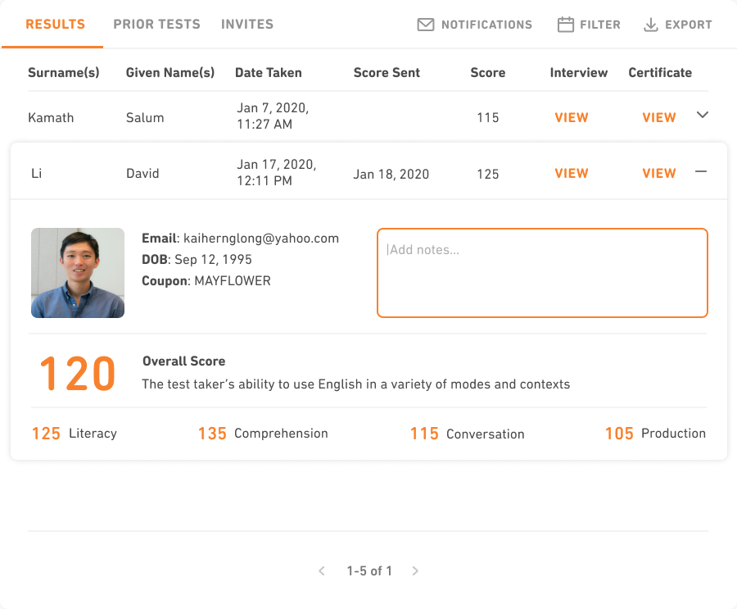
Institutional dashboard
+

Slide 19
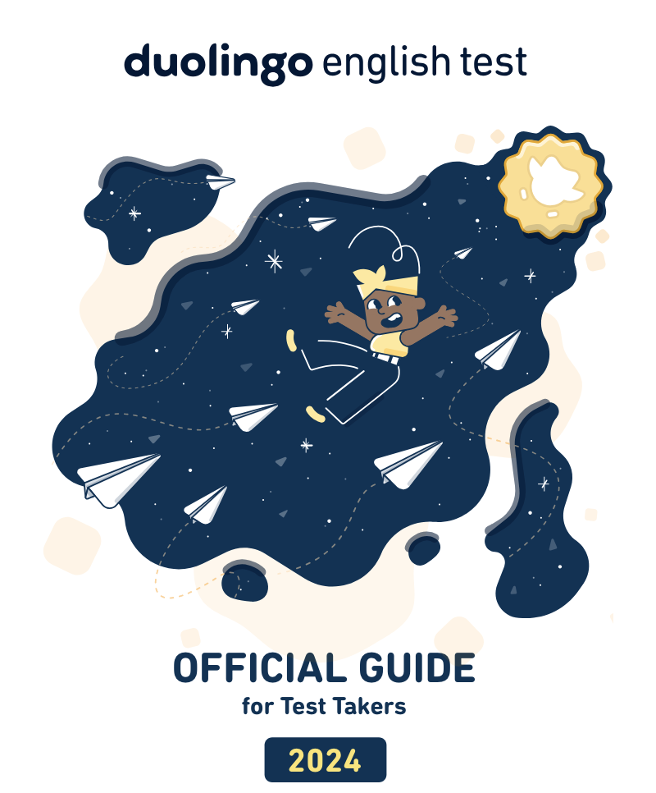
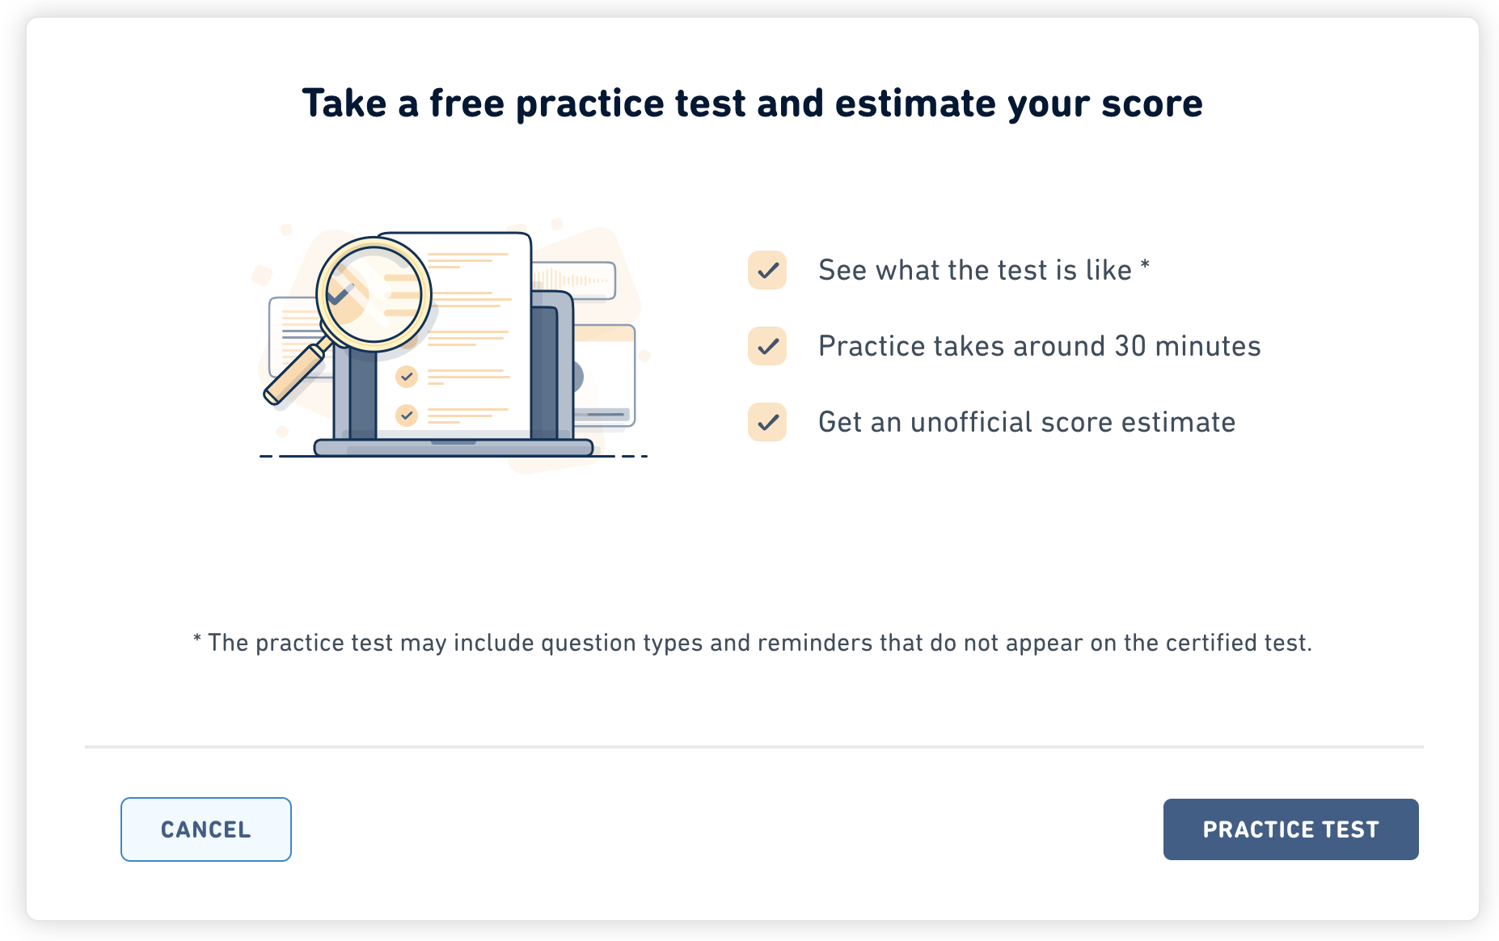
Test taker resources
https://englishtest.duolingo.com/readiness

Slide 20

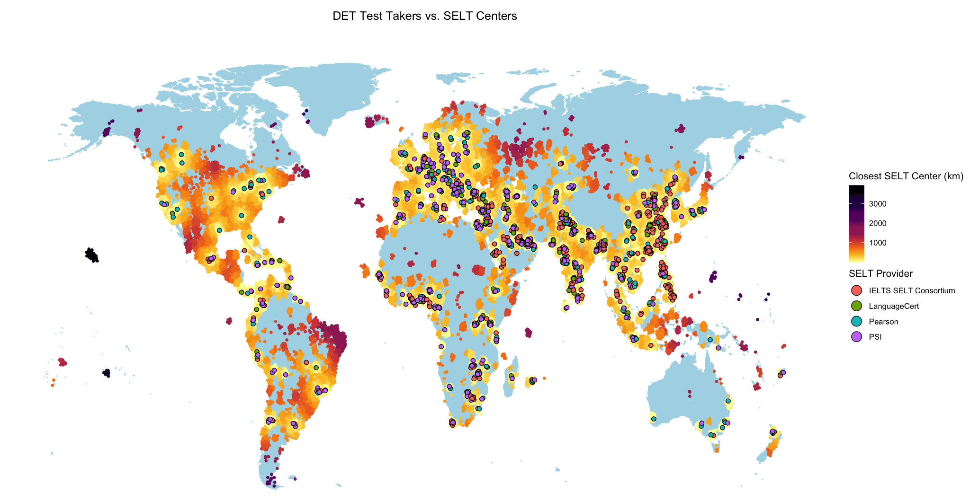
Onwards and upwards
  Taken in 70,250 Locations (cities/towns/villages)
  Trusted by 5,000+ programmes
  More than 1 million test takers in 2022
Harvard Yale MIT New York University University of California University of Toronto University of British Columbia Mcgill University Imperial College London
DET Test Takers vs. SELT Centres
Notes:
4.5K worldwide. 28 prgrammes in the UK. all Ivy league and top recruiting institutions

Slide 21
tamsin@duolingo.com

