Slide 1
A tale of two tribes: Developing the writing skills of financial mathematics students
Mumtaz Ayub & Suzie Coates
King’s Foundations
King’s College London

Slide 2
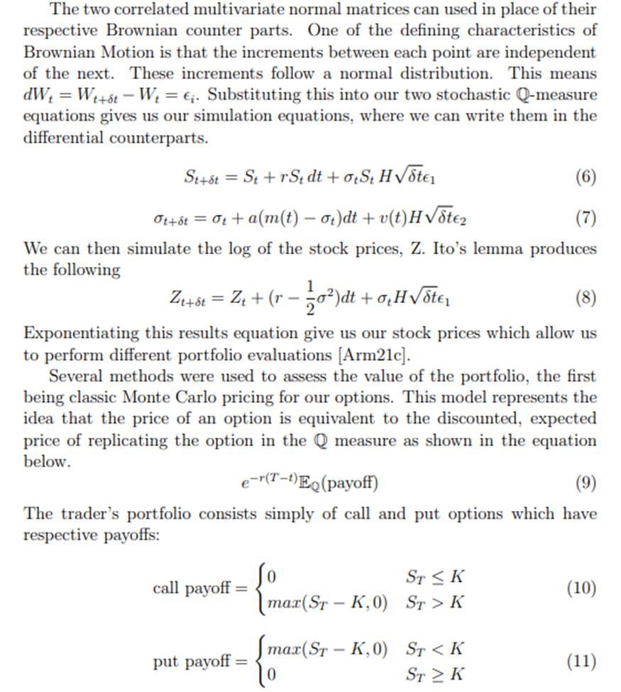
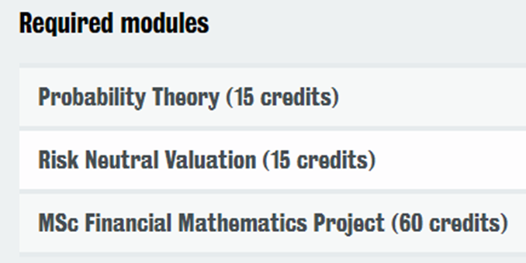

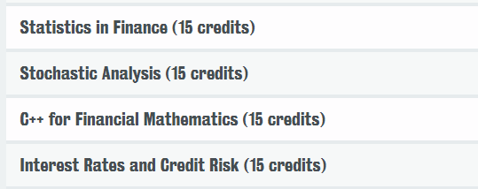
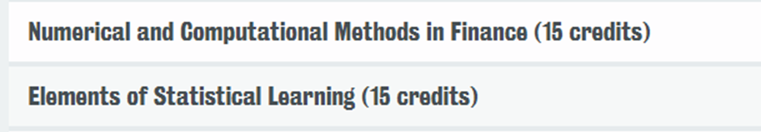
What do PGT Financial Mathematics students need to write?
Notes:
These guys are the ones who advise hedge fund managers (doing the maths in the background)
Here’s what they study – not lot of writing except
Here’s what a bit of that coursework looks like
From working with them – more than just a difference in content that defined/separated us

Slide 3
Academic Tribes & Territories (Becher 1989, 1994)
Hard Pure
natural sciences
eg, physics, maths
Soft Pure
humanities & social sciences
eg, history & anthropology
Hard Applied
science-based professions
eg, mechanical engineering
Soft Applied
social professions
eg, education, management
Biglan (1973)
Notes:
Becher provides a useful framework for understanding these differences – work on tribes & territories
Draws on Biglan – divided academic disciplines within HE into 4 categories
Much discussed recently that EAP practitioners don’t really fit
But as EAP scholars/researchers – we are definitely here – polar opposites

Slide 4
Academic Tribes & Territories (Becher 1989, 1994)
Nature of knowledge
- cumulative
- atomistic
- concerned with universals, quantities & simplification
- resulting in discovery/explanation
Nature of disciplinary culture
- competitive
- politically well-organised
- task-oriented
Nature of knowledge
- functional
- utilarian
- concerned with enhancement of professional practice
- resulting in protocols/procedures
Nature of disciplinary culture
- outward-looking
- uncertain in status
- power-oriented
Hard Pure
natural sciences
eg, physics, maths
Soft Pure
humanities & social sciences
eg, history & anthropology
Hard Applied
science-based professions
eg, mechanical engineering
Soft Applied
social professions
eg, education, management
Notes:
Becher developed Biglan’s framework further through researching different disciplines – takes beyond content – nature of knowledge & disciplinary culture – epistemological & cultural differences
Of course this is old, and has been critiqued as ‘over-essentialist’ particularly by postcolonial writers – stll useful in understanding the different perspectives we encounter when working with faculties

Slide 5
An awkward initial conversation…
and ‘principled pragmatism’
‘the uncomfortable juxtaposition around deficit understandings of students’ language levels’ (Bond 2022, p.123)
Diagnostic test
(co-designed by EAP and FM)
They can’t understand anything when I speak to them…
Term 1:
3 x Writing for Maths workshops
They can’t speak English…
They must be cheating at IELTS… you should test them again when they arrive at King’s and refund their fees if they don’t pass (External Examiner)
Term 2:
3 x Writing a Maths Dissertation
The Pre-sessional makes them worse; they need basic English
Notes:
First meeting – B B talks about – classic example
We challenged and al parties exercised principled pragmatism
Agreed on an intervention
I would develop and teach the Term 1 sessions, and Mumtaz would take Term 2

Slide 6
To be accepted
Started from a place of confusion.
Confusion about the topic and the text.
Also, communication with faculty was not really happening.
Hence, I went away and studied the topic before meeting John in person.
This was, firstly, to gain acceptance in order to allow communication and, hence, collaboration.

Slide 7
Collaboration
Now, I was equipped to understand the text to a degree and was able to ask questions.
First, I looked at his writing.
Then, I explained my understanding of the good example.
Hedging Beyond Black-Scholes
He corrected me and answered my questions about his assessment of the text.
Iterative and multi modal leading to materials development.
Also, I was modelling our process to John.

Slide 8
Impact: Students
Student feedback: Survey data
Quantitative
Students agreed workshops
had made them more confident in writing dissertation (89%)
had helped them understand the material being taught on their course (89%)
Qualitative
usefulness of examples
understanding expectations of language & structure
clarity of the sessions
Student outcomes
Coursework & Dissertation marks:
Students with Chinese name who attended writing workshops achieved 10% higher scores than those who didn’t. (NB. no correlation with diagnostic test scores.)
Readiness to submit:
85% of students who attended writing workshops submitted their dissertation within first 12 months of programme compared to 52% who didn’t attend.
Caveats/Limitations:
small sample size (33)
not true experimental design (self-selection to writing workshops)
other factors (time in UK, immersion)
Notes:
To evaluate – collected feedback via a survey
In terms of outcomes – benefits of working with maths experts is really hot on statistics – statistical difference between students who attended workshops and those who didn’t
Readiness to submit – another confidence indicator
Of course – caveats – but still presents v positive picture
O

Slide 9
Other impacts
Workshops repeated this year and set to continue (funded by Mathematics department)
Co-writing paper with John Armstrong (senior lecturer / L&T lead in in Mathematics department)
Case study to be shared by JA with teaching colleagues in maths department
Increased understanding of needs of students within maths department?
Increased awareness of academic literacy approaches within maths department?
Increased confidence in ourselves as effective EAP practitioners
Notes:
Tricky, a lot of work, felt very positive about end result

Slide 10
References
Becher, T. (1989). Academic Tribes and Territories Milton Keynes, Open University Press.
Becher, T. (1994). The significance of disciplinary differences. Studies in Higher education, 19(2), 151-161.
Biglan, A. (1973). The characteristics of subject matter in different academic areas. Journal of applied Psychology, 57(3), 195.
Bond, B. (2022). The Positioning and Purpose of EAP across the University Curriculum: Highlighting Language in Curriculum Policies. In Bruce, I. & B. Bond (eds) Contextualizing English for Academic Purposes in Higher Education: Politics, Policies and Practices, 109 - 128.
Notes:
Tricky, a lot of work, felt very positive about end result

Slide 11
Thank you
© 2020 King’s College London. All rights reserved

