Slide 1

EAP and the power dynamics of transnational (cross-border) collaboration.
Joanne Shiel, Ouyang Ting,
Liz Wilding, Shen Yixin

Slide 2

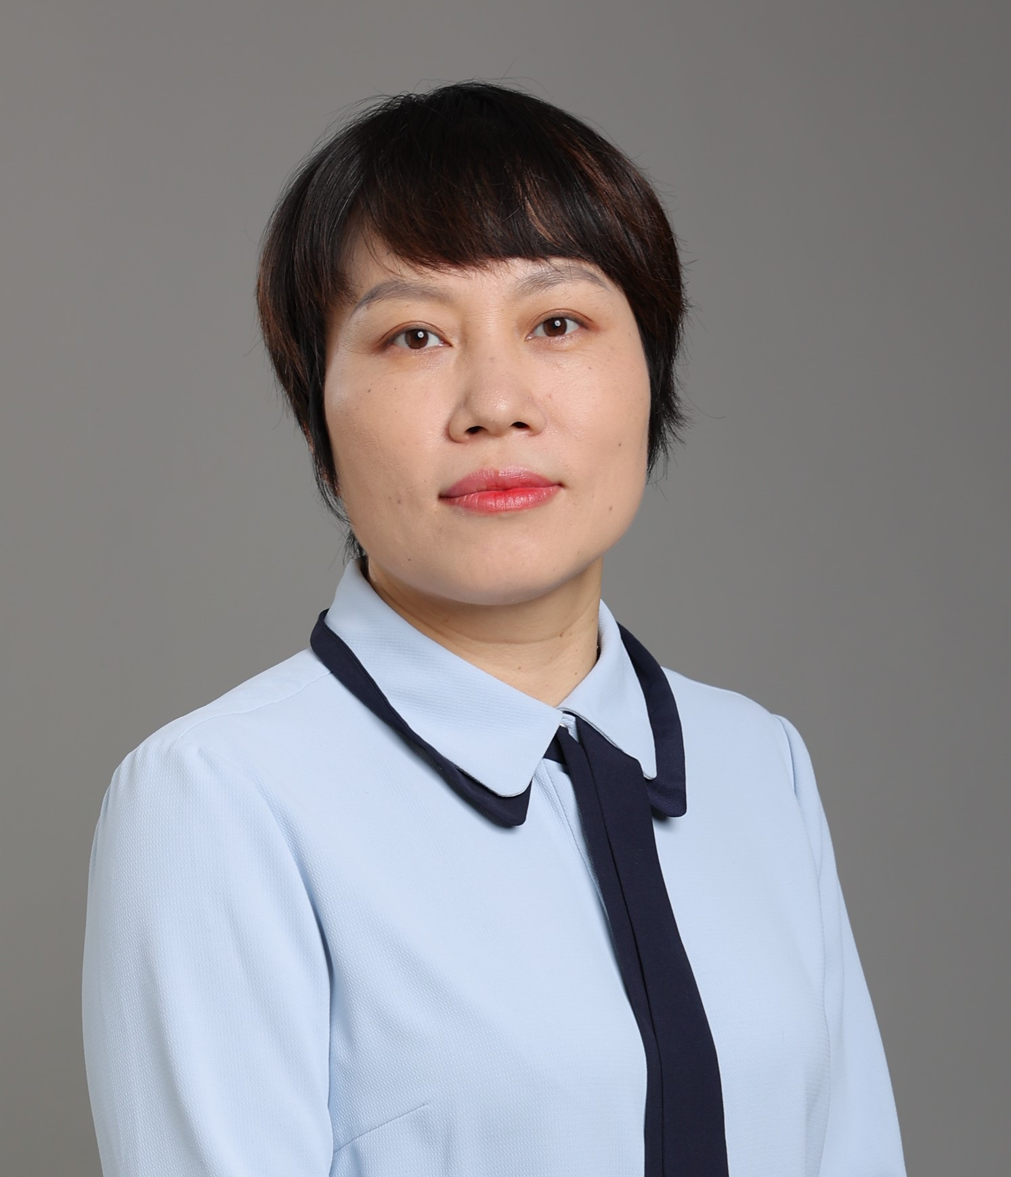


Context: collaborators in two UK-China Joint Institutes
Shen Yixin, South-West Jiaotong University
Deputy Director of Year 1, Module co-leader, SWJTU-Leeds Joint School
Ouyang Ting, Nanjing University of Information Science & Technology
EAP tutor, Module Lead for Foundation Year EAP Modules, NUIST Reading Academy
Liz Wilding, University of Reading
Foundation Year Programme Director and Module Convenor, NUIST Reading Academy
Joanne Shiel, University of Leeds
Director of Year 1, SWJTU-Leeds Joint School

Slide 3
Overview
Our context
TNE context
TNE and EMI
Boundary spanning
Decision-making and balance of power
Professional impact
Conclusion

Slide 4

SWJTU- Leeds Joint School
Collaborative teaching: one third by University of Leeds, two thirds by South-West Jiaotong University
Common first year (120 credits)
English (60)
Maths (20)
Physics (20)
Option (20)
Chemistry
Scientific Problem Solving
Dual Degrees in Engineering and Physical Sciences, Years 2, 3, 4
Mechanical Engineering
Electronic and Electrical Engineering
Civil Engineering and Transport
Computing
Materials Engineering
EAP in English module and language learning outcomes in all other Year I modules
Insessional EAP support in Years 2, 3, 4

Slide 5


NUIST Reading Academy
Sino-UK joint educational institute​
380 students
Dual degrees with option to transfer to UK
Year 1 (Foundation): 100/120 credits EAP
  English progression requirement
Year 2 (Part 1): 20 credits ESAP​
BSc Atmospheric Sciences
BSc Applied Chemistry
BSc Business Economics and Trade
BSc Environmental Engineering
BSc Mathematics and Applied Mathematics
BSc Data Science
BSc Human and Physical Geography
UK: Programme Director and Module Convenors
China: Programme Lead, Module Leads and English Teachers

Slide 6
TNE Context
Transnational Education (TNE) is “the mobility of education programs and providers between countries” (Knight 2016).
TNE is a significant feature of HE and EAP:
2021/22: 558,215 UK TNE students, including 72,205 (the largest cohort) in China (UUKi 2023).
Notes:
Our joint institutes are one form of transnational education

Slide 7
TNE and collaboration across borders
Working across institutional and national borders adds new layers of complexity on top of the “uncertain identity and position of the EAP practitioner” (Ding & Bruce 2017)
TNE is a “particularly intriguing context for conceptualising borders and power relations in knowledge production” (Leung & Waters 2017)
TNE boundaries are fluid and subject to negotiation: a 'collective performance' (Keevers et al. 2019)
Power relations between TNE partners are fluid, with both having agency (Djerasimovic 2014)
The TNHE context is made up of layers of power structures and identities, with shifting asymmetrical forms of interdependence (Caruana & Montgomery 2015)
Borders can act as axes of stratification or hierarchy, but can also be generative spaces for bridging differences and making changes (Leung & Waters 2017)
Notes:
EAP practitioners in these joint institutes are therefore working across multiple borders
Extra layer of complexity and challenge for EAP practitioner
Borders are particularly interesting contexts for examining issues of collaboration, power and control.
There can be a danger of viewing TNE in exclusively in dualistic terms of a sending and a host institution, or Western vs Chinese institution. Or seeing the structural inequalities only from one side, eg as Western cultural imperialism.
However, it is far more nuanced, dynamic and complicated, with shifting power relationships, borders and responsibilities. TNE borders are sometimes barriers, but can also be a context for exchange and potentially for generative change.
NB Positionality= situatedness of our identity, “shifting location within networks of relationships”

Slide 8
TNE and EMI – where does EAP fit in?
Links between TNE and EMI – English as academic ‘lingua franca’
Patterns of English language support in EMI (Macaro, 2018)
Where is the intersection between English Medium Instruction and EAP ? (Galloway & Rose, 2021, Wingate & Hakim, 2022)
TNE - ‘out of the comfort zone’ (Smith, 2009)
Collaboration with content specialists (Zappa- Hollman, 2018)
Notes:
Link between TNE & EMI – for historical, economic, geopolitical reasons, English is often used as the academic lingua – at the moment the most common ‘least bad’ choice, although in the literature on Emi, TNE contexts not often mentioned. TNE a particular ‘special case; as there is a partnership involved – Caruana & Montgomery (2015) but has similar issues to EMI,particularly in terms of language proficiency of both staff and students. EAP staff involved in both of these. Patterns of English language support selon Macaro 2018 (adapted in Galloway 2020) – selection/ostrich/preparatory/concurrent. Galloway saying there isn’t much about content and language specialists working together in EMI, Wingate maintaining EMI pressures are like ESAP. Anyway, TNE puts content specialists out of their comfort zone, forces them to reflect and can result in fruitful collaboration on equal footing with EAP staff – not just ‘butlers’, but leaders + equals. So EAP significant in both student and staff support.

Slide 9

Boundary Spanning in TNE & EMI
Some members of the organization occupy ‘boundary-spanning roles’ that enable them to transfer information from one constituency to another (Hayes, 2018) thereby linking outside organisations
Within the organization, there are also roles that straddle the boundaries between internal constituencies (Hayes 2018)
Duchek (2015), based on evidence collected from two German engineering firms, identified boundary spanners and gatekeepers as important facilitators of cross-functional communication and cooperation.
Bordogna (2019) – development of partnership relations between operational staff members key to TNE success
Notes:
In TNE & EMI, the EAP specialist is often working alone or in a small team on the margins/at the boundaries between institutions and within different factions within their own university. They can therefore have more power and influence than they would normally if they were entrenched in Language Centre. In a position to ‘carry/transfer’ something which is entirely normal in EAP but could be revelatory in another setting – eg – why don’t you write a lesson plan saying what you and the students will be doing in terms of activity at any given time….. But the power dynamics and need for collaboration are not only at the institutional or disciplinary level, but also between the two set of EAP teams.

Slide 10
Decision-making and balance of power in TNE partnerships
Assessment
Delivery
Pedagogy
Collaboration and boundary-spanning in action:
Sharing knowledge
Questioning assumptions
Managing disagreement and compromise
Communicating and developing trust
Building bridges
Finding creative solutions
Notes:
Make the point that EAP practitioners may already have plenty of experience doing this –eg working across different schools/faculties in a university, but can we argue that it is more extreme in the TNE context?

Slide 11
Decision- making in Transnational EAP
Who decides? Which partner ‘knows best’?
Pedagogy
  Morning reading
Delivery
  Role of the teacher
Assessment
  Formative assessment
Notes:
Content specialists are not the only ones who find TNE an uncomfortable experience which forces you to look at your own values and assumptions – this applies to EAP specialists too. These 3 examples show areas we disagreed, had a conversation and found a way to compromise, Not just one side giving way, but both sides reaching an acceptable solution by intercultural interaction. Finding the threads that unite us, rather than the blocks that separate us (Holliday 2106). Morning reading is an integral part of many Chinese university programmes (all?) in early years of degree. Purpose is to learn how to recite English, to get up early, be a good student etc. Leeds staff thought it was pointless reading something that students didn’t understand. Wanted to get rid of something ‘ridiculous’. Eventually incorporated it into the programme, but gradually segued into ‘Morning activities’. Role of teacher – one new member of staff was observed – performed fantastically – enthusiastic, imparting knowledge, showing students the way forward. But spoke herself for 3 hours. I asked Yixin what to do – we agreed this wasn’t what she should do , but also that we hadn’t made it clear enough what the criteria of a ‘good teacher’ were – couldn’t criticize her. Formative assessment will never work – but we agreed it did but only when there was an outcome like the poster presentation

Slide 12
Decision- making: NUIST Reading Academy
Assessment
UK EAP assessment in a new context:
  Replacing IELTS → Assessment Literacy project
  Introducing the ‘journal’ assessment → later withdrawn
Burden of working in two systems
Delivery
Class sizes
Weekly class hours
Imposition
Hybridisation
Transformation
(see Djerasimovic 2014)
Notes:
We have gone through similar processes as discussed by Joanne in relation to SWJTU. From my UK perspective, the cycle could be summed up as an attempt at imposition (ie a UoR policy or pedagogical approach being rolled out), followed by some negotiation (involving significant intercultural communication) – resulting in compromise/adaptation (ie hybridisation) or even some transformation.
Sometimes more or less individual power/agency but always both navigating responsibility and accountability to two institutions.
e.g. Assessment and Delivery
Frustration/stress when conflicting requirements cannot be aligned or changed. Isabella has noted that working in two systems has pushed additional burdens on the Academy teachers.
Power in (occasionally) finding creative solutions. Overall, we feel we’ve established a good balance in our working partnership. While there are top-down directives (from Uni or above) that constrain us, we have had scope for re-working and adapting ass’t and delivery to meet the needs of the students and ensure quality.
Importance of communication and trust

Slide 13
Professional impact and individual status
TNE as a challenging but potentially transformative experience:
Tensions inherent to working across two systems while ensuring quality (Wilding & Li 2021)
Potential for transformative professional development (Smith 2009)

Slide 14
Professional impact – SWJTU - Leeds
Shen Yixin
Increased visibility in SWJTU through Joint School
  More opportunity to apply for university projects
    Two important projects
    2 EAP textbooks
    2 MOOCs
Joanne Shiel
Recognition in University of Leeds/Advance HE:
Keynote speaker at Student Education Conference 2017
PFHEA - ‘You are a very experienced educator in your specialist field and your application demonstrates a deep commitment to student learning and contributions to curriculum development in STEM in a local and transnational context, as part of broader international educational activity’. (Advance HE)
Tangible benefits
Promotion to Senior Lecturer/Associate Professor
Tangible benefits
SYX - Promotion to Senior Lecturer
Notes:
In terms of how we are viewed by others. But still, only really in our own field, in comparison to other EAP staff? Still hear people say ‘the real teaching’ starts in Year 2. Maybe we have to accept that no one comes to study what we have to offer? They need to progress onto the next level, but once they have, they forget about us – unless the students fail or can’t operate in English….. But it terms of what we have learnt personally – tremendous amount. JS – much more open to different ways of teaching. More prepared to listen without giving an emotional ’Western’ response to something. Realisation of what needs to be accepted because of the context. SYX – new way of teaching – attitude to preparation/feedback. Mutual trust as we are both working so hard towards a common goal

Slide 15
Professional impact –NUIST Reading Academy
Shared positives of learning from our TNE experience, e.g.
  Ouyang Ting – benefits to teaching and increased confidence
  Liz Wilding – increased openness to different perspectives on teaching; greater understanding of a new context
Differing experiences of rewards:
  NUIST – more tangible benefits
  Reading – more professional advancement, e.g. promotion case and UTF
Notes:
Rewards: In my institution, my UK-China TNE experience has been valued → increased my ‘academic capital’

Slide 16
Conclusion
As hybrid educational spaces, Joint Institutes form a complex and multifaceted collaborative environment.
Dual potential:
Tensions, challenges, inequality
Innovation and individual development or empowerment
Notes:
Ultimately, collaboration has the potential to be extremely empowering

Slide 17
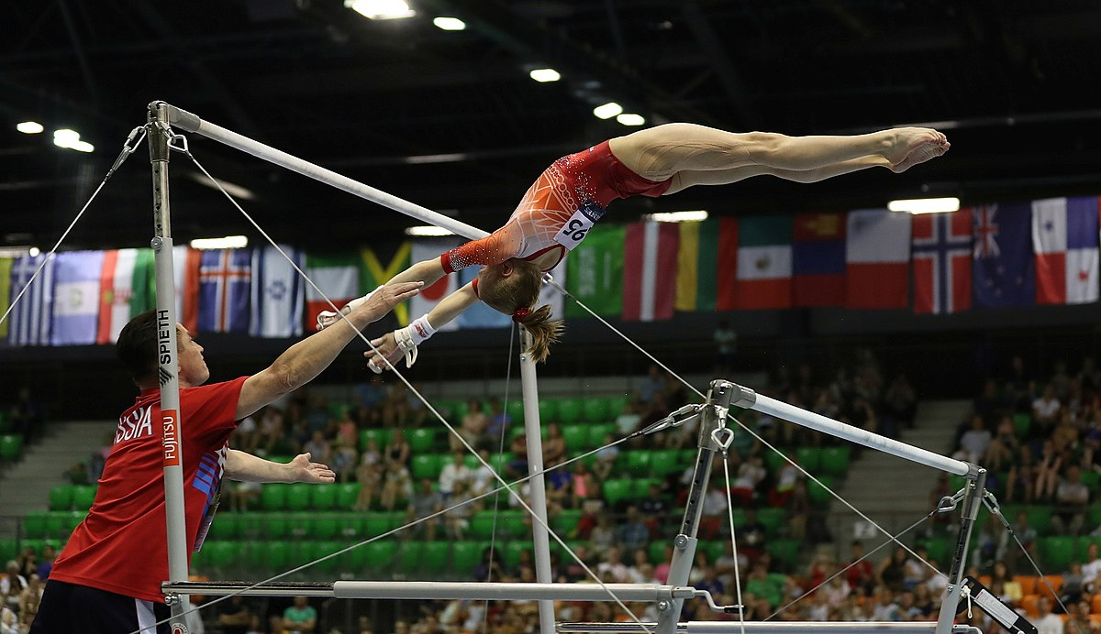
TNE in action: Any questions?
Involves the performance of complex connections, transitions, and ‘release skills’
High profile activity: team-based, with potential for individual reward or failure
Positioning is key
Support and trust are essential
Stress fractures are possible
Requires balance and flexibility
Requires navigating structural asymmetry
https://commons.wikimedia.org/wiki/File:2019-06-29_1st_FIG_Artistic_Gymnastics_JWCH_Women%27s_Apparatus_finals_Uneven_bars_%28Martin_Rulsch%29_290.jpg
Attribution: Martin Rulsch, Wikimedia Commons, CC BY-SA 4.0
Notes:
Ask audience to reflect on this metaphor. Pretty apt except for the glitter & leotards.
Lots of balancing back and forth required.
Uneven bars reflect uneven power balance (which in TNE can also shift: power sits differently with partners depending on the issue)

Slide 18
Bibliography
Caruana, V. & Montgomery, C. (2015). Understanding the transnational higher education landscape: Shifting positionality and the complexities of partnership. Learning and Teaching, 8(1), 5-29.
Ding, A. & Bruce, I. (2017). The English for academic purposes practitioner. Cham, Switzerland: Palgrave Macmillan.
Djerasimovic, S. (2014). Examining the Discourses of Cross-Cultural Communication in Transnational Higher Education: From Imposition to Transformation. Journal of Education for Teaching: International Research and Pedagogy, 40(3), 204-216.
Duchek, S. 2015. Enhancing Absorptive Capacity for Innovation and Change: The Role of Structural Determinants. Journal of change management. 15(2), pp.142–160.
Galloway, N. (Ed.), Curle, S., Jablonkai, R. R., Mittelmeier, J., Sahan, K., & Veitch, A. (2020). English in higher education: English medium instruction literature review. British Council.
Hayes, J. 2022. The theory and practice of change management Sixth edition. London: Red Globe Press
Holliday, A (2016) Difference and awareness in cultural travel: negotiating blocks and threads. Language and Intercultural Communication, 2016, volume 16, issue 3, pages 318-331
Keevers, L. M., Price, O., Leask, B., Dawood Sultan, F. K., Lim, J. S. Y., & Loh, V. C. (2019). Practices to improve collaboration by reconfiguring boundaries in transnational education. Journal of University Teaching & Learning Practice, 16(2), 11.
Knight, J. (2016). Transnational education remodeled: Toward a common TNE framework and definitions. Journal of Studies in International Education, 20(1), 34-47.
Leung M, & Waters, J. (2017) Educators sans frontières? Borders and power geometries in transnational education. Journal of Ethnic and Migration Studies 43(8): 1276-1291. doi: 10.1080/1369183X.2017.1300235
Macaro, E. (2018) English medium instruction: Content and language in policy and practice. Oxford: Oxford UP.
Macaro E. Curle S, Pun J, An J, Dearden J. (2018) A systematic review of English medium instruction in higher education. Language Teaching 51(1): 36-76. doi: 10.1017/S0261444817000350
Smith, K. (2009) Transnational teaching experiences: an under‐explored territory for transformative professional development. International Journal for Academic Development, 14(2), 111-122.
UUKi (2023). Scale of TNE 2021-22. Universities UK, https://www.universitiesuk.ac.uk/universities-uk-international/insights-and-publications/uuki-publications/scale-uk-he-tne-2021-22
Wilding, E. and Li, D. (2021) Staff development at a joint Sino-British institute in China. In: Tsiligiris, V. , Lawton, W. , Hill, C. , (eds.) Importing Transnational Education. Palgrave Macmillan pp. 137-153. doi: https://dx.doi.org/10.1007/978-3-030-43647-6_9

Slide 19

Questions?
Notes:
Don’t need this slide? Elicit questions while showing the ‘TNE in Action’ slide?

