Slide 1
Taking Bourdieu on a Field Trip: Analysing Practitioners, Power, Influence and Collaboration
Alex Ding*
*Inspired by work done with Laetitia Monbec and Ian Bruce

Slide 2
Social theory …
to provide explanatory power that can account for successes and failures in collaboration and account for the (lack of) power and influence of practitioners.
To insist on a reflexive understanding of the field of EAP to identify and confront the ideological, structural and discursive forces that shape our field and us.
EAP is ‘a social field like any other, with its distribution of power and its monopolies, its struggles and strategies, interests and profits’.
Bourdieu, 1975: 19

Slide 3
Social theory … EAP as pharmakon
T]he world of science is threatened by a serious regression. The autonomy that science had gradually won against the religious, political or even economic powers, and partially at least, against the state bureaucracies which ensured the minimum conditions for its independence, has greatly weakened. ... In short, science is in danger, and for that reason it is becoming dangerous.
Bourdieu 2004, p. vii.

Slide 4
From collective amnesia to collective anamnesis
Anamnesis in the field offers practitioners the first steps to a rupture with the unsaid, the unthought thought, the implicit, the doxas that permeate the field and then to trigger resistance to domination, orthodoxy, and injustices. And in doing so:
Socio-analysis is above all a never-ending collective reflexive practice, and it is equally a remedy to crisis. It is a way of grounding and enacting collective reflexivity

Slide 5
Socio-analysis and the field
In socio-analysis the primary focus is on the field:
the characteristics of a field are it is a structured social space; it contains agents (people and institutions) who dominate and who are dominated; the field is a permanent relationship of inequality; field agents struggle to transform or preserve the field; all agents harness the powers they have in this struggle; and power defines agents’ positions in the field and their strategies.
Ding, 2022: 157.

Slide 6
EAP as an ill-defined porous and contested field
Because these posts, ill-defined and ill-guaranteed but open and ‘full of potential’ as the phrase goes, leave their occupants the possibility of defining them by bringing the embodied necessity which is constitutive of their habitus, their future depends on what is made of them by their occupants, or at least those of them who, in the struggles with the ‘profession’ and in confrontations with neighbouring and rival professions, manage to impose the definition of the profession most favourable to what they are.
Bourdieu, 2000: 158.

Slide 7
Illusio – promises and deceptions in EAP
agents are drawn to a field because of the field illusio that presupposes and promises an ethos, values and normative orientation. Fields are laden with ethical doxas and illusio that promise rewards and recognition and fulfilling aspirations but also they are arenas for (widespread) ‘blighted hope’ or ‘frustrated promise’ (Bourdieu, 1984: 150).
Lacking in sufficient capitals, or the right configuration of capitals, there are agents who do not have enough (perceived) value and power to impose their values and practices. These dominated agents risk suffering a ‘sense of incompetence, failure or cultural unworthiness’ (Bourdieu, 1984: 389).

Slide 8
Symbolic capital
In terms of ‘conditions of access’ to the field EAP is unlike many academic fields where disciplinary autonomy from external fields is maintained with ‘sufficiently high entry barriers’ (Bourdieu, 2000: 111). Ding and Campion (2016), Ding (2019) and Ding and Bruce (2017) demonstrate that credentials to enter the field as practitioners are varied and vague and there is no specific prerequisite qualification…
EAP practitioners enter the field with little cultural capital in terms of both intellectual and academic capitals and this positions them in a highly dominated position within the larger HE field impacting their power, agency and symbolic capital
Status and location of EAP practitioners reveal the most significant struggle within and with other fields, that of its purpose as that of a mercantile service serving university profit-seeking imperatives or engaging in a legitimate, recognized academic/educational endeavour (Ding and Bruce, 2017).

Slide 9
Symbolic capital
Heterodoxy of locations and titles extends to rewards (economic capital features here) in terms of remuneration, career development, promotions and professional stability. From without, lacking symbolic capital (recognition and legitimacy) practitioners struggle to define their practices as educational and academic against those agents in the HE field who dominate the social space in which EAP takes place and by doing so condemns EAP to the edge of academia

Slide 10
EAP in HE
Practitioners engage in defining the field in ways ‘most favourable to what they are’ and are likely to draw on their habitus as language educators (through their credentials, teaching qualifications, previous experience and as part of the definition of the field of EAP) with paradoxical consequences

Slide 11
EAP in HE
Cultural capital and field boundaries are often claimed through practitioner linguistic capital (language experts) and pedagogical capital, expertise in teaching.
Language in HE is invisible, taken for granted, ethnocentric prejudices abound, until there is a perceived infringement on writing doxa (clarity, ‘grammar’, referencing, etc.) in which case academics turn to EAP practitioners (or learning support), as the perception of EAP practitioners is of sub-academic language fixers, ‘fixing up grammar in the language centre’ (Hyland and Hamp-Lyons, 2002: 6), who can offer remedial support. This sustains the notion of domination.
Because there is significant economic capital at play, there are greater rewards for agents in HE, opportunities for symbolic as well as economic capital. In investing in central services, acting as powerful institutional agents to enforce changes in teaching practices to satisfy student-customers, universities offer rewards, distinctions and power to those academic agents that undertake this mission. Therefore, these institutions attract those with greater cultural capital than practitioners to struggle over rewards and distinction. It is not unusual to have historians, chemists, engineers, or neurobiologists at the apex of power in teaching and pedagogy in HE NOT EAP practitioners

Slide 12
Resistance to scholarship in EAP
The increasing emphasis on scholarship in EAP, at least in the ideational domain but also through practical effects such as promotion, can be viewed as an insertion of heterodoxy into the field, a challenge to historical practices in EAP and a potential redistribution of power, distinction, and economic and cultural capital

Slide 13
Resistance to scholarship in EAP –a self-inflicted wound
Practitioners that have a habitus attuned to a field that has afforded them some rewards in historical, orthodox ways will tend to feel ill-equipped to compete for cultural capital through scholarship and some are likely to struggle against this heterodox insertion through asserting other values and practices that diminish scholarship. This may include a rejection of a more academic identity through asserting their pedagogical and linguistic capitals (defining themselves as expert language teachers), through aligning with business and neoliberal doxa (defining themselves as working in an ‘industry’ with all that this implies), and/or through a dismissal of scholarship (where theory is suspicious, research/scholarship irrelevant and experience priceless)

Slide 14
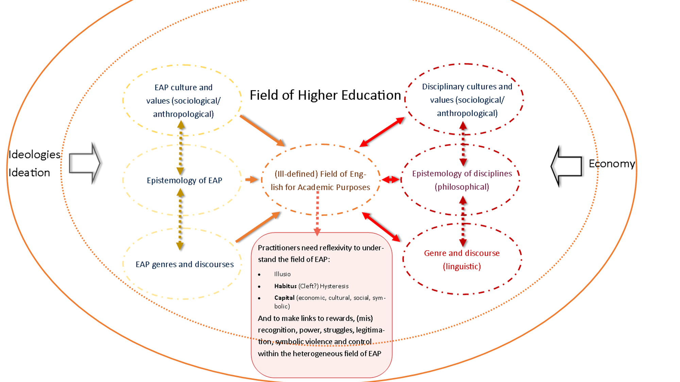
And solutions?

Slide 15
And solutions?
Develop credentials and expertise
Position ourselves as a legitimate academic and educational field and striving for/demonstrating this through our collective knowledge made visible through scholarship
Develop an ethical framework for EAP - Reflexively strive to understand our field and the field of HE to collectively reduce the gap from the real to the ideal
Fight for the autonomy of our field and its practitioners
a field is all the more scientific the more it is capable of channelling, of converting unavowable motives into scientifically proper behaviour. (Bourdieu & Wacquant, 1992, p. 177)

