Slide 1
Issues with the move to AI-proof assessments
Neil McGregor – University of Manchester, Centre for Academic English
Notes:
-

Slide 2
Departure – context of response
Via - Current trial
Destination – issues & next steps

Slide 3
Context of response
Lots of activity
Generally positive
Greater interest in alternative assessments
Some general guidance
AI-assisted malpractice treated same as other malpractice
No definitive decisions

Slide 4
Current trial
Critical reviews
Used across the university
Easy target for AI malpractice
Understanding of material
Ability to think critically
Time consuming
Only 1 or 2 texts per course
ILO 1: Assess and evaluate psychological theories and practices as they
relate to organisational problems and decision-making
ILO2: Critically evaluate published international business research.

Slide 5
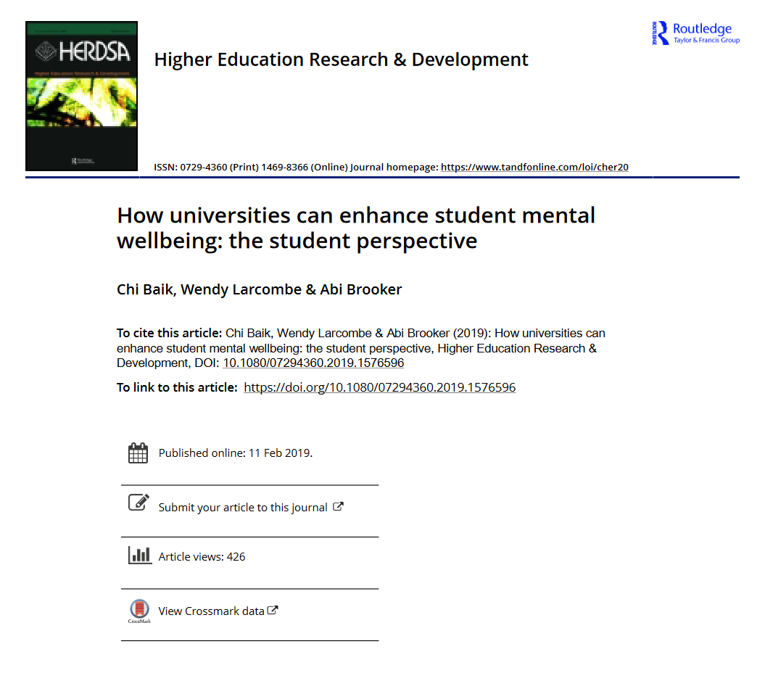
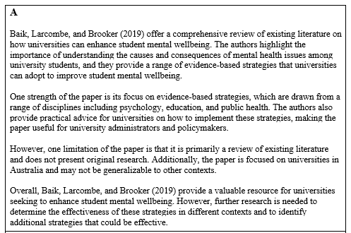

Slide 7
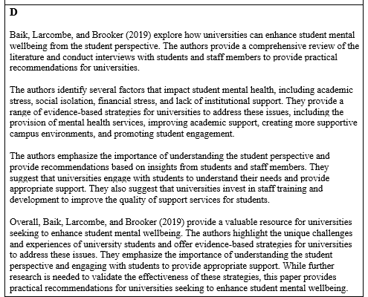
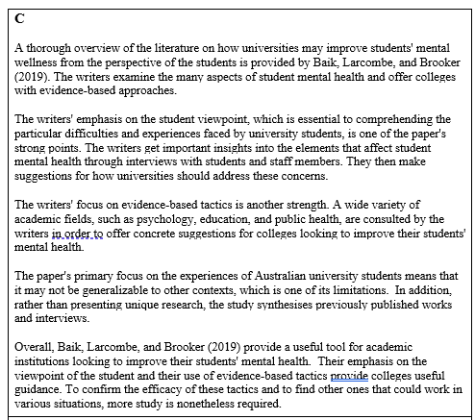
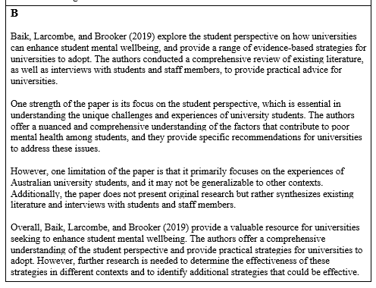

Slide 8
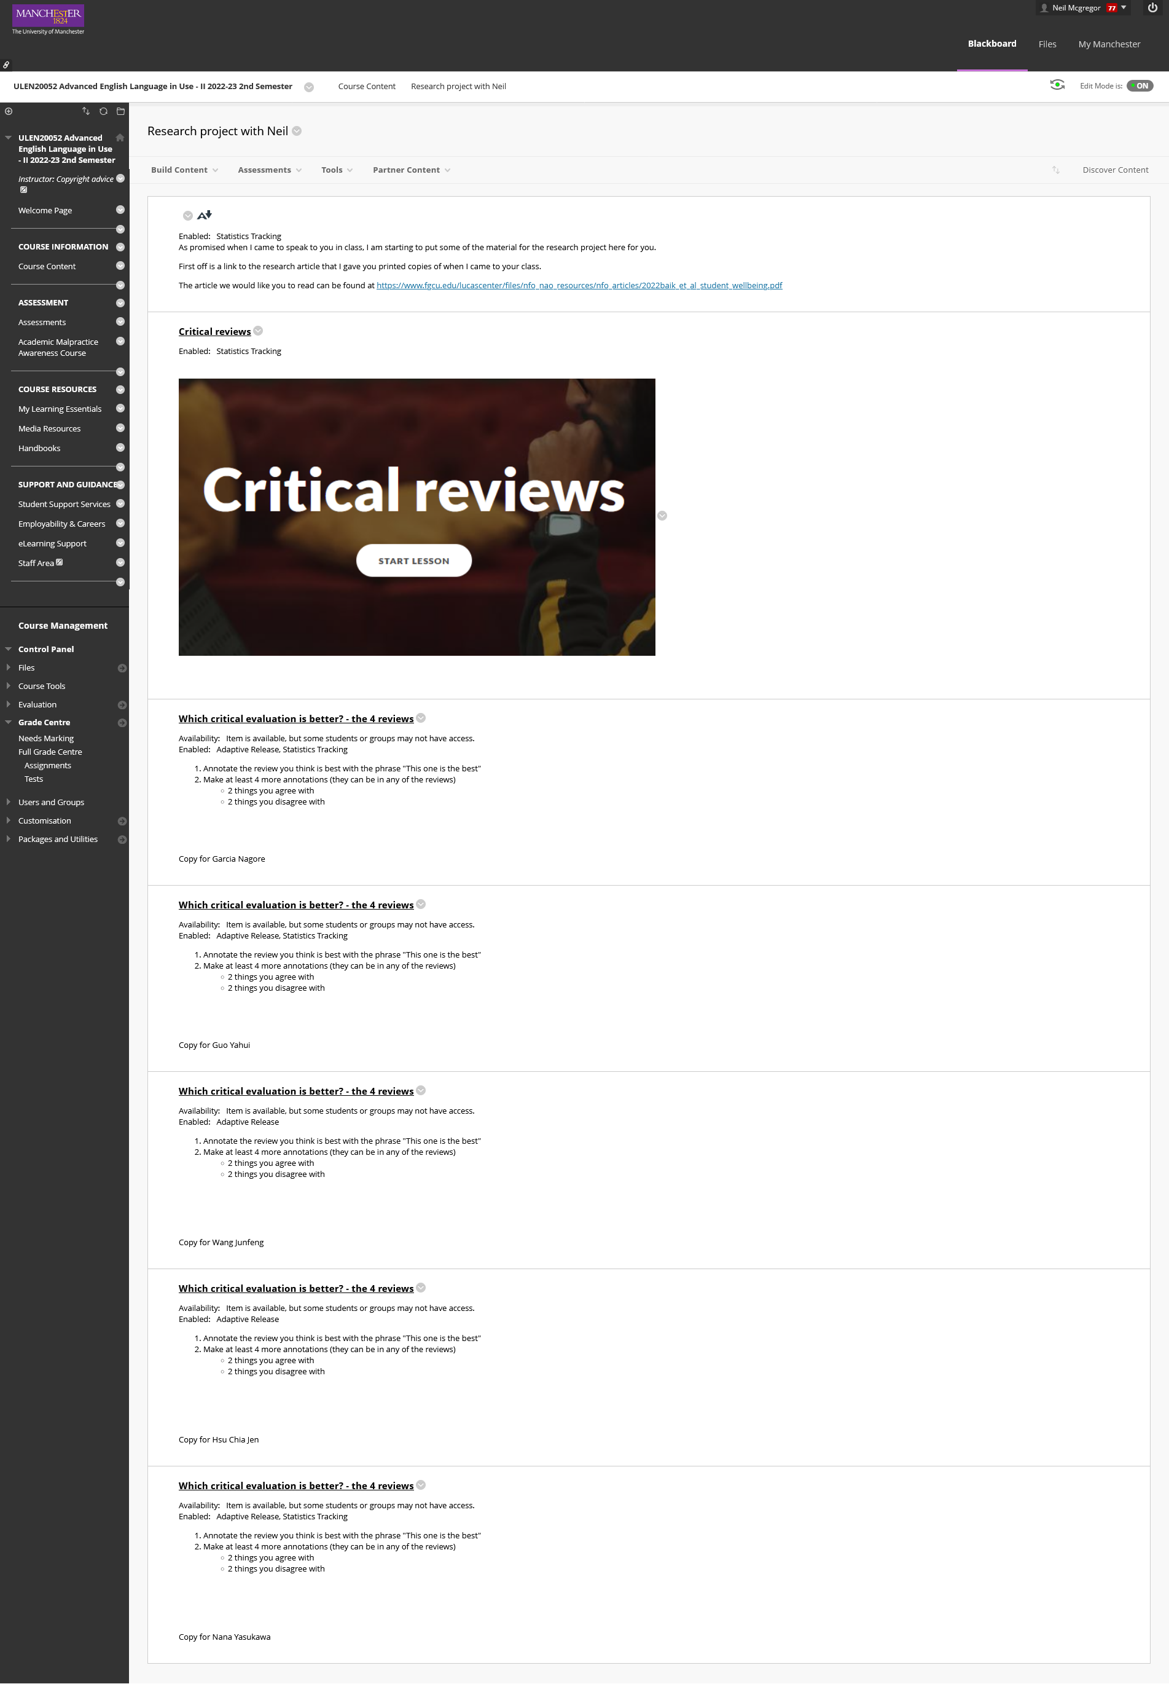

Slide 10
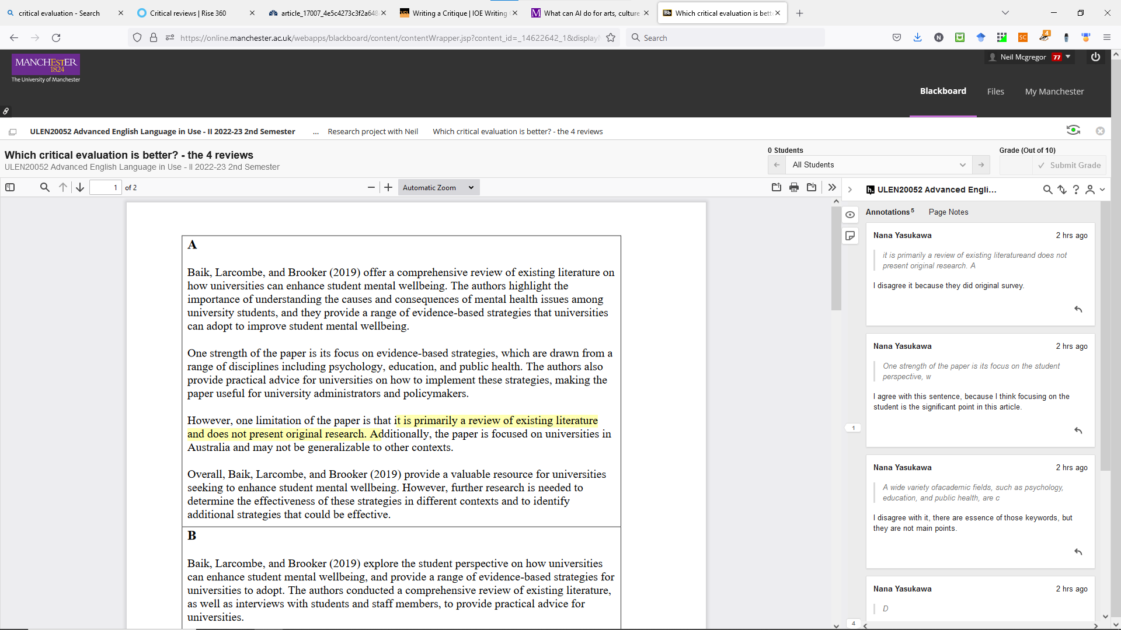

Slide 13
Task
Generate reviews
Critically evaluate the reviews
Report evaluation

Slide 14
Issues and responses
Feedback from students
“…but writing is my problem”
Scalability
Automate marking as much as possible
Return to sit down exams
Reliability
Contextual factors affect test-retest
Fairness
equal access for all or for none

Slide 15
Issues and responses
Validity & Constructive alignment
“ILO3: To be able to critically evaluate published research reports.”
“ILO4: Participants should be able to show enhanced skills in written, visual and oral presentation”
but
“ILO5: …use communications and information technology in acquiring, analysing, and communicating information”

X

