Slide 1


Generative AI and academic writing
Issues and opportunities
Mike Sharples
Institute of Educational Technology
The Open University
www.mikesharples.org
@sharplm

Slide 2
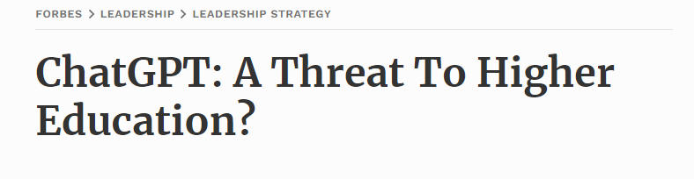

Generative AI
A threat to education?
Or a universal tutor?

Slide 3
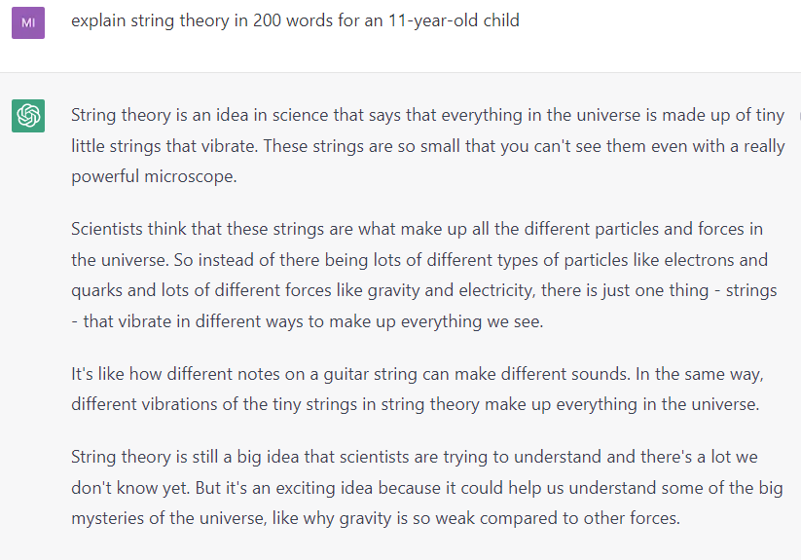
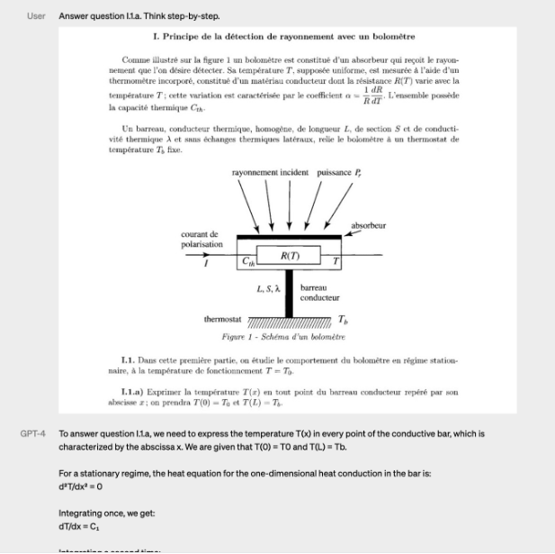
GPT-4
Highly-trained text completer and style copier
It can generate up to 25,000 words
It can write in any style in multiple languages
It can be given a direct instruction
It can interpret text and images
It is a general-purpose language tool

Slide 4

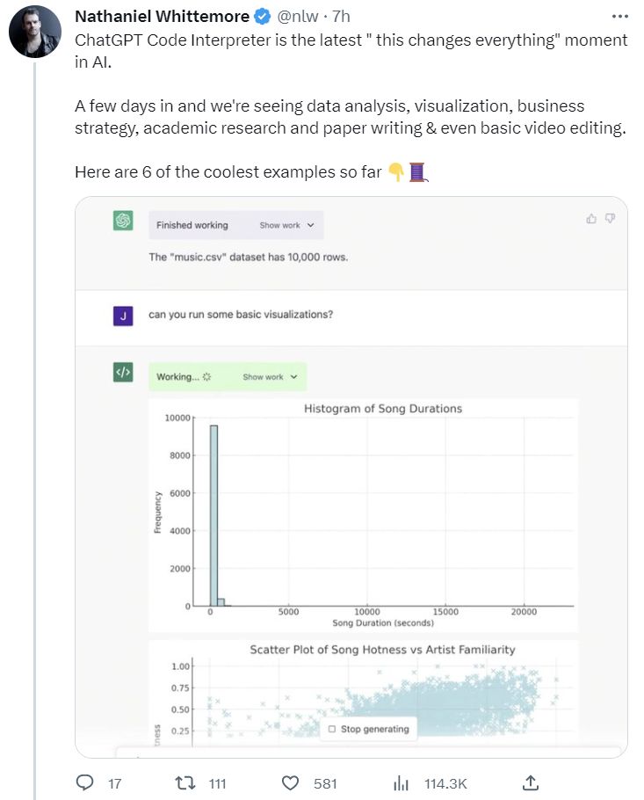
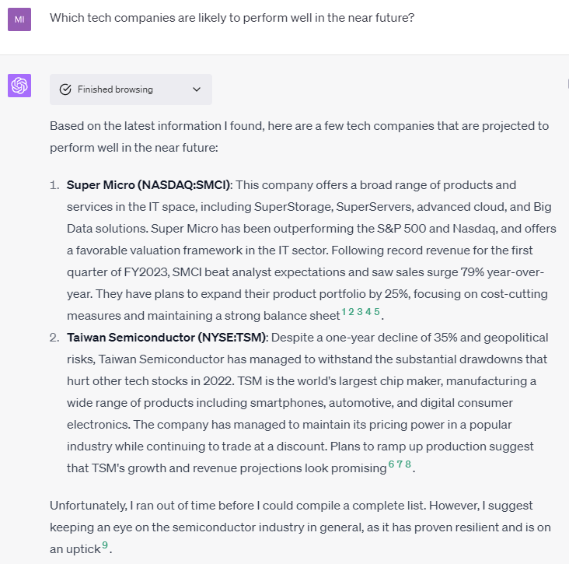
ChatGPT Plus
Plugins for maths, science, language, media, business
Integration with web browser
Code interpreter to run and display Python programs

Slide 5
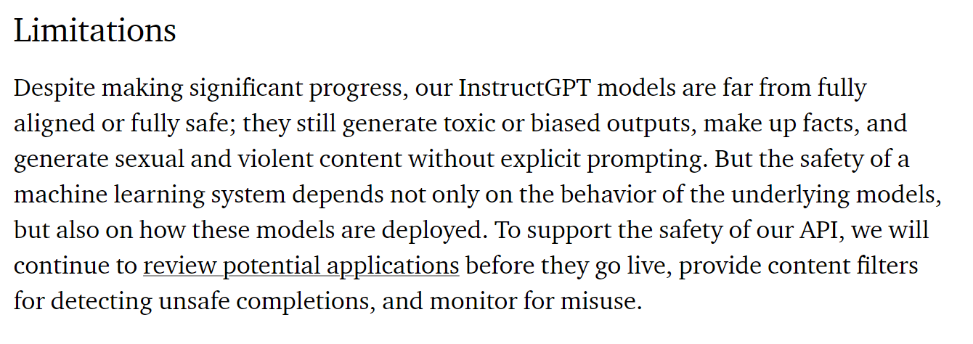
Generative AI hallucinates
It doesn’t “know” it shouldn’t invent research studies,
it has no explicit model of how the world works,
and is amoral.
It is a language model, not a database or reasoning system
https://openai.com/blog/instruction-following/

Slide 6
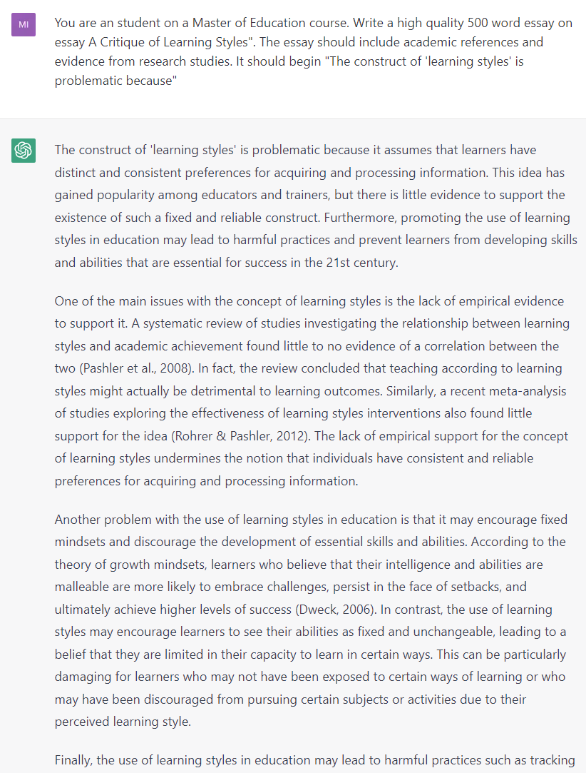
You are a student on a Master of Education course. Write a high quality 500 word essay on essay A Critique of Learning Styles". The essay should include academic references and evidence from research studies. It should begin "The construct of 'learning styles' is problematic because"

Slide 7
A Critique of Learning Styles
The construct of 'learning styles' is problematic because it assumes that learners have distinct and consistent preferences for acquiring and processing information. This idea has gained popularity among educators and trainers, but there is little evidence to support the existence of such a fixed and reliable construct. Furthermore, promoting the use of learning styles in education may lead to harmful practices and prevent learners from developing skills and abilities that are essential for success in the 21st century.
One of the main issues with the concept of learning styles is the lack of empirical evidence to support it. A systematic review of studies investigating the relationship between learning styles and academic achievement found little to no evidence of a correlation between the two (Pashler et al., 2008). In fact, the review concluded that teaching according to learning styles might actually be detrimental to learning outcomes. Similarly, a recent meta-analysis of studies exploring the effectiveness of learning styles interventions also found little support for the idea (Rohrer & Pashler, 2012). The lack of empirical support for the concept of learning styles undermines the notion that individuals have consistent and reliable preferences for acquiring and processing information.
Another problem with the use of learning styles in education is that it may encourage fixed mindsets and discourage the development of essential skills and abilities. According to the theory of growth mindsets, learners who believe that their intelligence and abilities are malleable are more likely to embrace challenges, persist in the face of setbacks, and ultimately achieve higher levels of success (Dweck, 2006). In contrast, the use of learning styles may encourage learners to see their abilities as fixed and unchangeable, leading to a belief that they are limited in their capacity to learn in certain ways. This can be particularly damaging for learners who may not have been exposed to certain ways of learning or who may have been discouraged from pursuing certain subjects or activities due to their perceived learning style.
Finally, the use of learning styles in education may lead to harmful practices such as tracking and labeling students. In tracking, learners are sorted into groups based on their perceived learning style, which can reinforce stereotypes and limit opportunities for growth and exploration (Gurung, 2004). Labeling students according to their learning style can also be harmful, as it may encourage teachers and learners to focus on weaknesses rather than strengths and may stigmatize learners who do not fit neatly into a particular category.
In conclusion, the construct of learning styles is problematic because it lacks empirical support, may discourage the development of essential skills and abilities, and can lead to harmful educational practices such as tracking and labeling. As educators, it is important to recognize the limitations of learning styles and instead focus on evidence-based practices that promote learning and growth for all learners, regardless of their perceived learning style.
References:
Dweck, C. (2006). Mindset: The new psychology of success. Random House.
Gurung, R. (2004). Black and white thinking about learning styles: A response to the Journal of College Reading and Learning. Journal of College Reading and Learning, 34(2), 7-17.
Pashler, H., McDaniel, M., Rohrer, D., & Bjork, R. (2008). Learning styles: Concepts and evidence. Psychological Science in the Public Interest, 9(3), 105-119.
Rohrer, D., & Pashler, H. (2012). Learning styles: Where's the evidence? Medical Education, 46(7), 634-635.
ChatGPT – November 2022

Slide 8
A Critique of Learning Styles
The construct of 'learning styles' is problematic because it assumes that learners have distinct and consistent preferences for acquiring and processing information. This idea has gained popularity among educators and trainers, but there is little evidence to support the existence of such a fixed and reliable construct. Furthermore, promoting the use of learning styles in education may lead to harmful practices and prevent learners from developing skills and abilities that are essential for success in the 21st century.
One of the main issues with the concept of learning styles is the lack of empirical evidence to support it. A systematic review of studies investigating the relationship between learning styles and academic achievement found little to no evidence of a correlation between the two (Pashler et al., 2008). In fact, the review concluded that teaching according to learning styles might actually be detrimental to learning outcomes. Similarly, a recent meta-analysis of studies exploring the effectiveness of learning styles interventions also found little support for the idea (Rohrer & Pashler, 2012). The lack of empirical support for the concept of learning styles undermines the notion that individuals have consistent and reliable preferences for acquiring and processing information.
Another problem with the use of learning styles in education is that it may encourage fixed mindsets and discourage the development of essential skills and abilities. According to the theory of growth mindsets, learners who believe that their intelligence and abilities are malleable are more likely to embrace challenges, persist in the face of setbacks, and ultimately achieve higher levels of success (Dweck, 2006). In contrast, the use of learning styles may encourage learners to see their abilities as fixed and unchangeable, leading to a belief that they are limited in their capacity to learn in certain ways. This can be particularly damaging for learners who may not have been exposed to certain ways of learning or who may have been discouraged from pursuing certain subjects or activities due to their perceived learning style.
Finally, the use of learning styles in education may lead to harmful practices such as tracking and labeling students. In tracking, learners are sorted into groups based on their perceived learning style, which can reinforce stereotypes and limit opportunities for growth and exploration (Gurung, 2004). Labeling students according to their learning style can also be harmful, as it may encourage teachers and learners to focus on weaknesses rather than strengths and may stigmatize learners who do not fit neatly into a particular category.
In conclusion, the construct of learning styles is problematic because it lacks empirical support, may discourage the development of essential skills and abilities, and can lead to harmful educational practices such as tracking and labeling. As educators, it is important to recognize the limitations of learning styles and instead focus on evidence-based practices that promote learning and growth for all learners, regardless of their perceived learning style.
References:
Dweck, C. (2006). Mindset: The new psychology of success. Random House.
Gurung, R. (2004). Black and white thinking about learning styles: A response to the Journal of College Reading and Learning. Journal of College Reading and Learning, 34(2), 7-17.
Pashler, H., McDaniel, M., Rohrer, D., & Bjork, R. (2008). Learning styles: Concepts and evidence. Psychological Science in the Public Interest, 9(3), 105-119.
Rohrer, D., & Pashler, H. (2012). Learning styles: Where's the evidence? Medical Education, 46(7), 634-635.
Invented research study
Fake academic paper

Slide 9
The construct of 'learning styles' is problematic because it implies a static and narrowly defined approach to the way individuals process and retain information. Despite the widespread popularity of this concept, there is a lack of empirical evidence to support the effectiveness of learning styles in enhancing educational outcomes. This essay aims to critique the learning styles theory by examining its origin, research evidence, and implications for educators.
The concept of learning styles has its roots in the work of Dunn and Dunn (1978), who posited that students have different preferred ways of processing information, including visual, auditory, and kinesthetic modalities. The VARK model (Fleming, 2001) expanded upon this idea, adding the reading/writing preference as a fourth category. Other models, such as Kolb's experiential learning theory (Kolb, 1984) and Gardner's theory of multiple intelligences (Gardner, 1983), further contributed to the proliferation of learning styles theories in education.
Despite the intuitive appeal of these theories, numerous research studies have consistently failed to support the effectiveness of learning styles in improving educational outcomes. For instance, a meta-analysis conducted by Pashler et al. (2008) found insufficient evidence to support the idea that tailoring instruction to students' learning styles resulted in improved learning. Similarly, a review by Coffield et al. (2004) identified more than 70 learning styles models and concluded that there was little scientific evidence to support the use of any of them in practice.
One of the primary criticisms of learning styles is the lack of a clear and consistent definition of what constitutes a learning style (Coffield et al., 2004). This has led to the proliferation of multiple, often contradictory, models that make it difficult to operationalize and test the theory. Furthermore, many of the assessments used to determine students' learning styles have been found to lack reliability and validity (Kirschner & van Merriënboer, 2013), further casting doubt on the utility of this concept in educational settings.
Another issue with learning styles is the oversimplification of the learning process. By categorizing students into distinct learning styles, the theory disregards the complex and dynamic nature of human cognition (Kirschner & van Merriënboer, 2013). In reality, learners are not limited to a single mode of processing information, and the effectiveness of a particular learning approach may vary depending on the context and the specific task at hand (Willingham, 2009).
Moreover, the focus on learning styles may inadvertently encourage teachers to limit their instructional methods, potentially hindering the development of a diverse repertoire of cognitive skills in students (Riener & Willingham, 2010). Instead of catering to specific learning styles, researchers have argued that teachers should emphasize the use of evidence-based instructional strategies that are effective across a wide range of learners, such as spaced repetition, retrieval practice, and elaboration (Dunlosky et al., 2013).
In conclusion, the concept of learning styles is problematic due to its lack of empirical support, inconsistent definitions, and oversimplification of the learning process. Rather than relying on this flawed theory, educators should focus on adopting evidence-based instructional strategies that promote learning for all students. Ultimately, fostering a diverse set of cognitive skills and flexible thinking will better prepare learners for the complex and dynamic challenges they will face in their lives.
References:
Coffield, F., Moseley, D., Hall, E., & Ecclestone, K. (2004). Learning styles and pedagogy in post-16 learning: A systematic and critical review. Learning and Skills Research Centre.
Dunn, R., & Dunn, K. (1978). Teaching students through their individual learning styles: A practical approach. Reston Publishing Company.
Dunlosky, J., Rawson, K. A., Marsh, E. J., Nathan, M. J., & Willingham, D. T. (2013). Improving students' learning with effective learning techniques: Promising directions from cognitive and educational psychology. Psychological Science in the Public Interest, 14(1), 4-58.
Fleming, N. D. (2001). Teaching and learning styles: VARK strategies. Christchurch, New Zealand.
Kirschner, P. A., & van Merriënboer, J. J. (2013). Do learners really know best? Urban legends in education. Educational Psychologist, 48(3), 169-183.
Pashler, H., McDaniel, M., Rohrer, D., & Bjork, R. (2008). Learning styles: Concepts and evidence. Psychological Science in the Public Interest, 9(3), 105-119.
Riener, C., & Willingham, D. (2010). The myth of learning styles. Change: The Magazine of Higher Learning, 42(5), 32-35.
Willingham, D. T. (2009). Why don't students like school? A cognitive scientist answers questions about how the mind works and what it means for the classroom. Jossey-Bass.
GPT-4 – March 2023

Slide 10
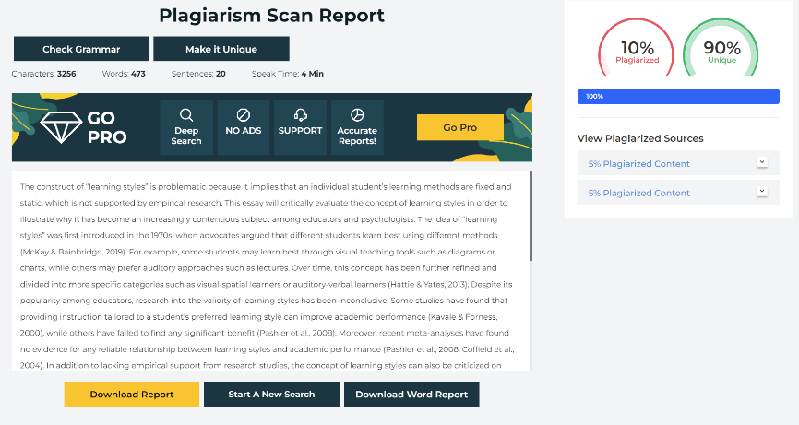

Plagiarism detectors don’t work – the text is generated, not copied
AI detectors have low reliability
OpenAI’s detector tool labels 9% of human-written text as written by AI
Turnitin AI detector
Claims of less than 1% false positives with GPT-3.5 (“based on data that was collected and verified in a controlled lab environment”) need to be independently verified. https://www.turnitin.com/products/features/ai-writing-detection
plagiarismdetector.net
Turnitin detector tool

Slide 11
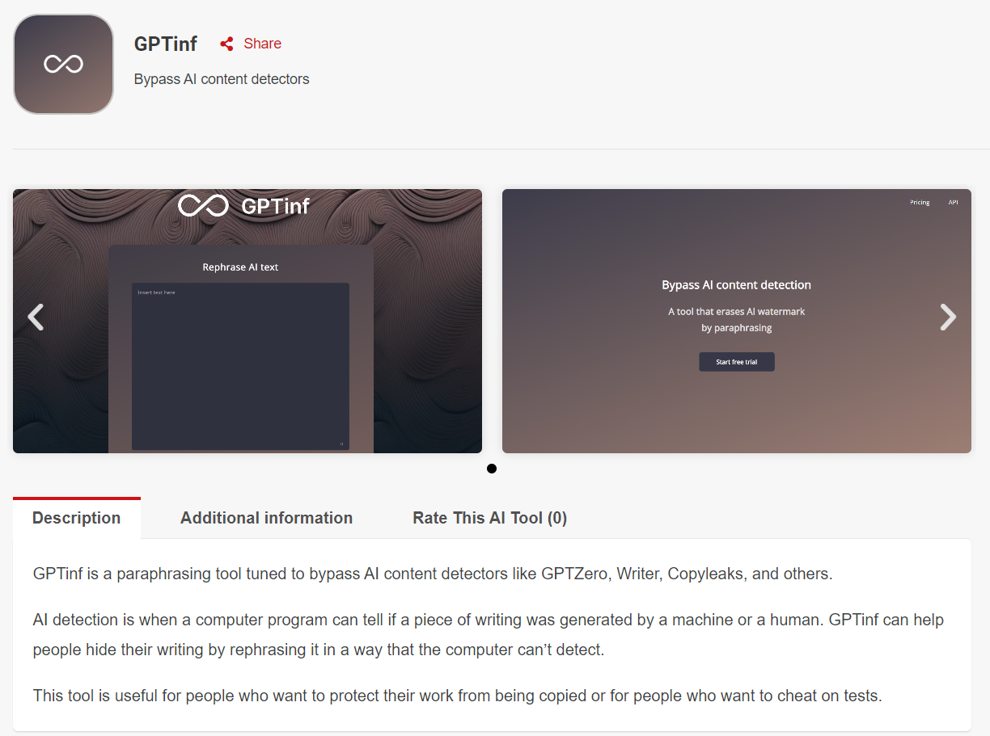
AI watermarking
Intended to help detect whether a text has been written by AI
ChatGPT inserts words from an internal “greenlist” at greater frequency that would be used by a human
Could be defeated by programs that paraphrase the text to remove the greenlisted words
Students use AI generators, institutions use AI detectors, students avoid AI detectors. Nobody learns, nobody gains – except the companies that harvest data.

Slide 12
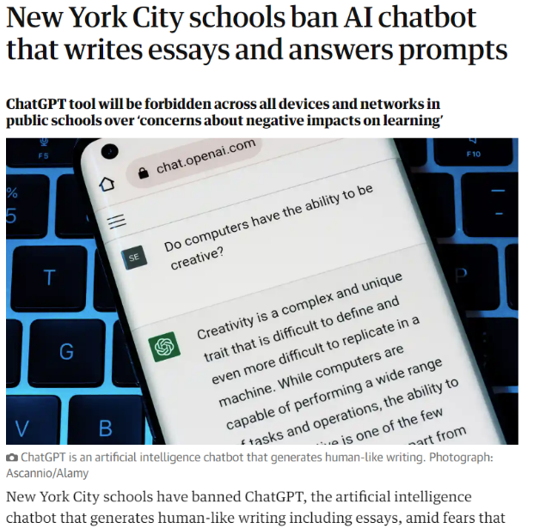
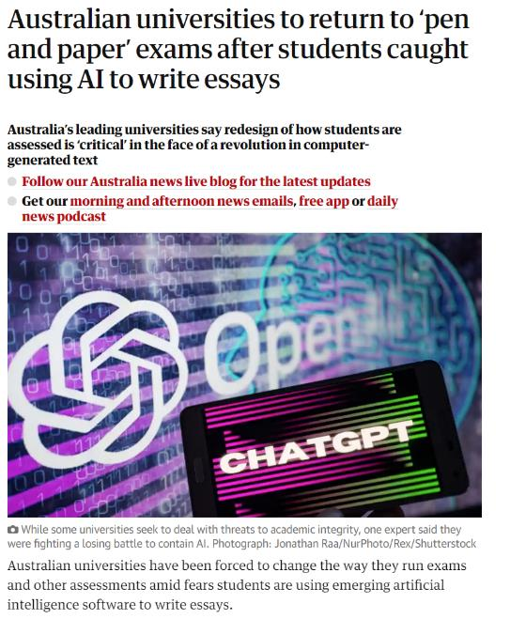
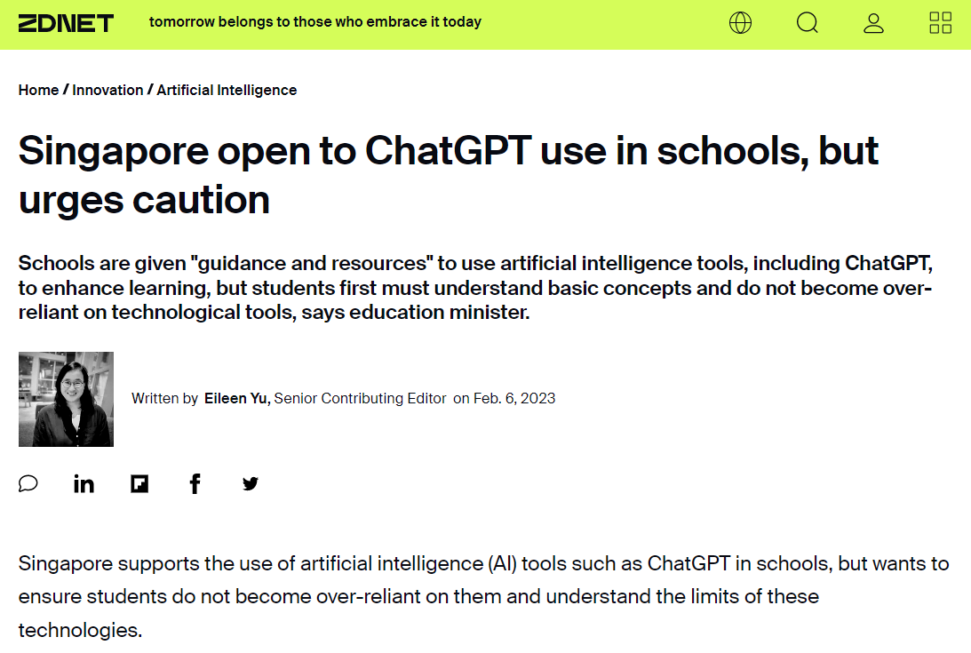
Ban
Confident students will continue to use AI and will challenge decisions based on AI detectors.
Evade
Invigilated exams are costly and limited.
Asking students to state when they use AI will become increasingly difficult
Adapt
Requires new methods of assessment, new policies and guidelines
Embrace
Involves a long process of building trust
The Guardian, 6 January 2023
The Guardian, 10 January 2023
https://www.zdnet.com/article/singapore-open-to-chatgpt-use-in-schools-but-urges-caution/

Slide 13
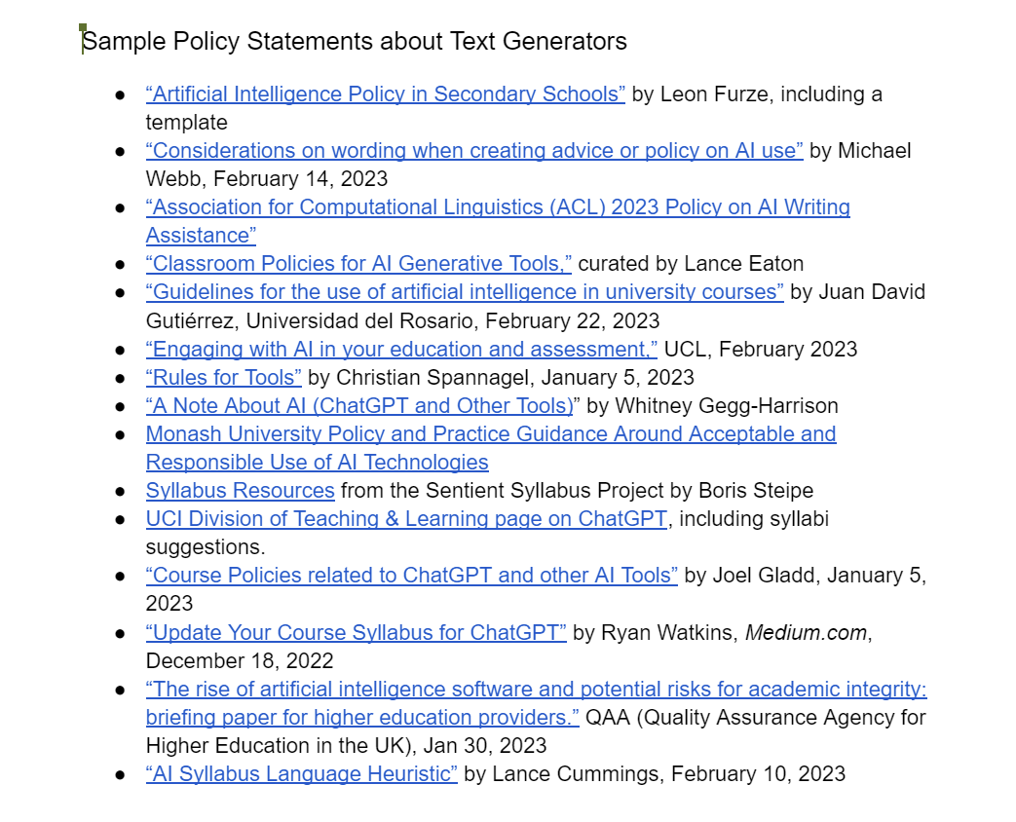
Emerging policy and strategy
Amend written assessments to make them harder for AI to generate
Move to more authentic assessments, such as project work
Establish guidelines for students and staff in use of generative AI
Reassure and engage students in developing strategies for effective learning
Explain to students how they should acknowledge use of generative AI in assignments
Manage suspected breaches of guidelines
Consider redesigning assessment for the next academic year to incorporate AI and develop critical thinking
https://tinyurl.com/y7z4fac4
AI Text Generators: Sources to Stimulate Discussion Among Teachers,
compiled by Anna Mills

Slide 14
Emerging policy and strategy
Amend written assessments to make them harder for AI to generate
Move to more authentic assessments, such as project work
Establish guidelines for students and staff in use of generative AI
Reassure and engage students in developing strategies for effective learning
Explain to students how they should acknowledge use of generative AI in assignments
Manage suspected breaches of guidelines
Consider redesigning assessment for the next academic year to incorporate AI and develop critical thinking
https://tinyurl.com/y7z4fac4
AI Text Generators: Sources to Stimulate Discussion Among Teachers,
compiled by Anna Mills

Slide 15
Flip the narrative from
“How will AI impact education?”
to
“What are new and effective ways to teach and learn with AI?”

Slide 16
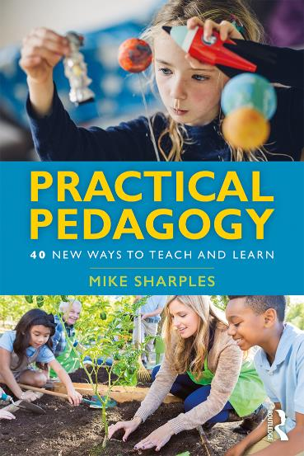
Every powerful pedagogy could be augmented by AI
Adaptive teaching
Spaced learning
Personal inquiry
Dynamic assessment
Stealth assessment
Translanguaging
Crossover learning
Seamless learning
Incidental learning
Learning from gaming
Geo-learning
Learning through social media
Navigating post-truth societies
Explore first
Teachback
Learning through argumentation
Computational thinking
Learning from animations
Learning to learn
Assessment for learning
Formative analytics
Threshold concepts
Learning through storytelling
Learning in remote labs
Context-based learning
Event-based learning
Learning for the future
Embodied learning
Immersive learning
Maker culture
Bricolage
Massive open social learning
Crowd learning
Citizen inquiry
Rhizomatic learning
Reputation management
Open pedagogy
Humanistic knowledge-building communities
Published by Routledge, 2019

Slide 17
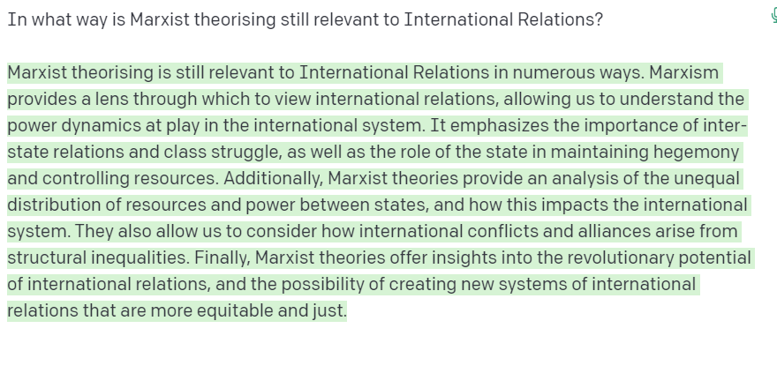
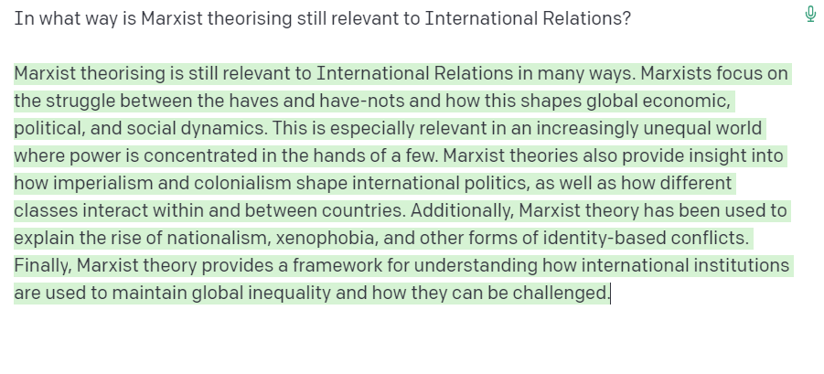
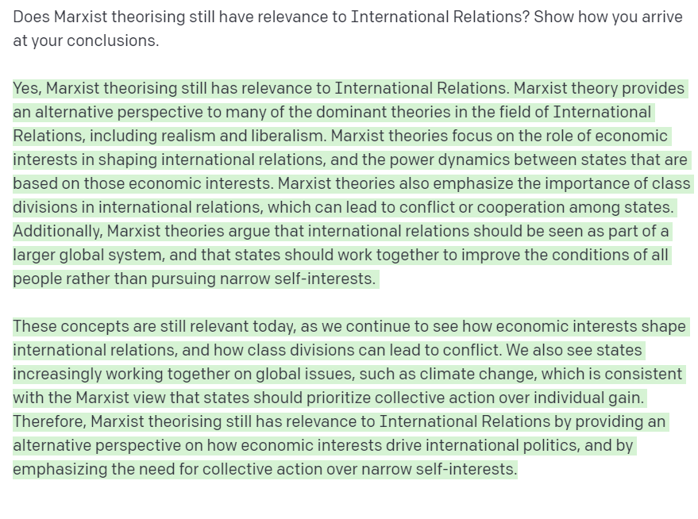
New ways of teaching and learning with AI
Possibility Engine
Educator or student uses AI to generate multiple responses to an open question. Each student synthesises and critiques the AI responses, to create their own written answer.

Slide 18
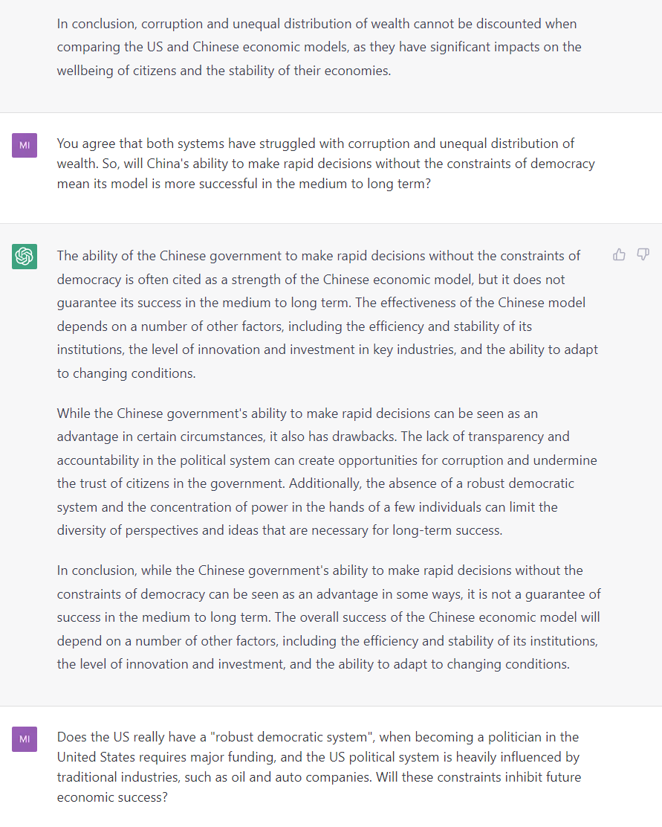
New ways of teaching and learning with AI
Socratic Opponent
In an individual or group activity, students engage with ChatGPT in a Socratic dialogue, then each student writes an argumentative essay.

Slide 19
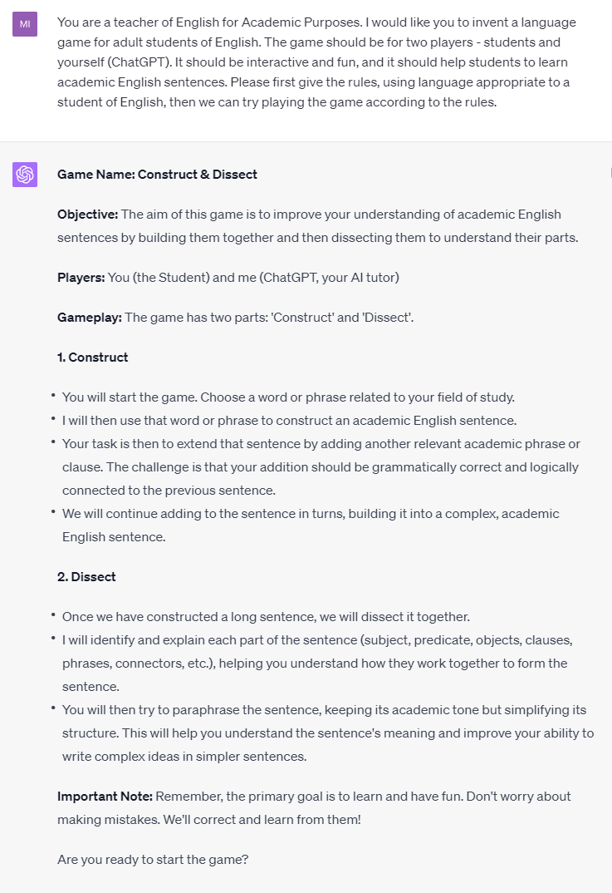
New ways of teaching and learning with AI
Exploratorium
Students explore language by generating games and quizzes.

Slide 20
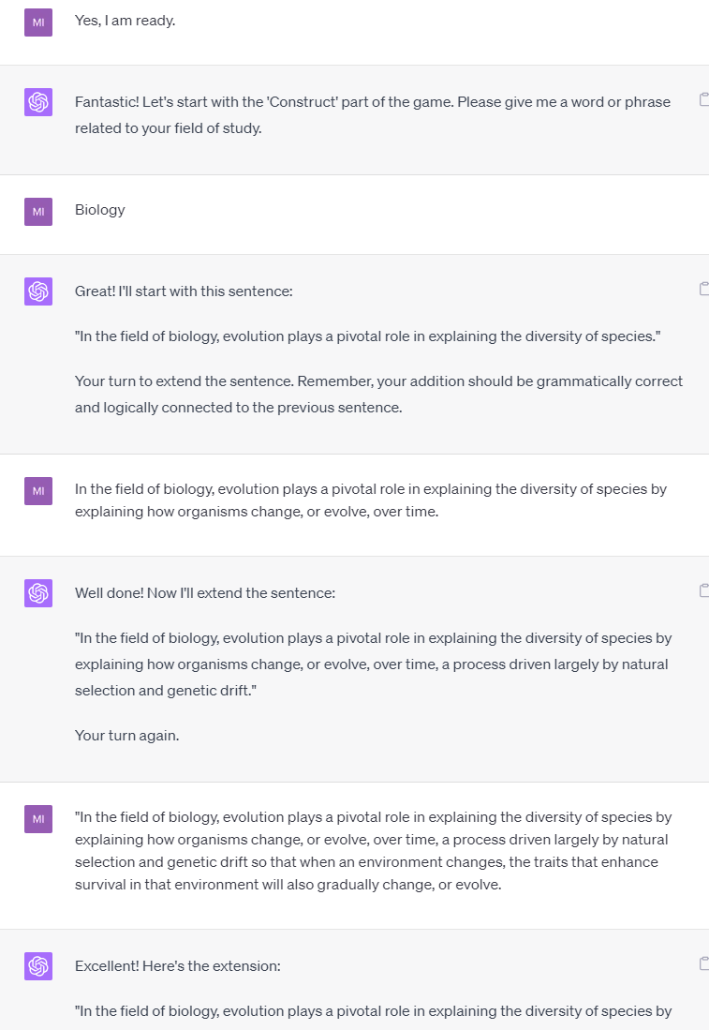
New ways of teaching and learning with AI
Exploratorium
Students explore language by generating games and quizzes.

Slide 21
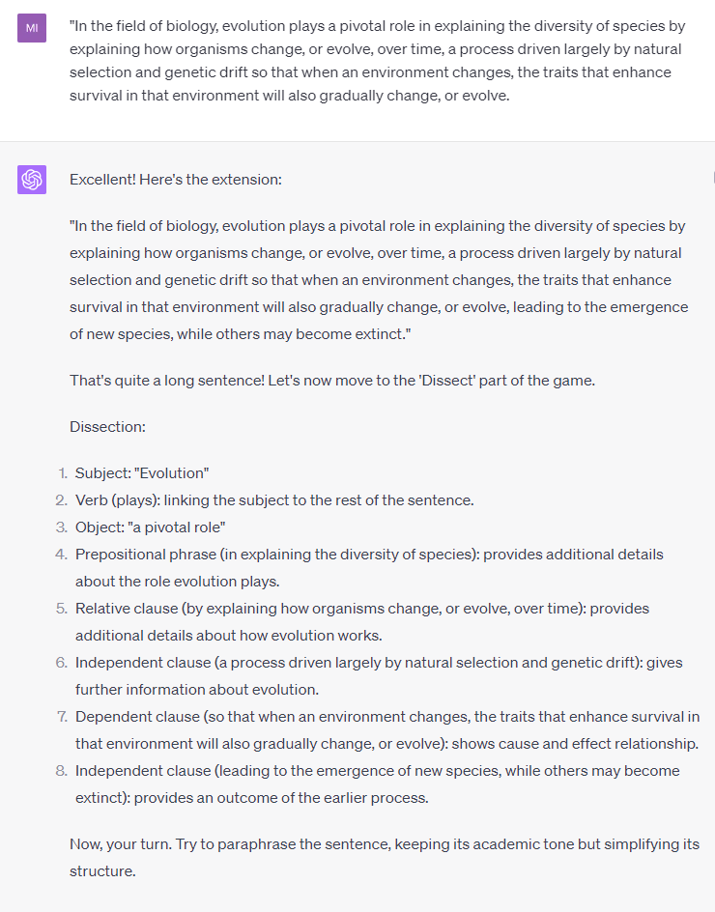
New ways of teaching and learning with AI
Exploratorium
Students explore language by generating games and quizzes.

Slide 22
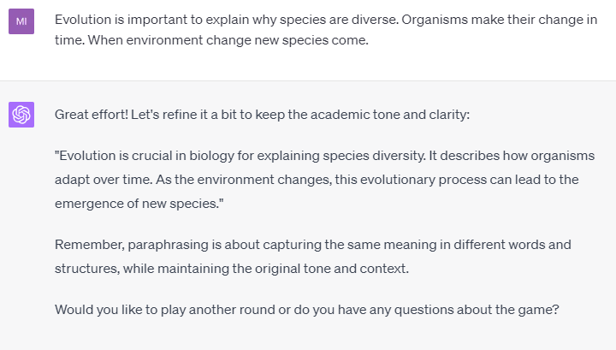
New ways of teaching and learning with AI
Exploratorium
Students explore language by generating games and quizzes.

Slide 23
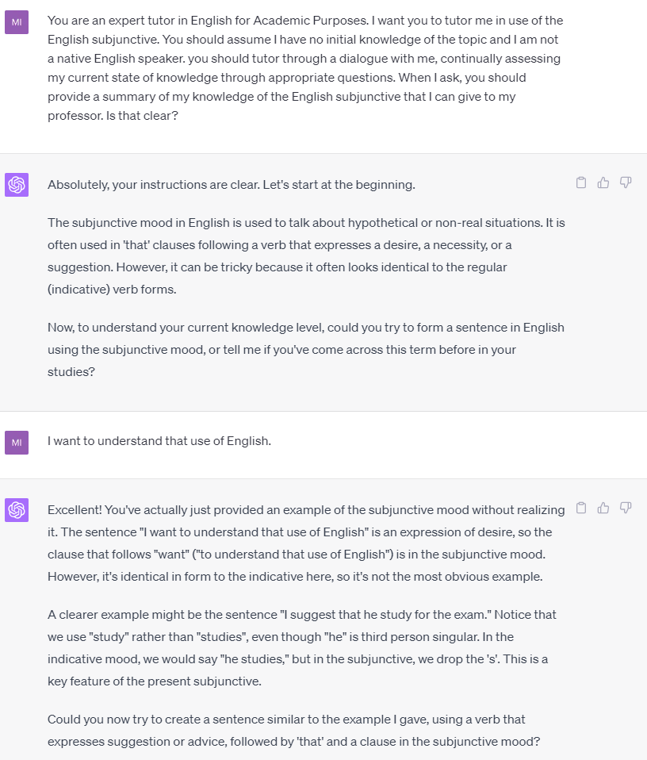
New ways of teaching and learning with AI
Personal Tutor
Students have a personal tutor for any topic.

Slide 24
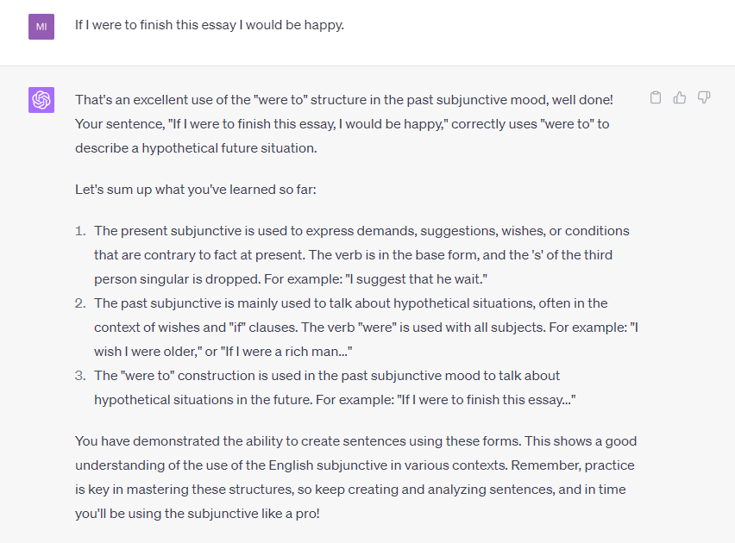
New ways of teaching and learning with AI
Dynamic Assessor
Students share summaries of their learning for dynamic assessment.
Summary assessment, based on my conversation with ChatGPT-4

Slide 25
New ways of teaching and learning with AI
Possibility Engine
AI generates alternative ways of expressing an idea
Socratic Opponent
AI acts as an opponent to develop an argument
Collaboration Coach
AI helps groups to research and solve problems together
Guide on the Side
AI acts a guide to navigate physical and conceptual spaces
Personal Tutor
AI tutors each student and gives immediate feedback on progress
Co-Designer
AI assists throughout the design process
Exploratorium
AI provides tools to play with, explore and interpret data
Study Buddy
AI helps the student reflect on learning material
Motivator
AI offers games and challenges to extend learning
Dynamic Assessor
AI provides educators with a profile of each student’s current knowledge

Slide 26
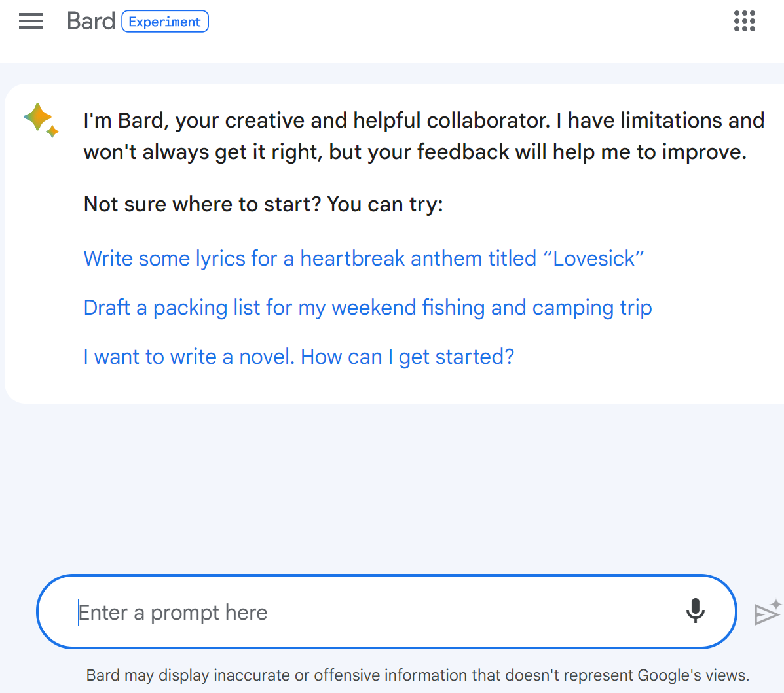
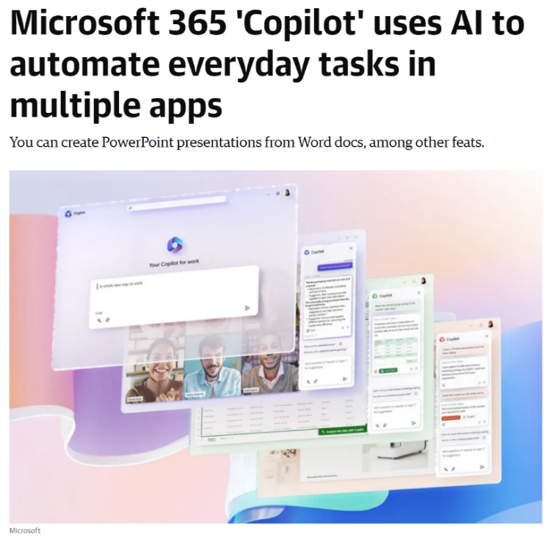

Beyond GPT
Microsoft Copilot
Generative AI integrated into Office suite
Google Bard with PaLM 2
Human pre-training, multimedia, topic-specific tuning for business, medicine etc.
AutoGPT
Goals, plans, tasks, tools, long-term memory
BLOOM
Open-science, open-access language model
Claude from Anthropic
Trained on ethical principles to be “helpful, honest, and harmless”
https://www.engadget.com/microsoft-365-copilot-uses-ai-to-automate-everyday-tasks-in-multiple-apps-151133434.html

Slide 27
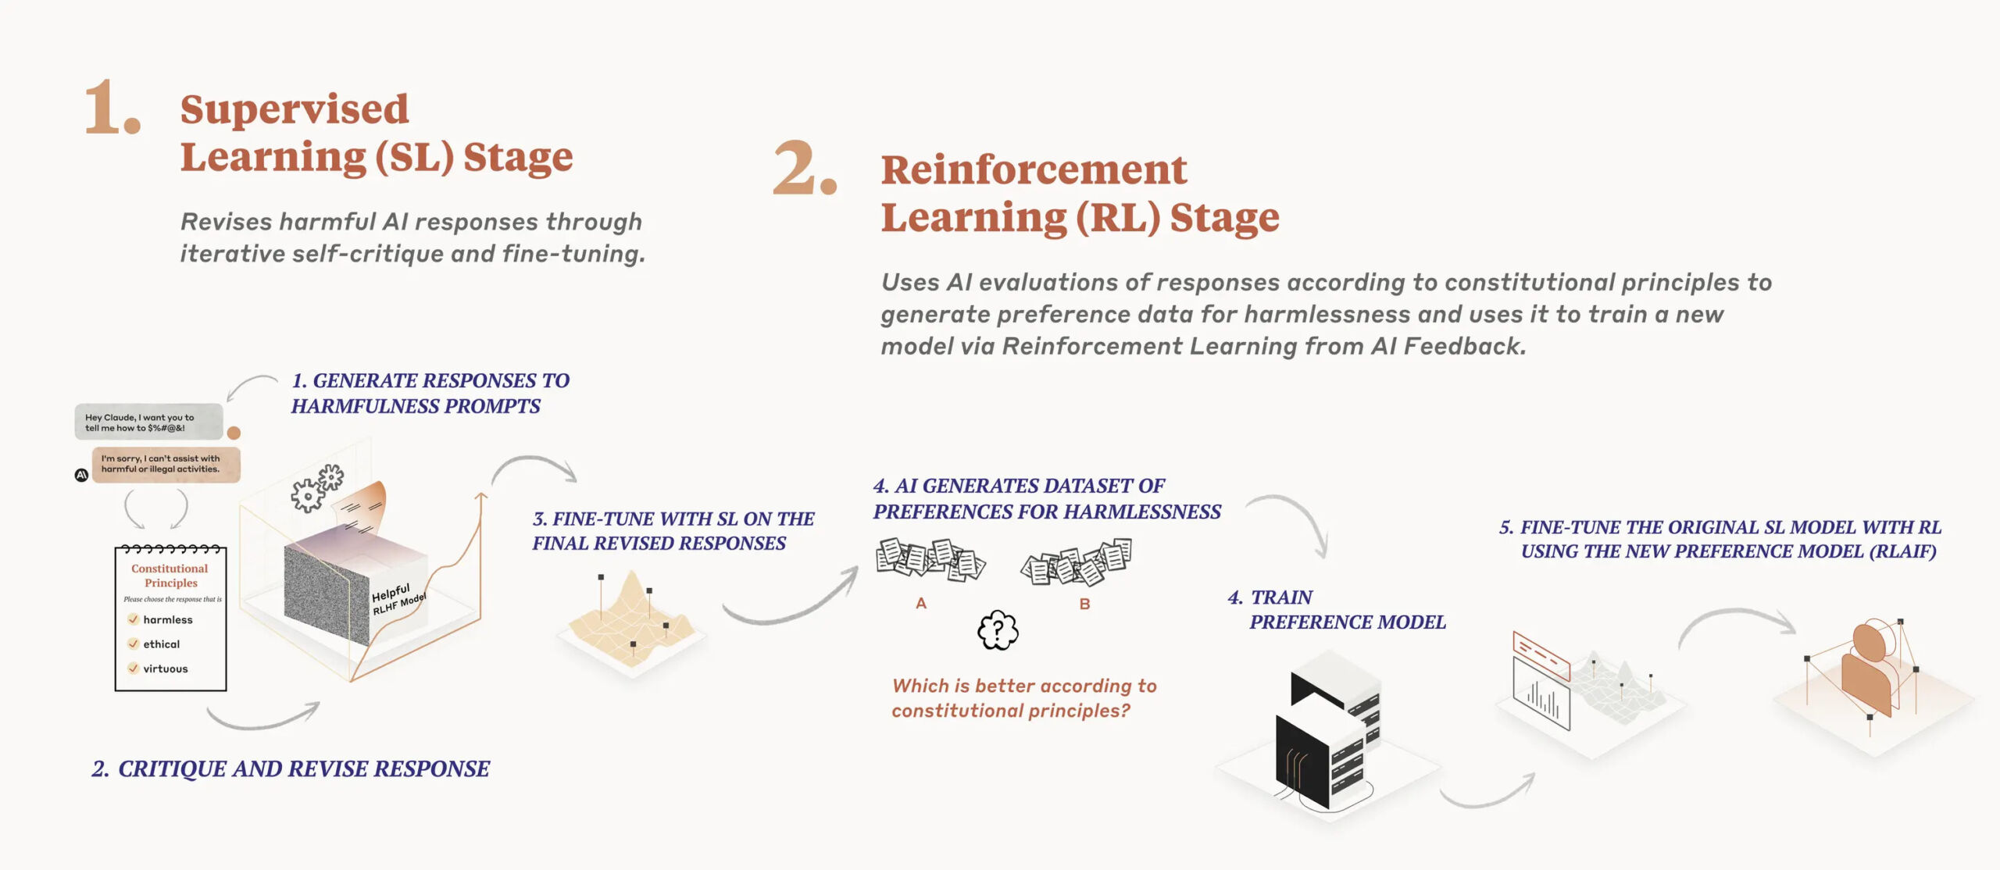
Claude – Constitutional AI
Model is trained to respect high-level constitutional principles based on UN Declaration of Human Rights, and Apple’s Terms of Service
E.g. “Please choose the response that is most supportive of life, liberty, and personal security”
https://www.anthropic.com/index/claudes-constitution

Slide 28
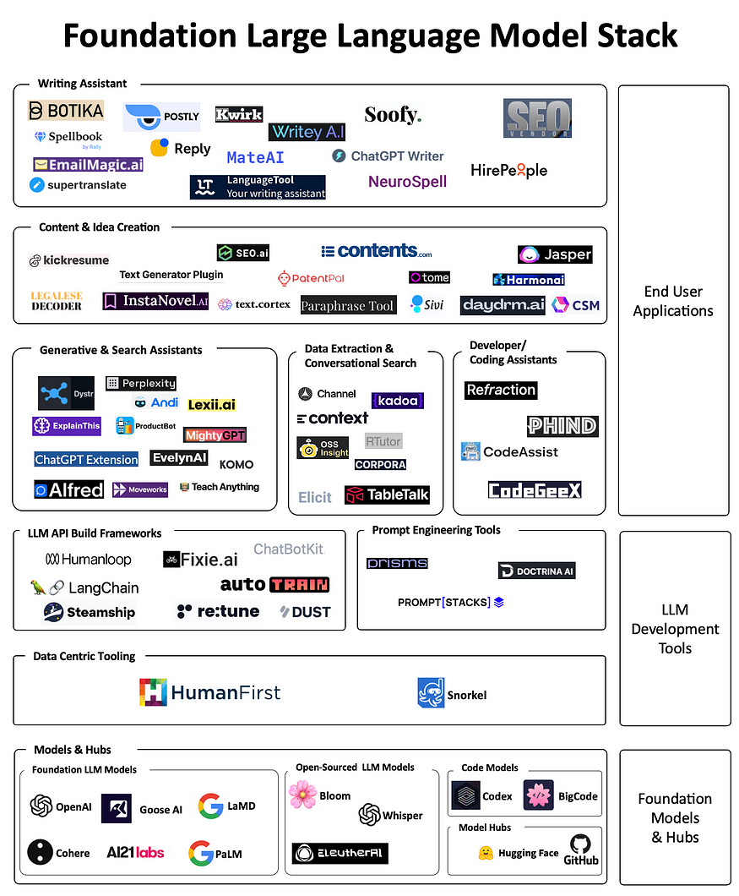
Pervasive AI systems for education, business, entertainment
AI-based tools
Foundation language models
https://cobusgreyling.medium.com/the-foundation-large-language-model-llm-tooling-landscape-8a849ebc7228

Slide 29
Pervasive AI systems for education, business, entertainment
Education experts, learning technologists and AI companies need to work together to create powerful, ethical systems for personal and social learning
AI-based tools
Foundation language models

Slide 30
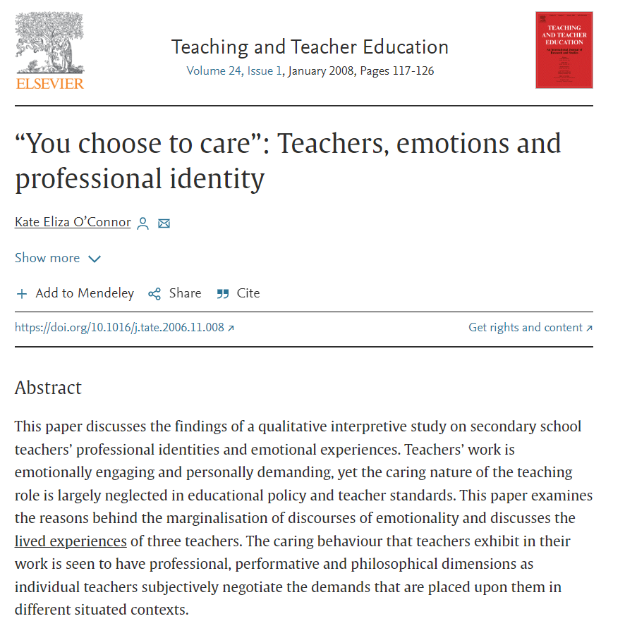
Use generative AI with care
Rethink written assessment
Beware of AI for factual writing
Explore AI for critical thinking, creativity, argumentation
Introduce and negotiate guidelines for students and staff
Develop AI literacy
Adopt ethical AI for education

Slide 31


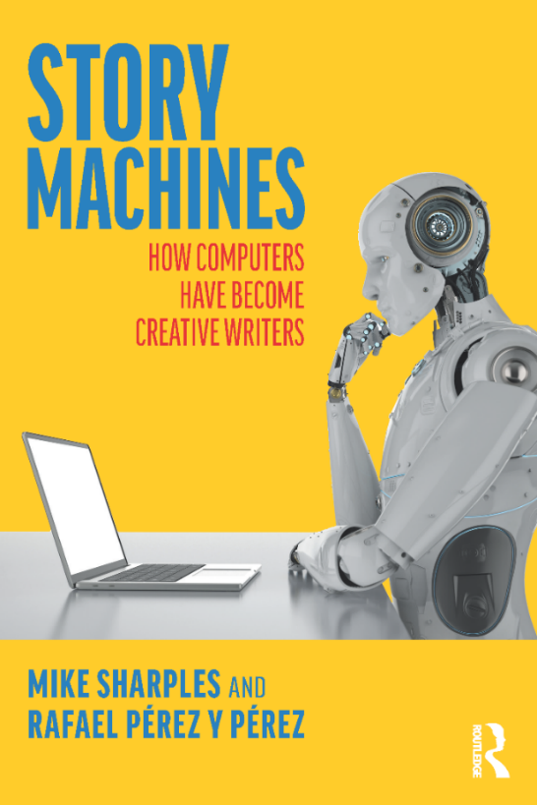
Resources
Sharples, M. (2022). Automated essay writing: an AIED opinion. International Journal of Artificial Intelligence in Education, 32(4), 1119-1126.
Sharples, M., & Pérez y Pérez, R. (2022). Story Machines: How Computers Have Become Creative Writers. Routledge.
Pérez y Pérez, R. & Sharples, M. (2023). An Introduction to Narrative Generators: How Computers Create Works of Fiction. Oxford University Press.
UNESCO (2023). ChatGPT and artificial intelligence in higher education: Quick start guide.

