Slide 1
The Living Laboratory: Transition to Generative AI-based Teaching and Learning
Melinda Whong
30 June 2023

Slide 2
Talk Outline
Context
Approach in our LC
GenAI and Assessment
Positive uses of AI
in Teaching and Learning
Acknowledgement
All colleagues in my Centre, and in particular: the 43 Course Leaders who have allowed me to draw from their work for this presentation

Slide 3
Context
EMI university in Hong Kong:
Science, Engineering, Business
Every UG: 4 credit-bearing English + 1 Chinese
7888 students this semester
88 full time instructors
43 language courses this Spring
Eng/Chi for Specific/Academic Purposes
‘Proficiency’ courses:
Beginner level: Spanish, Japanese, French, Chinese and Cantonese
Uni entry level: English, Chinese

Slide 4
Generative AI: Context
January 2023:
Generative AI, though ChatGPT not readily available in HK
CPD talk to introduce to instructors prior to semester start
February:
University stance: embrace AI
LC view
Cautiously open to the challenge
Cannot readily prevent use

Slide 5
LC Approach
This semester: Transition Period
Summer: meaningful modification
Next academic year: Embrace (i.e. maximise use)
Must all be on the same page…

Slide 6
The Great Unknown
We do not know….
Opportunity to explore in this transition period
Guided by
pedagogical principles
ethical commitment to ensure fairness

Slide 7
Feb/March Statement of Principles
‘We embrace innovation and technology including generative AI. But we also recognise that we are in a transition period this semester. Our approach in the centre is to rely firmly on pedagogical principles, with an ethical commitment to ensure fairness.’
All asked to upload on LMS site

Slide 8
Feb / early March Minor Modification
Changes to assignment tasks, task parameters or rubrics allowed, but only
At cross-course level
if clear, obvious what to change
If uncontroversially implement-able
No change in rubric criteria, approach to assessment by instructors

Slide 9
Recognition of Distinct Aspects to GenAI
1. a Source for Information
What to do: All ideas that elsewhere need to be cited
How: Like you would Wikipedia
2. a Tool
What to do: Declaration of Use
So that we have options later IF NEEDED
= The Great Unknown

Slide 10
March/April Declaration of Use (English version)
‘I understand that GenAI can be used as a tool but is not a substitute for doing my own work; and I acknowledge that any violation of academic honesty policies may result in disciplinary action, up to and including failing the assignment or the course. ’
By submitting this form, I confirm that I have read and agree with the above statements.
--------------------------------------------------------------------------------------
I hereby declare that I have (check one):
NOT used any GenAI tools to complete this assignment.
used GenAI tools to complete this assignment.

Slide 11
Declaration: Intention
We really don’t know
Open, honest
A University-level, professional, intelligent, curious
As educators, we provide guidance

Slide 12
Rationale for Declaration
To allow the option of modification of marks at the end of the course
Opportunity to maximise the situation: living laboratory
Allow students to use AI
Actively use AI in teaching
Students encouraged to declare, to ‘be honest’
If you don’t declare, and found to have used later, a problem

Slide 13
Beyond Question of Assessment
Generative AI Special Interest Group
Reading
Exploration of available AI tools
Survey of student perceptions and use
Advice, tips, guidance
Bulletin and Sharing Sessions

Slide 14
Declaration and Assessment
31 (of 43) Courses: Declaration added to LMS
Note: halfway through semester
8 added manually in order to ask for additional information
2 UG
Too late in semester, 2 main assignments already in
individualised Final Year Project support, a ‘personalised’ approach
2 RPG
existing university integrity statement is sufficient
a speaking/pronunciation course

Slide 15
Recommended Approach to End-of-course Assessment
Mark without looking at Declaration to begin with
No Change in Rubric Criteria
Do cross course analysis, decision-making in light of
Nature of the task
Declaration of Use information
Active encouragement to change weighting in light of Gen AI

Slide 16
Use of Declaration Information
Basis for open discussion with student if a sense that a student has not taken a principled approach to the work
Allowed for emphasis on honesty and personal responsibility for learning
Used alongside Turnitin report

Slide 17
Declaration of Use
4th year engineering course
T01 68%
T02 55%
T03 53%
T04 38%
T05 55%
T06 45%
all years Chinese course
T01 60%
T02 25%
T03 30%
T04 7%
T05 29%
T06 60%
T07 60%
T08 40%
T09 55%
3rd year science course
T01 40%
T02 38%
T03 36%
T04 31%
T05 25%
T06 5%
T07 35%

Slide 18
Analysis of Declaration Data
Course 1: Business Case Analysis
Summative Assessment: 2 presentations, 1 written recommendation report
Focus: audience awareness, evidence based, understanding of the case and interpersonal relationships as basis for recommendations
Findings in relation to those who declared use of AI on recommendation report:
average for Language criterion: 5.23% higher
overall average, all criteria: 4.31% higher
→ 0.96 mark higher
Declared Usage Rate: 22%
approx. 275 students

Slide 19
Analysis of Declaration Data
Course 2: Business English
Assessment: Business Pitch (spoken), Business Plan (written)
Focus: persuasive strategies, development of ideas/’effectively relate ideas to each other’
Findings in relation to those who declared use of AI:
→ 0.26 mark higher
Course 3: Business English
Relevant written assessment: email writing
Focus: audience, context awareness in selection of language, content and organisation
writing task 1: → .68 mark higher
writing task 2: → .1 mark higher
Declared Usage Rate: 22%
approx 500 students
Declared Usage Rate: 54%
52 students

Slide 20
Modification of weighting
Course A
language accuracy reduced
coherence, argumentation increased
Course B
coherence reduced
effectiveness of multimodality increased
Course C
grammar and organisation reduced
‘ideas that are clearly related and reinforced rather than just sequenced’

Slide 21
Modification of weighting
Course D
Speaking task
increase focus on delivery
pronunciation and intonation
tone and style
audience awareness
less on accuracy and vocabulary choice

Slide 22
Other Modifications
Writing tasks
Summative → formative
Mark → complete /incomplete
Tasks → in-class and/or live tasks
speaking
beginner language classes

Slide 23
Added Requirements
responses to Q&A formally marked in addition to presentation itself
notes, photos, screenshots to support assignments
demonstration of specific rhetorical devices that had been taught
passage on motivation for choosing the topic
reflection on use of AI, or why AI not used

Slide 24
‘Less affected’ Assessment Tasks
New ideas
e.g. identify a niche
Relate to a very specific context
e.g. invited to give a talk at X event in Dept Y
Creativity, specificity, persuasiveness, appropriate style

Slide 25
Teacher Observation
Lower proficiency students
‘seemed to have asked GenAI to generate the entire text. Their writing was error-free but did not adopt an appropriate language style for the task.’
‘did not score higher than lower proficiency students who did not use GenAI, made language errors but produced a more persuasive and creative piece’.
Higher proficiency students
’the style was recognisably their own’
‘these students probably scored a little higher than they might have done but I feel the higher score is justified as the use of assistive tools (dictionaries, Grammerly, etc) is something we encourage and shows positive motivation’

Slide 26
Positive uses of AI in Teaching and Learning
‘GenAI became an important component which we used in class every week’
Asking students to write a reflection on role of AI helped me understand student priorities in their own learning
ChatGPT very helpful to generate ideas and then Grammarly useful to check vocab and grammar
Students asked to compare human and GenAI produced texts (blog posts), ready samples of text for analysis and discussion

Slide 27
Plans going forward
Single module (=lesson/unit) for basic training and use of AI tools in our Center
Design tasks that recognise existence of AI
1. Require use, for example
Generate texts in AI. Assignment: modify to fit different specific contexts (mainland v HK)
Assignment: i) use GenAI to get feedback on writing, ii) evaluate and make use of constructive feedback iii) reflect/document in learning portfolio
2. AI-proof
Does it exist / Is it possible ?!?!?

Slide 28
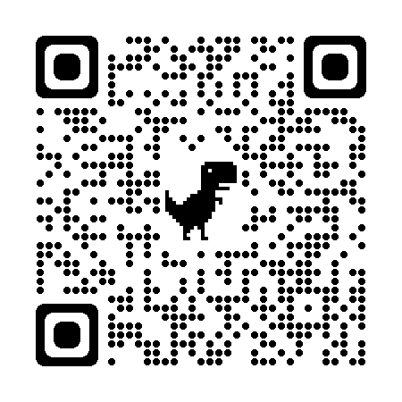
Flowchart for Incorporating AI into Assessments for Learning
https://view.genial.ly/648b081ddc3de9001110c3ed

Slide 29
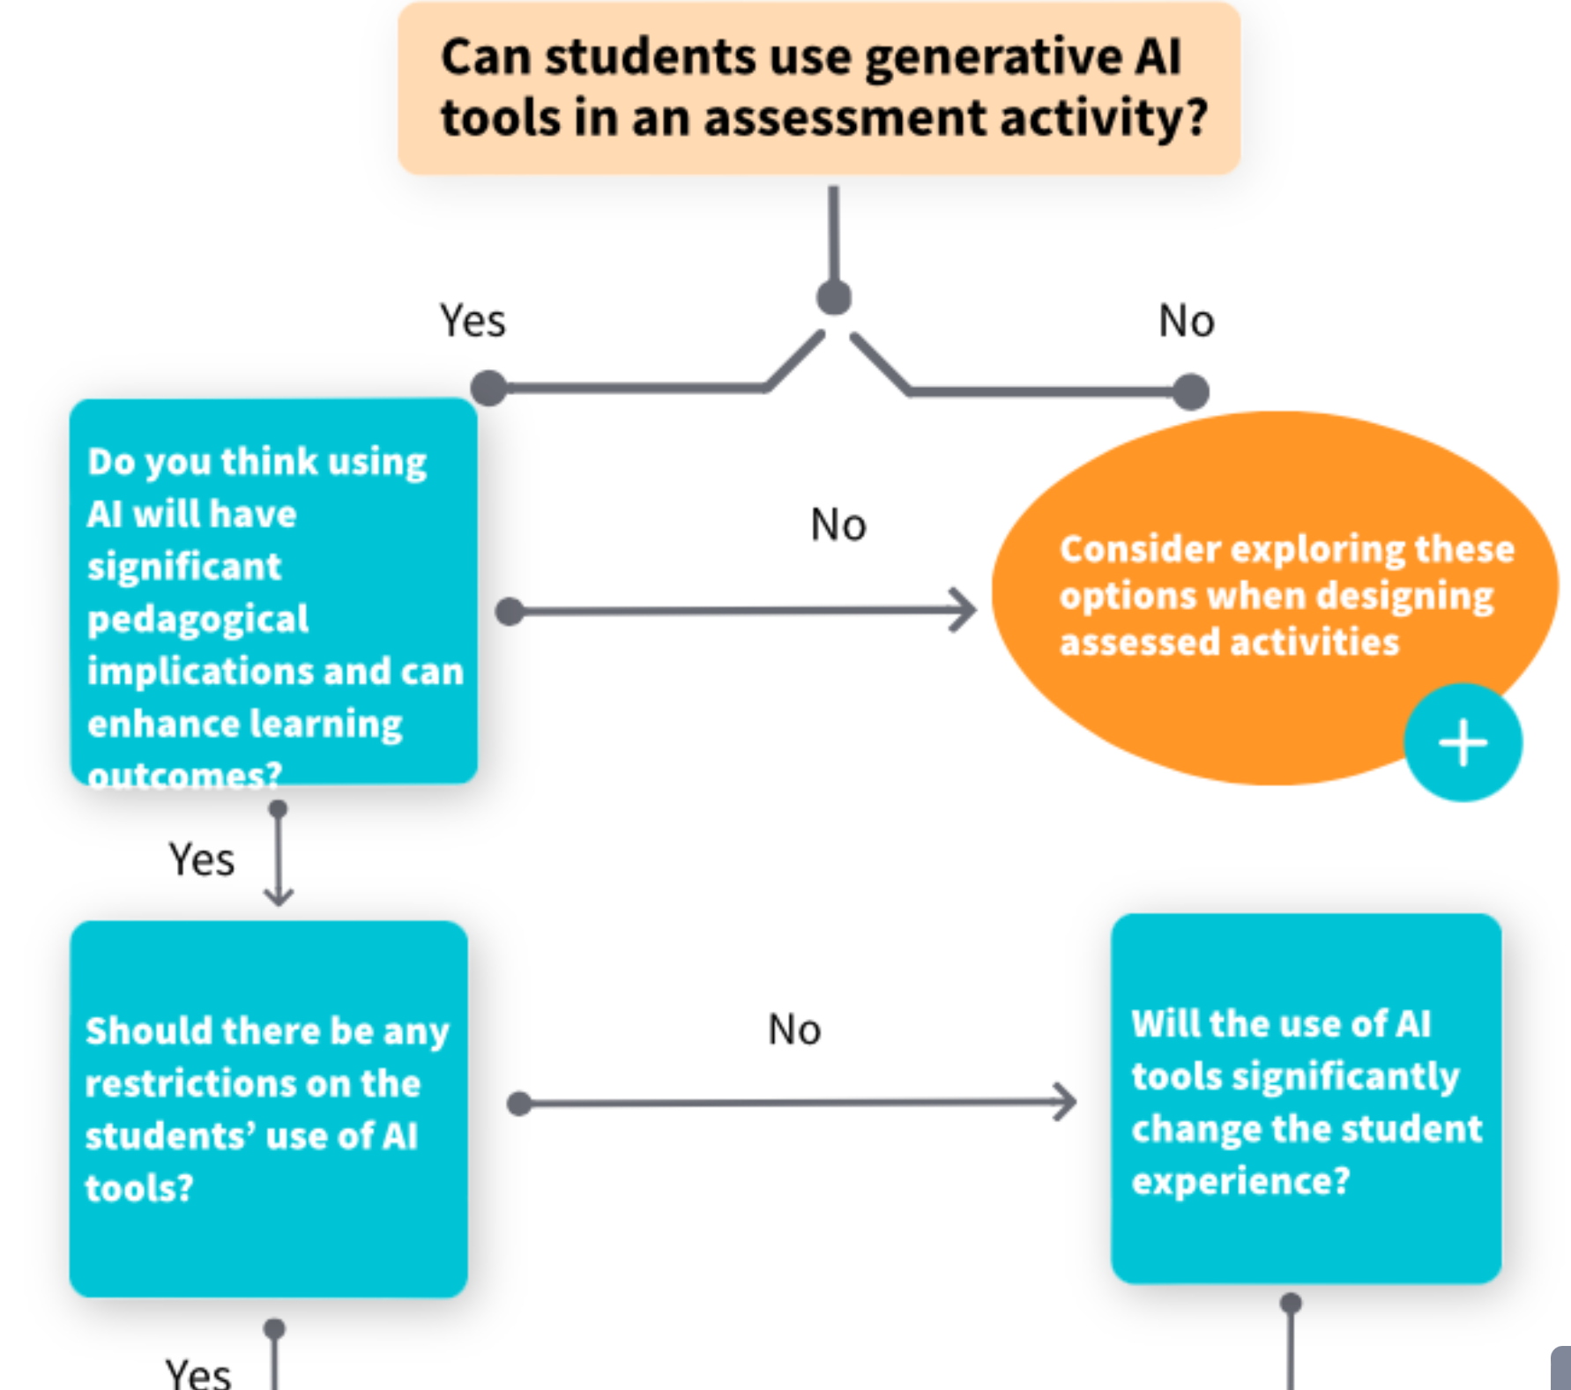

Slide 30
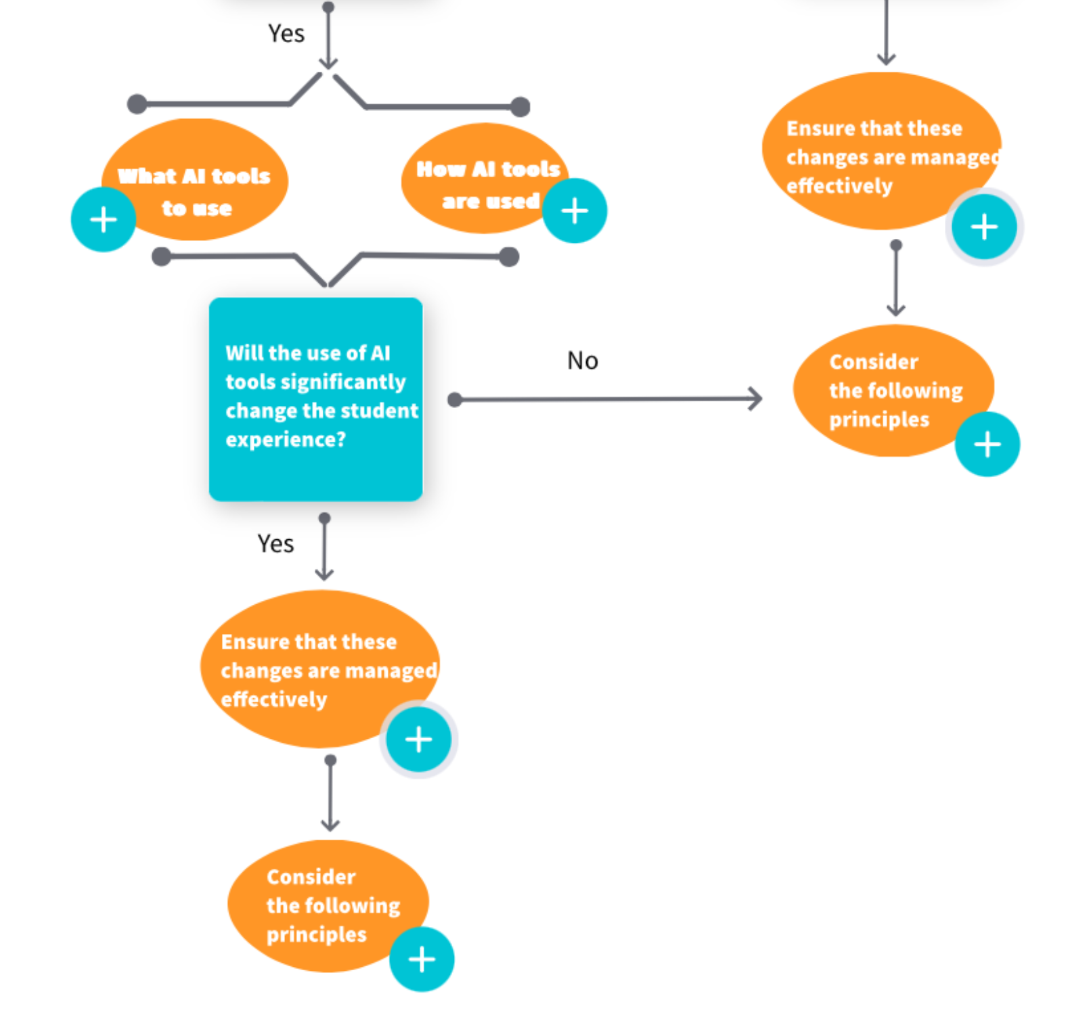
Ensure equitable access to tools
Communicate
what learning outcome will be measured
how the use of AI tools will be considered in evaluation
Provide AND communicate
guidelines on ethical implications and possible bias in AI tools
academic integrity policies
Provide exemplars

Slide 31
Thanks. Any questions?
Melinda Whong
lcmwhong@ust.hk

