Slide 1
ChatGPT in the Ivory Tower: Navigating Conversations with Academic Staff
Dr Matt Wood
Candace Nolan-Grant
Paul Finley
Durham Centre for Academic Development

Slide 3
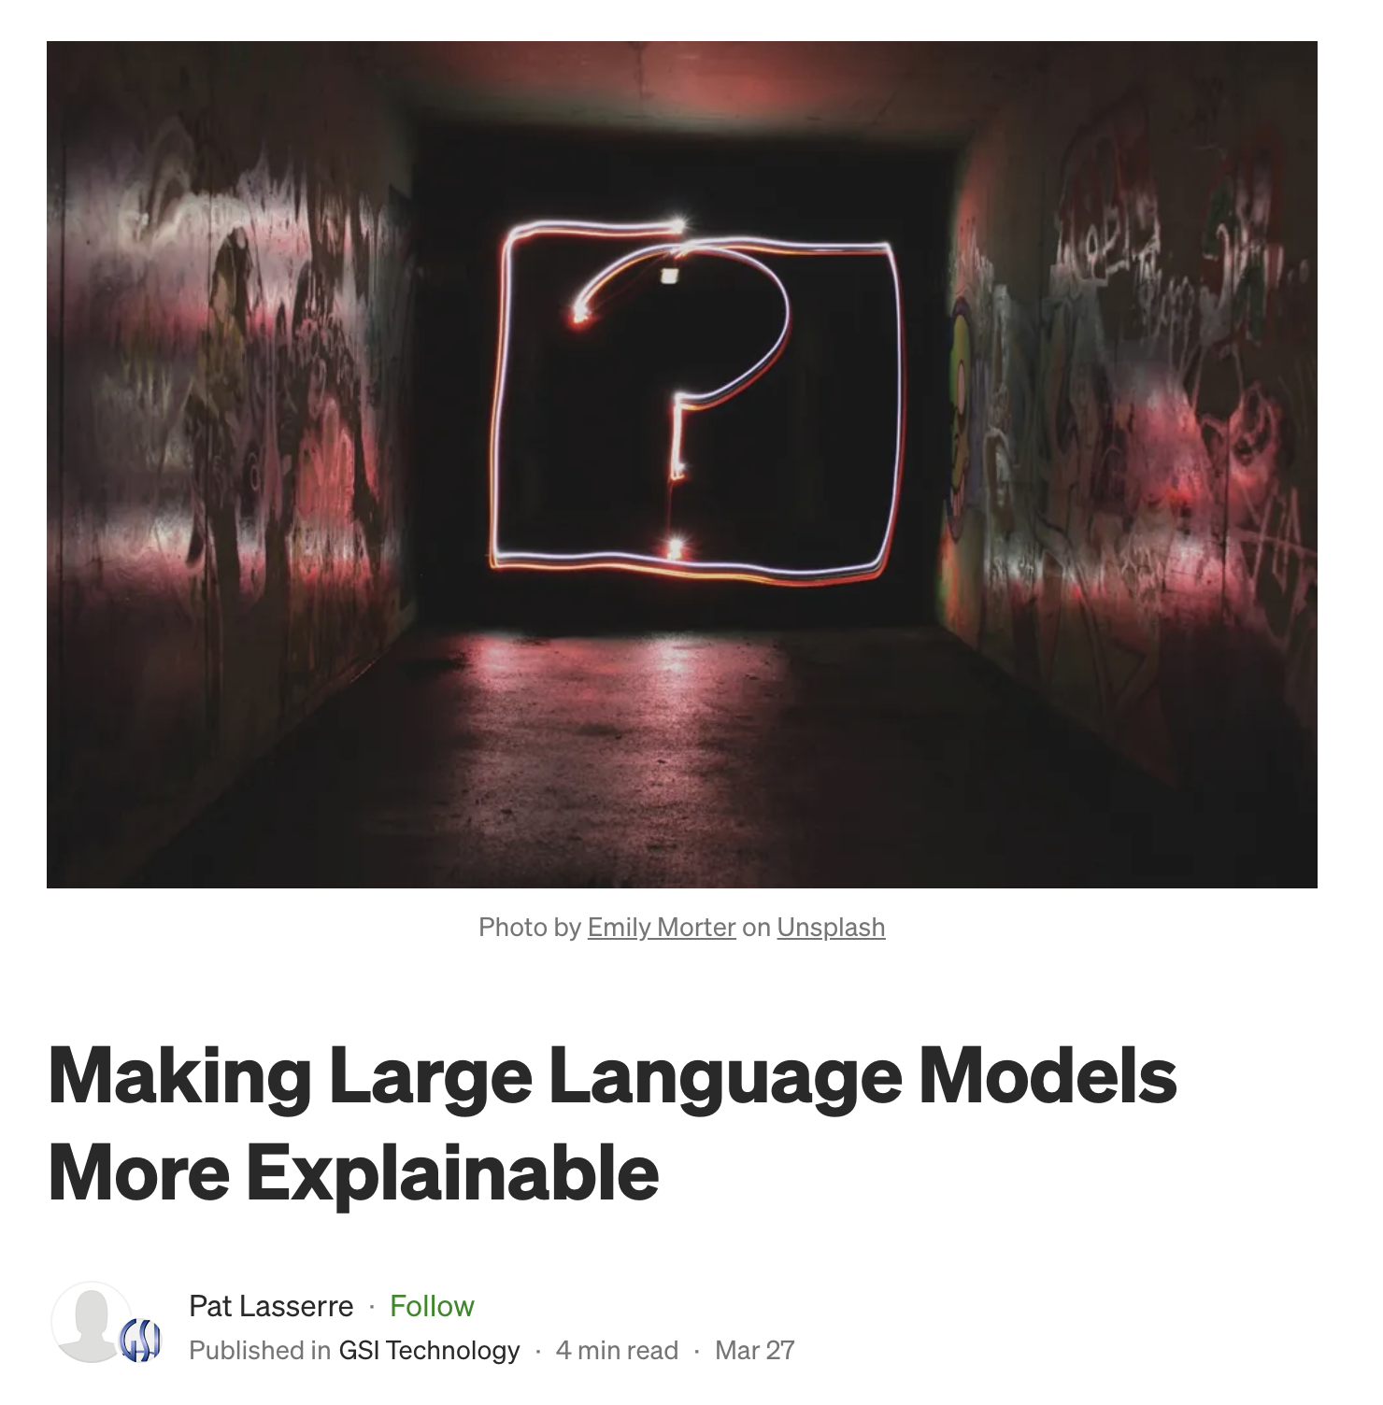
Explainable AI (XAI)
“if we’re going to trust large language models (LLMs), we need to better understand how they arrive at their answers….This touches on one of the key issues with LLMs — their lack of explainability. They’re so complex that they’re basically black boxes, and we’re not sure how they came up with their answers. The more sophisticated the model, the less transparent it becomes. This is the opposite of what is needed — explainable AI (XAI) where the responses can be explained.”
Notes:
https://medium.com/gsi-technology/making-large-language-models-more-explainable-b8215696a659

Slide 4
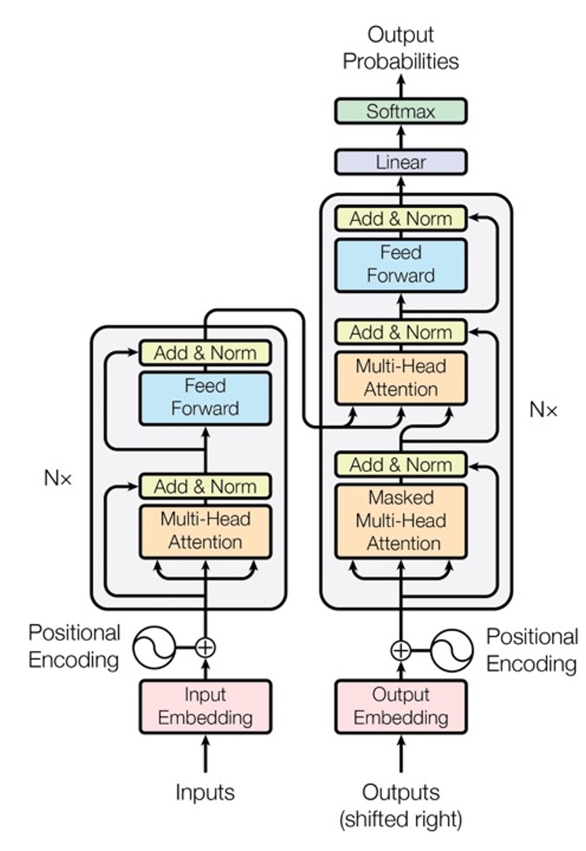
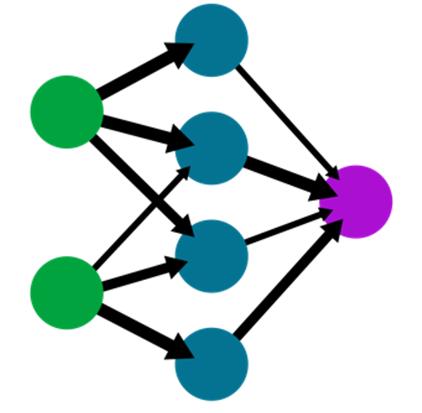
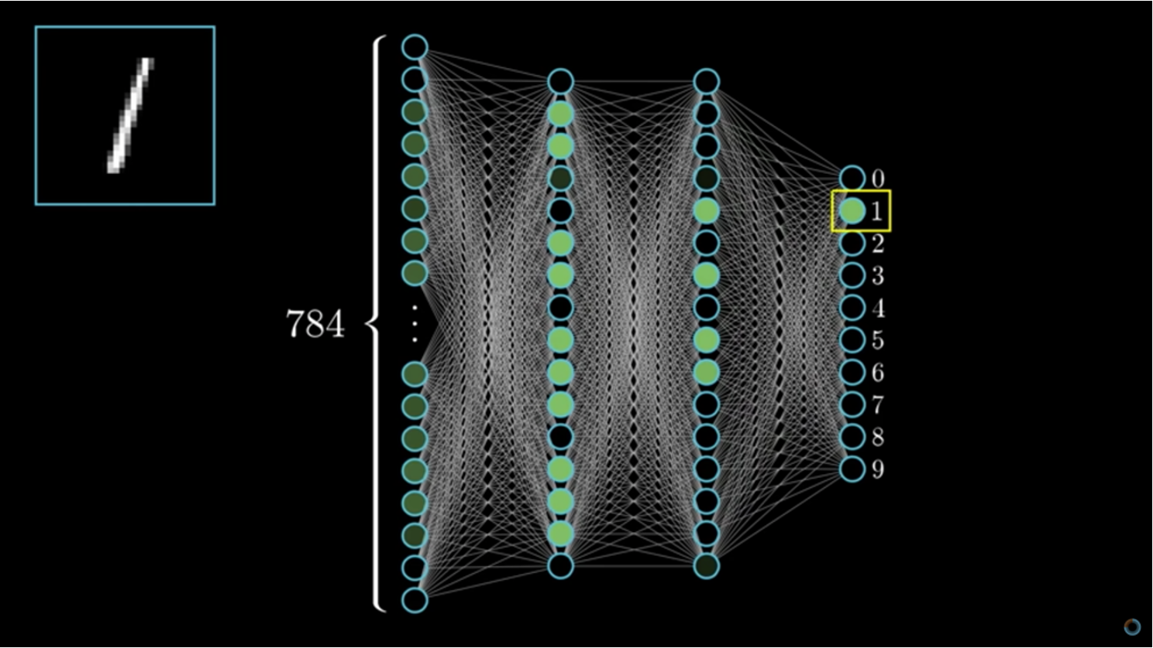
Explanation 1: The Neural Net

Slide 5
Explanation 2: “Input” / “Output”

Slide 6
Explanation 3: Predictive Text

Slide 7
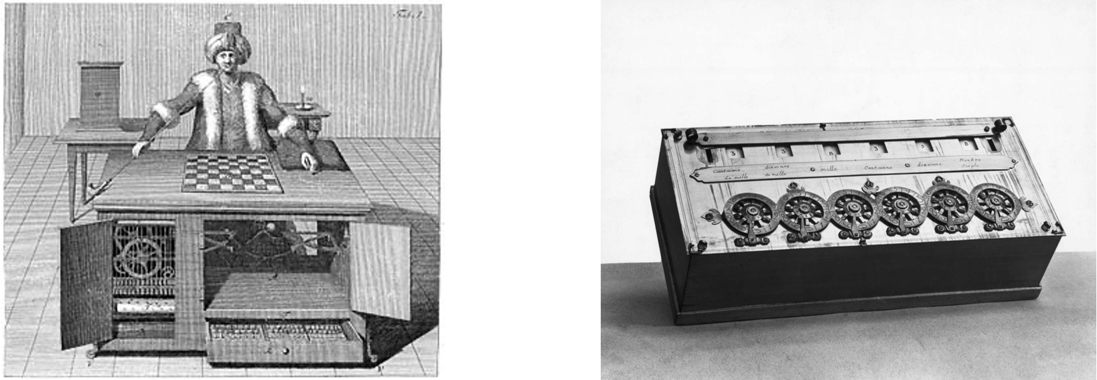
A new angle: Mind & Machines
Mechanical Turk
The early calculator

Slide 8
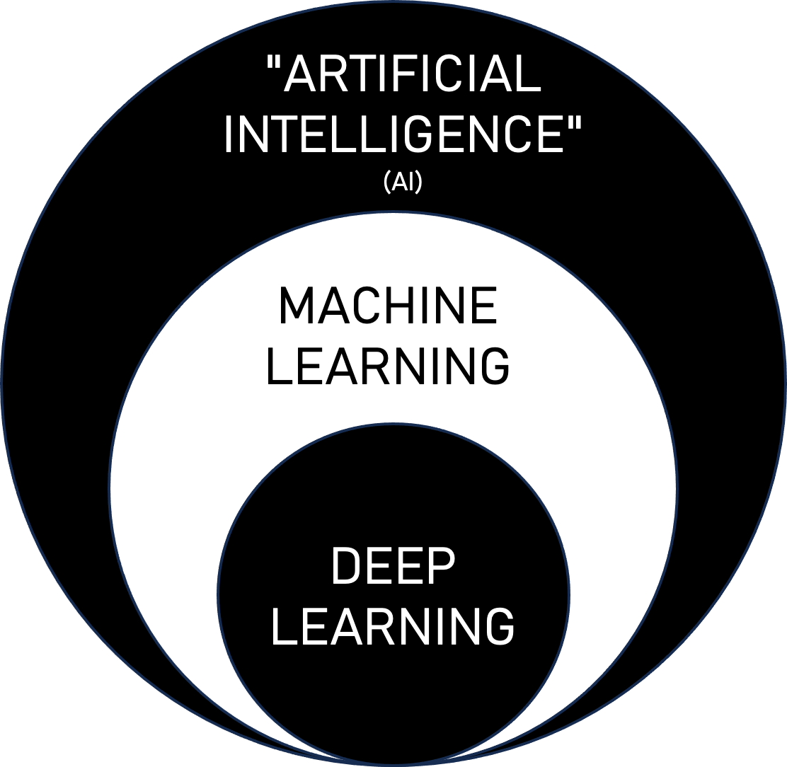
Key Explanation Points
Narrow vs General AI
Emphasising the unknown
The key premise of Large Language Models (LLMs)
Reinforcement Learning with Human Feedback (RLHF) a largely unsupervised training process with some human ‘tweaking’ at the end

Slide 9
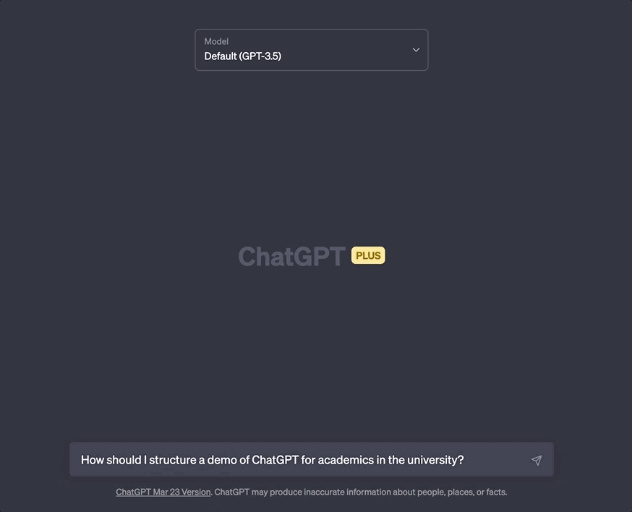
‘The ChatGPT Demo’
Where possible, using discipline specific examples
Can lead to ‘aha moments’ (i.e. ultimate futility of detection tools)
Importance of staff having hands on experiences with the tool - encouraging staff to sign up for themselves & ‘have a go’

Slide 10
My Personal Experience
The Disclaimer
“This is a rapidly changing area, what we tell you today is correct as of today but things are changing quickly.”
Rewrites & refinements
Assumptions

Slide 11
Hooks
Instant feedback about teaching
Low stack tests
Debate

Slide 12
Where are we now
ChatGPT – Challenges and Opportunities
AI/LLMs for Teaching and Learning
AI/LLMs for Researchers
Potential Future Workshops
AI/LLMs - Introduction to prompt engineering
AI/LLMs – Build a custom chatbot for your module

Slide 13
GenAI and Assessment
Unleashing Threshold Concepts in Higher Education

Slide 14
GenAI and Threshold Concepts
Troublesome
Lead to a state of liminality
See Threshold Concepts: A Short Introduction and a Bibliography from 2003 to 2018

Slide 15
 | Short-term | Medium-term | Long-term
Ignore | Risky
Prohibit | No way to enforce | Detection ‘arms race’
Invigilate | Where appropriate (i.e. content/process knowledge only) | Where appropriate | Where appropriate
Allow: design around | Requires grasp of what all LLMs can do | Less likely to make sense as technology develops
Encourage | Need to ensure equity & privacy | Evolve with the technology | Top of innovation curve: LLMs ubiquitous
Rethink learning & assessment | Needs 12+ month lead time | Workload & coordination | Learning outcomes reflect new norms
Adapted from Lodge, Howard & Broadbent (2023) Assessment redesign for generative AI: A taxonomy of options and their viability

Slide 16
GenAI and Threshold Concepts
Troublesome
Leads to state of liminality
Irreversible

Slide 17
2024-?? Change learning outcomes & assessment
2024-25 Change mode of assessment
2023-24 Change assessment title/focus
Reflective, opinion-based, experience-based, iterative, etc. aspects, and/or critical LLM use, can fit into the assessment(s) as described in the module pro forma
Questions to ask
Examples
Questions to ask
Examples
Assessment(s) described in the current module pro forma could categorically be produced by AI
The advent of LLMs necessitates reconsideration of the module [programme] learning outcomes and assessment modes
Questions to ask
Examples

Slide 18
GenAI and Threshold Concepts
Troublesome
Leads to state of liminality
Irreversible
Discursive

Slide 19
GenAI and Threshold Concepts
Troublesome
Leads to state of liminality
Irreversible
Discursive
Integrative

Slide 20
GenAI and Threshold Concepts
Troublesome
Leads to state of liminality
Irreversible
Discursive
Integrative
Reconstitutive
Transformative

Slide 21
Curated Padlet
ChatGPT, Generative AI and Large Language Models in Learning & Teaching
bit.ly/DurhamGenAI

