Slide 1
Integrating AI for Enhanced EAP Learning
Strategies and Case Study from XJTLU
BALEAP PIM, Durham University
30 June 2023
Jinyang (Sam) Song
School of Languages, Xi’an Jiaotong-Liverpool University

Slide 2
Outline
Pre-workshop Discussion
The timing of integrating AI in the EAP classroom
Implementing AI in the classroom
  Scenario 1: EAP103TC SCW2
  Scenario 2: Automated writing feedback tools
  Scenario 3: Personalized learning
Target audience for AI integration
Ethical Considerations
Summary and Recommendations
Reflection and Feedback

Slide 3





Pre-workshop Discussion
What are your thoughts on the use of AIGC tools in education?
Do you think it has the potential to transform the way we teach and learn, or do you have concerns about its impact?
Notes:
https://xjtlu1.padlet.org/jinyangsong/baleap-pim-durham-university-12-15-12-45-jinyang-song-tn8rwj2k9zpcgyd8

Slide 4
The timing of integrating AI in the EAP classroom
There is no one-size-fits-all answer to the question of when is the right time to integrate AI into the EAP classroom. However, there are a few factors to consider:
  The level of maturity of AI technology.
  The availability of AI tools and resources.
  The needs and interests of the students.

Slide 5
Implementing AI in the classroom
Discussion Question:
How would you implement AI/AIGC tools in your classroom?
Notes:
https://xjtlu1.padlet.org/jinyangsong/baleap-pim-durham-university-12-15-12-45-jinyang-song-tn8rwj2k9zpcgyd8

Slide 6
Implementing AI in the classroom
Some common approaches include:
    Using AI tools and resources alongside traditional teaching methods.
    Creating blended learning environments that combine AI-powered instruction with face-to-face instruction.
    Developing new AI-powered teaching methods.
The best approach for you will depend on the specific needs and interests of your students.

Slide 7
EAP1013TC at XJTLU
Context:
English Language And Academic Skills For B.A. Arts, Technology And Entertainment
10 credits, year-long
The module aims to support students in the development of English language and academic skills specific for the BA Arts, Technology and Entertainment. The main emphasis is for students to utilise English language skills to reflect on and produce work relevant to Arts, Technology and Entertainment forms.

Slide 8
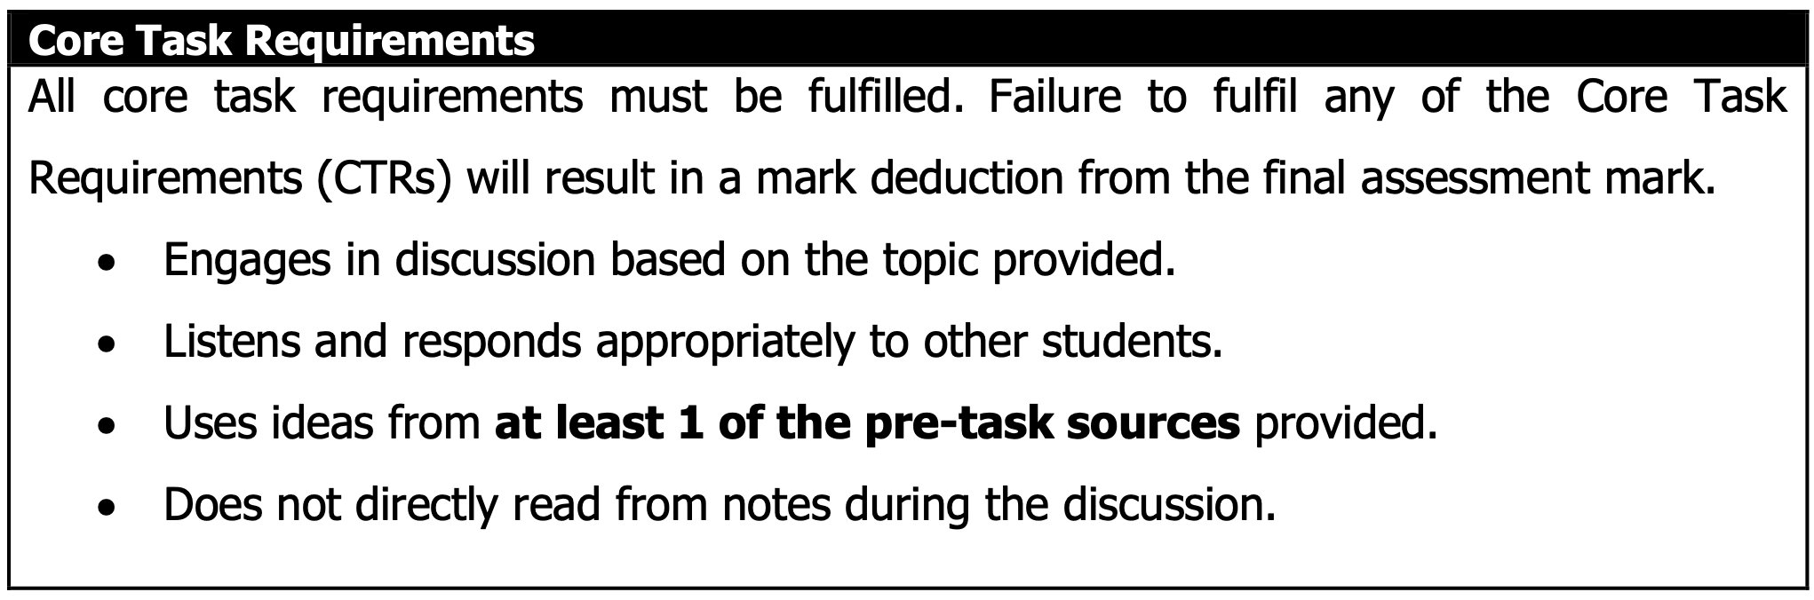
Scenario 1: EAP103TC Speaking Coursework 2
Task: Group discussion, 4 students – 16 minutes and 3 students – 12 minutes
Topics: Pop Culture and storytelling, Pop Culture and technology, and Pop Culture in the media, which are related to their study in Semester 2 of EAP103TC and other BA ATE content modules.
Discussion prompt: will be provided

Slide 9
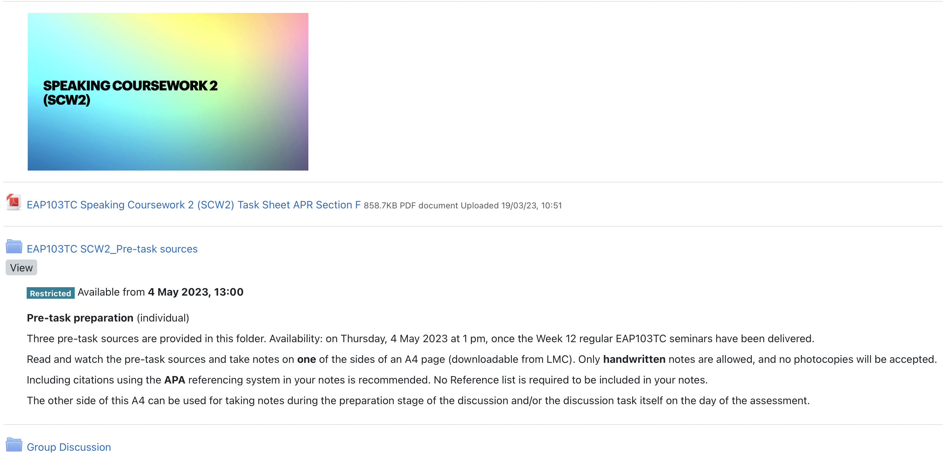
Scenario 1: EAP103TC SCW2
Notes:
https://twee.com/
The Inside Story of ChatGPT’s Astonishing Potential | Greg Brockman | TED
https://youtu.be/C_78DM8fG6E

Slide 10
Scenario 2: Automated writing feedback tools
EAP103TC Writing Coursework 2
Task: Write a Project Report about one of the practical projects you’ve been assigned in your ATE modules in Semester 2.
Q: Can an AI Chatbot write your assignment?

Slide 11
Scenario 2: Automated writing feedback tools
Automated writing feedback: AI-powered tools can provide students with feedback on their writing, including grammar, style, and content.

Slide 12

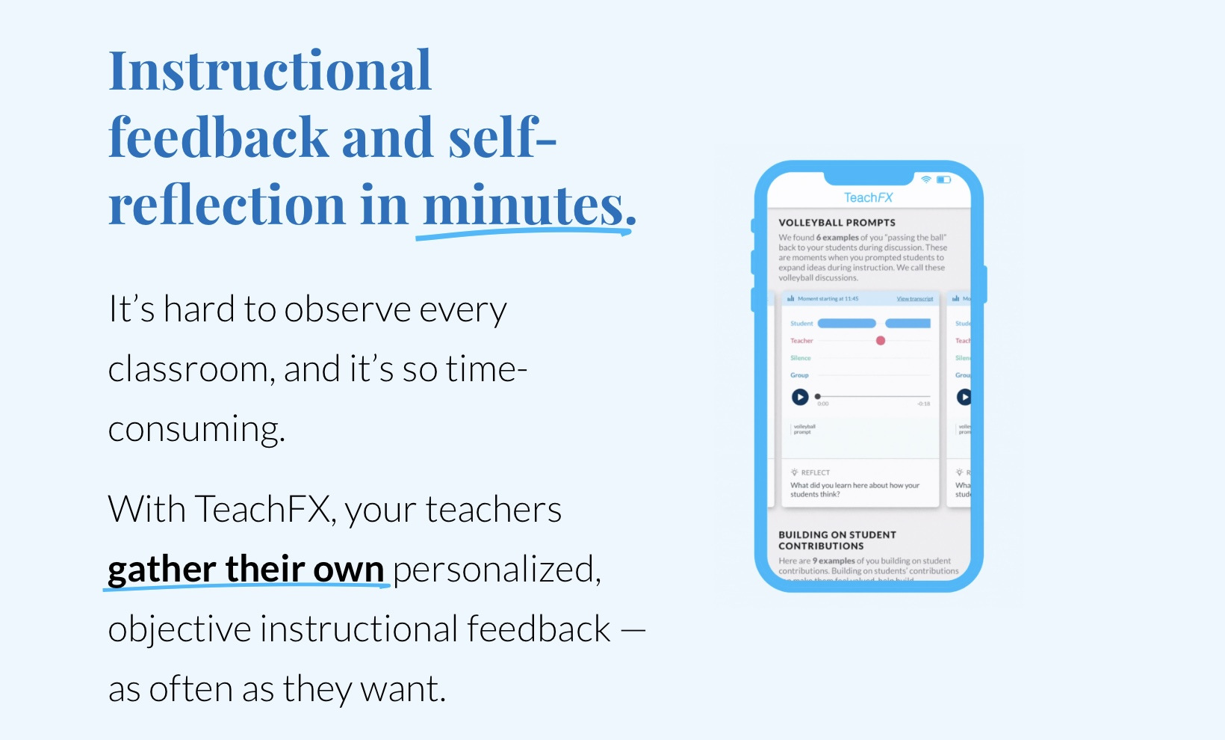

Scenario 2: Automated writing feedback tools
Notes:
https://teachfx.com/

Slide 13


Scenario 2: Automated writing feedback tools

Slide 14
Scenario 3: Personalized learning
Q: Are there any tools or platforms that you or your students use?
Notes:
https://xjtlu1.padlet.org/jinyangsong/baleap-pim-durham-university-12-15-12-45-jinyang-song-tn8rwj2k9zpcgyd8

Slide 15




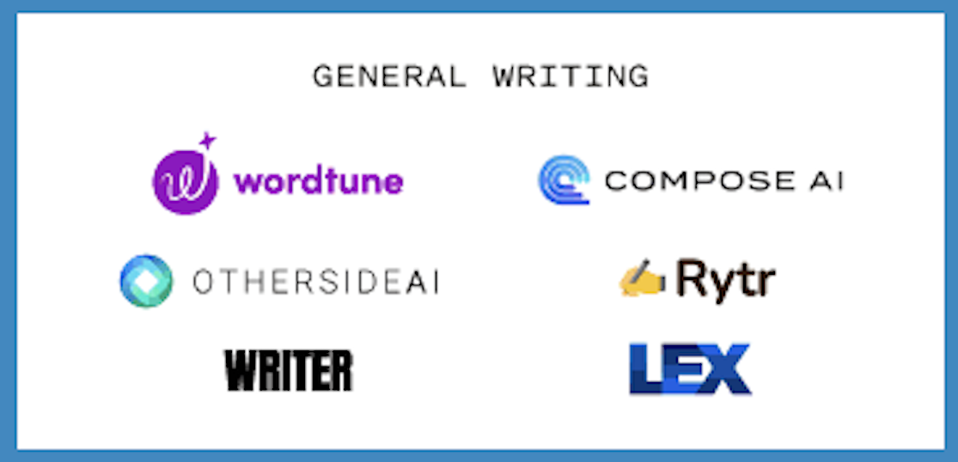
Scenario 3: Personalized learning
https://twitter.com/sonyatweetybird/status/1582040028015837187, 18 Oct 2022

Slide 16
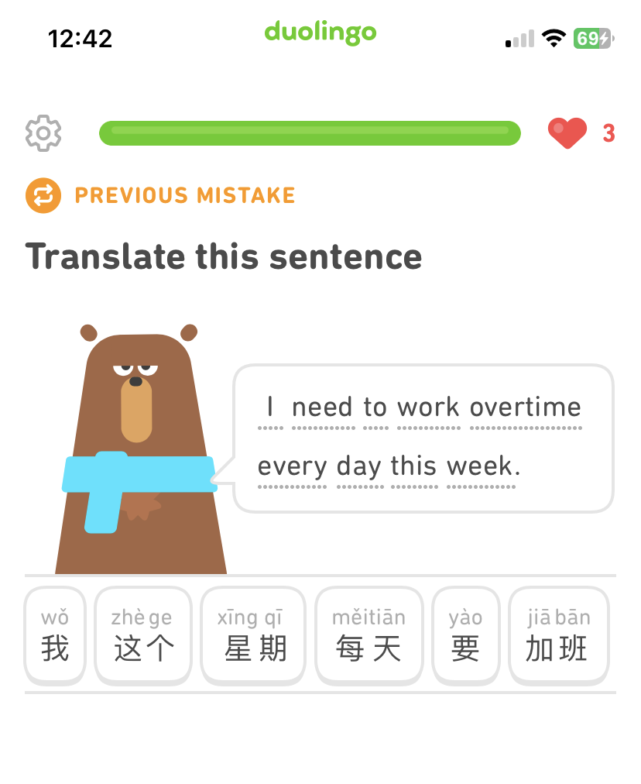
Scenario 3: Personalized learning

Slide 17
Target audience for AI integration
AI can be a valuable tool for all EAP learners, but it may be particularly beneficial for learners who:
    Are struggling with a particular skill or concept.
    Have learning disabilities.
It is important to adapt AI tools and technologies to the specific needs of the learners.

Slide 18
Ethical Considerations
The use of AI in the EAP classroom raises a number of ethical considerations, including:
  Privacy: How will AI-powered tools collect and use students' data?
  Bias: How can we ensure that AI tools are not biased against certain groups of students?
  Accountability: Who is responsible for the decisions made by AI-powered tools?
It is important to be aware of these ethical considerations and to take steps to mitigate them.
(Furze, 2023)

Slide 19
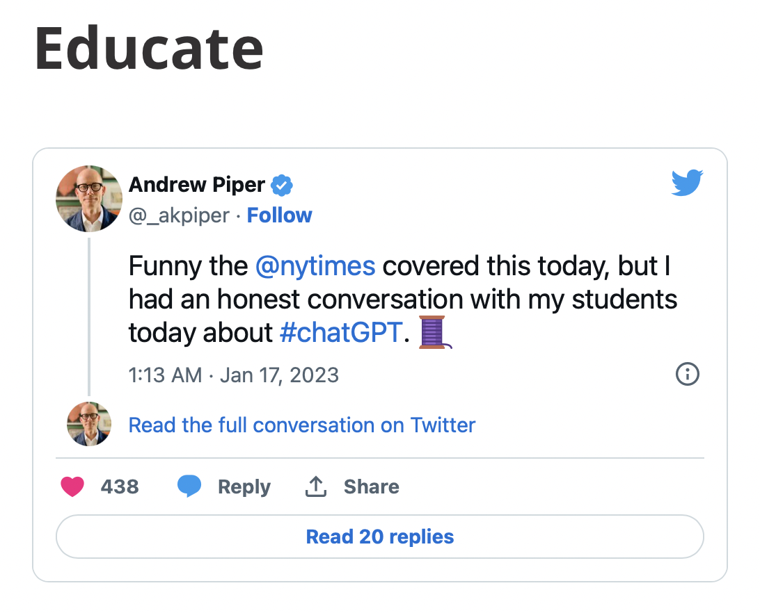
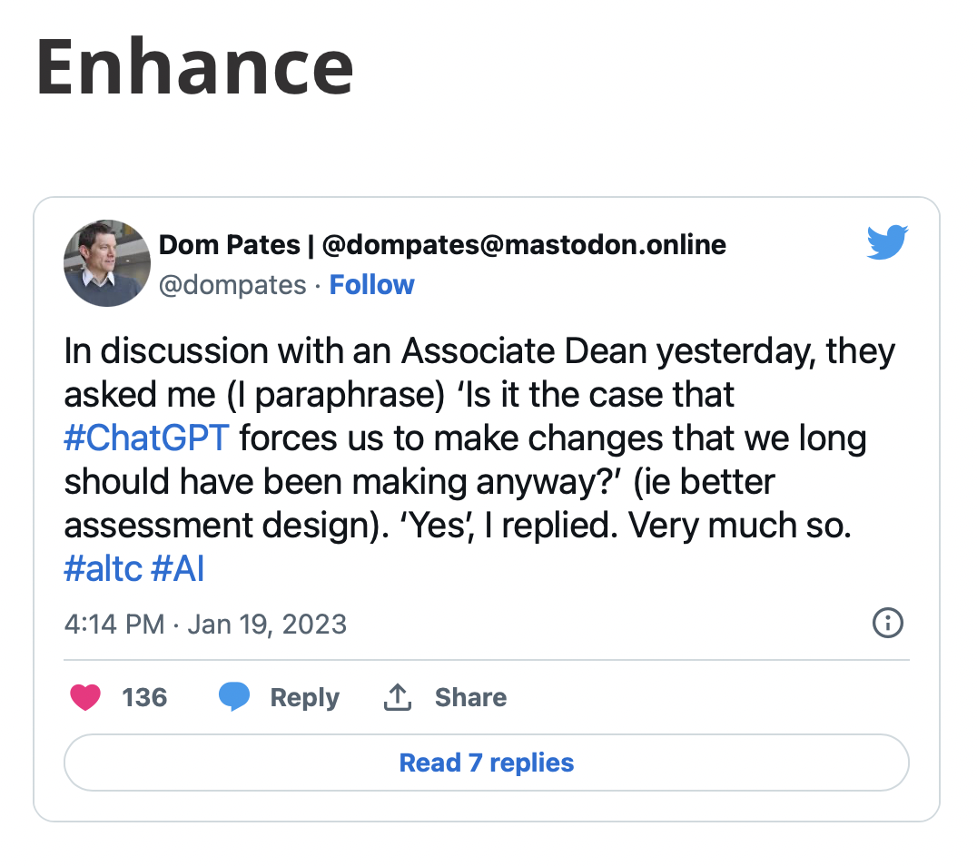
Summary and Recommendations
(Wood, 2023)

Slide 20
Summary and Recommendations
AI has the potential to revolutionise EAP learning by providing personalised instruction, timely feedback and access to a wealth of resources.
Explore the potential of AI tools in your own EAP classroom and guide students.
Be patient with the policy.

Slide 21
Reflection and Feedback
K | W | L
What do you know about AIGC tools now? | What do you want to know about AIGC tools in the future? | What have you learned about AIGC tools?
Notes:
https://xjtlu1.padlet.org/jinyangsong/baleap-pim-durham-university-12-15-12-45-jinyang-song-tn8rwj2k9zpcgyd8

Slide 22
Thank you
and any questions?
22

Slide 23
References
Furze, L, 2023. Teaching AI Ethics: Power. Available online: https://leonfurze.com/2023/06/19/teaching-ai-ethics-power/
(Accessed: 20 June 2023)
Wood, M, 2023. AI & the Future of Assessment in Higher Education. Available online: https://dcad.webspace.durham.ac.uk/2023/01/24/ai-the-future-of-assessment-in-higher-education/ (Accessed: 15 June 2023)

Slide 24
Integrating AI for Enhanced EAP Learning
Strategies and Case Study from XJTLU
BALEAP PIM, Durham University
30 June 2023
Jinyang (Sam) Song
School of Languages, Xi’an Jiaotong-Liverpool University
Jinyang.Song@xjtlu.edu.cn

