Slide 1
Navigating AI-assisted writing while keeping critical human voice Drew Shaw BA (Toronto), MA (Cape Town), PhD (London) Coordinator | Pre-sessional | Academic Language and Literacies Durham Centre for Academic Development| Durham University Drew.C.Shaw@durham.ac.uk
BALEAP PIM: Durham University: 30 June 2023
AI-Assisted Writing: who’s the author now?

Slide 2
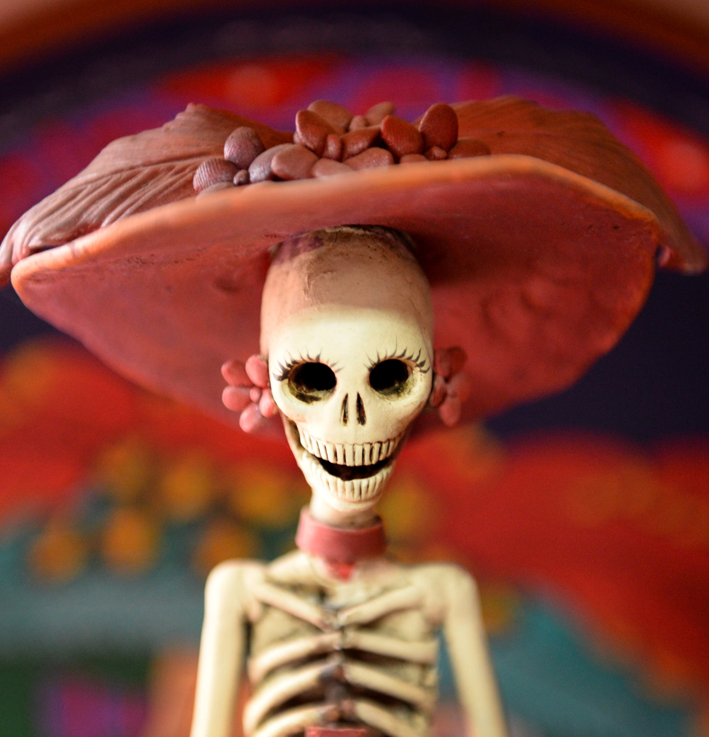
I begin with 3 Questions …
Is the author dead?
Is the student essay dead?
Is the EAP practitioner dead?
And in answering, we’ll consider HI (Human Intelligence) versus AI (Artificial Intelligence) and the critical role of human voice.

Slide 3
Outline
Types of AI-assisted writing that need navigating
Is the (human) author really dead?
Is the student essay dead, on life support or alive and well?
What would we lose if the student essay died?
How might we revive HI (and human voice) in the AI age?
EAP in action: using AI as a tool, not a substitute…
Identifying, encouraging, rewarding critical human voice
Notes:
Read quickly

Slide 4
Navigating AI-assisted writing types
Editors: e.g. Word spell and grammar check; Grammarly, Writefull, Quillbot
Translators: e.g. Google Translate; Baidu, DeepL
Citation: e.g. Zotero, Mendeley, End Note, Turnitin
Thinking/writing partners: e.g. ChatGPT, Bard, Bing..
Notes:
AI-assisted writing has been around for a while and there are multiple forms of it:

Slide 5
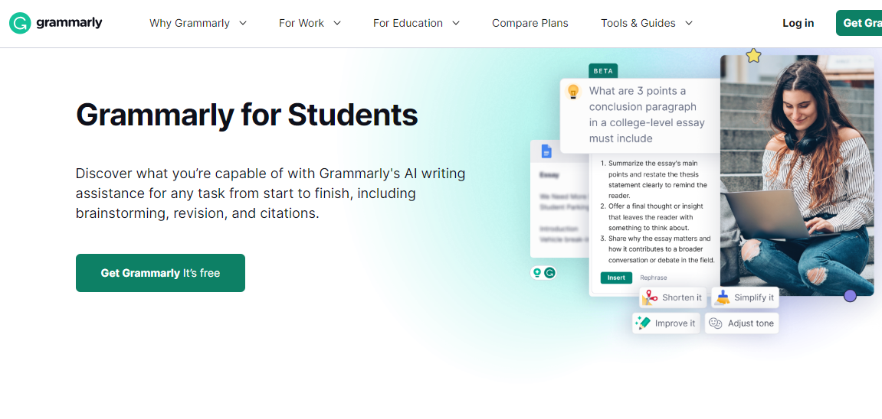
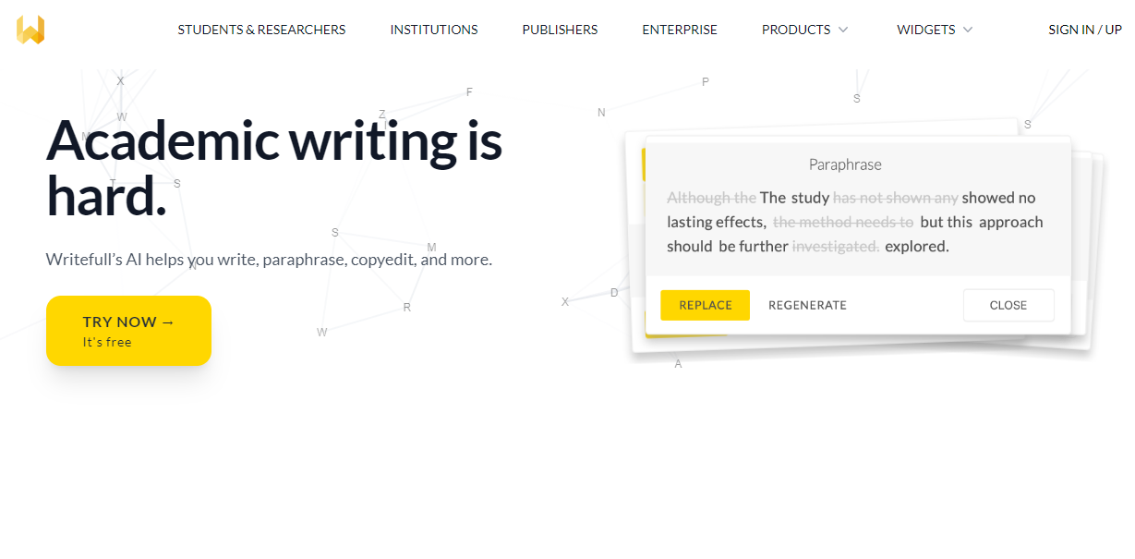
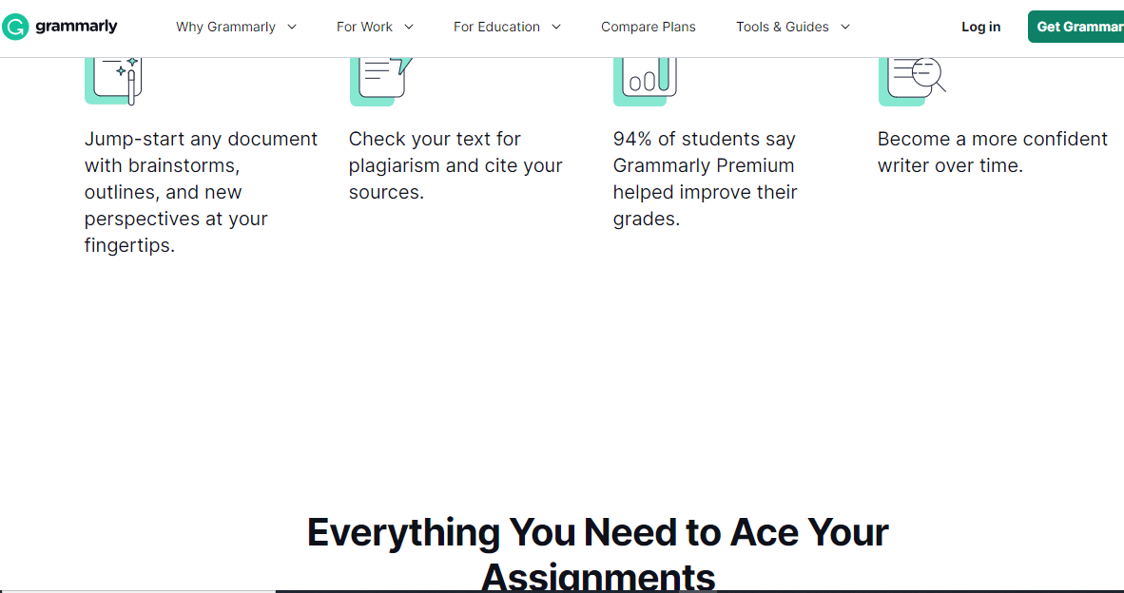
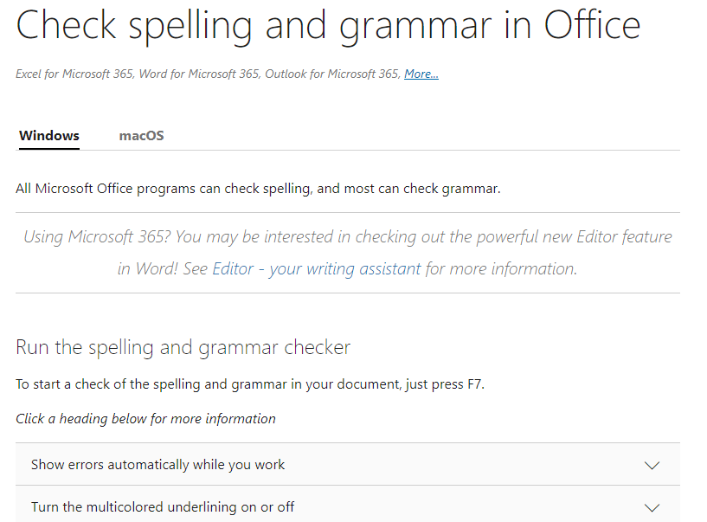
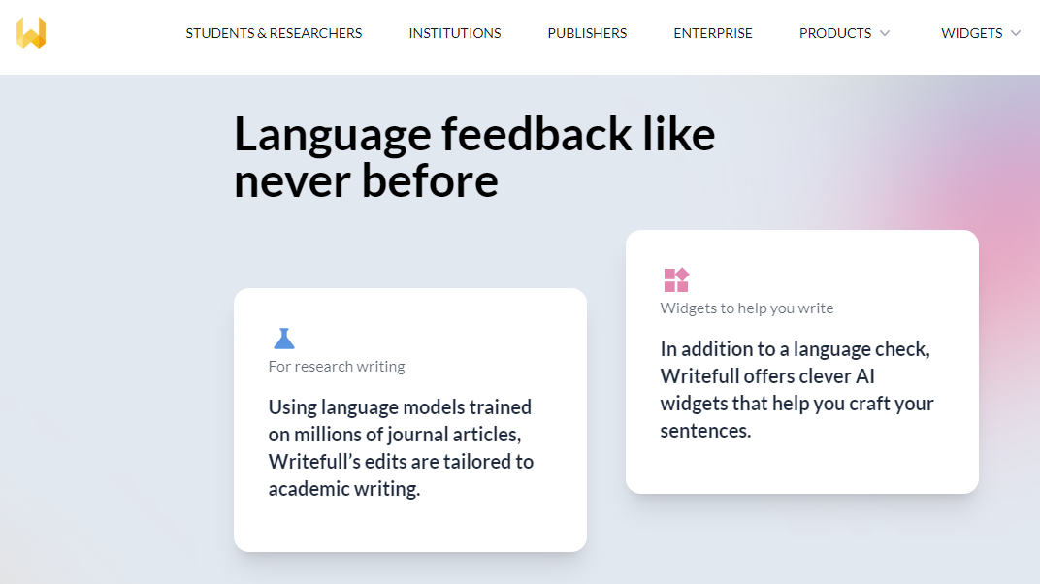
Notes:
These are the editors

Slide 6
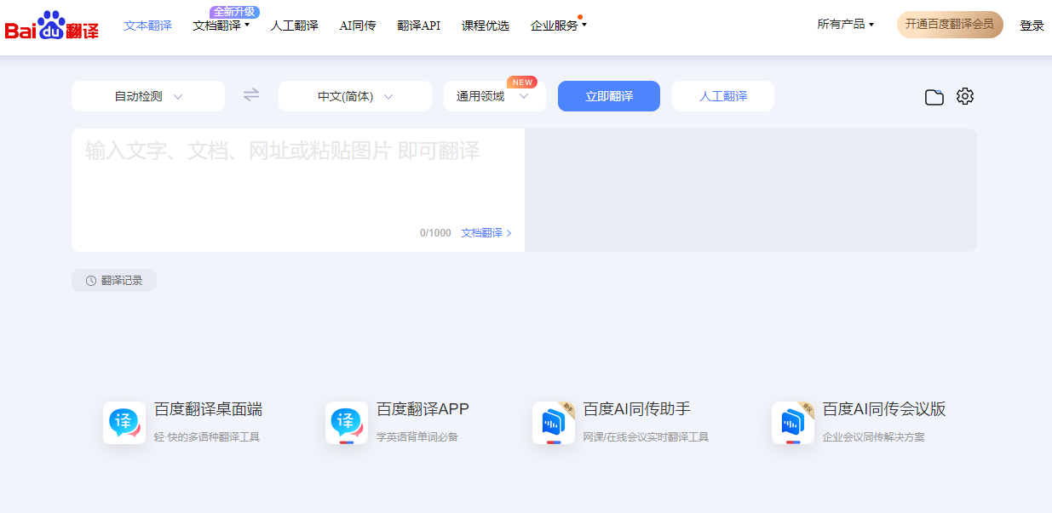
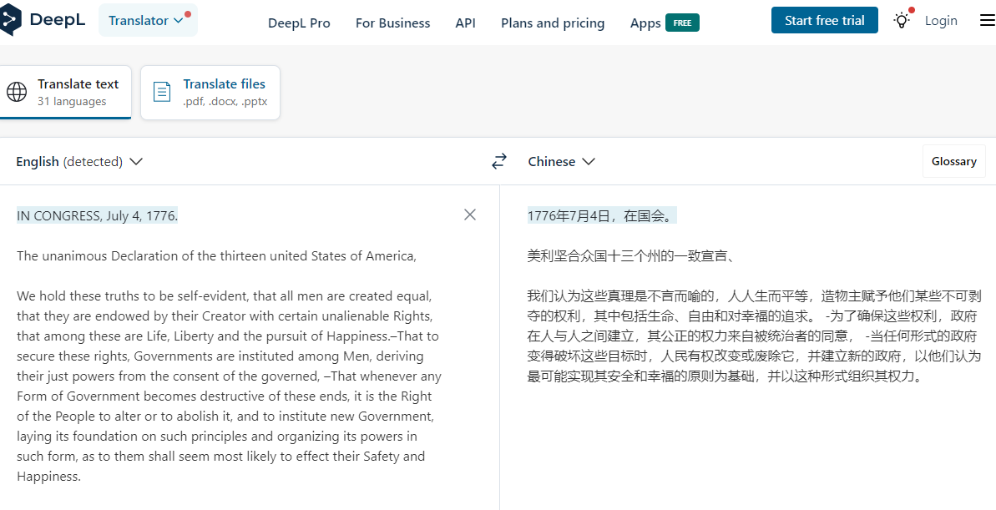
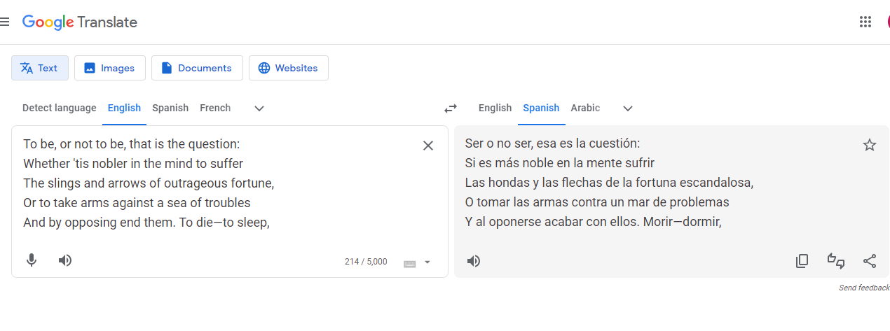
Notes:
These are some of the translators

Slide 7
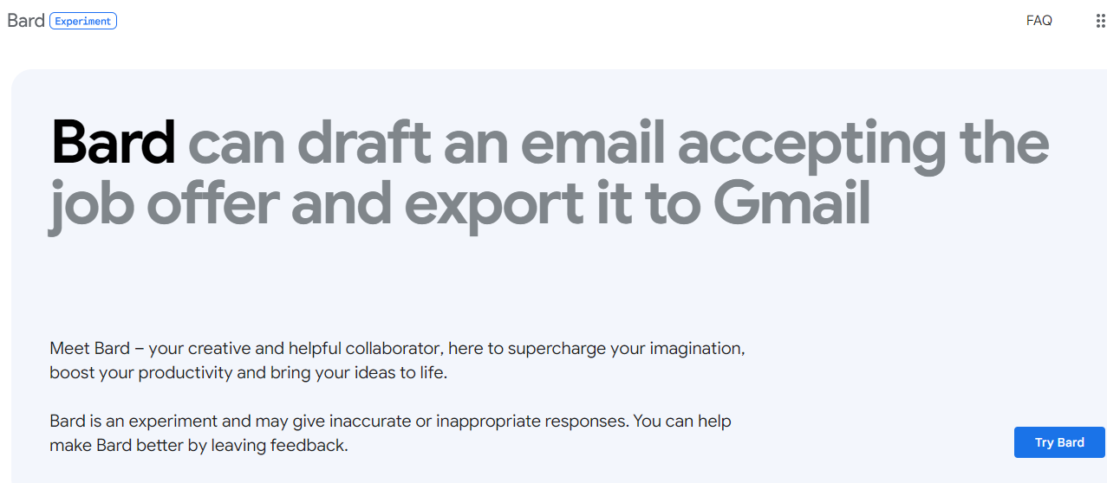
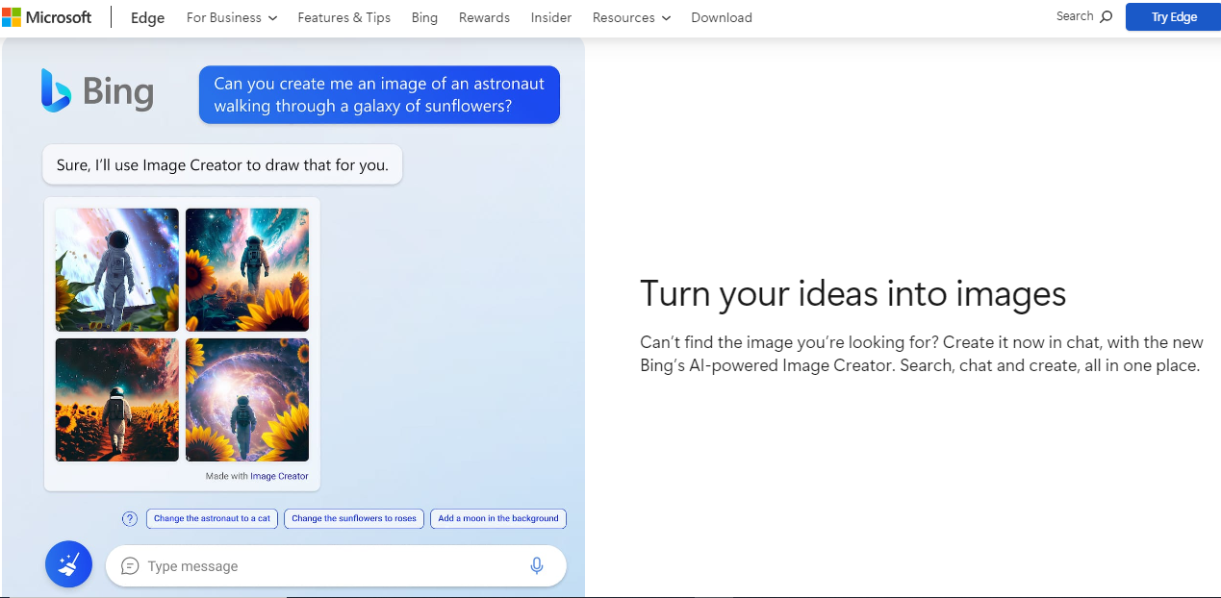
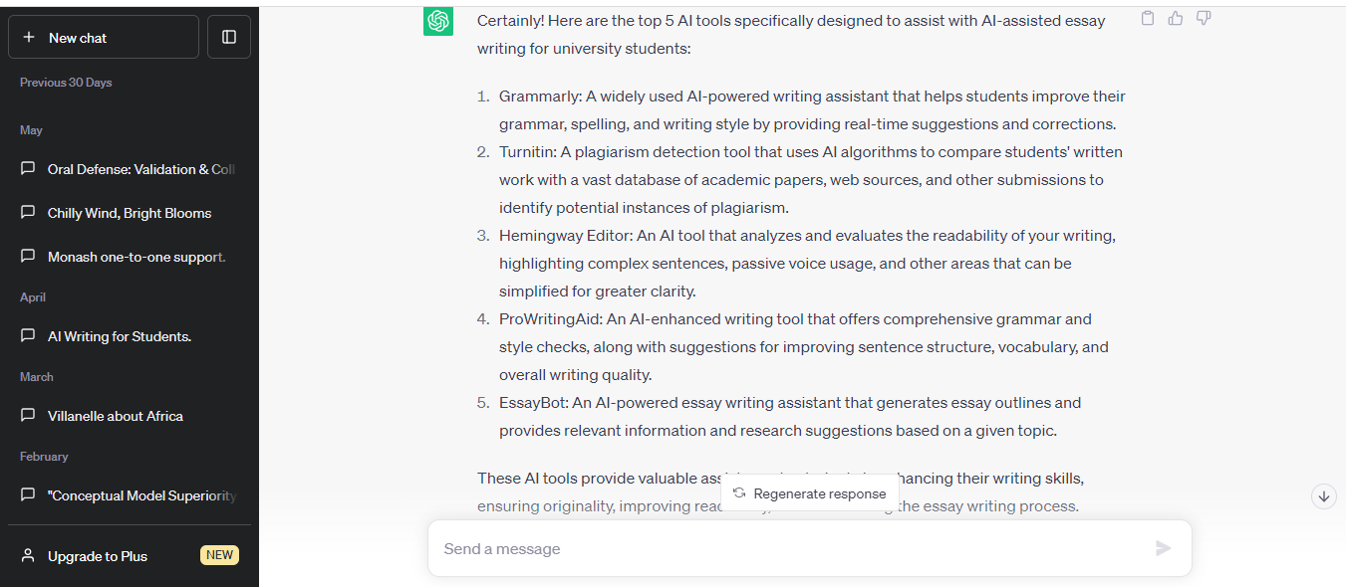
Notes:
These are ChatGPT and some other thinking/writing partners.

Slide 8
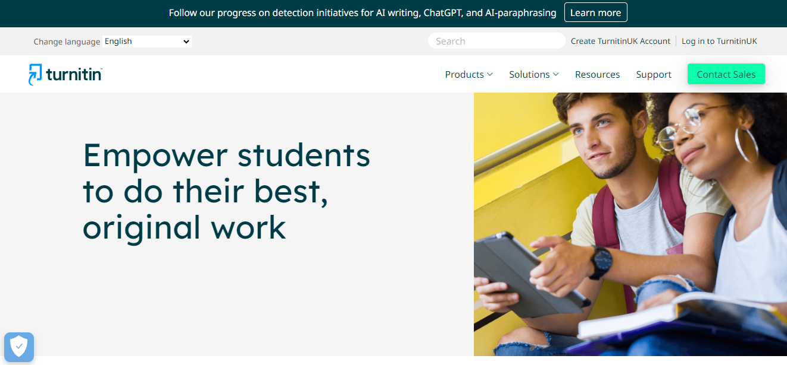
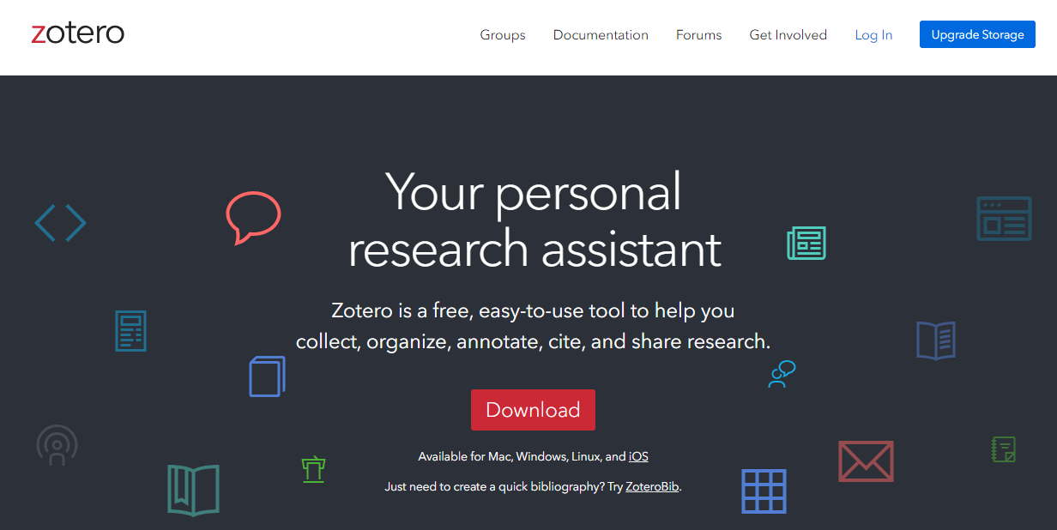
Notes:
And citation and referencing helpers

Slide 9
AI implications for HEIs
How to deal with AI in the classroom?
How to defend academic integrity and purpose?
A moment of crisis, but maybe opportunity?
Notes:
Read quickly

Slide 10
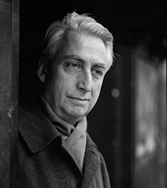
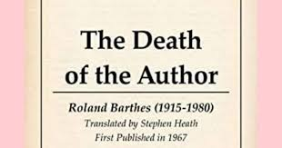
Firstly – Is the (human) author really dead?
Roland Barthes, post-structuralist, advocated this in 1967.
But he surely could not have imagined ChatGPT and LLMs (writing poems, novels, screenplays and academic essays) in the 2020s.
Notes:
As I stated in my abstract for this paper: When the post-structuralist Roland Barthes announced ‘the death of the author’ in 1967 he could not have imagined artificial intelligence would by 2023 be capable of writing novels, essays, reports and dissertations, upending traditional teaching and assessment in higher education, including EAP.
What Barthes proclaimed was the author’s loss of ownership of words and text.

Slide 11
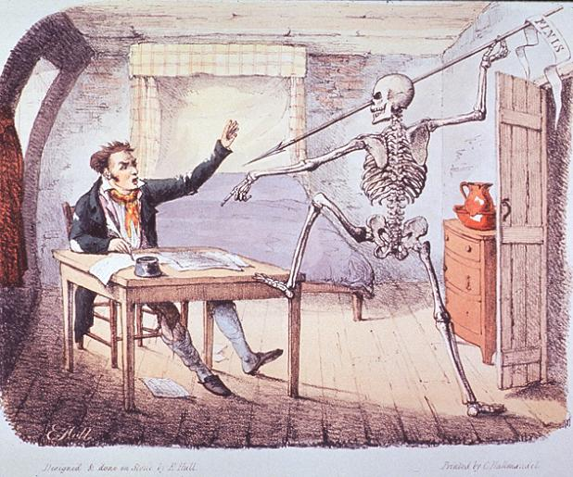
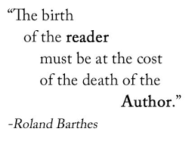
Roland Barthes
Debunked notion of originality.
“A text is … a multi-dimensional space in which a variety of writings, none of them original, blend and clash” (1977: 116).
The act of authorship is one of assembling various influences, rather than a magical process of creating something from nothing…
Barthes was right, to an extent, to shift focus to the reader…

Slide 12
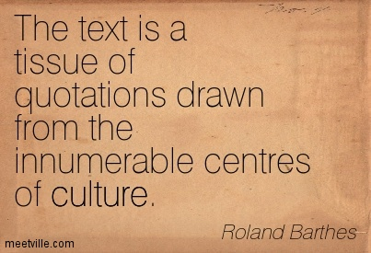
But…
in detaching texts from their ‘dead’ authors,
Barthes unfortunately negated the critically-minded human writer –
who engages with the ‘tissue of quotations drawn from innumerable centres of culture’
– to add their own perspective!

Slide 13
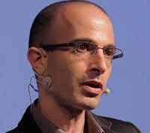
The danger of killing off the human author
Yuval Noah Harari (2023) argues:
Democracy is a conversation, and conversations rely on language.
When AI hacks language, it could destroy our ability to have meaningful conversations, thereby destroying democracy.
Yuval Noah Harari argues that AI has hacked the operating system of human civilisation | The Economist
Notes:
Yuval Noah Harari argues LLMs threaten to wrest control of language away from us, eventually, completely, and through its mastery of our language, AI soon could to master us as well.

Slide 14
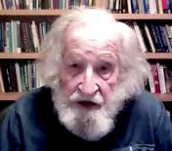
Yet HI is resilient, according to Chomsky..
Noam Chomsky (Bove 2023) warns, ‘A.I.'s lack of morality and rational thought makes it an example of the “banality of evil,” or indifferent to reality and to truth while simply going through the motions spelled out in its programming’
But it may ‘be an insurmountable obstacle for A.I. to imitate human thinking.’
He says, don’t underestimate the human brain!
Notes:
How worried should we be? Chomsky has more faith in HI prevailing over AI, which he doesn’t have much time for.

Slide 15
What does this mean for the student essay?
It’s not the first time we’ve contemplated the essay’s demise.
In 2003, long before ChatGPT…
Richard Andrews asked if this is ‘The End of the Essay?’

Slide 16
Richard Andrews’ The End of the Essay? (2003) concluded, No:
‘The essay … is alive and well.’
Part of its longevity is its flexibility, its ability to adapt to different functions. Although it reflects the rationalist paradigm underpinned by argumentation and in turn by logic, dialectic and rhetoric, it gives students the space to inject personal perspectives, to alter the sequence and play with the tone of the genre.’
But we need to be clear about requiring a personal v. impersonal voice (reflective or rationalist, distanced).
Notes:
Read this …

Slide 17
But what ‘threat’ does AI present to the student essay?
Do students really need to read and write in English?
with translation software such as DeepL
How can we defend academic integrity?
if it’s so easy to cheat, if ChatGPT can compose essays in seconds.
Notes:
Read this.

Slide 18
Can the student essay survive ChatGPT?
Zaretsky (2023) claims it’s already ‘a corpse that students and teachers have an equal interest in pretending is still alive…’ https://theamericanscholar.org/words-words-words/
Marche says, ‘In a tech-centered world, language matters, voice and style matter, the study of eloquence matters, history matters, ethical systems matter. But the situation requires humanists to explain why they matter, not constantly undermine their own intellectual foundations’(2022). https://www.theatlantic.com/technology/archive/2022/12/chatgpt-ai-writing-college-student-essays/672371/
Notes:
Quickly. Don’t read them. The debate continues and here are some comments by Zaretsky and Marche.

Slide 19
Did ChatGPT Kill the Student Essay?
Skorburg and White (2023) say No! It cannot rival HI.
1. It shows no regard for understanding, judgment or truth.
2. ChatGPT is a consummate ‘Bullshitter’ that doesn’t give a damn!
3. Understanding and judgment require giving a damn; and student essays should too!
https://theconversation.com/chatgpt-killed-the-student-essay-philosophers-call-bullshit-200195
Notes:
Skorburg and White, philosophers, have more faith in HI – are quite dismissive of ChatGPT and AI.

Slide 20
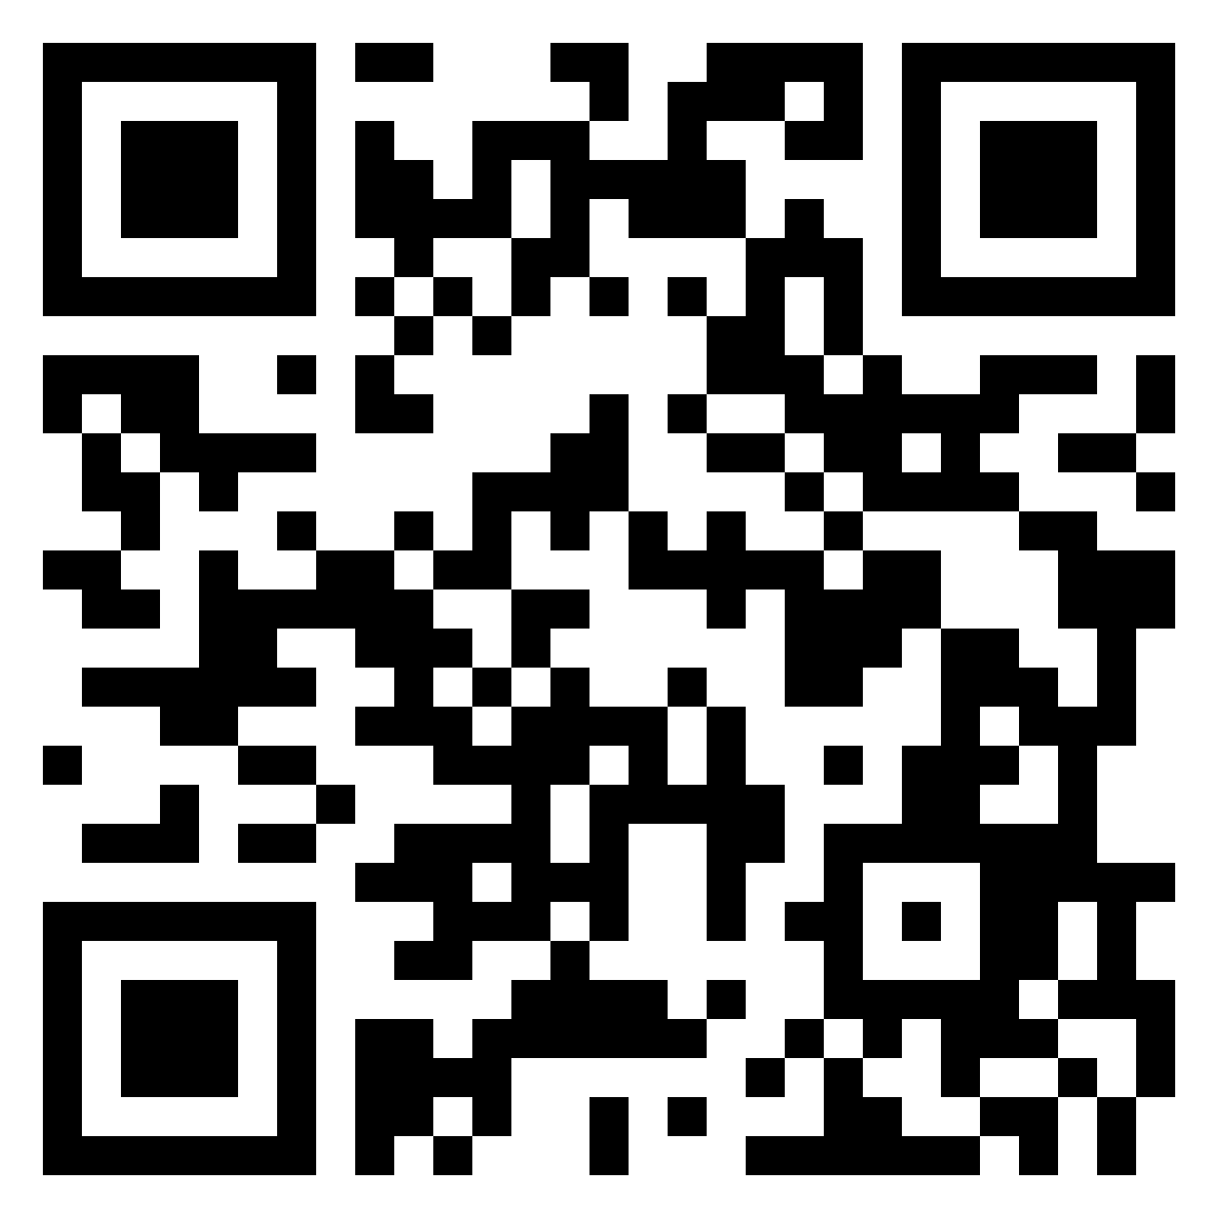
What would we lose if the student essay died?
Please discuss with the person(s) next to you for 2 minutes, and comment on the Padlet link.
https://padlet.com/drewcshaw1/implications-of-ai-assisted-writing-what-would-we-lose-if-th-xmgd6sdqq8y30rxk

Slide 21
Reforming assessment types and processes
Katia Dowdle (2023) proposes an alternative ‘Oral Essay’.
Others advocate oral (in-class) presentations of essay plans and outlines – followed by Q&A - before any writing begins.
Vivas are making a comeback.
UDL (Universal Design for Learning) proposes many alternatives.
Yet, as Richard Andrews (2003) argued, the essay is the ‘Genre par excellence for assessment in the academy’ and we will be hard-pressed to replace it.
Notes:
Read from slide

Slide 22
So… the student essay might be on life support but, I argue, it’s worth reviving!
AI-assisted writing is here to stay.
It could present a threat and/or an opportunity.
We should consider ways of using AI effectively yet elevating HI ultimately.
This requires promoting discursive, critical, evaluative voice.
Notes:
Read from slide

Slide 23
Ways of dealing with AI
Current Durham University guidance
Examples from Durham’s 2023 20-week EAP Pre-sessional
Notes:
Quickly

Slide 24
Allow acknowledged use of generative AI. E.g.
Generation of ideas and providing some alternative perspectives.
Rewording and simplifying text, to help students better understand complex concepts.
Improving vocabulary and language skills by suggesting synonyms, antonyms, and explanations of unfamiliar terms.
Support for drafting and editing providing suggestions for outlines, sentence structure, paragraph organisation, or arguments.
DCAD, Durham. 2023. Discussing Generative AI with Students.
Notes:
Here you can see that DCAD are encouraging intelligent use of ChatGPT, which can be aid the learning process.

Slide 25
Comment from Durham pre-sessional ChatGPT pioneers (Jess Sequera and Michael Mortimer):
[Monday, 14:33] MORTIMER, MICHAEL R.
The GPT lesson went pretty well. What Jess and I are discovering is HUGE potential with incorporating GPT into the learning process (research, reading, even note-taking and to some extent criticality - drafting/writing and checking written work presents more of a problem).
Students also got to see GPT’s faults and limitations. They also realised that it’s only a useful tool if you already understand the text/topic/concept which you’re analysing.
[Monday 26 June, Teams Chat]
Notes:
Here we have a comment from our 2023 pre-sessional post-ChatGPT pioneers..

Slide 26
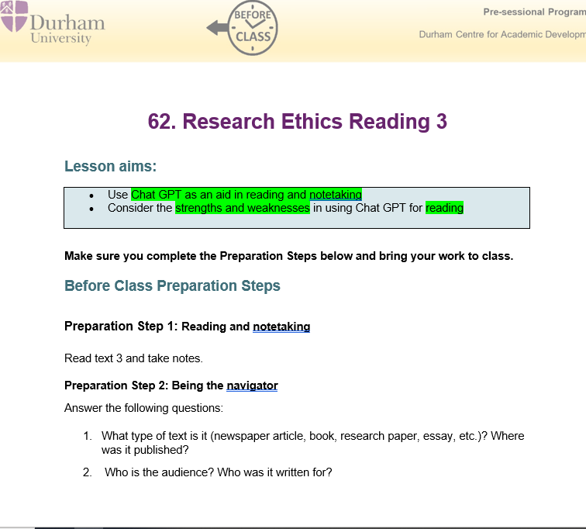
Notes:
This is one of two AI literacy, ChatGPT lessons, which went very well.

Slide 27
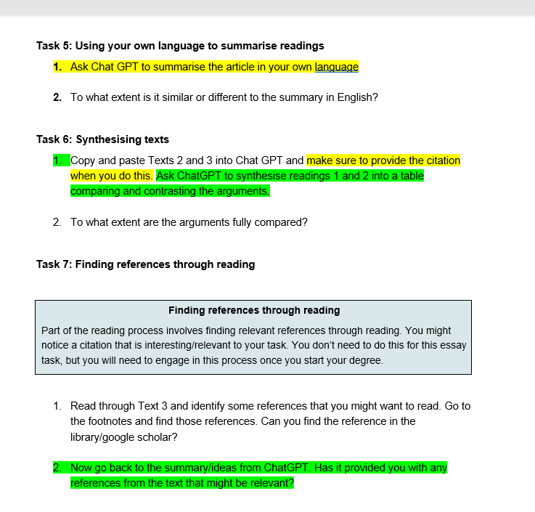

Slide 28
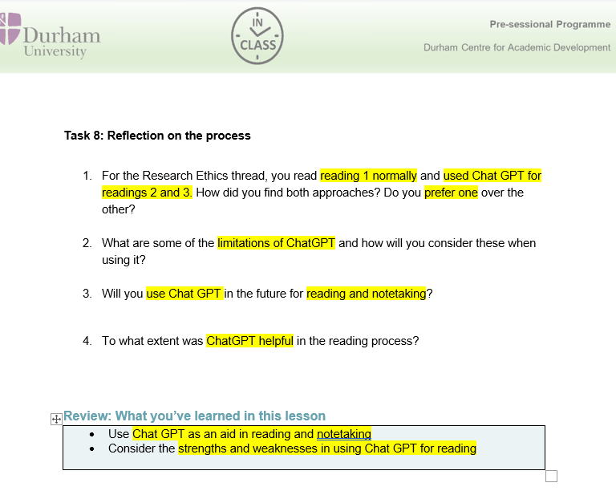
Notes:
You can see how the lesson gets ahead of the curve, working with students, to explore the benefits and drawbacks of the technology.

Slide 29
Navigating AI-assisted writing
Students need to know:
AI tools can be fluent liars.
AI tools may exhibit biases.
how to incorporate AI-generated texts ethically and effectively, noting and citing use of AI.
EAP practitioners will likely have to integrate AI literacy skills into what they already teach.
Warschauer et al, 2023. The Affordances and Contradictions of AI-Generated Text for Second Language Writers
Notes:
Read

Slide 30
A widening gap …
the gap between L1s and L2s may get bigger.
those who can already write well without AI may become more and more valued.
those who cannot write well, with or without AI, may be increasingly excluded (Warschauer et al, 2023).
A possible remedy, I argue, is to teach effective writing and the value of critical (human) voice!
Warschauer et al, 2023. The Affordances and Contradictions of AI-Generated Text for Second Language Writers
Notes:
Read – mostly.

Slide 31
Identifying, encouraging, rewarding human voice in academic writing
Departments should consider first-person perspectives as a requirement, because we know it’s here that AI can’t compete:
‘[AI] cannot demonstrate genuine human empathy, intuition and insight, or draw on the personal experience and tacit knowledge,’ as Durham’s (DCAD 2023) guidelines observe.
Oral presentations of essay plans are valuable
Viva-type questions are valuable
Notes:
Read – mostly. First 3 bullets… Last bullet.

Slide 32
(AI-busting) Viva-type questions for students
Why did you choose this topic?
What’s the main issue for you?
What’s your own position on this issue?
Why does it matter to you?
How does it make you feel when you talk about this issue?
Notes:
These are some questions to consider when drawing out an individual perspective and voice.

Slide 33
How to encourage more HI voice in academic writing
Some suggestions -

Slide 34
University of Melbourne guidelines on Voice https://students.unimelb.edu.au/academic-skills/resources/referencing/voice-in-academic-writing
Notes:
The University of Melbourne has some helpful advice on Voice. [ Move to next slide]

Slide 35
I
Notes:
Read Tips…. And highlighted bits

Slide 36
Notes:
Students – and ChatGPT – seem to neglect the author prominent choice for citation – which offers a chance to show attitude to their argument.

Slide 37
Notes:
Reporting verbs can be neutral or evaluative.

Slide 38
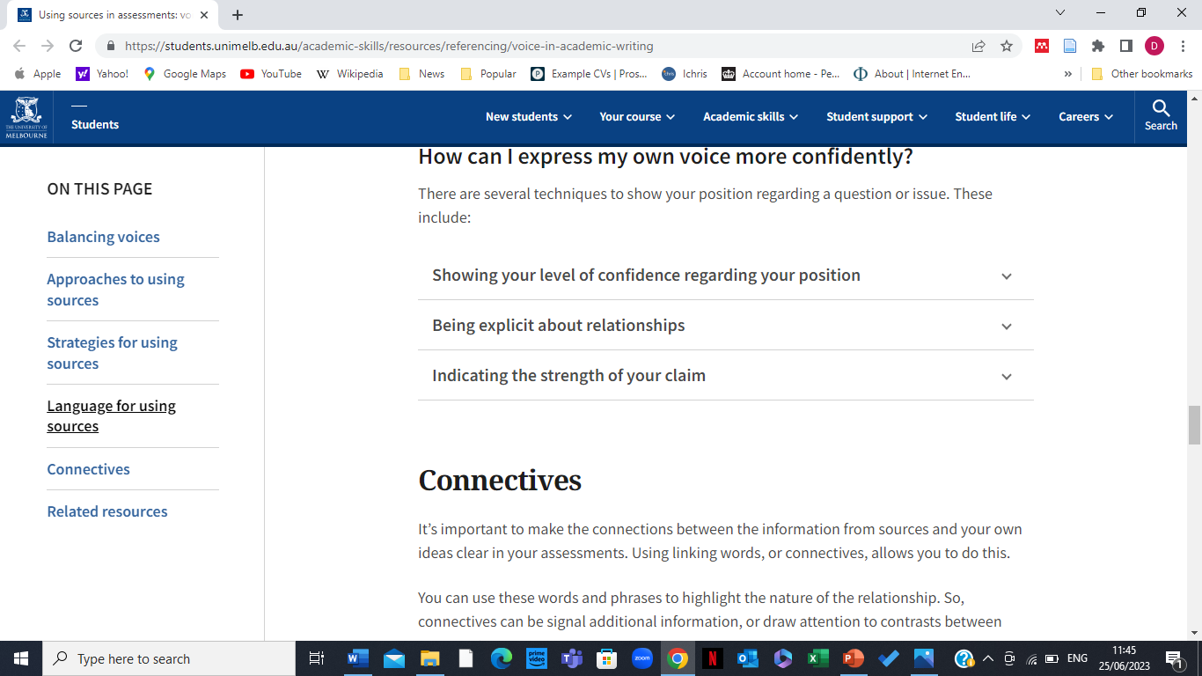
Notes:
Read…. And this is an example of supporting students to express their own voice in academic essay, crucial to rescuing the student essay, empowering also to the student themselves, exercising HI.

Slide 39
Conclusions
The human author is not dead.
The student essay is not (yet) dead, and worth rescuing/reviving.
The EAP practitioner is far from dead - ever more important, arguably.
L2s need us more than ever (while English remains a default lingua franca).
We will need to teach AI literacy alongside EAP.
HI supersedes AI in its intrinsic (critical) value, but…
We need to encourage and reward individual voice and personalised perspectives in academic discourse, and in essay creation.
Notes:
To conclude… Read all.

Slide 40
And finally….
Here’s a handout essay on ‘China’s approach to international politics’:
How can you tell this essay was written by AI (ChatGPT), not HI?
What is lacking or seriously wrong with it?
What would you do if the student presented this to you as their formative essay?
How could you adapt the question/prompt to demand more human critical input?
Notes:
If there is any time…

Slide 42
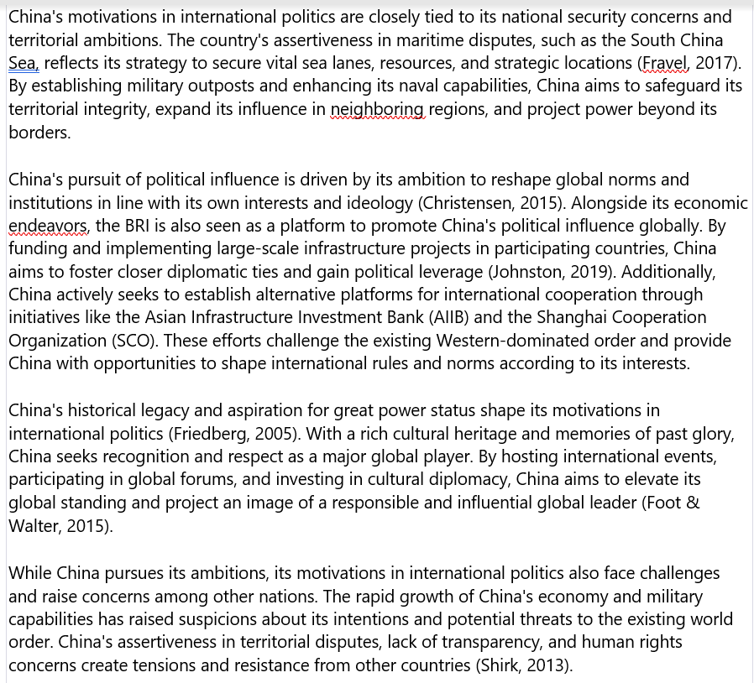

Slide 43
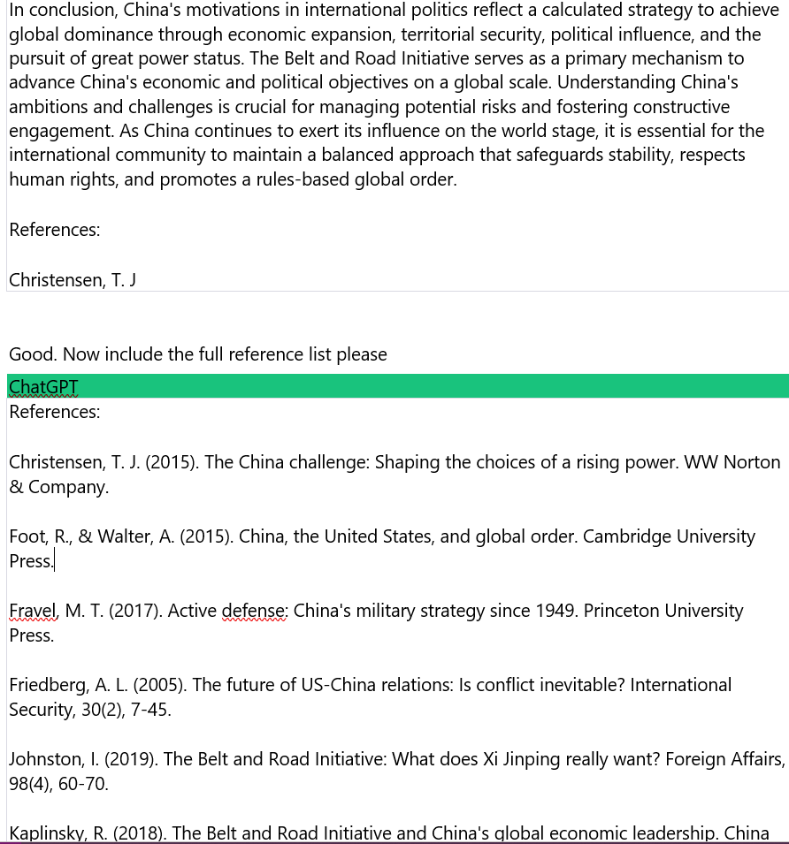

Slide 44
Questions & Comments

Slide 45
REFERENCES
Alharbi, Wael. 2023. AI in the Foreign Language Classroom: A Pedagogical Overview of Automated Writing Assistance Tools. Hindawi Education Research International. Volume 2023, Article ID 4253331. https://doi.org/10.1155/2023/4253331
Andrews, Richard. 2023. The End of the Essay. Teaching in Higher Education 8(1):117-128. DOI:10.1080/1356251032000052366
Barthes, Roland, 1977. The Death of the Author in Image, music, text, London, Fontana, pp. 142-148.
Bearman, Margaret and Rola Ajjaw. 2023. Learning to work with the black box: Pedagogy for a world with artificial intelligence. BERA, British Journal of Educational Technology. DOI: 10.1111/bjet.13337 BritJEducationalTech-2023-Bearman LearningtoworkwiththeblackboxPedagogyforaworldwithartificial.pdf
Bove, Tristan. 2023. Iconic leftist intellectual Noam Chomsky says chatbots are ‘marvels of machine learning’ but also the banality of evil, rebooted. Fortune Magazine (March 8) https://fortune.com/2023/03/08/noam-chomsky-ai-chatgpt-are-not-true-intelligence/
Bugeja, Michael. 2023. If AI kills the essay, I will be a pallbearer at the funeral. In Poynter. https://www.poynter.org/commentary/2023/will-chatgpt-kill-term-papers-essays/
DCAD, Durham University. 2023. Discussing Generative AI with Students.
Dowdle, Katia. 2023. PhD. UCL. Deconstructing the concept of essay creation: Can it be delivered in an oral mode? BALEAP Conference Presentation. Deconstructing the concept of essay creation – YouTube
Harari, Yuval Noah. 2023. Yuval Noah Harari argues that AI has hacked the operating system of human civilisation | The Economist

Slide 46
REFERENCEES CONTINUED
Konoval, Brandon. 2022. Is the Essay Dead? Research and Writing Instruction in the Humanities at a Research-Intensive University. ResearchGate. https://www.researchgate.net/publication/362694572
Marche, Stephen. 2022. The College Essay is Dead. In The Atlantic. https://www.theatlantic.com/technology/archive/2022/12/chatgpt-ai-writing-college-student-essays/672371/
Skorburg and White. 2023. Did ChatGPT kill the student essay? In The Conversation. https://theconversation.com/chatgpt-killed-the-student-essay-philosophers-call-bullshit-200195
Tufekci, Zeynep. 2023. What would Plato Say About ChatGPT? New York Times. https://www.nytimes.com/2022/12/15/opinion/chatgpt-education-ai-technology.html
University of Melbourne. 2023. Using Sources in assessments: voice in academic writing. https://students.unimelb.edu.au/academic-skills/resources/referencing/voice-in-academic-writing
University of Western Australia. 2023. Using AI Tools at UWA: A Guide for Students. https://www.uwa.edu.au/students/Support-services/Academic-support
Warschauer, Mark, Waverly Tseng, Soobin Yim, Thomas Webster, Sharin Jacob, Qian Du,and Tamara Tate. 2023. The Affordances and Contradictions of AI-Generated Text for Second Language Writers.
Zaretsky, Robert. 2023. Words, Words, Words. What does the advent of ChatGPT mean for already beleaguered teachers? The American Scholar. Phi Beta Kappa. January 12, 2023. https://theamericanscholar.org/words-words-words/

