Slide 1
Chat GPT/AI: a campus wide response Or a tale of assessment review & renewal told as a heist movie
Chris Macallister

Slide 2
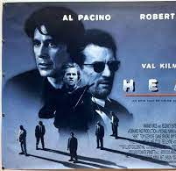
Today’s presentation (a six-act heist movie)
The challenge – AI/Chat GPT & Sunderland London
The theory – AI and Ulrich Beck’s risk society
Creating the team to effect change ‘combined talents’
The plan
What happened: known unknowns, unknown unknowns, and dogs that didn’t bark
What we learnt from the liminal philosophy of EAP

Slide 3
Why the heist movie metaphor?
Reflection on how a learning development centre team goes about having an impact on it environment
What was our process?
The practice of "projectising" (A Moriarty Pro VC) what we do
The Heist movie is also about assembling a complimentary team of specialists

Slide 4
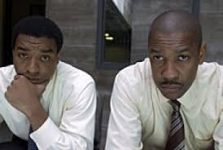
Act 1. The Challenge
Many of our programmes use ‘classic’ written assessments
Read, assimilate, write
ChatGPT can do this in minutes…
Will some of our programmes be rendered meaningless?

Slide 5
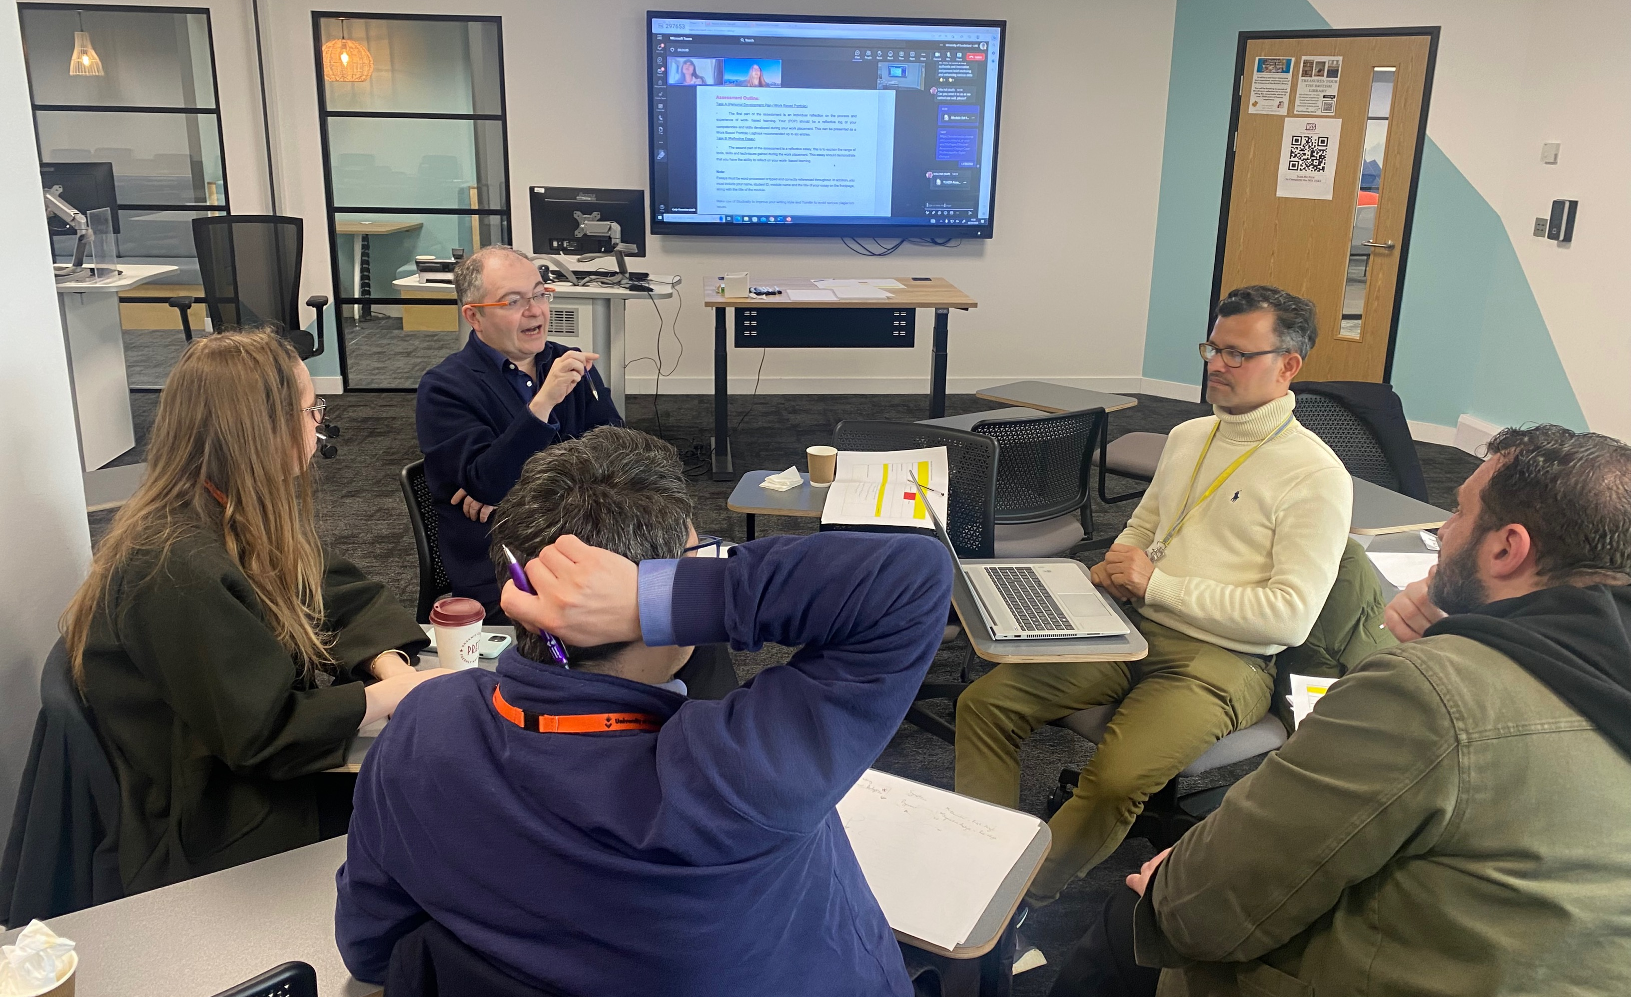
The Sunderland London Context
Time is of the essence
We have four intakes each year: October, January, April, August
So limited time and resources to make changes happen
And as a satellite campus our sovereignty has its limits…

Slide 6
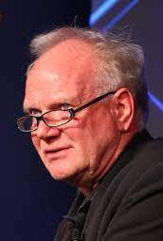
Act 2. AI: the latest iteration of Beck’s Risk Society
A human created risk – we caused this problem!
An unknowable risk not visible to our senses – experts needed
A risk that defies and cuts through boundaries
A risk that defies containment and traditional ‘hard border’ responses

Slide 7
Beck’s and our response to the risks of late modernity
Cross border, trans institutional responses
Collaboration – across disciplines, between teams
‘hard border’ solutions are bound to fail
“Make it difficult for students to fail” (Pro-VC A. Moriarty) – make it difficult to succeed by relying purely on ChatGPT

Slide 8
Act 3. Creating the team of 'combined talents'

Slide 9
The Sunderland London Academic Development Centre (6 months old):
10 ‘career’ personal academic tutors
5 EAP lecturers
3 in the library team
2 digital learning technology leads
2 ACEES – employability advocates
5 senior lecturer – ‘consultant advocates’ – specialists in assessment, student voice and the NSS, learning design, employability, enterprise

Slide 10
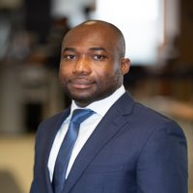
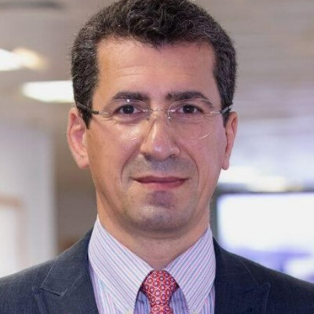
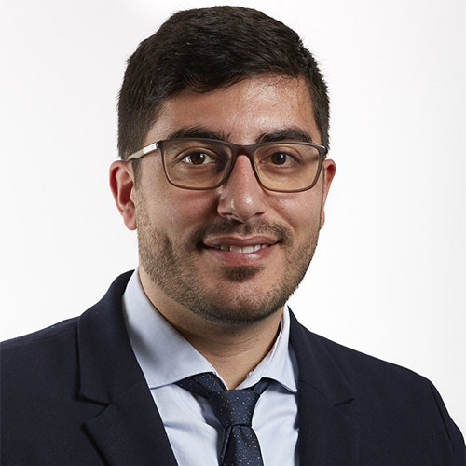
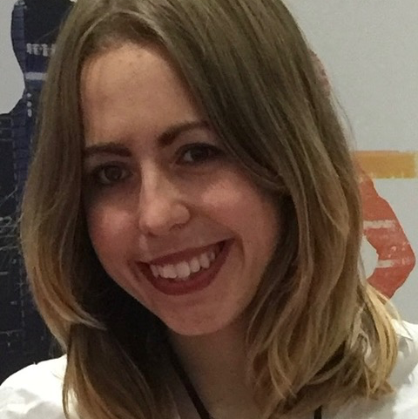
Theo – assessment
Daniella – EAP & thinking
Giuseppe - enterprise
Elisha - employability
Evi – digital Team leader
Chris – producer(?)

Slide 11
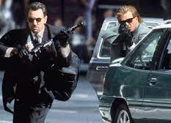
Act 4. The plan… PROJECT SPRINT
Speed = a triage plan
“inflight changes”
Formative, chunking, or alternative assessments
Bypassing traditional bureaucratic processes
Buy in and collaboration from the Programme Managers

Slide 12
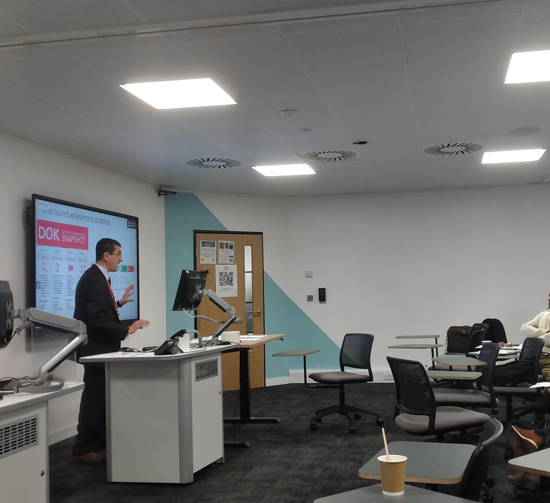
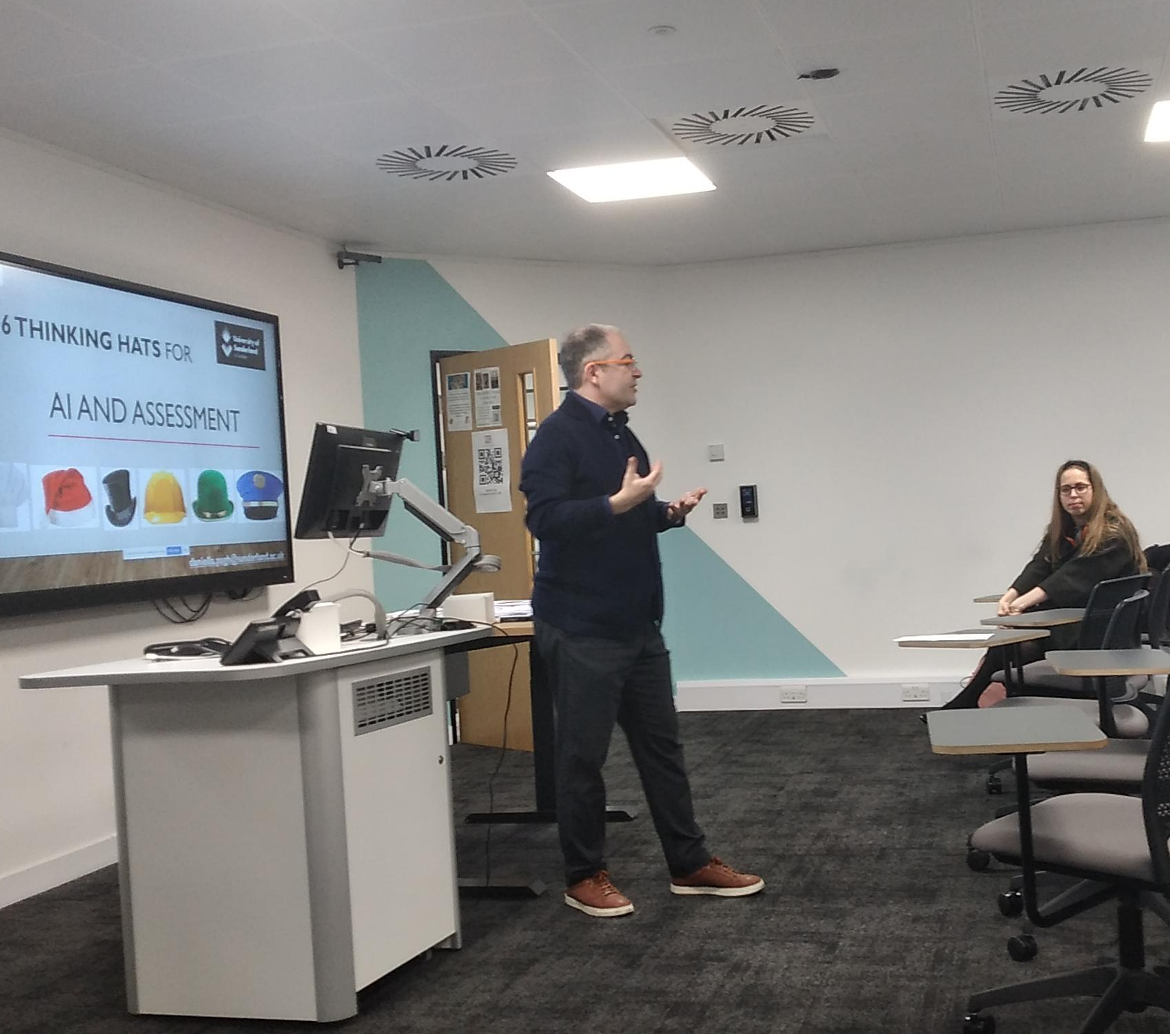
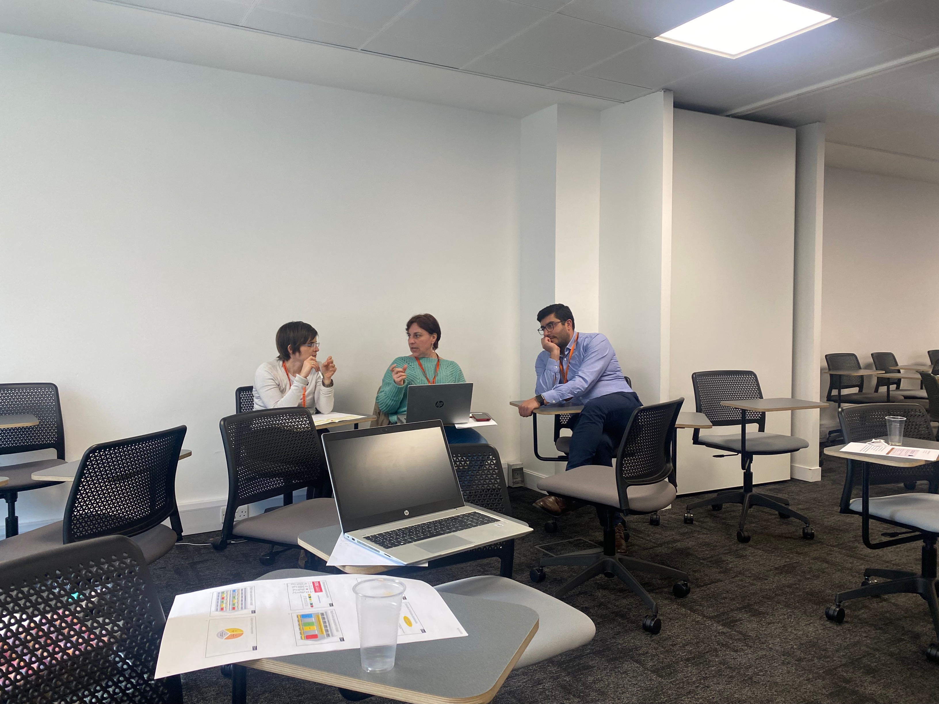
The pivot point: the SPRINT away day
Get programme teams into the same room
Present the context and theory
Present the opportunity
Begin the rewrite your assessment plans:
Formative work
Chunking
Alternative assessments

Slide 13
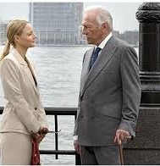
Another agenda… (every heist movie has more than one storyline)
Assessing to Learn
Assessment linked to employability
Assessment and Sustainable goals
Assessment that motivates, engages and develops combined skills

Slide 14
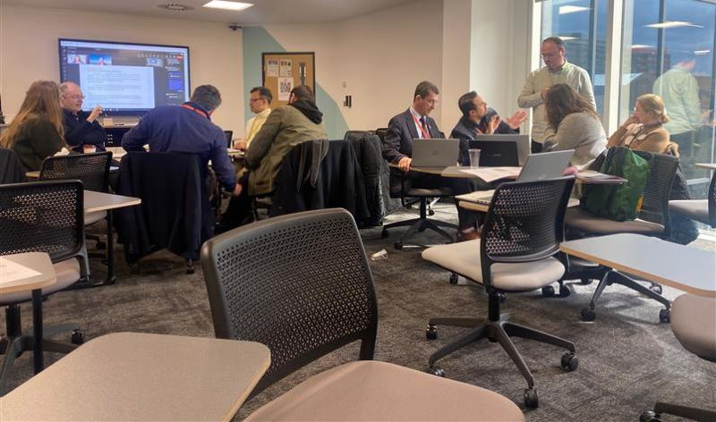
Act 5. what happened in April – June 2023…

Slide 15
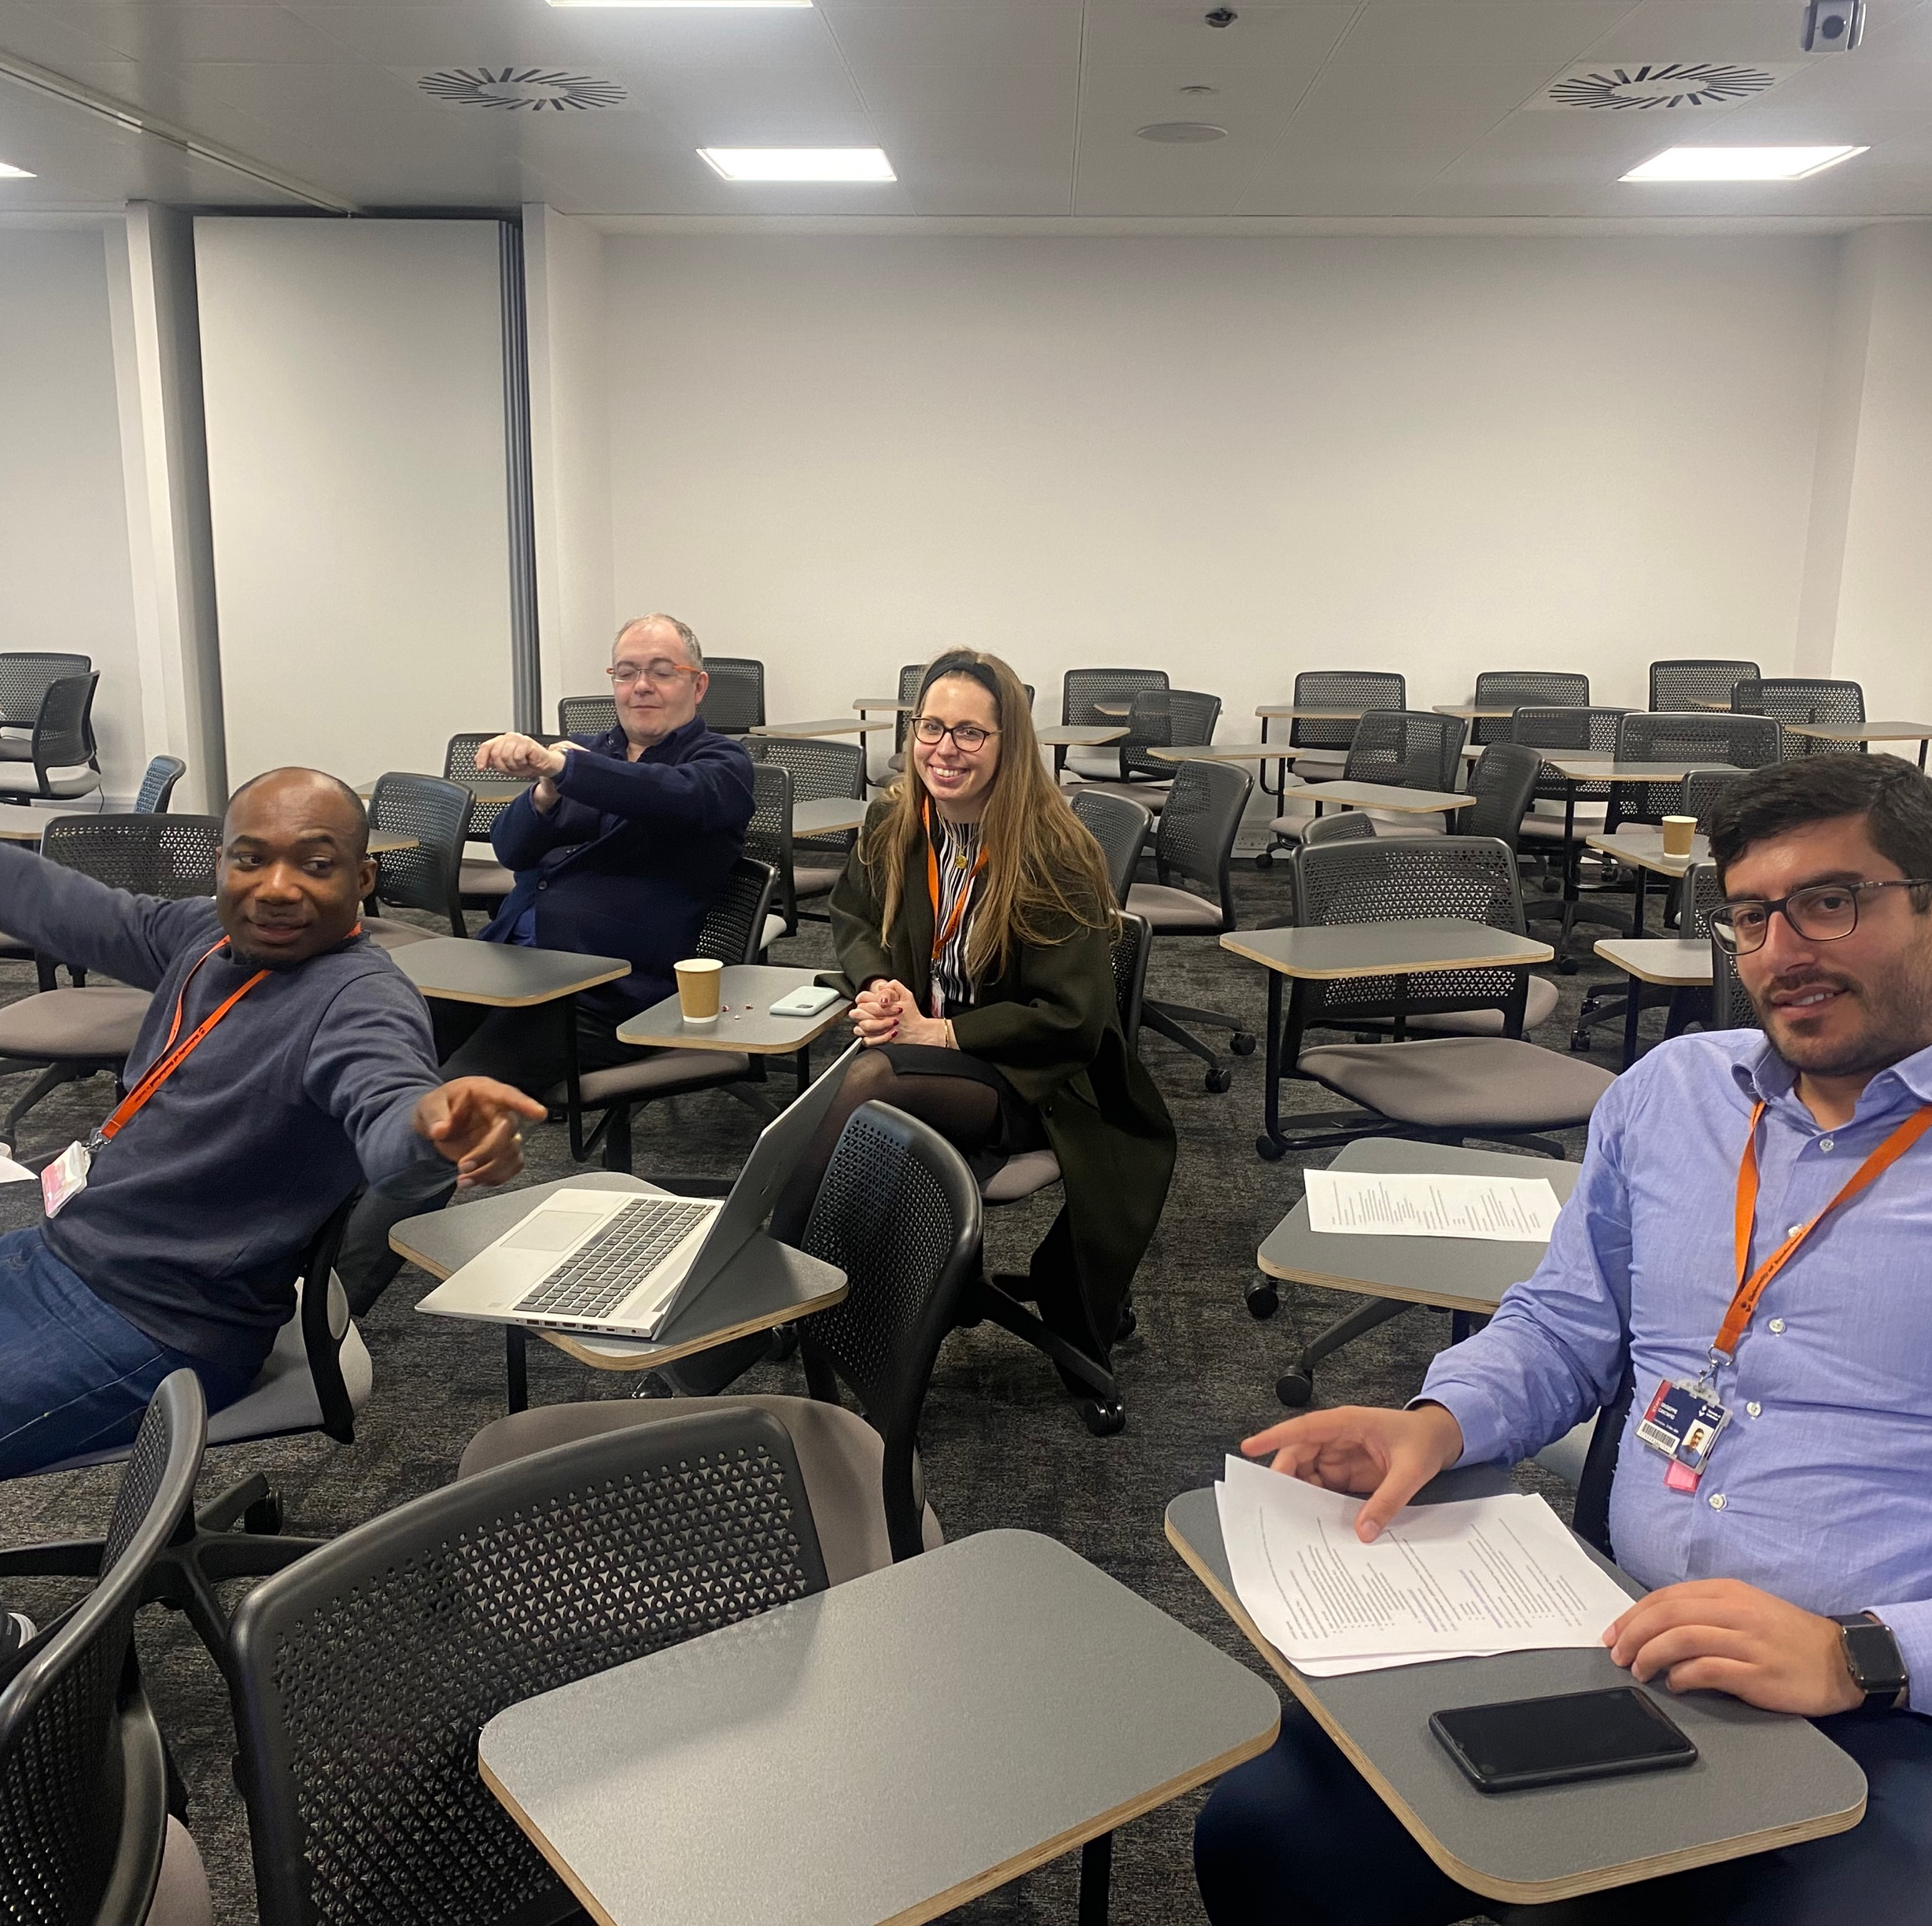
Did we succeed?
All programme teams went through the away day process
All teams engaged
All teams began to develop inflight changes
By June 6th we had sprinted all the teams
Changes to be implemented from the fourth intake in August 2023

Slide 16
Key factors in our success…
Hard diplomacy
Well worked out materials, well run sessions
Giving the team freedom; an organic approach
Working with very invested, curious, open minded, and courteous colleagues from the programme teams

Slide 17
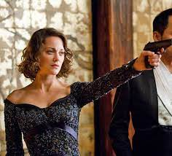
Known unknowns… challenges we knew were out there
Not fully grasping the risk (as Beck would tell us to expect)
Difficulties timetabling the away days
Programmes needed varying levels of intervention

Slide 18
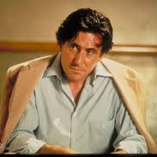
Unknown Unknowns… challenges we didn’t see coming
The sheer scale of the challenge logistical
We couldn’t do it all on the day
An exponential crisis – work made more work
Team burn out – training fatigue
Resistance & denial at higher levels
The follow up work

Slide 19
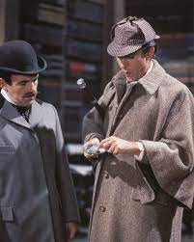
Dogs that didn’t bark in the night…
Outright opposition to the project
“how dare you guys tell us about our programme”
Calls to simply ban AI

Slide 20
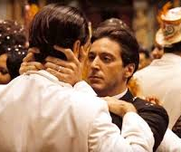
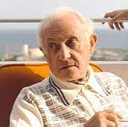
What next? Part 2. a stronger sequel
From SPRINT to marathon
SPRINT part 2. longer, deeper
Students Union engagement
We’ve secured VC award funding to this!

Slide 21
What would Beck have to say?
B+ for our solutions…
Collaboration; a trans borders approach
We recognise the hazard can’t be wished away or simply banned
But… will our solutions generate more problems?

Slide 22
Act 6. Liminality, EAP & HE; the twist at the end of the movie…

Slide 23
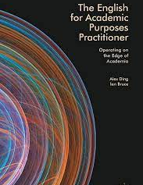
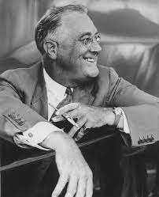
The liminality of EAP, the liminality of HE…
EAP has traditionally been a liminal precarious space
As much of HE is… the high risk, high stakes London satellite campus sector
This may well be changing; for good or ill?
However, this acceptance and experience of the opportunity and hazard of the liminal may have equipped some of us to adapt

Slide 24
Questions…
And if you are in London on 18th or 19th July come to our learning and teaching symposium in Canary Wharf!

