Slide 1



Will the next student essay you mark
be written by A.I.?
Implications of the recent A.I. technology development on the future of the teaching of EAP writing skills
Helen Beech & Angela Xia
April 20th , 2023

Slide 2

Outline
Landscape: where are we now?
AIGC/Generative AI: why are we vulnerable to it?
Plagiarism and cheating in a post-AIGC world
The role of writing
A Chinese EMI institution’s potential approach

Slide 3
Landscape: where are we now?

Slide 4




Landscape: where are we now?
1. Faster, better, more Large Language Models

Slide 5





Landscape: where are we now?
2. Integration of AIGC with existing popular applications

Slide 6

Landscape: where are we now?
3. Microsoft 365 + CoPilot
Source: https://www.howtogeek.com/879737/microsoft-365-copilot-will-add-ai-to-word-outlook-and-more/

Slide 7

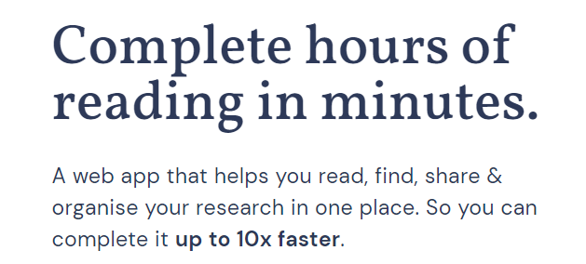
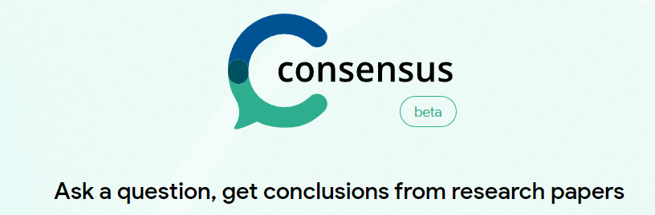

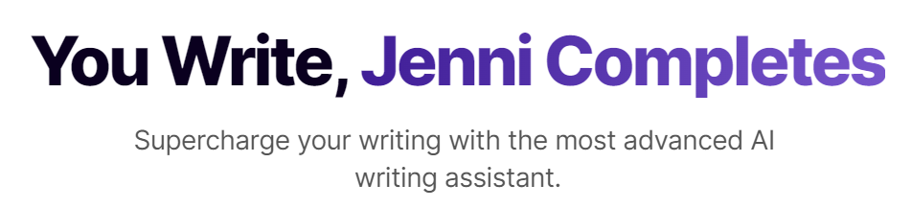
Landscape: where are we now?
4. More specialized AIGC-applications targeting researchers and students

Slide 8
AIGC/Generative AI: why are we vulnerable to it?

Slide 9
Why are we vulnerable to it?
Two main reasons:
1. Massification of Higher Education
2. The types of assessments that we often use on EAP modules

Slide 10
Amid excitement and anxiety, the rest of the world is trying very hard to keep apace with the latest AIGC development , including education institutions…

Slide 11
Which side to take?
As of March, 8 of the 24 Russell Group universities have officially announced a ban on the program in assessed work¹
International Baccalaureate (IB) said that said schoolchildren will be allowed to use the chatbot in their essays³
Ban it?
More universities are in the process of updating guidance and assessment policies ²
Embrace it?
https://www.redbrick.me/top-uk-universities-ban-chat-gpt
https://inews.co.uk/news/oxford-cambridge-ban-chatgpt-plagiarism-universities-2178391
https://www.ibo.org/news/news-about-the-ib/statement-from-the-ib-about-chatgpt-and-artificial-intelligence-in-assessment-and-education/

Slide 12
Which side to take?
Imperial College London
University College London
“We believe these tools are potentially transformative as well as disruptive, that they will feature in many academic and professional workplaces, and that rather than seek to prohibit your use of them, we will support you in using them effectively, ethically, and transparently.”²
“Submitting work and assessments created by someone or something else, as if it was your own, is plagiarism and is a form of cheating, and this includes AI-generated content.”¹
¹ https://www.imperial.ac.uk/about/leadership-and-strategy/provost/vice-provost-education/conversational-ai-tools-guidance/
² https://www.ucl.ac.uk/teaching-learning/assessment-resources/ai-education-and-assessment-staff-briefing-1

Slide 13
Plagiarism and cheating in a post-AIGC world

Slide 14
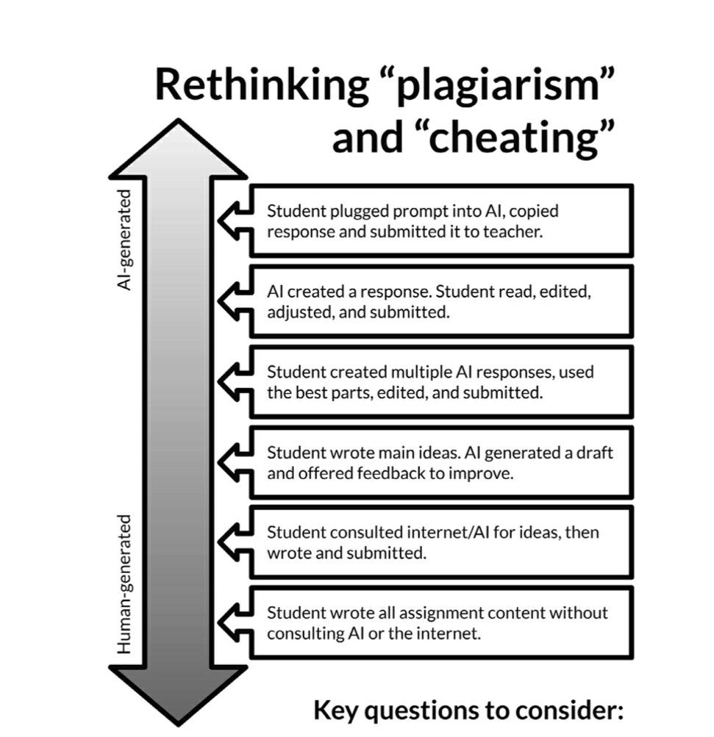
1
Q1: Which of these would you consider “cheating”?
Q2: Which of these is relevant to our students’ future?
Q3: Which of these would you use in your work as a teacher?
2
3
4
5
6
Source：https://ditchthattextbook.com/ai/

Slide 15
The role of writing

Slide 16
The role of writing
“(Academic writing) is the main way that students consolidate their learning in a subject area, the means by which tutors judge the extent students have understood material, and the main instrument for assessing success or failure”.
Hyland (2006, p.56)

Slide 17
The role of writing
“…(ChatGPT and other forms of Generative AI) may push professors to consider the way writing is used for assessment in courses that are not designed to develop writing”
“One of the things that may come up is we discover that certain written assessments we’ve done because we think students should be writing could be better done in other ways”.
John Warner, in a recent interview with Beckie Supiano (2023)

Slide 18
The role of writing
“writing-intensive classes need to be small enough so that instructors can offer personalized feedback. This is especially important because it creates buy-in from those who matter: the students.”
Why would students who are getting little to no feedback on their work not resort to ChatGPT to write their essays?
De Oliveira (2023)

Slide 19
The role of writing
Why would they make themselves vulnerable on a page (for writing is indeed a very vulnerable act) if they know that the instructor reading doesn’t have the resources to offer generous feedback? Better to let the machine produce a bland text than to take risks finding your own idiosyncratic voice.
“The problem is not just the technology, but the context in which the technology embeds itself. If students feel like they are just another cog in the university assembly line, then they will submit generic, machine-produced essays".
De Oliveira (2023)

Slide 20
A Chinese EMI institution’s potential approach

Slide 21
English Language Centre
School of Languages, XJTLU
Context
Largest transnational EMI university in China
5000+ new UG students and 3000+ PG students every year
ELC is responsible for delivering Y1 (EGAP approach) and Y2 (ESAP approach) credit-bearing EAP modules

Slide 22
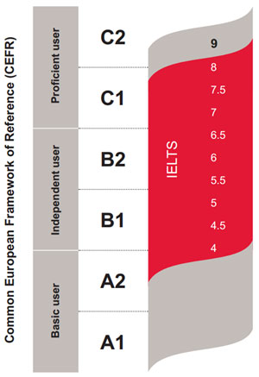
English Language Centre
School of Languages, XJTLU
B2+ expected language proficiency at the end of Y2
B1: average language proficiency of new Y1 UG students

Slide 23
Potential Approach
Y1 EGAP
Y2 ESAP
Include more analog tests
  Encourage critical thinking and problem-solving skills
Reduce the weight of written coursework
More emphasis on speaking assessment
Find a way to link speaking and writing assessment (e.g., viva approach)
Include more project-based learning tasks
  Promote more language and content integration
  Increase student engagement
  Ensure students’ language proficiency development

Slide 24
Potential Approach: EAP for Design
Context
EAP module for Y2 students from the Design School, XJTLU.
10 credit, year-long
450+ students and 8 EAP teachers

Slide 25
Potential Approach： EAP for Design
Before
After
Three coursework
  One writing coursework
  Two speaking coursework
Exam
  Two-hour integrated exam
A series of in-class tests added
Project-based Learning
  Two projects added
    Final project worth 70% of the module marks
  Resit exam also changed to a project

Slide 26
Summary
Acknowledging the fact that AI is going to stay and students will use them now matter how we want to regulate their use behaviors.
Rethink and keep improving the contextualized approach to EAP teaching and assessment
Continue to reskill and upskill so that we can fully tap the benefits of AIGC applications

Slide 27
References
De Oliveira, P.L.S., 2023. The Case for Luddism Against ChatGPT. Available online: https://www.insidehighered.com/views/2023/04/03/case-luddism-against-chatgpt-opinion (Accessed: 3rd April 2023)
Hyland, K., 2006. English for Academic Purposes: An Advanced Resource Book. New York: Routledge.
Supiano, B., 2023. Will ChatGPT change how professors assess learning? It won't be easy without their college's' support. Available online: https://www.chronicle.com/article/will-chatgpt-change-how-professors-assess-learning?cid2=gen_login_refresh&cid=gen_sign_in (Accessed: 14th April, 2023)

Slide 28
Thank you!
Questions?

