Slide 1
Twisting the Screw the Other Way: Legitimising EAP Differently
Alex Ding, University of Leeds
Laetitia Monbec, National University of Singapore

Slide 2

A thought experiment – positions in the field

Slide 3
Twisting the screw – a socio-analysis of the field - metanoia
a transformation of how we see the field of EAP;
to repudiate past practices and doxas;
to adopt a new gaze,
and to break with illusio - ‘the enchanted circle of collective denial’ (Bourdieu, 2000: 5).
Our rhetorical strategy is to ‘twist the screw the other way’ (Bourdieu, 1990: 53)
in order ‘to emphasise the truth very strongly’ (Bourdieu, 2000a: 173)

Slide 4
Socio-analysis and the field
In socio-analysis the primary focus is on the field:
the characteristics of a field are: it is a structured social space; it contains agents (people and institutions) who dominate and who are dominated; the field is a permanent relationship of inequality; field agents struggle to transform or preserve the field; all agents harness the powers they have in this struggle; and power defines agents’ positions in the field and their strategies.
Ding, 2022: 157.

Slide 5
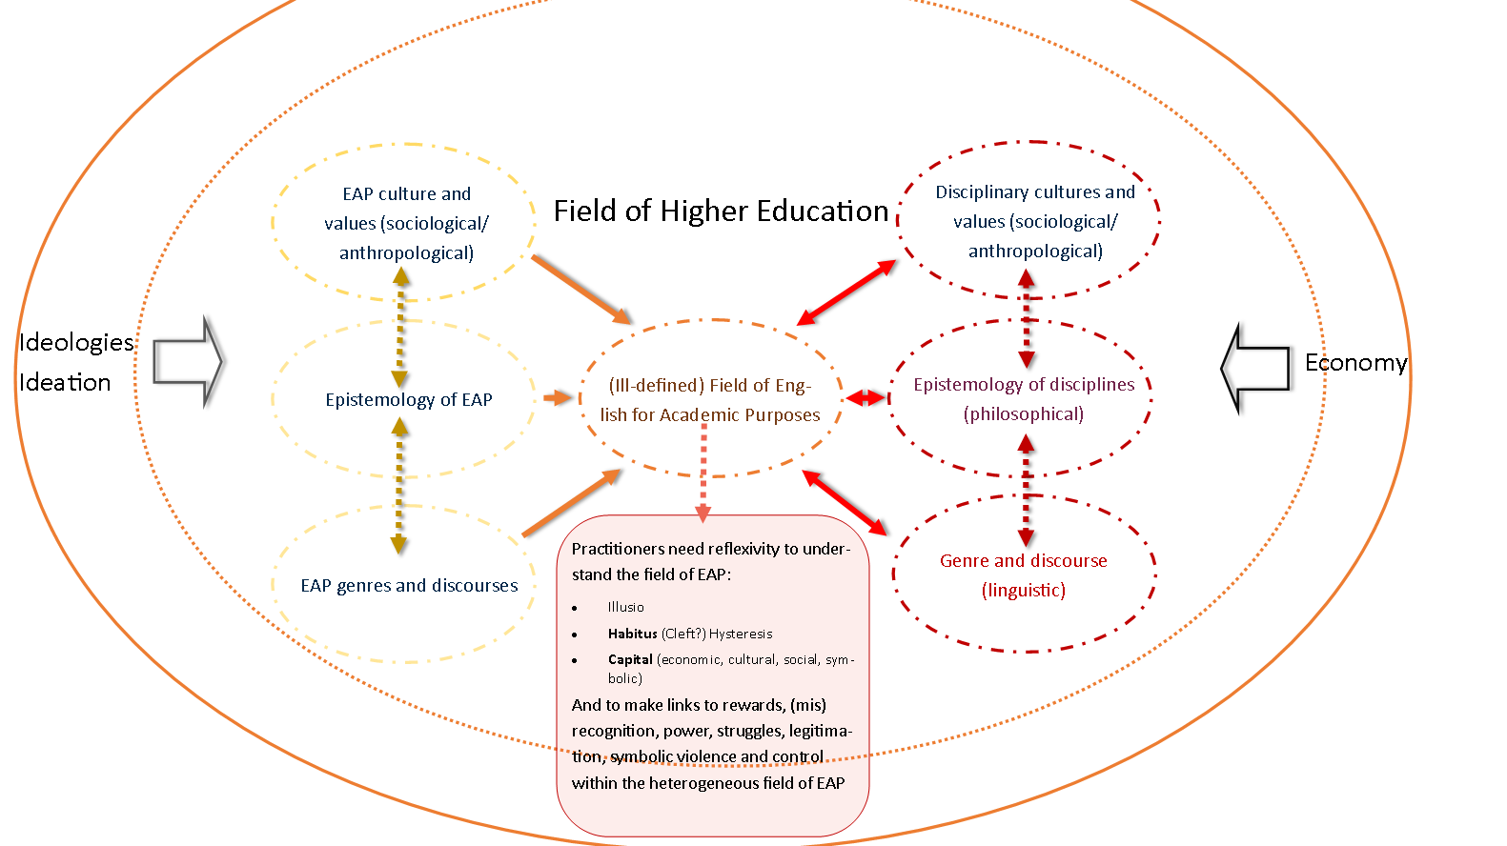

Slide 6
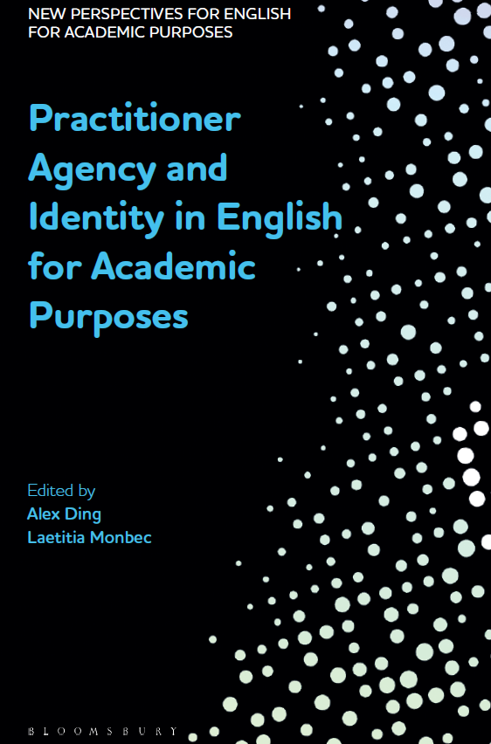

Work in progress
Monbec, L and A. Ding (forthcoming), Reconfiguring Language in Higher Education - Social Justice, Ethics and Practices, Palgrave Macmillan.

Slide 7
EAP as an ill-defined field
Because these posts ill-defined and ill-guaranteed but open and ‘full of potential’ as the phrase goes, leave their occupants the possibility of defining them by bringing the embodied necessity which is constitutive of their habitus, their future depends on what is made of them by their occupants, or at least those of them who, in the struggles with the ‘profession’ and in confrontations with neighbouring and rival professions, manage to impose the definition of the profession most favourable to what they are.
Bourdieu, 2000: 158.

Slide 8
Research questions
1. What are the historical, social and cultural determinants which have traditionally been valued, and have shaped different positioning in the field? What is the narrative of origin about EAP practitioners?
2. What types, volume and configuration of capital characterise EAP practitioners?
3. How do practitioners perceive and understand their positions in the field?

Slide 9
Methodology: operationalising Bourdieu with CDA-SFL
Combination of analytical approaches: Field theory and Critical Discourse Analysis (Systemic Functional Linguistics).
Bourdieu’s perspective on language as social action presents similarities with SFL: language is key to the symbolic representation of the social world, a main mediator in social reproduction.
  “the whole social structure is present in each interaction (and thereby in the discourse uttered)’ (Bourdieu, 1991:67).
SFL Linguistics analysis: Transitivity (Bartlett, 2014; Lukin, 2019); Appraisal (Martin and White, 2005); Social Actor Theory (Van Leeuwen, 2008) on representation and erasure
Data:
Publicly available texts constructing the EAP practitioner identity, specifically important actors at the beginning of their careers (‘luminaries’) on various websites such as BALEAP, platforms such as uefap.net, and in various publications such as blogs, obituaries, theses.
Questionnaire: 47 responses, 27 women, 17 men, and 1 non-binary

Slide 10
Illusio
Agents: epistemic agents and institutions
Knowledge:
What we teach
What influences us
Pedagogy:
Critical/Subversive/Pragmatic

Slide 11
The high priests, the missionaries and the diplomats
The narratives of origin: These stories constitute the field’s heritage, frame our understanding. Bourdieu (1990) explains how our habitus is shaped by a collective memory which reproduces itself through the ways social actors are represented.
Representation of the practitioner in the early days of the field provides an insight into the basis of legitimation of agents, purposes, and values in EAP.
Data: Publicly available texts, interviews, obituaries, auto-biographical texts, theses...
3 main narratives of legitimation
Notes:
Not looking at the intellectual development of the field: Dudley-Evans and St-John (1998), Jordan (1997), Hyland and Hamp-Lyons (2002)

Slide 12
1st Narrative of legitimation: practitioner’s mobility
Circumstance of place and time (Bartlett, 2014) and the ‘expansionist rhetoric’ (Pennycook, 2002)
Agents' names are consistently followed by an inventory of countries: Emirates, Hong Kong, Jordan, Kuwait, Libya, Saudi, Singapore, Sri Lanka, Venezuela…
Economic and cultural motif: "Petroleum companies", “British telecom”, "BP", "Shell", references to “the Royal Family”, “the year of the Queen’s Silver Jubilee”, “the Centre for British Teachers”, “VSO” “coincidental careers”, and quaint lexis such as “cutting your teeth”, “[name's] Libyan period”, “3-year posting to the University of Kuwait”
The British Empire is no more, but the empire of its language flourishes. This is in part because of the efforts of itinerant teachers in far-flung corners of what used to be called British spheres of interest. Enduring coups and odd customs, enjoying unexpected delights, two veterans of this life provide intimate recollections of what it was like to ply their profession during the decades of change between 1960 and 1990.
Abbott and Jordan (2001), English all over the place
Paul Theroux
Bill Bryson
David Crystal
(Pennycook, 2002)

Slide 13
2nd Narrative of legitimation: expertise and agency
Agents are represented through ‘activation’ as powerful, agentive, dynamic experts (van Leeuwen, 2008). Transitivity: process types and active/passive voice (Bartlett, 2014), nominalisation (Lukin, 2019).
EAP practitioners are active agents in most clauses and act on the local educational world through material processes: They set up centres and programmes, they build educational initiatives, they consult on government educational plans, They ‘advised on’ ‘worked with the education authorities to develop’, ‘led on … projects’.
When not active agents, they are a willing passive agent of a powerful institutional agent, as in: “I was posted in … by the British Council’, “further British Council postings” or their missions are aligned with the broader linguistic expansion (as in Abbott and Jordan)
This evokes a world where white English-speaking academics make use of their epistemic, cultural, racial (also gender) capital to develop the ‘less fortunate’, the ‘linguistically deprived’ and embody “the onward march of the English language’ (Pennycook, 2002:136).

Slide 14
In Bourdieu’s words
The grip of strongly integrated groups […] is to a large extent due to the fact that they are linked by a collusio in the illusio, a deep-rooted complicity in the collective fantasy, which provides each of its members with the experience of an exaltation of the ego, the principle of a solidarity rooted in attachment to the group as an enchanted image of the self. It is indeed this socially constructed feeling of being a ‘superior essence’ which, together with the solidarities of interests and the affinities of habitus, does most to engender and support what must indeed be called an ‘esprit de corps’ – however strange the expression may seem when applied to a set of individuals persuaded of their prefect non-substitutability.
Bourdieu, 2008:7.

Slide 15
3rd Narrative of legitimation: Erasing local actors and knowledge
Discursive strategy: Erasure is shown by a complete absence of linguistic traces - a void or suppression (Stibbe, 2020; Venkataraman 2018; van Leeuwen, 2008).
Rare but deficit representation: the need for foreign experts because of a lack of local ones.
No mention of local knowledge, expertise, scholars, practices…
The erasure of local agents:
  how they can be envisaged and envisage themselves
  agency to define issues
  ability to be heard
Perceived differently by practitioners originating from the countries themselves

Slide 16
A basis of legitimacy that is difficult to shake off
Narratives are shifting: professionalization, scholarship, inclusivity, diversity, equity, anti-racism, decolonization, translanguaging and multilingualism
Anti-hegemonic discourses: Native-speakerism and linguistic imperialism (Ndebele, 1987; Phillipson, 1986, 1988, 1992; Pennycook, 1994; Braine, 1999; Canagarajah, 1999; Kirkpatrick, 2002 and many others in TESOL and Applied Linguistics; Benesch, 2001, in EAP)
BALEAP mailing list: “outside the UK we are very likely to find ’English’ teachers who are unqualified or poorly qualified: they may be qualified as teachers, but not of English; they may have a degree in English, but no teacher training/educ coursework.’ (Ding, Bond and Bruce, 2022:8).
Jobs in 'faraway' countries constructed as a 'non-ideal' but necessary notch on one's professional trajectory belt.
Global North experts in leadership positions, or representing 'expertise'

Slide 17
Representation is key
It is essential to pay attention to the ways local actors and knowledge are represented in discourse, and to notice (and call out) when they remain occluded or inconsequential, mere props in a practitioner’s negotiation of their own position in the field.
[…]The way participants are construed, erased, positioned as agentive or passive actors, is partly how dominance in the material world is perpetuated and so […] close attention to and deliberate use of language is a way, if not to transform the world, at least to lift the illusio.
Ding and Monbec (forthcoming)

Slide 18
Illusio
Agents: epistemic agents and institutions
Knowledge:
What we teach
What influences us
Pedagogy:
Critical/Subversive/Pragmatic

Slide 19
Impact on the EAP knowledge-base
cultural constructs of colonialism shape common myths in ELT: English is simple, superior for thinking. (Pennycook, 2002)
The monolingual fallacy, or no L1 in rhe English classroom (Tupas and Renandya, 2021; Reynanda et al. 2023).
The critical period hypothesis for a ‘native-like’ accent is anchored in ‘nativeness’ ideology and has supported the ‘young learner’ industry in ELT.
Lack of clarity around language ontology.
This, working hand in hand with the erasure of local knowledge and agents, can be seen as having legitimized and empowered thousands of monolingual anglophone teachers around the world.
The zombie-like persistence (even sadly when well-meaning) of the portrayal of multi/bilingual teachers of EAP as lacking, deficient, struggling and agentless. Claim to moral capital?
Imagination around the curriculum's breadth and depth is impacted

Slide 20
The minor prophets and the heretics
Survey of practitioners: capitals, influence, values, ethics...
Legitimate capitals: professional experience, qualifications, scholarship, multilingualism
Influences: practitioner scholarship is cited beyond the high priests: Swales, Hyland, Bruce, Ding, Halliday, Kirk, Street, Alexander, Lillis, Lea, Bond, Benesch…Evans, Cowley-Haselden, Monbec, Walková - Compare with Hyland and Jiang (2020)
  "any EAP teacher reaches their point of saturation with articles on lexical bundles and starts disengage with the endless papers on minute elements of academic writing".
Ethical concerns: calls for more diverse representation, more ethics in scholarship, in employment conditions, better treatment of (international) students.

Slide 21
Problematic dichotomies: scholarship vs teaching skills; knowledge of language, language ontology, assumptions around pragmatism (pragmatic vs critical)
A homogeneous (fairly heterodox) on what EAP practitioners contribute (academic genres, conventions, 'ways to think', 'critical thinking'…)
Influences are mostly limited to the global North and mostly white: with the exceptions of Suresh Canagarajah at the 19th place, bell hooks (35^{th)}, and Ruqaiya Hasan (101st). In Singapore, the top influences were: Hyland, Swales, Halliday, Canagarajah, and (Michelle) Lazar.
Ethics are for others to practise..
To be continued....

Slide 22
From collective amnesia to collective anamnesis
Anamnesis in the field offers practitioners the first steps to a rupture with the unsaid, the unthought thought, the implicit, the doxas that permeate the field and then to trigger resistance to domination, orthodoxy, and injustices. And in doing so we have:
a small chance of knowing what game we play and of minimizing the ways in which we are manipulated by the forces of the field in which we evolve …[Sociology] allows us to discern the sites where we do indeed enjoy a degree of freedom and those where we do not.
Bourdieu and Wacquant 1992: 198–9.

Slide 23
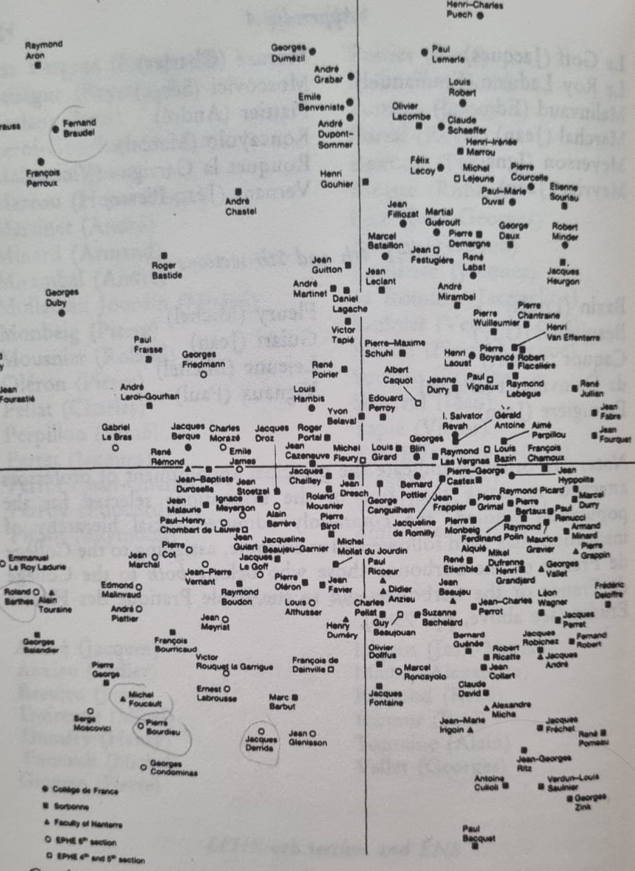
Bourdieu (1988:276)

Slide 24
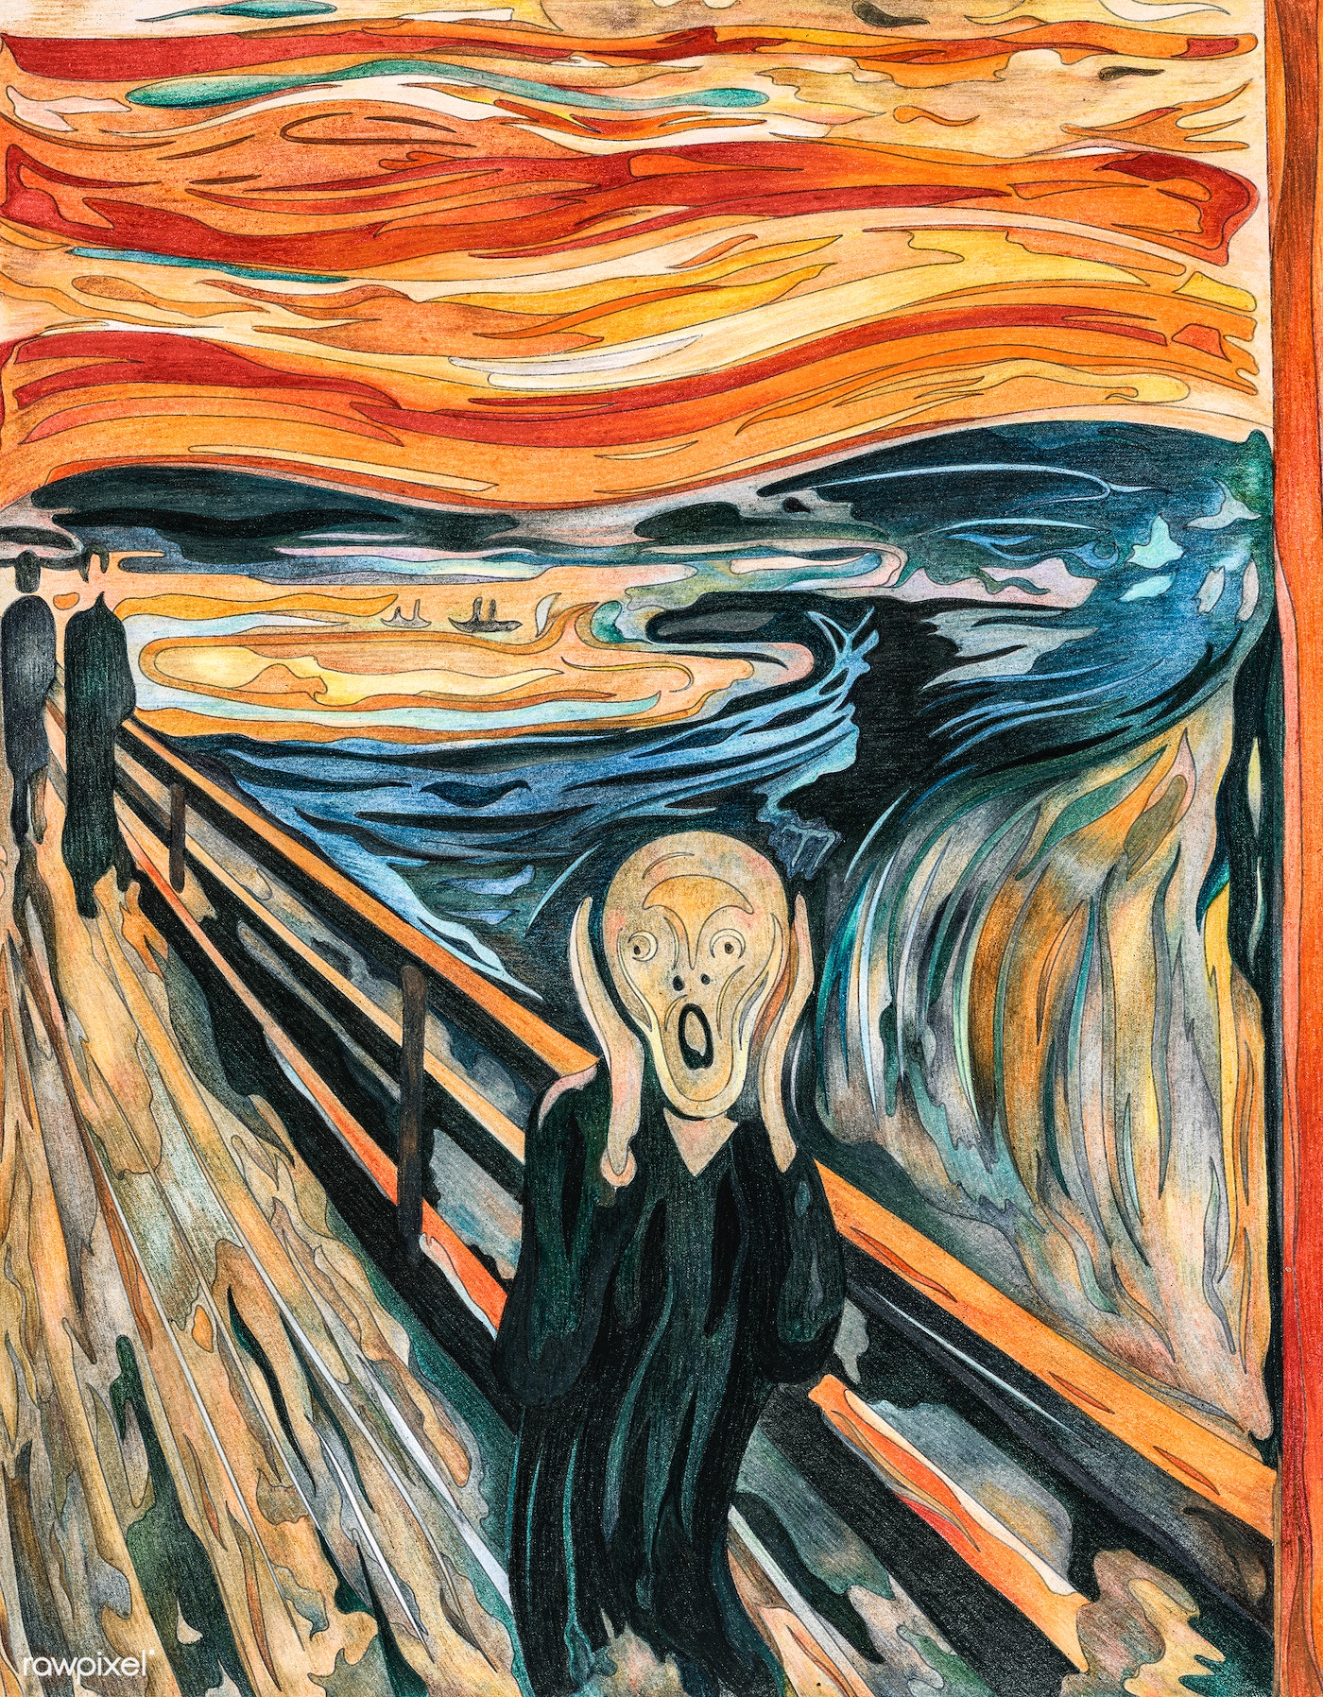


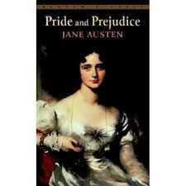

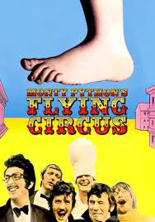
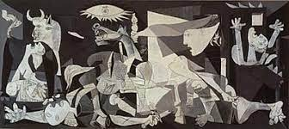
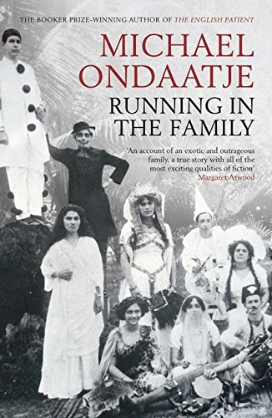

What would EAP be ...
"The Penguin Book of Short Stories - a wide range of forms, structures, characters and interesting sketches which are valuable in themselves but perhaps do not quite add up to a completely coherent 'whole', somewhat culture-bound and which most universities have on their shelves but rarely, if ever, bother to read."

Slide 25
References
Abbott, G. and B. Jordan (2001), English All Over the Place: Experiences While Teaching Abroad, London: Starhaven.
Bartlett, T. (2014), Analysing Power in Language: A Practical Guide, London: Routledge.
Benesch, S. (2001), Critical English for Academic Purposes: Theory, Politics, and Practice, Mahwah, NJ: Lawrence Erlbaum Associates Inc.
Bourdieu, P. (1988), Homo Academicus, Cambridge: Polity Press
Bourdieu, P. (1991), Language and Symbolic Power, Cambridge, MA: Harvard University Press.
Bourdieu, P. (1990), The Logic of Practice, Cambridge: Polity Press.
Bourdieu, P. (2007), Sketch for a Self-analysis, Cambridge: Polity Press.
Braine, G. (1999), Non-native Educators in English Language Teaching. Mahwah, NJ: Lawrence Erlbaum Associates.
Canagarajah, A. S. (1999), Resisting Linguistic Imperialism in English Teaching, Oxford, UK: Oxford University Press.
Ding, A., B. Bond and I. Bruce (2022), ‘“Clearly you have nothing better to do with your time than this”: A Critical Historical Exploration of Contributions to the BALEAP Discussion List’, Journal of English for Academic Purposes, 58: 101109.
Hyland, K. and F. K. Jiang (2020), ‘A Bibliometric Study of EAP Research: Who Is Doing What, Where and When?’, Journal of English for Academic Purposes, 49. DOI: https:// doi.org/10.1016/j.jeap.2020.100929
.Lukin, A. (2019), War and its Ideologies, Singapore: Springer.Pennycook, A. (2002), English and the Discourses of Colonialism, London: Routledge.
Kirkpatrick, A. (2002), Englishes in Asia: Communication, Identity, Power and Education. Language Australia Ltd, Melbourne, Australia. Retrieved from http://languageaustralia.com.au/ 2002.
Ndebele, N. S. (1987), ‘The English Language and Social Change in South Africa’, The English Academy Review, 4 (1):1-16.
Pennycook, A. (2002), English and the Discourses of Colonialism, London: Routledge.
Pennycook, A. (1994), The Cultural Politics of English as an International Language, London and New York: Longman.
Pennycook, A. (2021), Critical Applied Linguistics: A Critical Introduction, London: Routledge.

Slide 26
Phillipson, R. (1986), ‘English Rules: A Study of Language Pedagogy and Imperialism’ In R. Phillipson and T. Skutnabb-Kangas (eds) Linguicism Rules in Education, 124-343, Denmark: Roskilde University Centre.
Phillipson, R. (1988), ‘Linguicism: Structures and ideologies in linguistic imperialism’, In J. Cummins and T. Skutnabb-Kangas (eds), Minority Education: From Shame to Struggle, 339-358, Avon: Multilingual Matters.
Phillipson, R. (1992), Linguistic Imperialism, Oxford, UK: Oxford University Press.
Renandya, W. A., T. T., M. Nguyen and G. M. Jacobs (2023), ‘Learning to Unlearn Faulty Beliefs and Practices in English Language Teaching’, Studies in English Language and Education, 10 (1): 1-15. doi: 10.24815/siele.v10i1.26009.
Stibbe, A. (2020), Ecolinguistics: Language, Ecology and The Stories We Live By, Abingdon: Routledge.
Tupas, R. and W. A. Renandya (2021), ‘Unequal Englishes: Re-envisioning the Teaching of English in Linguistically Diverse Classrooms’, In B. Spolsky and H. Lee (eds), Localizing Global English: Asian Perspectives and Practices, 47-62, Abingdon: Routledge.
Van Leeuwen, T. (2008), Discourse and Practice: New Tools for Critical Discourse Analysis. Oxford: Oxford University Press.
Venkataraman, N. (2018), ‘What’s not in a Frame? Analysis of Media Representations of the Environmental Refugee, In M. Schröter and C. Taylor (eds), Exploring Silence and Absence in Discourse: Empirical Approaches, 241-279, London: Palgrave Macmillan.

