Slide 1
Turn and Face the Strange
From EAP Tutor to Intercultural Trainer
Heather McClean
Queen Mary University of London

Slide 2
Biography
Education & Recognition Adviser at Queen Mary University of London (January 2023-present)
Head of EAP Programmes at University for the Creative Arts (June 2019-November 2022)
25+ years’ experience teaching EFL and EAP
https://www.linkedin.com/in/heathermcclean/
https://www.qmul.ac.uk/queenmaryacademy/about/meet-the-team/profiles/heather-mcclean.html

Slide 3
Session Aims & Outline
Introduce research into academics’ intercultural competence and their ability to scaffold knowledge effectively for international students
Examine the effectiveness of four EAP-led initiatives designed to address identified knowledge and skills gap among academic staff
Discuss rationale for EAP-led initiatives
Make recommendations for future developments

Slide 4
Context
Research conducted at University for the Creative Arts (UCA) in 2020 as part of the Internationalisation of Curriculum action plan
Clear knowledge gap among staff (especially regarding language levels and the need for grading/scaffolding language)
Informally identified through: sitting in on taught sessions; reading assessment briefs; conversations with lecturers regarding students’ language ability; regular requests for a Chinese interpreter
Research aim: to investigate (a) academics’ intercultural competence; (b) their ability to convey knowledge effectively to international students; and (c) to see whether there was a correlation between the two

Slide 5
How does cultural intelligence correlate to academics’ teaching strategies?
Quantitative Data: questionnaires distributed to academic staff – 50 returned (60% subject lecturers; 40% EAP tutors)
Qualitative Data: in-depth interviews with 10 academic staff (subject lecturers and EAP tutors)

Slide 6
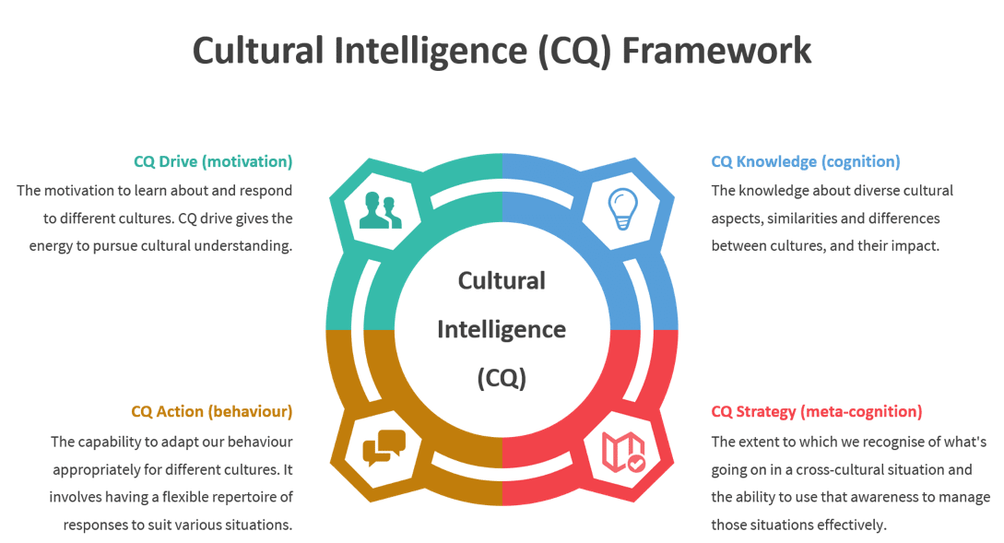
Livermore, 2011
Image from https://betterboards.net/

Slide 7
Research Findings
95% of participants had average (55%) or high (40%) cultural awareness
BUT
Only 30% displayed high competencies in all four CQ elements
  Commonalities: worked overseas; speak a second language; 4+ years’ experience teaching international students
AND
  20% of participants unable to give any examples of adjusting teaching approach
  Commonalities: monolingual; less confident in multilingual contexts

Slide 8


RESEARCH FINDINGS: EAP TUTORS’ & SUBJECT LECTURERS’ SCAFFOLDING STRATEGIES
EAP Tutors
use of discourse strategies
academic vocabulary development
metacognitive strategies
Subject Lecturers
providing supportive materials (multimedia &
semiotics)
drawing on prior knowledge
Mahan (2020)

Slide 9
Research Conclusions
High CQ Drive and Knowledge does not necessarily equate to high CQ Strategy and Action
Learning another language has a positive impact on CQ Strategy and CQ Action
Need for knowledge exchange and collaboration between language and the disciplines
Need for staff development and support to develop best practice in teaching in an internationalised university
Yu, C. and McClean, H. (2022) ‘International Student Success in the UK: scaffolding curriculum strategies and cultural intelligence.’ Chapter in: International Environments and Practices of Higher Education. Bingley: Emerald Publishing.

Slide 10
Literature Review
1. Attitudes towards international students:
  Fallon and Brown (1999)
2. Need for Professional Development for Academics in Internationalised Universities
  Washburn and Hargis (2017)
  Jin and Schneider (2019)
3. Strategies for Teaching International Students – intercultural competence and linguistic adjustments
  Crose (2011)
  Gopal (2011)
  Haan, Gallagher and Varandani (2017) “linguistically-responsive instruction”
4. Scaffolding for International Students
Mahan (2020)
5. Taking a Transcultural Approach
Ryan (2011)

Slide 11
Rationale for EAP-LED approach
Work across a wide range of courses, so see first-hand how some international students struggle to cope with dense academic texts, academic lectures, or even understanding module handbooks and assessment requirements
Solid theoretical knowledge of language levels and competencies
Highly experienced at communicating with students from all linguistic backgrounds and abilities
Wide-ranging experience of working in language schools with rolling intake – therefore highly skilled at creating good group dynamics

Slide 12
EAP-Led Initiatives to support academics
Staff development workshops:
  Communicating across Cultures (also for professional services staff)
  Teaching Students from Diverse Backgrounds: Scaffolding Strategies
  Teaching Students from Diverse Backgrounds: Group Dynamics
Co-teaching/co-creating workshops (EAP & subject lecturers)
EAP/subject lecturer peer observation scheme
Offering assessment brief readability/review service

Slide 13
1. Staff Development Workshops
  Communicating across Cultures (also for professional services staff)
  how culture affects communication; strategies to improve spoken and written communication
  Teaching Students from Diverse Backgrounds: Scaffolding Strategies
  why scaffolding is necessary and how to scaffold learning
  Teaching Students from Diverse Backgrounds: Group Dynamics
  how to build good group dynamics in a multilingual classroom

Slide 14
Staff Development Workshops: Evaluation
Workshops ran via L&D team at 6-week intervals
Demand was overwhelming: Communicating Across Cultures most popular workshop L&D had run
194 staff attended between January and October 2022 with the majority (75%) attending Communicating Across Cultures
Feedback from participants was 100% positive (post-workshop feedback forms & anecdotal feedback)
Promotional materials need to show clear distinction between workshops so staff don’t assume they all have similar content

Slide 15
Staff Development Workshops: Evaluation
Sample Quotes:
“It really helped me to re-evaluate my own communication.”
“I liked the practical suggestions of what to do with regards activities in the classroom that will either give good scaffolding or will check learning.”
“We got lots of practical tips that I can put into action, as well as things for me to consider in the longer term.”
“This should be a compulsory part of new staff induction.”
“There were lots of practical tips of things to do with students to get them to mix.”
“My teaching has changed because of these workshops!”

Slide 16
2. Co-Teaching/Co-creating with Lecturers
September 2021 – September 2022 five sessions co-created
How to be a Student: an introduction to UK academic life (a 3-part workshop)
Engaging with Art Crits: giving constructive feedback*
Avoiding Plagiarism with Turnitin (a 2-part workshop)*
Engaging with the Reading List
Intercultural Group Work*
*also co-taught

Slide 17
Co-Teaching/Co-Creation: Evaluation
Positive feedback from students (anecdotal and post-workshop feedback forms)
Requests from all lecturers for repeat sessions with additional cohorts
Most effective when co-taught, not just co-created
Amount of subject lecturer interaction/input during sessions varied – could be affected by relationship between staff, or confidence of subject lecturer
Need to state roles/responsibilities/expectations clearly at the outset

Slide 18
3. EAP/Subject Lecturer Peer Observation Scheme
  EAP Tutors
  many opportunities for regular informal observations of subject lecturers, esp. if studio-based
  Subject lecturers
  Many on sessional contracts – therefore many time/resource constraints
  Peer observations conducted by those who were already very engaged
  Reflections
  Subject lecturers need to see value of peer observation outside their discipline – understand they are observing teaching practice
  Need guided support in place – a guide for observers – what should I look for?
  Provide questions to encourage self-reflection, e.g. How did the tutor check understanding? What did they do to encourage engagement?

Slide 19
4. Assessment brief readability/Review Service
Completed review and edit of assessment briefs and programme specifications for 12 new BA programmes in July 2021

Slide 20
Assessment brief readability/Review : evaluation
Extremely labour-intensive!
Increased visibility with PD and Senior Leadership Team
Fix-it approach – not developmental for subject lecturers
Writing Accessible Assessment Briefs workshop – more impactful

Slide 21
Measuring Impact Of Initiatives
Short-term:
Have the staff said they found it helpful?
Medium-term:
Has teaching changed?
Longer-term:
Have changes been sustained?

Slide 22
Next Steps
Offer bespoke staff development workshops for Schools/Departments
Leading specialist sessions on PGCHE (e.g. teaching in the internationalised classroom)
Becoming an HEA Fellow and a mentor for the Fellowship Scheme

Slide 23
Conditions for success
A supportive line manager
Experienced EAP team
Strong links with academic staff/ PDs/Departments who can champion initiatives in their Schools
Representation on internal boards/committees/working groups
Cultural capital (Ding, 2019) within the institution

Slide 24
References
Bond, B., 2020. Making language visible in the university: English for academic purposes and internationalisation. Multilingual Matters.
Crose, B., 2011. Internationalization of the higher education classroom: Strategies to facilitate intercultural learning and academic success. International Journal of Teaching and Learning in Higher Education, 23(3), pp.388-395.
Ding, A., 2019. EAP practitioner identity. In Specialised English. pp. 63-76 Routledge.
Fallon, G. and Brown, R.B. , 1999. What About the Workers? Academic staff opinions about working with non‐UK postgraduate students in higher education. Journal of Further and Higher Education, 23 (1), pp 41-52.
Gallagher, C., Haan, J. and Lovett, S., 2020. Faculty and international student perceptions of language performance and instructional support: A mismatch of expectations. TESOL Journal, 11(1).
Gopal, A., 2011. Internationalization of higher education: Preparing faculty to teach cross-culturally. International Journal of Teaching and Learning in Higher Education, 23(3), pp.373-381.
Haan, J.E., Gallagher, C.E. and Varandani, L., 2017. Working with linguistically diverse classes across the disciplines: Faculty beliefs. Journal of the Scholarship of Teaching and Learning, 17(1), pp.37-51.
Jin, L. and Schneider, J., 2019. Faculty views on international students: A survey study. Journal of International Students, 9(1), pp.84-99.

Slide 25
References
Livermore, D., 2011. The Cultural Intelligence Difference: Master the One Skill You Can’t Do without in Today’s Global Economy. Amacom.
Mahan, K.R., 2022. The comprehending teacher: Scaffolding in content and language integrated learning (CLIL). The Language Learning Journal, 50(1), pp.74-88.
Murray, N. and McConachy, T., 2018. “Participation” in the internationalized higher education classroom: An academic staff perspective. Journal of International and Intercultural Communication, 11 (3), pp 254-270.
Ryan, J., 2011. Teaching and learning for international students: towards a transcultural approach. Teachers and Teaching, 17:6, pp 631-648.
Washburn, C. and Hargis, J., 2017. Changes in faculty practice for international students: A case study. Transformative Dialogues: Teaching and Learning Journal, 10(1).
Yu, C. and McClean, H. 2022. ‘International Student Success in the UK: scaffolding curriculum strategies and cultural intelligence.’ In: International Environments and Practices of Higher Education. pp. 115-127 Emerald Publishing Limited.

Slide 26
Thank you for listening!
h.mcclean@qmul.ac.uk
https://www.linkedin.com/in/heathermcclean/
https://www.qmul.ac.uk/queenmaryacademy/about/meet-the-team/profiles/heather-mcclean.html

