Slide 1
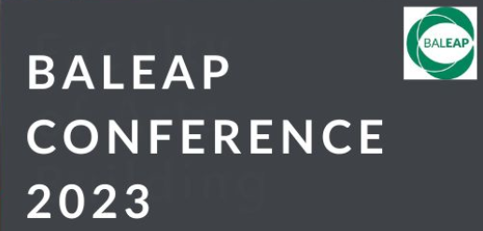
Troubling academic writing in the academy: a conversation about more than writing
#BALEAP2023
with Amanda French and Julia Molinari
Amanda.French@bcu.ac.uk and julia.molinari@open.ac.uk
Notes:
JM: Hello and welcome, thank you for coming to our conversation
JM: for those of you who don't know us, this is Dr Amanda French who currently works at Birmingham City University as a Reader in Education. She has spent most of her working life in FE/HE and Adult education as a teacher and learning developer. In that sense her book is culmination of years of thinking about academic writing.
AF: and this is Dr Julia Molinari who works in the UK at the Open University's Graduate School and department of Languages and Applied Linguistics. Her background is in philosophy, education, applied linguistics and EAP and her book brings together her thinking in all of these areas.
AF: the idea of this conversation was not our own. It was the brain child of Dr Fadia Dakka, a colleague of mine who invited us …

Slide 2
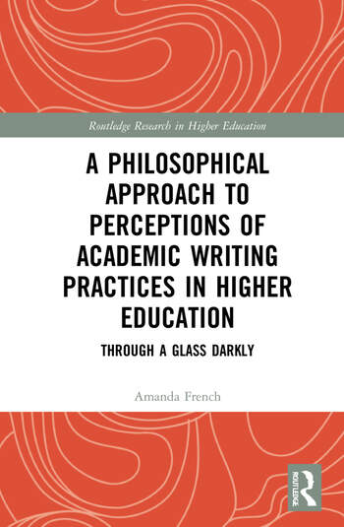
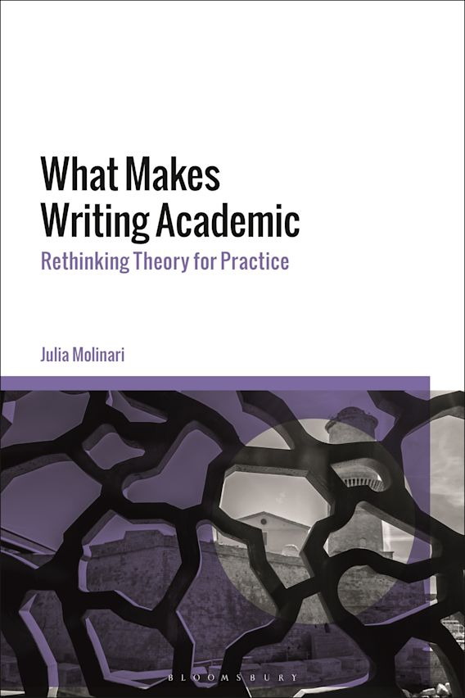
The plan:
overview of our books
a set of provocations
facilitated conversations
where does this leave us?
Notes:
JM: our plan for today is to give …
We would like to leave as much time as possible for actual conversations but before we do that we will each provide an overview of our books, especially for those who have not read them.
(ntm: Timings: 15 mins overview (AF+JM); 5 mins provocations; 25 mins group discussions and padlet; 15 mins to round up)

Slide 3
An overview of our books
Julia Molinari on
What Makes Writing Academic: Rethinking Theory for Practice, Bloomsbury, 2022
Amanda French on
A Philosophical Approach to Perceptions of Academic Writing Practices in Higher Education: Through a Glass Darkly, Routledge, 2022
Notes:
AF: in the next 10 minutes, we will each provide an overview of our 2 books and conclude with some brief remarks about their shared visions. Julia will start and I will follow on from there.

Slide 4
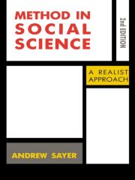
Andrew Sayer in Method in Social Science, 1992: 258
social scientists have paid surprisingly little attention to the fact that their knowledge is invariably presented in the form of text. […].
this underestimates the significance of the fact that academic knowledge takes this textual form, which textual form may have a largely hidden influence on how we re-present knowledge and how it is read.
Notes:
JM: to capture what I think my book is about, I have chosen this quotation by sociologist Andrew Sayer who says that …
Sayer’s words resonate because they signal that writing – ie the multimodal and rhetorical choices that we make - shapes (or influences) knowledge, both in terms of how it is re-presented and in terms of how it is received (or read). Later, Sayer also indicates that in virtue of the power writing has to shape knowledge, it can be thought of as an actual method of enquiry.
In this sense, academic writing becomes more than a finite set of standardised forms or conventions that are transferable to any context and starts instead to look more like a researcher’s companion in the quest to adequately capture the complexities of the social and natural worlds. This way of understanding academic right has consequences for how we write …

Slide 5
Standardised forms require abstracts, introductions, main bodies and conclusions. They are also predominantly monolingual and monomodal. One troubling shortcoming of this kind of standardisation is that it can narrow, distort or flatten epistemic representation. A related shortcoming is that standardisation is exclusionary and this can lead to a range of epistemic losses and gains (p. 3)
Standardisation [of academic writing] based on contingent and outdated norms becomes at best disingenuous and at worst exclusionary because it ignores the diverse identities of writers. Epistemically, it is also self-defeating, since knowledge is best arrived at via multiple representations (p. 37)
Notes:
JM: specifically, I make the following claims quite early on […]
This 1st claim captures the idea that how we choose to represent knowledge necessarily leaves some aspects of reality out whilst privileging, or foregrounding, the inclusion of other aspects. For this reason alone, academic writing can never be objective, despite EAP pedagogy being overwhelmingly premised on the assumption that it can be objective.
This 2nd claim particularly recalls Sayer’s who reminded us that “textual forms may have a largely hidden influence on how we re-present knowledge”. This again indexes the subjective nature of academic writing and allows me to argue throughout the book that knowledge is best-served when we open it to multimodal and multilingual representations.

Slide 6
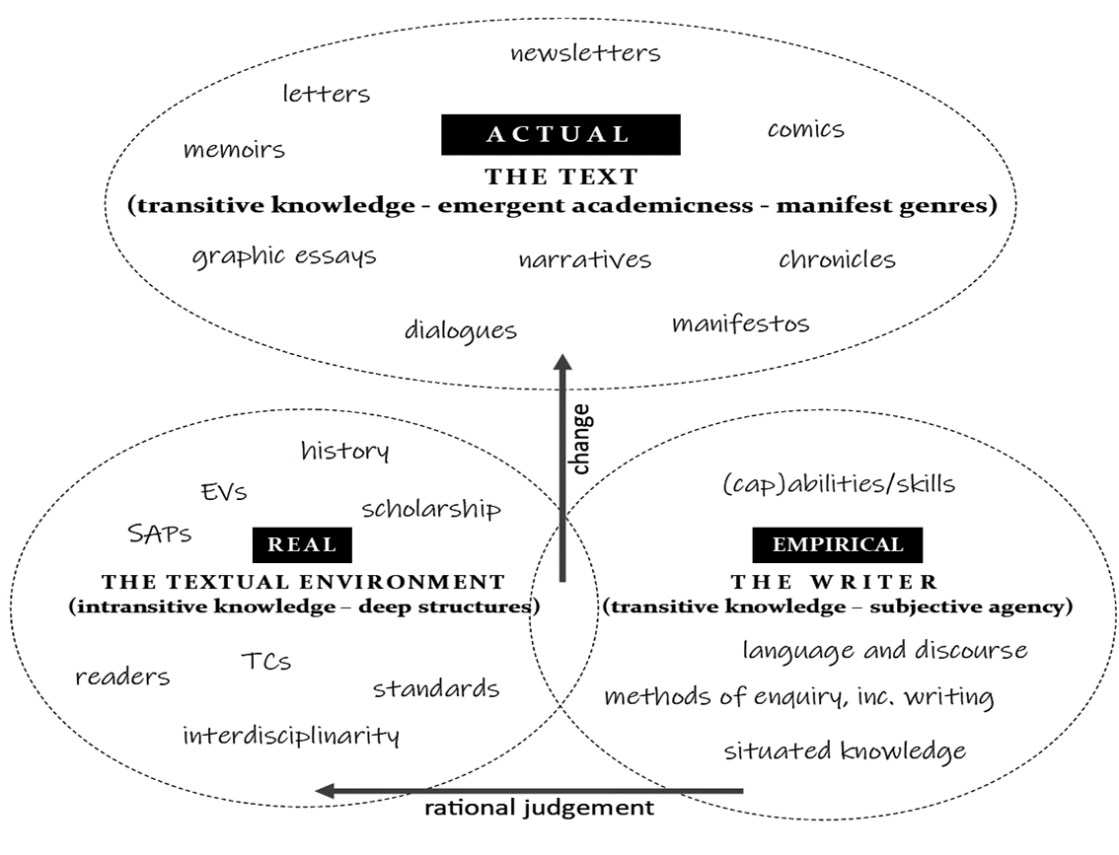
A critical realist conception of academic writing, Molinari, 2022: 105
Notes:
JM: the diagram that appears in chapter 4 captures my critical realist conception of academic writing.
In essence, my claim is that the types of writing we have come across – as students, teachers and researchers - at the subjective EMPIRICAL level are not the only possibilities.
This is because the TEXTUAL ENVIRONMENT is much bigger and much richer than the narrow one EAP has chosen to foreground.
Because the TEXTUAL ENVIRONMENT is so much bigger and richer, the ACTUAL possibilities for the textual representation of knowledge are far greater than we assume them to be.
This was vividly evidenced on Wednesday in Sian Lund and Sarah’s Blair’s session on ‘curiosity and disruption’ where they too asked what is ‘academic’ about a range of texts that included Donna Haraway, Tom Fisher and Maria Puig de la Bellacasa.

Slide 7
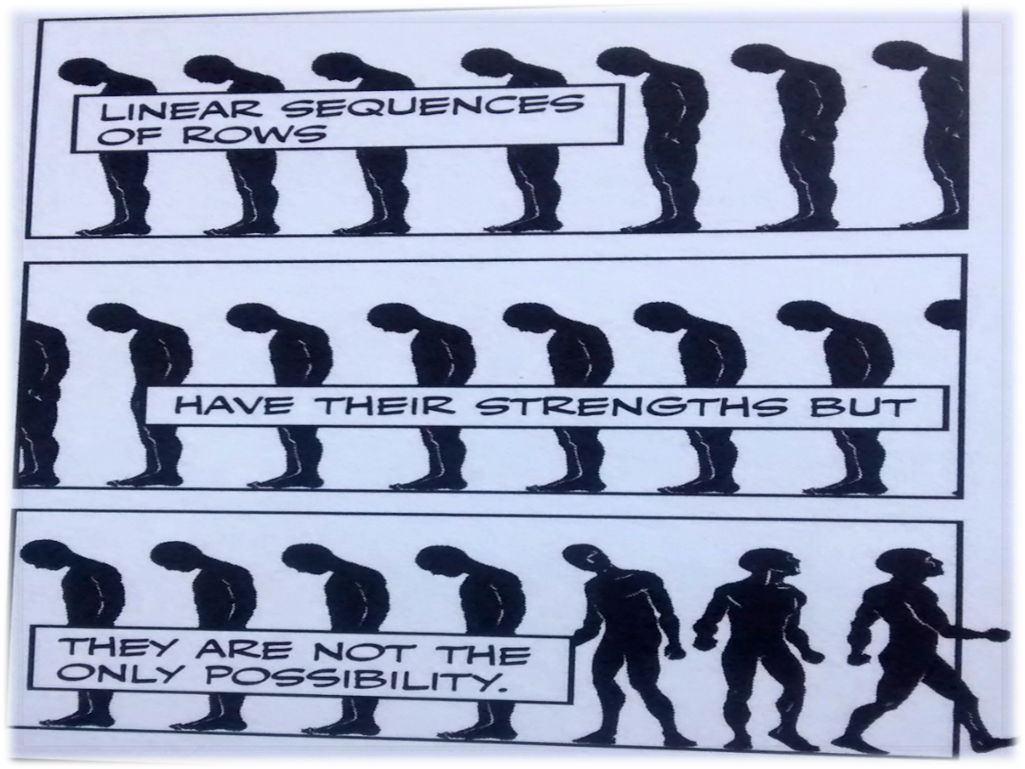
Sousanis (2015, p. 66 © Harvard University Press) in Molinari, 2022: 131
Notes:
JM: In my book, I have argued that what makes writing academic is contested and always emergent, that it’s not the forms of writing that make it academic but what writing does and the practices it affords. This explains why the characterisation of academic writing as ‘linear and objective’ is both reductive and highly selective. And as Rob Playfair might say, does not meet the ‘academic’ needs of students.
There are other possibilities for writing academically.
And on that note, I’ll hand over to Amanda who similarly has issues with narrow and reductive characterisations of academic writing.

Slide 8
Thinking otherwise about academic writing
Traditional conceptualisation of academic writing | Problematised conceptualisation of academic writing
Autonomous | Ideological
Objective | Subjective
Technicist skills set | Social practice
Universal | Situated
Functional | Creative
Performative | Developmental
Fixed | Fluid
Notes:
Abstract notes for mandy's book
The original research underpinning the book looked into lecturer perceptions of academic writing and writing development practices in higher education.
I became very interested in lecturers' complex relationships with academic writing and increasingly vexed by the fact that universities have not traditionally thought critically, politically or philosophically about the nature of academic writing, despite the fact that writing is the principal means through which academia conducts much of its core business, namely knowledge production and transfer.
I wanted increasingly to think generatively about how HE could begin to think about academic writing in radically different ways.

Slide 9
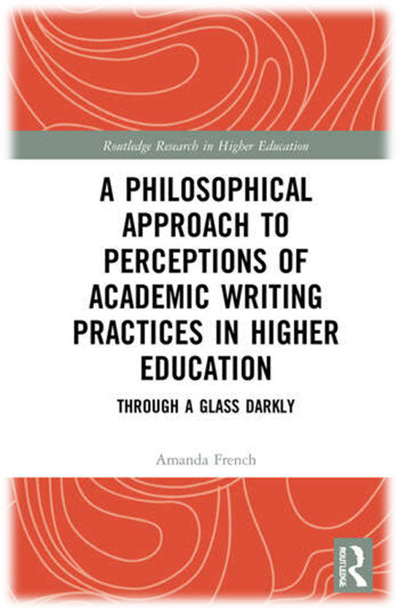
Throughout the book I treat lecturers, academic writing practices and their associated artefacts and events in higher education as part of a generative rhizomic configuration of entangled (Barad, 2007) intra-actions, experiences and discourses, existing within what Donald called the ‘muddle of education’ (1985, p. 242).
…a queered philosophical practice imaginary for academic writing in higher education defines itself in opposition to the dominant, institutional, linear, hierarchical ways that lecturers are currently encouraged to think (or not think) about their own and their students’ academic writing practices and products in higher education.

Slide 10
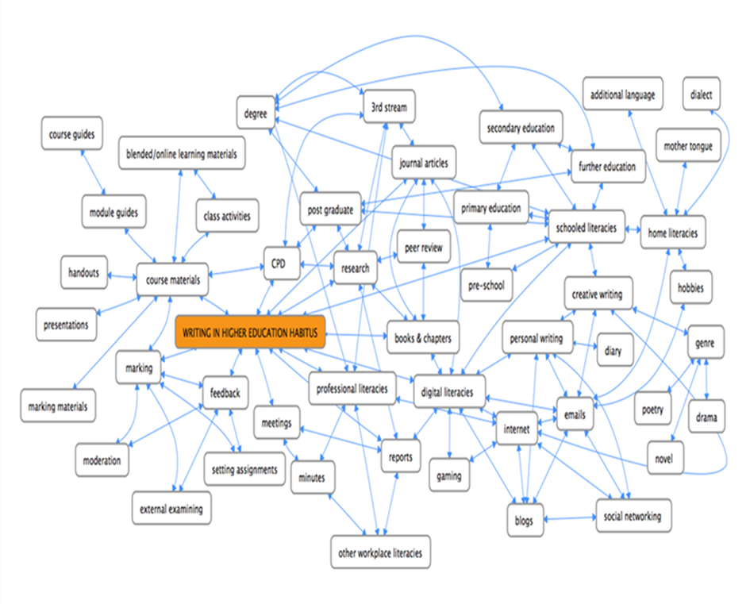

Slide 11
An affirmative politics of difference for academic writing
The diversity that characterizes university students and that universities boast of in their promotional literatures as hallmarks of their inclusive provision rarely manifests itself as diversity in academic writing practices (Molinari, 2022, p.4)
Higher education needs to take seriously forms of academic writing development for lecturers and students in higher education that contribute to debates around diversity, inclusion, equality and belonging. It can do so by linking how academic writing has the capacity to acknowledge different ways of being, different ontologies, experiences and knowledges that reflect diversity and difference in higher education.
The proposed ‘new queered academic writing aesthetic’ is messy, dialogical and critically reflexive, blurring boundaries between conventional/dominant discourses around academic writing artefacts and bodies and entangling them productively in different spaces and settings.
Notes:
AF:
JM: And I would like to briefly comment on why the troubled and troubling notion of ‘diversity’ in academic writing matters. It matters because …
We’ve managed to demote, as well as deride, RP as the gold standard of English pronunciation: why are we not managing to do the same for standardised forms of academic writing?

Slide 12

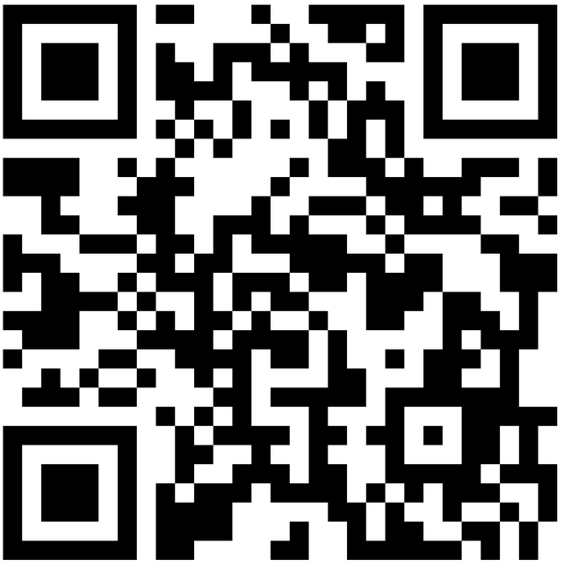
5 provocations
Students will benefit from the idea that academic writing is a troubled and troubling concept
Teachers currently have little agency/incentive/understanding to shape written forms of knowledge
The ‘powers that be’ need educating about what makes writing academic
We’re all colluding by defaulting to the status quo
The machines have been fed on standardised #AcWri
https://ougraduateschool.padlet.org/julia1796/troubling-academic-writing-in-the-academy-a-conversation-abo-pfiyhpw86hs6uubb
Notes:
AF: so, what we’d like to do now is open up the debate that we have started in our books and here with you, now, in this room.
To this end, we’ve put together 5 provocations that reflect issues we have raised in our books.
The Padlet is an anonymous, safe space to try out these ideas so please feels free to record your reactions to these provocations. You can respond from your multiple perspective: as a student, a teacher or researcher as you will all identify with academic writing from a range of perspecties.
After 20-25 minutes we will ask you to speak to what’s there on the padlets and then we can it from there.

Slide 13
Where does this leave us?
Notes:
- Joan Turner on ethics
- Complexity theory
- Scholarship/teacher training as the way to become knowledgeable, confident and sustain change in academic writing practices
- We both critique ‘common sense’ (Mandy) and ‘shallow’ (Julia) approaches to acwri
- We talk about ‘ecologies of literacies’
- Edward Said (which is how I understand Humanism, btw)
- Jan Blommaert
- An interest in theory/philosophy as a method of enquiry
- Ron Barnett
- We recognise the importance of history as a heuristic/method for understanding phenomena
- Focus on practices (vs skills)
- Reference to genre as a ‘straightjacket’
- We also refer to ‘cookie-cutter’ approaches to writing
- We discuss ‘clarity’
- References to Open Access

