Slide 1
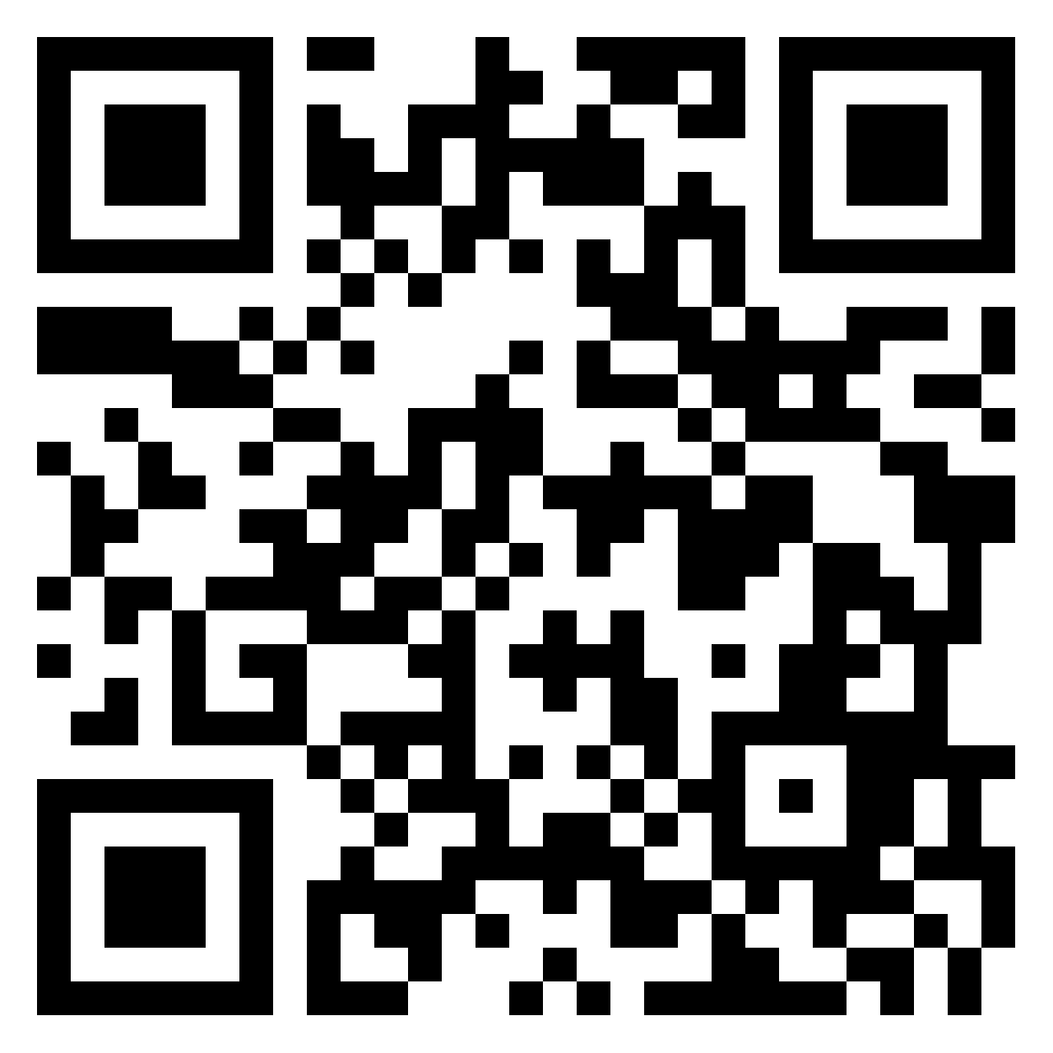

‘Transferring the benefits of community building in teaching EAP online to onsite’.
https://manchester.padlet.org/mewxgmn3/baleap-session-transferring-the-benefits-of-community-buildi-awq2sfmupjy7ym6p
https://www.menti.com code 8604 0433
By Michelle Nixon and Kamil Stobiecki

Slide 2
Abstract
The recent pandemic has had a profound impact on EAP provision. Not unlike other universities, Manchester had to adapt and move courses online in both 2020 and 2021. Although the adaptation was undeniably successful in many ways, it came with certain costs to both students and teachers. This encouraged us to investigate the benefits of community building in teaching EAP online, specifically focusing on strategies that aid learning. We distributed questionnaires and conducted interviews with students, tutors and the course designer of the six-week pre-sessional course. The findings indicate that both students and tutors perceived community building as important and that the strategies that promote developing learners’ social presence (Garrison, Anderson & Archer, 2000) used on the course were seen as effective. Some of these include providing opportunities for students and teachers to get to know each other before the course and develop a sense of community further during the six weeks through completing a range of activities associated with using selected applications and websites.
In 2022, we were able to return to the campus and deliver some of our pre-sessional courses onsite. Fortunately, it did not mean parting with the strategies that proved to be so important in previous years and most of the elements of the course that promote community building remained. While we are still investigating whether the students and tutors perceived them to be as important as those who had studied and taught entirely online, we would like to use the opportunity to lead a discussion on various aspects of course design and delivery among conference attendees. In addition, we would like the participants to share strategies for community building to give us information about the elements of online EAP teaching that are vital in the blended provision of the future. To achieve the above, we will use the key findings of our research as stimuli for discussion, followed by opportunities to share ideas through various applications and live polling.
References:
Garrison, D.R., Anderson, T. and Archer, W. (2000), ‘Critical Inquiry in a Text-Based Environment: Computer Conferencing in Higher Education., The Internet and Higher Education, 2 (2-3), pp. 87-105
Stobiecki, K. and Nixon, M. (2022). ‘The benefits of community building in teaching EAP online’, Life online and beyond (EAP in the North event) University of Manchester 24th November 2021. Available at: https://www.baleap.org/wp-content/uploads/2021/05/EAP-in-the-North-abstracts-with-links-to-papers.pdf (Accessed: 29/09/2022)

Slide 3
Outline
Discussion context
    1.1 Theoretical background
    1.2 The 2021 research context
Selected findings and discussion:
    2.1 The value of getting to know each other
    2.2 The value of sharing personal and study updates
    2.3 The value of developing a sense of community further
    2.4 The value of working in groups
Conclusion and recommendations

Slide 4
1. Discussion context

Slide 5
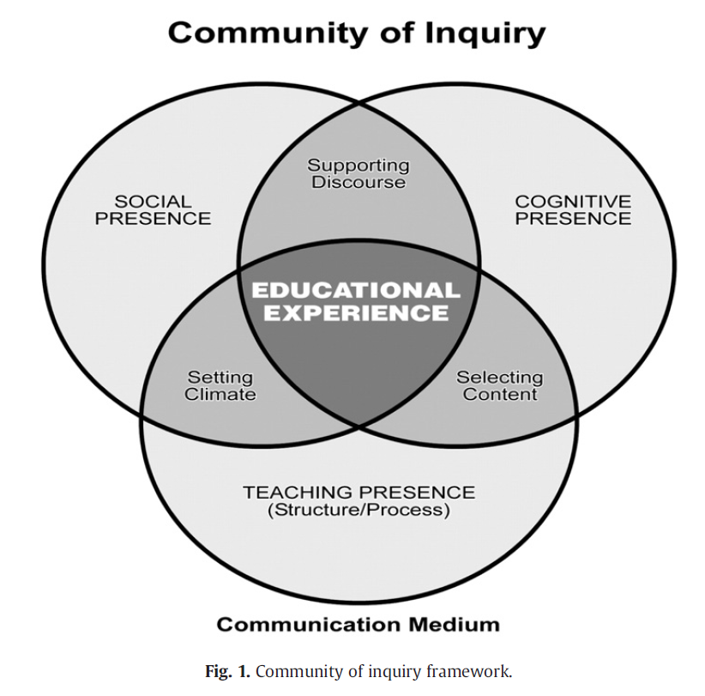
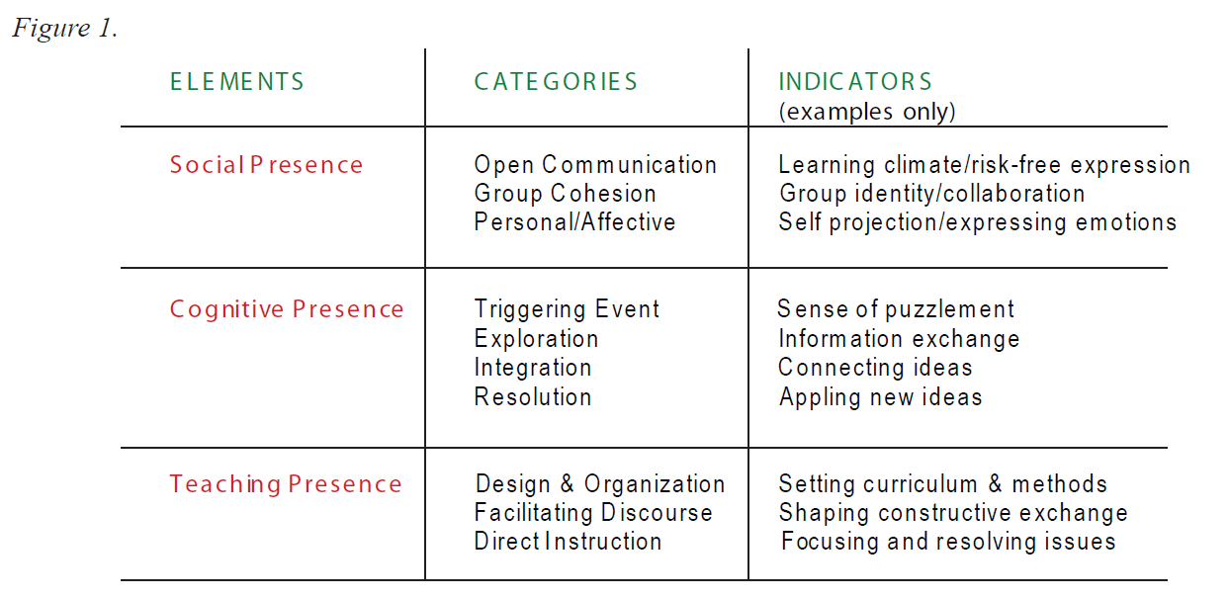
1.1 Theoretical background
(Garrison et al., 2010, p. 6)
(Garrison, 2009, p. 3)

Slide 6
1.1 Theoretical background
‘Classroom community was defined as the connections among students and between students and instructors that lead to increased learning’ (Young and Bruce 2011, p. 220).

Slide 7
1.1 Theoretical background: the benefits
‘A sense of community is central to student engagement and satisfaction.’
(Berry 2019, p. 164)
‘Higher education has consistently viewed community as essential to support collaborative learning and discourse associated with higher levels of learning.’
(Garrison and Arbaugh 2007, p. 158)
‘Student engagement and sense of classroom community are closely related to one another; students who feel a sense of connectedness rather than isolation are very likely better prepared to become more actively involved with course learning, successfully persist, and experience real world success.’
(Young and Bruce 2011, p. 227)

Slide 8
1.1 Theoretical background: The strategies
Berry (2019, p. 164) identifies four strategies for building community online:
reaching out to students often
limiting time spent lecturing
using video and chat as modes to engage students
allowing class time to be used for personal and professional updates
Online community can be improved by:
decreasing the learners’ transactional space
increasing social presence
providing equal opportunity for involvement
designing small group activities
facilitating group discussions
matching teaching style with the learning stage
limiting class size
(Rovai 2002, pp. 7-10)

Slide 9
1.2 The 2021 research context
Six-week pre-sessional online course at the University of Manchester
Synchronous and asynchronous elements

Slide 10
1.2 The 2021 research context: Methods
  Questionnaires distributed to approximately over 500 students with 147 responses
  Questionnaires distributed to 47 tutors with 9 responses
  A small focus group with 2 students
  An interview with one of the course designers

Slide 11
2. Selected findings and discussion
Please join our padlet to access questionnaire links and other resources

Slide 12
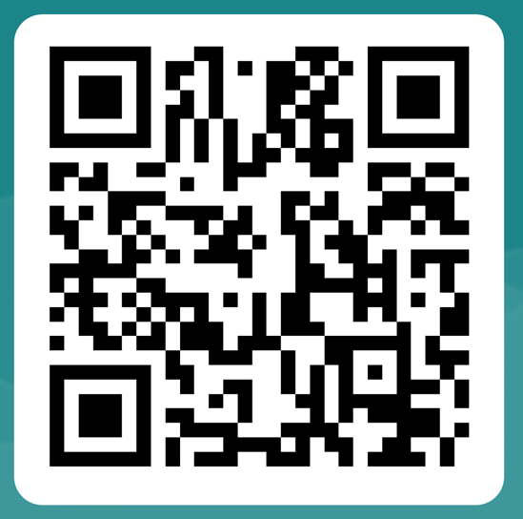
2. 1 The value of getting to know each other
It's easier for students to learn after getting to know their class.
Scan the QR code or click the link in our Padlet to answer this question.
https://forms.office.com/e/i8xwzcg52R

Slide 13
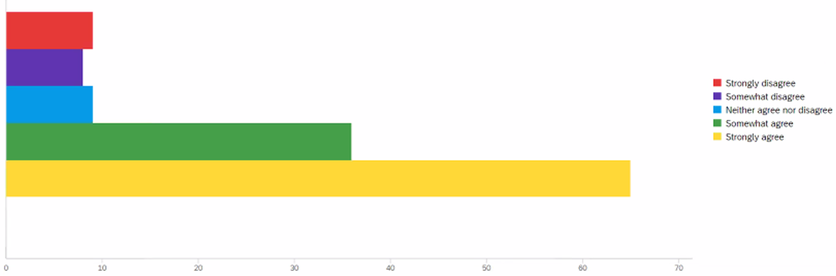
2. 1 The value of getting to know each other: students’ perspective
It's easier for me to learn after getting to know my class.

Slide 14
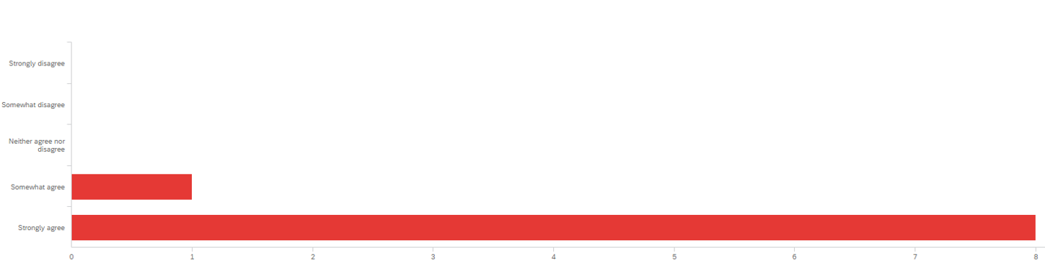
2. 1 The value of getting to know each other: tutors’ perspective
It's easier for my students to learn after getting to know their class.

Slide 15
Group discussion 1
How can a teacher help students to get to know their classmates online and onsite at the start of a course?
Discuss your views in groups (5 mins.)

Slide 16
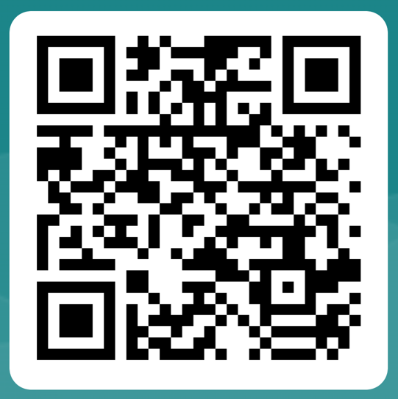
2.2 The value of sharing personal and study updates
It’s important that students are given time to get to know one another and share personal (and study) updates.
Scan the QR code or click the link in our Padlet to answer this question.
https://forms.office.com/e/meXftnN7eF

Slide 17
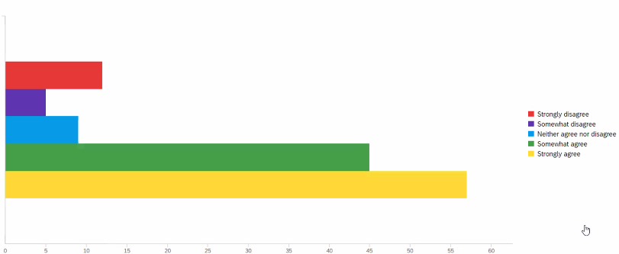
2.2 The value of sharing personal and study updates: students’ perspective
It’s important that our tutor gives us time to get to know one another and share personal (and study) updates.

Slide 18
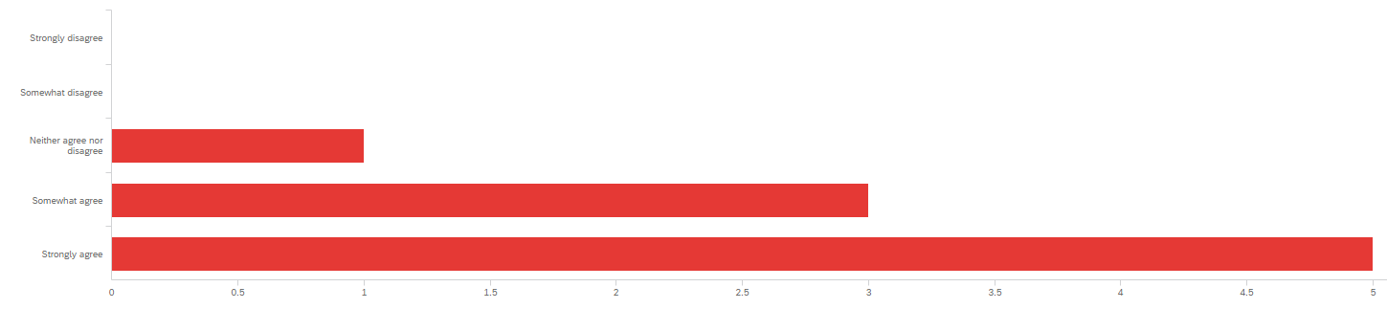
3. The value of sharing personal and study updates: tutors’ perspective
It’s important that I give them time to get to know one another and share personal (and study) updates.

Slide 19
Group discussion 2
How can a teacher help students to share updates with their classmates online and onsite to maintain community?
Discuss your views in groups (5 mins.)

Slide 20
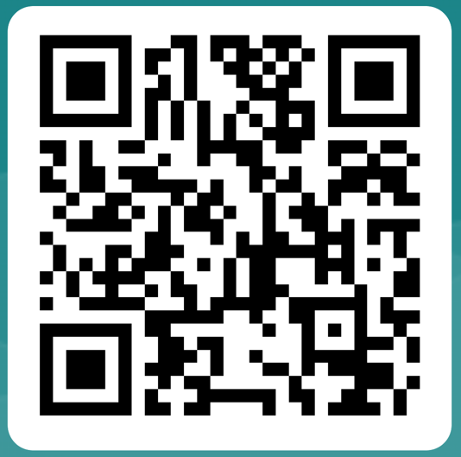
2.3 The value of developing a sense of community further
- I think it’s easier for students to learn in a class that feels connected.
- Good rapport with the tutor and other students is important for course satisfaction.
Scan the QR code or click the link in our Padlet to answer the questions.
https://forms.office.com/e/NVebjywNVk

Slide 21
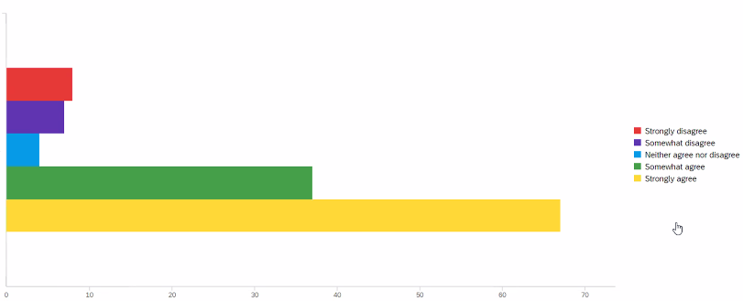
2.3 The value of developing a sense of community further: students’ perspective
I think it’s easier for me to learn in a class that feels connected.

Slide 22
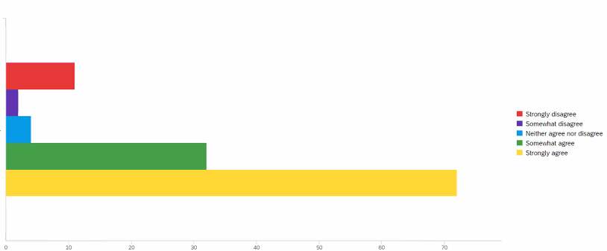
2.3 The value of developing a sense of community further: students’ perspective
Good rapport with the tutor and other students is important for my course satisfaction.

Slide 23
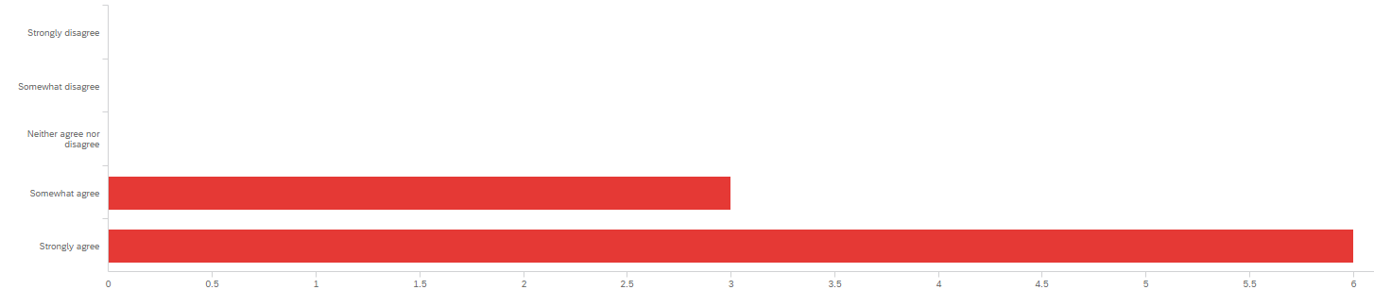
2.3 The value of developing a sense of community further: tutors’ perspective
It’s easier for my students to learn in a class that has a sense of togetherness.

Slide 24
Group discussion 3
How should the sense of community be developed further online and onsite?
Discuss your views in groups (5 mins.)

Slide 25
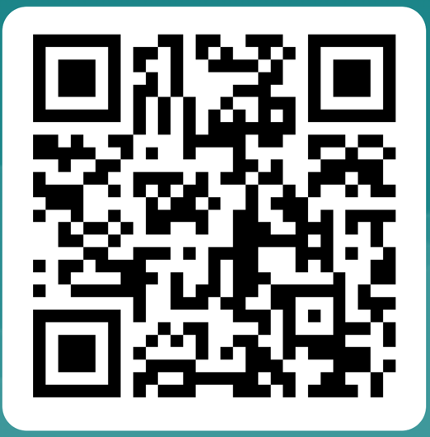
2.4 The value of working in groups
Completing tasks as a group helps students to learn more.
Working in breakout rooms in smaller groups helps students to feel more ‘connected’ to the class.
Scan the QR code or click the link in our Padlet to answer this question.
https://forms.office.com/e/Kp5CBVuhKK

Slide 26
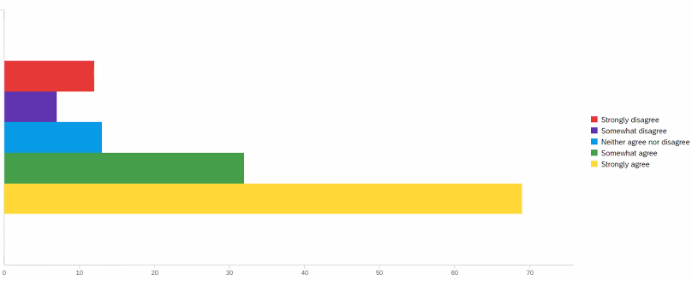
2.4 The value of working in groups: students’ perspective
Completing tasks as a group helps me to learn more.

Slide 27
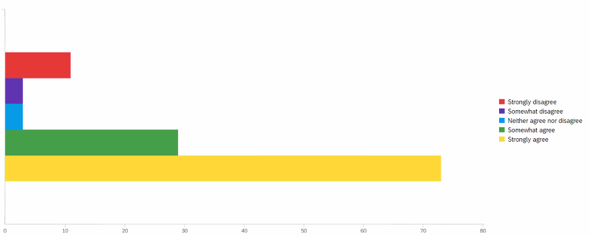
2.4The value of working in groups: students’ perspective
Working in breakout rooms in smaller groups has helped me to feel more ‘connected’ to the class.

Slide 28
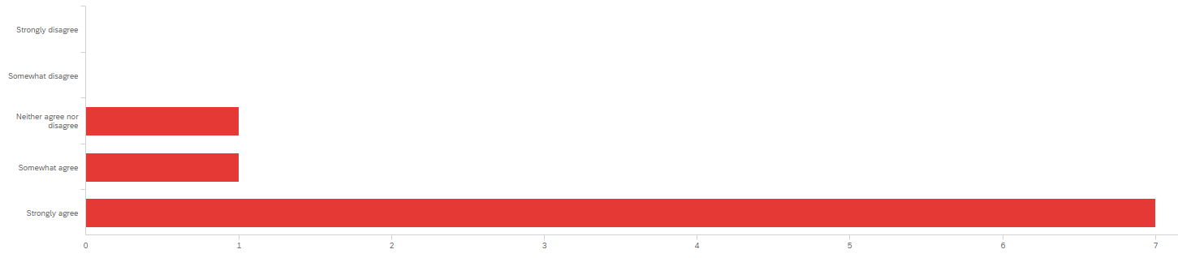
2.4 The value of working in groups: tutors’ perspective
Working in breakout rooms in smaller groups has helped my students to feel more ‘connected’ to the class.

Slide 29
Group discussion 4
How can tutors facilitate group-work online (both synchronous and Asynchronous) and onsite?
Discuss your views in groups (5 mins.)

Slide 30
3. Conclusion and recommendations
Our aim has been to share strategies for community building to give us information about the elements of online EAP teaching that are vital in the blended provision of the future.
Why?
  In our context, a sense of community appears vital for student engagement and satisfaction (Berry, 2019).
  Community seems instrumental in supporting collaborative learning (Garrison and Arbaugh, 2007).
  Students who feel a sense of ‘connectedness’ are likely to be more active and motivated in their learning (Young and Bruce, 2011).

Slide 31
3. Conclusion
  Getting to know other students is important.
  It is valuable to develop a sense of community further during the course.
  It appears that good rapport with the tutor and other students is important for course satisfaction.
  It seems vital to give students opportunities to share personal and study updates.
  Students value group work and perceive it as helpful to their learning.
  It is useful to give students opportunities to work in smaller groups.
  Using different tools for communication facilitates engagement and can have a positive influence on emotional wellbeing.

Slide 32
References
Berry, S. (2019). Teaching to connect: Community-building strategies for the virtual classroom. Online Learning, 23(1), 164-183. http://dx.doi.org/10.24059/olj.v23i1.1425
Garrison, D. R., Anderson, T. & Archer, W. (2010). ’The first decade of the community of inquiry framework: A retrospective’. The Internet and Higher Education, 13(1–2), 5-9. https://doi.org/10.1016/j.iheduc.2009.10.003
Garrison, D. R. (2009) Communities of Inquiry in Online Learning. Encyclopedia of Distance Learning, 352-355. https://doi.org10.4018/978-1-60566-198-8.ch052
Garrison, D.R. & Arbaugh, J. B. (2007) ‘Researching the community of inquiry framework: Review, issues, and future directions’. Internet and Higher Education 10 (2007), 157-172
Rovai, A. (2002). ‘Building sense of community at a distance’. International Review of Research in Open and Distance Learning, 3(1), 1-16.
Young, S. & Bruce, M. A. (2011). ’Classroom Community and Student Engagement in Online Courses’. MERLOT Journal of Online Learning and Teaching, 7 (2), 219 – 230.

