Slide 1
Time to deconstruct needs analysis?
Friday 21st April, 2023 – BALEAP conference
Rob Playfair, Birkbeck College, University of London
rplay01@student.bbk.ac.uk
@RobPlayfair

Slide 2
Overview
Aim of session
Background:
Development of needs analysis in EAP
Examples of needs analysis studies
Discomforting thoughts about needs analysis:
Rhetorical uses of the concept
Some reasons to deconstruct needs analysis
Individual question formation → Small group discussion → Larger group discussion
Notes:
Aim: To question the role of NA in our practice. I’m not making an argument to scrap needs analysis – but to question its role (and centrality) in EAP.

Slide 3
Development of needs analysis
Needs analysis is considered a course development process using a range of methods – such as questionnaires, interviews or textual analysis – and sources – such as students, teachers and texts – to identify the language and skills that are most relevant to a group of learners to be included in course design (Basturkmen, 2010).
Notes:
Give definition then: “Now I’ll explain now how the development of EAP and NA are connected.”

Slide 4
EAP research research orientation
Conceptual growth of Needs Analysis
Based on Benesch (2001)
Notes:
I’ll explain now how the development of EAP and NA are connected.
NA focus expansion:
the current or future situation the course is aimed at (target situation analysis)
descriptions of the learners (present situation analysis),
the context in which learning will take place (means analysis) (give example of each)

Slide 5
Variations in (published) needs analysis

Slide 6
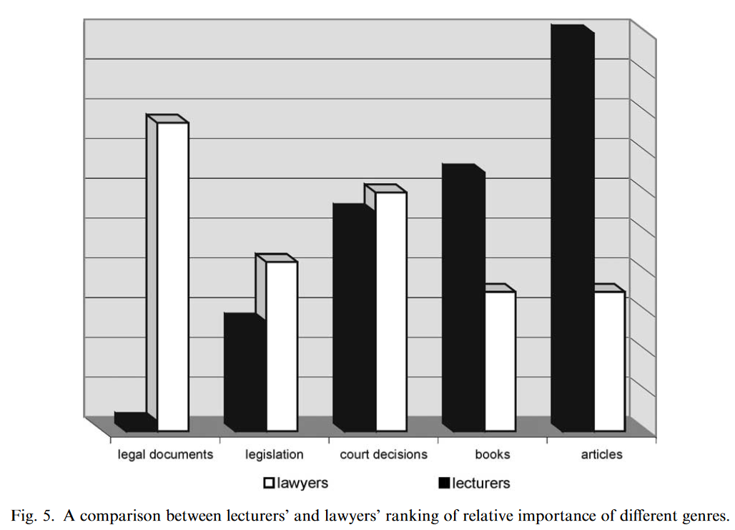
Target situation: Lecturer and professional perspectives (Deutch, 2003)
“The relative amount of course time allocated to [the genres] should correspond to the importance attributed to them by the lecturers’ rankings.” (p.137)
Notes:
Law UGs - Deutch (2003) looked beyond the immediate context of her undergraduate Israeli law students by consulting law lecturers and practising legal professionals. Using questionnaires followed by interviews she explored participants’ perceptions of the extent and importance of the English language for legal practice in Israel and gathered data about the genres that are most commonly used. Regarding the ‘linguistic skill’, she asked participants to rank reading, writing, listening and speaking, by importance.

Slide 7
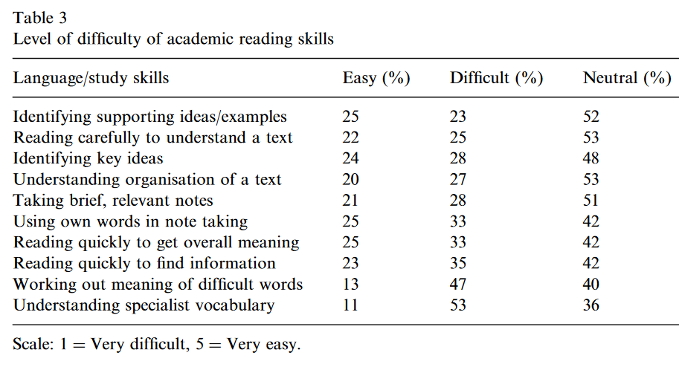
Present situation: Student focused large scale survey (Evans & Green, 2007)
“Put simply, inadequate receptive and productive vocabulary in English is the main problem confronting the almost 5000 students who participated in the survey. Clear pedagogical concerns emanate from the findings presented here: one is that EAP programme design should place a great deal of stress on the teaching and learning of subject-specific and common core lexis.” (p.14)
Notes:
Report of a survey of 4932 UGs in all departments at a university in HK. Focusing on “students’ perceived strengths and weaknesses in academic writing, reading, speaking and listening, together with their assessment of the relative importance of different writing and speaking tasks in their studies” (p.7).

Slide 8
Present-situation: Learner-initiated puzzles (Banister, 2021)
Prompt question: ‘What puzzles you (i.e., what would you like to better understand) about learning English, and in particular, about academic English?’
Using diaries, group discussion, webquests based on puzzles over an EAP course.
Teacher analysis of data
“After the first run of the module, we were considering changing the oral presentation assessment component to a reading-into-writing task. However, the surprising amount of puzzling about speaking skills prompted a reassessment. Learner puzzling in this area suggested that it was a want (and for some also a lack) and this contributed to our retention of the oral component.” (p.6)
Notes:
Small scale classroom-based research – positioned learners as needs analysts.

Slide 9
Discomforting thoughts about needs analysis
Notes:
Chosen this picture to start questioning NA as for me it represents the question of what having NA as a basis for EAP affords – and restricts (thanks to Julia Molinari’s use of the same building for inspiration!).

Slide 10
Rhetorical uses of ‘needs’ in EAP discourse

Slide 11
To sell EAP products
“The course is tailored to your needs and the needs of your students thanks to the extensive market research we have carried out with a global panel of ELT professionals. By listening to the needs of the teacher and student, we have developed a highly robust course.”
(web advertising for Unlock coursebook, CUP)
To position EAP practice in HE
“EAP is very target orientated […] We are teaching skills, and these skills are related to HE. These are necessary to be able to study successfully; that’s the point of it […] but I don’t think it puts us on a par with somebody who does research into psychology or physics.”
Participant cited in Taylor (2022)
To position EAP practice in society
“We should be ‘in solidarity’ with our students and their needs, as professionals. We should not be closing down conversations nor pushing a dubious revolutionary political agenda.”
(BALEAP JISCmail thread, 13th April, 2023)
Notes:
Read out

Slide 12
Some reasons to deconstruct needs analysis
NA as static: “…like the constantly changing learning targets [ESP] addresses, is itself becoming harder and harder to capture in anything like a single stop-action frame" (Belcher, 2006, p. 134)
NA as based on deficit: “By ignoring socio-semiotic and multimodal research on literacy development, for example, which approaches writing instruction as part of a complex educational ecology that cares about and integrates students’ previous and current literacies into the acquisition of new ones…, EAP projects itself as a perpetrator of functional transferable skills continually aimed at future ‘target situations’” (Molinari, 2022, p.41)
NA as neutral: “…to arrive at an ethics of EAP, needs analysis must include examination of who sets the goals, why they were formulated, whose interests are served by them, and whether they should be challenged.” (Benesch, 2001, p. 43).
NA as an exclusive practice: “EAP course design is a high stakes activity usually carried out by senior members of the EAP team, who can interact with staff in their institution to establish the expectations of the academic community that EAP students wish to join. This target needs analysis supports the development of a ‘defensible syllabus’ for the course…” (BALEAP, 2022, p. 8)
Notes:
Here are some reasons to question the role of NA in EAP – which you may wish to use as inspiration for discussion. [Read the bold headings] then ask to take some time to formulate some questions you would like to discuss in your groups (5 mins).

Slide 13
References
BALEAP. (2022). BALEAP TEAP Handbook. BALEAP. https://www.baleap.org/wp-content/uploads/2022/04/BALEAP-TEAP-Handbook-2022-edition.pdf
Banister, C. (2021). Harnessing learner research agendas to continuously explore EAP learners’ needs. Journal of English for Academic Purposes, 51, 100980. https://doi.org/10.1016/j.jeap.2021.100980
Belcher, D. D. (2006). English for Specific Purposes: Teaching to Perceived Needs and Imagined Futures in Worlds of Work, Study, and Everyday Life. TESOL Quarterly, 40(1), 133–156. https://doi.org/10.2307/40264514
Benesch, S. (2001). Critical English for Academic Purposes: Theory, Politics, and Practice. Routledge.
Deutch, Y. (2003). Needs analysis for academic legal English courses in Israel: A model of setting priorities. Journal of English for Academic Purposes, 2(2), 125–146. https://doi.org/10.1016/S1475-1585(03)00013-4
Evans, S., & Green, C. (2007). Why EAP is necessary: A survey of Hong Kong tertiary students. Journal of English for Academic Purposes, 6(1), 3–17. https://doi.org/10.1016/j.jeap.2006.11.005
Molinari, J. (2022) What makes writing academic. Bloomsbury. Available at: https://www.bloomsburycollections.com/book/what-makes-writing-academic-rethinking-theory-for-practice/
Taylor, S. (2022) Scholarly activity and EAP professional identity: Tensions and alignments. Proceedings of 2019 BALEAP conference. Available at: https://www.garneteducation.com/app/uploads/27_Paper-BALEAP_GS_2019-27.pdf
Unlock 2nd Edition, Cambridge, available at: https://www.cambridge.org/gb/cambridgeenglish/catalog/skills/unlock-2nd-edition

