Slide 1
The Use of Artificial Intelligence (AI) in Academic Writing: Implications for EAP
Debra Jones and Neil Adam Tibbetts
Centre for Academic Language and Development
University of Bristol

Slide 2
Our research context
In-sessional Coordinators PGT
Special Interest Group (SIG) Online translation tools
Has become AI SIG – emergence of ChatGPT

Slide 3
Our research approach
Situated practice of academic writing
Positioning - intermediaries in PGT learning
Exploratory research
Non-judgmental, open-minded approach
Ethnographic account
Aim: Be better informed as a centre and teachers, and to share findings with lecturers

Slide 4
Questions to think about
1. Which online translation tools / software can you name and which ones do you use?
2. How do you think students use online tools / software in their studies?
3. What do you consider to be acceptable/unacceptable use of online tools / software in academic writing?
4. Are there any potential benefits of using online tools / software for academic writing?
What are your initial thoughts?

Slide 5
Initial project (summer 2022)
"To explore the views of EAP teachers and subject teachers on an International Foundation Programme regarding student use of online tools in their academic work"
Focus mainly Google Translate/ Grammarly
Survey: 23 responses (out of 51) - 17 EAP tutors/6 subject tutors
Focus Groups: 8 tutors – 6 EAP/2 subject tutors
Notes:
Also Quillbot/Scholarcy/ - teachers mentioned other tools they’d heard of in the Survey but mostly GT and Grammarly
Wanted to compare attitudes of EAP/subject teachers.
An online survey was sent to 51 tutors on an International Foundation at a UK university. The tutors were both EAP and subject tutors from the three IFP pathways, STEM, Arts and Humanities and Law & Social Science. 23 tutors responded.
Balance of respondents was a reflection of the balance of EAP/Subject teachers in CALD

Slide 6
Previous findings
No consensus about the acceptability of online tools
More acceptable for reading/vocabulary than writing (Jolley & Maimone, 2015)
Gap between teacher perceptions and student practice (Clifford et al, 2035; Jolley & Maimone, 2015)
Focused on foreign language/translation studies context not EAP/ non-language subjects (exception Groves & Mundt, 2021)
Notes:
Some of lit is dated but recent lit tends to focus on accuracy/reliability of the tools & the academic integrity aspect

Slide 7
Our findings: Survey
Teachers more positive about online tools use in reading/vocabulary than writing
No differences between EAP & Subject teachers
Majority (20/23) think teacher should help students use these tools more effectively
Is it cheating? - majority say depends on context
Notes:
Interesting in exploring what it depends on. Where do you draw the line?

Slide 8
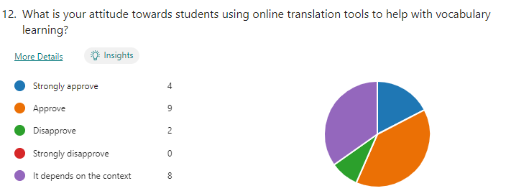
Using online tools to help vocabulary
Notes:
Results confirm previous research [Jolley & Maimone, 2015; Groves & Mundt, 2021] showing teachers were more positive about the use of translation tools for reading and vocabulary development rather than writing. Also, using the tools to develop subject knowledge was viewed less favourably than reading and vocabulary. Interestingly, EAP teachers were more favourable towards students using translation tools to develop subject knowledge whereas subject teachers were less positive about this which was contrary to my initial assumption. There were no other significant differences between the views of EAP and subject tutors on the use of OTT to develop English language skills

Slide 9
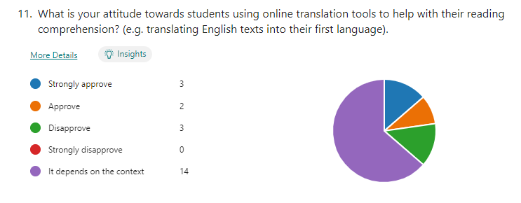
To help with reading
Notes:
Results confirm previous research [Jolley & Maimone, 2015; Groves & Mundt, 2021] showing teachers were more positive about the use of translation tools for reading and vocabulary development rather than writing. Also, using the tools to develop subject knowledge was viewed less favourably than reading and vocabulary. Interestingly, EAP teachers were more favourable towards students using translation tools to develop subject knowledge whereas subject teachers were less positive about this which was contrary to my initial assumption. There were no other significant differences between the views of EAP and subject tutors on the use of OTT to develop English language skills

Slide 10
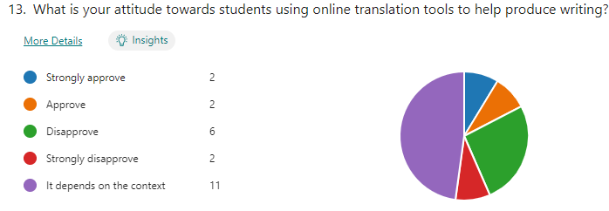
To help with writing
Notes:
Results confirm previous research [Jolley & Maimone, 2015; Groves & Mundt, 2021] showing teachers were more positive about the use of translation tools for reading and vocabulary development rather than writing. Also, using the tools to develop subject knowledge was viewed less favourably than reading and vocabulary. Interestingly, EAP teachers were more favourable towards students using translation tools to develop subject knowledge whereas subject teachers were less positive about this which was contrary to my initial assumption. There were no other significant differences between the views of EAP and subject tutors on the use of OTT to develop English language skills

Slide 11
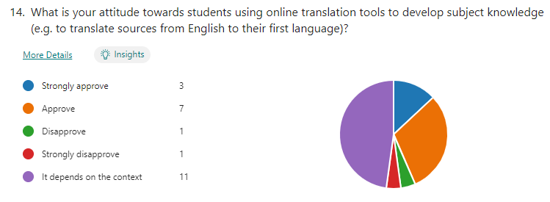
To develop subject knowledge
Notes:
Results confirm previous research [Jolley & Maimone, 2015; Groves & Mundt, 2021] showing teachers were more positive about the use of translation tools for reading and vocabulary development rather than writing. Also, using the tools to develop subject knowledge was viewed less favourably than reading and vocabulary. Interestingly, EAP teachers were more favourable towards students using translation tools to develop subject knowledge whereas subject teachers were less positive about this which was contrary to my initial assumption. There were no other significant differences between the views of EAP and subject tutors on the use of OTT to develop English language skills

Slide 12
Our findings: Survey
No differences between EAP & Subject teachers
Majority (20 out of 23) think teacher should help students use these tools more effectively
Acceptable use – Is it cheating?
Notes:
Only 3 (13%) said yes, 6 (26%) said no with 60% saying it depends on context. This compares with Clifford et al’s (2013) findings where 42% considered the use of translation tools as cheating. Groves & Mundt’s (2021) more recent findings suggest that subject teachers were uncertain whether the use of translation tools such as Google Translate constitutes academic misconduct

Slide 13
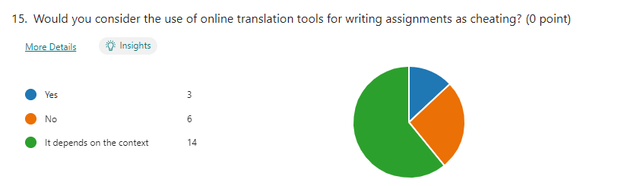
Is it cheating?
Notes:
Results confirm previous research [Jolley & Maimone, 2015; Groves & Mundt, 2021] showing teachers were more positive about the use of translation tools for reading and vocabulary development rather than writing. Also, using the tools to develop subject knowledge was viewed less favourably than reading and vocabulary. Interestingly, EAP teachers were more favourable towards students using translation tools to develop subject knowledge whereas subject teachers were less positive about this which was contrary to my initial assumption. There were no other significant differences between the views of EAP and subject tutors on the use of OTT to develop English language skills

Slide 14
Focus groups
If you answered ‘it depends on the context’ to any of the questions in the survey, can you explain what it depends on; in what context would the use of translation tools be acceptable or unacceptable?
Notes:
To investigate what it depends on? What’s acceptable/not acceptable? Where to draw the line? NB – this was pre-Chat GPT

Slide 15
What does it depend on?
Depends on what they’re doing and why:
“Perhaps looking up a word to check that they understand its meaning would be fine, but directly translating a whole paragraph of work in their native tongue to English would be considered cheating”
“If words in L1 pop into their head and they do not know the English for it , they might use a tool and this could be appropriate. If they translate an entire essay from L1 to L2 , this would be inappropriate”
“if students use translation tools in a way that enhances their learning then there may be a place for them. So ….. if they are translating, but then recording what they translate and doing this in the target language, then it can be useful”
Notes:
Egs of where it was useful in learning - checking

Slide 16
What does it depend on?
The purpose of the task:
“to access the content, I think initially students might need to have texts translated into their own language to get the ideas. However, if the purpose is for them to develop language, I think then we need to consider or to have the discussion with students about, you know, the reason why it's important to read in the target language”
“if the learner's aim is to learn to write an essay really well in English and they're really relying on translation tools, they're not going to achieve that aim. But if their aim is to just get the get the subject knowledge out of it, then you know, they don't really care about writing in English”
Notes:
Teachers purpose and students purpose

Slide 17
What does it depend on?
The purpose of the assessment:
“if the purpose of the assignment is to demonstrate knowledge in the target language, writing the assignment in L1 and then translating would be cheating as it would not in effect be reflective of the student's own language”
“If the thing to be assessed is their ability to write, then they should not rely on a translation tool. If the thing to be assessed is something else, why not use whatever tools available to make the best piece of work possible?”
Notes:
Egs of where it was useful in learning

Slide 18
What does it depend on?
Motivation:
“Those who view the existence of different languages as a communication problem to be solved, rather than as an example of the richness and diversity of human culture and cognition, would argue that rapidly improving MT technologies, plus the dominance of English internationally, obviate the need for the study of other language” (Case, 2015)
Notes:
Egs of where it was useful in learning

Slide 19
What does it depend on?
Motivation
“the problem might be that students are very result oriented and so they're thinking OK, I need to use these tools in order to write this particular essay or assignment so I can get the grade that I need in order to progress.”
“if the student isn't really interested in improving their English very much because they're going to go back to their home country and they're not really going to use much while they're there, you know, maybe there isn't much for point in them learning these things. So maybe it just comes down to what the individual student wants to get out of their degree. I don't know.”
Notes:
Egs of where it was useful in learning

Slide 20
Negative perceptions
“students [use] these tools with good intentions, but then they rely on them as a crutch, and then that they default to technology for their answers.”
“when we introduce certain digital tools to kind of help out our students, we’re making their lives easier, but we're denying them that struggle that's necessary to develop.”
“They want the results there and then, they're not prepared to work… they've got access to all these and devices or tools that they can use to get to that path very easily and the joy of the hard work and falling down and learning from your mistakes seems to have almost disappeared or been forgotten.”
Notes:
In terms of learning not in terms of assessment – links to motivation

Slide 21
In summary
willingness to engage with these tools in the classroom
nuanced views about when it's appropriate
acceptable if used for learning but not as a 'quick fix'
instrumental v intrinsic motivation
Notes:
Link to Neil – research into what students are actually doing and why – are the teachers perceptions correct? (summary of focus group findings then link)

Slide 22
Current research project
"An ethnographic investigation into student use of online translation tools and student and lecturer perceptions of the acceptability of using these tools in the academic writing process."

Slide 23
Research details
Students AND Lecturers – in-sessional contexts (not Foundation level)
Semi-structured interviews with students we work with
And lecturers we work with
Not comparing lecturer with specific cohort- we want a snapshot of PGT practice
Started with PGT students in Science (School of Physics) – have taught them in TB1 – positioning of researcher

Slide 24
Questions for students (in yellow will be different for lecturers)
Which online translation tools / software can you name?
Which ones do you use?
What is your process of using these tools? Can you explain exactly how you use them?
Do you think it is acceptable to use online tools/software in academic writing? What would be unacceptable use?
Are there any potential benefits of using online tools/software for academic writing?
What are the rules on your course about using online tools / software? Has this been communicated to you?

Slide 25
Initial findings- Practical points
GT – limitations, e.g. not formal enough
Convenience (efficiency/speed/quality) is important- more likely to use if built into app = Word/Grammarly
Tendency to use tools more for reading/vocab than writing
Can't use translated content without checking it
Want to be able to write 'proper' academic writing
Know the potential problems but no guidelines, only rules about plagiarism
ChatGPT - not yet landed?

Slide 26
Use
(GT)” [I use it] for translation, it's generally when I'm reading papers, when I'm researching, it's generally helpful just to like because sometimes the technical language is a bit difficult to use Google Translate in that case a lot. It's less when I'm writing because generally, like the words are coming to my mind.”
“For example, I just suppose I want to write a line which I have no clue how to how to write it. I am very much clear in my own language. What I want to write, but I I can't type it in English for some reason like I can't catch good words just for that line. I use Google translate.”
“Sometimes for example the connection words I just run out of connection words, so it just literally type in Chat GPT. I need a new.. I need a connection word for this case or I can put my whole sentence and say I want a connection word here or something and it can help me in that and I can use it sometimes I have, I have a sentence, it's written and everything, but it's not very professional.”
Notes:
See notes on previous slides- highlighted bits from interviews

Slide 27
Use and limitations
(GT) “I think is the only one which has Hindi. So among these I use Google translator and as I mentioned that I use Grammarly more than these translation tools. So how do I use it? Well, I would say I try to write it as a rough draft using the Google translator and then I use QUILBOT to paraphrase it. So you just need to open the site and then just copy and paste your rough draft on the site and then you can just paraphrase it. So it's very easy and then you can copy from it and then paste in your document. Of course you need to reverify and review it before you actually like put it into your document, but yeah.”
“It's going to take a lot of time when I need to check it from Grammarly or maybe I check the vocabulary from the thesaurus or Google Translate it's a lot of time if I just write it in my own language, probably it's just going to take like one day. But doing the translation I need like one week.”
Notes:
See notes on previous slides- highlighted bits from interviews

Slide 28
Problems with use
“I actually also prefer when I don't prefer too much using Google Translate in translating words because I want them in English because it's better to understand, because like I think of it like the whole English language system and the whole Arabic language system, … It is different. “
“I know that some of my classmates they translate from Chinese to English use Google Translate in Chinese. But there's for me it's more like I could write English directly rather than writing Chinese first in my first draft. […] how you write and how you thinking in Chinese and English in different languages it's different. So you if you start with another language just directly translate this now it will not work […] when you come to England to, you know, improve your English level so if you still using the Chinese directly, you know, just directly translate you will not improve your English level English and study.”
Notes:
See notes on previous slides- highlighted bits from interviews

Slide 29
Benefits
[translation tools] “They give me new vocabulary, so I gained another vocabulary from them.”
“It's helped me a lot because I'm not, I said, not fluent in English”
“Sometimes the one problem that I always go through is that I don't know how to start, where to start. I think I just try to make this draft in my mind as simple as possible, like as simple as possible for me, and then I just write it in the Grammarly and then it translate it paraphrases to really to really a nice piece of lines. So it's definitely beneficial. Because it saves a lot of time.!
Notes:
See notes on previous slides- highlighted bits from interviews

Slide 30
‘Self-scaffolding’
“Now at this level I think I have good command over English so I never I can,I can never like if I go from Hindi to English. I think it's a very bad idea and I believe that I think it's only useful like Google translators and all these are only useful for the people who have really less knowledge about English. So they but people like that generally on that. But as I said I have OK command on English, I just use a bit of it. And for some phrases or some lines actually which I have no clue how to write. So I would say that to create a rough draft for some lines or some paragraphs.”
“So, I think when put all of the one paragraph to Google Translate, the translation is not good. I don't know why […] especially for more scientific terms, yeah. But if it's like a daily… like when I reading newspaper it's good to use Google Translate for this whole page. But I'm trying not to do it again now because I try to learning.”
“I'm big fan of Grammarly, but I'm not really like the using it. […] this is not the real sentence that I wrote, so this is not really me […] I'm not really happy, but I'm using it […] I wish that I can write without any software help and my English will be fluent.”
Notes:
See notes on previous slides- highlighted bits from interviews

Slide 31
Acceptable?
“If you have a sentence and you don't think it's very appropriate, you want to rephrase it. You can ask it to rephrase it to you. I don't think there's a problem with it because you already have the thing in your mind.”
“Based on my point of view, using Google Translate it's not good because you can detect it as plagiarism for the similarity and also from ChatGPT. That's definitely taking from another people, right?”
“I wouldn't like the ChatGPT to write everything for me like I want to write my own work. I just need sometimes help with it. Yes, but I want to write what I'm writing.”
Notes:
See notes on previous slides- highlighted bits from interviews

Slide 32
Rules?
“I have like 99 to 95% have switched to Grammarly, so initially to be honest I had no i… I was not very aware of this concept of plagiarism, how much serious it is. So I I remember where I'm just writing an example here. I remember my first first piece of writing for the UoB I just wrote something on the Grammarly section and then I just paraphrased it, and then I just copied it, but that is the worst way to do it, because even though it's a paraphrasing tool, but it will never be good enough, you will be caught of plagiarism in a click.”
“X and the other lecturers, they just don't talk about any of any of these things, none of them, they don't mention. No, they just really care about the similarity and also the grammar I think.”
“I don't know that there exists even a line that a beyond this is unacceptable. So even if I write everything in Arabic, then I translated to English, I think their only concern is that would it make sense or not?”
“I wouldn't say there is a clear communication about the lines not to go beyond […] They only talk about plagiarism. […] some may suggest like use Grammarly to check your grammar […] No one talks about translation and what's accepted, what's not.”
Notes:
See notes on previous slides- highlighted bits from interviews

Slide 33
What comes next?
Different disciplines (different English proficiency levels?) + lecturers
ChatGPT will have more impact in the future?
Efficiency and efficacy – a focus for discussion?
No-one talks about
Notes:
See notes on previous slides- highlighted bits from interviews

Slide 34
Tentative conclusions
Need to be more open about this issue
Students using the tools responsibly
Students understand their limitations of the tools they’re part of a process of development (self-scaffolding)
Writer identity is important to student writers
Notes:
Maybe add lecturers

Slide 35
References
Clifford, J., Merschel, L., & Munne, J. (2013). Surveying the landscape: What is the role of machine translation in language learning? @ tic. Revista D’innovacio Educativa, 10, pp.108-121.
Groves, M. & Mundt, K. (2021). A ghostwriter in the machine? Attitudes of academic staff towards machine translation use in internationalised higher education. Journal of English for Academic Purposes, 50, pp. 1-11.
Jolley, J. R., & Maimone, L. (2015). Free online machine translation: Use and perceptions by Spanish students and instructors. Learn languages, explore cultures, transform lives, pp.181-200. Lincoln: University of Nebraska.

Slide 36
Any questions?
debra.jones@bristol.ac.uk
neil.tibbetts@bristol.ac.uk

