Slide 1
That’s not it! Exploring practitioners' understandings of Flipped Learning in an online presessional course.
Dr Paula Villegas, EdD, SFHEA
International Education Institute, University of St Andrews
pvv1@st-Andrews.ac.uk
Notes:
Target - Presentation (20 mins) + Q&A (20 mins)
Thanks audience - Introduction – role

Slide 2

Outline
The Research Project
What is Flipped Learning?
  Insights from the literature
Enacting Flipped Learning
  The Context
  What is Flipped Learning for…
    …Course designers?
    …Team Leaders?
    …Teachers?
So, what is Flipped Learning? Implications for Practice
Notes:
I’ll start by telling you a little bit about how this project came to light. Then I’ll move on to explore FL so if that is not it, then what is it? A brief overview of the Literature exploring FL. Then I will introduce the context in which this research took place followed by the understanding of FL that different stakeholders course designers, Team Leaders and Teachers revealed in the semi-structured interviews I conducted. I realise that Team Leader may be a centre-specific term, so I would just like to clarify that this role refers to…

Slide 3

The Research Project
Data collected in the Summer of 2020
  Mixed Methods Research (questionnaires & semi-structured interviews)
    RQs exploring students’, teachers’ and managers’ perceptions of FL in the OL EAP pre-sessional course
Practitioner – Researcher
Insider researcher
Notes:
In this presentation, I will focus on what is FL. I will used Qual data, extracts form interview.

Slide 4

What is FL for you?
What do you understand by FL?
What informs your understanding of FL?

Slide 5
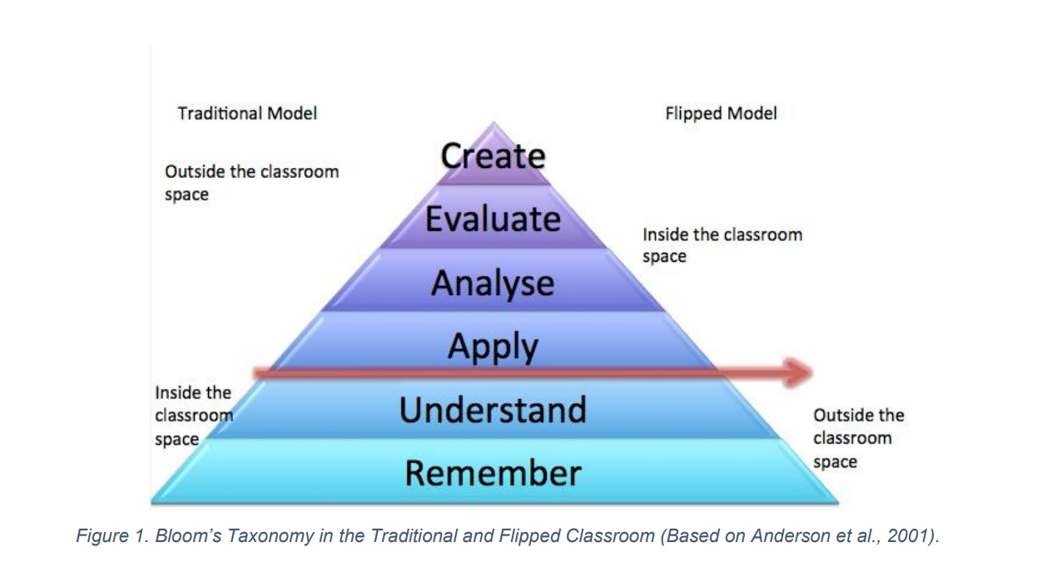
Flipped Learning in the Literature
A pedagogical approach in which direct instruction moves from the group learning space to the individual learning space, and the resulting group space is transformed into a dynamic, interactive learning environment where the educator guides students as they apply concepts and engage creatively in the subject matter (Flipped Learning Network, 2014, p. 1)
Flipping the classroom is simply turning Bloom’s Taxonomy upside down, moving the higher-order thinking skills tasks into the classroom (Brinks-Lockwood, 2014, p. 2)
Notes:
The flipped Learning network was founded by Bergmann and Sams (2012). They are credited as the founders of FL as it is currently understood, used pre-recorded lectures to present the content, thus actively engaging with TEL. This is quite interesting as some definitions of FL from the literature, for example, Abeysekera & Dawson (2014) explicitly include TEL/ use of videos as part of FL. The fact that there are different definitions within the literature can make implementing FL challenging. For me, FL is independent of the use of TEL and is intrinsically linked to social constructivism. It is an exciting approach that can level the playing field and create a more dynamic space in the classroom where students engage with tasks within their ZPD Ss engage with these tasks with the support of their peers and the guidance of the teacher.

Slide 6

Enacting Flipped Learning – Research Context
EAP Presessional course, Russell Group University in the UK
  10-weeks and 6-weeks presessional courses
FL had been adopted in 2018, making 2020 the third year this approach was implemented.

Slide 7

Enacting Flipped Learning – Research Context
The presessional courses are designed by the department.
  Quality of materials consistently praised
Course Directors (x1 participant)
  Team leaders (x 2 participants)
  Teachers (x 8 participants)
    Permanent members of staff (x3 participants) and temporary members of staff (x5 participants)
    TEFL-Q
Notes:
"Um, team leaders are team leaders are trained teachers who have demonstrated that they are very, they are good teachers, and that they're very reliable, and organized and good at supporting other teachers, particularly new teachers who are new to the context and new to the centre."
The British Council requirements for TEFL-Q qualifications are validated programmes with 100+ hours of input and 5+ hours of teaching practice (BC, 2016).

Slide 8
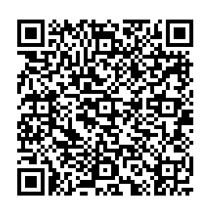
What is Flipped Learning? – Course Director
FL was adopted as a response to circumstances but perceived to bring key benefits to the EAP classroom
  Autonomy
  Learner-centred lessons
Coursed design based Brinks-Lockwood’s (2014) understanding of FL but also
    Task-Based Learning
    Andragogy
  Flipped content informs the sessions and the assessments, sometimes flipped content is picked up in the assessment (e.g. writing tasks) but not explicitly in the sessions.
  Nature of FL was explicitly addressed with teachers in 2018 and 2019 but not in 2020 as OL training took priority
We did in 2018, and 2019, we provided sessions about flipped learning for teachers, and we even flipped it when we gave a reading on flipped learning to teachers to read in advance, and then we had a live session. Now, in 2020, I think that was something that was sacrificed. (Lester, course director)

Slide 9
What is Flipped Learning? – Team Leaders
I'd say the teachers I work with overwhelmingly just focused on the practicalities of where we go, how do we start? What do the students need to do? (Dennis, Team Leader)
  Perceived focused on practicalities, not on pedagogical principles.
  Unclear understanding of FL
    Why is it used?
    How is it used?
When I was a teacher, last summer the summer before, I just thought, okay, we just want to make more money {laugh}
(William, team leader)

Slide 10
What is Flipped Learning? – EAP tutors
They're almost coming into the live sessions and they're almost recycling, what they've done at home, but it's certainly at the beginning at the initial stages. So yes, I think that the link is very clear to them, then (Cedric, first time teaching in the course).
Oh, I think the best thing is definitely the students’ preparation the, you know, a lot of their questions are already answered (…) once in a while, you might get a tricky grammar question. And then they need to be clarified (…) those types of questions crop up, then less frequently, which is helpful when you teach an online course (Naomi, returner).

Slide 11
What is Flipped Learning? – EAP tutors
Ah, well flipped now flipped learning was what we did last year. So flipped learning to me is entirely separate to this online experience (Clarence, returner).
And, and I remember a colleague telling me about it (…) her idea of flipped learning was where the student comes to the front, you give the students a task, and they come to the front, and they teach the rest of the class (Jen, first time teaching in the course).

Slide 12
What is Flipped Learning? – EAP tutors
  Practitioners systematically demonstrated different conceptualisations of FL
    This is true for practitioners that taught a FL presessional in 2018 and 2019 when FL was specifically addressed at a theoretical level during induction.
  Different understandings of FL can co-exist under the premise that FL is turning Bloom’s Taxonomy upside-down.
  Lester’s vision of flipped content informing sessions and assignments was not homogenously filtered down.

Slide 13
What is Flipped Learning? – Implications for Practice
FL definitions vary in the literature…and in practice!
  Talking about the FL in specific terms may foster better understanding among practitioners
A top-down approach has the advantages of
  Consistency
  Quality of materials
And the dangers of…
  Pedagogical underpinnings becoming invisible

Slide 14
Reference List
Abeysekera, L., & Dawson, P. (2014). Motivation and cognitive load in the flipped classroom: definition, rationale and a call for research. Higher Education Research & Development, 34(1), 1–14. https://doi.org/10.1080/07294360.2014.934336
Bergmann, J., and Sams, A. 2012. Flip your classroom: reach every student in every class every day. Eugene, Alexandria, Washington DC: International Society for Technology in Education.
Bloom, B.S. 1956. Taxonomy of educational objectives, Handbook I: The cognitive domain. New York: David McKay Co Inc.
Brinks-Lockwood, B. (2014). Flip it! : strategies for the ESL classroom. University Of Michigan Press.
Correa, M. 2015. Flipping the foreign language classroom and critical pedagogies. Higher Education for the Future. 2(2), pp.114-125. https://doi.org/10.1177/2347631115584122
Flipped Learning Network. (2014, March 12). Definition of Flipped Learning. Flipped Learning Network Hub. https://flippedlearning.org/definition-of-flipped-learning/
Vygotsky, L.S. 1978. Mind and society: The development of higher mental processes. Cambridge, MA and London: Harvard University Press.
Villegas, P. (2022). Who wins when we flip? Exploring perceptions in an OL EAP course. [EdD thesis, University of Sheffield]
Villegas, P. (2022) Beyond the four pillars of FLIP. Exploring theoretical underpinnings of FL in EAP. The Language Scholar,

Slide 15

Any Questions?
Thank you so much!

