Slide 1

Silo Busting in Academic Language: A Fresh Look at the Elements of Academic Language
Alex Ding
The University of Leeds
Ian Bruce
The University of Waikato, New Zealand

Slide 2


Joint Book Project: Aim
To develop a more comprehensive theoretical framing of the dimensions of academic language based on the categories of Ferguson (1997). Developments of ideas from (and elsewhere) …

Slide 3

Ferguson’s (1997) Dimensions of ESP Teacher Knowledge
a discipline’s:
culture and values
epistemology
characteristic discourse and genres

Slide 4
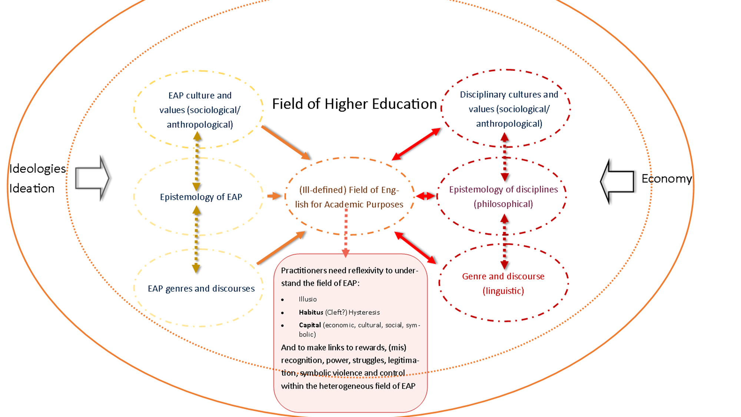

Slide 5
Outline of Talk
current approaches to academic language in EAP
constraints on EAP practitioner knowledge and research
Ferguson’s (1997) knowledge domains – broadening the approach
implications for EAP practitioner knowledge and practice and research

Slide 6

Approaches to Academic Language in EAP
diversity of the knowledge base of EAP, yet there is . . .
limited operationalization of the dimensions of academic language in EAP practice
a ‘spiral of narrowing focus’ on the range of language elements examined in EAP research and publication

Slide 7
EAP Practice: Approaches to academic Language
often governed by commercial textbook series based on a structural syllabus – TESOL model
genre – elements of ESP approach drawn upon in writing instruction
linguistic knowledge - eclectic use of elements of SFL grammar, insights from corpus studies

Slide 8
EAP Research in Key Journals
Focus of articles in JEAP and ESPJ: 2018-2023
language issues - 82% of ESPJ articles, 76% of JEAP articles
social issues* – 16% of ESPJ articles, 24% of JEAP articles
epistemology - 2% of articles in ESPJ, % in JEAP ??
* often EAP practitioner- or student-related focus

Slide 9
Understandings of Academic Language: Influences and Constraints in EAP
practitioner/researcher divide
(narrowing) research agendas set by journal editorial boards
recent bibliographic studies and their ‘reifying’ function
metrics
past ‘luminary’ culture (inherited from TESOL?)
EAP as a commodifiable service in third spaces (reliance on commercial materials – no needs analysis)

Slide 10
Ferguson’s Knowledge Domains as an Approach to Disciplinary Language
disciplinary communication integrates knowledge of:
  interactions (sociological & anthropological knowledge)
  epistemology (philosophical knowledge)
  discourse and textual practices and artefacts (discursive & linguistic knowledge)

Slide 11
Implications of Framework
practitioner formation – knowledge development
research and practice frameworks

Slide 12
Practitioner Knowledge Development
An EAP practitioner toolkit that includes knowledge of:
social theory – to understand the social processes and procedures of disciplinary communities
epistemological theory – to understand how disciplines create and validate their knowledges
discourse theory – to deconstruct and understand the communicative forms and routines of disciplinary communities

Slide 13
EAP Research Frameworks
a broader conception of the knowledge elements involved in academic communication
a refocusing on the ‘applied’ nature of EAP research

Slide 14
EAP Practice Frameworks
need to account for:
ethics
needs analyses
interrogate relationships between needs and parameters of provision

Slide 15
The Way Forward . . . .

