Slide 1
Revisiting the language needs of students in English- medium universities
Ramsey Cardwell & Ben Naismith
Duolingo
March 31, 2023
BALEAP ‘23

Slide 2
Agenda
Background
Survey and data collection
Results & interesting items
Comparison to BALEAP descriptors
Discussion

Slide 3
Background

Slide 4
BACKGROUND
What is the TLU domain?
EAP encompasses “the communicative needs and practices of individuals working in academic contexts” (Hyland & Shaw, 2016, p. 1)
Defined only by the university context?
Restricted to academic tasks?

Slide 5
BACKGROUND
University language skills students need
Rosenfeld et al. (2001) survey study
US-based students (n=345) & teaching staff (n=370)
42 task statements based on TOEFL frameworks
No digital technology, no interaction, no extracurricular
BALEAP Can Do Framework (2013?)
Interviews with “lecturers who teach international students”
About competencies needed for masters students in the UK

Slide 6
BACKGROUND
More recent developments
Technology-mediated learning environments (Kyle et al., 2021)
Considerations for language use by:
What students feel is important
What faculty feel is important
Undergraduate level? Graduate level?
Field of study?
We’re here to learn more about the modern EAP construct

Slide 7
The survey

Slide 8
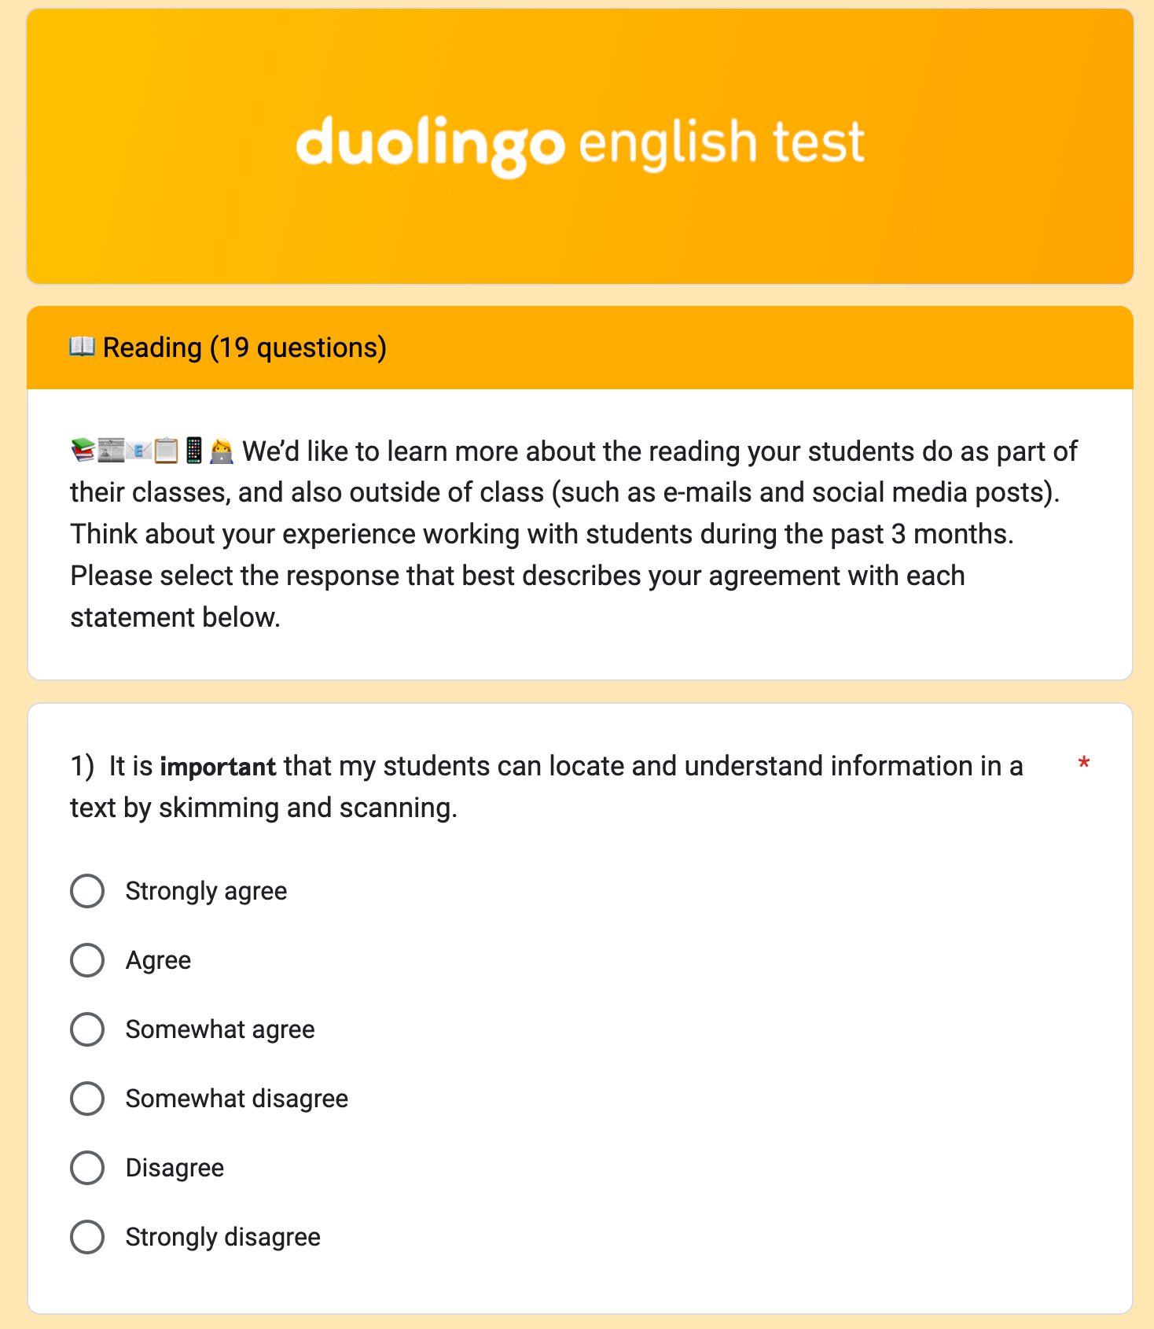
Topic 2
Survey sections (60 questions)
Reading
Writing
Speaking
Listening
Language & Technology
Demographics (e.g., age, gender, L1, field)
Survey timing: Approximately 15-20 minutes

Slide 9
THE SURVEY
Survey development process
3 researchers
Backgrounds in Computational & Applied Linguistics, Ed Measurement
Experience teaching/TAing at the university level
Experience studying in non-English immersion contexts
Started with tasks used in Rosenfeld et al. (2001)
Added tasks based on CEFR activities, BALEAP framework, & experience
Combined similar tasks
Iteratively voted on tasks for inclusion

Slide 10
THE SURVEY
Data collection
So far administered at 4 universities (1 UK & 4 US; N=418)
Results presented only for masters students & staff (N=286)
Most demographic questions were optional
Institution | Student N | Staff N
UK–1 | 24 | 34
US–1 | 22 | 44
US–2 | 5 | 52
US–3 | 9 | 21
US–4 | 29 | 46
TOTAL | 89 | 197

Slide 11
THE SURVEY
Student participant demographics
Concentration | UK | US
Business | 3 | 10
Humanities/Social Science | 10 | 17
STEM | 11 | 37
Spoken L1 grouping | UK | US
Austroasiatic | 0 | 3
Dravidian | 2 | 7
English | 5 | 18
European | 5 | 19
Indo-Iranian | 4 | 8
Semitic | 0 | 3
Sinitic | 2 | 7
Other | 3 | 3
Age | UK | US
18–22 | 1 | 9
23–29 | 9 | 37
30–39 | 8 | 12
40+ | 6 | 7
Gender | UK | US
Woman | 16 | 34
Man | 8 | 31

Slide 12
THE SURVEY
Staff participant demographics
Gender | UK | US
Woman | 12 | 84
Man | 18 | 65
Prefer not to say | 4 | 10
Spoken L1 | UK | US
Chinese | 1 | 1
Czech | 0 | 1
English | 30 | 147
German | 1 | 3
Greek | 1 | 1
Igbo | 0 | 1
Spanish | 0 | 5
Thai | 0 | 1
Teaching Experience (yrs) | UK | US
0–5 | 5 | 26
6–10 | 6 | 33
11–15 | 9 | 35
16–20 | 4 | 21
> 20 | 10 | 47
Age | UK | US
30–39 | 6 | 26
40–49 | 12 | 48
50–59 | 10 | 42
60+ | 5 | 41

Slide 13
Overall results

Slide 14
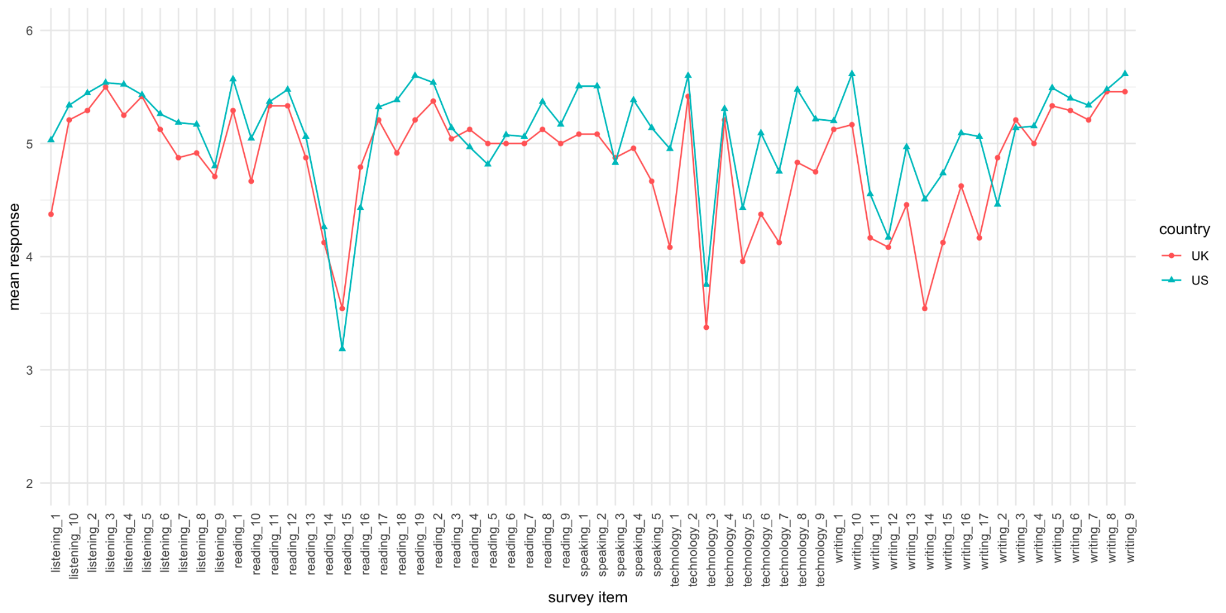
RESULTS
Student responses by country
Agree

Slide 15
TOPIC 3
RESULTS
Highest rated – UK students
Item | Domain | UK mean | US mean
It is important that I can understand the instructor’s spoken directions regarding assignments. | 👂 | 5.50 | 5.54
It is important that I can use references appropriately to support ideas, analyze, and refine arguments. | ✍️ | 5.46 | 5.48
It is important that I can finish writing assignments on time. | ✍️ | 5.46 | 5.62
It is important that I can understand the difference between suggestions, advice, directives, and warnings when spoken (e.g., as heard in a lecture or during a conversation). | 👂 | 5.42 | 5.43
I frequently need to read digital reading assignments (e.g., PDFs, e-books). | 💻 | 5.42 | 5.60

Slide 16
RESULTS
Student responses by country

Slide 17
TOPIC 3
RESULTS
Most discrepant – UK & US students
Item | Domain | UK mean | US mean
I frequently need to write a narrative (i.e., telling a story, or describing something that happened to you or someone else). | ✍️ | 3.54 | 4.51
I frequently need to prepare slides with written text (e.g., bullet points) for an oral presentation. | ✍️ | 4.17 | 5.06
I frequently need to read paper-based reading assignments (e.g., printouts, physical textbooks). | 💻 | 4.08 | 4.95
I frequently need to speak in in-person settings (e.g., in a classroom). | 💻 | 4.38 | 5.09
I frequently need to take notes during a lecture. | 👂 | 4.38 | 5.03

Slide 18
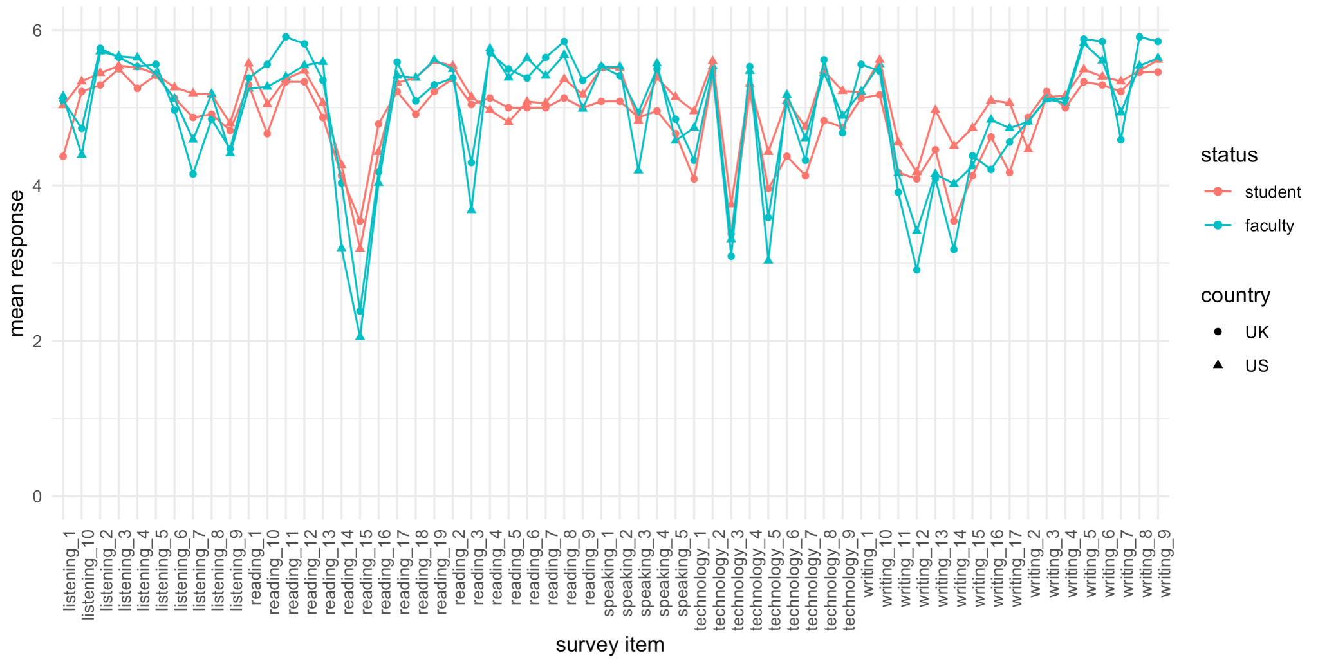
RESULTS
Student and staff responses by country
staff

Slide 19
TOPIC 3
RESULTS
Most discrepant – students & staff
Item | Domain | Student mean | Staff mean
use keyboard shortcuts (e.g., ctrl/Cmd+F) to locate specific content in digital texts. | 📖 | 5.11 | 3.79
type paragraph-length (or longer) text on a smartphone or tablet. | 💻 | 4.30 | 3.13
read extra material in another language to help me understand course topics. | 📖 | 3.28 | 2.11
read and understand texts written in different varieties of English (e.g., American, British, Indian, Chinese). | 📖 | 4.22 | 3.34
understand recorded speech (e.g., a lecture video) without subtitles. | 👂 | 5.30 | 4.45
communicate with professors via text messages, instant messaging, and social media. | ✍️ | 4.15 | 3.32
read and understand written instructions, directions, or announcements about classroom assignments and/or examinations. | 📖 | 5.01 | 5.75

Slide 20
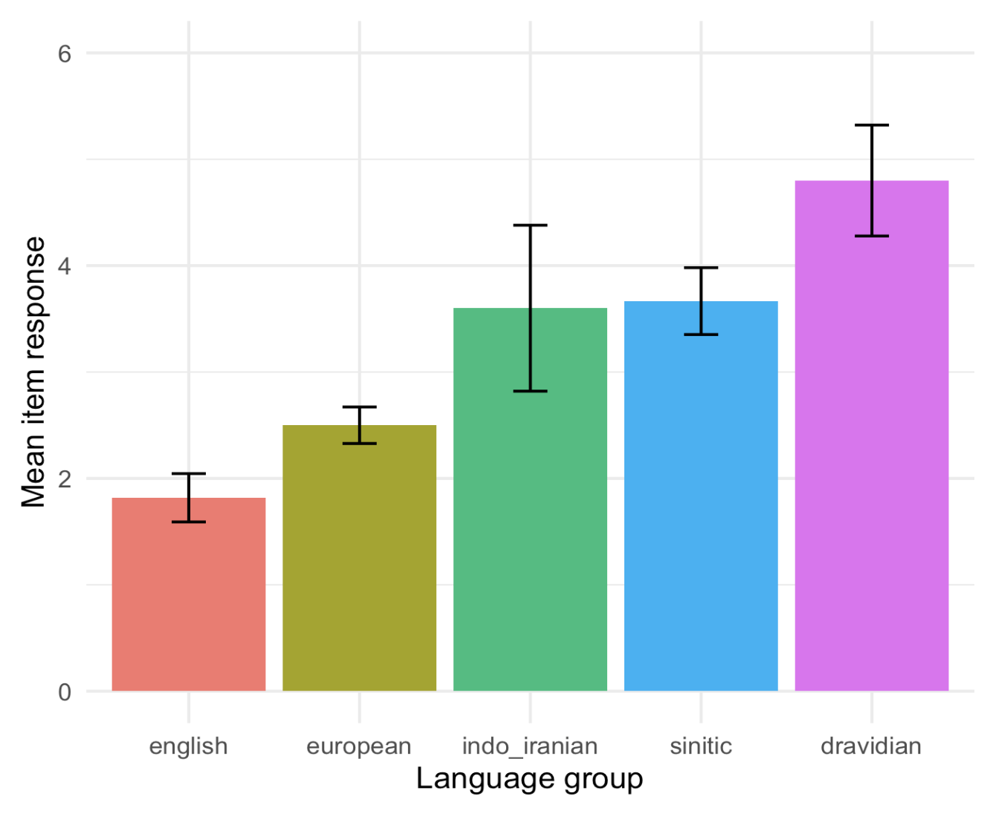
TOPIC 3
RESULTS
Student responses by language group
Reading 15
I frequently need to read extra material in another language to help me understand course topics.

Slide 21
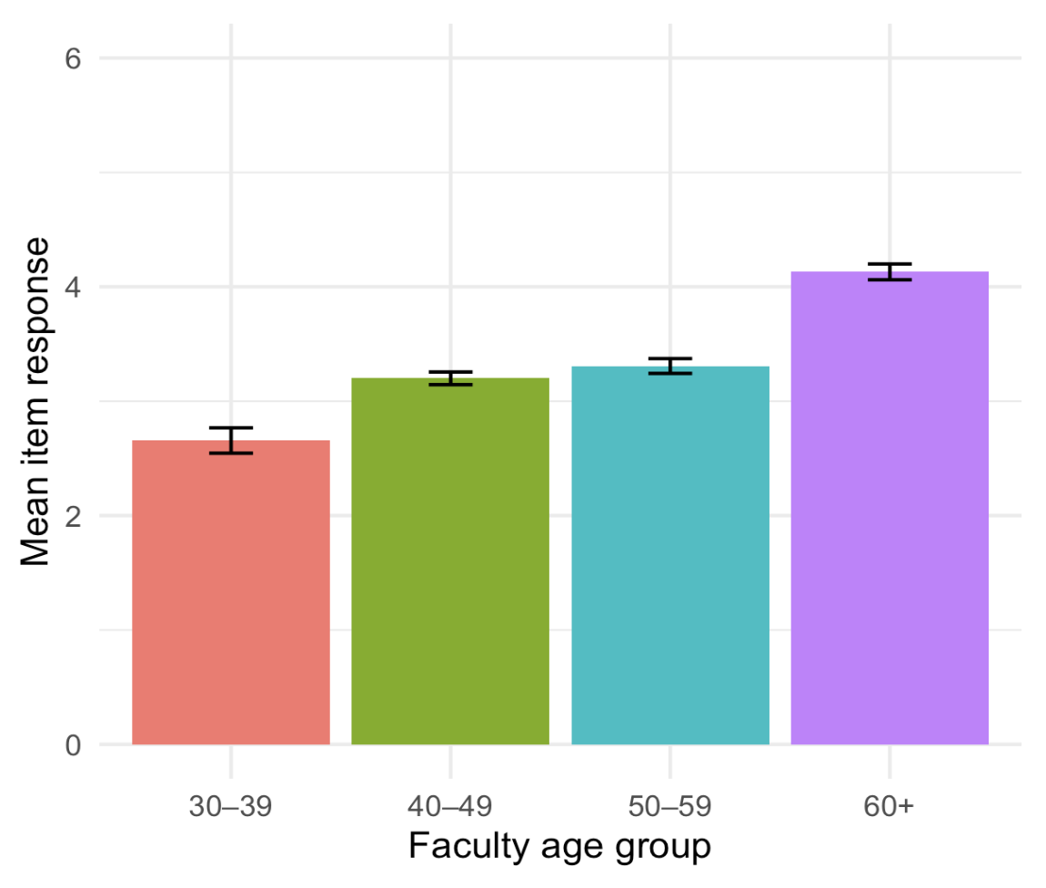
TOPIC 3
RESULTS
Staff responses by age group
Writing 12
My students frequently need to communicate with professors via text messages, instant messaging, and social media.

Slide 22
BALEAP descriptors

Slide 23
BALEAP
Survey items & BALEAP descriptors
33 survey items
Technology
Extracurricular reading
Written communication
Plurilingualism
64 descriptors / 27 items
Reading comprehension
Select and evaluate source materials
Write clearly and concisely
Language knowledge and accuracy
Spoken interaction
Note-taking
104 descriptors
Critical thinking
Synthesize information
Format and components of written products
Engage in discussion/ debate
British context

Slide 24
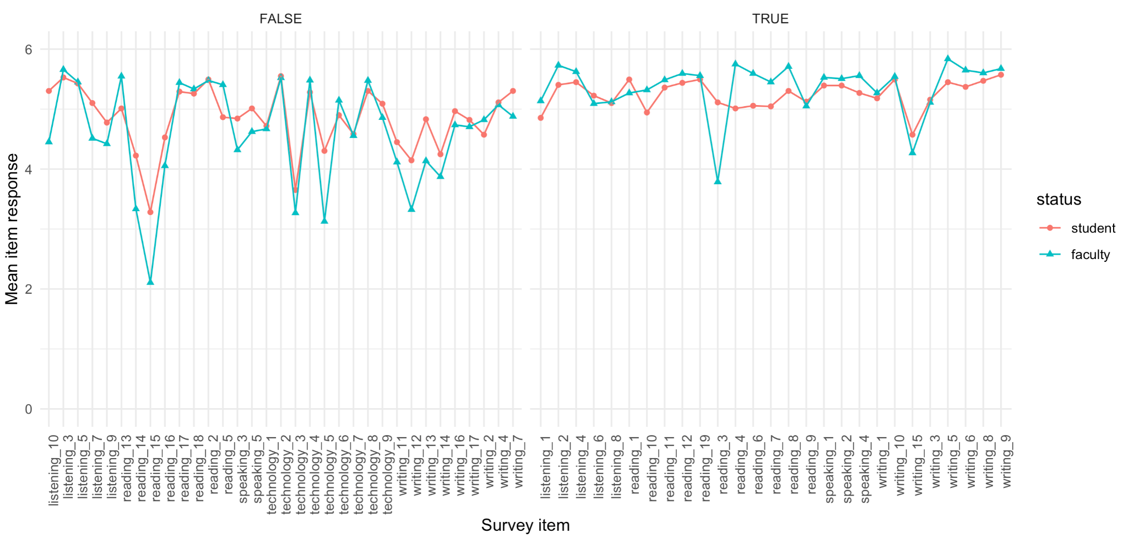
BALEAP
Survey items by BALEAP mapping
Does NOT map to BALEAP descriptors
DOES map to BALEAP descriptors
staff

Slide 25
TOPIC 3
RESULTS
Highest rated unmapped survey items
Item | Domain | Student mean | Staff mean
understand the instructor’s spoken directions regarding assignments. | 👂 | 5.53 | 5.66
type paragraph-length (or longer) text on a computer. | 💻 | 5.28 | 5.48
locate and understand information provided in charts, graphs, and tables. | 📖 | 5.49 | 5.48
understand the difference between suggestions, advice, directives, and warnings when spoken (e.g., as heard in a lecture or during a conversation). | 👂 | 5.43 | 5.45
read and understand text on lecture presentation slides and video subtitles. | 📖 | 5.29 | 5.44
read for everyday purposes (e.g., train schedules, food menus, street signs). | 📖 | 5.26 | 5.34

Slide 26
Conclusion

Slide 27
Concluding thoughts
Generally similar trends across country (UK/US) and status (student/staff)
A few interesting differences between students and staff
Using keyboard shortcuts, typing on a smartphone, reading in another language
Some items differ by other demographic variables
Language group (reading in another language)
Age/teaching experience (texting with students)

Slide 28
More concluding thoughts
~50% of our survey items correspond to BALEAP descriptors
These items were generally highly rated
Unmapped survey items present possible expansion of BALEAP framework
Typing skills
Interpreting charts, graphs, and tables
Reading time-limited text (slides, subtitles)
Reading for everyday purposes

Slide 29
Thanks!
Questions?
Suggestions?
ramsey@duolingo.com
ben.naismith@duolingo.com
BALEAP ‘23

