Slide 1



Network Launch
BALEAP 2023
Aleks Palanac
University of Leicester
ap417@le.ac.uk
@AleksPalanac
Dr Tomasz John
University of Strathclyde
tomasz.john@strath.ac.uk
@tomaszjohn84
Sadie-Jade Fouracre-Reynolds
Swansea University
s.fouracre-reynolds@swansea.ac.uk
Eva Hanna
University of Glasgow
e.hanna.1@research.gla.ac.uk
Jonathan Birtwell
University of Auckland
jonathan.birtwell@cantab.net
Notes:
Aleks (and everyone could introduce themselves at this point too?)

Slide 2
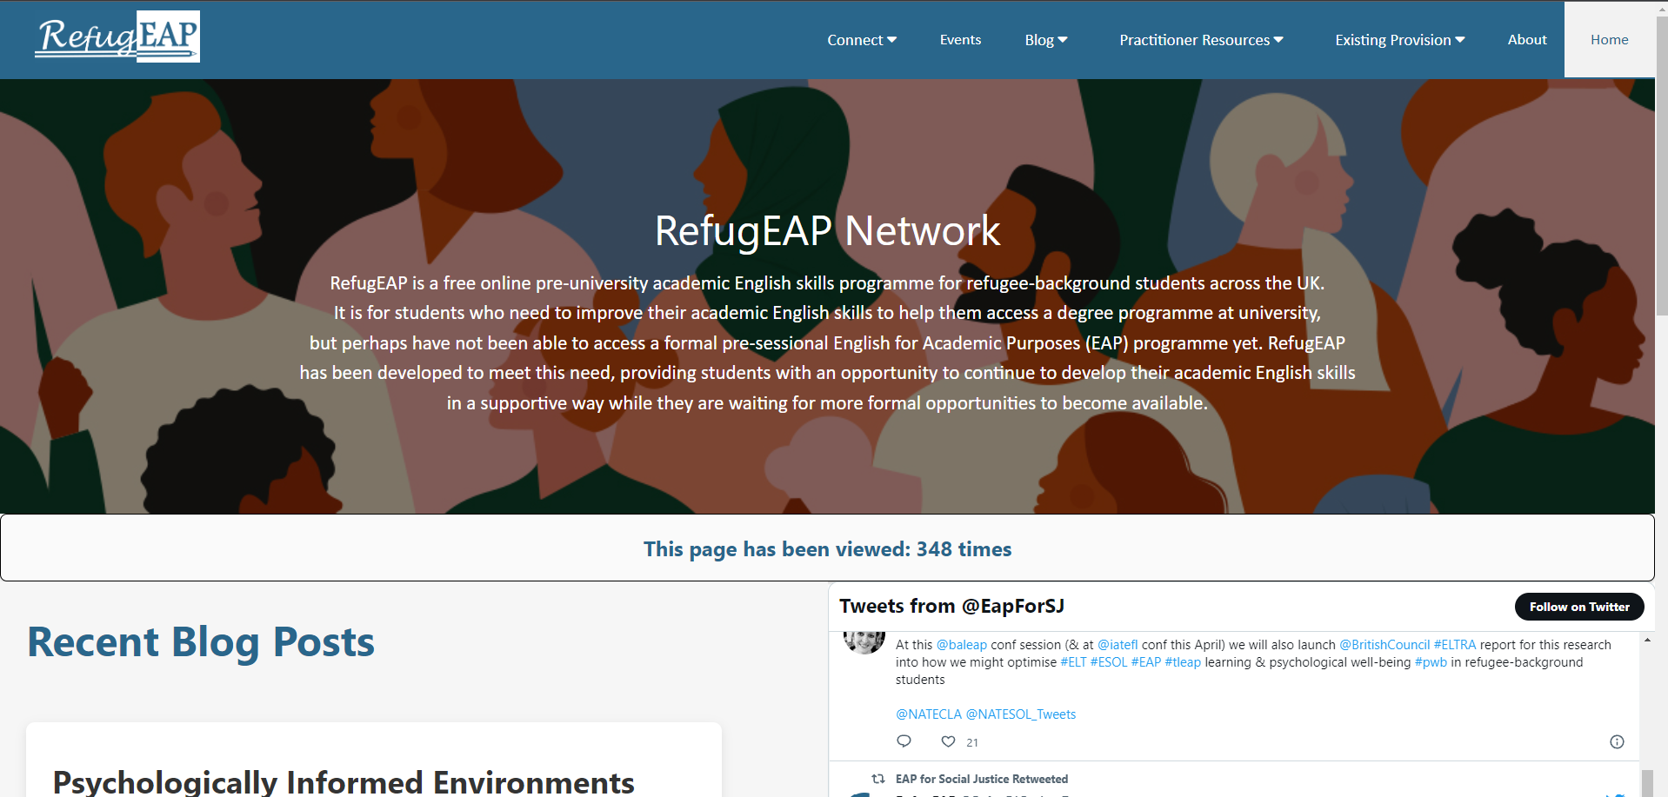
Session “Menu”
About
Existing provision
Practitioner resources
Blog
Events
Connect
Notes:
Aleks

Slide 3
About
Notes:
Aleks

Slide 4
Purpose
The RefugEAP Network’s overarching objective is to facilitate the development and implementation of ‘pathway to Higher Education’ English language provision for refugee-background students (RBS), with a particular focus on
English for Academic Purposes (EAP)
Notes:
Aleks

Slide 5
The Need: Context
only 6% of the world’s eligible refugees have access to HE,
as compared with 40% of non-refugees (UNHCR, 2023)
Notes:
Aleks

Slide 6
The Need: Common Barriers to HE for Refugees
The reasons …
Finance
Difficulty evidencing prior educational achievements
Information, Advice and Guidance
Mental health
Practical / situational barriers (e.g. due to asylum case, poor housing, etc)
Language
A range of barriers getting into HE
+ through HE
+ beyond HE
(Stevenson & Baker, 2018)
Notes:
Aleks

Slide 7
The Need: EAP
“What those seeking access to HE need is English for Academic Purposes which enables learners to develop those sorts of English language skills needed for higher level academic and vocational courses, specifically those relating to critical reading. These courses are not free and so are
out of the reach of many refugees.”
(Stevenson and Baker, 2018:57)
Notes:
Aleks

Slide 8
The RefugEAP Network Working Group
Set up in April 2022 to redress this situation
A working group of the EAP for Social Justice SIG
EAP practitioners, researchers and managers from across the UK HE sector
Main aim: to develop and run the RefugEAP Network
The RefugEAP Network’s overarching objective is to facilitate the development and implementation of ‘pathway to Higher Education’ English language provision for refugee-background students (RBS), with a particular focus on
English for Academic Purposes (EAP)
http://eap4sj.weebly.com/
Notes:
Aleks

Slide 9
Aims of the RefugEAP Network
to connect and support individuals and institutions from across the UK HE sector who are keen to take this work forward
to gather and share examples of good practice and impact in order to:
  provide evidence of successful sanctuary initiatives related to facilitating access to EAP to allow individuals/organisations to build strong cases for the development of similar initiatives within their institutions
  provide ideas, strategies and resources to those developing and engaging in sanctuary initiatives
to advocate for increased opportunities across the HE sector for RBSs to access pre-sessional EAP provision (or similar) and successfully move onto degree programmes
to create new sector-wide systems, where necessary, to optimise communication flow between all stakeholders (including universities, RBSs, potential partner organisations) in order to match opportunities to needs
Notes:
Aleks

Slide 10
How?
Notes:
Aleks

Slide 11
Significance of the RefugEAP Network
Adds to existing HE access-related networks for displaced learners
cc
Contributes complementary and specialised focus on academic English language needs, i.e. beyond general ESOL provision
cc
Enables evidence and practice sharing, provides detailed guidance and strategies
cc
Empowers practitioners to work-around and challenge Hostile Environment policies, bordering, neoliberal marketization of HE, etc.
cc
Supports practitioners to harness and hold to account university marketing strategies related to EDI, Widening Participation/Access, internationalisation (at home), rankings, and commitments to international frameworks e.g. SDGs, etc.
Notes:
Eva
The RefugEAP Network builds on previous and ongoing work done in the area of access into, through, and out of higher education for forced migrants, such as Universities of Sanctuary, STAR, etc., but is unique in its exclusive focus on language, and in particular English language in the context of university access.
This focus is critical, because there is a relative lack of awareness and acknowledgement of the specialised English language needs forced migrants with aspirations to begin or continue university studies. That is, there is a wide array of valuable work being done around general ESOL, but this is often aimed at civic integration and immediate employment. Such employment may not be aligned with individuals’ previous qualifications and professional experiences prior to fleeing to the UK, or may represent younger, school-leaving refugees being told to adjust their expectations with respect to their future professional aspirations.
Building the website and its content has involved bringing together interested practitioners from around the UK not only to share their own practice at their respective institutions or organisations, but to develop a new system of expanding a support network to reach stakeholders across the UK nations and potentially beyond.
Empowering practitioners to work-around and challenge prevailing Hostile Environment policies, bordering, neoliberal marketization of HE, while also
harnessing and holding to account university marketing strategies re EDI, widening participation, internationalisation, rankings, etc

Slide 12
Existing Provision
Notes:
Jade

Slide 13
Examples of provision for refugees
Types of HE lang. provision for refugees | Examples
Free places on pre-sessional (pre-university) academic English programmes | University of Leicester’s pre-sessional fee waivers for RBS
Free informal English classes based on a variety of possible models, including: Put on directly by the university (e.g. perhaps by staff in the English language teaching centre or via a staff/student volunteering scheme) Put on in partnership with a charity (e.g. local City of Sanctuary branch) Put on as part of a TESOL teacher training course such as CELTA or MA TESOL and classes taught by student trainees | Community Classes - Swansea University University of Leicester + Leicester City of Sanctuary ESOL classes
Free places on exam preparation courses such as IELTS, Cambridge ESOL, Occupational English Test (for requalifying medics) – with external exam funded by RefuAid | University of Leicester’s OET online intensive University of Sheffield’s IELTS classes
RefugEAP Programme of online EAP classes for refugee background students in the UK (More information about the programme and eligibility criteria here: https://le.ac.uk/cite/sanctuary-seekers-unit/initiatives/refugeap ) | https://le.ac.uk/cite/sanctuary-seekers-unit/initiatives/refugeap
Notes:
Jade

Slide 14

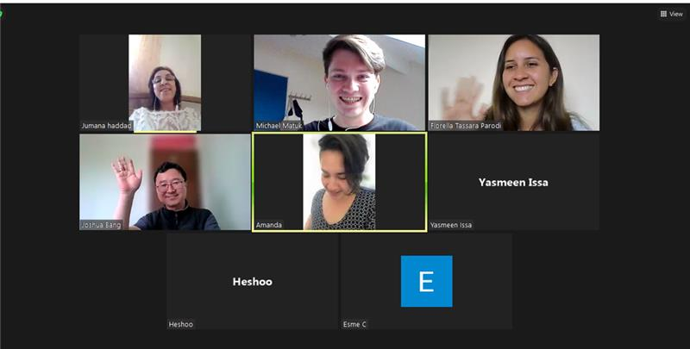
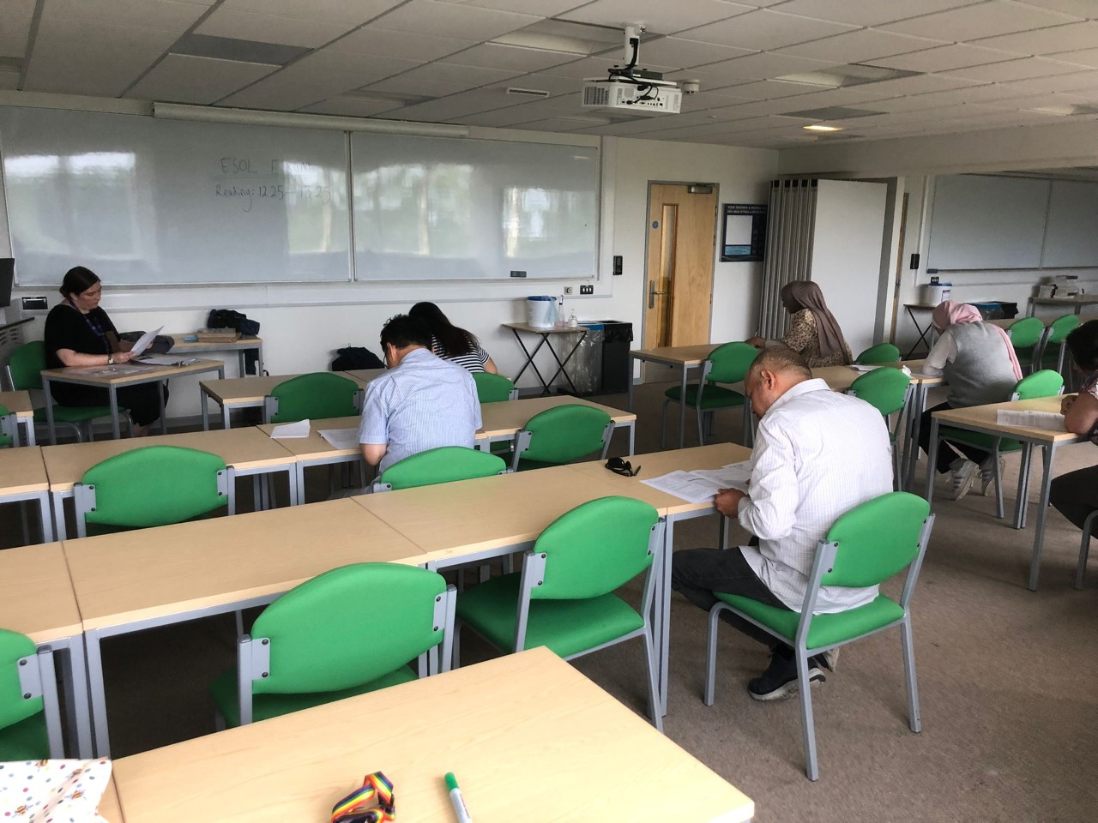
Examples of provision: Community classes (Swansea University)
an online ESOL class
students celebrating the end
of exams with their teacher
students sitting their Trinity ESOL Entry 3 exam
Notes:
Jade

Slide 15




Examples of provision: RefugEAP Programme
Free online pre-university academic English skills programme for refugee-background students across the UK
Stop-gap for students who can’t access a pre-sessional
Classes taught by volunteer EAP tutors
Guiding principles:
  Trauma-informed pedagogy
  Social justice education (e.g. UN SDGs)
  Students as Partners approach
Phase 1 (10 weeks)
Part-time online pre-sessional style course
2 x 90 minute classes per week
Assessments – essay and presentation
Independent study
Phase 2 (10 weeks)
1:1 mentoring programme (5-10 tutorials)
Opportunity to attend IELTS prep workshops
Opportunity to continue
EAP studies using Oxford
EAP (UI) online course book
Notes:
Aleks

Slide 16
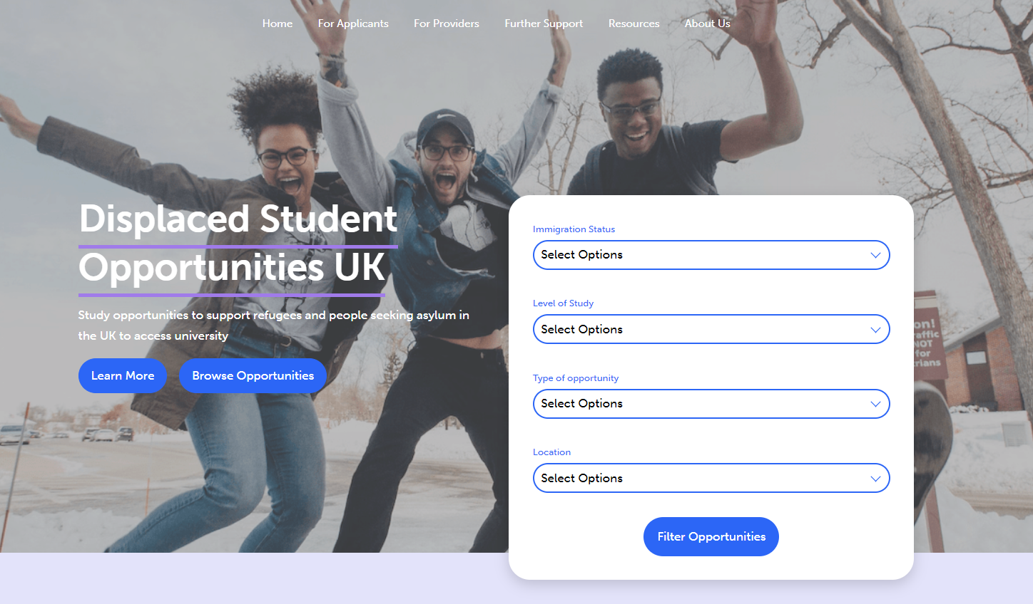
Examples of provision for refugees
Directing people to Displaced Student Opportunities UK: https://www.displacedstudent.org.uk/
For organisations: further examples of provision on offer
For students: a means of finding current opportunities
Notes:
Aleks

Slide 17
Practitioner Resources
Notes:
Tomasz

Slide 18
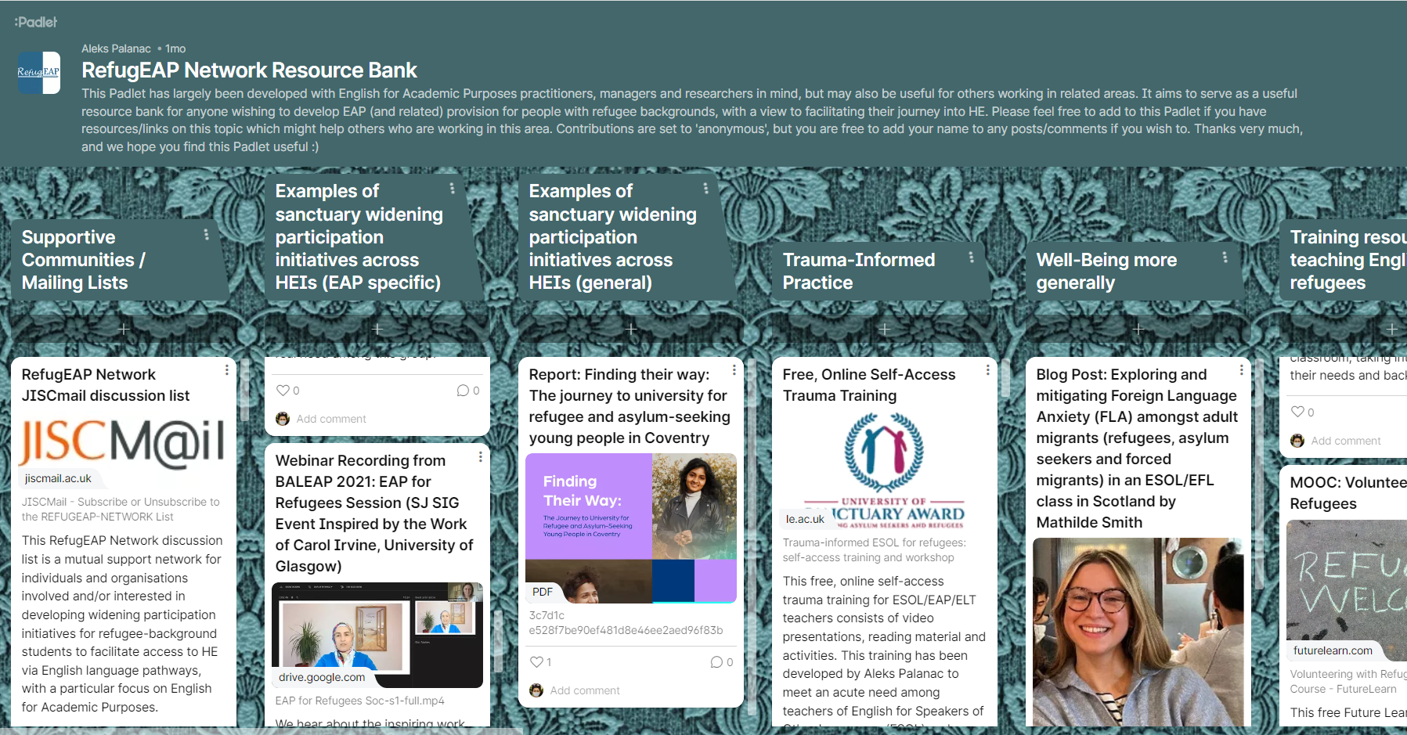
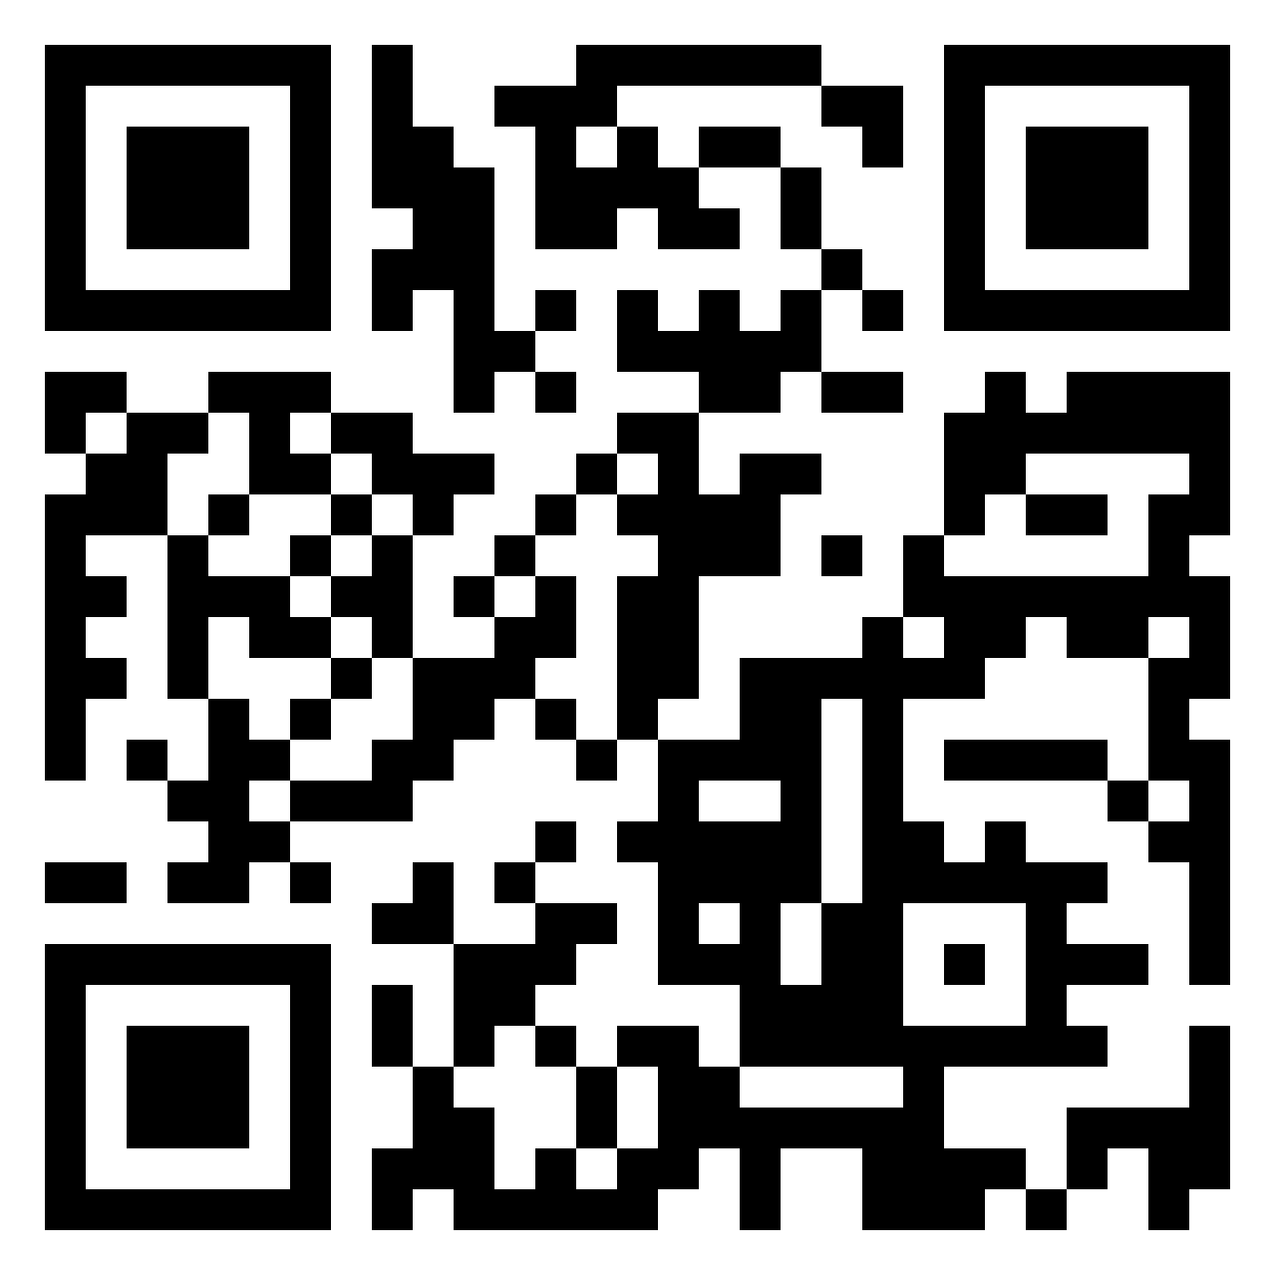
Practical Resources: Resource Bank Padlet
Notes:
Tomasz
This Padlet has largely been developed with English for Academic Purposes practitioners, managers and researchers in mind, but may also be useful for others working in related areas. It aims to serve as a useful resource bank for anyone wishing to develop EAP (and related) provision for people with refugee backgrounds, with a view to facilitating their journey into HE.
Examples of resources include:
Supportive communities and mailing lists
Examples of sanctuary widening participation initiatives across HE and EAP
Trauma-informed practice
Well-being more generally
Training resources – teaching English to Refugees
Volunteering and activism in refugee education
Pastoral support
Useful partner organisations and movements (specific to education)
Courses and resources for learning English
Research related to Sanctuary and HE and refugees
Relevant job descriptions and volunteering opportunities
Please feel free to scan the QR code and add to this Padlet if you have resources/links on this topic which might help others who are working in this area. Contributions are set to 'anonymous', but you are free to add your name to any posts/comments if you wish to.

Slide 19
Tips for Developing Provision
General tips
Connect with others
Tap into inspiring vision
Start small + demonstrate impact
Find partner organisations
Link to key university strategies / systems
Feed into key national / int’l rankings
Mitigate concerns about loss of revenue
Base proposals on evidence, where poss
Gain backing of advocates at higher level of your org
Tips for developing EAP sanctuary provision
Consider entry requirements and expectations for pre-sessional fee waivers
Consider how to identify and meet additional needs (e.g. needs analysis, TIP, additional support)
Evidence of language level (e.g. free tests)
joined up provision and pathway support (into and out of your programme)
Notes:
Tomasz
In terms of general tips:
Start by connecting with others who share your vision for the provision you want to develop. This may include colleagues within your university or external partners in the community. Tap into an inspiring vision for the provision that aligns with key university strategies and systems. This will help to ensure that your proposal is well-supported and has the potential to achieve institutional buy-in. Begin small by demonstrating the impact of your provision. This will help to build momentum and garner support from stakeholders. Find partner organizations that share your vision and can help you to achieve your goals. This may include community organizations, businesses, or other academic institutions. Link your proposal to key university strategies and systems, and feed into national and international rankings where possible. This will help to demonstrate the value of your provision and increase its visibility. Develop strategies to mitigate concerns about revenue loss. This may include exploring alternative funding sources or finding ways to offset costs. Base your proposals on evidence wherever possible. This may include research studies or data-driven analysis. Finally, gain the backing of advocates at a higher level within your organization. This will help to ensure that your proposal receives the necessary resources and support to be successful. By following these steps, you can develop a strong and well-supported provision that meets the needs of your institution and the wider community.
These tips are aimed at developing an EAP sanctuary provision:
Entry requirements and expectations for pre-sessional fee waivers: When developing EAP sanctuary provision, it is important to establish clear entry requirements for the program. This may include specific language proficiency levels, academic requirements, or other criteria. Additionally, you should consider offering fee waivers for pre-sessional courses for students who meet certain criteria, such as those from low-income backgrounds or those with demonstrated financial need. Consider how to identify and meet additional needs: To ensure that your EAP sanctuary provision is effective, it is important to consider how to identify and meet additional needs of students beyond language support. This may include conducting a needs analysis to identify specific areas where students require additional support, offering targeted intervention programs (TIPs), or providing additional academic support services. Evidence of language level: It is important to have a clear understanding of the language levels of students entering your EAP sanctuary provision. You may consider offering free language proficiency tests to students to ensure that they are placed in the appropriate level of language support. Joined-up provision and pathway support: It is important to develop a joined-up provision and pathway support system for students in your EAP sanctuary provision. This means ensuring that the support offered is integrated with other academic programs and pathways, both into and out of your program. For example, you may consider developing clear pathways for students to progress from your EAP sanctuary provision into academic programs, as well as offering support for students who are transitioning out of your program and into other academic programs.

Slide 20
Example of Tip for Developing Provision (University of Strathclyde)
Implementing research / researching implementation: Integrating trauma-informed pedagogy in training MSc TESOL students volunteering to teach English to Ukrainian Displaced People.
Research: Trauma-informed pedagogy (Finn, 2010; Furneaux, 2018; Palanac, 2019; Stone, 1995) recognises and addresses the effects of trauma on the learning and development of individuals, and highlights the importance of creating a safe and supportive learning environment that fosters trust, empathy, resilience and growth.
Training: Drawing on this research, the researchers / teacher-educators devised and piloted a training programme for student-volunteers, incorporating a trauma-informed approach to teaching English to Ukrainian Displaced People.
Teaching: Student-volunteers observe, assist and teach classes for Ukrainian Displaced People attending a regular drop-in programme of English classes.
Reflection: Students-volunteers and researchers / teacher-educators meet on a regular basis to review experiences, compiling reflective diaries which focused on the impact of the trauma-informed pedagogy element of the training, among other features.
Research: Students-volunteers draw on their experiences and reflections for their dissertations, while researchers / teacher-educators analyse the data collected over the course of the cycle to develop understandings of how training for trauma-informed pedagogy can be effectively implemented.
Notes:
Tomasz
There is a growing demand for English language provision for vulnerable adults and children among refugees, asylum seekers and forced migrants in Glasgow, Scotland. To address this need, my colleague from The University of Strathclyde and I have implemented an initiative that allows our MSc TESOLIC students to observe, support and teach vulnerable learners while developing access to potential research data. The program focuses on trauma-informed pedagogy, which recognizes the impact of trauma on students' learning and well-being and seeks to create a safe and supportive learning environment. The program involves a cycle of research, training, teaching, reflection and research again, with the aim of enhancing the quality of learning and teaching and developing collaborative partnerships between TESOL programs, students and ESOL provision providers. Early findings suggest that the program has created greater awareness of the challenges that stakeholders may encounter when working with vulnerable adults and has helped to develop a better understanding of teaching strategies and research.

Slide 21


Testimonials
Wenwen: “I started to know my student’s situation and the best English class they need, according to their needs. As a teacher, I paid attention to their mental health, not just teaching techniques. I signed up for a training session on trauma-informed pedagogy to become more professional as an English teacher for refugees. After two months of theoretical and practical training, I felt I was able create safe learning atmosphere and enjoyable classes.”
Mehrdad: “As part of my PhD project, I taught an ESOL course to 17 Ukrainian students at elementary level. I also received training on trauma-informed pedagogy, which, combined with my ongoing literature review on trauma-informed teaching and learning, provided me with valuable insights into creating a safe and supportive learning environment. Overall, the experience was rewarding for both me and the students. “
Notes:
Tomasz

Slide 22

Evidence Base
Blog – case studies, testimonials, other forms of evidence
Repository of studies on HE access for forced migrants (curated by Eva Hanna)
Database
Notes:
Eva
Emphasise the fact that we are looking for more contributions for Eva's repository.
We are complementing the HERE network

Slide 23
Blog
Notes:
Eva

Slide 24

Blog
To encourage sharing of good practice, experience, evidence
Submissions encouraged from practitioner, student, researcher, policy and personal perspectives
Different formats accepted (and encouraged!)
Notes:
Eva

Slide 25
Blog
Testimonials
Other blog contributions
Case Studies
Utilising universities as ESOL providers
by Jade Fouracre-Reynolds
Psychologically Informed Environments (PIE) and Trauma Informed Practice (TIP) at the Centre of Open Learning (COL) at the University of Edinburgh
cc
By Amelia Harker
A RefugEAP Programme Student Testimonial
By Iuliia Kniupa
Implementing research / researching implementation: Integrating trauma-informed pedagogy in training MSc TESOL students volunteering to teach English to Ukrainian Displaced People.
by Tomasz John
Trauma-Informed Pedagogy for Teaching Refugee Background Students Online - Opening a Conversation
By Jonathan Joseph Birtwell
Notes:
Eva – added Tomasz's blog entry (Fri 14 April). Jonathan's blog title is still to come (to be added on 15th April)

Slide 26


An example blog contribution
Trauma-Informed Pedagogy for Teaching Refugee Background Students Online - Opening a Conversation
By Jonathan Joseph Birtwell
Notes:
Eva – could you briefly introduce Jonathan's blog contribution here? Sth like – Jonathan wasn't able to attend in person today but has recorded a short video highlighting the main points from his blog post on the RN website

Slide 27
Events
Notes:
Tomasz – when will we have access to the website so that I can embed the events here? Unless we have a separate list of the events?

Slide 28
Events
Date: 20-05-2023
Event: Classrooms of Sanctuary and Struggle: Trauma-Informed and Participatory ESOL
Time: 10:30-17:00 (UK time)
More Info: This face-to-face day-long conference will take place at King’s College London. It is an exploratory and experiential conference on the symbioses and tensions of participatory ESOL and trauma-informed practices. More details are available here
Features upcoming events
Website visitors can add events to this too via a form
Date: 21-04-2023
cc
Event: Beyond Resilience: Facilitating Learning and Well-Being in the Refugee Language Classroom
cc
Time: 10:10 – 10:50 (UK time)
cc
More info: This face-to-face session is part of the BALEAP 2023 conference (entitled Caution! EAP Under Deconstruction). Speaker: Aleks Palanac (University of Leicester). The full programme of events can be found here.
Notes:
Tomasz – shall we dedicate one slide to the events?

Slide 29
Connect
Notes:
Aleks

Slide 30
Ways to connect
Contact Us refugeap-network.net
refugeap-network@baleap.org
Join Us subscribe to our JISCmail discussion list
contribute to our RefugEAP Network Resources Bank Padlet
contribute to our Blog
suggest an event for our Event calendar
follow us on Twitter at @RefugEAP
join our Working Group
add your details to our Directory
Directory Find others involved in ‘pathway to Higher Education’ English language provision for refugee-background students across other UK HEIs
Notes:
Aleks

Slide 31
References + Resources
RefugEAP Network website: refugeap-network.net
RefugEAP Network Resources Bank Padlet: https://padlet.com/alekspalanac/94dn9e90rewkm1p3
EAP4SJ website: http://eap4sj.weebly.com/
RefugEAP Programme web pages: https://le.ac.uk/cite/sanctuary-seekers-unit/initiatives/refugeap
Displaced Students Opportunities UK: https://www.displacedstudent.org.uk/
Hub for Education for Refugees in Europe: https://hubhere.org/
RefuAid: https://refuaid.org/
Screen Share: https://www.screen-share.co.uk/
Password English Language Testing: https://www.englishlanguagetesting.co.uk/
Stevenson, J. & Baker, S. (2018) Refugees in Higher Education: Debates, Discourse and Practice. Bingley: Emerald Publishing Ltd​
UNHCR (2023) Tertiary Education. UNHCR [online]. Available: https://www.unhcr.org/uk/tertiary-education.html
Notes:
Aleks

