Slide 1
Reading group: Using corpus linguistics to understand the academic domain
Ben Naismith & Ramsey Cardwell
Duolingo English Test
April 21, 2023
BALEAP 2023 Conference

Slide 2
Agenda
Intros & paper summary (15 mins)
Methods questions (15 mins)
Implication questions (25 mins)
Wrap up (5 mins)
Notes:
First, we will present a short summary of the paper and will answer any clarification questions so that we all have a shared understanding of the study design and purpose.
Next, we will discuss questions related to the study’s methodology, focusing on its suitability and generalizability to contexts like EAP in the UK.
The majority of the session will focus on questions relating to the implications of the study. This is where the conference theme fits in - how might the findings challenge current EAP practices in relation to assessment, curriculum design, and pedagogy.
Finally, if time, we can briefly touch on other relevant readings which may be of interest

Slide 3
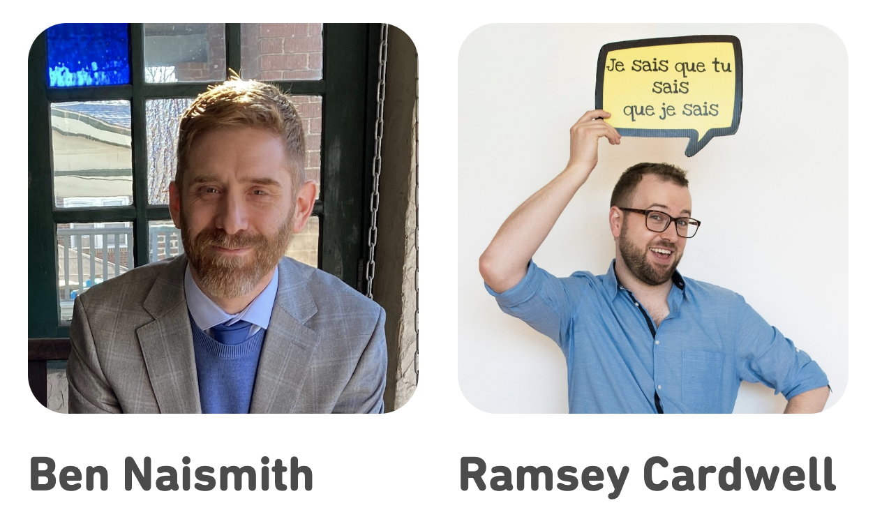
Introductions
Duolingo English Test Assessment Scientists
Notes:
If small group (<10), go round and give names affiliations or interests

Slide 4
paper summary

Slide 5
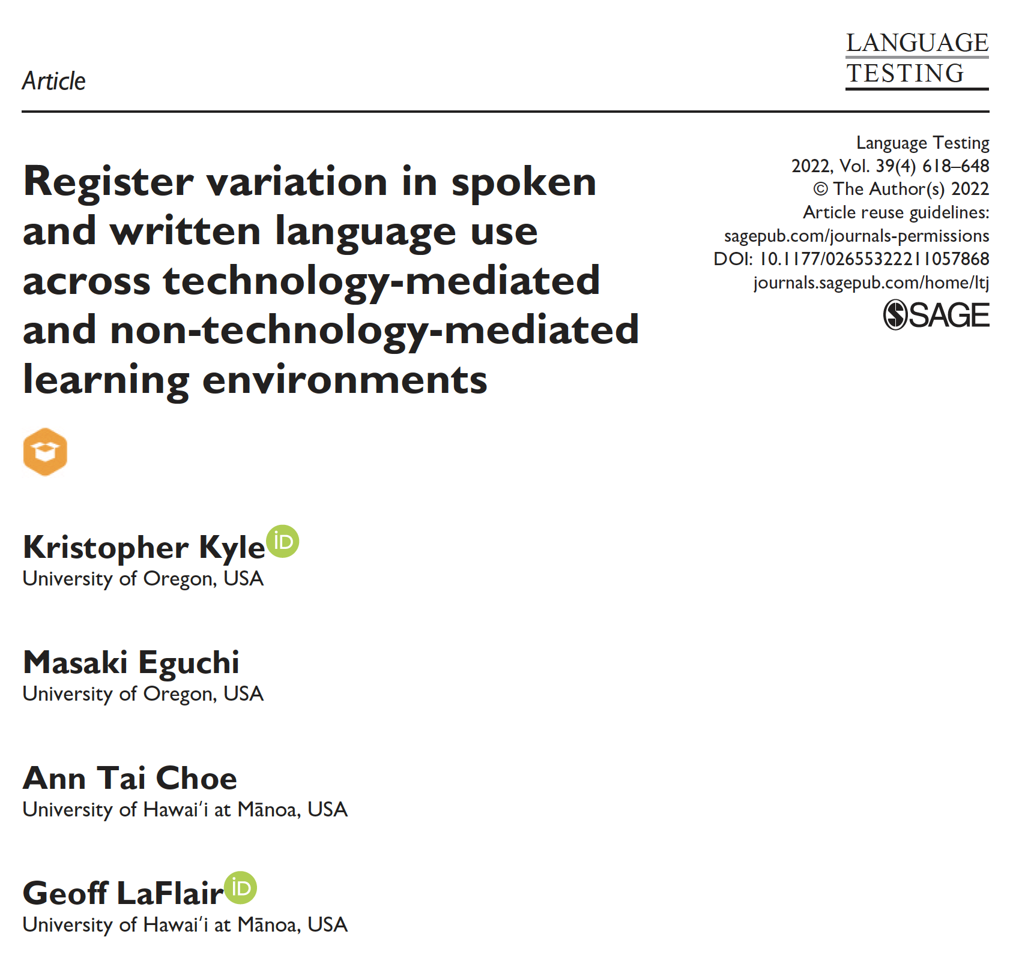
PAPER SUMMARY
Focus
Changes to the language in current university settings compared to the early 2000s
RQ: How (dis)similar are the features of spoken and written language use within and across registers represented in technology-mediated and non-technology-mediated learning environments?

Slide 6
PAPER SUMMARY
Background: Corpora to describe TLU domains
Used to identify linguistic features specific to a language use domain
Register affects the distribution of linguistic features (e.g., Biber 1988, 2004)
Biber et al. (2004)
university writing has features that increase informational density
university speaking has more interactional language features
features vary by register across modalities, e.g., syllabi and service encounters share similarities that syllabi and textbooks don’t in terms of amount of procedural discourse
Notes:
Same subheadings as the paper, assistance from ChatGPT for bullet points:
Corpus analyses can identify linguistic features specific to a language use domain.
Registers, which are combinations of mode and situation of use, can affect the distribution of linguistic features.
Biber et al. used multidimensional analysis (MDA) to document the lexicogrammatical features characteristic of various spoken and written registers in a corpus of university language.
Biber et al. (2004) showed that written university language is characterized by complex noun phrases and increased informational density (e.g., nominalization, relative clauses), while spoken university language is characterized by interactional language and reduced forms (e.g., personal pronouns)
The lexicogrammatical features of written texts also vary by register, with textbooks and course packs including very few features related to procedural discourse, while course management texts (e.g., syllabi) included a similar proportion of these features as service encounters.

Slide 7
PAPER SUMMARY
Background: Corpora and validity arguments
Descriptions of linguistic features in a TLU can support validity for language proficiency assessments (e.g., Chapelle et al., 2008)
Domain description inference (Is the language elicited authentic in the TLU domain?)
Extrapolation inference (Are the constructs assessed representative of successful language use in the TLU?)
Corpora can provide this information, assuming they are representative
TOEFL validation used T2K-SWAL corpus, but what changed in last 20 years?
KANE
Notes:
Corpus analyses can provide evidence for the domain description inference and support the extrapolation inference for test development.
The corpora used must be reasonably representative of registers in the target language use domain to ensure validity.
As university learning environments become increasingly technology-mediated, corpora may need to be supplemented with typical TMLE registers to adequately represent the target language use domain.

Slide 8
PAPER SUMMARY
Background: Technology-mediated learning environments
Increase in TMLEs, accelerated by COVID-19 (online courses, course management systems, etc.)
Corpus analysis can identify differences between TMLEs and non-TMLEs, e.g., TMLE project (Kyle et al., 2021)
Meaningful differences between TMLEs and non-TMLEs
TMLE spoken input more challenging, written input less
Still a need to explore register differences
Notes:
TMLEs have been increasingly used in university courses over the past two decades, and the COVID-19 pandemic has accelerated this trend.
TMLEs include online, hybrid, and face-to-face courses that use course management systems, simulations, tutorials, games, wikis, blogs, and social media, among others.
Determining how TMLEs differ from traditional, non-technology-mediated registers requires systematic analysis using corpora.
Kyle et al., 2021: Meaningful differences between TMLEs and non-TMLEs: In general, comprehending spoken input in modern TMLEs is more challenging than in traditional learning environments (especially in instructional videos), whereas comprehending written input in TMLEs is less challenging (especially for instructional readings).

Slide 9
PAPER SUMMARY
Methods
Comparing texts from T2K-SWAL and TMLE corpora:
T2K-SWAL: 2.8M words, US unis, 1990s-early 2000s
TMLE corpus: 4.5M words, TMLE environments in US unis, 2018-2020
Multi-dimensional analysis (MDA; Biber et al., 2004)
TAASSC to analyze lexicogrammatical features (Kyle, 2016)
Tool for the automatic analysis of syntactic sophistication and complexity
Exploratory Factor Analysis to find common latent dimensions
Notes:
T2K-SWAL (Biber et al., 2004):
Spoken and written, registers include formal (lectures and textbooks), less formal (office hours, study groups, service encounters)
Range of disciplines
TMLE corpus (Kyle et al., 2021):
Various geographic regions, publicly available MOOCs from US universities
Spoken and written, various registers (presentation slides, instructional readings, course announcements, etc.)
Range of disciplines
Data analysis - 6 dimensions found

Slide 10
PAPER SUMMARY
Main results
Dimension 1 (Oral vs Literate Discourse):
TMLE speech more ‘writing-like’ than T2KSWAL speech
TMLE - syllabi and slides least ‘speech-like’ of registers
Dimension 2 (Lexical and Phrasal complexity)
TMLE registers varied, instructional videos least complex, instructional readings more complex than other written registers
Dimension 3 (Procedural discourse)
More in speech than writing (both corpora)
Variation in written TMLE registers
announcements & discussions = most
presentation slides = least
Notes:
DIMENSIONS 4-6 FEW SIG DIFFERENCES ACROSS REGISTERS/MODALITIES/CORPORA
Dimension 1 (Oral vs Literate Discourse):
All spoken registers showed significantly higher scores than written registers across learning environments.
Spoken TMLECorp registers had higher mean scores than all written registers but lower than T2KSWAL spoken registers.
Variation found between particular registers; study groups had higher scores than lectures in T2K-SWAL, and syllabi and slides had lower scores than other TMLE-Corp registers.
Dimension 2 (Lexical and Phrasal Complexity):
T2K-SWAL spoken registers had the lowest mean scores for lexical and phrasal complexity features.
T2K-SWAL written registers had the highest proportion of these features, making them relatively difficult to comprehend.
TMLE-Corp registers fell between T2KSWAL spoken and written registers, with instructional videos having the fewest features.
Instructional readings had significantly higher mean scores than less formal TMLE-Corp written registers.
Dimension 3 (Procedural Discourse):
Most spoken texts across learning environments and registers included a higher proportion of procedural discourse than most written texts.
Written course management texts in T2K-SWAL included more lexicogrammatical features related to procedural discourse than other T2K-SWAL registers.
Variation was evident in written TMLE-Corp registers, with announcements and discussions having the highest mean score and presentation slides having the lowest.
Dimensions 4, 5, and 6 (Elaborated Discourse—Clausal Complements, Narrative Orientation, and Elaborated Discourse—Relative Clauses):
Some variation found between registers, but significant and meaningful differences were few and far between.
These dimensions may be helpful in discriminating between disciplines.

Slide 11
PAPER SUMMARY
Additional results
“Few” sig differences between TMLEs & non-TMLEs on Dimensions 4-6
Elaborated Discourse—Clausal Complements
Narrative Orientation
Elaborated Discourse—Relative Clauses
Notes:
DIMENSIONS 4-6 FEW SIG DIFFERENCES ACROSS REGISTERS/MODALITIES/CORPORA
Dimension 1 (Oral vs Literate Discourse):
All spoken registers showed significantly higher scores than written registers across learning environments.
Spoken TMLECorp registers had higher mean scores than all written registers but lower than T2KSWAL spoken registers.
Variation found between particular registers; study groups had higher scores than lectures in T2K-SWAL, and syllabi and slides had lower scores than other TMLE-Corp registers.
Dimension 2 (Lexical and Phrasal Complexity):
T2K-SWAL spoken registers had the lowest mean scores for lexical and phrasal complexity features.
T2K-SWAL written registers had the highest proportion of these features, making them relatively difficult to comprehend.
TMLE-Corp registers fell between T2KSWAL spoken and written registers, with instructional videos having the fewest features.
Instructional readings had significantly higher mean scores than less formal TMLE-Corp written registers.
Dimension 3 (Procedural Discourse):
Most spoken texts across learning environments and registers included a higher proportion of procedural discourse than most written texts.
Written course management texts in T2K-SWAL included more lexicogrammatical features related to procedural discourse than other T2K-SWAL registers.
Variation was evident in written TMLE-Corp registers, with announcements and discussions having the highest mean score and presentation slides having the lowest.
Dimensions 4, 5, and 6 (Elaborated Discourse—Clausal Complements, Narrative Orientation, and Elaborated Discourse—Relative Clauses):
Some variation found between registers, but significant and meaningful differences were few and far between.
These dimensions may be helpful in discriminating between disciplines.

Slide 12
clarification questions?
Notes:
Check if any clarification questions about the study (anyone can answer)

Slide 13
methods
questions

Slide 14
METHODS QUESTIONS
Do you think the TMLE corpus is representative of the target language use (TLU) domain? Would you have included any other text types?
Do you think corpus data from this context is generalizable to the TLU domain in the UK?
Are there any other corpora you would like to see compared using these methods?
How do you feel about focusing on lexicogrammatical features for describing the TLU domain?
Have you ever used TAASSC or tools of this nature to analyze texts? Why/Why not?

Slide 15
implication questions

Slide 16
IMPLICATION QUESTIONS
Did you find any of the results surprising? If so, why?
How might the findings inform EAP assessment practices?
How might the findings inform EAP curriculum design practices?
How might the findings inform EAP pedagogic practices?
What might be some other differences between TMLEs and non TMLEs not captured by corpus data?
What further studies in this same vein would be useful for understanding the current TLU domain?
Notes:
We are not suggesting we know the answers!
Implications suggested by the paper: It is necessary to consider TMLE registers to make sure the domain description inference and extrapolation inference is valid.

Slide 17
additional readings

Slide 18
ADDITIONAL READINGS
Staples et al. (2022)
Example of similar lexicogrammatical feature analysis, but in a UK context
Analysis of linguistic complexity development over 1 year in UK EAP context
Significant differences for most complexity features
Differences between L1 English and L2 English writers
Differences across disciplines
Notes:
Staples, S., Gray, B., Biber, D., & Egbert, J. (2022). Writing trajectories of grammatical complexity at the university: Comparing L1 and L2 English writers in BAWE. Applied Linguistics. https://doi.org/10.1093/applin/amac047
Grammatical complexity has been established as a key indicator of language and writing development (Ortega 2003; Bulté and Housen, 2014; Crossley and McNamara 2014). The present study uses the Register-Functional approach to complexity (Biber et al. 2022) to compare the development of L1 English and L2 English writers across year of study and discipline in the British Academic Written English corpus. It also introduces a novel method of examining developmental trajectories that uses both inferential statistics and descriptive measures to account not only for relationships between the year of study and use of linguistic features, but also for the shape of the trajectories and frequencies of occurrence over time. Statistical analyses reveal significant relationships for most of the complexity features. Means and confidence intervals indicate overall similarities in trends from early undergraduate to graduate-level writing across L1/L2 English writers, but also key differences in the developmental trajectories, including greater use of phrasal complexity features and less use of clausal features by L2 English writers in early levels, as well as distinct use of complexity features across certain disciplines.

Slide 19
ADDITIONAL READINGS
Yan et al. (2020)
Example of dimensionality analysis of speech features
Focus on speaking performances on the Aptis test
Grouping of features into macro and micro fluencies
Application of these methods to a Complexity/Accuracy/Fluency (CAF) framework
Notes:
Yan, X., Kim, H. R., & Kim, J. Y. (2021). Dimensionality of speech fluency: Examining the relationships among complexity, accuracy, and fluency (CAF) features of speaking performances on the Aptis test. Language Testing, 38(4), 485–510. https://doi.org/10.1177/0265532220951508
Speech fluency has been extensively researched as a core construct for second language (L2) speaking assessment. Despite the broad consensus on its multifaceted nature, few researchers have empirically explored the dimensionality of this construct. Operationalizations of fluency vary across research and practice, using both holistic and fine-grained features. To address the dimensionality of speech fluency, in this study we examined an array of fluency features of speaking performances on the Aptis test. We conducted both univariate and multivariate statistical analyses to investigate the relationship between individual fluency features and language proficiency, as well as the relationships among fluency, complexity, and accuracy features. We found differences in the holistic and fine-grained fluency features, suggesting that they might reflect different dimensions of speech fluency and be associated with different components of language proficiency. Based on the findings, we labeled these two types of fluency features as macro and micro fluencies. Whereas macro fluency features tend to entail a holistic representation of fluency, micro fluency features tend to be more closely related to the automatic processing of lexico-grammar, constituting a more direct reflection of the cognitive processes in speech production. The findings support the multidimensionality of speech fluency and the need to include both macro and micro fluency features in the scoring, scale development, and validation of L2 speaking assessment.

Slide 20
References
Biber, D. (1988). Variation across speech and writing. Cambridge University Press.
Biber, D., Conrad, S. M., Reppen, R., Byrd, P., Helt, M., Clark, V., Cortes, V., Csomay, E., & Urzua, A. (2004). Representing language use in the university: Analysis of the TOEFL 2000 spoken and written academic language corpus. TOEFL monograph series. http://www.ets.org/Media/Research/pdf/RM-04-03.pdf
Chapelle, C. A., Enright, M. K., & Jamieson, J. M. (2008). Building a validity argument for the test of English as a foreign language. Routledge.
Kane, M. T. (2006). Validation. In R. L. Brennan, National Council on Measurement in Education, & American Council on Education (Eds.), Educational Measurement. Praeger Publishers.
Kane, M. T. (2013). Validating the interpretations and uses of test scores. Journal of Educational Measurement, 50(1), 1–73.
Kyle, K. D., Choe, A. T., Eguchi, M., LaFlair, G. T., & Ziegler, N. (2021). A comparison of spoken and written language use in traditional and technology mediated learning environments. ETS Research Report No. RR–21-16. Educational Testing Service. https://doi.org/10.1002/Ets2.12329
Kyle, K. D. (2016). Measuring syntactic development in L2 writing: Fine grained indices of syntactic complexity and usage-based indices of syntactic sophistication. Georgia State University. http://scholarworks.gsu.edu/alesl_diss/35/
Staples, S., Gray, B., Biber, D., & Egbert, J. (2022). Writing trajectories of grammatical complexity at the university: Comparing L1 and L2 English writers in BAWE. Applied Linguistics. https://doi.org/10.1093/applin/amac047
Yan, X., Kim, H. R., & Kim, J. Y. (2021). Dimensionality of speech fluency: Examining the relationships among complexity, accuracy, and fluency (CAF) features of speaking performances on the Aptis test. Language Testing, 38(4), 485–510. https://doi.org/10.1177/0265532220951508

Slide 21
Thank you for attending!
Any questions?
ben.naismith@duolingo.com
@BenNaismithELT
www.bennaismith.com
ramsey@duolingo.com
@RamseyCardwell
linkedin.com/in/ramseycardwell

