Slide 1
Putting corpora to work:
applications of corpus tools in the EAP classroom

Slide 2
Aims
Introduce widely-available tools to enable students and teachers to use corpora in the EAP classroom.
Practise using these tools for:
  Using formulaic language (e.g. thesis statements).
  Providing constructive feedback on student writing.
  Preparing for presentations
  Micro-writing practice focusing on improving word choice (e.g. collocations)
Reflect on how these tools might be used in the classroom.

Slide 3
Which quote is more true for you?
“Now corpora, large and small, are seen by many teachers as useful tools, and are being put to use more and more every day. Access has become fairly easy on standard small computers, user-friendly software is available for most normal tasks, websites are accumulating fast, and corpora are almost part of the pedagogical landscape” (Sinclair, 2004, p.2).
“While the contribution of computer corpora to language description is by now an uncontested fact, with corpus linguistics being firmly established as a branch of linguistic inquiry in its own right, the application of computer corpora for language teaching is still a rather neglected area”(Kaltenböck & Mehlmauer-Larcher, 2005, p.65).

Slide 4

How we ended up here…
We want learners to engage with language as it is actually used.
We want learners to be given tools to grow in their skills and autonomy.
We want learners to be empowered to make informed decisions about their language use, rather than being provided with a set of acceptable answers by a teacher.
We want to encourage learners to be critical users of online and digital tools.

Slide 5
Rationale/principles for choice of activities
We want to put corpora to work in way which:
Is easy to use: for both teachers and students, corpora need to be straightforward to use, and not a distraction from other priorities.
Develops and promotes learner autonomy.
Helps with differentiation: putting corpora to work provides good opportunities for differentiation.
Is adaptable: not requiring the rewriting of curricula or generating complex materials (nothing we present here took us more than a couple of hours to create).

Slide 6
Corpora we have used in teaching
The British Academic Written English (BAWE) corpus contains approx 3000 good-standard student assignments (6,968,089 words) distributed across four broad disciplinary areas (Arts and Humanities, Social Sciences, Life Sciences and Physical Sciences) and across four levels of study (undergraduate and taught masters level).
The British Academic Spoken English (BASE) corpus consists of 160 lectures and 38 seminars recorded in a variety of university departments and contains 1,477,281 words. Holdings are distributed across the same four disciplinary groups as BAWE.
(The British National Corpus (BNC) has an academic component.)

Slide 7
Using formulaic language to develop thesis statements
Take advantage of formulaic language to develop parts of students’ writing.
Example: Thesis statements.
  “This essay will…”

Slide 8
Using formulaic language to develop thesis statements
Students guess words likely to follow ‘This essay will…’
Use corpora to provide data to check guesses.
Follow up with observation questions:
E.g. write 5 words which follow the phrase more than once.
Students then developed their thesis statements using this data.
Which do you think are the top 3 verbs which follow ‘this essay will…’?
Notes:
Here’s the link to what I did.

Slide 9

Using formulaic language to develop thesis statements
Which do you think are the top 3 verbs which follow ‘this essay will…’?
Notes:
Here’s the link to what I did.

Slide 10
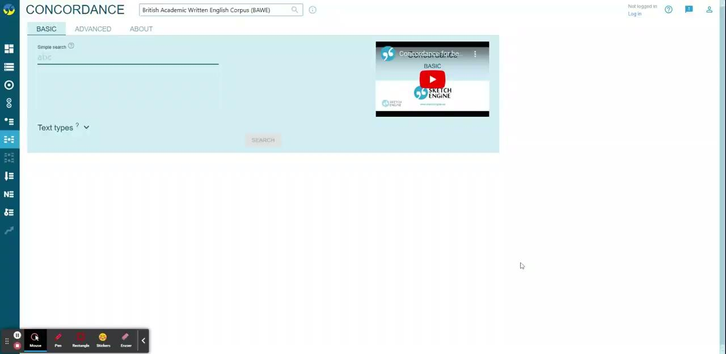
Using formulaic language to develop thesis statements
Notes:
Here’s the link to what I did.

Slide 11
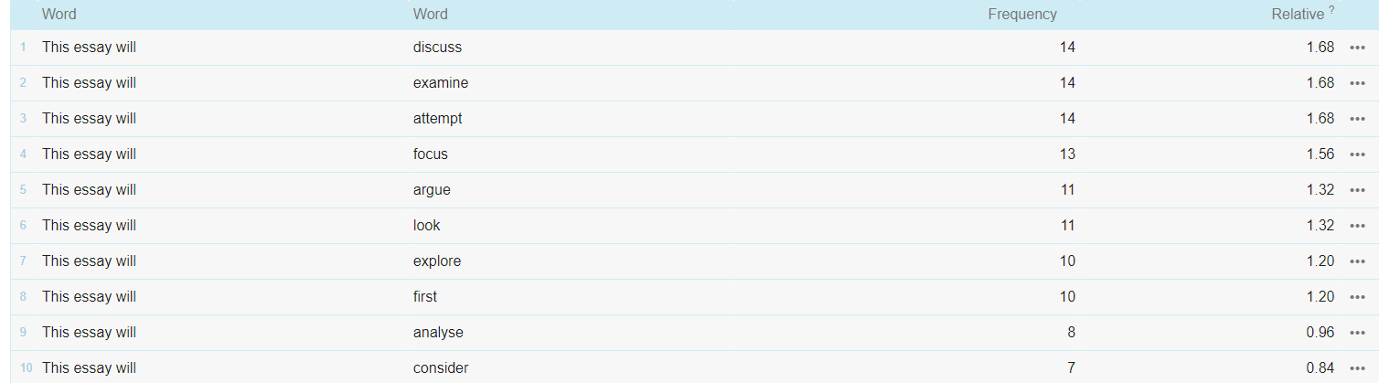
Using formulaic language to develop thesis statements: for lower levels

Slide 12
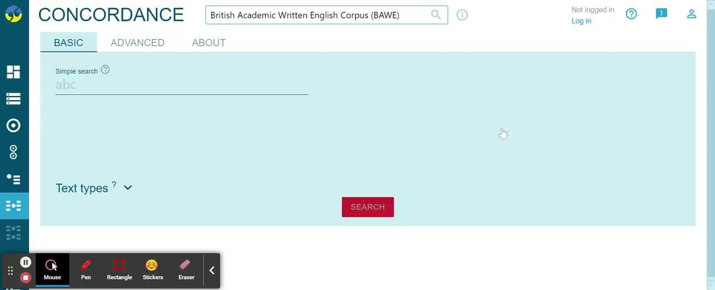
Using formulaic language to develop thesis statements
Students guess words likely to follow ‘This essay will…’
Use corpora to provide data to check guesses, ideal for higher levels.
Notes:
Here’s the link to what I did.

Slide 13
Activity: Using formulaic language to develop thesis statements
Can you use the corpus to start investigating so you can create something you could potentially use with a class of students?
Use Sketch Engine (concordance)
Type the formulaic language and see what you get.
Can you think of any other applications of this tool?
Notes:
Here’s the link to what I did. We could return to this when we’ve done some work on CQL.

Slide 14
BAWE QUICKLINKS and OWN LINKS
based at Coventry University
a database of hyperlinks to concordance lines, collocations lists or word sketches from BAWE in response to some common student errors
can be accessed by anyone
our experience: making own links allows for differentiation and specificity.
Notes:
Coventry BAWE Quicklinks

Slide 15
Making your own links for error correction: Some principles
Differentiation:
Important to note that there is a range of searches you can perform and provide to the students. Some students will benefit from a more open-ended search, maximising scope for autonomy, analysis and decision-making.
Some students will need something which provides them with a limited range of possibilities from which to choose.
Ease of use:
Some searches require more skill and expertise from the teacher and the learner.
In general, the lower level the student, the greater the expertise needed by the teacher.

Slide 16
Making your own links for error correction: Some tools
Filter by part-of-speech
Corpus Query Language (handout available, but we will not cover this today)

Slide 17
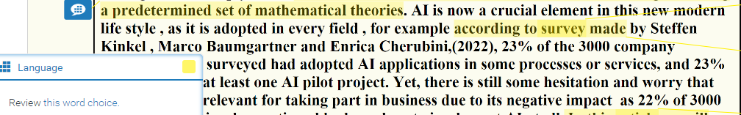
Tool 1: Part of Speech

Slide 18
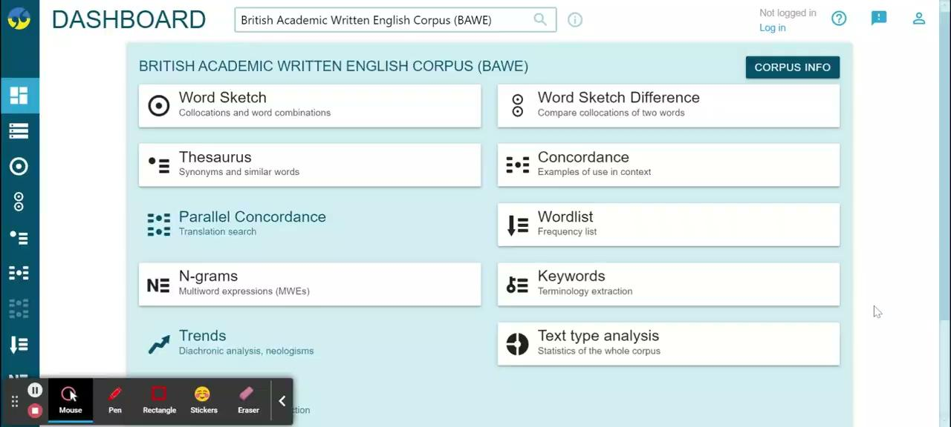
Filtering by part-of-speech is often enough

Slide 19
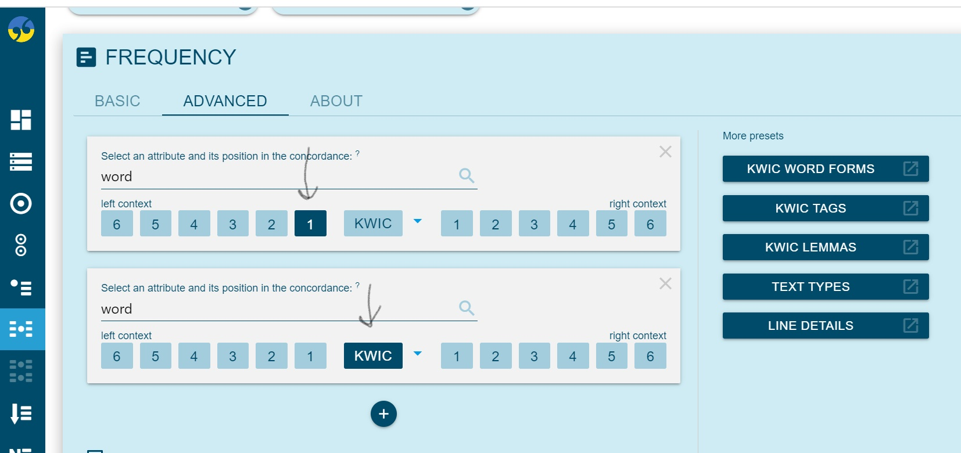
Errors 1-3: Filter by part-of-speech
Access Handout 2 on Sched to try this now.
Note: to display the list of words most frequently to the left of the key word, you need to do this:
Notes:
This goes with errors 1-2 on the handout. 1 is just the same error as this for anyone who’s brand new to corpora.

Slide 20

Making your own quicklinks for error correction: Some tools
Filter by part-of-speech
Using Corpus Query Language
  Enables more specific, tailored examples.
    More granular grammar (e.g. superlative adjectives, modal verbs).
    Either/or choices.
    Numerous tools to make exemplars more specific (and thus helpful to lower levels).

Slide 21
Using BASE to prepare for presentations
Context:
Students preparing for presentations.
Presenting issue of scripts.
Aim:
Understanding differences between written and spoken academic language.
Evaluate progress on presentations and make improvements.
NB: This also reinforces some of the learning about distinct conventions of academic written language.

Slide 22
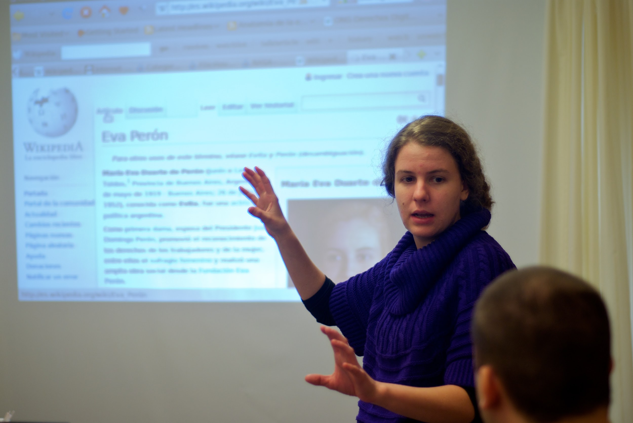
Using BASE to prepare for presentations
‘And so today, I’m going to explain the findings of my research into…’
We considered this phrase, and asked students to note features of the language.
Students guessed at relative frequency of the following in written and academic English.
‘So today’
‘I’m going to’
What do you think?

Slide 23
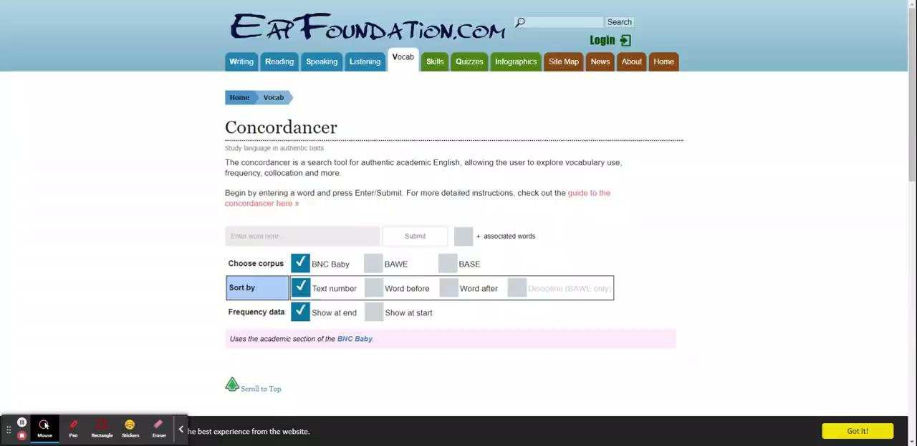
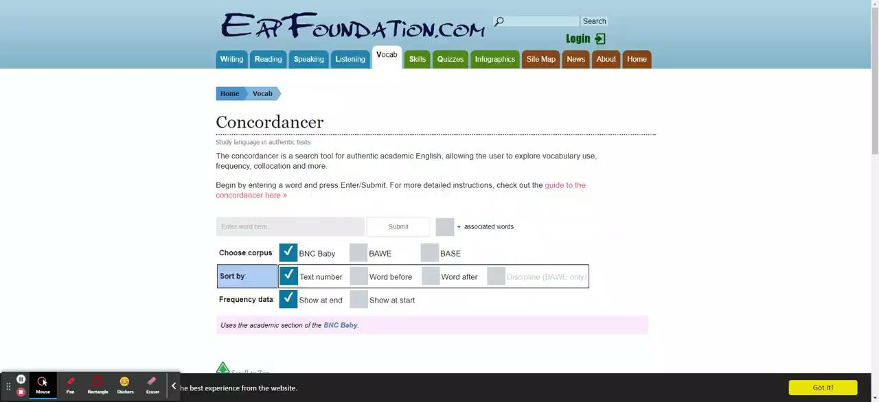
Using BASE to prepare for presentations
Notes:
so

Slide 24
Using BASE to prepare for presentations
Lots of examples were then provided of language, some of which were much more common in BASE (e.g. we’re going).
Compare the following examples using EAP Foundations concordancer (eapfoundation.com/vocab/concordancer)
we’re going
move on
consider
think about
consideration
What information does this give a learner?
How could they use this information?
What features of language could this tool help you teach?
Notes:
so

Slide 25
Developing writing skills using ColloCaid.
University of Surrey, Bangor University, Adam Mickievicz University in Poznan, Poland
suggests collocations and provides examples in real time
Notes:
Structure: - describe the activity; tell the story.
Attempt the activity.
Group evaluation - how could this be adapted or developed for other needs?

Slide 26
Developing writing skills using ColloCaid.
We asked students to report the information below first without ColloCaid, then relying on collocations suggestions offered by ColloCaid.
The British Social Attitudes Survey 2021.
Information:
40% are very concerned about the environment. 22% were very concerned in 2011.
45% view climate change as being the most important environmental issue (up from 19% in 2011).
76% of those who are ‘very concerned’ about the environment are willing to pay to protect it.10% of people say they will not pay to protect the environment, despite their concern.
Source: British Social Attitudes Survey (2021)
Notes:
Group evaluation - how could this be adapted or developed for other needs?

Slide 27
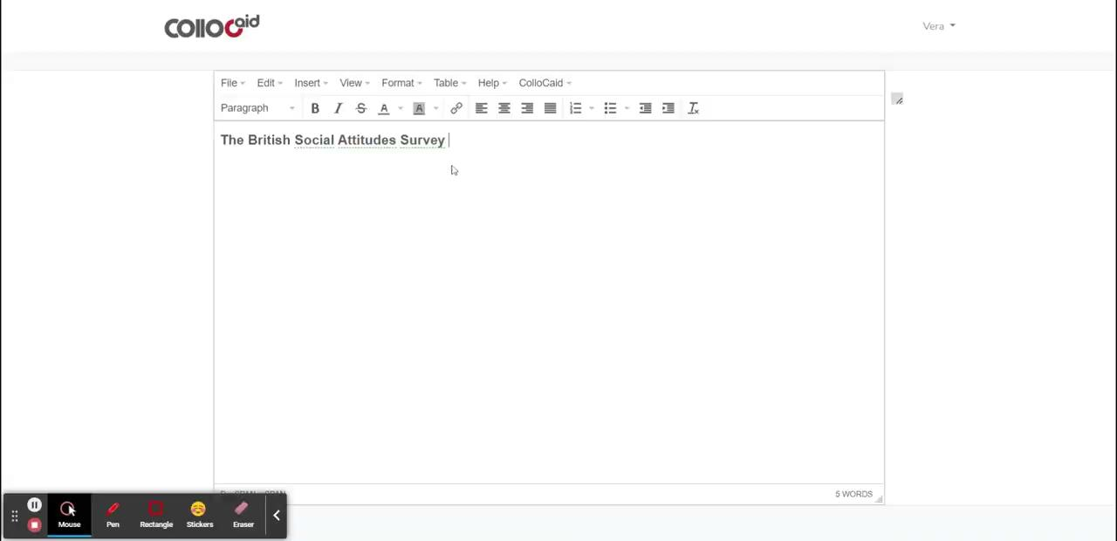
Developing writing skills using ColloCaid.
Notes:
Structure: - describe the activity; tell the story.
Attempt the activity.
Group evaluation - how could this be adapted or developed for other needs?

Slide 28
Some examples of student writing
Sentences without ColloCaid | Sentences with ColloCaid
According to the British Social Attitudes Survey (2021), 40% of British are extremely concerned about the environment, which has doubled from 2011. | The British Social Attitudes survey reveals 40% of British view climate change as the most important environmental issue, which is up from 19% in 2011.
There was a dramatic rise in the number of people considering climate change to be a critical issue between 2011-2021, which increased from 19% to 45%. | According to the survey, the numbers of people concerned about the environment doubled between 2011 and 2021…

Slide 29
Activity: Developing writing skills using ColloCaid.
Try using ColloCaid www.collocaid.uk - Try the prototype - Register
Use your own ideas or report the same information from the British Social Attitudes Survey 2021:
Information:
40% are very concerned about the environment. 22% were very concerned in 2011.
45% view climate change as being the most important environmental issue (up from 19% in 2011).
76% of those who are ‘very concerned’ about the environment are willing to pay to protect it.10% of people say they will not pay to protect the environment, despite their concern.
Source: British Social Attitudes Survey (2021)
Notes:
Structure: - describe the activity; tell the story.
Attempt the activity.
Group evaluation - how could this be adapted or developed for other needs?

Slide 30
Activity: Developing writing skills using ColloCaid.
Reflection (suggested questions)
What did you think? Could you use it?!
What kind of learning activities could it support?
How might it be used in a differentiated way?
Notes:
Structure: - describe the activity; tell the story.
Attempt the activity.
Group evaluation - how could this be adapted or developed for other needs?

Slide 31
ColloCaid: initial reflections
works well with higher level students, but can be confusing for lower level students (complex grammar)
good potential to develop autonomy
requires repeated exposure
works better for writing in real time, not for proofreading/introducing improvements/corrections
Notes:
Do you have your reflections?
Group evaluation - how could this be adapted or developed for other needs?

Slide 32
Corpora and the tools to access them
BAWE
The British Academic Written English
BASE
The British Academic Spoken English
BNC
The British National Corpus
Sketch Engine http://www.sketchengine.eu/
EAP foundations concordancer https://www.eapfoundation.com/guides/concordancer/
ColloCaid https://collocaid.uk/prototype/editor/public/
BAWE Quicklinks - lexico-grammatical patterns common in academic writing
https://bawequicklinks.coventry.domains/
Sketch Engine http://www.sketchengine.eu/
EAP foundations concordancer https://www.eapfoundation.com/guides/concordancer/
BNC lab
http://corpora.lancs.ac.uk/bnclab/search
BNC https://www.english-corpora.org/bnc/

Slide 33
References
Kaltenböck, G., & Mehlmauer-Larcher, B. (2005). Computer corpora and the language classroom: on the potential and limitations of computer corpora in language teaching. ReCALL, 17(1), 65–84. https://doi.org/10.1017/S0958344005000613
Kilgarriff, A., Baisa, V., Bušta, J., Jakubíček, M., Kovář, V., Michelfeit, J., Rychlý, P., Suchomel, V. (2014). The Sketch Engine: ten years on. Lexicography, 1, 7-36, . http://www.sketchengine.eu/
Lew, R., Frankenberg-Garcia, A., Rees, G., Roberts, J. C., & Sharma, N. (2018). ColloCaid: A real-time tool to help academic writers with English collocations. Paper presented at Proceedings of the XVIII EURALEX International Congress, Ljubljana, Slovenia. https://www.collocaid.uk/
Sinclair, J. (2004). Introduction. In: Sinclair J. M. (ed.) How to use corpora in language teaching (pp.1-10). J. Benjamins.
Smith, C.H.S. (2013). Concordancer. EAP Foundation. https://www.eapfoundation.com/vocab/concordancer/
Vincent, B. & Nesi, H. (2018) The BAWE Quicklinks project: a new DDL resource for university students. Revue de Linguistique et de Didactique des Langues (Lidil), 58: http://journals.openedition.org/lidil/5306 https://bawequicklinks.coventry.domains/

