Slide 1
Power and the Canadian EAP Practitioner
Multiethnography as Resistance?
Jen

Slide 2
Research Participants
James Corcoran, York University
Jennifer MacDonald, Dalhousie University
Jonathan Mendelsohn, York University
Leo Gomez, Independent
Corcoran, J., MacDonald, J.J., Mendelsohn, J. and Gomez, L. (In press). Power and the Canadian EAP Practitioner. In A. Ding and L. Monbec (Eds.) Practitioner Agency and Identity in EAP. Bloomsbury.
The authors thank SSHRC and York University for supporting this project.
Jon

Slide 3
Today’s Session
Rationale and Objectives
EAP in Canada: Literature
Multiethnography as Critical Methodology
Findings: Convergence and Divergence in our Conversations
Discussion
Conclusions: improving Practitioners’ Work Lives
Q & A
Jon

Slide 4
Rationale, Objectives, & Literature
Jen

Slide 5
EAP across Canada: Programs and Practitioners
EAP across Canada: Programs and Practitioners
Jen

Slide 6
EAP across Canada: Programs and Practitioners
EAP across Canada: Programs and Practitioners
EAP Assessment (e.g., Huang, 2018)
EAP Impact (e.g., Fox et al., 2013)
EAP Teacher / student beliefs (e.g., Douglas et al., 2022; Douglas & Kim, 2014)
EAP & L2 Writing Pedagogies (e.g., Bhowmik et al., 2021; Galante, 2020; Marshall & Walsh Marr, 2018; Van Viegen & Zappa-Hollman, 2020)
EAP Programming (MacDonald, 2022; Corcoran et al., 2021; Douglas & Landry, 2021; Dyck, 2013)
EAP Practitioners (Breshears, 2019; Corcoran et al., in press; MacDonald, 2016; Valeo & Faez, 2013;)
Jen
Notes:
This research builds on recent work investigating EAP programs and practitioners across Canada, fill out the dearth of work focusing on /eap in Canada and aims to Recognize, validate, and improve the lives of EAP practitioners, an under-researched cadre of ELT professionals

Slide 7
Lens and Orientations
James

Slide 8
EAP Orientations: Service vs. Field
James
Notes:
Drawing on our critical, multiethnographic framework, we argue that our data point to a cadre of professionals operating within programs and institutions driven by neoliberal economic principles, the consequences of which are a marginalized workforce with oft-alienated and disenfrachised agentive work lives.

Slide 9
CALx Lens
Critical applied linguistics (CALx) lens (Pennycook, 2021)
Draws upon both neo-marxist (Block, 2015; Hadley, 2015) and post-structuralist (Canagarajah, 2017; Sousa Santos & Menezes, 2020) approaches to language (teaching) and (social relations of) power.
Adopting this multifaceted CALx lens affords an interrogation of power-imbued issues related to “the contingent and contextual effects of power in relation to access, exclusion, reproduction, and resistance” (Pennycook, 2021, p. 162) within Canadian EAP.
For our study, we are interested in reconciling social structures with EAP practitioners’ perceived professional agency, or capability to “act, initiate, self-regulate, or make differences or changes to their situation.” (Liddicoat & Taylor-Leech, 2021, p. 1.)
James

Slide 10
Methodology & RQs
James

Slide 11
Methodology
Data collection
Four two-hour conversations conducted and recorded via Zoom
Additional notes via shared Google Drive
Data analysis
Multi-level, inter-rater coding of group interviews to flesh out and agree on main themes, followed by specific coding of most salient elements related to power, agency, and EAP
Mixing of data into narrative form (actually another level of analysis)
Inter-participant polishing of conversations to provide coherence
Research Design
Qualitative paradigm
Participants are both researchers and researched
Storytelling
Positioned as a bridge between theory, research, and practice (ideal for us)
Sampling & Participants
EAP directors and instructors from private EAL, college and university contexts invited to participate
James

Slide 12
Research Questions
Research Questions
How do we perceive our roles as EAP practitioners?
How do we navigate our EAP professional lives?
What are the salient features of Canadian EAP?
Jon

Slide 13
Participants
Jon

Slide 14
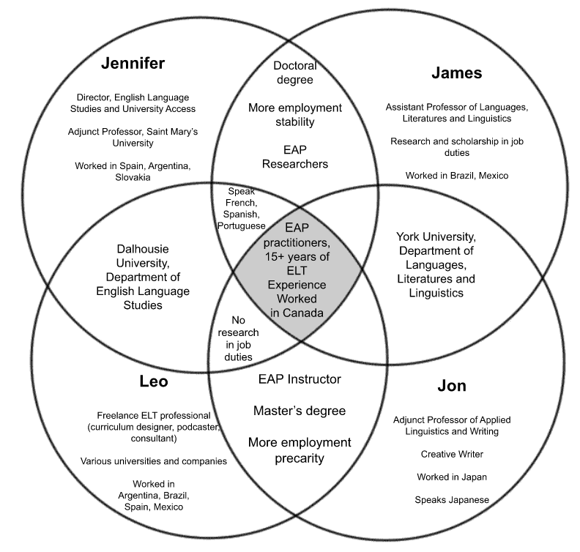
Participants
Jon
Notes:
Plurilingual repertoires
International and domestic journeys
“Falling into” the profession
Varied but overlapping education & certification

Slide 15
Findings
Jen

Slide 16
Overview
Convergent Themes
Divergent Themes
The dedication of EAP practitioners to student life and learning outcomes
The challenges of carving out a career in EAP
The optimum qualifications for EAP instructors
The benefits of professional development within EAP programs,
The place of unions
Jen

Slide 17
EAP Competencies, Credentials & Autonomy
Leo: I've been teaching in this [university] program for, maybe seven years, and classroom teaching is how you learn most. Experience is key.
Jon: Totally agree.
Jennifer: From the EAP director point of view, providing regular PD and teacher development in-house to complement classroom teaching experience is essential…alongside the usually non-existent formal EAP training that most people have never had…it is really hard to meet practitioners where they are.
Jon

Slide 18
EAP Competencies, Credentials & Autonomy
James: Well, I love teaching, period…but my graduate degrees have opened the door to a broader EAP experience. In my faculty role, I can do research and some theorizing, both of which allow me to understand and engage with my professional practice in ways that would not be possible otherwise. I’m still unsure, though, which teaching credentials and degrees should be mandatory for EAP instructors.
Jennifer: I'm so with you, James. I’m a massive nerd, I actually like reading and writing and researching – that’s a big part of my motivation for doing this. And I think to myself, how can you have an ounce of credibility teaching thesis writing to a PhD student if you have a bachelor's degree that you did 25 years ago and you haven't written anything academic since?
Jon

Slide 19
Neoliberal EAP
Jennifer: Canada is the Wild West for EAP, with a lot of instructor precarity.
[...]
Jon: I’ve worked at institutions where you see this MBA-ification of these EAP programs, where the administration is valued above pedagogy, above teaching and teachers. I’ll never forget a certain Christmas work party. The newly hired head of the EAP program was up on stage giving her big end-of-year speech, thanking the web designers, and the marketing team. She goes on and on, and never once mentioned the teachers. She just plum forgot. It just summed up the whole thing for me.
Jen

Slide 20
Neoliberal EAP
James: EAP programs are almost inevitably looking to maximize profit and that is a deeply problematic model to superimpose on educational activities. Not all programs are the same, though, nor are the experiences of those working therein. In my university’s case, we have credit-bearing EAP courses, which is different than yours [Jennifer] which is a pre-sessional language program.
Jennifer: That being said, yours is an academic unit, with central funding, and so I think it’s a bit different than a cost recovery model, where when you get more students, your centre gets more revenue, and you can hire more teachers, and employ people to do other things.

Slide 21
Native Speakerism?
Leo: I googled the term precariousness, and the term originates from Latin, which basically relates to the act of praying or asking for favours. I think a lot of teachers feel like their fate is in the hands of… people who can make or break their lives and probably don’t give it much thought. You know, I immigrated to Canada because I wanted more challenge in my work. But when I first arrived, I couldn't find a job teaching even though I had taught in Argentina and the US and Brazil. I'm like, ‘what do you mean Canadian experience? Because it sounds like a catch 22 to me. How am I going to get Canadian experience if you never offer me a job?’
[...]
James: [...] I think there is a growing recognition from those in the field, though, that the days of native speaker dominance are in the rearview. For example, I have seen culturally and linguistically representative EAP staffs at most programs in Canada.
Jen

Slide 22
Unionization
James: As we discuss neoliberal EAP, it occurs to me that we should be discussing ways to combat the disposable labour model that allows for EAP instructors to potentially be mistreated at their institutions. Unions, anyone?
Jon: Ok, but I’m gonna take the other side here regarding unions. You sometimes get [EAP practitioners] who haven't been to a meeting in years because there is no way of forcing them and they, I imagine, don’t want to come also because they feel their voices do not carry the same weight as their tenured or tenure-stream colleagues.
Jennifer: [...] when COVID hit in the Spring of 2020, at some centres, certain unionized instructors refused to do anything online—it wasn’t in their collective agreement. I heard people saying, “I can't wait to for this online crap to be over, so I can get back to REAL teaching,” as if online teaching wasn't teaching. And I was like, “Do you realize that you have dozens of students and by refusing to teach you're preventing them from graduating?!”
Jon/James

Slide 23
Unionization
James: Seriously, people? We need more and more powerful unions as a bulwark against the advanced capitalist assault on language education, no? I am proud to be part of an institution with unions that fight for my rights and the rights of those around me.
Jon: That’s the problem, right? The extremes. I’m deeply grateful for my union and its benefits but am so conflicted about it because we go on strike a lot and I'm constantly terrified they're going to do it again, which could mean far fewer students and my not getting enough work to support my family. One of these days they’re [the union] going to make our university the place that nobody wants to go, and then none of us have work. [...]
Jon/James

Slide 24
Reflections on Multiethnography
Jennifer: Why do therapy when you can just do a multiethnography? [...]
Jon: This has been huge for me to just have my voice heard and to say this is what matters to me. [...] Also, these conversations have made me think more about my role as a language teacher and how I can best support students while dealing with all the other bullshit that comes with being a part-timer.
James: It's interesting because I think we're incentivized to not talk about certain aspects of our profession, but during this project we have been able to air our grievances and talk about uncomfortable and unequal distribution of power in a comfortable space [...]
Leo: [...] I have to admit that these chats have actually helped me reflect on my experiences in the profession while sharing perspectives that I really couldn't share with anyone, especially management.
James

Slide 25
Discussion
Jen

Slide 26
Discussion
Discussion: Summary
Evidence of conflicting perceptions of EAP instruction (“butler stance” service vs. invaluable support) (Charles & Pecorari, 2016)
Evidence of differential lived experiences and sense of legitimacy/satisfaction between those with and without job stability (Breshears, 2019)
Evidence of contested practitioner sense of agency and asymmetrical relations of power within the market of EAP (Bourdieu, 2012; Ding & Bruce, 2017)
Evidence of dedication by EAP practitioners to improving EAL student learning outcomes / lives
Might this form of doing CALx result in better equipping EAP practitioners for the realities of the “field of battle” (Bourdieu, 2012; Haque, 2007)?
Jen
Notes:
Adopting a critical lens that considers practitioner agency within the market of EAP, these findings highlight the tensions, juxtapositions, and contestations related to practitioner agency and identity within Canadian EAP.

Slide 27
Multiethnography as Resistance?
Critical storytelling approaches to research can afford easily accessible (more democratic) engagement with scholarship for diverse population of EAP practitioners
Multiethnography as affirming and validating for participants (Norris & Sawyer, 2015)
Can promote camaraderie, shared purpose, and collaborative relations of power between practitioners (Cummins, 2021)
Challenging of entrenched hierarchies and asymmetrical power relations, potentially leading to a level of critical praxis (Hoggle & Bramble, 2020; Pennycook, 2021).
Self-reflexivity as critical endeavour in EAP can clearly lead to improved awareness of systemic barriers and heightened social agency; however, it also necessarily leads to uncomfortable moments of heightened tensions (Kennedy & DeCosta, 2023).
James

Slide 28
Conclusions and Future Avenues
James

Slide 29
Improving EAP Practitioners’ Work Lives
● Transparent hiring criteria (e.g., education, certification, experience);
● Improvements to working conditions for EAP instructors (e.g., permanent status, regularization, unionization and/or other forms of collective mobilization);
● Incentives for engagement with research and pedagogical innovation;
● Practitioner-driven professional development;
● Collegial exchange of research- and classroom-teaching inspired learnings;
● Program leadership which builds relationships between EAP and other units (e.g., writing centres; disciplinary and administrative units);
● Collective curricular (re)design that includes practitioner input.

Slide 30
Q & A
Power and the Canadian EAP Practitioner

Slide 31
Thank you!
James Corcoran corcora2@yorku.ca
Jennifer MacDonald jennifermacdonald@dal.ca
Jonathan Mendelsohn jmendel@yorku.ca
Leo Gomez leo.gomez@learnyourenglish.com

Slide 32
Selected References

Slide 33
References
Bhowmik, S., & Chaudhuri, A. (2021). “I Need My Instructor to Like Sit with Me”: Addressing Culture in L2 Writing Instruction. BC TEAL Journal, 6(1), 11-28. https://doi.org/10.14288/bctj.v6i1
Block, D., Gray, J., & Holborow, M. (2012). Neoliberalism and applied linguistics. London: Routledge.
Breshears, S. (2019). The precarious work of English language teaching in Canada. TESL Canada Journal, 36(2), 26-47.
Charles, M., & Pecorari, D. (2016). Introducing English for academic purposes. Routledge.
Corcoran, J. N., Johnston, K., & Williams, J. (forthcoming). EAP Practitioners across Canada: Diversity, agency, and employment (dis)satisfaction. TESL Canada Journal.
Corcoran, J. N., Williams, J., & Johnston, K. (2022). EAP Programs and Practitioners in Canada: Results from an Exploratory Survey. BC TEAL Journal https://ojs-o.library.ubc.ca/index.php/BCTJ/issue/view/38

Slide 34
References
Ding, A., & Bruce, I. (2017). The English for academic purposes practitioner. Palgrave Macmillan. https://doi.org/10.1007/978-3-319-59737-9
Douglas, S. R., & Kim, M. (2014). Task-based language teaching and English for academic purposes: An investigation into instructor perceptions and practice in the Canadian context. TESL Canada Journal, 1-1.
Douglas, S. R., & Landry, M, H., (2021). English for academic purposes programs: Key trends across Canadian universities. Comparative and International Education/Éducation comparée et internationale. 50 (1). https://doi.org/10.5206/cieeci.v50i1.10925
Douglas, S. R., Landry, M. H., Doe, C., & Cheng, L. (2022). English for Academic Purposes Student Reflections: Factors Related to Their Additional Language Socialization at a Canadian University. TESL Canada Journal, 39(1), 21-43.

Slide 35
References
Dyck, G.N. (2013). Chinese and Canadian students in undergraduate degree programmes in a Canadian university: A quantitative comparison. In T. Coverdale-Jones (Eds.), Transnational Higher Education in the Asian Context (pp. 216-225). Palgrave Macmillan, London. https://doi.org/10.1057/9781137034946_14
Fox, J., Cheng, L., & Zumbo, B. D. (2014). Do they make a difference? The impact of English language programs on second language students in Canadian universities. TESOL Quarterly, 48(1), 57–85.
Galante, A., Okubo, K., Cole, C., Elkader, N., Carozza, N., Wilkinson, C., Wotton, C., & Vasic, J. (2019). Plurilingualism in Higher Education: A Collaborative Initiative for the Implementation of Plurilingual Pedagogy in an English for Academic Purposes Program at a Canadian University. TESL Canada Journal, 36(1), 121 - 133. https://doi.org/10.18806/tesl.v36i1.1305

Slide 36
References
Hadley, G., & Hadley, G. (2015). EAP in the Third Space of Neoliberal Universities. English for academic purposes in neoliberal universities: A critical grounded theory, 25-43.
Haque, E. (2007). Critical pedagogy in English for academic purposes and the possibility for ‘tactics’ of resistance. Pedagogy, Culture & Society, 15(1), 83-106. https://doi.org/10.1080/14681360601162311
Huang, L. S. (2018). A call for critical dialogue: EAP assessment from the practitioner's perspective in Canada. Journal of English for Academic Purposes, 35, 70-84. https://doi.org/10.1016/j.jeap.2018.07.005
Liddicoat, A. J., & Taylor-Leech, K. (2021). Agency in language planning and policy. Current Issues in Language Planning, 22(1-2), 1-18.
MacDonald, J. J. (2022). The Differing Discursive Constructions of EAP within the University: Contrasting Institutional and Language Centre Perspectives. In I. Bruce and B. Bond (eds.) Contextualizing English for Academic Purposes in Higher Education: Politics, Policies and Practices. Bloomsbury.

Slide 37
References
MacDonald, J. (2016). The margins as third space: EAP teacher professionalism in Canadian universities. TESL Canada Journal, 34(1), 106-116.
Marshall, S., & Walsh Marr, J. (2018). Teaching multilingual learners in Canadian writing-intensive classrooms: Pedagogy, binaries, and conflicting identities. Journal of Second Language Writing, 40, 32-43.
Pennycook, A. (2021). Critical applied linguistics: A critical re-introduction (2nd edition). Routledge.
Valeo, A., & Faez, F. (2013). Career development and professional attrition of novice ESL teachers of adults. TESL Canada Journal, 1-1.
Van Viegen, S., & Zappa-Hollman, S. (2020). Plurilingual pedagogies at the post-secondary level: possibilities for intentional engagement with students’ diverse linguistic repertoires. Language, Culture and Curriculum, 33(2), 172-187.

