Slide 1
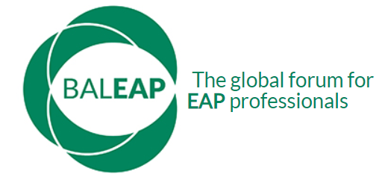
BALEAP Conference:
Caution! EAP under construction
Multimodal feedback tool for writing-to-learn: teachers’ and students’ perceptions

Slide 2
Agenda
01
Motivation for study
Background
02
Methods
Preliminary Findings
03
Preliminary findings
04
Implications for pedagogy
Discussion

Slide 3

Westminster International University in Tashkent
Uzbekistan

Slide 4



Who are we?
Liliya Makovskaya
Senior Lecturer
lmakovskaya@wiut.uz
Iroda Saydazimova
Lecturer
isaydazimova@wiut.uz
Kholida Begmatova
Lecturer
kh.begmatova@wiut.uz

Slide 5
01
Motivation for Study

Slide 6
Our context
Our context
Course
Module
Assessment
Focus of assessment
Content and Structure
Language and Style
Reference and Presentation
Summary and Response Essay (one component)
Certificate of International Foundation Studies
Academic English
1
2
3
4

Slide 7
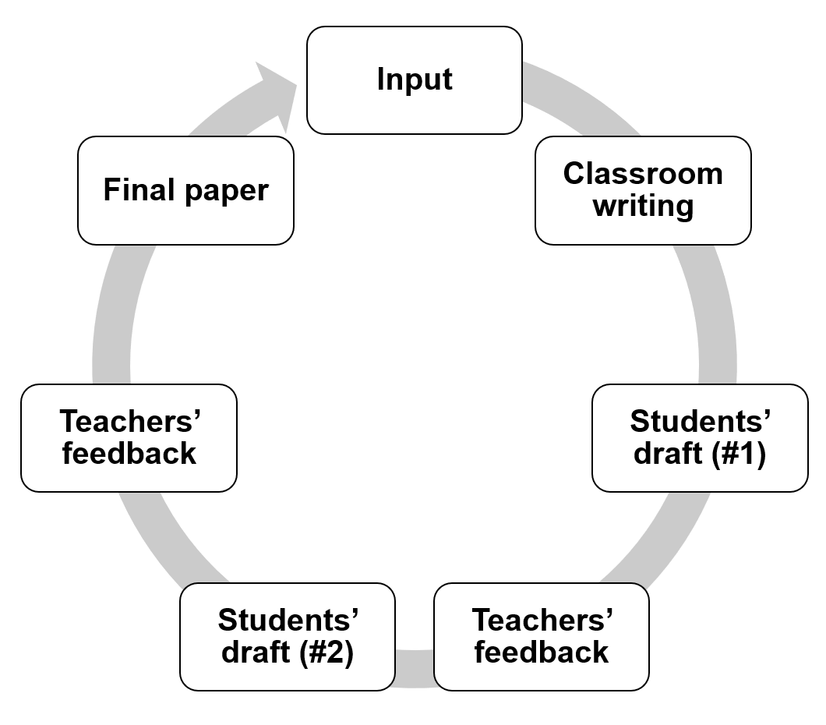
Our context: process

Slide 8
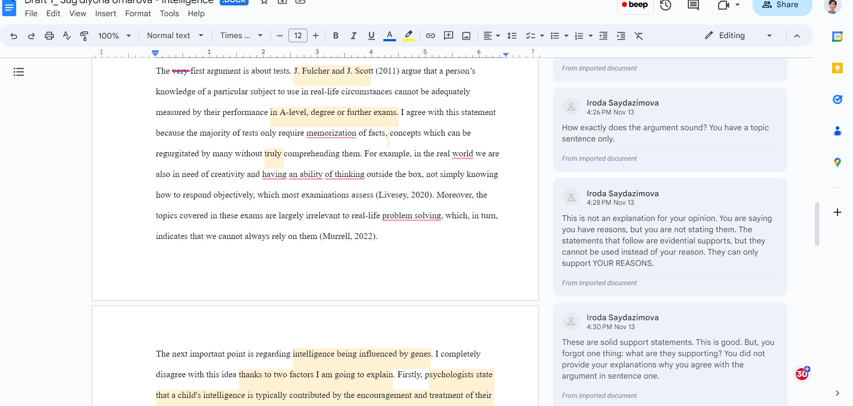
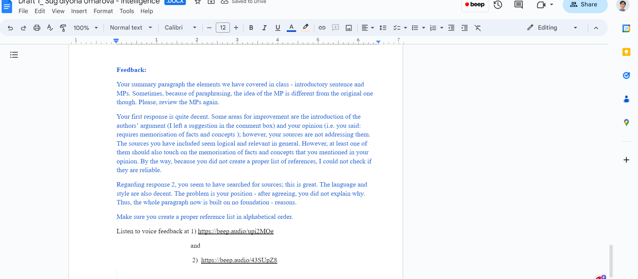
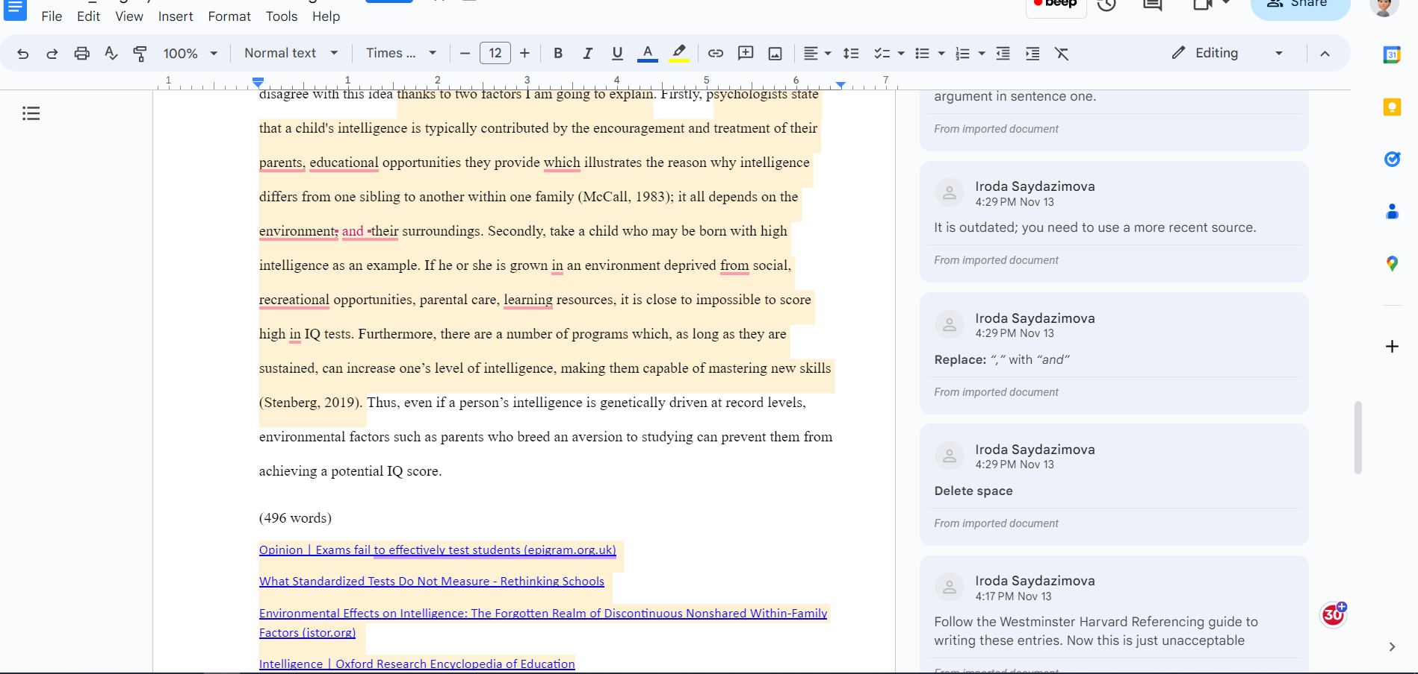
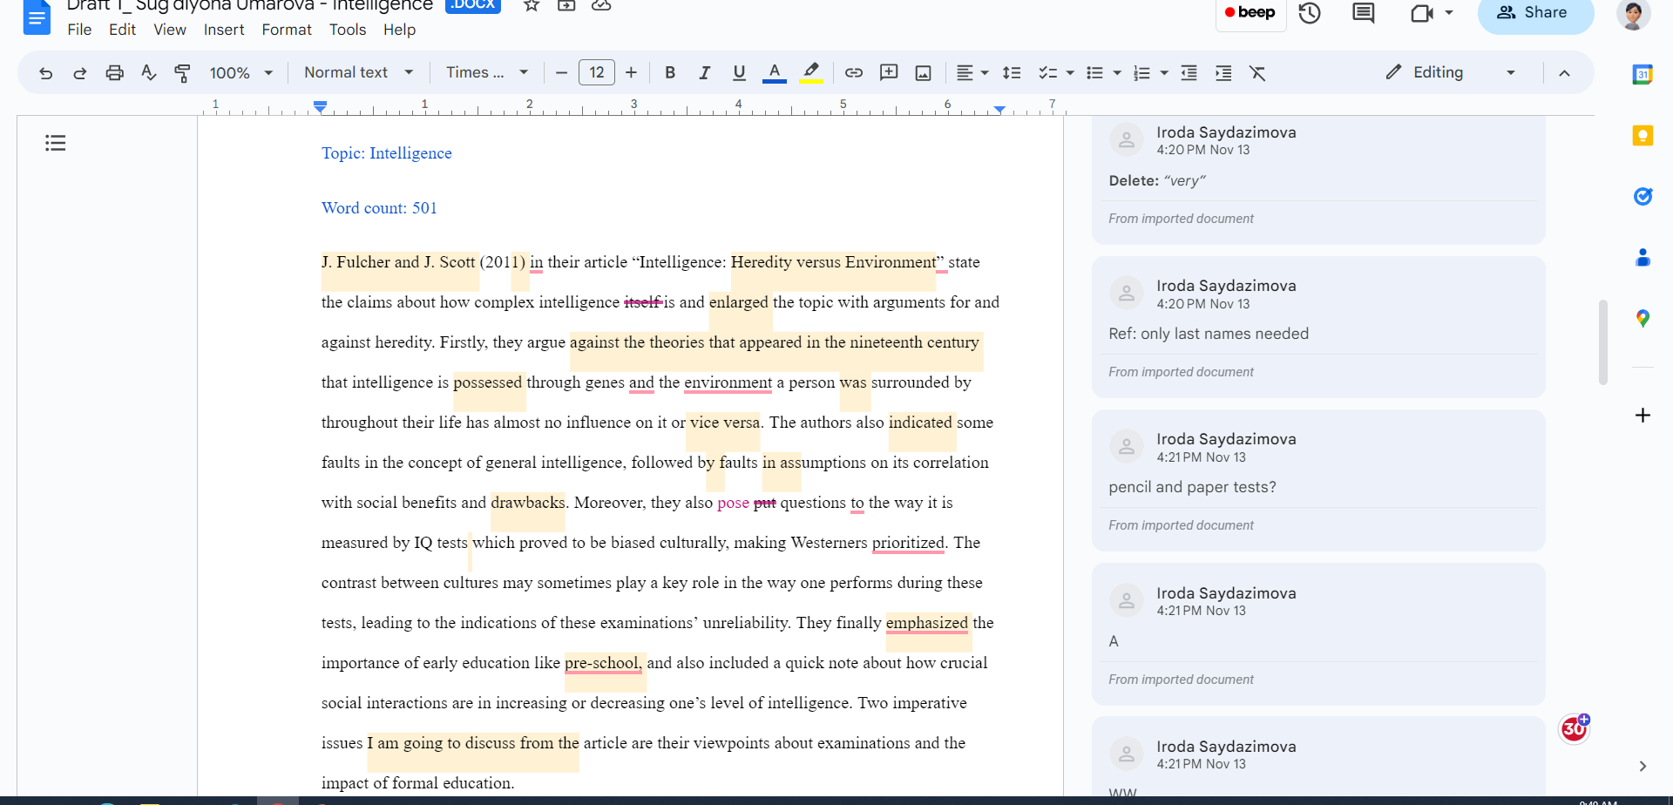
Summary and Response Essay

Slide 9
Motivation for the study
The efficacy of choosing and applying more than one feedback type appropriately is indispensable in meeting the individual needs of learners.
The application of technology seems to have expanded how feedback can be provided.
One method of externally supporting learners is through computer-based scaffolding (Proske, Narciss & McNamara, 2010).
Oral feedback is generally more valued by learners (Cavanaugh & Song, 2014; Bless, 2017; McCarthy, 2015; Kauf, 2015)

Slide 10
Results of other studies
Study | Context & participants | Approach to feedback | Focus of feedback | Research questions
Elola & Oskoz (2016) | 4 Spanish FL writing course undergrad. students, USA | Screencast-O- Matic Microsoft Word | Content, structure & language (oral & written) | 1. To what extent does using Word or screencast to provide written or oral feedback influence how the instructor provides feedback to students? 2. To what extent does receiving oral or written feedback using Word or screencast influence students’ revisions?
Kim & Bowles (2019) | 22 undergrad. EFL students, USA | Think alouds; direct correction; reformulation | Content, structure & language | 1. Is there a relationship between the type of feedback and learners’ depth of processing? 2. Is there a relationship between the error type and learners’ depth of processing?
Solhi & Eğinli (2020) | 51 EMI Turkish university | Recorded audio feedback; written correction code | Content; organization style & mechanics | Does recorded oral feedback yield improvement in the writing of EFL learners?
Bakla (2020) | 33 Turkish EFL university students | Google Drive, Kaizena; a screencasting software | Linguistic problems; content & organization | 1.Which digital feedback modes could help the participants perform a higher rate of successful revisions at the microlevel, macro level, & global level in revising the essays supplied to them? 2. What are the participants’ preferences of the feedback modes & what factors could account for these preferences?
Moham- med & AL-Jaberi (2021) | 2 linguistic Master program students in Malaysia public university | Google Docs & Microsoft Word (track changes function) | Content; organization; linguistic accuracy & appropriateness | 1.How do the two case study participants engage with the instructor’s written feedback delivered through Google Docs and MS Word? 2. To what extent do the two case study participants engage with the different types of written feedback through both tools?

Slide 11
02
Methods
Participants, Instruments, Data Collection

Slide 12
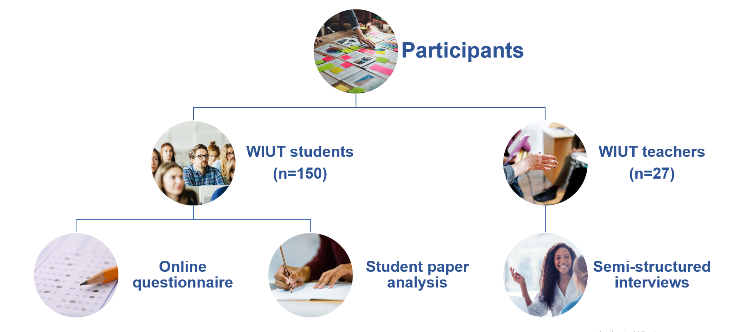
Research instruments: context and participants
Notes:
Final grades=student paper analysis

Slide 13
03
Preliminary findings

Slide 14
Questionnaire results
Forms of feedback | Most useful | Least useful
Strikethrough that shows the text that needs to be removed | 59.1% | 12.9%
Indication of mistakes via symbols (correction code) in comment boxes | 43.9% | 25.8%
Comments on mistakes and suggestions to improve given in comment boxes | 79.5% | 4.5%
Reference to other sources and lessons (i.e. links to websites) | 21.2% | 18.2%
Written feedback provided at the bottom of my draft | 57.6% | 10.6%
Voice-recorded feedback provided at the end of my draft | 56.1% | 14.4%

Slide 15
Student comments
Strikethrough showed me grammar mistakes
I cannot listen to voice recordings any time in public places
Comments indicate structure and content mistakes and voice feedback made the comments clearer
They are concise and accurate, convenient to read and understand
Although I had the key to the code, It was time consuming to look for and correct
They indicated specifically which words,sentences need to be changed
It is harder to evaluate mistakes using different sites. I don't want to spend time for researching a new website just to find my mistake
Because oral feedback contained more information and explanation

Slide 16
Questionnaire results
Skills of writing that improved based on the teacher's feedback | %
Paraphrasing | 47.7%
Organization and structure | 50.8%
Incorporating in-text citations | 36.4%
Compiling a reference list | 41.7%
Introduction of the argument from the original text | 40.2%
Development of arguments | 50.8%
Style | 34.8%
Grammar | 38.6%
Vocabulary | 27.3%

Slide 17
Interview results: most useful forms
Comments on mistakes &
Suggestions for improvement
Written feedback
(summary)
Voice-recorded feedback
There is a rationale explaining the mistakes, which constructive and instructive; it is specific and tailored for a particular area, which also creates a dialogue between a student and a teacher.
There is a clear indication of strengths and areas for improvement. It allows systematic and consistent growth in writing. Plus, it can be referred to frequently.
Due to teacher’s voice and intonation that resemble everyday communication, it is clearer and personalised, making learners feel encouraged; as teachers use names and friendly tone, learners feel valued and appreciated.
Students can be lazy to read a long text.
Not always accessible to listen; it is easier to meet face-to-face than record a message

Slide 18
Interview results: least useful forms
Using
correction codes
References to other sources
Strikethrough to indicate mistakes
They can be misinterpreted or misunderstood; they require time for learners to be trained to act on them. Learners are not fond of decoding and processing the problematic areas in their writing.
Learners rarely read them or follow them as it requires more efforts and self study. They may feel reluctant to check out the sources as they prefer a straightforward answer.
When text chunks are striked, learners may not understand the reason as there is no explanation; it will not guide the learners for improvement;
It is explicit
It is individually tailored; students can be lazy to search, so the teacher does it for them.

Slide 19
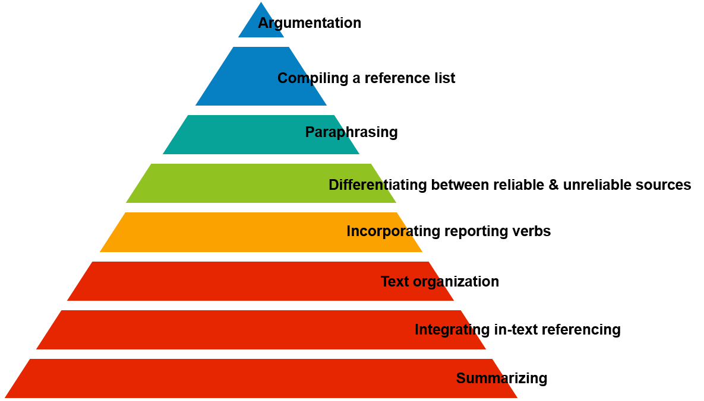
Student paper analysis

Slide 20
04
Implications for pedagogy

Slide 21
Implications for pedagogy
As several researchers suggest (Elola & Oskoz, 2016; Lee, 2017), the combination of several feedback provision approaches can eliminate limitations and bring together the benefits of different modes (commenting on mistakes and suggesting improvements; written feedback on strengths and weaknesses and voice-recorded feedback). Both parties found them useful and productive.
Integrating teacher’s audio feedback is useful for students as it brings some human touch. Although feedback should be dialogic from a sociocultural perspective (Lantolf, 2006), it could take time to establish such a dialogue considering the volume of work to check and frequency of feedback provision teachers need to undertake.
Google Docs is a recommended platform for feedback provision to students’ works in their writing-to-learn journey. It supports several functions and adds-on tools to realize this. It also allows asynchronous dialogue between a teacher and a student.

Slide 22


Slide 23
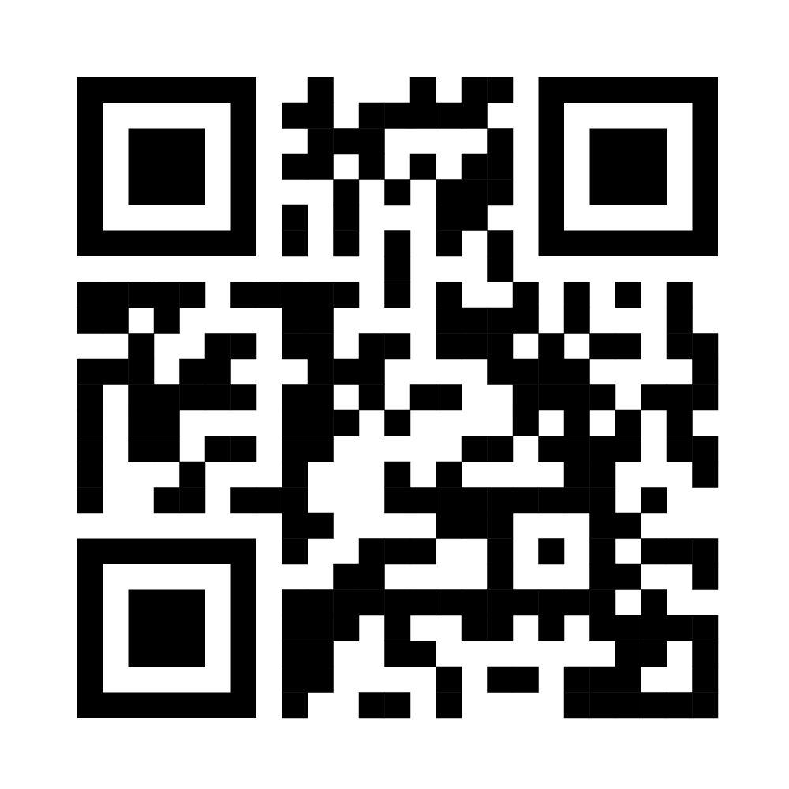
QR code for the contact details and the presentation

Slide 24
Thank you

