Slide 1
Mediating a role for social justice in the activity of
EAP teaching
Thursday 20th April 2023, 12:10-12:50
Dr Paul Breen – paul.breen@ucl.ac.uk
Katherine Mansfield – k.mansfield@westminster.ac.uk

Slide 2
Outline of structure
The context
Research project overview
Challenges & contradictions
Proposed framework
Issues for discussion

Slide 3

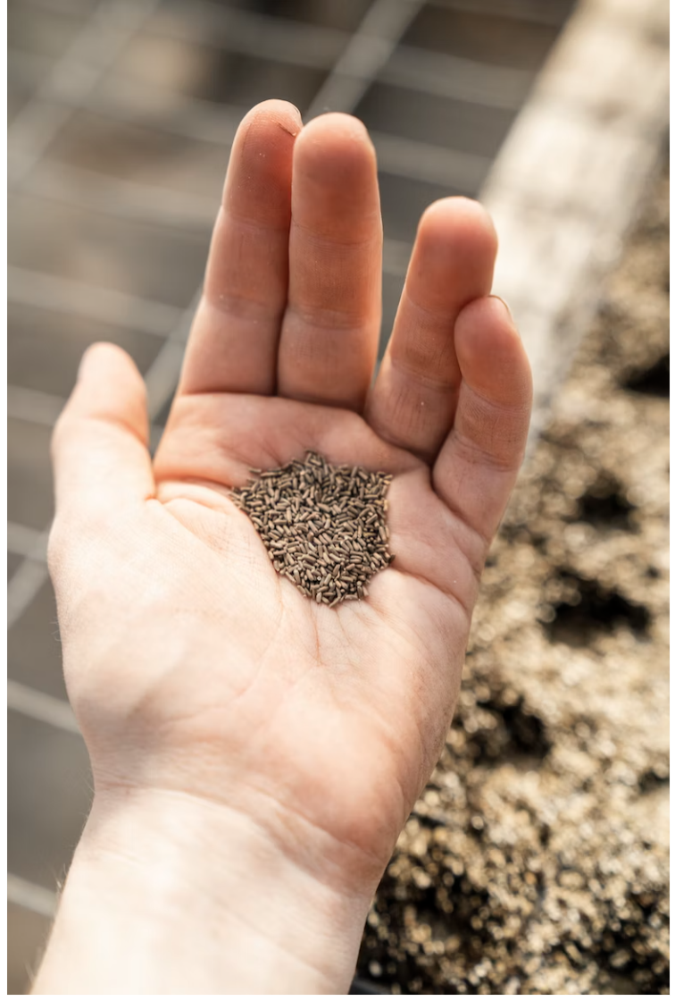
The Context
Began life on a pre-sessional course - scattering the seeds of an idea to do something connected to social issues
Very much an Etienne Wenger-esque 1990s notion of organic growth - build topics into the regular course
Quickly realised we needed something much more structured and cultivated - dedicated electives

Slide 4
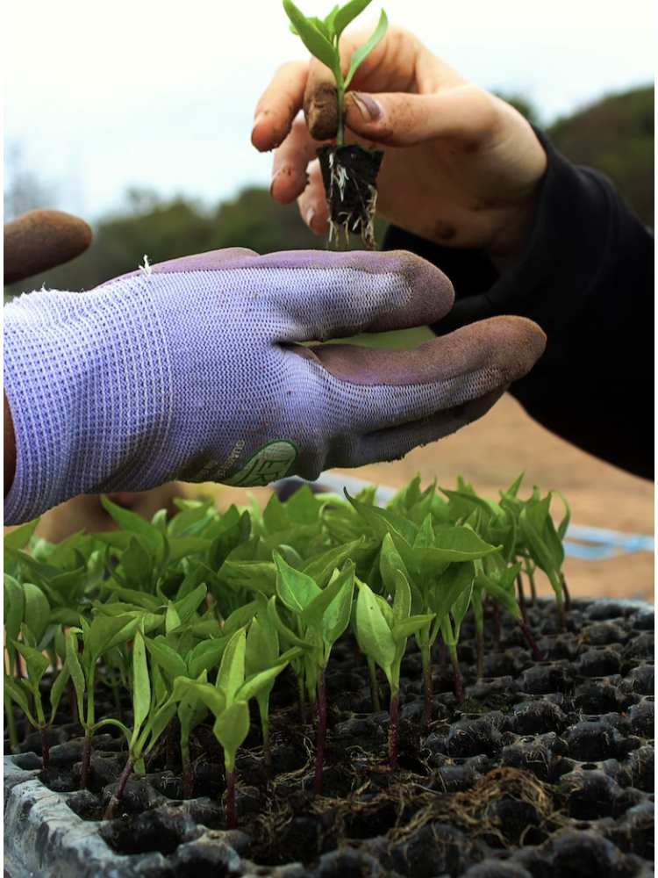
The Context
To create such electives we needed materials and having taught an MA TESOL course realised the paucity of theory regarding the production of materials
Decided then to investigate how such a course might be designed and how theory might inform it
Applied for BALEAP funding and got that
Began a research project that was quite ambitious but felt worthwhile for so many reasons

Slide 5
Research project overview
RQ1: What is meant by Social Justice in EAP teaching and learning contexts, both locally and globally?
RQ2: How do existing sets of EAP teaching and learning resources incorporate aspects of Social Justice in both materials and curriculum levels?
  Curriculum and materials used at UoW pre-sessional courses
  Bolster & Levrai’s (2020) ‘Develop EAP: A sustainable Academic English Skills Course’
  The British Council’s ‘The Climate Connection course’ (ten-part podcast series)
Notes:
Gained BALEAP funding for a research project which aimed to evaluate and design a framework for integrating the awareness of social justice into teaching and learning materials in an EAP curriculum.

Slide 6
RQ1: What is meant by Social Justice in EAP teaching and learning contexts, both locally and globally?
Locally
Linkage between EAP teaching and core values of SJ: human rights, immigration, child labour, etc.
Most critically engaged definition: “my definition of social justice relates to power imbalances within society – political, financial, cultural, social power and the interrelationship with factors such as race, gender, sexuality, socio-economic status, etc”.
Whose role is it to teach SJ? More cautious voices: “somebody else’s’ responsibility”
Should it be incorporated into EAP teaching? “Depends on the principles underpinning the curriculum”
Globally
Perceptions differ according to country of origin, workplace & teaching-learning environments
Agreement? Transgender rights highlighted as very difficult to discuss and certain topics cause teachers to “self-censor”
Conclusion:
Most EAP practitioners are advocates of SJ and general agreement on the necessity of SJ in EAP but... uncertainty as to how theory might relate to practice beyond ad-hoc, context-specific enactments.
Notes:
Range of responses

Slide 7
RQ2: How do existing sets of EAP teaching and learning resources incorporate aspects of Social Justice in both materials and curriculum levels?
Part of a course or one-off lesson? Encountered both
Meet the needs of learners? Yes, those designed with EAP learners in mind
Informed by a particular theory? EAP materials seem driven or informed by principles of academic language acquisition and development
Considerations? The practical needs e.g. most aim to prepare students for university life through incorporation of academic skills
Authentic & expose students to real world language? Yes but would need to be adapted
Scope for input & output? Yes

Slide 8
RQ2: How do existing sets of EAP teaching and learning resources incorporate aspects of Social Justice in both materials and curriculum levels?
Relevant to wider curriculum? Depends on the ss’ course, might have to make special mention to ss disciplines to tie the questions
Long term benefits? Yes, BUT when used with adaptations and highlight these benefits to ss
Shortcomings? Only a few included discursive elements
Conclusion:
Most address issues of Social Justice in one-off lessons, not throughout & need to be adapted

Slide 9

Challenges & Contradictions
Assessment and curricular contradictions - the recurring mismatch between what/how we teach and how we assess students (McArthur, Pearson).
Finding a synergy between ‘topics’ and the focus of Pre-Sessional courses (if we even know the focus) - defining the activity of EAP teaching.
The justice of Pre-Sessionals in themselves - why do they exist as they do? How are they staffed? Colonialism? Deficit model?
Challenges and contradictions within a social justice epistemology itself. Fragmented - fractured - a reincarnation of imperialistic divisions.
A challenging balancing act in terms of managing all of the contradictions and tensions (snapshot opposite)

Slide 10
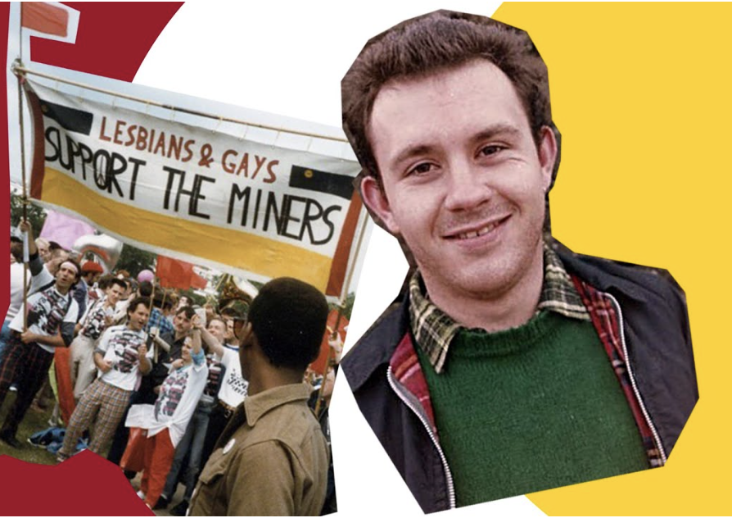
Challenges & Contradictions
A need to join together our respective struggles in terms of who we are (personally/professionally) and what we are trying to achieve regarding Social Justice.
Image opposite accessed at metro.co.uk

Slide 11
Proposed framework for the design and development of EAP materials / curricula

Slide 12
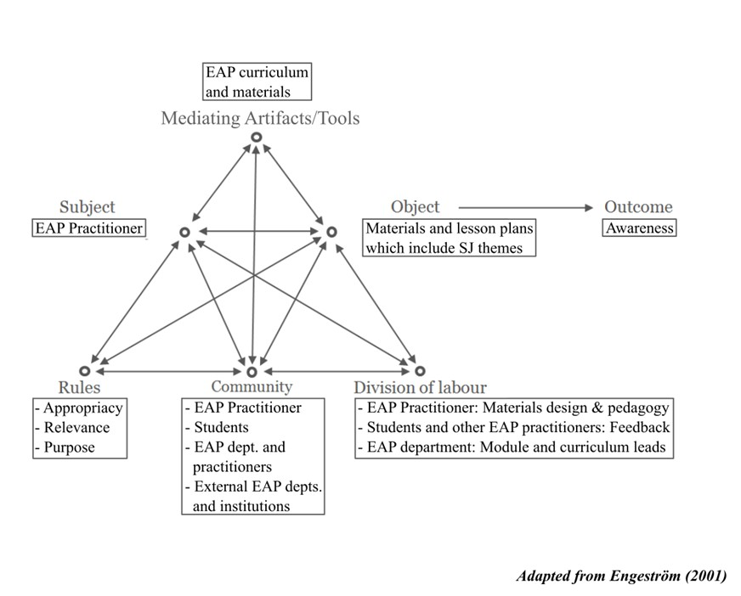
Proposed framework

Slide 13

Issues for discussion
Do you see a need for a greater sense of SJ in the EAP classroom?
Or do we need a greater sense of EAP/HE ecosystem as a whole?
What is your role as an EAP practitioner in relation to SJ?
Is the EAP classroom the right place to do this?

Slide 14
References
Bolster A., & Levrai, P. (2020). Develop EAP: A sustainable academic English skills course. Develop EAP. https://developeap.weebly.com/
Braun, V., & Clarke, V. (2006). Using thematic analysis in psychology. Qualitative Research in Psychology 3, (2), 77-101. https://dx.doi.org/10.1191/1478088706qp063oa
Braun, V., & Clarke, V. (2012). Thematic Analysis. In APA Handbook of Research Methods in Psychology, edited by H. Cooper, Vol. 2: Research Designs, pp 57–71. Washington, DC: APA books.
Braun, V., & Clarke, V. (2019). Reflecting on reflexive thematic analysis, Qualitative Research in Sport, Exercise and Health, 11:4, 589-597, https://doi-org.uow.idm.oclc.org/10.1080/2159676X.2019.1628806
British Council. (n.d.) The Climate Connection. https://www.britishcouncil.org/climate-connection
DISCs – Disciplines Inquiring into Societal Challenges. (2022). https://discs.ie/
Engeström, Y. (2001) Expansive Learning at Work: Toward an activity theoretical reconceptualization, Journal of Education and Work, 14(1), 133-156.
Tomlinson, B. (2003). Developing materials to develop yourself. Humanising Language Teaching, 5(4). Bloomsbury Academic.
Tomlinson, B. (2012). Materials development for language learning and teaching. Language Teaching, 45(2), 143–179. https://doi.org/10.1017/S0261444811000528

Slide 15
References
Images accessed at Unsplash.com and metro.co.uk
Links to authors mentioned without direct citation:
McArthur, J. (2010). Achieving social justice within and through higher education: the challenge for critical pedagogy, Teaching in Higher Education, 15:5, 493-504
McArthur, J. (2022). Critical theory in a decolonial age. Educational Philosophy and Theory, 54(10), pp.1681-1692.
Pearson, J. (2017). Processfolio: Uniting academic literacies and critical emancipatory action research for practitioner-led inquiry into EAP writing assessment. Critical Inquiry in Language Studies, 14(2-3), pp.158-181.
Pearson, J. (2021). Assessment of agency or assessment for agency?: a critical realist action research study into the impact of a processfolio assessment within UK HE preparatory courses for international students. Educational Action Research, 29(2), pp.259-275.
Wenger, E. (1998). Communities of practice: Learning, meaning, and identity. Cambridge University Press.
Wenger, E., McDermott, R., & Snyder, W. M. (2002). Seven principles for cultivating communities of practice. Cultivating Communities of Practice: A Guide to Managing Knowledge, 4.

