Slide 1

Teaching English and Teaching IN English: A teacher professional development MOOC to support EMI practitioners in Indonesia
BALEAP Conference, University of Warwick
April 19-21, 2023
Carole MacDiarmid, Ide Haghi, Sofia Di Giallonardo, Nurmala Simbolon, Daniel Lam, Mike Budzenski

Slide 2
Thank you to the project team
Indonesia team: Dr. Nurmala Simbolon, Dr. Nizamuddin Sadiq, Dr. Mariana Syamsudin, Sarah Bibi, Nurul Fadillah
UK team: Dr. Nicola Galloway, Dr. Kari Sahan, Dr. Daniel Lam, Dr. Carole MacDiarmid, Dr. Ide Haghi, Sofia Di Giallonardo, Michael Budzenski
Notes:
First things first…thanks to the whole UK-Indonesia team, and Daniel who helped with presentation and Mike who can’t be here today

Slide 3
British Council​ UK-Indonesia Digital Innovation Grants
Project background
Growth of EMI
Internationalisation of higher education in Indonesia
Challenges to EMI implementation
Student support
Teacher training/development
EMI lecturers
EAP/ESAP lecturers
Notes:
Why this project?
responds to growth in EMI as part of the internationalisation of higher education agenda in Indonesia.
builds on research highlighting challenges to successful and sustainable EMI policy implementation, particularly student support and teacher training/development for both content and English language teaching (ELT) practitioners (Galloway et al, 2017; Galloway & Sahan, 2021; Galloway & Ruegg, 2022).
The MOOC targets those working in vocational universities in Indonesia with emerging EMI needs, addressing the professional development needs of both ,
EMI content lecturers
ELT lecturers moving into English for academic purposes (EAP). [and ESAP?]
as both can be instrumental in the successful delivery of EMI
A British council funded project

Slide 4
The project aims to build…
Infrastructure
an online database for a) EMI and ELT-EAP teaching resources and b) delivery of a Massive Online Open Course (MOOC)
Capacity
by designing and delivering a teacher professional development (TPD) programme
Community
a collaborative network of EMI and ELT-EAP practitioners and researchers
Notes:
Our ambitious project had three overall objectives
A mooc to provide a sustainable, accessible resource with reach– this will develop capacity to deliver EMI
A key aim for us was to develop a resource that encourages collaboration and cooperation between EMI Lecturers and EAAP lecturers – not only to enhance practice and implementation but also to facilitate further research in this context

Slide 5
A needs-based TPD online course
Videos of real university classes
in Indonesia
Interviews with teachers and students
Short lecture videos
UK and Indonesia academics
researching EMI and researching and teaching in EAP
Notes:
To ensure it is context specific and locally relevant, we drew on a range of expertise from both Indonesia and UK

Slide 6


This presentation…
How the literature review and needs analysis informed the MOOC’s
  syllabus content
  design features & resource development
Notes:
In this presentation, we are going to focus on ….

Slide 7
Overview of needs analysis
EMI in context
Professional development needs of EMI & ELT-EAP teachers
MOOC development
Ethical approval
Survey
Lit review
Focus group
Module content
Features of resources & activities
143 participants (55 EMI, 74 ELT-EAP, 14 EMI/ELT-EAP)
Themes
Materials development
Pedagogy
Language use
Professional development
Technology and MOOC
6 FG, 28 participants (15 EMI, 13 ELT-EAP;)
Notes:
Started with Lit review of three areas- EMI; EAP teaching and Mooc dev- themes that emerged -
Talk through ethics
Informed the design of the survey –( Qualtrics )
Survey (SPSS software)
Fgs- thematic analysis
6 focus groups, 28 lecturers
Both separate ie EMI only or EAP only and 1 mixed group
Group 1 : EMI lecturers with more 5 years of teaching experience 6
Group 2 : ELT lecturers with more 5 years of teaching experience 6
Group 3 : Mixed group of EMI and ELT lecturers with more than 5 years of teaching experience 4
Group 4 :EMI lecturers with less 5 years of teaching experience 4
Group 5 : ELT lecturers with less 5 years of teaching experience 5
Group 6: EMI lecturers with less 5 years of teaching experience 3

Slide 8

How did the needs analysis inform the MOOC syllabus development?
An example

Slide 9
Literature review
EMI/ELT-EAP teachers’ limited skills in supporting students' language needs (Galloway & Ruegg, 2020; Vu & Burns, 2014)
Content lecturers need EMI pedagogy /methodology (Lamb et al, 2021; Vu & Burns, 2014)
Questionnaire survey
“My students always understand me when I speak English in class” – 44.4% positive
Open-ended Q: Teaching in English to match students’ limited English & Explaining technical terms were the most frequently mentioned language-related challenges
Focus groups
More time spent on translating rather than understanding content due to students’ limited English (FG3)
EMI lecturers < 5 years' experience feel less confident when asked to teach EMI (FG6)
Module:
Teaching students with mixed or lower English proficiency
Notes:
Results under the themes of pedagogy and language use [and??] 6 units]
One theme that emerged related to student proficiency level and its impact on delivery ; relevant qs and themes related to pedagogy and language use /language related challenges and impact on pedagogy/challenges for teaching
Lit review– reflected also in our results
Q’aire
Q15
Statement 2 My students always understand me when I speak English in class.
3.24 .84 0 23.1 23.9 40.5 3.5
e.g., Q:17
What language-related challenges (if any) do you have when teaching your course in English?
FGs
Pedagogical Approaches
Please share your practice in delivering your subject/course in the class.
Are you familiar with EAP or ESP?
Language Use
In EMI programs, some studies show that EMI teachers feel that using English is challenging for their students. What do you think about this?
Feel free to add / change / delete any points as appropriate – e.g. the point from FG3 might be difficult to follow; I’m guessing it means more time is spent on translating content rather than understanding the subject content due to limited English?
Survey:
Challenges in understanding the lecturer / content,
55.6% participants selected ‘disagree’ or ‘neither agree or disagree’ to the statement “My students always understand me when I speak English in class” /44.4% positive
and implications for, e.g., language use, the discourse of explaining, when/how terminology is introduced, ways of checking and ensuring understanding (cf. survey p.10 Q16.2); modifying language (e.g. adjust pace, simple vocab) (cf. survey p.10 Q16.7); scaffolding
When discussing language-related challenges in an open-ended question (Q17), issues with the highest frequency of mentions were
1. Teaching in English to match students’ limited English -- 30
2. Delivering/explaining technical terms/things -- 10

Slide 10
Module:
Teaching students with mixed or lower English proficiency
A. Teaching mixed ability classes
B. Scaffolding for mixed ability students
C. Classroom interaction and learning opportunities
Lecture by Dr Sari Karmina
Challenges and potentials
Teaching strategies
Ways of checking students’ learning progress
Lecture by Ms Sofia Di Giallonardo
Theory and literature on scaffolding
What can teachers do?
What can teachers say?
Lecture by Prof Steve Walsh
Interaction and learning
Classroom recordings and interviews
Checking and ensuring students’ understanding
Extending interaction & opening up learning opportunities
Notes:
For the module we had three themes and section
Drawing on expertise of both teams and observations and interviews from the Indonesian context; external experts
Outline here for content

Slide 11
MOOC Syllabus
Lecture videos/ PPT slides with talking heads
MOOC Introduction
Module 1: Introduction to EMI and EAP in EMI
Module 2 : Designing learning materials
Module 3 : Teaching (in) English to students with mixed
or limited proficiency
Module 4 : Translanguaging and L1 use
Module 5 : Engaging students in the classroom
Module 6 : Teacher development
Example extracts from real EMI classes
Video clips of interviews with EMI and EAP lecturers and students
Notes:
Resources- mod 2
Lang use 3 & 4
Pedagogy throughout and 3/4/5
Prof deve- throughout with reflection and mod 6

Slide 12

How did the needs analysis inform the MOOC’s design features and resource writing?
Examples
Notes:
Ide 14 onwards
NA, lit review and experience of developing online provision (EAS- TEAP; PS)

Slide 13
Needs analysis
Guiding principle
Design feature
Survey participants showed a preference for
interactive elements (84.6%)
Feedback from other course participants (79.0%)
hands-on activities (79%)
Discussion forum
Variety of activities
Active engagement
Higher levels of motivation for those who could relate their learning on the MOOC to real life (Hood et al., 2015)
Reflections & forward planning
NA findings highlighted in intro
Real-life relevance
Time as most frequently mentioned PD challenge (survey)
Majority reported 2-4 hours/week availability
Shorter videos more engaging (Guo et al., 2014)
Max 4 hours per module
3-5min videos; 3-part lectures
Time
Notes:
[Note: percentage = ‘agree’ and ‘strongly agree’ combined]
The three principles together is ART ☺
More detailed notes that can be used in the oral presentation – see “presentation outline” document

Slide 14
MOOC Development: Resource writing
Design templates
Selecting& developing content
Activity design
Reviewing & curating
Notes:
How did we put it all together?
Design templates- PPT/branding; Planning templates- aims; ILOs; tuning in ; pre/post activities
Content development & selection – of eg ints/obs
Activity design- pre/post etc ; impact qs
Reviewing and curating content
Select activities
pre/post; tuning in;
Pre and post qs- reflect NA points and can be used for impact assessment
Initial design templates to provide consistent format and structure
Include: aims of unit, Tuning in, pre and post lecture activities, unit summary ; PPT templates
Illustrate here in relation to key features and requirements related to NA findings
Collaborative and cooperative work to develop
Lectures from: UK-Indonesia team members
External experts
Clips of interviews and extracts of classroom observations

Slide 15

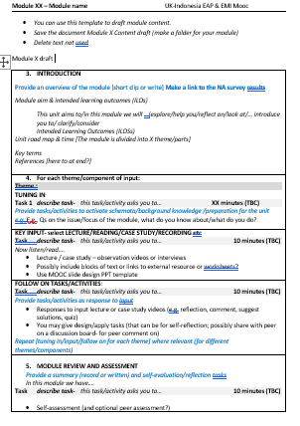
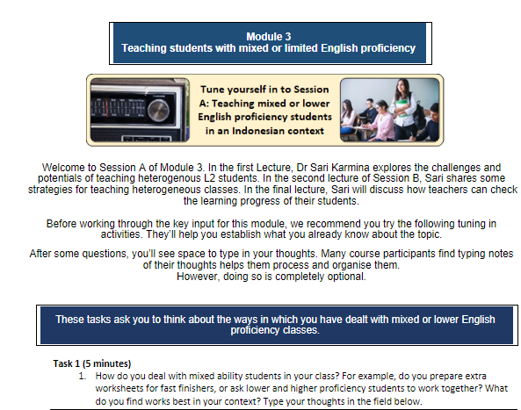
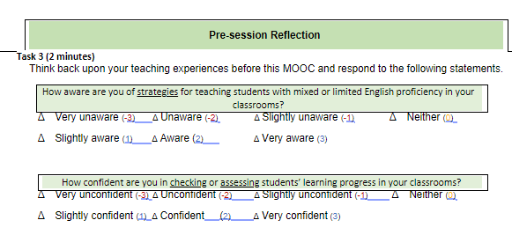
Planning & design docs
Notes:
Design preparation ‘back story work’
Planning template to allow for consistency in organisation and guide design/materials writers
Includes eg activities
PPT branded templates
Worksheets here used to structure context and activities before being exported to the platform

Slide 16
MOOC structure
Q.34 Are you familiar with MOOCs (Massive Open Online Courses)? (N=143) (in percentage)
Lecturer | Very familiar | Somewhat familiar | Not Very familiar | Unfamiliar
EMI | 20 | 30.91 | 25.45 | 23.64
EAP | 28.38 | 16.22 | 25.68 | 29.73
EMI&EAP | 14.29 | 42.86 | 7.14 | 35.71
Q.35 Have you previously enrolled in a MOOC (Massive Open Online Course)? (N=143) (in percentage)
Lecturer | Yes | No | I don’t know
EMI | 34.55 | 54.55 | 10.91
EAP | 33.78 | 58.11 | 8.11
EMI&EAP | 42.86 | 50 | 7.14
Notes:
Importance of simplicity and clarity of structure (reflected in digital literacy needs and responses from NA)
Reason for setting a simple structure of the module because most of them are unfamiliar with MOOC as follows
SOME quotes from FG:
"Could you please share what it is like? For MOOC, or online courses, I think this is server learning or like online classes or self-learning....Maybe you can give a little idea about MOOC." FG 5 ( EMI lecturer more than 5 years of teaching experience)

Slide 17
MOOC module overview
Module introduction
Session A
  Tuning-in
  Key input 1 -> follow-on activity
  Key input 2 -> follow-on activity
  Key input 3 -> follow-on activity
Session B
Session C
Module review
Notes:
Seems like a lot – but keeping each input and activity bite-sized; shorter ‘cycles’ of engagement where participants can take breaks
The learning journey goes from: initial self-assessment, reflecting on past experience and current practice → input → application to own context / making action plans → end-of-module self-assessment (to see if awareness / confidence has developed)

Slide 18
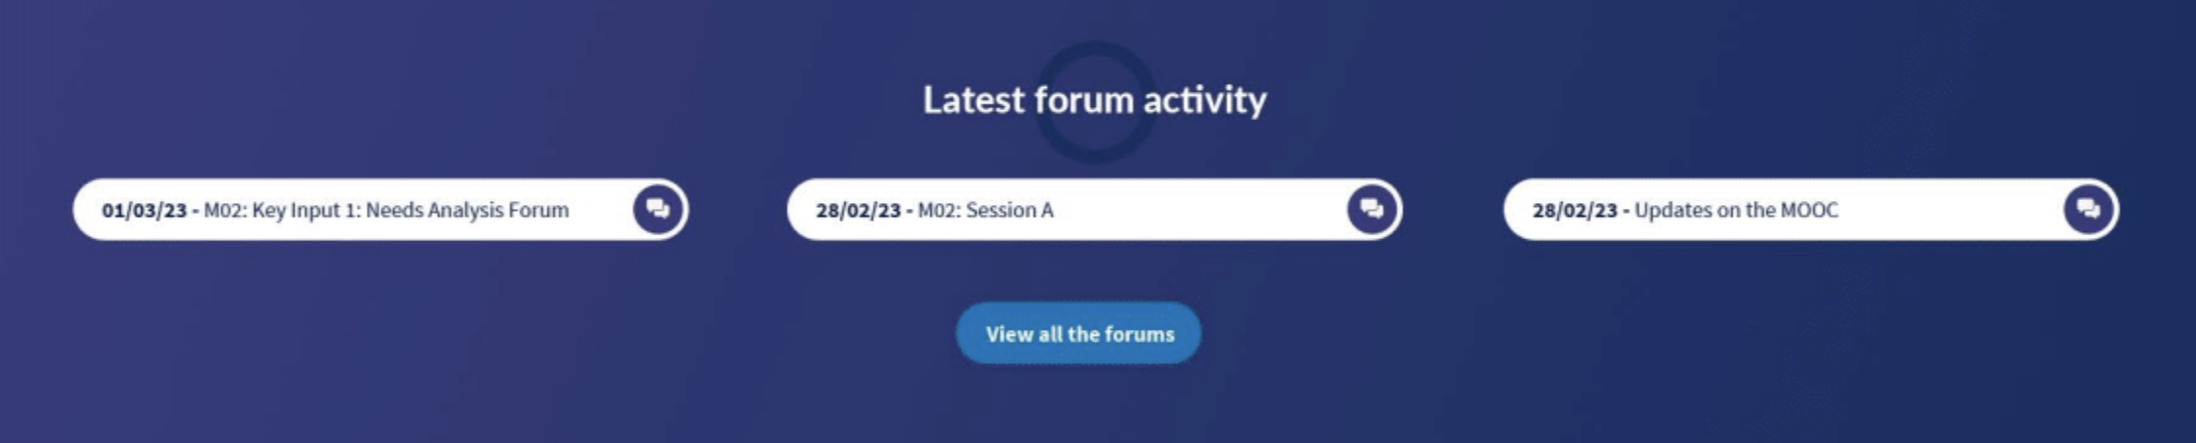
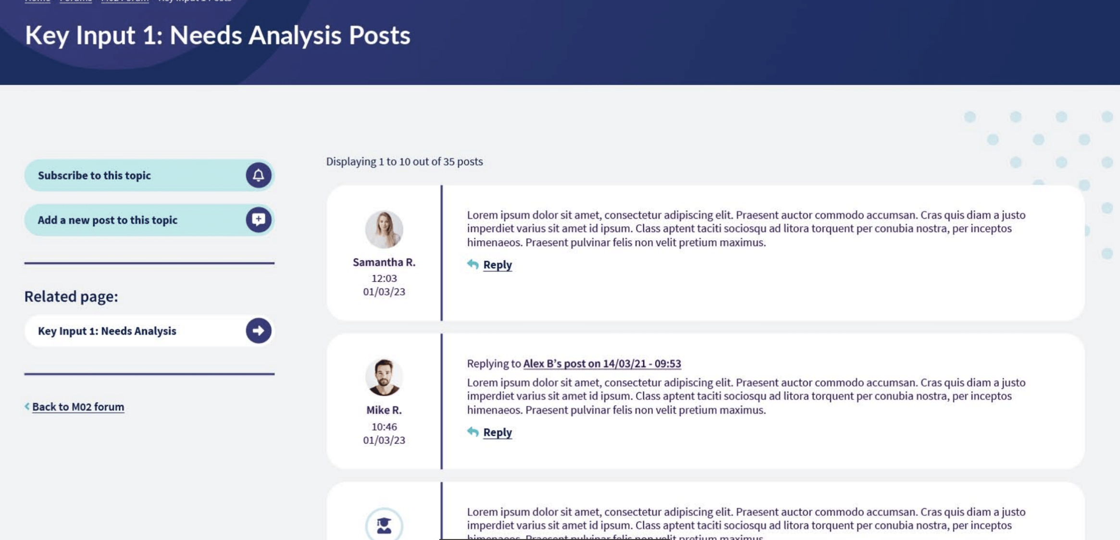
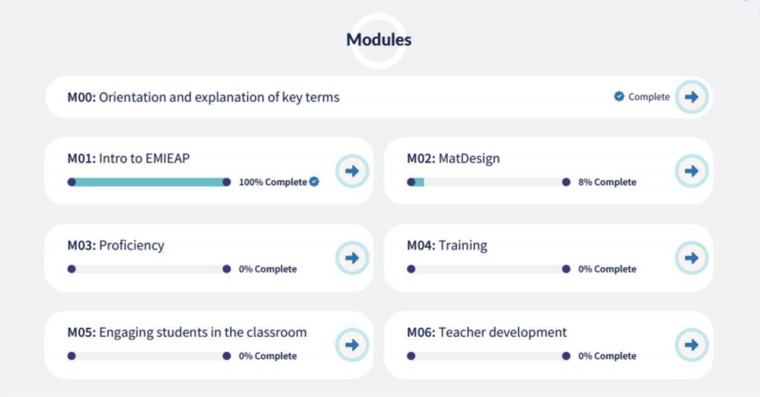
MOOC structure

Slide 19
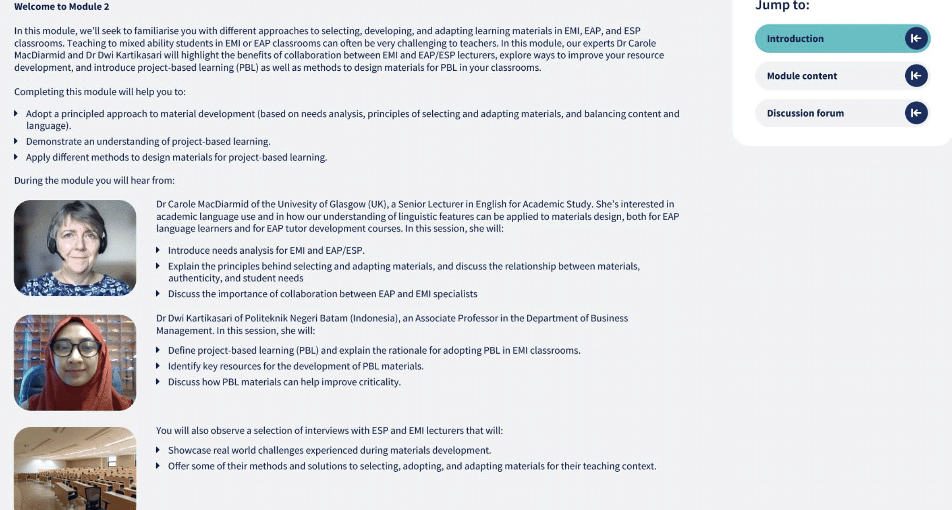
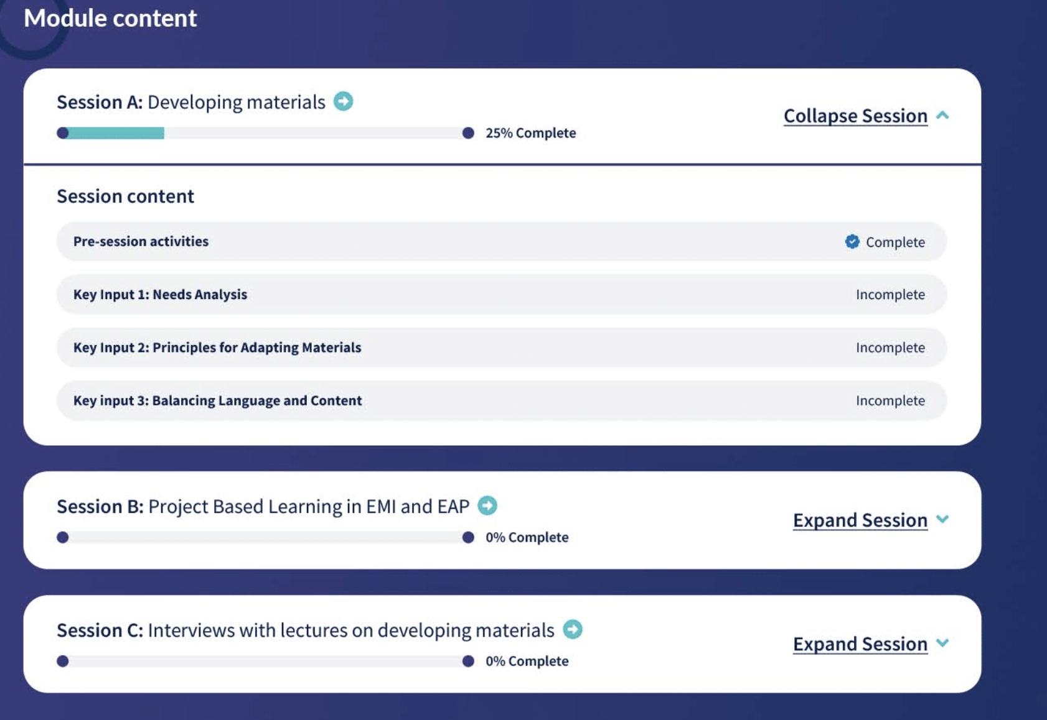
Module 2: Developing materials for EMI

Slide 20
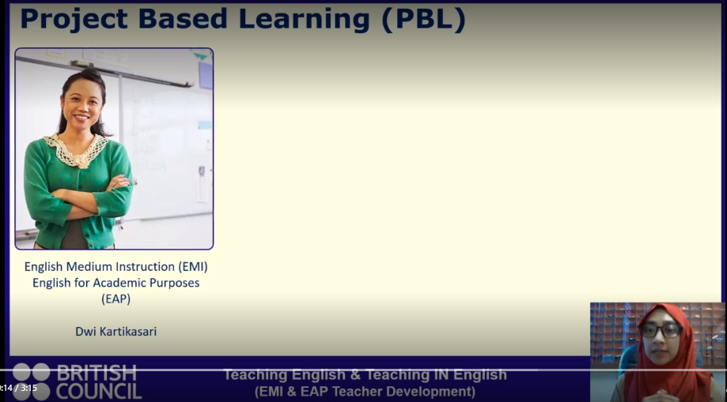

Slide 21
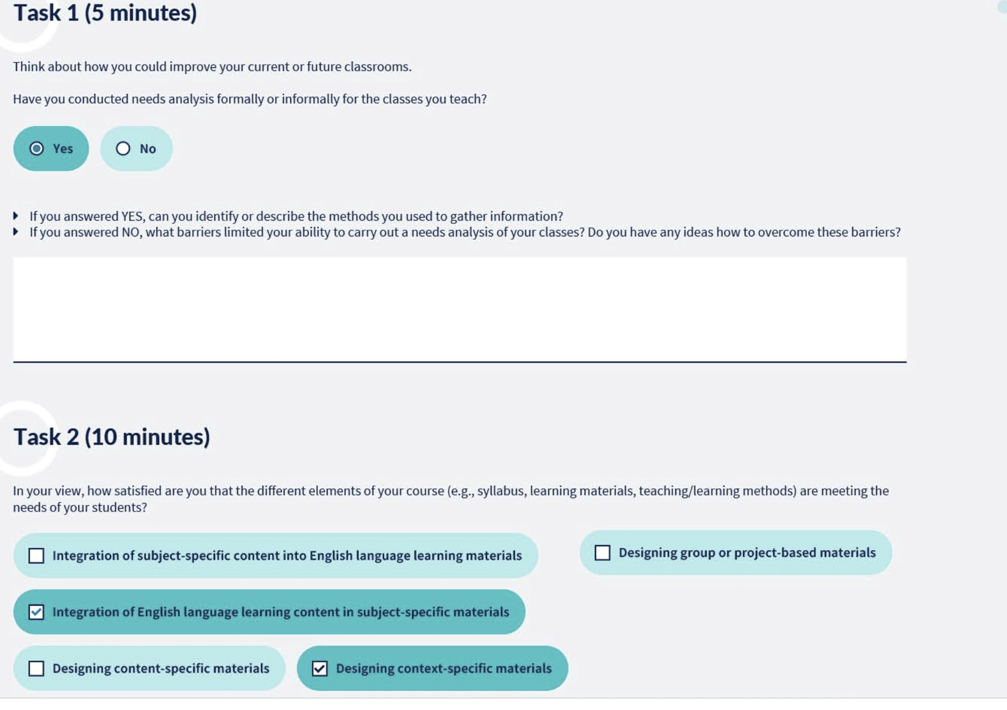

Slide 22
Teacher Development Workshop
MOOC launch / taster
28-30 March 2023
Workshop participants have the opportunity to:
familiarise themselves with the social and political driving forces behind the growth of EMI globally and in Indonesia
share their experience of teaching EAP and EMI, and build professional networks
apply theory to practice through practical approaches
take away knowledge of the MOOC created to support professional development
Notes:
Despite delays in the completion of the MOOC, a face-to-face CPD was designed to:
Bring EAP and EMI teachers together to share their experience and build professional networks
Provide opportunities for applying theory to practice through experiential tasks

Slide 23
Workshop Structure
Day​ | Session​ | Focus​
​ 1​ | Session 1 ​ | Welcome Ceremony​ Getting to know to each other​
 | Session 2 ​ | EMI and higher education internationalisation​
2​ | Session 3​ | Teaching (in) English to students with mixed or limited proficiency​ Applying theory to practice​
 | Session 4​ | Materials adaptation and design​
 | Session 5​ | Teacher Professional Development​ ELINET​ MOOC Teaching English & Teaching IN English (EMI & EAP Teacher Development)​
3​ | Session 6​ | Wrapping up​ Reflection and future TPD planning​ Workshop evaluation​
Follow the MOOC learning
journey
Tuning in Task
Input
Follow up activity - discussion, reflection
Notes:
Based on the Needs Analysis, we chose to focus on teaching mixed ability classes and adapting materials

Slide 24
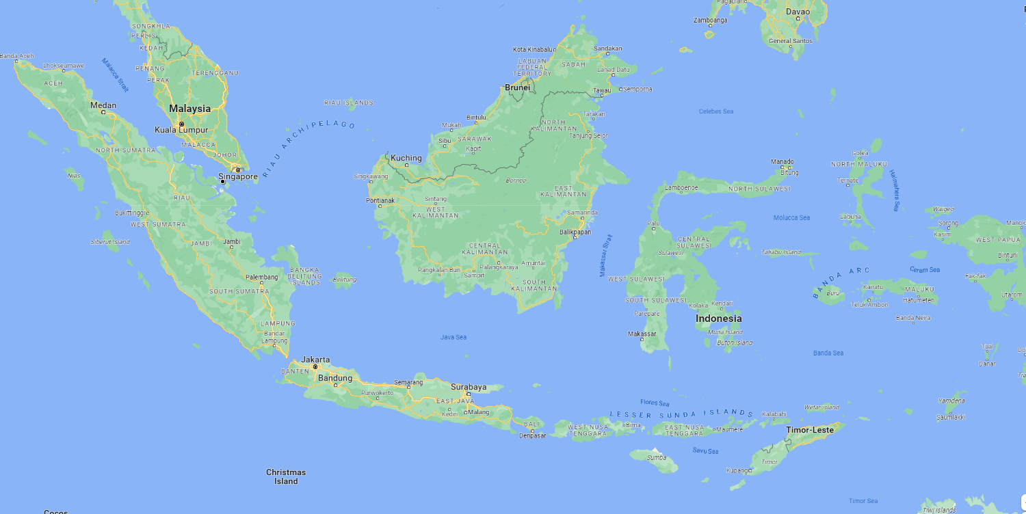
Workshop Participants
Notes:
Most of the participants were based in Pontianak in West Kalimantan. Others flew from Jakarta and Bandung; some from East Kalimantan had to fly to Jakarta and then to West Kalimantan

Slide 25
Participants
Courses Taught
EAP Business Admin
EAP Business, IT, Tourism
EAP Business Mgt
EMI Engineering
EMI Accounting
EMI Banking
EMI International Business Admin
EMI for management
EAP Tourism
EAP Agriculture, Business, Computer Engineering, Sciences
EAP-ESP
General English and Maritime English
EAP Agriculture students
EAP construction engineering
EAP Business admin, public speaking, EMI excellent service
EAP Auditing
EAP Engineering
29 participants attended
  17 EAP
  12 EMI
20 completed the evaluation
  15 EAP teachers
  5 EMI Content instructors
Institutions
10 vocational higher education institutions
1 university
1 Islam-based University (EAP & EMI)
Experience
14 7 years or more
2 5-6 years
4 3-4 years

Slide 26
Workshop Evaluation
 | SA / A | N | D
The workshop was an appropriate length (i.e. number of days) | 18 | 1 | 1
The workshop was well organised | 19 | 1
The workshop met my needs | 18 | 2
I valued the opportunity to share my ideas with peers | 20
The workshop was stimulating and engaging | 20
I broadened my awareness of the EMI context | 19 | 1
Notes:
Participants are provided funding for a maximum of 3-day CPD

Slide 27
 | SA/A | N | D
I broadened my awareness of strategies for dealing with mixed ability classes. | 20
I broadened my awareness of teacher professional development routes | 17 | 2 | 1
I gained some new strategies in materials development | 19 | 1
I have gained some strategies to apply into my classroom from this workshop. | 18 | 2
I have learned the importance of collaboration between Emi content and EAP lecturers | 20
I have learned some ways to realise collaboration between Emi content and EAP lecturers | 19 | 1
I understand more about EMI teaching practice from attending this workshop. | 18 | 1 | 1

Slide 28
Workshop Evaluation
 | Most Useful | Least Useful
Session 1 GTKY | 3 | 2
Session 2 EMI and HE Internationalisation | 1 | 1
Session 3 Teaching Mixed Proficiency Groups | 3 | 5
Session 4 Adapting and Designing Materials | 7 | 4
Session 5 Routes to Teacher Professional Development | 6 | 8
Notes:
NB the input for Session 3 'Teaching Mixed Proficiency Groups' was fairly general and perhaps more English language based, rather than specifically EMI, hence the number of 'least useful'.

Slide 29
Overall, what did you like most about the workshop?
It gave me chances to share our teaching situation with the other lecturers.
It fully engaged the participants.
It offered me a new networking so I can participate globally connecting with people around the world.
ELINET offers a good platform for research collaboration n publication which be beneficial for our university
It's open my mindset about EMI, collaborative learning and handle the heterogenous class

Slide 30
Overall, what did you like most about the workshop?
Thank you very much for having this workshop and all the material inside. As an English Lecturer of course I have opened my mind related to teaching. As well as I'm not only an English lecturer but also teacher of Bahasa Indonesia for foreigners, and this workshop gave me a lot of ideas related to the approach and methodologies of teaching Bahasa Indonesia for foreigners also.

Slide 31
What suggestions do you have...?
Needs more teaching simulation and feedbacks for improvement; extending the material, contents and duration.
If it's possible, give a full training for all lecturers about how to implement EMI in their classes.
Maybe you can promote this EMI to all stakeholders especially to all vice directors in academic affairs in all Polytechnics, so this method will be spread all over Indonesia.

Slide 32

Where are we now?
MOOC in development stage format
To be hosted on ELINET (Education, Language and Internationalisation ) webpages
Writing up projects?
https://elinet.org.uk/
Notes:
Hosted on ELINET/ Education, Language and Internationalisation
Users will register (so they can track progress) but will be open access
Platform construction as we speak- uploading files etc

Slide 33


Slide 34
References
Galloway, N., & Ruegg, R. (2020). The provision of student support on English medium instruction programmes in Japan and China. Journal of English for Academic Purposes, 45, 100846-100846.
Guo, P. J., Kim, J., & Rubin, R. (2014). How video production affects student engagement: an empirical study of MOOC videos. In Proceedings of the First ACM Conference on Learning@ Scale Conference (pp. 41-50). Association for Computing Machinery.
Hood, N., Littlejohn, A., & Milligan, C., (2015) Context counts: How learners’ contexts influence learning in a MOOC. Computers and Education, 91, 83-91.
Vu, N. T. T. & Burns, A. (2014). English as a medium of instruction: Challenges for Vietnamese tertiary lecturers. The Journal of Asia TEFL, 11(3), 1-31.

