Slide 1
It’s a two-way street: Informing Irish Pre-sessional EAP Programs with a Needs
Analysis of Irish Higher Education
Jessica Garska
garskaj@tcd.ie
@JessicaGarska
Trinity College Dublin; Studentship funded PhD

Slide 2
rationale
Globalisation and internationalization
Increase of international students in Ireland
Lack of EAP research in Ireland (7 published studies)
Few studies focusing on curriculum as a whole
Lack of alternative curricula and assessment
Lack of research focusing on pre-sessional programmes
Notes:
Those that exist employ holistic needs analysis(Sheridan, 2011), explore writing instruction at six academic writing centers(McClay,
55
2017), investigate spoken academic discourse through corpora(Farr, 2003), and develop individual guidebooks with Irish institutions as cases or institutional-specific program evaluations focusing on writing centers
(Farrell, O'Sullivan, & Tighe-Mooney, 2015; E. Kelly & Harding, 2016; O'Sullivan, TigheMooney, Lenihan, & Farrell, 2017; Tighe-Mooney & Farrell, 2015).

Slide 3
Theoretical underpinning
Academic Literacies
Translanguaging and global englishes
Notes:
7/14 mentioned translanguaging

Slide 4
Research questions
1. Do international students feel overall positively or negatively towards their educational experiences in Irish higher education?
2. What do international students and faculty feel that international students need for academic success, and what do they struggle with and succeed in?
a. What level of agreement do faculty and international students have with respect to the issues raised in the foregoing research question?
3. What implications do the answers to the above research questions have for Irish pre-sessional EAP programs?

Slide 5
Methodology
124 student questionnaires
41 student and 14 faculty interviews
2018-2019 data collection
Notes:
*note – had 14 faculty surveys – survey results not represented due to low response rate

Slide 6
faculty

Slide 7
Faculty Demographics
1 STEM
3 Medical Sciences
10 AHSS
6 Institutions

Slide 8
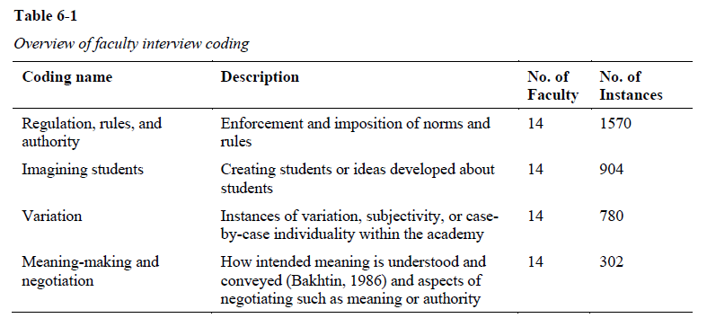

Slide 9
Regulation, rules and authority
Expectations and dominant discourse
Writing
Oral communication
Listening
Reading
Rubrics, criteria and handbooks
External authority
College, school or departmental-level authority
Business or numbers-drive policies
Lack of resources

Slide 10
Imagining students
Causes of student struggle
English L1 and LX struggle
Culture
Other factors
Evaluation of students
Writing ability
International or LX student definition
Non-EU
General international students
Erasmus and EU students

Slide 11
Variation
Modules, assessment and practice
Types of assessment and deliverables
Lectures
General mention
Lectures
Roles and identities
Examples or personal experience
Course director
Communities of discourse
Discipline-specific
Englishes
Other languages in the classroom
Culture

Slide 12
Meaning-making and negotiation
Faculty and student meaning-making and negotiation
Assessment
Discussion of expectations
Putting a personal “stamp” on assessment
Feedback
Giving feedback
Faculty meaning-making and negotiation
Internal
Faculty reflection
External
Negotiating external authority

Slide 13
students

Slide 14
Student Demographics
6 STEM
1 Medical Sciences
34 AHSS
6 Institutions
Notes:
6 institutions

Slide 15
Student Demographics
6 Undergraduate
20 Master’s
1 H.Dip
14 PhD

Slide 16
Student Demographics
20 different countries
4 students from traditionally thought of English-speaking countries
3 additional students who completed entire schooling in English

Slide 17
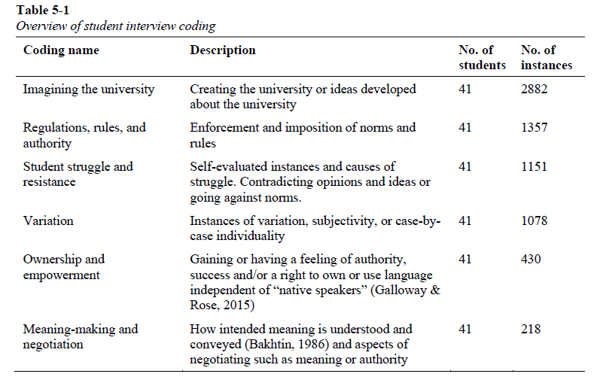

Slide 18
Imagining the university
Expectations, qualities for success, and dominant discourse
Student expectations and needs
Institutional factors
Improved student supports and resources
Other and internal factors
Writing
Faculty expectations and needs
Writing
Oral communication
Listening
Evaluation of faculty and institutions
Negative
Positive
Overall negative
Unclear, unsupportive, lack of facilities and infrastructure, lack of communication
More specific
Named supportive services / professors, good supervision
Contrast
Notes:
Mainly focus on expectations

Slide 19
Regulations, rules, authority
Faculty expectations and needs
External authority
Focused on previous English schooling and entrance exams

Slide 20
Student struggle and resistance
Causes of struggle
Institutional factors
Language
Struggle
Self-blame and doubt
Writing
Disagreement/ independence from faculty
Low numbers

Slide 21
Variation
Modules, assessment and expectations
Roles and identity
Culture
Communities of discourse
Englishes
Translanguaging

Slide 22
Ownership and empowerment
Strengths
Personal qualities
Ownership of English

Slide 23
Meaning-making and negotiation
Discussion of expectations
Not discussed
Unclear

Slide 24
Overall Factors: faculty and students

Slide 25
Main factors
Linguistic
Institutional
Integration and social life
Internal and emotional
Culture
External authority
Notes:
Look at conclusion

Slide 26
Implications

Slide 27
Implications for pre-sessional programmes
In-house, inclusive, free or means-tested, embedded or discipline-specific
Heuristic Academic Literacies framework with Global Englishes and translanguaging strategies intertwined within the curriculum and assessment
Social programme, workshops, community service / work experience, mentoring scheme
Accommodation

Slide 28
Governmental and institutional implications
Policies: international-student friendly, increased resources and encouragement of ‘holistic’ programmes
Subsidized housing: affordable and mixed housing
Institutional change

Slide 29
Thank you!
garskaj@tcd.ie
@JessicaGarska

