Slide 1
Integrating culture (academic and social) into an EAP provision: A case study of an international induction programme
Jennifer Cowell & Meghan Bowling-Johnson jc138@stir.ac.uk & mb120@stir.ac.uk
BALEAP 2023 conference
Friday 21st April

Slide 2
Context
Response: bespoke and holistic support aimed to address common potential barriers:
    Acculturation stressors (Berry, 1970)
    Crucial understanding of key literacy
    Expectations regarding academic integrity (Berry, 2015; Smith & Khawaja, 2011)
  Consultation: staff, students, & alumni.
    Highlighted induction ideal time for increased support = promote & support successful transition
    The need to interweave culture!
Increase of highly diverse cohorts – similar to many UK HEIs (HESA, n.d.; 2022)
Staff noticed signs of potential difficulties linked to educational and social acculturation (Berry, 2015; Fovet, 2021)
Previous cohorts mentioned difficulties and requested support provision

Slide 3

Overview of programme
8 x 1-hour over 2 weeks online
    6 workshops – key academic skills
    2 conversation/Q&A sessions – alumni & staff
3 occurrences in autumn, 1 in spring
Students:
Autumn 2022 | Spring 2023
313 | 171

Slide 4
Programme design
  Programme aim:
  Reduce stressors to increase positive outcomes (Smith and Khawaja, 2011; Wadworth et al., 2007)
1. EAP (4 skills), academic skills, and acculturation combined.
  Interweaving language & acculturation for optimal success (Fovet, 2021)
  Relatable examples – linking theory to everyday
  Short, sharp, targeted – order of workshops specific to occurrence

Slide 5
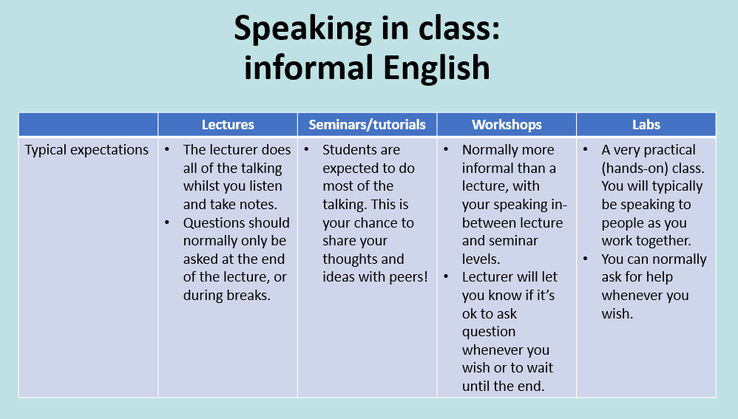
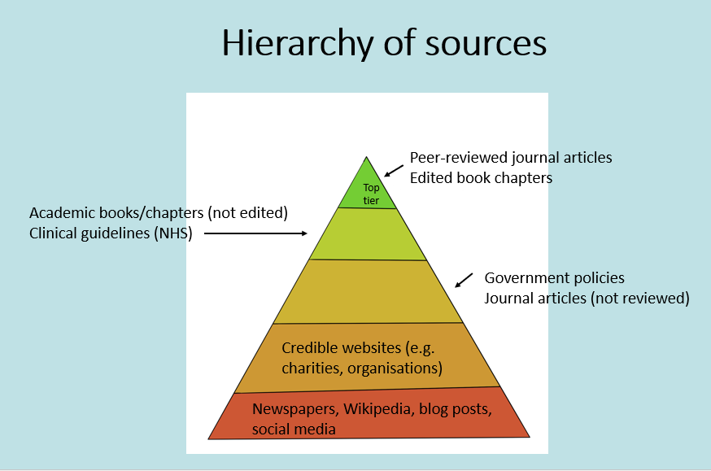

Slide 6
Programme design
  Programme aim:
  Reduce stressors to increase positive outcomes (Smith and Khawaja, 2011; Wadworth et al., 2007)
1. EAP (4 skills), academic skills, and acculturation combined.
  Interweaving language & acculturation for optimal success (Fovet, 2021)
  Relatable examples – linking theory to everyday
  Short, sharp, targeted – order of workshops specific to occurrence
  2. Free to all and online to ensure inclusivity and accessibility
  Traditional pre-sessional optional
  Ensure avoidance of accidental marginalisation or isolation (Plotts, 2021)
  3. Best practice e.g. trauma-informed pedagogy
  Esp. important as Stirling is University of Sanctuary

Slide 7



Feedback (individual workshops)
Average score: 4.8/5
Introduced studying expectations in a UK HEI
Refreshed memory on key concepts
Talked to other students and asked questions

Slide 8



Feedback (overall programme)
Average score: 4.6/5
Overview of Stirling helped with acculturation (Berry, 2015)
Reassurance about available support
Promoted sense of belonging at Stirling

Slide 9

Programme impact (students)
Students reported feeling:
More settled and prepared to start studying at Stirling
Students reported that the programme:
Helped them to feel like they belong to the Stirling community
Enabled them to feel a connection to both staff and students

Slide 10
Programme impact (institutional)
95% of int. students satisfied with their virtual orientation programme (2% higher than UK benchmark)​
Satisfaction with orientation went up 7% (average) compared to 2018​
90% of int. students satisfied with their learning experience at this stage (on par with UK benchmark)

Slide 11
Next steps
Expansion of induction model to whole university:​
    International​
    UG​
    PG​
    Mature/advanced entry​
    Online/commuting​
Still focusing on reducing stressors (mental, emotional, educational) that could impact academic performance (Smith and Khawaja, 2011; Wadsworth et al., 2007)
Each strand tailored to that cohort
Logistics and expectations
Critical thinking
Research strategies
Maintain a focus on cultural integration based on experience and feedback (Fovet, 2021)

Slide 12
QAA case study
Induction programme recently published as a 1-page QAA case study (pp. 14 & 15) as part of the campaign to support and enhance the experience of international students in the UK.
Click on this link to navigate to the QAA case studies document – a free QAA log in may be required.

Slide 13

Thank you!
Any questions?

Slide 14
References
Berry, J. W. (1970). Marginality, stress and ethnic identification in an acculturated Aboriginal community. Journal of Cross-Cultural Psychology, 1, 239-252.
Berry, J. W. (2015). Acculturation. In J. E. Grusec & P. D. Hastings (Eds.), Handbook of socialization: Theory and research (pp.520–538). The Guilford Press.
Fovet, F. (2021). Using Universal Design for Learning to Create Inclusive Provisions for Indigenous Students in Higher Education: Decolonizing Teaching Practices. In L. Roberts (Eds.), Redesigning Teaching, Leadership, and Indigenous Education in the 21st Century (pp.253-274). IGI Global.
HESA. (n.d.). Students 2000/01. https://www.hesa.ac.uk/data-and-analysis/publications/students-2000-01/introduction
HESA. (2022). Where do HE students come from? HE student enrolments by domicile. https://www.hesa.ac.uk/data-and-analysis/students/where -from#non-uk
Smith, R.A. and Khawaja, N.G. (2011). A review of the acculturation experiences of international students. International Journal of Intercultural Relations, 35(6), 699-713. https://doi.org/10.1016/j.ijintrel.2011.08.004​
Wadsworth, B.C., Hecht, M.L. and Jung, E. (2007). The Role of Identity Gaps, Discrimination, and Acculturation in International Students. Educational Satisfaction in American Classrooms’. Communication Education, 57(1), 64-87. https://doi.org/10.1080/03634520701668407

