Slide 1

Integrating Community Engaged Learning Initiatives into the Academic English Classroom:
An Opportunity for Students to Grow as Language Learners and as Global Citizens
Presenters: Jennifer Lightfoot & Daniel Riccardi
University of British Columbia
Collaborators: Dr. Katherine Lyon, Nicole Malette & Nina Bennett
Notes:
Stock photos ubc

Slide 2

We would like to share with you
An overview of the potential benefits of community engaged learning
How we have implemented community engagement initiatives within our EAP courses
Student perspectives from engaging in these initiatives
A project that can be transferred and implemented into different teaching and learning contexts
Our reflections as project leads
Notes:
Throughout this presentation, we would like to share…

Slide 3
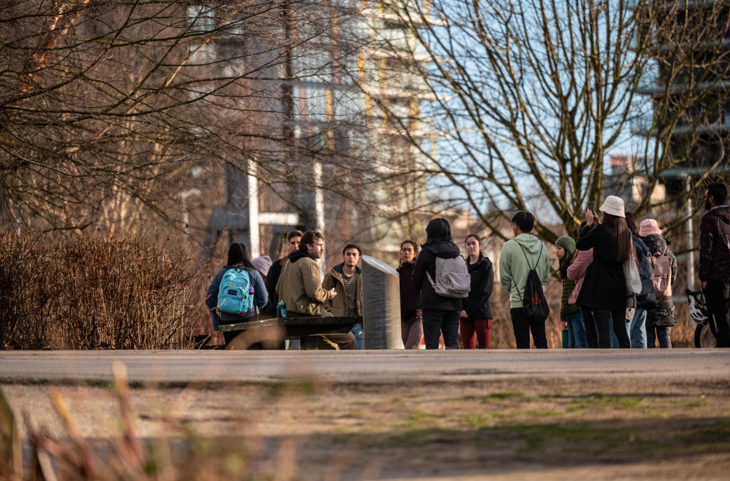
What is Community Engaged Learning?
A form of experiential education where students apply, engage, and further their education through community involvement
Often interdisciplinary and hands on, these opportunities connect classroom learning to help solve real world issues within the community.

Slide 4

Benefits of Community Engaged Learning
Offers an opportunity to apply course learning to authentic contexts, applying course concepts to help develop solutions to social and environmental issues
Allows students to move beyond the classroom to practice skills
that they are learning in class, and even build new (transferable,
resume boosting) skills
Provides opportunities for networking, learning about
different possibilities within the community
Allows students to connect outside of the classroom and
build their own communities, out of the campus bubble
A chance to give back to the community and make a positive
change in the world!
Notes:
This integration of community involvement into the classroom has been shown to be beneficial in multiple ways:
Integrating this form of experiential learning allows participants to move their education beyond the classroom by engaging students with the aims of community organizations outside of the university, thinking about how their education can be applied to help solve real world issues within their community.
Education and pedagogy play an important role for advancing social justice (Arnold, 2019), and CEL offers an opportunity to apply course learning to authentic contexts.

Slide 5

The Centre for Community Engaged Learning at the University of British Columbia
Notes:
The CCEL at UBC helps design and implement opportunities for students to apply their knowledge and skills to help address the most critical social and environmental issues by collaborating with diverse university and community partners and stakeholders.
The Centre’s programming and initiatives align and advance a learning journey for students that is progressive; moving a student from the early stage of awareness and understanding, through to co-creation, innovation, and real-time action on social and environmental challenges affecting communities both locally and globally.
The centre works with students who would like volunteering experience within the community as well as instructors who would like to build these opportunities into their classrooms.

Slide 6
A UBC Funded Project:
Expanding Community Engaged Learning Opportunities Across First Year Cohort-Based Programs
Building faculty knowledge and confidence in developing CEL opportunities in first year cohort programs
Sustainable resource support
  Specially trained CEL TA Fellows who, combined with CEL Mentors, support new practitioners of CEL in exploring this innovative pedagogical method
Notes:
2018 – Present Teaching & Learning Enhancement Funded (TLEF) Project: Expanding Community Engaged Learning Opportunities Across First Year Cohort-Based Programs –collaboration with Kelly Greer (Principal Investigator), Claudia Ruitenberg, Susan Grossman, Katherine Lyon, Laurie McNeill, Tom Kemple, Evan Mauro, Simon Lolliot, Daniel Riccardi, Christine D’Onofrio and Kelsea Perry. Noting how faculty knowledge of and confidence in developing CEL opportunities for students is limited in in first year cohort programs, specifically the Coordinated Arts Program and Vantage College, this project builds faculty capacity and sustainable resource support by providing specially trained CEL TA Fellows who, combined with CEL Mentors, will support new practitioners of CEL in exploring this innovative pedagogical method (TLEF Application Summary, 2018).

Slide 7
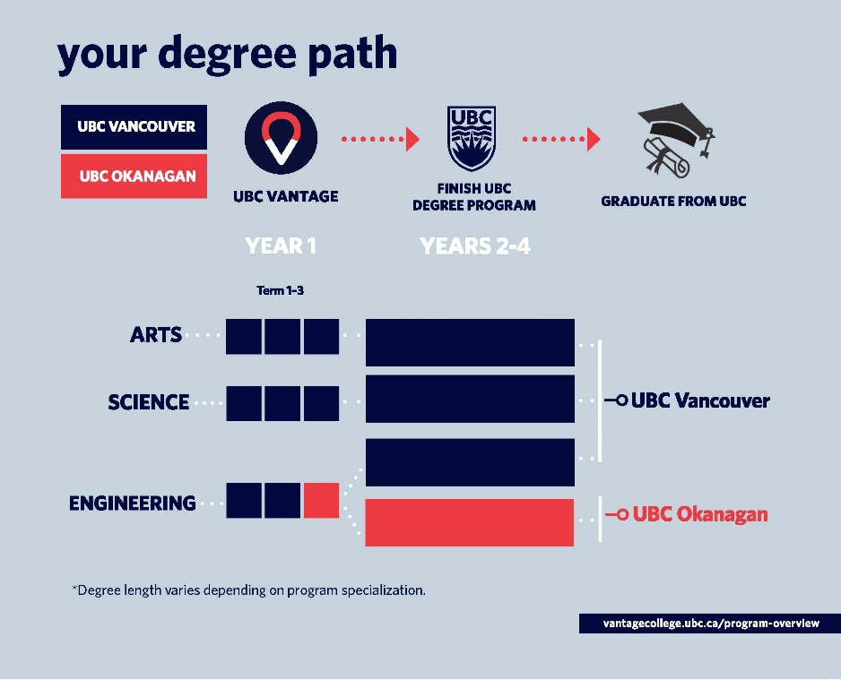
Our Context: The Vantage One Programs at UBC
Notes:
A little bit about our context and what this looked like for us…
Situated in a Canadian university first-year Bachelor of Science program that embeds academic language and literacy instruction, this presentation reports on a classroom-based inquiry that examines how academic English classrooms can create space for Community Engaged Learning (CEL) initiatives.
The Vantage One Programs at UBC Vantage College
Enriched first year program with a view of students as novice scholars
All students international (visa status), multilingual speakers of English as an additional language
Cohort model, immersive and progressively sheltered
Three Program options: Arts, Science and Engineering
1st year courses in relevant disciplines (e.g. Sociology, Psychology, etc.)
Student engagement with multidisciplinary and interdisciplinary learning experiences
Academic English courses supporting disciplinary language & literacy

Slide 8
Vantage College Curricular Model:
Term 1
Term 2
POLI 100 (3)
PSYC 101 (3)
SOCI 101 (3)
POLI 102 (3)
PSYC 102 (3)
SOCI 102 (3)
Term 3
Elective of choice (3)
Language & Literacy-driven Content-driven
Term 1
Term 2
Term 3
ASTU 204A (3)
LLED 200 (3)
​VANT 140 (3)
WRDS 150 (3)
LLED 200 (cntd.)
VANT 140 (cntd.)
VANT 148 (2)
VANT 149 (1)
Academic English Program Tutorials & Workshops

Slide 9
Embedded Literacy Support
POLI
VANT 140
PSYC
SOCI
EAP instructors work closely with the content instructors in order to:
ascertain the literacy practices common to the discipline and how those fit with course expectations
advise content instructors on ways in which they integrate a focus on language in assignments or lectures
deliver a course that supports students’ acquisition of academic literacies related to the discipline.

Slide 10


Benefits of CEL for International EAL Students
Allows students to learn about Vancouver and connect with the community beyond their Vantage cohort
Beneficial particularly for EAP language classrooms by “enhancing the linguistic and communicative competence of language learners and advancing the intercultural competence that is necessary for global citizens to engage with a diverse world” (Lee et al., 2017, p. 169).
Notes:
Why this was so important for our students…
2018 – Present Scholarship of Teaching and Learning (SoTL Seed) supported project: Documenting the Impact of Course-Embedded Community Engaged Learning on First-Year International Students’ University Transitions –collaboration with Dr. Katherine Lyon (Principal investigator), Kerry Greer, Simon Lolliot and Daniel Riccardi. This project documents the experiences of first-year international students participating in an innovative pedagogical approach: course-embedded community engaged learning (CEL), noting various ways CEL facilitates first-year international students’ transitions to their host university and city, and forms of support these students require in engaging with CEL pedagogy. Bringing together research on student benefits from and challenges with CEL (Stoecker et al., 2008; Yi & Lee, 2018) with literature on international students’ university transitions (Moores & Popadiuk, 2011), we ask: How does course-embedded CEL inform first-year international students’ academic, social, and linguistic transitions? What challenges do first-year international students face in engaging with course-embedded CEL, and what forms of support do these students value in addressing these challenges? (SoTL Appliction Summary 2018) (See section 7(b) for further information on how our VANT 140 classes supported students in the application process for this opportunity)

Slide 11
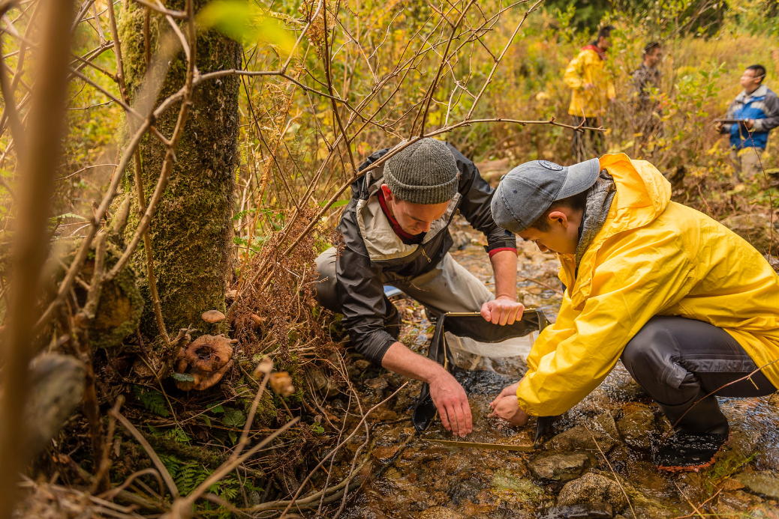
Our Projects
Various Levels of Engagement Opportunities Provided
Notes:
As project leads, we will share our experience with various levels of classroom-based CEL initiatives, where students can choose which level of engagement best suits their comfort and learning needs.

Slide 12

Sociology & EAP
Course Collaboration
Provided students an opportunity to volunteer as classroom assistants in Vancouver elementary schools for three consecutive days during their Winter Reading Week
Joint Assignment:
  Produce a Community Engaged Learning Reflective Essay based on their experience
EAP Course Focus:
  Stages of a critical, reflective essay with comparison and contrast writing to demonstrate their understanding of community before and after the placement
Notes:
Project 1a: CEL in Elementary Schools
Collaborations around assessment
Happening throughout the courses, and this is one case study
Miller & Pessoa, 2016
Different colour for focus

Slide 13


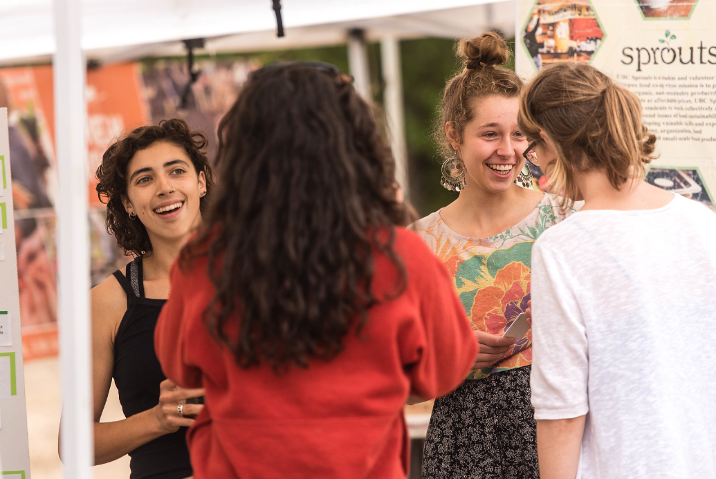
Food Communities in Vancouver
Our EAP Course Focus:
Food Sustainability
Notes:
EAP Course Focus: food sustainability
Project 1b: Food sustainability with multiple levels of possible engagement (food stash, gardens, markets vs. farm tour)
We looked specifically at community and food sustainability

Slide 14
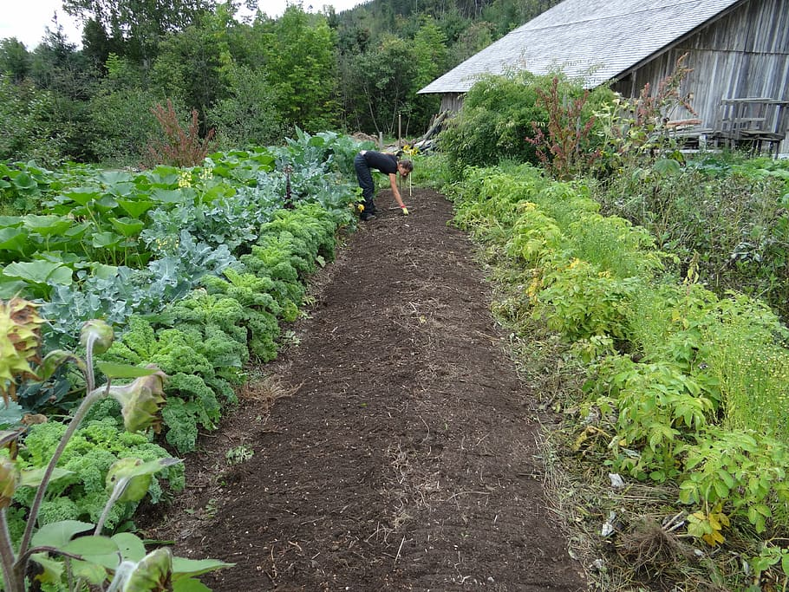
Community Partners
& The Project
Overview of the off-campus
1 day Placements
Notes:
Off campus, accessible by bus and/or skytrain
Students volunteered in small groups and got to the placements themselves
Three options

Slide 15
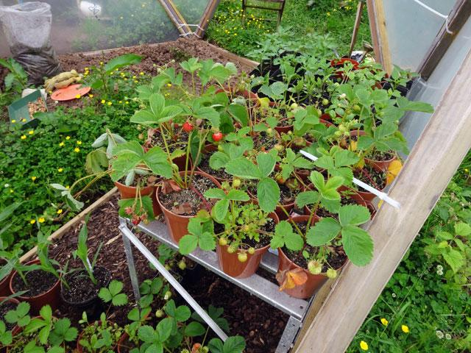
Option A:
Village Vancouver Community Garden
Village Vancouver envisions Vancouver as a vibrant city at the leading edge of sustainability, where residents know their neighbours and participate in collective actions to minimize their ecological footprint. The focus is on local food production and distribution, a full-employment local economy, renewable energy, and low-impact transportation.
Notes:
In this opportunity, students volunteered to plant and work in the community garden. Get their hands dirty a bit ☺

Slide 16

Option B:
Food Stash
Food Stash Foundation is a Canadian Charity with the goal of rescuing surplus food directly from suppliers and redirecting it to households in our community that experience food insecurity, while reducing the environmental impact of food waste.
Notes:
Foodstash is on a mission to bridge the food insecurity gap and bring awareness to how our food choices impact our environment and our health.
In this opportunity, students volunteered to pack food bags from participating grocery store and provide these to household in need

Slide 17

Option C:
Food Stash Stall at
Riley Park Farmer’s Market
Riley Park Farmer’s Market envisions the creation of community space and social cohesion to promote promote food security.
Notes:
In this opportunity, students worked with the Food Stash organization and volunteered at the farmer’s market to collect food donations and spread awareness about food sustainability and the goals of Food Stash

Slide 18
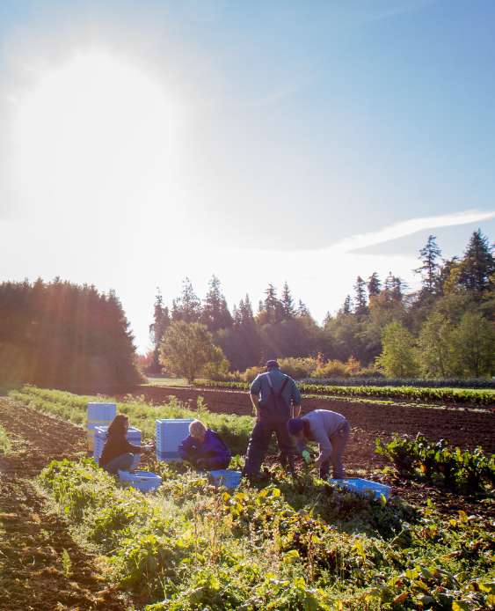
Class Visit to the UBC Farm
Students participated in a walking tour of the site, stopping at different research projects and production field areas (bee hives, orchards, blueberries, truffle planting), and learning about community programming, exploring topics such as biodiversity, urban/rural relations, organic practices, and Indigenous ways of knowing and education
Lowest level of CEL engagement
Notes:
We will get an overview of the site, its history, its relationship to UBC.
Option 4: Completed during class time; walking distance from the classroom. Everyone was welcome to join this tour, and it was manditaory for everyone who did not participate in other volunteering opportunities. Those who did participate in other volunteering opportunities had the option of using this as a free period, but most decided to join us on the tour anyways. ☺

Slide 19

Written Project Assessments
Before volunteering, interested students submitted applications
  Based on a resume writing and cover letter
  EAP class
Final Term Assessment: a Community Engaged Learning Reflective Essay
Notes:
Before students could volunteer, they went through an application process and needed to submit cover letters based on a resume and cover letter writing class
All students submitted a reflective essay, no matter which level of engagement they participated in (in order to keep things easy for us)

Slide 20

The Student Perspective
Findings from our Focus Group Interviews
Notes:
Linguistic benefits and challenges from student perspectives
Focus group interviews

Slide 21
The Student Perspective:
Noticing Communication Challenges & Barriers
Language Barriers
  “Their [other UBC students and people at the organizations] English is good and… it's more stressful to communicate with... sometimes I can't… I also don’t understand what they are talking about.”
Subject Knowledge Barriers
  “It's also difficult to say what I want to say and if the topic is about nutrition and there are a lot of professional words that I also don’t know in English.”
Social Barriers
  “The other one specifically for me, and I bet a lot of international students also like relate with, was like the cultural language… The slang? Between when you hang out with friends… and then like names of people that I am not really familiar with, so like celebrities or… accents, connotations when you are speaking, the content itself as in very different mindsets… they have different ideologies, different perspective, open mindedness which I struggle with a lot… certain etiquettes and social norms which I wasn’t really exposed to before, so I was not familiar with.”
Notes:
Students noted it was particularly challenging to “go through those gaps” in cultural and social differences.

Slide 22
The Student Perspective:
These barriers can lower EAL student confidence
“I kind of feel bad about myself because I didn’t really speak a lot. But maybe because there’s so many native speakers over there I feel very shy. And, doesn’t have the encourage to speak. Cause I always thinking if the grammar is right or something like that.”
“Well, to be honest, I feel less confident to interact with them because I…If I know they are from Vantage I kind of feel more confident because I least know they are not native speakers. So, they are like the same level of English compared to me… I also, I think the willingness to learn and communicate is also a big essential tool. Because, some of the students will like to stay in their comfort zones. They just don’t want to and just like keep up with their…like, students that they know.”
Notes:
Sometimes it caused students to be afraid to speak

Slide 23
The Student Perspective:
Breaking through the Barriers
“There was this one girl in the classroom and I was assigned to read with her. She was very shy, because when I asked to read, “Could you read with me please?” And she said, “No, I’m not going to read. You will read for me.” And, I didn’t want really to argue with her, I didn’t know maybe she is shy, maybe she has some problems with reading. So, I started reading with her… I felt really happy… when she corrected me, like, I made some… maybe mistakes in public so that girl could correct me and say something. And I felt a little bit better… she kind of interacted with me.”
“I was feeling very anxious before the experience… I was really frightened… But, after this experience, I understood like maybe people do not really pay attention to my mistakes, like grammar mistakes or pronunciation mistakes. Like, not a lot of people really care about all that. And it made me a little bit more confident in English.”
Notes:
Many noted times that they felt anxious but just tried their best to communicate and then quickly realized that it didn’t matter if they made small mistakes
“Honestly, no one cares. No one cares about your accent. No one cares about if you said a word wrong as long as you made yourself understood. That's what, what is important, but we as a students don't see it that way, especially when you're just learning. And that's what caused me to learn, that, it's OK.”

Slide 24
The Student Perspective:
Noting the Linguistic Learning Opportunities
“I think it all still provides, like pushes me to really interact with others… although you’re in Canada, you’re studying in Canadian university, your opportunity to really speak English with others are still limited in this program. So, I think attending this Reading Week Program somehow is like pushing me to, like, go out; to like explore and just communicate with others.”
“In this way, I have more chances to speak in English rather than class. Cause they’re always too many people in class. The professor don’t always have time to, like, communicate with EACH one of them. And, like, especially when I communicate with kids, like…Cause, like, their English skill is better than me I know. Cause sometimes there are communication problems. So, I have to EXPLAIN to them, and they have to explain to me like some local food I don’t know or yeah. So, in this way I have to improve my English.”
“Sometimes I can ask them, what's this word about? And they can help me to paraphrase or just make some examples and teach me.”
Notes:
Pushes students to practice English in authentic settings outside of their comfort zones - increased Willingness to take chances and make mistakes… Curiosity to learn from CEL experiences when they feel there is a communication barrier

Slide 25
The Student Perspective:
Learning about Cultural Differences, the Community
“I learned a different kind of teaching method in Canada... In China, we only do a lot of homework in the elementary school but they're really heavy.”
“I understood, like, okay there are children that there are also kind of different cultures and maybe they also have some problems even though they kind of growing up in this country.”
“Actually, I said “no” one time, and suddenly, I found that “no” is a harsh word for them, actually, when I said “no”, the child went silent and suddenly I realized this is not gonna be okay and I have to change.”
Notes:
Cultural differences in communication styles: Learning about the importance of interpersonal positioning and cultural differences (ie, less direct):

Slide 26
The Student Perspective:
Connecting through Community & Culture
Connecting through their culture
  “In the elementary [school], there are still some, like Chinese students… but they born in Canada, but part of them, they can speak a little Chinese. And I think, when they first saw me, they have the sense of familiar, and they are willing to talk to me and learn from me cause I’m the only foreign student in my group. They kept asking me questions about, like, some questions about Chinese background, or, even ask me to teach them some Chinese phrase.”
Building Community within UBC
  “For this time, I am engaging with students, but I’m also engaging with my peers, they’re also, like there are local students, there some international students from other countries, this project provide us a chance to like, communicate with each other, to share our experience to make more friends, and provide me more opportunities to engage.”

Slide 27
The Student Perspective:
Implications for Future CEL Initiatives
The importance of supportive CEL environments
  “I have a lot of support from the teachers in elementary school. Sometimes if I say something too difficult for kids to understand… the teachers can always rephrase it to another funny way to say it, so I think I get a lot of support from the teacher and also, I learnt how to say things in more interesting way.”
Time commitments of CEL activities
  “Three days are really tiring because I need to use my second language to communicate.”
  “Actually, I don't improve a lot because it's only three days. Most of the time is the Vantage College that helps me improve my English.”
Students enjoyed interacting in CEL contexts & expressed a desire to learn more about “daily” communication skills in our EAP classes.
Notes:
At the same time, it may not be enough to make an impact: Bruno: Do you think you improved your English during these three days? Was there something that helped you improve? K: Actually, I don't improve a lot because it's only three days. Most of the time is the Vantage College that helps me improve my English.

Slide 28

A Transferrable Community Engaged Learning Project
Promoting Social Activism

Slide 29
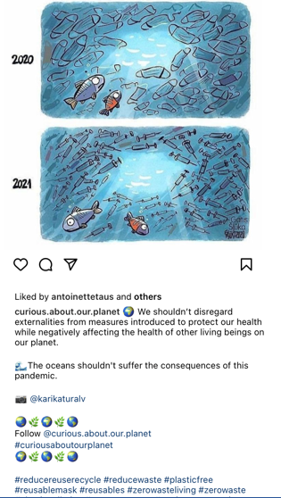

A Transferrable CEL Project for EAP Classes
Our challenge: How to make this more sustainable
  Online challenges with COVID-19
  Transferrable to different disciplinary linked courses
Theme of Advocacy linked to course assignments
  Written blogs and social media posts
  Letter of advocacy
Notes:
Project 3: the online engagement (COVID)
Project 4: the easily transferable project: blogs and social media posts
This classroom-based project centers on a course assignment designed to foster student discussion around one of the largest and most pertinent problems facing humanity: environmental sustainability. International students in our Academic English Program were provided with the opportunity to engage with their host community through involvement with a local organization focusing on climate change and food sustainability. Students were asked to become advocates, learning more deeply about a specific food sustainability topic through academic research, and support the local organization by synthesizing this research in a written blog post, content which was then used on the organization’s webpage and social media pages as a way of informing the public about the essential and immediate need for environmental sustainability.
Advocacy can take many forms, for example, public education and spreading awareness through various methods (e.g., webpages and social media), public demonstrations such as a strike or a rally, volunteering for a cause, starting a petition, or contacting your local government.

Slide 30
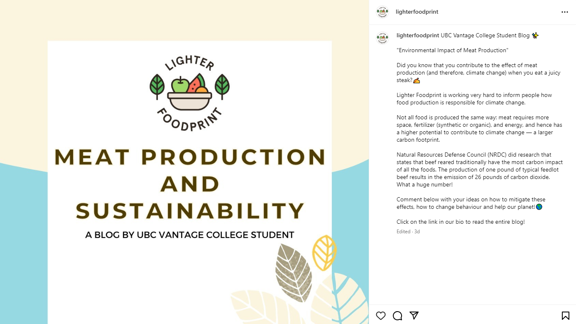
Notes:
This year’s successful blogs and social media posts are now published

Slide 31
Our Reflections
This project offers a pedagogical example of how less explored genres in academia, such as the genre of blogs and social media posts, can be used to provide possibilities for community engagement within the academic English classroom.
These CEL initiatives provide students a chance hone their research skills, learn more deeply about course concepts, and produce an authentic piece of writing used to inform the general public, while also benefitting partnered community organizations.
These projects also serve as a way for students to engage with the host community, a particular challenge for international EAL students.
Notes:
This project offers a pedagogical example of how less explored genres in academia, such as the genre of blogs and social media posts, can be used to provide possibilities for community engagement within the academic English classroom.
These CEL initiatives provide students a chance hone their research skills, learn more deeply about course concepts, and produce an authentic piece of writing used to inform the general public, while also benefitting partnered community organizations.
These projects also serve as a way for students to engage with the host community, a particular challenge for international EAL students.
potential to export this type of course project to other disciplinary contexts.
Could even look at some of our material for writing blogs and social media posts

Slide 32

Thank you!
Jennifer Lightfoot - jennifer.lightfoot@ubc.ca
Daniel Riccardi - daniel.riccardi@ubc.ca
Notes:
Q&A

