Slide 1
UK Teacher Opinions of Grammar in EAP: Past and Present
Kaitlinn Flower
Notes:
Hello.
Kaitlinn Flower
Edge Hill
As this conference looks at the deconstruction of EAP
From my research, I’ve found one contentious component is GRAMMAR.
Before we begin, does anyone remember receiving an email regarding a survey investigating teacher opinions on grammar? Yes, that was me. You’re in this presentation with me. Thanks very much.

Slide 2
Topics
Background Research
The Present Study
The Results
So what?

Slide 3
Background Research

Slide 4
MA TESOL at Edge Hill University
Theories of Second Language Education
Practical Knowledge of TESOL
TESOL Syllabus and Material Development
Educational Management of TESOL
Researching TESOL
Notes:
There were little to no resources on HOW to teach EAP grammar. This is where my project began.

Slide 5
What is grammar?
‘...the way words are put together to make correct sentences.’ (Ur, 2012, p. 76).
The entire system and structure of English language including syntax, lexis, morphology, and semantics (Ellis, 2016).
The language we use ‘to say things, do things and be things.’ (Gee, 2011, p. 3).
Notes:
What is grammar?
The definition of grammar continues to evolve but for this presentation, here is a working definition of what I am referring to when I say ‘grammar’.
Have a think, what is grammar to you?

Slide 6
Approaches to Teaching Grammar
Focus on Form (FonF)
brief, and sometimes spontaneous, attention to linguistic forms.
Primary focus is on meaning.
assumes that acquisition occurs best when learners' attention is drawn to language items when they are needed for communication.
input flood, input enhancement, and corrective feedback.
Focus on Forms (FonFs)
primary emphasis on linguistic structures, often presented as discrete grammar rules or other metalinguistic information.
emphasizes the role of explicit knowledge in the acquisition process.
present, practice, produce (PPP) and explicit language instruction
Notes:
Long – FonF (Focus on form)
Drawing attention to linguistic elements as they arise in class possibly through student errors.
FonFs (Focus on Forms)
Explicitly highlighting grammatical forms as discreet objects.
Doughty and Williams : FonF and FonFs are not polar opposites... FonF entails a focus on formal elements of language, whereas FonFs is limited to such a focus.
FonM (Focus on Meaning)
Incidental and implicit learning of grammatical elements with a focus on meaning.

Slide 7
Timeline of EAP pedagogy and EAP Grammar Research
2019
2023
1994
BALEAP PIMs and proceedings.
2002
JEAP journal submissions.
2013
Occurrence of ‘writing’ decreased to lower than 20%.
2020
273 occurrences of:
grammar/grammatical, discourse/s, phrase/s, /phraseology, vocabulary, lexis/lexical and word/s
11 hits for methodology and 68 hits for EAP pedagogy.
Notes:
Charles (2021) Compilation of all PIMS from 1994-2019
Assessment dominates PIM and proceedings topics
Charles’ data – grammar/grammatical discourse occurs in 21% of topics but significantly declining as BALEAP moves away from linguistic concerns.
Less than 20% discuss writing by 2013
Journal for English for Academic Purposes JEAP (2002-2020) – Bell EAP methodology.
Boolean key word search through JEAP found 11 hits for methodology and 68 hits for EAP pedagogy.
Dearth of research into EAP specifically grammar pedagogy.

Slide 8
The Present Study

Slide 9
Previous research into grammar and EAP teacher opinions.
Burgess and Etherington (2002) Focus on grammatical form: explicit or implicit?
Investigated teachers’ attitudes to grammar and its teaching and learning within an EAP context.
Results:
Majority of teachers appreciate the value of grammar and that students possess a sophisticated understanding of the problems and issues involved.
Evidence to support a favourable attitude to Focus on Form approaches.
Student characteristics, needs and wishes have a strong influence on teachers’ classroom actions in relation to grammar.

Slide 10
Research Questions
Which beliefs about grammar and grammar teaching are most widely held by EAP teachers in the UK?
Do teachers hold a bias towards any single grammar teaching method?
Have beliefs about the place of grammar and grammar teaching changed over the last 20 years?
Notes:
Data presented in this presentation derived from a replication of the Burgess and Etherington 2002 survey.
Replication study
For consistency, similar research questions were used - taken similar paths of investigation
Survey on teacher opinions of EAP grammar.
20 years since its publication. Have opinions changed?

Slide 11
The Survey
Three sections.
Approaches to the teaching of grammar.
Student and teacher difficulties with grammar.
Information about you and your teaching situation.
Notes:
Three sections:
Approaches to the teaching of grammar’,
‘Student and teacher difficulties with grammar’ and
‘Information about you and your teaching situation.’
Time of year – June
Mostly pre-sessional tutors - 49 were specifically pre-sessional EAP tutors
Three sections.
50 attitudinal statements.
6-point MC response scale.
BALEAP mailing list.
Google forms
89 sets of data were used

Slide 12
The Results

Slide 13
Qualitative Data.
I generally focus on highlighting grammatical structures specific to the texts my students will encounter or produce
Explicit templates (and exceptions) can be helpful.
All approaches may work, depending on the context.
There is a place for explicit grammar teaching in EAP but possibly less so than in General English
Giving student explicit grammar instruction can save a lot of time and frustration.
Notes:
Results have suggested grammar pedagogy has moved beyond FonF, FonFs and FonM.
Teachers prefer to adopt a range of grammar teaching approaches rather than make an exclusive commitment to one single method.
Although results show that EAP teachers will primarily choose either a FonF or FonFs approach, this decision heavily depends on which grammatical features are being taught

Slide 14
Qualitative Data Cont.
It always depends on the student.
A lot of these answers depend on the students.
... it very much depends on context.
... what is "best" would change depending on the students in front of me and their needs
Context and purpose for language learning is always important.
Context is everything.
It also depends on the students

Slide 15
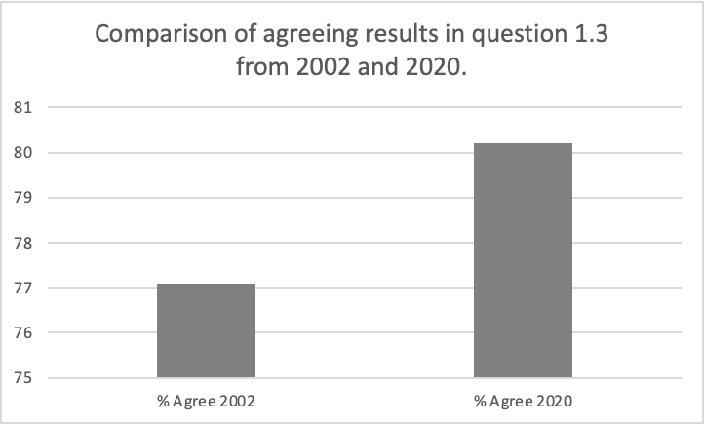
Q1.3
Formal instruction helps learners to produce grammatically correct language.
Section One Results
80% of all teachers surveyed agree that formal grammar instruction helps students produce grammatically correct language.
Notes:
Teachers’ opinions have changed.
The overwhelming majority of teachers’ qualitative responses include the discussion of ‘student needs’ in a variety of forms. Their attitudes and concerns fundamentally concern what is best for their students
It appears that teachers are more focussed on student needs and expectations than their own personal beliefs.
Most teachers appear to support the idea that student needs should drive an EAP course so that students are academically equipped for HE study.

Slide 16
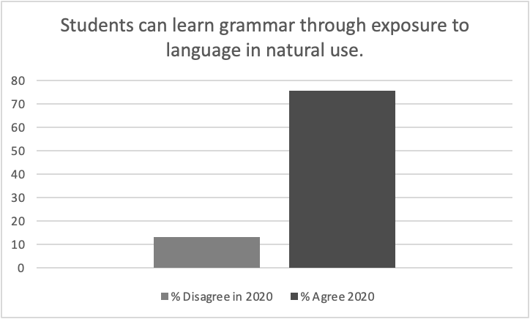
Q1.2
Students can learn grammar through exposure to language in natural use.
Section One Results
76% of teachers surveyed agreed that students can learn grammar through exposure to language in natural use.

Slide 17
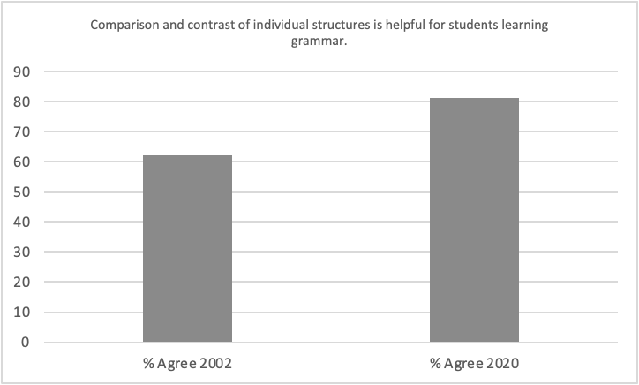
Q1.17
Comparison and contrast of individual structures is helpful for students learning grammar.
Section One Results
In 2002, 4% of teachers disagreed that comparing and contrasting individual structures is helpful for students learning grammar.
Notes:
Previous data shows students expected explicit grammar instruction however, current data shows this is no longer the case.
Teachers show no singular preference towards a teaching approach but instead, they utilise all approaches depending on the features being taught and the students’ needs.
Results show teaching should be flexible and reflective of students’ needs so they drift between FonF and FonFs to find the most appropriate approach.
Some teachers report that more proficient students do not require grammar instruction during a pre-sessional course but suggest it could be refined as part of their chosen field of study

Slide 18
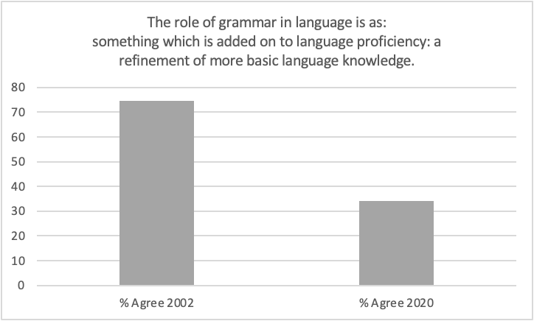
Section One Results
Q1C
The role of grammar in language is as:
something which is added on to language proficiency: a refinement of more basic language knowledge.
In 2002, 75% of teachers agreed.
41% less teachers agreed in 2020 compared with 2002.
Notes:
Majority of teachers still hold the belief that comparison and contrast of grammatical structures is helpful for students.
Explicit discussion of grammar rules is helpful for students.
INCREASE:
More teachers believe that students can learn grammar through exposure to language in natural use
More teachers now believe students should have a conscious awareness and knowledge of grammar if they are expected to produce such language
Teachers agree that more students are finding the grammar and vocabulary presented in authentic texts more challenging than in the past
DECEASE:
Less teachers view grammar as an addition to L2 proficiency

Slide 19
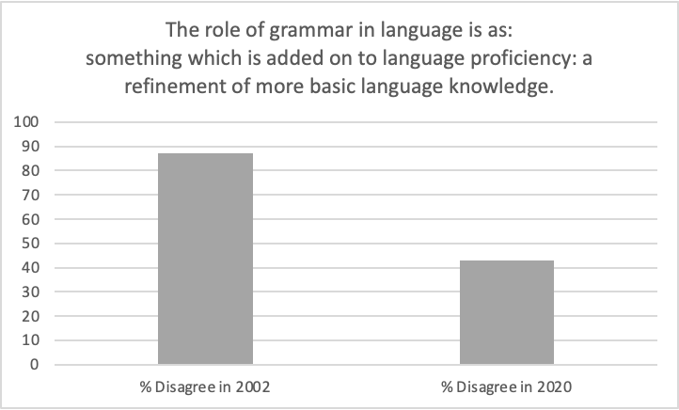
Section One Results
Q1C
The role of grammar in language is as:
something which is added on to language proficiency: a refinement of more basic language knowledge.
In 2002, 87% of teachers disagreed.
Only 43% of teachers disagreed with this statement in 2020.

Slide 20
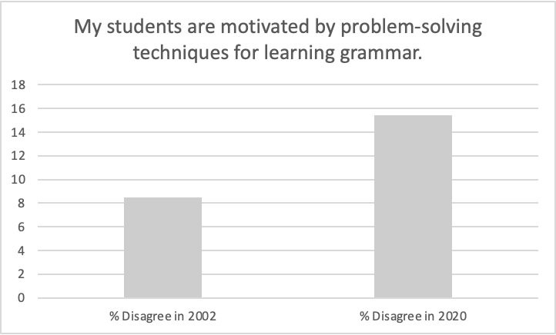
Section Two Results
Q2.2
My students are motivated by problem-solving techniques for learning grammar.
In 2020, 20% less teachers believed that students are motivated by problem-solving techniques for learning grammar.
Notes:
67% to 47%.

Slide 21
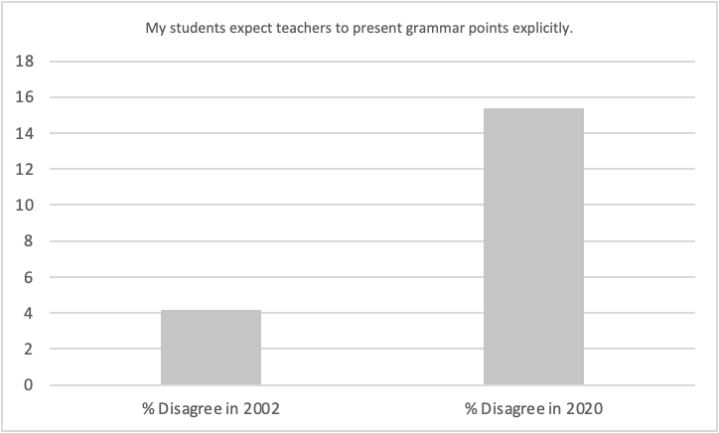
Q2.3
My students expect teachers to present grammar points explicitly.
Section Two Results
In 2002, 92% of teachers agreed that students expect teachers to present grammar points explicitly.
In 2020, this total dropped by 31%.

Slide 22
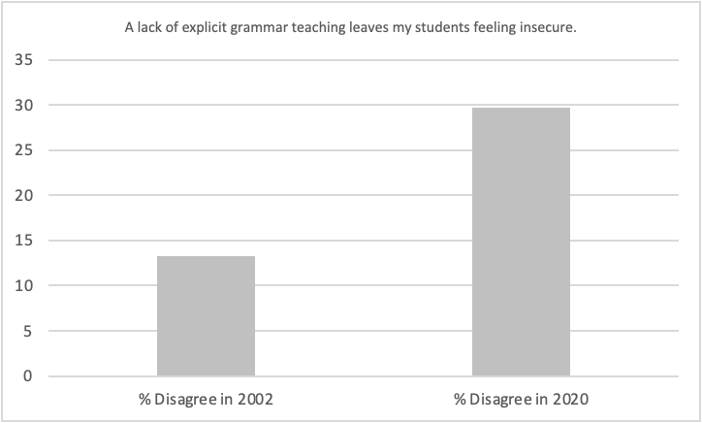
Q2.13
A lack of explicit grammar teaching leaves my students feeling insecure.
Section Two Results
In 2002, 69% of teachers believed that lack of explicit grammar teaching leaves students feeling insecure.
This has dropped by 35%.
Notes:
35% reduction in agreement
According to teachers, students are expecting to be taught explicit grammar rules but are becoming more relaxed about it if that doesn’t happen.

Slide 23
Research Questions
Which beliefs about grammar and grammar teaching are most widely held by EAP teachers in the UK?
Do teachers hold a bias towards any single grammar teaching method?
Have beliefs about the place of grammar and grammar teaching changed over the last 20 years?

Slide 24
So what?

Slide 25
Approaches to teaching grammar have shifted.
Grammar teaching – is it necessary?
Less students are expecting explicit grammar instruction.
Student opinions on Grammar
To what extent is grammar valuable?
Are courses which include a grammar component seen as more valuable?
What motivates students to learn during an EAP course?

Slide 26
Kaitlinn Flower
kaitlinnflower@gmail.com

