Slide 1

Give us a chance!
A call for greater focus on differentiated instruction on pre-sessional courses
Caroline Fletcher
carojfletcher@gmail.com

Slide 2
The Issue
Lack of focus on differentiated instruction in pre-sessional course materials
A need to upskill pre-sessional tutors in techniques for teaching mixed-level groups

Slide 3
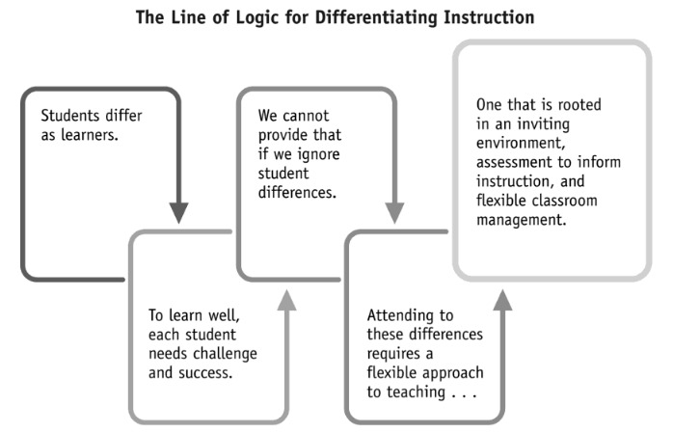
Why Differentiate?
Tomlinson, 2017, p. 13

Slide 4
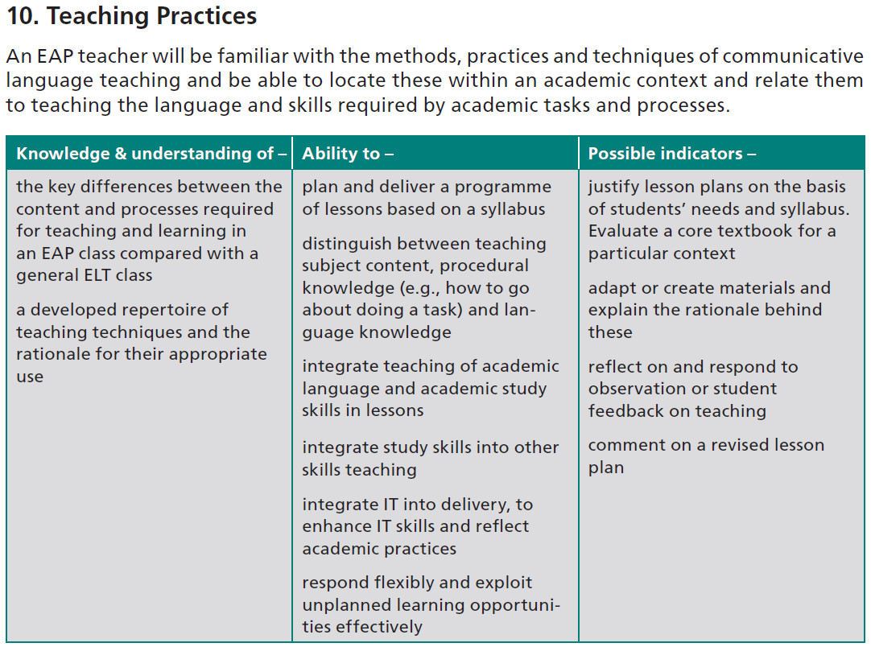
BALEAP Competency Framework
BALEAP CFTEAP, 2008, p. 8

Slide 5

BALEAP Competency Framework
BALEAP CFTEAP, 2008, p. 8

Slide 6



BALEAP Competency Framework
BALEAP CFTEAP, 2008, p. 8

Slide 7




BALEAP Competency Framework
BALEAP CFTEAP, 2008, p. 8

Slide 8


BALEAP Competency Framework
BALEAP CFTEAP, 2008, p. 8

Slide 9
What Can Be Done?
Upskill tutors in teaching mixed-level groups
Build differentiated instruction into course materials
BALEAP CFTEAP, 2008, p. 8

Slide 10
Upskilling Tutors
Tutor development sessions
The impact of differentiation on motivation and learning
Teacher reflection activity
Teaching approaches
2. Ongoing dialogue
shared document for extension activities
collaborative lesson planning

Slide 11
Strategically Implementing DI
“DI is not a short-term classroom strategy, but rather a component of teaching that allows instructors to have an impact on individual students at all levels. This is accomplished by planning and strategically implementing an array of integrated teaching and learning activities that are right for a particular class of students.”
Watson & Agawa, 2011, p. 33

Slide 12
Building Differentiation into Materials
Elements that can be differentiated:
Content (what students learn)
Process (how students learn)
Product (how students demonstrate learning)
Tomlinson, 2017

Slide 13
Building Differentiation into Materials
Foster a positive approach within teaching groups:
Openly discuss mixed-level situation with classes
Offer a variety of activities at different levels
Encourage students to work at a level they find achievable but challenging

Slide 14

In Summary
My plea to those designing pre-sessional courses:
Respect tutors as skilled practitioners who can recognise and respond to student needs
Train tutors in approaches and techniques for teaching mixed-level groups
Help tutors by strategically building differentiated instruction into course materials

Slide 15
References
BALEAP. (2008). Competency framework for teachers of English for Academic Purposes. https://www.baleap.org/wp-content/uploads/2016/04/teap-competency-framework.pdf
Tomlinson, C. A. (2017). How to differentiate instruction in academically diverse classrooms (3rd ed.). ASCD.
Watson, K., & Agawa, G. (2011). Differentiated Instruction in a university English CALL setting. In A. Stewart (Ed.), JALT2010 Conference Proceedings. JALT. https://jalt-publications.org/sites/default/files/pdf-article/jalt2010proc-14_0.pdf

