Slide 1
From Language to Skills Development: Deconstructing EAP in Transnational University
BALEAP 2023 Conference University of Warwick
19-21 April 2023

Slide 2
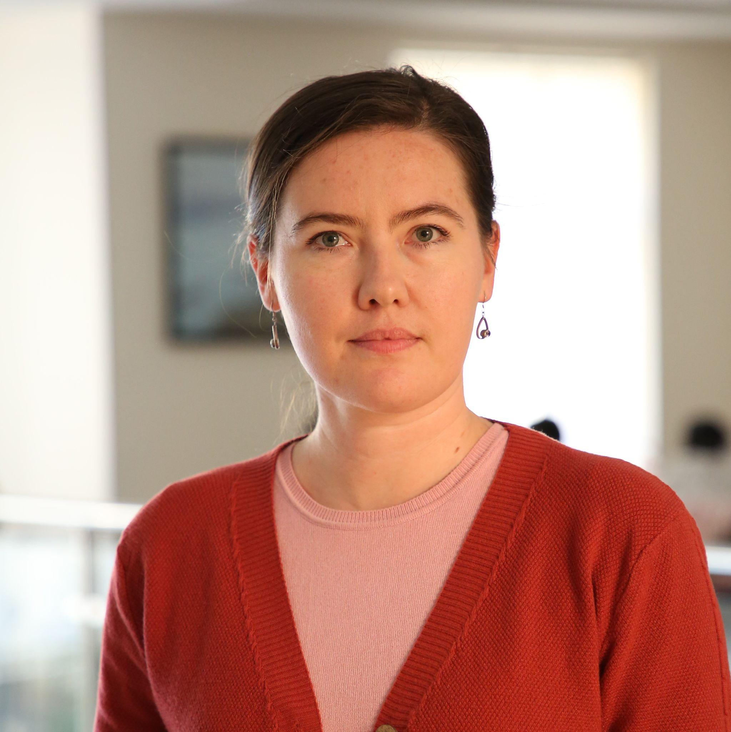
Contact details
Saida Akbarova, PhD
sakbarova@wiut.uz
Liliya Makovskaya
lmakovskaya@wiut.uz
Saida Radjabzade
sradjabzade@wiut.uz

Slide 3
Where are we from?

Slide 4
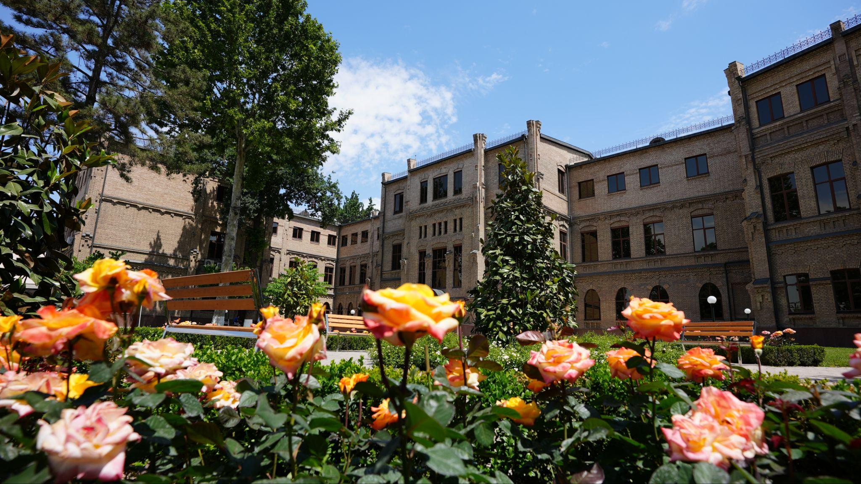
Affiliation: Westminster International University in Tashkent
Global Education department
Academic English module
1,200+ first-year students
5,069 students
524 academic staff
4,987 alumni
BA, MA, PhD courses
Business
Economics
Finance
Commercial law
Information technology
Education
Healthcare

Slide 5
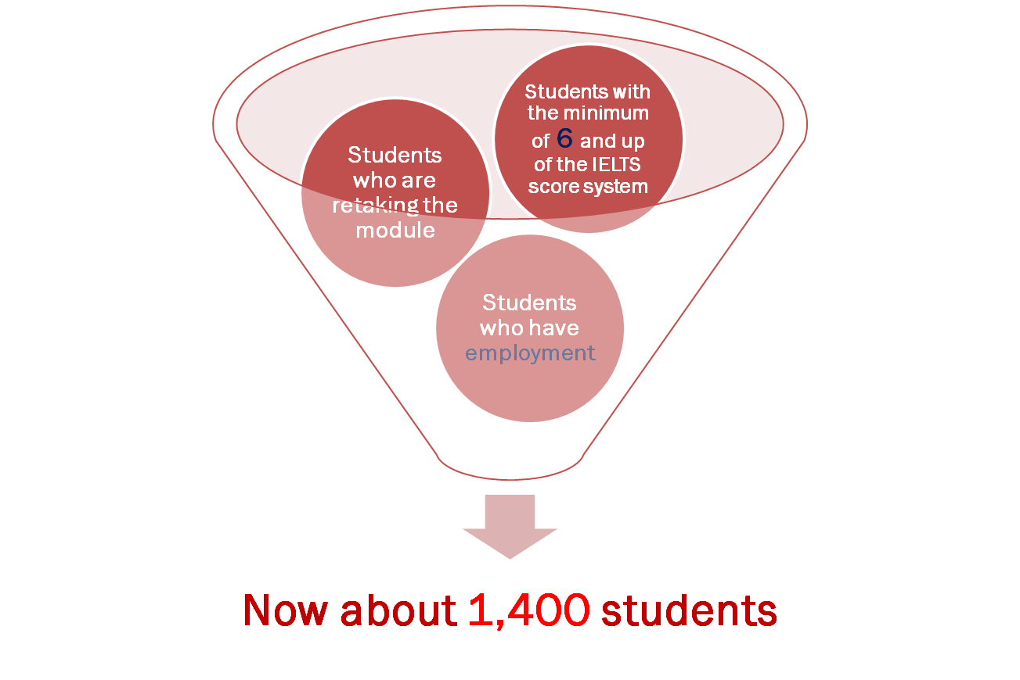
Who are our freshmen?

Slide 6
What does it mean for the teaching team?

Slide 7
Reasons for change
Increase in students' number
University admission requirements
Needs of other modules and students’ needs
Labour demands
Graduate Attributes changes
Technological development
Generation Y to Z
COVID-19

Slide 8
Changes from EAP to AE: focus on…
Till 2010
2016 – present
General English and a little of EAP
Academic English language competencies and study/transferable skills
Academic English language competencies some General English, and certain study skills
2010–2015

Slide 9
Sample of 2009-2010 EAP Calendar

Slide 10
Students’ Needs

Slide 11
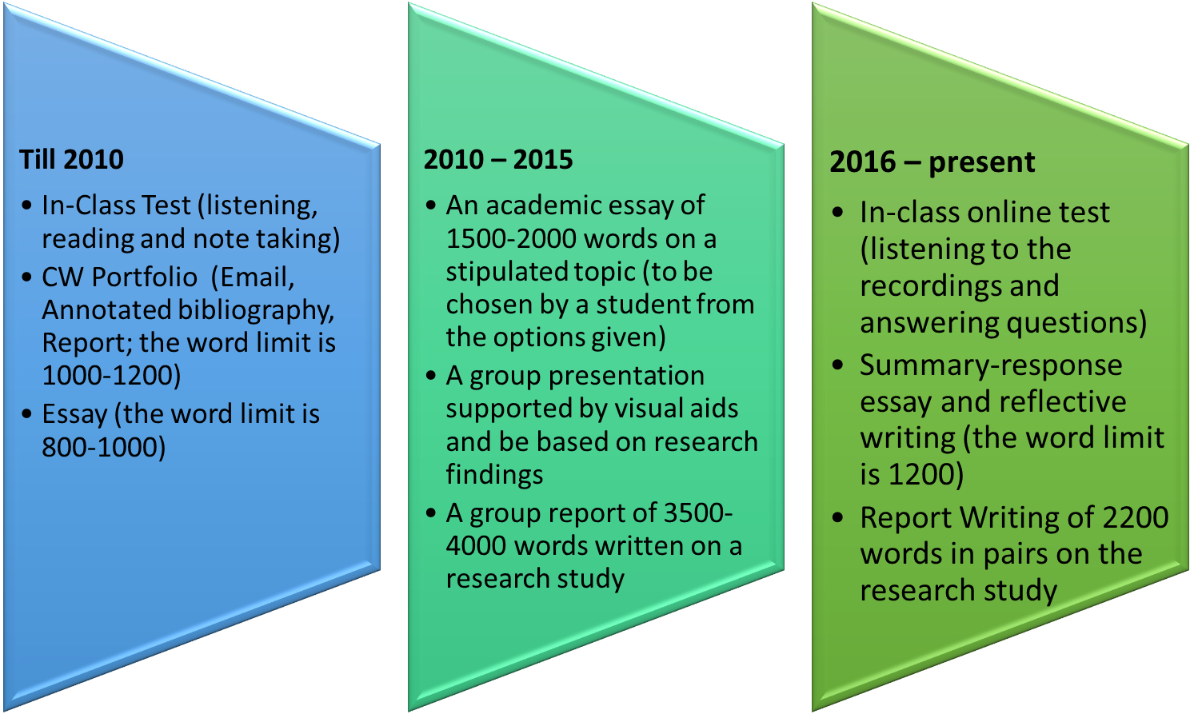
Changes from EAP to AE: Assessment

Slide 12
EAP Skills (2006-2010)
In-Class Test: listening, reading and note taking, language
Portfolio: writing, annotating, referencing, reading, language
Essay: reading, writing different essay types, referencing, use of sources, language

Slide 13
AE Skills (2010-2015)
Essay
Group presentation
Group report
Academic writing skills
Using sources
Compiling a reference list
Providing arguments
Responding to feedback
Academic writing skills
Critical reading
Evaluation of sources
Providing arguments
Compiling a reference list
Responding to feedback
Basic research skills
Delivering a presentation
Working in a group
Problem solving
Digital skills

Slide 14
AE Skills (2016-present)
In-class computer-mediated test
Individual written coursework
Pair-work report
Listening (for gist, details, inference)
Digital literacy skills
Argumentation
Summarizing
Paraphrasing
Critical reading
Referencing
Evaluating skills in terms of evidence
Secondary research
Reflection
Learning how to find and use sources
Critical thinking
Group/pair work
Basic research skills / primary research
Synthesizing / Summarizing
Communication skills / discussions
Argumentation
Paraphrasing
Basic statistical analysis
Use of sources

Slide 15
Lessons Learnt
Considering students’ needs
Integrating technology
Introducing report writing
Including basic research skills
Improving communication skills
Incorporating sources
Developing digital literacy

