Slide 1


From The College English Test (CET) to English for Academic Purposes (EAP): teacher development in a transnational education (TNE) setting
Alex Runchman
Li Jin
Zhong Feng
BALEAP Conference: Caution! EAP under (De)construction
20th April 2023

Slide 2

Caution! EAP under (De)construction
– professional identity (re)construction of Chinese teachers training as EAP practitioners.
– deconstruction of Western-centric and postgraduate-oriented notions of EAP.
– constructive deconstruction of experiences of Chinese university English teachers.

Slide 3

Research Questions
How have Chinese university English teachers adapted to teaching EAP in the context of a transnational partnership college?
– How has their understanding of EAP developed?
– To what extent they have refined their teaching methodologies and philosophies?
– What challenges have they encountered and how have they overcome them?

Slide 4

Context of Project
– Chang’an-Dublin International College of Transportation (CDIC) is a partnership between University College Dublin (UCD) and Chang’an University, Xi’an.
– Students study for undergraduate degrees in Civil Engineering Infrastructure, Automotive Engineering, and Transport, City Planning, and Environmental Policy. Teaching is through the medium of English.

Slide 5

Context of Project
– Credit-bearing EAP modules are delivered in years 1 and 2 of a 4-year degree programme. The modules are co-ordinated by the UCD Applied Language Centre and taught by both Chinese and international teachers employed directly by CDIC.
– Since 2018, 23 Chinese teachers have taught for CDIC and/or the previous joint programme co-hosted by UCD’s School of Civil Engineering and Chang’an University’s Highway School.

Slide 6
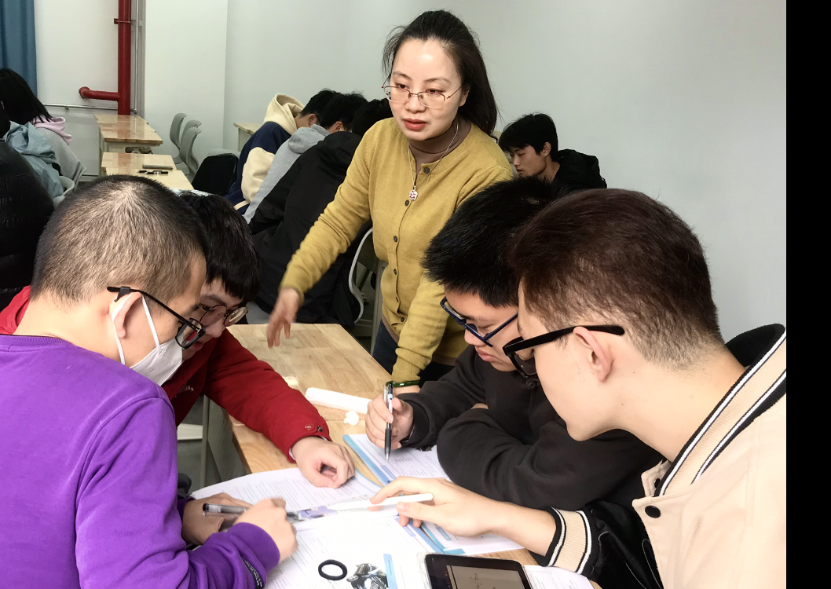
Context of Project (Teachers)
– Prior to joining CDIC, teachers had mostly focused on preparing students for the College English Test (CET4 and CET6). Many of them still teach these courses alongside their EAP modules.
– Some teachers have also taught IELTS, adapted to changes in the curriculum, and adapted to teaching online during the Covid-19 pandemic.

Slide 7

Context of Project (Literature)
Recent articles in JEAP have examined:
– the identity construction of novice EAP teachers (Atai, Nazari, and Hamidi, 2022).
– how practitioners believe they gain expertise as EAP teachers (Fitzpatrick, Costley, and Tavakoli, 2022).
– the knowledge base, practices, and challenges of teachers in expanding circle countries (Kaivanpanah, Alavi, Bruce, & Yahya Hejazi, 2021).

Slide 8
Context of Project
Less widely examined areas:
– the professional development of experienced teachers retraining to work in new contexts.
– the contribution of Chinese teachers to EAP programmes at international partnership colleges.

Slide 9

Methodology
– 18 teachers completed a questionnaire and took part in an interview.
– questions related to perceptions of EAP and experiences of teaching it; Professional Development and Training; issues related to course implementation and assessment; and the role of EAP in the Chinese context.
– qualitative analysis – interview transcripts coded, recurring issues identified and analyzed.
– sequential exploratory design: – our hope is to use our findings to design items for a questionnaire to survey a wider range of Chinese teachers’ attitudes towards EAP at other TNE partnerships in China.

Slide 10
Key Findings – Overview
1.
Teachers generally have a clear understanding of the principles, objectives, and methods of EAP, though sometimes find these difficult to apply in their own context.
2.
They are conscious of several differences between teaching EAP and General English and and have adapted / are adapting their teaching methodologies accordingly (especially to encourage interaction).
3.
Challenges include enabling students to ‘buy in’ to EAP, negotiating sometimes opposing goals of management and administration, and addressing own gaps in knowledge and experience. A need for more systematic training was identified.

Slide 11
Teachers’ Understanding of EAP and Teaching Methodology

Slide 12

Findings – points from questionnaire
– Only 3 out of 18 teachers had had the experience of learning EAP as students themselves.
– Many teachers noted that teaching EAP had also improved their own English language proficiency – particularly in terms of Academic Writing and Critical Thinking.
– Teachers felt more confident teaching Reading and Listening than teaching Writing and Speaking.
– Most teachers felt that their previous General English teaching experience had prepared them for teaching EAP to some extent – though one teacher thought it had not prepared them at all.

Slide 13
Findings – points from questionnaire
– Most teachers enjoy teaching EAP though feel they would benefit from further training:
‘I really enjoy teaching this course. It is a very systematic field which provides me and the students with an authentic English language context.’
‘I like the experience so much. It's extremely beneficial for my own career. I need more detailed training on class planning and interaction.’

Slide 14

Findings – points from interviews
– a general perception that EAP is more student-centred and interactive than General English (at least in the Chinese context).
– this may be encouraged by smaller class sizes and promotion of task and project-based methodologies.

Slide 15
Findings – points from interviews
– ‘EAP is more student-centred; General English is more teacher-centred […] EAP is more project-based’
– ‘EAP classes are more interactive than General English classes’
– ‘The whole structure of teaching is very different’

Slide 16

Findings – points from interviews
– Teachers recognize that in EAP development of language skills needs to occur alongside development of critical thinking and study skills.
‘In the College English Test, language proficiency is the most important thing even if content is weak […] but EAP is not only about language.’
‘In College English we have to teach everything; the result is that we teach nothing.’
‘EAP requires autonomy.’

Slide 17
Findings – points from interviews
– teachers are interested in adopting student-centred methodologies, but many feel they need ongoing training and support to achieve this.
– teachers feel that their students are fortunate to be taught in this way when they did not have the experience themselves.
‘Teaching the theory is easy…. applying it is difficult’
‘I feel like I’m learning [EAP] with my students.’
‘I’m learning on the job.’

Slide 18
Challenges

Slide 19

Motivation
– for some teachers, convincing students of the benefits of an EAP approach (rather than exam preparation) has been challenging.
‘One thing that has puzzled me is how to motivate my students in an EAP classroom. It seems they value their specialist subjects much more. This experience has taught me to consider ways of teaching from the perspective of my students.’
‘Students haven’t transferred from GaoKao mode to EAP mode.’
‘Some students are upset that they can’t do work for CET-4 or CET-6.’

Slide 20
Assessment
EAP Assessment format and objectives are very different from General English and Standard English Language Tests (eg. listening-into-note-taking).
Teachers feel a need to help students overcome ‘fossilization of learning habits.’
‘Some students find it hard to see the relationship between what is taught and what is assessed.’
Concerns were also raised about the changing role of technology in learning and assessment.

Slide 21

Collaboration with international pair teachers
All teachers share classes with international EAP teachers.
While all classes involve integration of skills, Chinese EAP teachers are primarily responsible for Reading and Listening assessments and international EAP teachers for Writing and Speaking assessments.
Teachers reported varied degrees of collaboration and engagement with their pair teachers, with some meeting to discuss their classes often but others rarely.
A move back to fully face-to-face teaching and use of a shared classroom may make collaboration easier.

Slide 22

Expectations of local management and administration
– several teachers identified a mis-match between requirements of local managers and administrators and their own needs.
– e.g. modes of appraisal by UCD module coordinators and local managers may conflict.
– workload (teaching CET alongside EAP) may limit time for professional development.
– a local rotation policy whereby new teachers are introduced to the programme every year, replacing others, gives more teachers experience of EAP but undermines team stability.

Slide 23
Expectations of local management and administration
‘management realise that we have to shift [our approach] but they are not quite clear how…’

Slide 24
Next steps
Introduction of 3-module Professional Certificate in TESOL at UCD Applied Language Centre to address training needs.
Increased engagement with growing community of EAP practitioners within China.
Advocacy for EAP across the university and among subject lecturers:
– ‘EAP or ESP will become the norm’ [in China]
– ‘[The rest of the university] is catching up!’
Status of EAP in China is related to China’s position in a globalized world.

Slide 25
References
Atai, M. R., Nazari, M. and Hamidi, F. (2022). Novice EAP identity construction: A qualitative study from Iran. Journal of English for Academic Purposes, 59. https://doi.org/10.1016/j.jeap.2022.101162
Fitzpatrick, D., Costley, T, and Tavakoli, P. (2022). Exploring EAP teachers’ expertise: Reflections on practice, pedagogy and professional development. Journal of English for Academic Purposes, 59. https://doi.org/10.1016/j.jeap.2022.101140
Kaivanpanah, S., Alavi, S. M., Bruce, I., & Yahya Hejazi, S. (2021). EAP in the expanding circle: Exploring the knowledge base, practices, and challenges of Iranian EAP practitioners. Journal of English for Academic Purposes, 50. https://doi.org/10.1016/j.jeap.2021.100971

Slide 26
Images
Adobe Stock
Powerpoint Stock Images
Runchman, A. (2023), photos (with permission of subjects)

