Slide 1
Exploring Signature Pedagogies for EAP
Problems, Principles & Practices
Steve Kirk | Durham University
BALEAP Biennial Conference, Warwick | 20.04.2023
This Photo by Unknown Author is licensed under CC BY-SA-NC

Slide 2
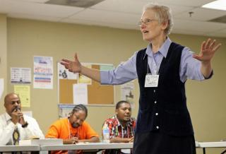
Teaching EAP…
This Photo by Unknown Author is licensed under CC BY

Slide 3
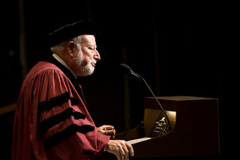
“[S]ignature pedagogies […] are types of teaching that organize the fundamental ways in which future practitioners are educated for their new professions. In these signature pedagogies, the novices are instructed in critical aspects of the three fundamental dimensions of professional work - to think, to perform, and to act with integrity.”
(Shulman 2005: 52)
This Photo by Unknown Author is licensed under CC BY-SA-NC
Notes:
Originally…

Slide 4
Examples:
(E.g.) Modelling method and peer instruction in introductory Physics (Lattery 2009)
Communicative approach in language education (Ham & Schueller 2012)
Crits in graphic design (Motley 2016)
Digital storytelling in the ‘New Humanities (Benmayor 2008)
The engineering design process and learning from professionals in Engineering (Lucas & Hanson 2016)
Inquiry also extended to include, e.g., signature assessment & feedback practices (Pitt & Quinlan 2021)

Slide 5
Signature pedagogies in EAP?
Possible candidates:
Approaches underpinned by genre theory
Swalesian (ESP)
Sydney School (SFL)
This Photo by Unknown Author is licensed under CC BY-SA-NC

Slide 6
Problem:
EAP is characterised by diversity:
Local affordances
Material conditions
Institutional positioning
Routes into & through the profession
Conceptions of ‘EAP’

Slide 7
Different views of what we’re preparing students for with our EAP…
Language development via ‘academic’ carrier topics
Generic, ostensibly transferable, skills (‘essay writing’, notetaking, etc)?
Readiness for participation and engagement in higher education (e.g. demystifying expectations)?
The specific academic discourse of students’ current/ target discipline?
The pedagogic practices & values of the target/ current discipline? (e.g. lecture participation)?
The research practices & values of the target/ current discipline? (e.g. ethnography)?
‘Higher order’ (e.g. cross-disciplinary) academic discourse awareness?
Critical empowerment and emancipation?
Notes:
Some of these overlap, of course, and may exist within the same programme…

Slide 8
How can ‘signature pedagogies’ help us think about EAP classroom practice in diverse global contexts?
This Photo by Unknown Author is licensed under CC BY-SA-NC
Notes:
Interested less in identifying SPs per se and more as a lens to think about pedagogic practice in EAP
>> We clearly don’t want – and couldn’t achieve - ‘convergence’ when contexts are so diverse

Slide 9
Signature pedagogy: 3 dimensions
‘surface structure’
“concrete, operational acts of teaching and learning…”
‘deep structure’
“a set of assumptions about how best to impart a certain body of knowledge and know-how”
‘implicit structure’
“a moral dimension that comprises a set of beliefs about professional attitudes, values, and dispositions.”
(Shulman 2005: 54-55)
This Photo by Unknown Author is licensed under CC BY-SA

Slide 10
Classroom Practices
(‘surface structures’)
Knowledges
(‘deep structures’)
Values
(‘implicit structures’)

Slide 11
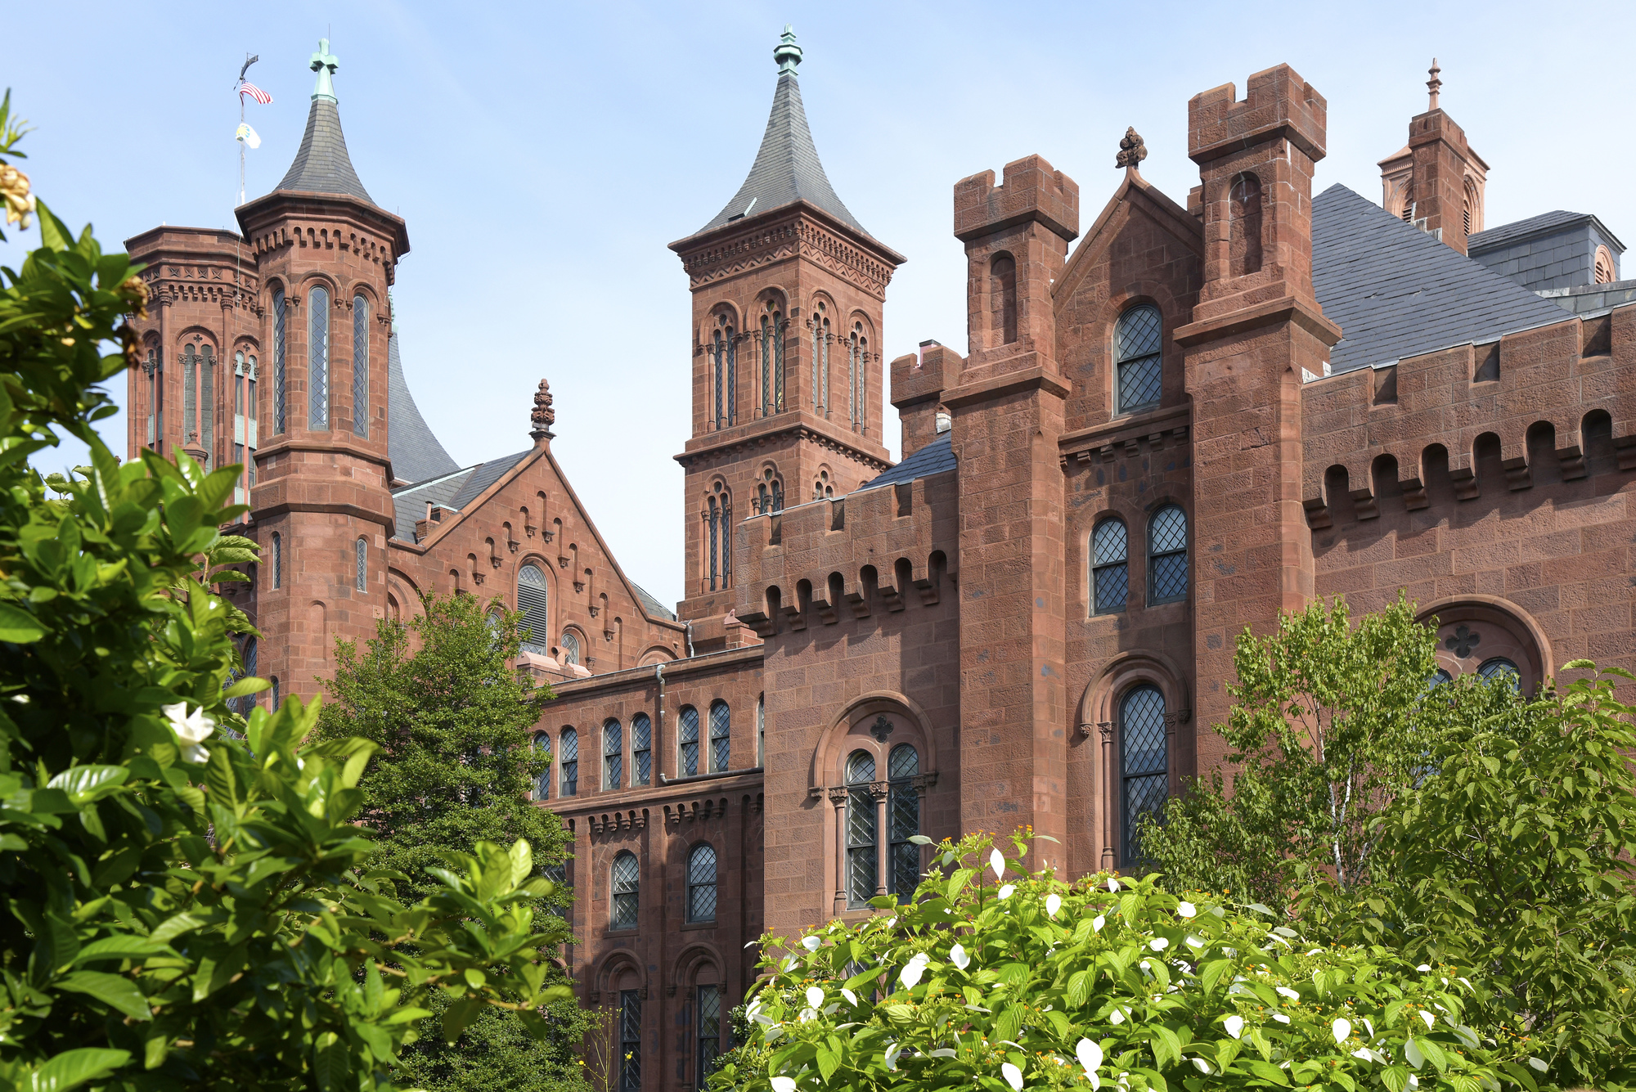
Challenge 1: Social power
Where do SPs come from?
The professions (Shulman)
The disciplines – epistemic
Institutional structures; traditions; norms (Horn 2013)
>> ‘powerful pedagogies’ (Horn 2013)
E.g. Swalesian genre theory…??
This Photo by Unknown Author is licensed under CC BY-NC

Slide 12
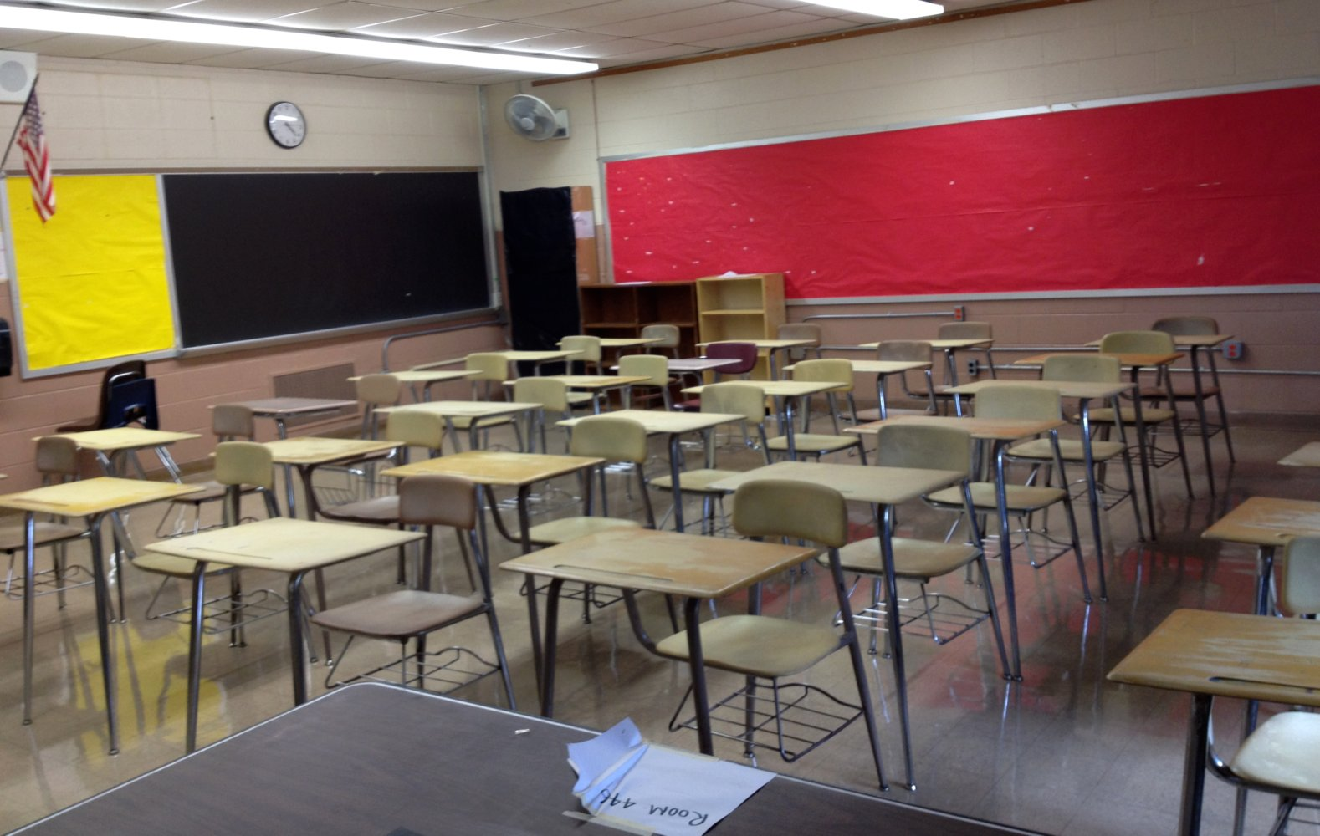
Challenge 2: Global view
International contexts + (e.g.) changing face of UK higher education:
Local affordances, practices (and success) shaped by:
Embodied realities – e.g. multilingual Ss (e.g. Canagarajah 2013)
Students’ prior/existing material conditions (Jacobs, 2019)
Material artefacts – e.g. curriculum
>> Consider material ecologies
This Photo by Unknown Author is licensed under CC BY-NC-ND

Slide 13
Knowledges
(‘deep structures’)
Classroom Practices
(‘surface structures’)
Material Ecologies
Social Structures
Values
(‘implicit structures’)
EAP signatures: Emergence locally?

Slide 14
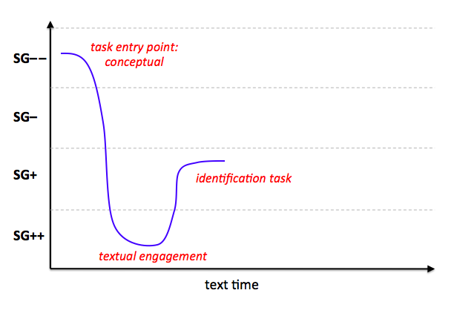
Signature task profile (Kirk 2018)
E.g. "what is a research question?”
"what is the difference between a topic and a research question?"
‘pearl dive’

Slide 15
Knowledges
(‘deep structures’)
Classroom Practices
(‘surface structures’)
Material Ecologies
Social Structures
Values
(‘implicit structures’)

Slide 16
Challenge 3: Change
Practices shift. Signatures evolve:
Influences from within and without:
new knowledge; practices; technologies; ‘inclusivity’; decolonisation; etc
In EAP: Teachers may also be key – “institutional ‘trading zone’” (Horn 2013)
Can’t see across signatures to why things are similar/ different
>> Move beyond ‘lists’ of pedagogies
>> Need to be able to see internal variation and change over time

Slide 17
Legitimation Code Theory (LCT)
A "multidimensional toolkit" (Maton 2014: 17) for educational research, practice and change
Karl Maton

Slide 18
Legitimation Code Theory (LCT)
Pierre Bourdieu
(Field Theory)
Basil Bernstein
(Code Theory)
Principal influences:

Slide 19
Specialization
Offers concepts to explore: who and what matter in practices
All practices are about something and by somebody…giving:
Epistemic relations (ER) or Relations to knowledge
Social relations (SR) or Relations to knowers
(Maton 2014: 29-33)
This Photo by Unknown Author is licensed under CC BY-ND

Slide 20
Stronger orientations to knowledge (ER+)
knowledge code
elite code
Weaker orientations
to knowers (SR–)
Stronger orientations
to knowers (SR+)
relativist code
knower code
The specialisation plane
(Adapted from Maton, 2014, p. 30)
Weaker orientations to knowledge (ER–)

Slide 21
Stronger orientations to knowledge (ER+)
knowledge code
elite code
Weaker orientations
to knowers (SR–)
Stronger orientations
to knowers (SR+)
relativist code
knower code
The specialisation plane
(Adapted from Maton, 2014, p. 30)
Weaker orientations to knowledge (ER–)

Slide 22
Stronger orientations to knowledge (ER+)
knowledge code pedagogies
elite code pedagogies
‘Pragmatic EAP’
(socialisation; normative views)
Weaker orientations
to knowers (SR–)
Stronger orientations
to knowers (SR+)
Critical Approaches
(transformative views)
Generic Skills
relativist code pedagogies
knower code pedagogies
Weaker orientations to knowledge (ER–)
The specialisation plane
(Adapted from Maton, 2014, p. 30)

Slide 23
Stronger orientations to knowledge (ER+)
knowledge code pedagogies
elite code pedagogies
Weaker orientations
to knowers (SR–)
Stronger orientations
to knowers (SR+)
Study Skills
relativist code pedagogies
knower code pedagogies
Weaker orientations to knowledge (ER–)
The specialisation plane
(Adapted from Maton, 2014, p. 30)

Slide 24
Stronger orientations to knowledge
knowledge code pedagogies
elite code pedagogies
Weaker orientations
to knowers
Stronger orientations
to knowers
AcLits/ LD?
Critical EAP?
relativist code pedagogies
knower code pedagogies
Weaker orientations to knowledge
The specialisation plane
(Adapted from Maton, 2014, p. 30)

Slide 25
Stronger orientations to knowledge (ER+)
knowledge code pedagogies
elite code pedagogies
SFL
Genre Pedagogy?
ESAP?
Weaker orientations
to knowers (SR–)
EGAP?
Stronger orientations
to knowers (SR+)
relativist code pedagogies
knower code pedagogies
Weaker orientations to knowledge (ER–)
The specialisation plane
(Adapted from Maton, 2014, p. 30)

Slide 26
Stronger orientations to knowledge (ER+)
knowledge code pedagogies
elite code pedagogies
Weaker orientations
to knowers (SR–)
EGAP?
Stronger orientations
to knowers (SR+)
relativist code pedagogies
knower code pedagogies
Weaker orientations to knowledge (ER–)
The specialisation plane
(Adapted from Maton, 2014, p. 30)

Slide 27
Stronger orientations to knowledge (ER+)
knowledge code pedagogies
elite code pedagogies
Weaker orientations
to knowers (SR–)
EGAP?
Stronger orientations
to knowers (SR+)
relativist code pedagogies
knower code pedagogies
Weaker orientations to knowledge (ER–)
The specialisation plane
(Adapted from Maton, 2014, p. 30)

Slide 28
Stronger orientations to knowledge (ER+)
knowledge code pedagogies
elite code pedagogies
E.g. Pre-sessional
(Kirk 2018)
Weaker orientations
to knowers (SR–)
Stronger orientations
to knowers (SR+)
‘Autonomy’
curriculum thread
relativist code pedagogies
knower code pedagogies
Weaker orientations to knowledge (ER–)
The specialisation plane
(Adapted from Maton, 2014, p. 30)

Slide 29
Stronger orientations to knowledge (ER+)
knowledge code pedagogies
elite code pedagogies
Weaker orientations
to knowers (SR–)
‘Signature Space’
Stronger orientations
to knowers (SR+)
‘Autonomy’
curriculum thread
relativist code pedagogies
knower code pedagogies
Weaker orientations to knowledge (ER–)
The specialisation plane
(Adapted from Maton, 2014, p. 30)

Slide 30
Stronger orientations to knowledge (ER+)
knowledge code pedagogies
elite code pedagogies
?
Weaker orientations
to knowers (SR–)
Stronger orientations
to knowers (SR+)
relativist code pedagogies
knower code pedagogies
Weaker orientations to knowledge (ER–)
The specialisation plane
(Adapted from Maton, 2014, p. 30)
Notes:
LCT makes visible a fourth space, which we haven’t considered…but I think we’re heading there

Slide 31
Signature / Powerful Pedagogies for EAP?
Emerge in relation to social and material ecologies...
...in addition to
Classroom practices
Underpinning knowledges
Driving axiology (values)

Slide 32
Signature / Powerful Pedagogies for EAP?
Practices operate in four spaces...
‘Signature spaces’ probably emerge locally + via networks (e.g. BALEAP)
Not all ‘powerful’ pedagogies are epistemically powerful...
EAP pedagogies may vary mostly within a space (quadrant)...
...but may code shift through:
Movement of practitioners/ expertise
Institutional change
Scholarship

Slide 33
Signature / Powerful Pedagogies for EAP?
Might an espoused signature space be emerging in the elite code?
...i.e. EAP pedagogies that orient both to academic discourse(s) and to students’ material conditions & lived experience
>> A centring of knowledge and a centring of social justice
>> Powerful pedagogies in both senses – epistemic & social

Slide 34
Signature / Powerful Pedagogies for EAP?
Might an espoused signature space be emerging in the elite code?
= A challenge for EAP practitioner education and development, if so...
...but all teachers should have access to these powerful pedagogies
= an issue of social justice also for staff

Slide 35
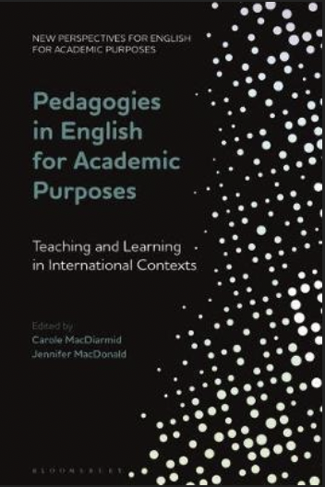
Signature / Powerful Pedagogies for EAP?
Reminds us that individual repertoires become community reservoirs through:
Communities of open classrooms
Making explicit the principles & values underpinning ‘surface’ EAP practices
(E.g. via peer observation + critical discussion; curriculum conversations; etc)
Engagement across borders
(E.g. via network building; reading across contexts; voices from the Global South)

Slide 36
References
Benmayor, R. (2008). Digital storytelling as a signature pedagogy for the new humanities. Arts and Humanities in Higher Education, 7(2), 188-204.
Canagarajah, A. S. (2013). Literacy as translingual practice: Between communities and classrooms. Abingdon, Oxon: Routledge.
Ciccone, A. A. (2012). Exploring more signature pedagogies: Approaches to teaching disciplinary habits of mind. Stylus Publishing, LLC..
Gurung, R. A., Chick, N. L., & Haynie, A. (2009). Exploring signature pedagogies: Approaches to teaching disciplinary habits of mind. Stylus Publishing, LLC.
Ham, J., & Schueller, J. (2012). Traditions and transformations: Signature pedagogies in the language curriculum. In Ciccone, A. A. (Ed.) Exploring more signature pedagogies: Approaches to teaching disciplinary habits of mind (pp.27-41). Stylus Publishing, LLC..
Horn, J. (2013). Signature pedagogy/powerful pedagogy: The Oxford tutorial system in the humanities. Arts and Humanities in Higher Education, 12(4), 350-366.
Kirk, S. (2018). Enacting the Curriculum in English for Academic Purposes: A Legitimation Code Theory Analysis’. Unpublished doctoral thesis. Durham University.
Lattery, M. J. (2009). Signature pedagogies in introductory physics. In Gurung, R. A., Chick, N. L., & Haynie, A. (Eds), Exploring signature pedagogies: Approaches to teaching disciplinary habits of mind (pp.280-294). Stylus Publishing, LLC.

Slide 37
References
Liyanage, I. & T. Walker (2014) (Eds.) English for Academic Purposes (EAP) in Asia: Negotiating Appropriate Practices in a Global Context. Rotterdam: Sense Publishers.
Lucas, B., & Hanson, J. (2016). Thinking like an engineer: Using engineering habits of mind and signature pedagogies to redesign engineering education. International Journal of Engineering Pedagogy, 2(2), 4-13. https://doi.org/10.3991/ijep.v6i2.5366
MacDiarmid, C., & MacDonald, J. J. (Eds.). (2021). Pedagogies in English for academic purposes: Teaching and learning in international contexts. London: Bloomsbury Publishing.
Maton, K. (2013). Knowledge and knowers: Towards a realist sociology of education. London: Routledge.
Motley, P. (2016). Critique and process: Signature pedagogies in the graphic design classroom. Arts and Humanities in Higher Education, 16(3), 229–240. https://doi.org/10.1177/ 1474022216652765
Pitt, E. & K. M. Quinlan (2021) Signature assessment and feedback practices in the disciplines, Assessment in Education: Principles, Policy & Practice, 28:2, 97-100,DOI: 10.1080/0969594X.2021.1930444
Shulman, L. S. (2005). Signature pedagogies in the professions. Daedalus, 134(3), 52-59.

Slide 38
Thank you
Steve Kirk | Durham University
BALEAP Biennial Conference, Warwick | 20.04.2023
This Photo by Unknown Author is licensed under CC BY-SA-NC

