Slide 1

Differing perceptions, differing expectations:
Who are WE?
Ilkem Kayican Dipcin & Merve Karabulut Baykan, Sabanci University
Baleap Conference 2023, University of Warwick
20.04.2023

Slide 2
What are we going to do here today?
Explain where we are coming from
Go over the research
Share the results – those that stand out / Look at the results together & discuss what they unveil
Give you a quick questionnaire? / Quick literature review
Discussion

Slide 3
Context
SPS 101&102 ( Society & Humanity) common core curriculum courses
Components of Input: Lectures & Discussion Sections (Recitations)
Lectures: Course Instructors (Hist & POLS)
Discussion Sections (Recitations): Interdisciplinary Co-Teaching (Grad Sts & EAP Instructors)

Slide 4
Organizational Diagram
Course Director
Course Coordinators
Course Instructors
EAP Instructors & Grad Students

Slide 5

OUR RESEARCH
Context: Humanities course with multiple stakeholders: Faculty members, EAP Instructors, Graduate students
Survey & Interviews started in 2020 (Online survey & Individual Zoom interviews)
76 students/ 5 EAP instructors/ 7 Graduate students/ 5 Faculty members
Questions:
What roles(s) would you most readily associate with the responsibility of SL facilitators?
How would you describe the EAP/ SL facilitator role within academia?
How do you think SL facilitators define their identity (including professional roles, responsibilities and qualifications) within the course?

Slide 6
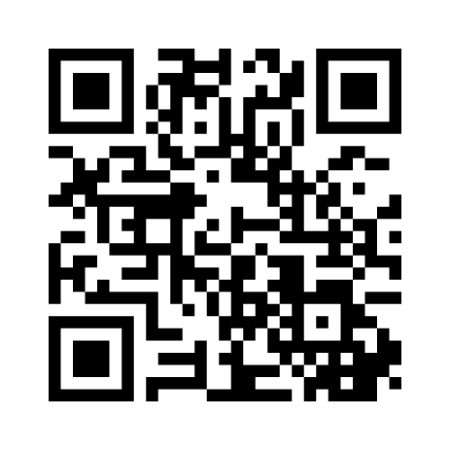
MINI POLL
Think of your experience so far and please indicate top 3 roles that you identify with teaching EAP
Voting code: 6125 7923
Notes:
Mention Frustrations after this slide

Slide 7

Online Survey Questions (Students)
What do you consider to be the main roles of SPS-SL facilitators? Rank the following in order of importance, from 10 (most) to 1 (least).
Teacher (Academic skills and language)
Teacher (Course content)
Feedback Provider
Administrator
Tutor
Examiner/grader
Mentor
Researcher
Assessor of academic integrity

Slide 8
Roles; as they are perceived by our students, colleagues (FASS coordinators & facilitators) and us (SL facilitators)
 | STUDENTS (27) | FASS COORDINATORS (3) | FASS FACILITATORS (GRADUATE STUDENTS -TAs of the course) (8) | SL COORDINATORS (EAP Instructors) (7)
The MOST FREQUENT ROLE after ALL the Teaching Roles | Feedback Provider | Assessor of academic Integrity / Examiner | Feedback Provider | Feedback Provider
LEAST FREQUENT | Researcher / Administrator | Researcher | Mentor / Administrator | Course designer /Administrator
Notes:
Do you see anything surprising about these results? / We’ll share the results of virtual f2f interviews, do you think there are different outcomes compared to the online survey?

Slide 9

Interview Results- Labels

Slide 10
Common themes- I
EAP Instructors- Perceptions
Ambiguity of our position within academia
Assumptions stemming from different understandings about the value of a PhD;
Lack of official status within institutional structure may influence core team perception of us
Course Instructors don’t really seem to take our own research interests/project seriously
Different perceptions between SL and FASS core team as to what constitutes ‘personal closeness’ in tutor role
Issue of recognition: mixed results
Acknowledgement of pedagogical perspective and experience teaching writing/academic skills
Capacity to design/teach/evaluate content-related material underestimated and excluded from decision-making
Condition of equality

Slide 11
Common themes- II
Course Coordinators & Instructors
Graduate Students (Co-teachers)
Language/writing/academic skills teacher (pedagogical perspective)
Grading, designing rubrics, creating content, peer teaching (involved in the other roles but not primarily)
Position of EAP practitioners valuable within broader context of academic for integrating language with research/content
Acknowledge importance of SL facilitators having at least some social sciences background
One-on-one interaction with students
Academic English Instructors / Teachers of academic writing/academic skills
Pedagogical perspective
Experience
Asking/ receiving help (Organizer/ class mom)
*Teaching ethics of learning and writing in an academic environment

Slide 12

In search of an identity: Metaphors
Butler stance - Raimes- 1991
Third space- Whitchurch (2008)
Multiple personality disorder (Ilkem & Merve) – Juggler

Slide 13
Butler stance - Raimes- 1991
According to Raimes, the ‘butler stance’ designation is predicated on the assumption that writing courses (such as EAP courses) are ‘service courses, in the service of the larger community ... [a view that] positions language and composition courses outside of academia, with no academic process of their own’ (p. 243)
Within institutions, EAP practitioners adopting the ‘butler stance’ are expected to adopt the identity of skilled technicians whose work supports the larger enterprise of the university in terms of language competence development, but they are not required to engage intellectually with the larger, collective knowledge-building role of the university, such as in theory development or in undertaking research that relates to the curriculum and pedagogy of their subject

Slide 14
Third space- Whitchurch (2008)
Whitchurch (2008) describes the third space in higher education contexts as one which exists “between the traditional binary of an academic domain and an administrative or management domain that supports this” (p. 378)
Third space professionals exist in different contexts across the university and have mixed identities: they straddle the professional and academic domains in that they are not faculty members, whose work traditionally includes research, teaching, and “third-leg” functions, nor are they strictly administrators supporting the academic domain.

Slide 15


Multiple personality disorder
Juggler/ Plate Spinner

Slide 16

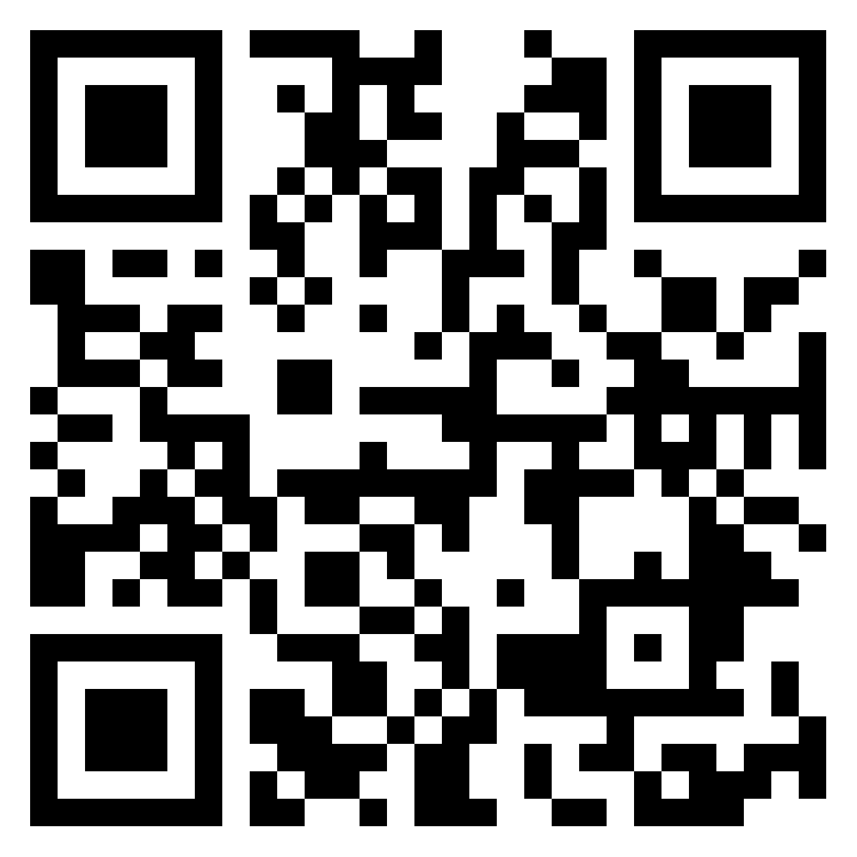
DISCUSSION
Can you think of similar identifications that are prevalent in your own institution?
2. Do you think the way we are perceived has anything to do the with the following?
Professional development: command over EAP theories
Academic development; degrees; MA, Phd
Experience
The current political, social, economic forces
Transitioning from being a TESOL to EAP teacher
PADLET:
https://padlet.com/ilkem/baleap-2023-differing-perceptions-differing-expectations-who-p0wnyphd6h65c5x6

Slide 17
ISSUES
1
2
3
4
Whether EAP
is a research-informed academic subject or a peripheral support service?
Persona and role inside & outside the classroom
Recognition for scholarly efforts?
Hierarchy

