Slide 1

Deconstructing the concept of essay creation.
Can it be delivered in an oral mode?
Katia Dowdle
Associate Lecturer in EAP
Academic Communication Centre
University College London
Doctoral researcher, IoE, UCL
Qualifications:
MA Linguistics
MSc Educational Research
Diploma TESOL

Slide 2

Are we good at spontaneous academic/formal speaking?
Can we ‘hold the floor’ when we are unexpectedly ‘given the floor’?
Do we always need to write our speech down before delivering it? Do we always need to rehearse formal monologues before delivering them? Do we always need visual aids?
Can we trust ourselves to finish a line of sophisticated thought without memorising it in advance?
Before I start,
let’s quietly reflect …

Slide 3
Outline:
Aim:
to discuss ‘oral essay’ as a concept under construction
to discuss the results of a PhD pilot study
(supervisors: prof. Lesley Gourlay & prof. Alison Clark-Wilson)
Is the essay really dead?
Conceptualising ‘oral essay’
Motivators for the research project
Pilot study design
Pilot study preliminary results
Quotes from interviews
What’s next?

Slide 4
Is the essay really dead…
Articles in academic journals
Richard Andrews, ‘The End of the Essay’, 2003
Tom Gyenes and Judith Wilks, ‘Is the Essay Dead?’, 2014
Brandon Konoval, ‘Is the Essay Dead?, 2022
Current media hype and metaphors of death
‘The college essay is dead’ (Marche, 2022)
‘The essay is dead, but it’s not yet buried’ (Zaretsky, 2023)
‘Did ChatGPT kill the student essay?’ (Skorburg & White, 2023)
‘If AI kills the essay, I will be a pallbearer at the funeral’ (Bugeja, 2023)
… or is it still ‘alive and well’? (Andrews, 2003)?

Slide 5
Conceptualising oral essay
‘Part of its [essay] longevity is a result of its flexibility, its ability to adapt to different functions’.
(Andrews, 2003, p.126)
Can an essay adapt to a different mode of delivery?
‘Oral essay’ - a ‘spontaneous’ structured oral monologue without visual aids or prepared manuscripts (where students are ‘given the floor’ to orally construct a critical academic argument combining personal stance and experts’ ideas)
Performance aspect removed (no standing, no microphone required, body language irrelevant)
Focus on articulating ideas, building on the views of others and constructing an academic narrative
Aimed at all students, regardless of linguistic background (home and international students)
? Assessment? Assessment of learning, for learning or as learning? Skill-development task? Exercise in academic literacy? Assignment? Scaffolding tool? ‘A means by which learning could take place’ (Tsang, 2020)? Communication genre? Speech event?
? Marking criteria? Assessment rubrics? Rating scales? Learning outcomes? Desirable goals?

Slide 6
Conceptualising oral essay
Mercer, Warwick & Ahmed’s Oracy Skills Framework (2017)
Ervin Goffman’s ideas about ‘fresh talk’ (1981)
Peter Elbow (ed.) Landmark Essays on Speech and Writing (2015)
Gordon Joughin’s dimensions of oral assessment (1998)
Ursula Wingate’s essay framework (2012)

Slide 7
Motivators for the ‘oral essay’ project
My professional experience and the concepts of ‘ownership’ and ‘detachment’
‘I own the words I speak more than I own the words that I write’.
(student’s sentiment recorded by Joughin, 2008, p.107)
‘Omnia mea mecum porto’ (‘All that is mine I carry with me’)
The appeal to develop students’ oracy skills and put oracy in HE on research agenda
(Heron, 2019; Heron et al, 2021; Mercer et al, 2017; Wilkinson, 1965)
‘Skewed by deprivation and privilege’ (Dockrell, 2019)
‘Cultural capital’ (Bourdieu, 1986) that can improve employability and enable social mobility?
‘Oracy as competence’ and ‘oracy for learning’ (Heron et al, 2022)
Tool for thinking, meaning making, constructing knowledge and enhancing learning? (Mah, 2016; Vygotsky, 1986)
The need to continue diversifying assessment for an increasingly diverse student cohort
(O’Neill and Padden, 2021)
The introduction of sophisticated AI writing tools (Rudolph et al, 2023)
AI vs HI? What makes us human? Raising the standards on being human.

Slide 8
Pilot study
Part of the on-going Design-Based Research PhD project
(interventionist, collaborative, iterative – McKenney & Reeves, 2018; Bakker, 2018)
Exploratory stage
(to illuminate potential features of an oral essay & to listen to students’ voices)
R.Q.1. How is the task of ‘oral essay’ interpreted by students?
R.Q.2. What are students’ attitudes towards an essay task when it is implemented in an oral format?
R.Q.3. How do students characterise their performance of an oral essay task?
R.Q.4. Which features of the written essay are exhibited in the oral essay?
Sample: non-probability small convenience sample, n=7, international, Master’s
Ethics: voluntary participation, outside classroom time, minimised power imbalance
‘Oral essay’ task: read a small number of quotes (experts’ ideas), then synthesize and incorporate them into your own oral argument on a given topic
Mixed methods (pragmatism paradigm): observation of oral essay production, semi-structured interview, background questionnaire, self-rating scale

Slide 9
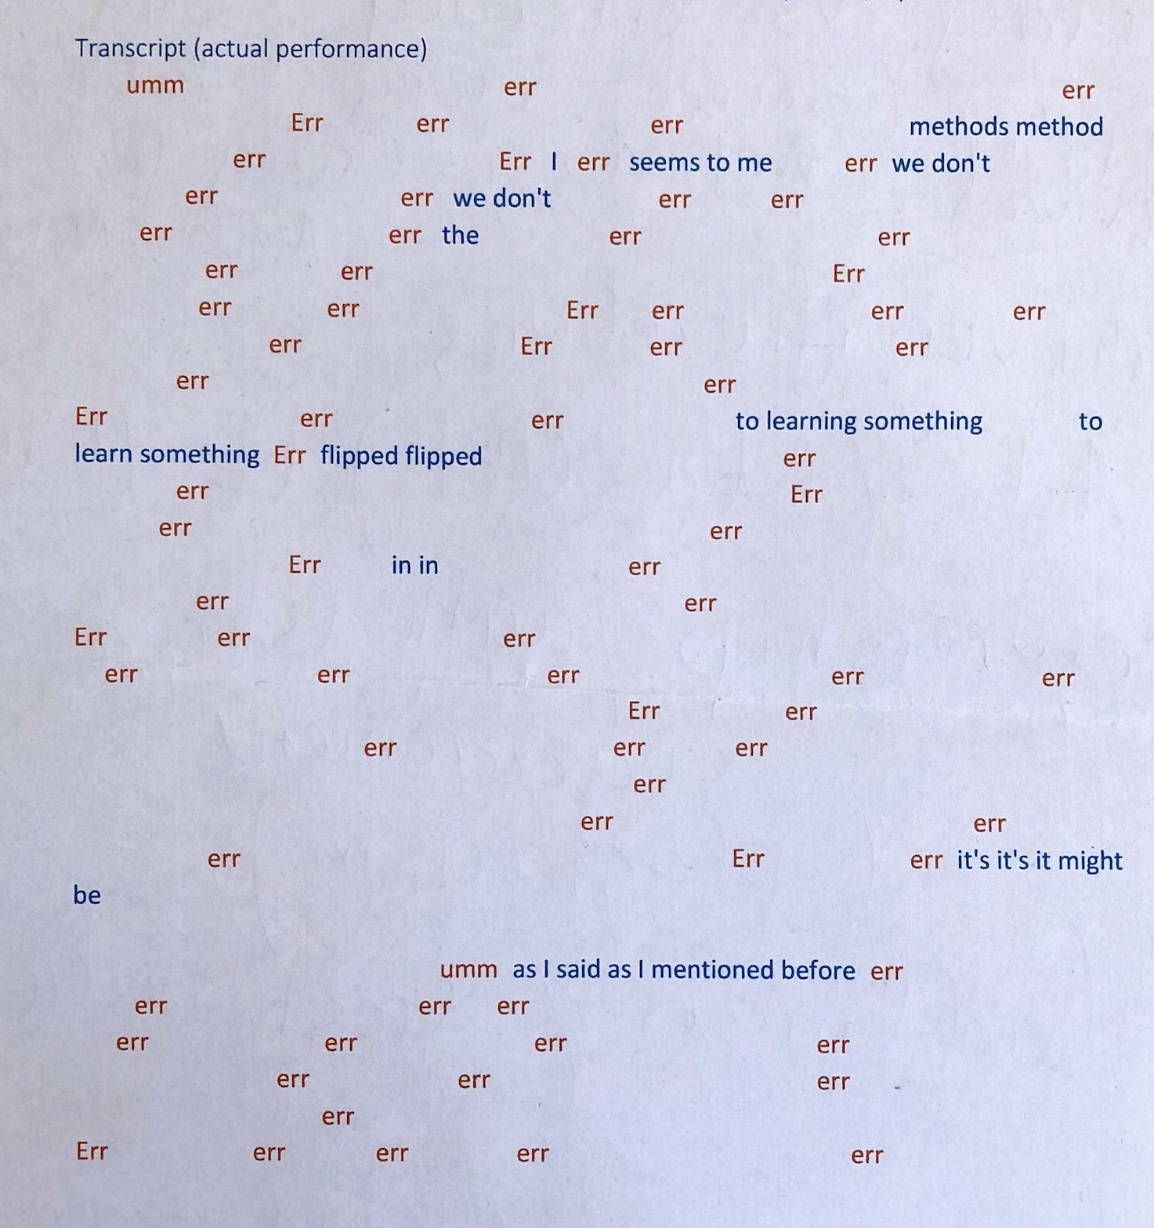

Slide 10
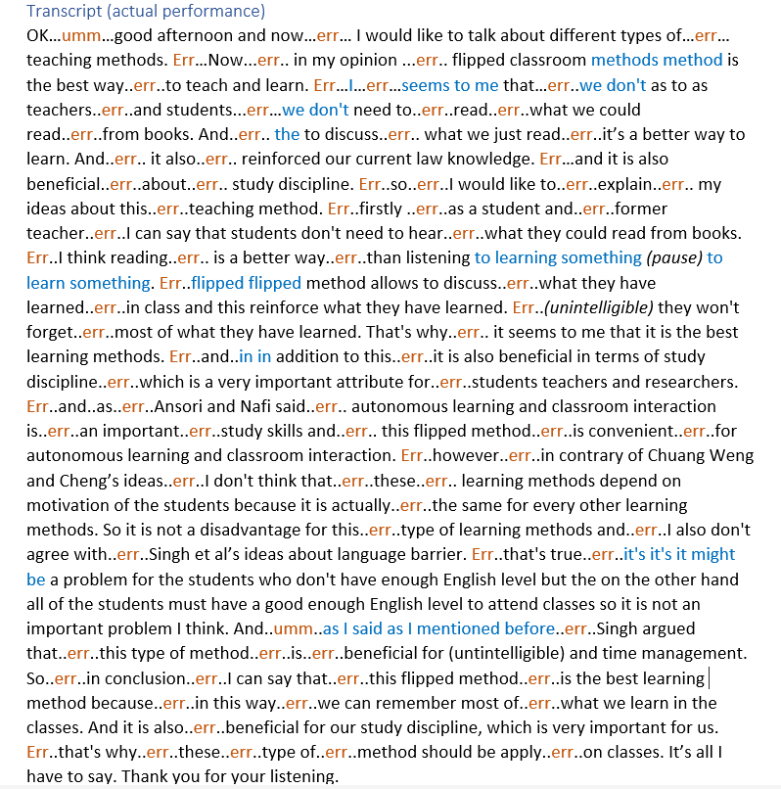

Slide 11
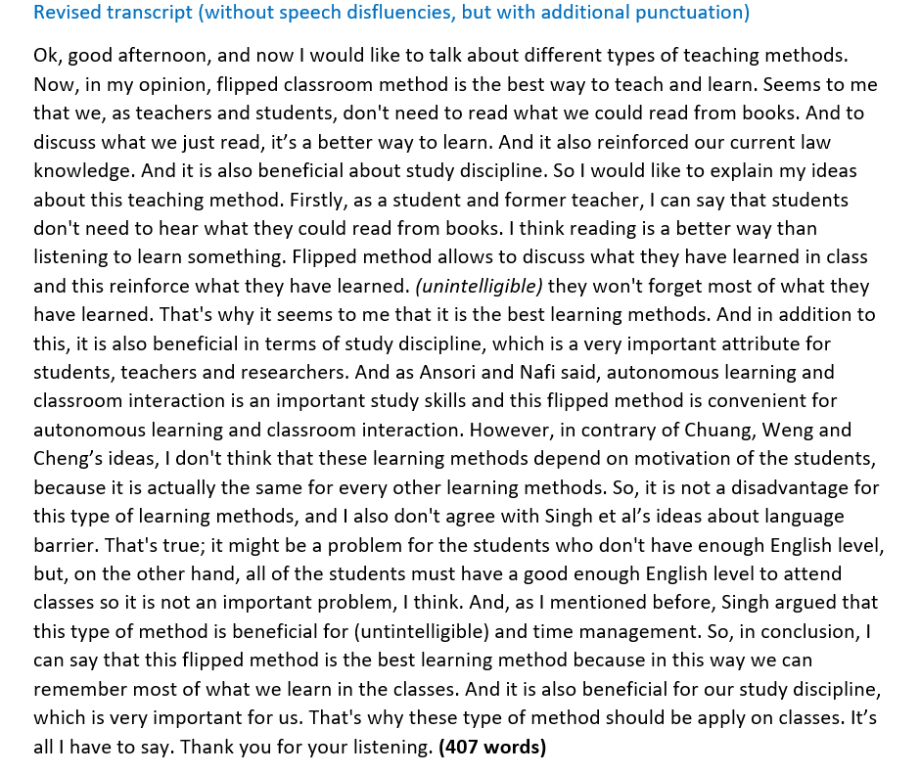

Slide 12
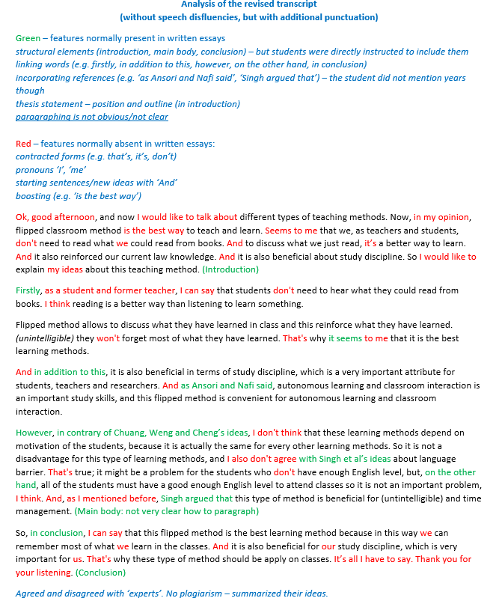

Slide 13
Preliminary findings
Content analysis of researcher’s observation notes + students’ written notes:
A range of task interpretations and strategies were adopted to successfully produce an oral argument.
Genre analysis (oral essay transcripts)
Despite the expected speech disfluencies (filled pause, repetition, repair, false start), the transcripts of oral narratives showed recognizable genre features of an essay, suggesting its potential to act as a measure of students’ critical argumentation skills.
Reflexive thematic analysis (Braun &Clarke, 2006) of interview transcripts
Students (unprompted) framed the purpose of ‘oral essay’ from both perspectives: oracy as competence and oracy for learning
While acknowledging the struggles and challenges of the task, students expressed interest in developing skills of spontaneous oral argumentation within their disciplinary context.

Slide 14
Students’ thoughts as reflection of academic theories
Interacting relationship between speech and writing (Halliday, 2008; Elbow, 2015):
It's like I can ride a bicycle or take a taxi. It's the same. Both are vehicles to transport something.
(participant 3)
Memorisation as a useful learning tool (Booker, 2007; Goffman, 1981):
Researcher: How can the oral essay task be designed to facilitate spontaneity and prevent memorization? Participant 1: We cannot speak fluently if we don't memorize some important knowledge.
Participant 2: If I have good memory, I will use it. If I can remember all of this, I definitely will remember it, but I can’t.
The ideas of ownership and detachment (Joughin, 2008):
When you need to write a 2000-word essay, you need a lot of information, and some of the information you just.. even don't know what the meaning is, but you still put that in the essay. You just wanna make your words, make enough words.. yeah. So, I feel this way is a better way to learn information. It’s not that much and it's very appropriate and you can learn…and then it becomes your information. It becomes yours, yeah, but the [written] essay - no. (participant 7)

Slide 15
What’s next?
No claims to generalisability Potential transferability
(& ecological validity)
Authentic (real-life) settings, situated learning environments
- different university disciplines (Arts & Humanities, STEM, Social Sciences)
- subject lecturers as co-designers
Multiple iterations: design-test-reflect-redesign
Focus of the future empirical investigation:
NOT on impact or effectiveness (yet!)
BUT on appeal, relevance, consistency, practicality,
local viability & broader institutionalisation

Slide 16

Thank you for ‘giving me the floor’
Disclaimer:
My speech was not spontaneous ☺
Questions?
Comments?
Suggestions?

Slide 17
‘Oral essay’ task – pilot design
Handouts (oral essay task + self-rating scale)
What is your initial reaction to the task?
Would you be able to do it?
Would you take notes? What would your notes look like?
Would you write the whole essay down first?
How long would you take to prepare?
How long do you think you would speak for?
Would you memorise some parts of your speech?
Would you be ‘scared’ to do it spontaneously (as Goffman’s ‘fresh talk’)?
Practice makes perfect?

Slide 18
References
Andrews, R. (2003). The end of the essay? Teaching in Higher Education, 8(1), 117-128. https://doi.org/10.1080/1356251032000052366
Bakker, A. (2018). Design Research in Education. Routledge.
Booker, M. (2007). A roof without walls: Benjamin Bloom’s taxonomy and the misdirection of American education. Academic Questions, 20, 347–355. https://doi.org/10.1007/s12129-007-9031-9
Bourdieu, P. (2018). The forms of capital. In The sociology of economic life (pp. 78-92). Routledge.
Braun, V., & Clarke, V. (2006). Using thematic analysis in psychology. Qualitative Research in Psychology, 3(2), 77-101. https://doi.org/10.1191/1478088706qp063oa
Bugeja, M. (2023, January 24). If AI kills the essay, I will be a pallbearer at the funeral. Poynter. https://www.poynter.org/tech-tools/2023/will-chatgpt-kill-term-papers-essays/
Davis, M. (2019). Publishing research as an EAP practitioner: Opportunities and threats. Journal of English for Academic Purposes, 39, 72-86. https://doi.org/10.1016/j.jeap.2019.04.001
Dockrell, J. (2019, October 3). Oracy: children’s skills are skewed by deprivation and privilege. How can skills bridge the gap? IOE Blog. https://blogs.ucl.ac.uk/ioe/2019/10/03/oracy-childrens-skills-are-skewed-by-deprivation-and-privilege-how-can-schools-bridge-the-gap/
Elbow, P. (ed.) (2015). Landmark Essays on Speech and Writing. Routledge.
Goffman, E. (1981). Forms of talk. University of Pennsylvania Press.
Gyenes, T., & Wilks, J. (2014). Is the essay dead?: Revitalising argument in the era of multiliteracies. English in Australia, 49(1), 7-15. https://doi/10.3316/informit.381482637174994

Slide 19
References
Halliday, M.A.K. (2008). Complementarities in Language. Commercial Press.
Heron, M. (2019). Making the case for oracy skills in higher education: practices and opportunities. Journal of University Teaching & Learning Practice,16(2). https://ro.uow.edu.au/jutlp/vol16/iss2/9/https://doi.org/10.53761/1.16.2.2
Heron, M., Dippold, D., Hosein, A., Sullivan, A.K., Aksit, T., Aksit, N., Doubleday, J. & McKeown, K. (2021). Talking
about talk: tutor and student expectations of oracy skills in higher education. Language and Education, 35 (4), 285-300. https://doi.org/10.1080/09500782.2021.1895206
Heron, M., Baker, S., Gravett, K., & Irwin, E. (2022). Scoping academic oracy in higher education: knotting together forgotten connections to equity and academic literacies. Higher Education Research & Development, 1-16. https://doi.org/10.1080/07294360.2022.2048635
Hyland, H. (2006) English for Academic Purposes. Routledge.
Joughin, G. (1998). Dimensions of Oral Assessment. Assessment & Evaluation in Higher Education, 23(4), 367-378. https://doi.org/10.1080/0260293980230404
Joughin, G. (2008). Oral assessment from the learner’s perspective. VDM.
Konoval, B. (2018). Is the essay dead? research and writing instruction in the humanities at a research-intensive university. Higher Education Review, 50(2), 1-36.
Mah, A.S.H. (2016). Oracy Is as Important as Literacy: Interview with Christine CM Goh. RELC Journal, 47 (3), 399-404. https://doi.org/10.1177/0033688216681671

Slide 20
References
Marche, S. (2022, December 6). The college essay is dead. Nobody is prepared for how AI will transform academia. The Atlantic. https://www.theatlantic.com/technology/archive/2022/12/chatgpt-ai-writing-college-student-essays/672371/
McKenney, S., & Reeves, T. C. (2018). Conducting educational design research. London: Routledge.
Mercer, N., Warwick, P., & Ahmed, A. (2017). An oracy assessment toolkit: Linking research and development in the assessment of students' spoken language skills at age 11-12. Learning and Instruction, 48, 51-60. https://doi.org/10.1016/j.learninstruc.2016.10.005
O'Neill, D. K. (2012). Designs that fly: What the history of aeronautics tells us about the future of design-based research in education. International Journal of Research & Method in Education, 35(2), 119-140.
O’Neill, G. & Padden, L. (2021): Diversifying assessment methods: Barriers, benefits and enablers. Innovations in Education and Teaching International, 1-12. https://doi.org/10.1080/14703297.2021.1880462
Rudolph, J., Tan, S., & Tan, S. (2022). ChatGPT: Bullshit spewer or the end of traditional assessments in higher education? Journal of Applied Learning and Teaching, 6(1). https://doi.org/10.37074/jalt.2023.6.1.9
Skorburg, J.A. & White, D.J. (2023). Did ChatGPT kill the student essay? University of Guelph. https://news.uoguelph.ca/2023/03/did-chatgpt-kill-the-student-essay/

Slide 21
References
Tsang, A. (2020). Enhancing learners’ awareness of oral presentation (delivery) skills in the context of self-regulated learning. Active learning in higher education, 21(1), 39-50. https://doi.org/10.1177/1469787417731214
Vygotsky, L. S. (1986). Thought and Language. MIT Press.
Wilkinson, A. (1965). Spoken English. Edgbaston, University of Birmingham.
Wingate, U. (2012). ‘Argument!’ helping students understand what essay writing is about. Journal of English for academic purposes, 11(2), 145-154. https://doi.org/10.1016/j.jeap.2011.11.001
Zaretsky, R. (2023, January 12). Words, words, words. What does the advent of ChatGPT mean for already beleaguered teachers? The American Scholar. https://theamericanscholar.org/words-words-words/

Slide 22
Appendix (useful documents/slides for Q&A)

Slide 23
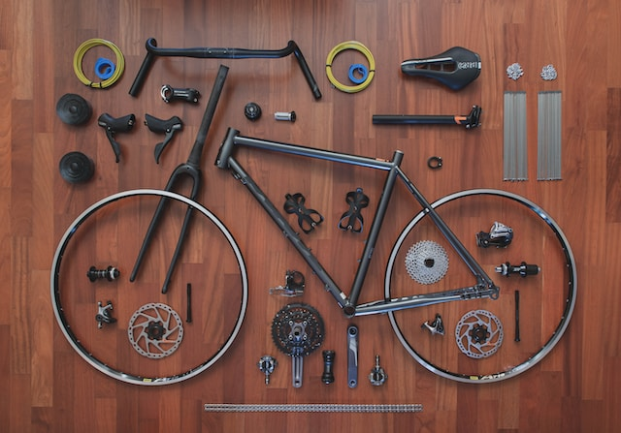
The right to deconstruct …
‘Alternative assessment certainly fits with the theme of deconstructing EAP. However, given the nature of EAP is to support students in their studies, it is unclear how preparing students for an assessment format that they will not encounter in their studies will benefit them.’ (reviewer’s comment)
Photo by Paolo Candelo on Unsplashed
‘If EAP is considered a field, and not a ‘peripheral support service’ (Ding and Bruce, 2017, p.3) or other often deprecating terms, then it is a legitimate academic discipline in which research and publication are component parts, integrated with teaching.’ (Davis, 2019, p.2)
Can EAP practitioners be equal participants in HE assessment research?

Slide 24

The underlying ‘spirit’ of the enquiry
Critical friend: ‘If it’s never been done before, maybe it cannot be done…’
Me: ‘Maybe it cannot. But why don’t we try?’
O’Neil (2012, p.134): ‘Fail early, fail often and report it’.

Slide 25
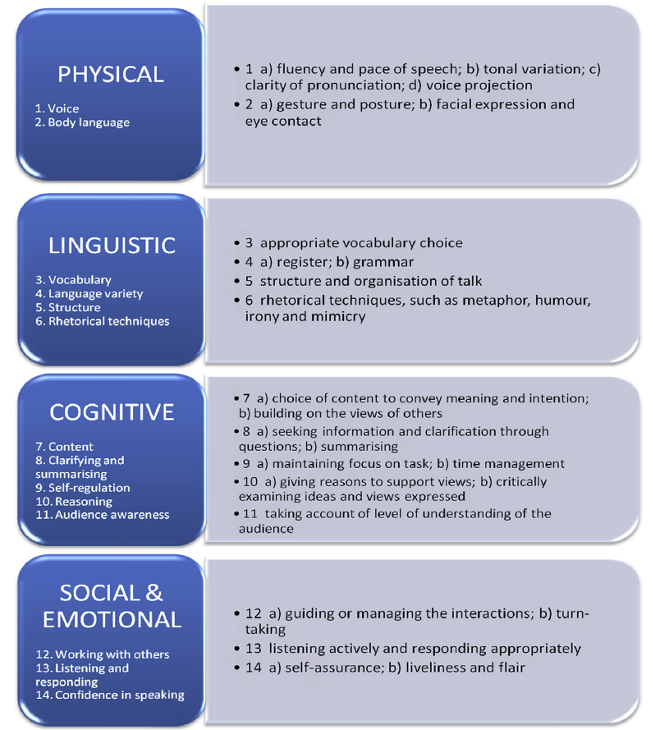
In ‘oral essay’, students would draw upon some of these skills, but not all.
Cambridge Oracy Skills Framework (Mercer et al, 2017, p.54)

Slide 26
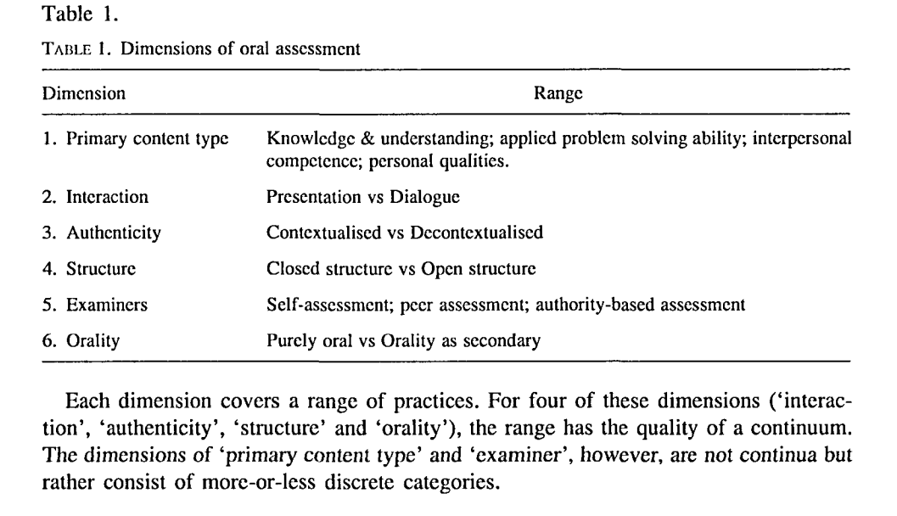
‘Oral essay’ can be positioned within the proposed dimensions.
Joughin’s dimensions of oral assessment (1998, p.368)

Slide 27
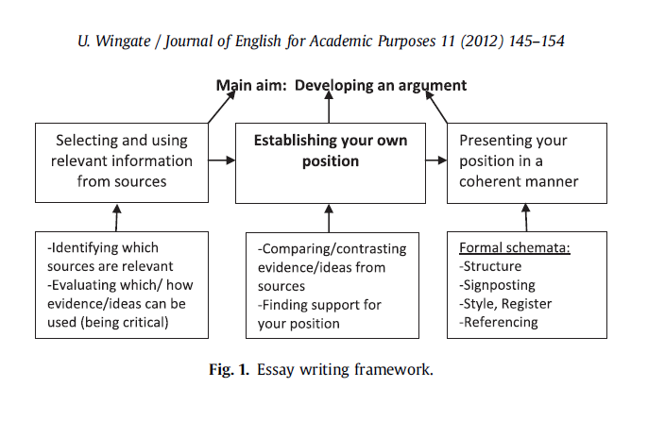
The framework can be adapted for the ‘oral essay’.
Essay writing framework (Wingate, 2012, p.153)

