Slide 2
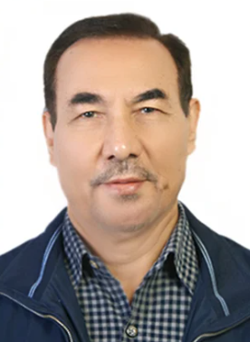
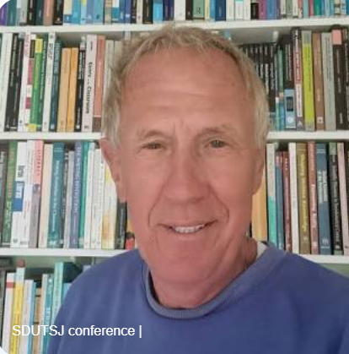
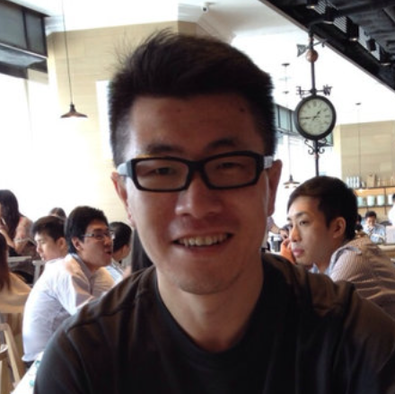
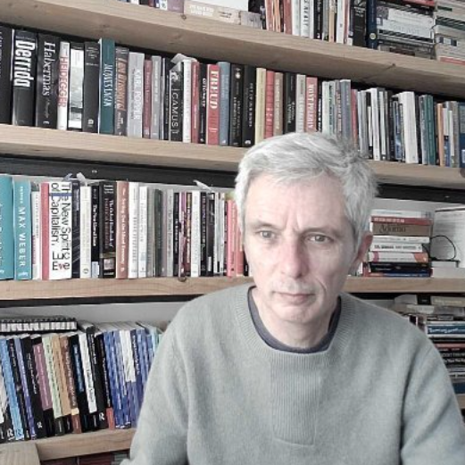
3 Recent Surveys of EAP
Riazi et al. (2020)
Data: research articles from JEAP, 2002-2019
Findings: Increased attention to intercultural rhetoric, assessment, student produced academic discourse
Hyland and Jiang (2021)
Data: research articles, 40 journals,1980-2020
Findings: Increased attention to identity, interaction and genre
Ding et al. (2022)
Data: BALEAP discussion list,1998-2021
Findings: Lack of attention to interests and concerns of practitioners

Slide 3
Data for this Study (Charles, 2022)
Practitioner research data
PIMS
66 meetings (1994-2019)
919 Titles of PIMS presentations (9,547 words)
Proceedings
23 volumes (1975-2017)
391 Titles of published chapters (3,922 words)
Combined
1,310 titles (13,469 words)
Period: 1975 – 2019
Notes:
immediate post-course (343) and delayed post-course, after one year (221). Charles and Hadley 2022

Slide 4
Method: Bottom-up, Top-down
Corpus: 13,469 words
Sub-corpora: PIMS = 9,547; Proceedings = 3,922 words
Bottom-up Corpus Analysis (AntConc, Anthony 2020)
Word lists
Corpus Keywords
A word which occurs more often than would be expected by chance in comparison with a reference corpus.
Top-down Manual Analysis
PIMs & proceedings classified by topic
Topics cross-checked with keyword and wordlist data
Associated terms identified
Concordances run on all terms and checked for relevance, double counting of titles etc.
Notes:
immediate post-course (343) and delayed post-course, after one year (221). Charles and Hadley 2022

Slide 5
Research Questions
RQ1 What were the most frequently addressed topics over the period 1975–2019?
RQ2 To what extent have these topics varied over the period?

Slide 6
Results
5 areas reported
PIMs and Proceedings
Courses and students
Major topics in BALEAP
The communicative skills of writing, speaking, reading and listening;
Approaches to EAP

Slide 7
PIMs & Proceedings: Research in BALEAP
Number of titles per year: PIMs and Proceedings combined
Huge growth in research

Slide 8
PIMs & Proceedings: Most Frequent Topics
PIMs Topics | No. PIMs | No. papers | % PIMs papers
Assessment | 6 | 85 | 9.3%
Teacher education | 5 | 72 | 7.8%
Writing | 5 | 68 | 7.4%
In-sessional issues | 4 | 76 | 8.3%
ESP | 3 | 41 | 4.5%
Reading | 3 | 25 | 2.7%
Technology | 3 | 42 | 4.6%
Total | 29 | 409 | 44.5%
Proceedings Topics | No. Procs. | No. papers | % Procs. papers
ESP | 4 | 57 | 14.6%
Change & Development | 3 | 57 | 14.6%
Collaboration | 2 | 47 | 12%
Total | 9 | 161 | 41.2%
Notes:
When we look closer, we see that most of these papers are not concerned with student corpus use or DDL. Concordancing is usually mentioned in terms of language analysis
The cited papers do have at least some discussion or examples of DDL, although not all have this as their main focus
In fact, teachers would get very little exposure to DDL from JEAP over this period.
What about the language analysis papers. Here are some typical examples

Slide 9
Courses & Students: Combined Data
Topics | No. papers | % papers (n = 1,310) | Trend
Students | 297 | 22.7% | stable
Courses | 168 | 12.8% | stable
Graduates | 102 | 7.8% | falling
Pre-sessional issues | 89 | 6.8% | falling
In-sessional issues | 92 | 7% | rising
Foundation | 34 | 2.6% | rising
Students/Courses
Ongoing practical focus of research in BALEAP
Graduates
Surprising falling trend
Master’s level: increase
Doctoral level: static
Pre-sessional
Early interest, now decreasing
In-sessional
Ongoing interest
4 PIMs,1998-2016
Foundation
Low interest
Notes:
When we look closer, we see that most of these papers are not concerned with student corpus use or DDL. Concordancing is usually mentioned in terms of language analysis
The cited papers do have at least some discussion or examples of DDL, although not all have this as their main focus
In fact, teachers would get very little exposure to DDL from JEAP over this period.
What about the language analysis papers. Here are some typical examples

Slide 10
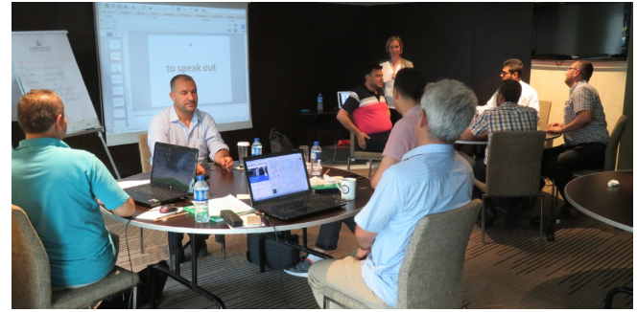
Research for New Purposes: Students & Courses
Non-traditional EAP Users Researchers
Staff
Secondary level
Non-University Provision
Outreach
Tutoring

Slide 11
Major Topics: Combined Data
Topics | No. papers | % papers (n = 1,310) | Trend
Language | 273 | 20.8% | falling
Specificity | 179 | 13.7% | falling
Assessment | 187 | 14.3% | rising
Technology | 113 | 8.6% | rising
Teacher education | 89 | 6.8% | rising
Language
Little recent interest
Fall from 40% - 20%
Specificity
4 Procs. 4 PIMs 1981-2011
Early interest; Fall: 38% - 9%
Assessment
Ongoing interest
Rise 5% - 20%
Technology
Ongoing interest
Rise 4% - 10%
Teacher Education
5 PIMs 1997-2014
Ongoing interest
Notes:
When we look closer, we see that most of these papers are not concerned with student corpus use or DDL. Concordancing is usually mentioned in terms of language analysis
The cited papers do have at least some discussion or examples of DDL, although not all have this as their main focus
In fact, teachers would get very little exposure to DDL from JEAP over this period.
What about the language analysis papers. Here are some typical examples

Slide 12
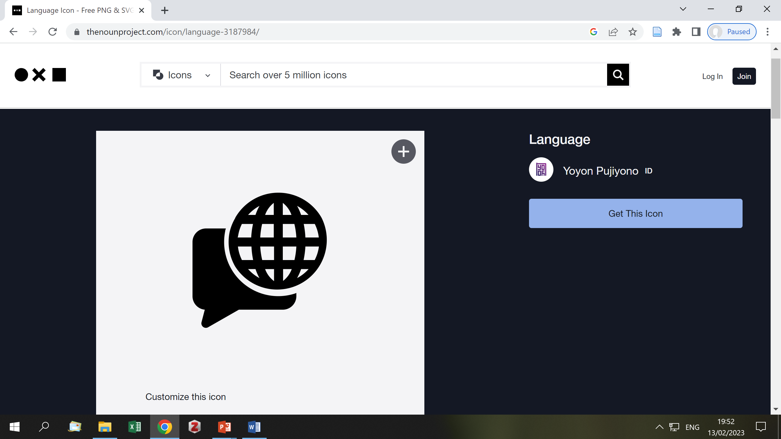
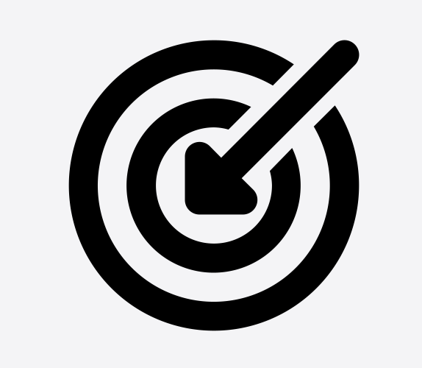
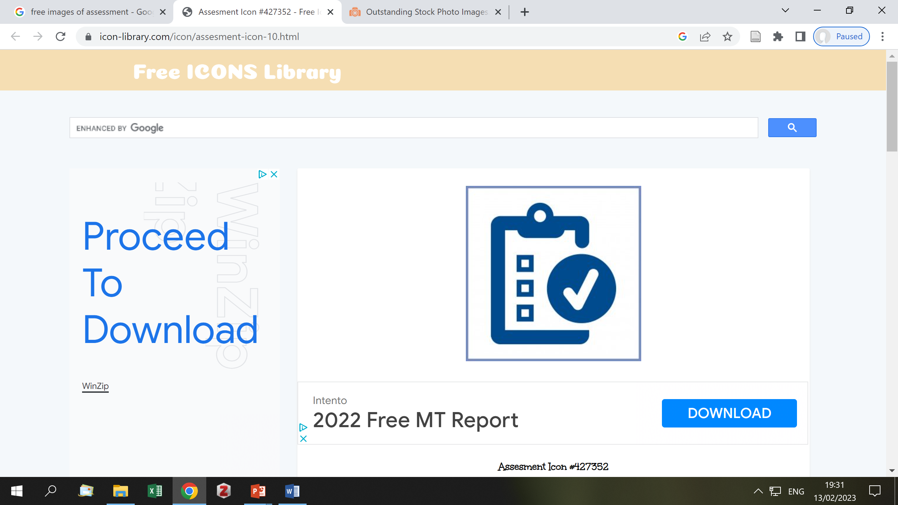
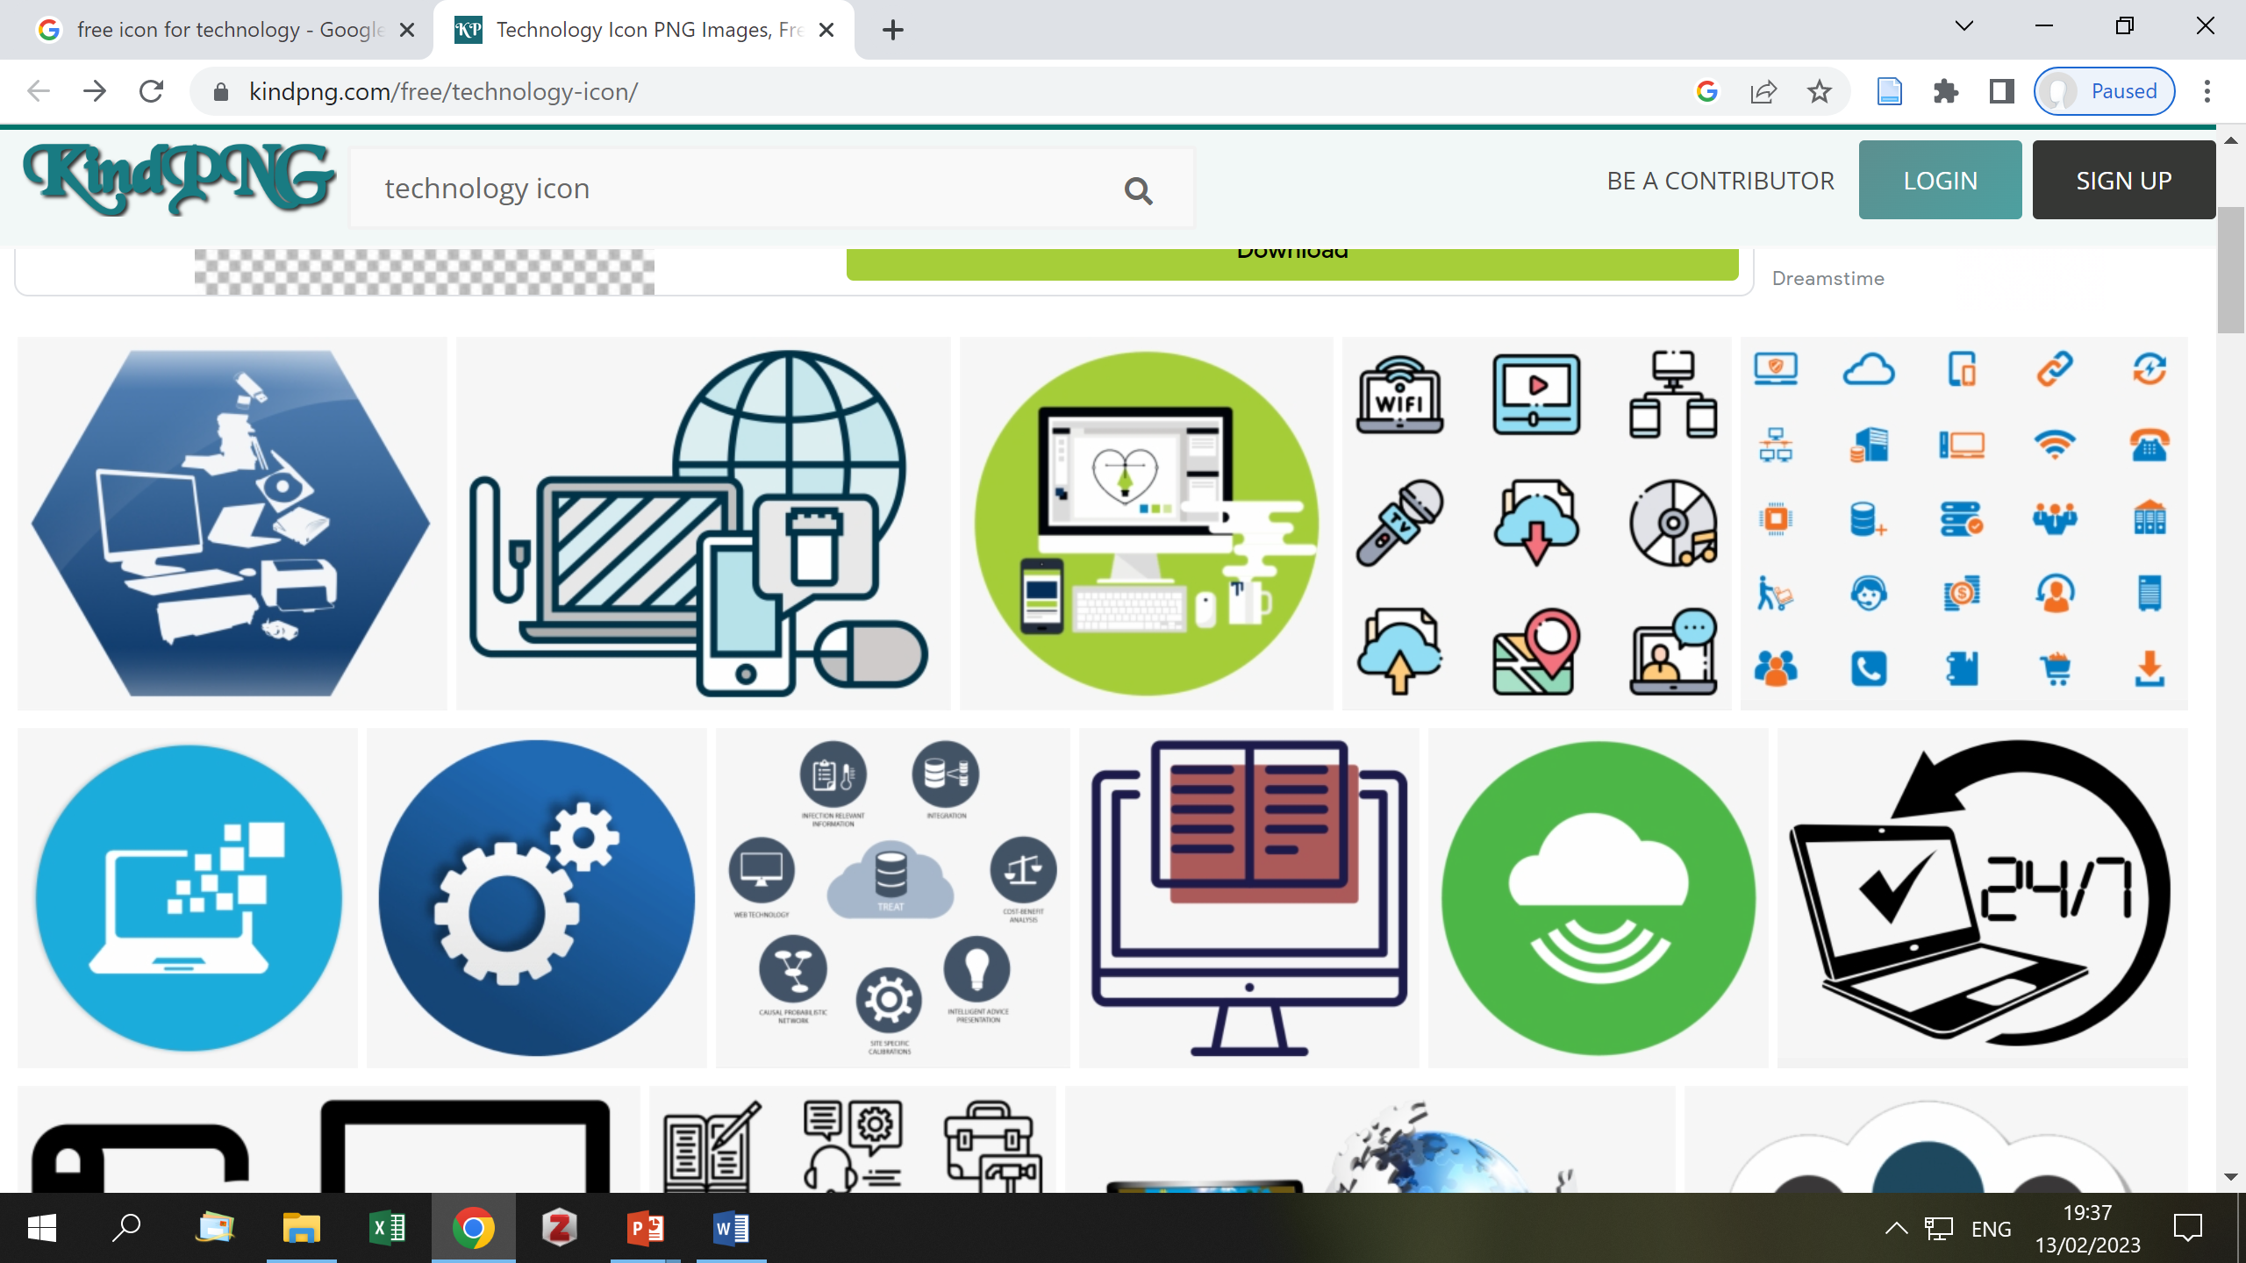
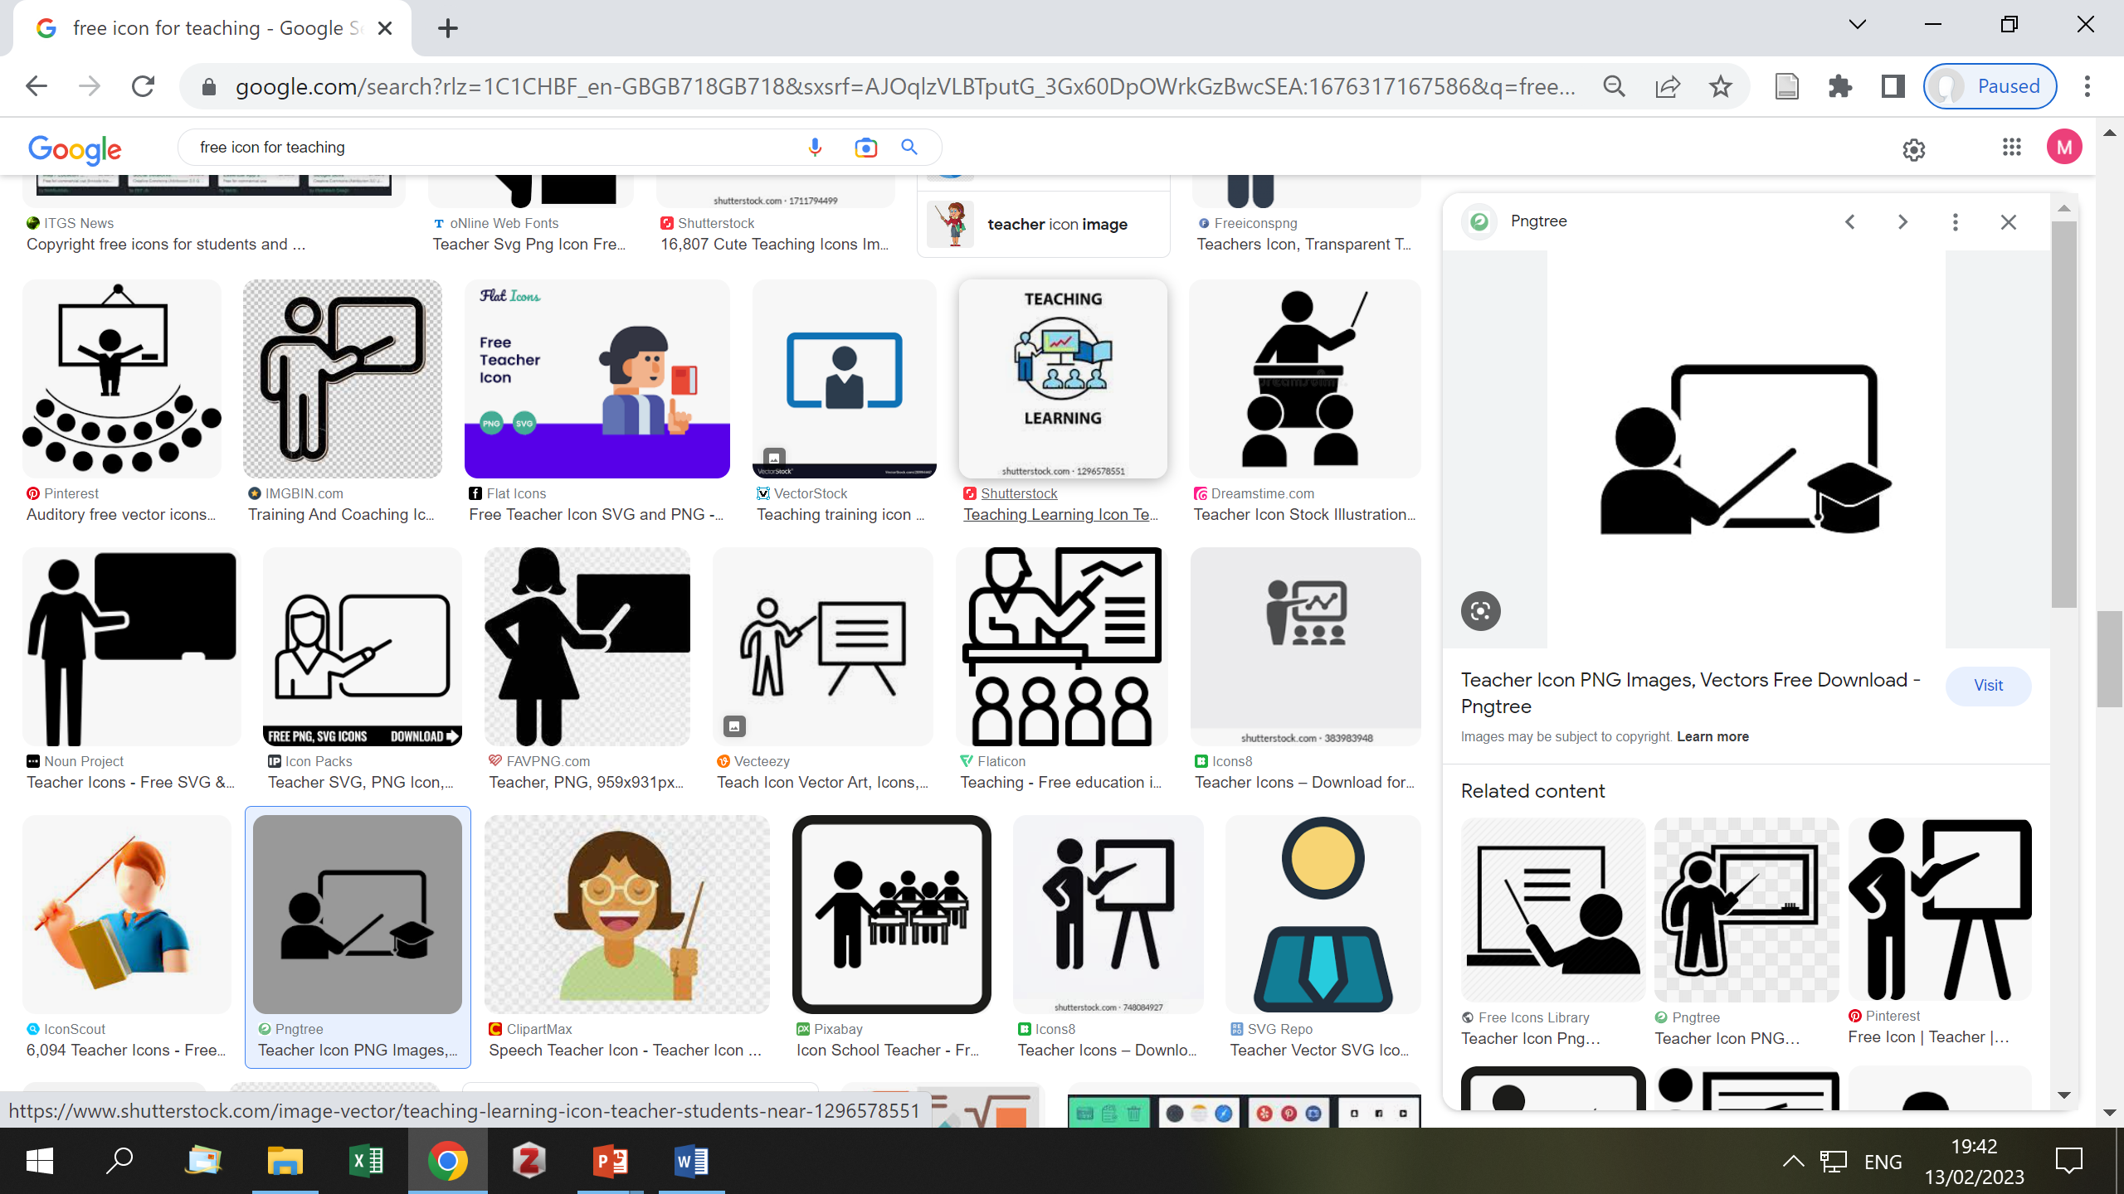
Research for New Purposes:
Major Topics
Artificial Intelligence
Interdisciplinary issues

Slide 13
Writing, Speaking, Reading, Listening: Combined Data
Topics | No. papers | % papers (n = 1,310) | Trend
Writing | 265 | 20.2% | falling
Speaking | 64 | 4.9% | rising
Reading | 56 | 4.3% | rising
Listening | 34 | 2.6% | stable
Writing
1 Proc. 5 PIMs, 1985-2013
Ongoing interest
But fall from 25% to 16%
Speaking
2 PIMs, 1994 & 2018
Recent revival of interest
Reading
3 PIMs, 1994, 1998 & 2015
Recent revival of interest
Listening
1 PIM 2009
Ongoing low interest
Notes:
When we look closer, we see that most of these papers are not concerned with student corpus use or DDL. Concordancing is usually mentioned in terms of language analysis
The cited papers do have at least some discussion or examples of DDL, although not all have this as their main focus
In fact, teachers would get very little exposure to DDL from JEAP over this period.
What about the language analysis papers. Here are some typical examples

Slide 14
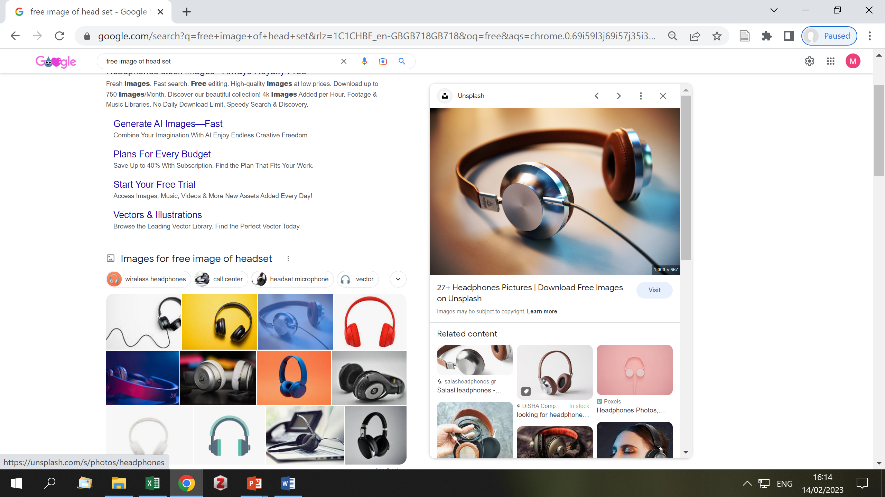
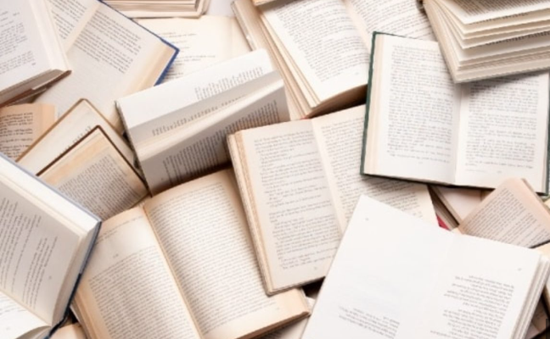
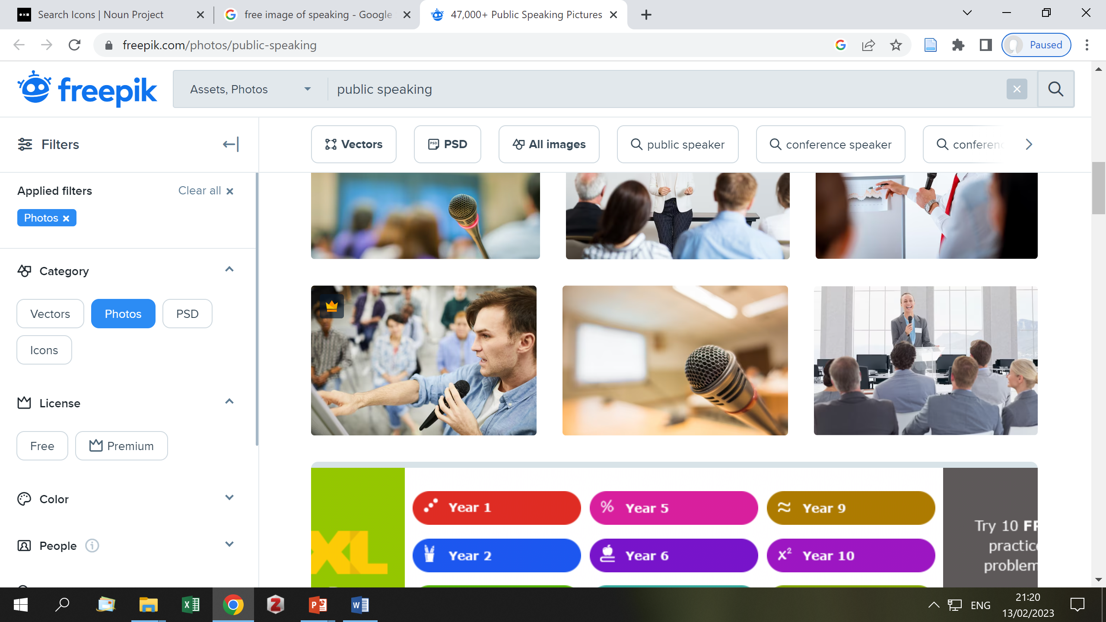
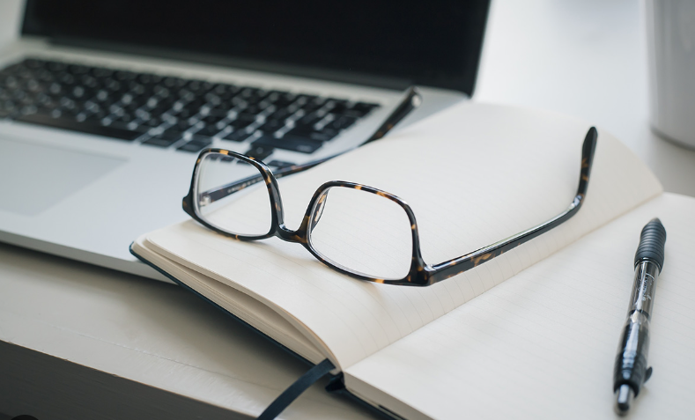
Research for New Purposes: Writing, Speaking, Reading, Listening
Listening, Speaking, Reading, Writing
  In/for online environments
Integrating skills

Slide 15
Approaches to EAP: Combined Data
Topics | No. papers | % papers (n = 1,310) | Trend
Intercultural | 84 | 6.4% | stable
Academic literacy | 56 | 4.3% | rising
Corpora | 46 | 3.5% | rising
Critical | 42 | 3.2% | rising
Genre | 28 | 2.1% | rising
Intercultural
Ongoing interest
Proc. 1991, PIMs 2005, 2017
Academic literacy
Proc. 2003, PIM 2018
Low interest, but rising to 8%
Corpora
2 PIMs 2003, 2014
Low interest, but rising to 5%
Critical
Low interest, but rising to 4%
Genre
Surprisingly, No Proc. or PIMs
Low interest, but rising to 2.5%
Notes:
When we look closer, we see that most of these papers are not concerned with student corpus use or DDL. Concordancing is usually mentioned in terms of language analysis
The cited papers do have at least some discussion or examples of DDL, although not all have this as their main focus
In fact, teachers would get very little exposure to DDL from JEAP over this period.
What about the language analysis papers. Here are some typical examples

Slide 16
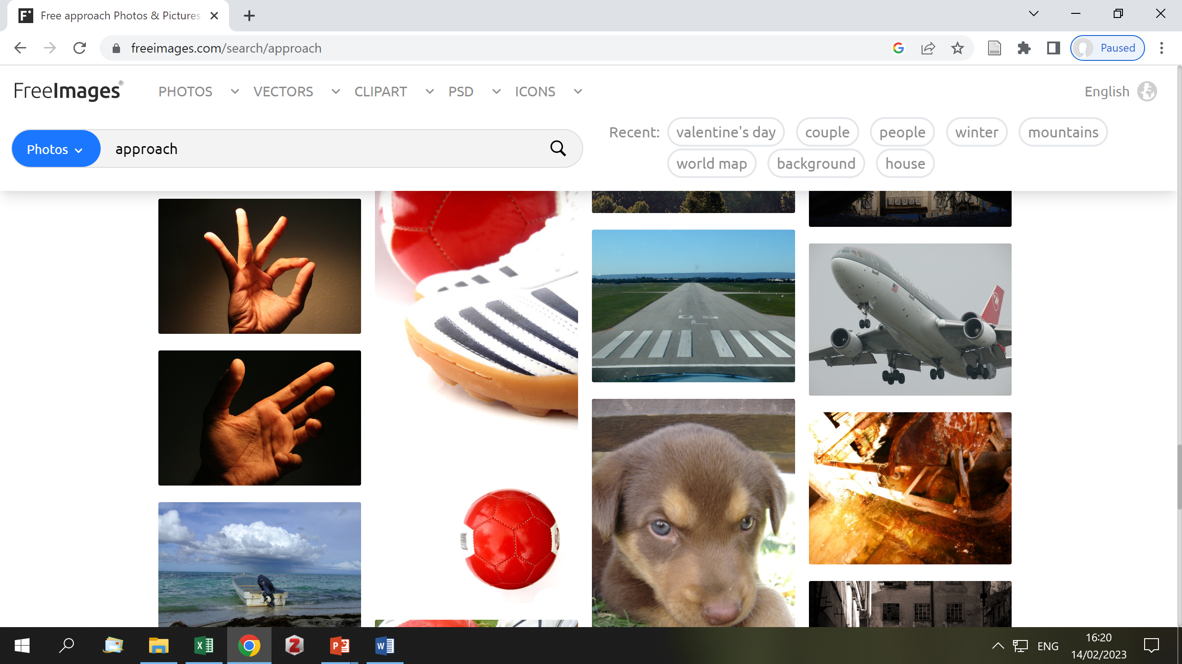
Research for New Purposes: Approaches to EAP
Exploration of social context
Data-driven learning
Multi-modal and digital genres

Slide 17

Possible Future Directions
Most importantly
Let us keep our diversity of research
9 areas
Non-traditional EAP users
Non-university provision
Artificial intelligence
Interdisciplinary issues
Listening, Reading, Speaking, Writing in/for online environments
Integrating skills
Exploration of social context
Data-driven learning
Multi-modal and digital genres

Slide 18
Thank you!
Any questions?

Slide 19
Acknowledgement & References
Acknowledgement
I would like to thank Andy Gillett, who kindly let me use the data he had collected on BALEAP PIMs and proceedings.
References
Anthony, L. (2019). AntConc (3.5.8) [Computer software]. Tokyo, Japan: Waseda University. Available from http://www.antlab.sci.waseda.ac.jp/
Charles, M. (2022). EAP research in BALEAP 1975–2019: Past issues and future directions. Journal of English for Academic Purposes, 101060. https://doi.org/10.1016/j.jeap.2021.101060
Ding, A., Bond, B., & Bruce, I. (2022). ‘Clearly you have nothing better to do with your time than this’: A critical historical exploration of contributions to the BALEAP discussion list. Journal of English for Academic Purposes, 58, 101109. https://doi.org/10.1016/j.jeap.2022.101109
Hyland, K., & Jiang, F. (Kevin). (2021). A bibliometric study of EAP research: Who is doing what, where and when? Journal of English for Academic Purposes, 49, 100929. https://doi.org/10.1016/j.jeap.2020.100929
Riazi, A. M., Ghanbar, H., & Fazel, I. (2020). The contexts, theoretical and methodological orientation of EAP research: Evidence from empirical articles published in the Journal of English for Academic Purposes. Journal of English for Academic Purposes, 48. https://doi.org/10.1016/j.jeap.2020.100925

