Slide 1
Deconstructing in-sessional: underpinning theories and practical implications to define our EAP practice
Lisa Hanson, Paul Hendrie, Katherine High, Debra Jones, Neil Tibbetts
BALEAP Conference April 2023
Notes:
LH
Actually 20min presentation, 20min questions according to original guidelines from organisers.
30min + Questions
Slide2-4 - ~10min
Slide 5-10 ~10min
Slide 11 ~5-7min
Slide 12 10min

Slide 2
Deconstructing our approach
Expanding Team
2 to 4 Coordinators
(Coming from International Foundation programme and Pre-sessional)
What is academic language and literacy (ALL)?
Deconstruct & evaluate our understandings of the theoretical underpinnings
In order to explain to others in the expanding team
what we do and
why we do it
  The practical implications from the theoretical underpinnings
Notes:
LH

Slide 3
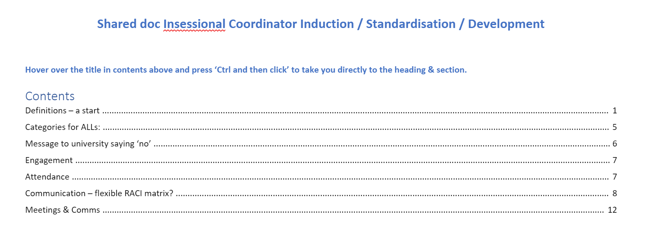
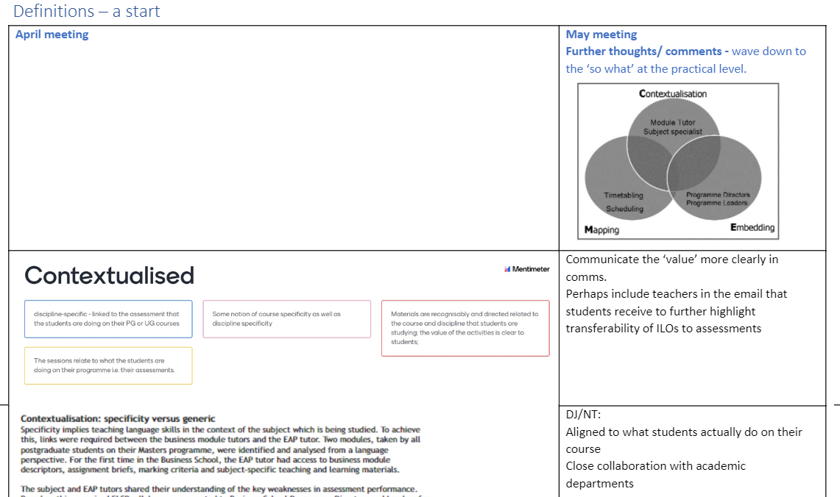
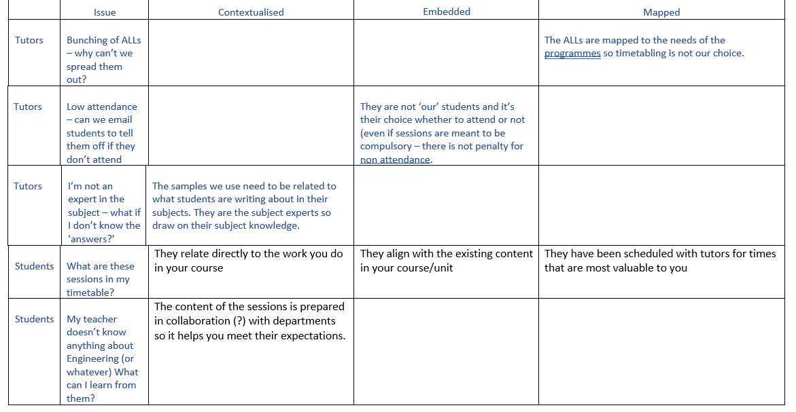
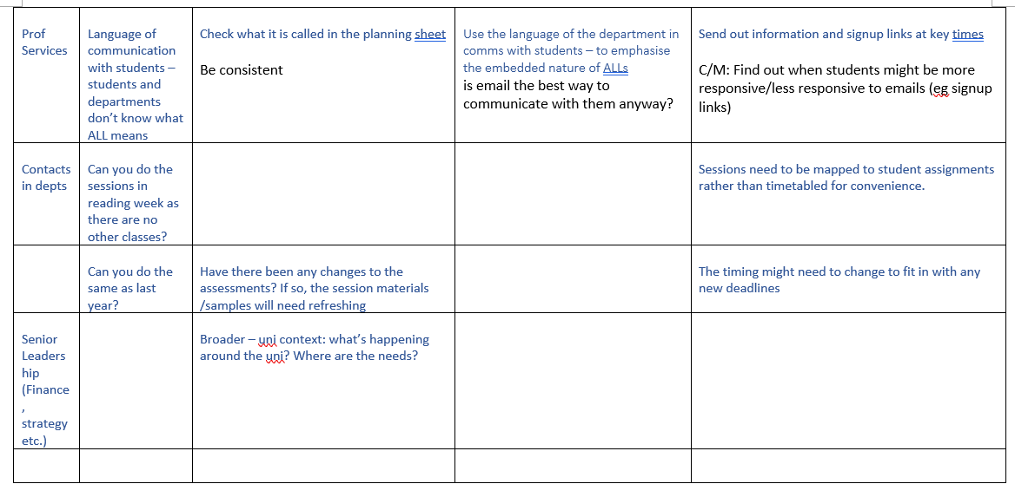
Deconstructing our approach
What is academic language and literacy (ALL)?
Deconstruct & evaluate our understandings of the theoretical underpinnings
In order to explain to others in the expanding team
what we do and
why we do it
  The practical implications from the theoretical underpinnings
Notes:
LH

Slide 4
Deconstructing our approach
Expanding Team
2 to 4 Coordinators
(Coming from International Foundation programme and Pre-sessional)
What is academic language and literacy (ALL)?
Deconstruct & evaluate our understandings of the theoretical underpinnings
In order to explain to others in the expanding team
what we do and
why we do it
  The practical implications from the theoretical underpinnings
Reading Circles
deconstruct / began to co-construct at one level
Notes:
LH

Slide 5
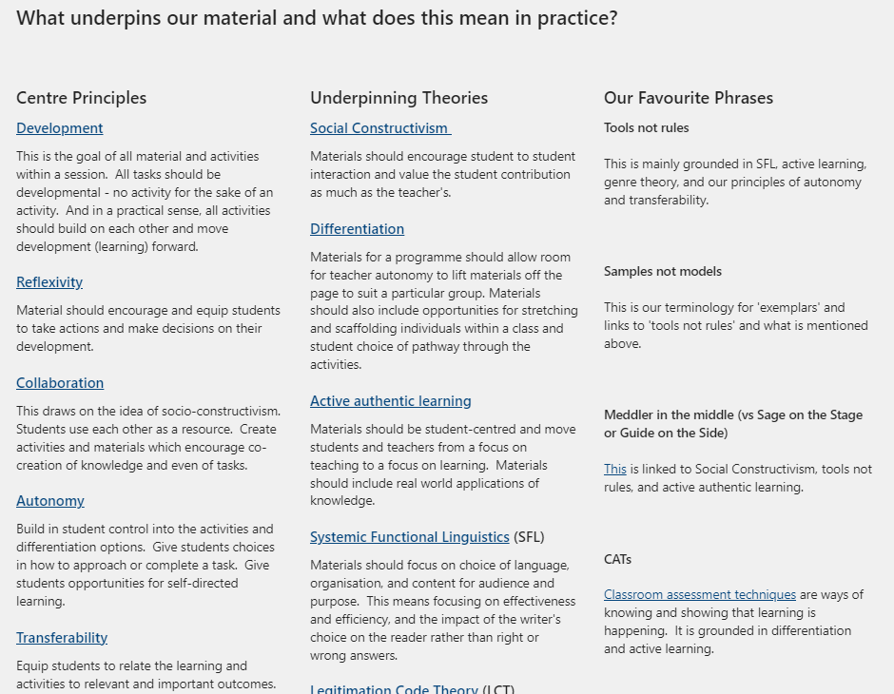
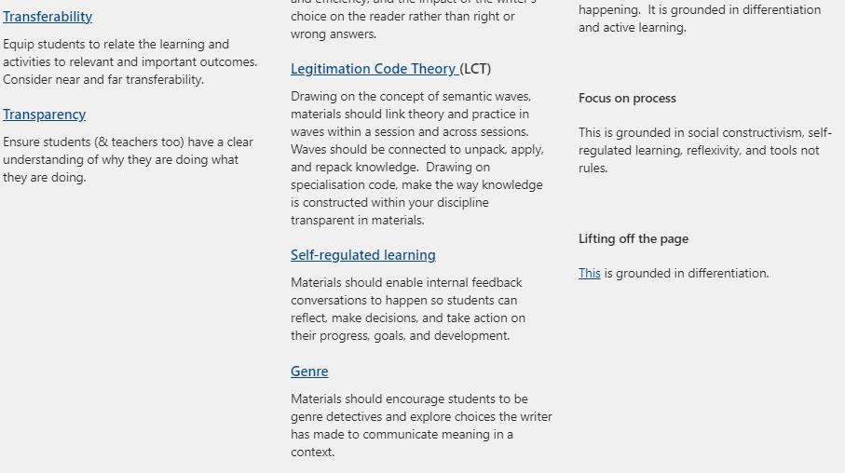
Reading Circles
  Met x4 over the summer
  (+ additional meetings based on the initial shared doc)
  Chose 4 underpinning theories we say ALL is based on
  But not interrogated recently
Notes:
LH

Slide 6
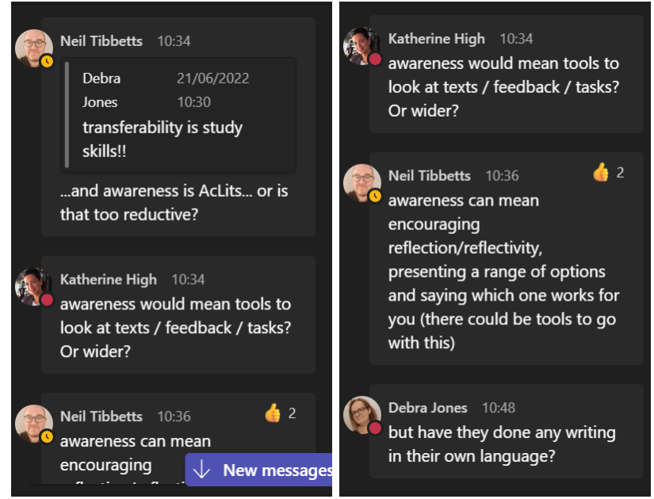
Outcome of reading circles
Outcomes:
  Elements of ALL to continue deconstructing & evaluating
  Initial alignment of our approach
  Teacher induction
Notes:
LH

Slide 7
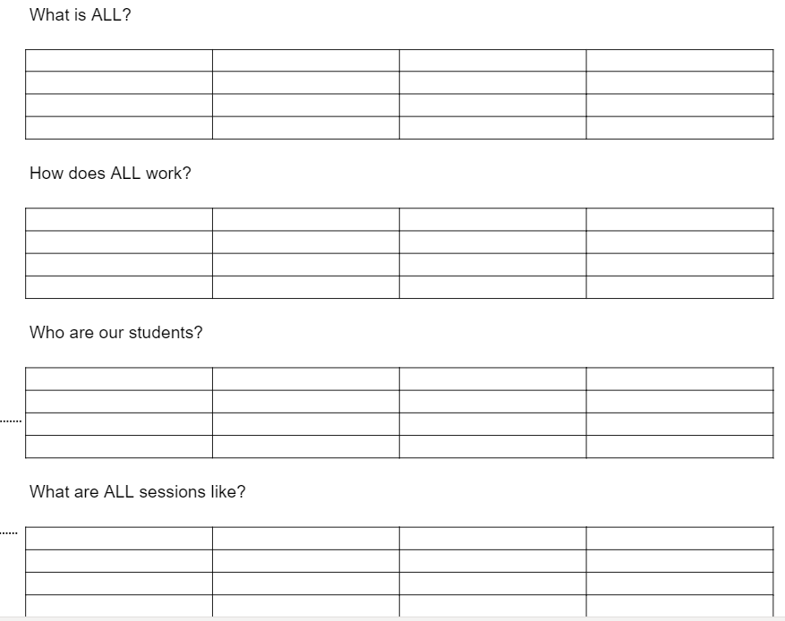
Stage 1: What is ALL?
Initial individual ideas through a shared doc
Notes:
NT & PH

Slide 8
Stage 2: How is it different to other provisions?
Group discussion through the shared doc
"We don’t get to know the students like we do on Foundation/ pre-sessional"
"ALL is different, so, as usual, teachers need to be flexible and responsive to a broad cast of individuals and their differing needs."
"Sense of imposter syndrome when going into departments (especially STEM) to deliver sessions"
"Home students bring a different dynamic to the space"
"Expectations / conduct can be influenced by culture of department (e.g. in terms of interaction / collaboration)"
Notes:
NT & PH

Slide 9
Stage 3: What are our underlying pedagogies?
Group discussion through reading circles
“CEM = (Contextualising, Embedding, Mapping). A tool to measure effectiveness of in-sessional provision -
reading this helped us to see our ALL provision as part of a wider picture (I.e. there is a framework that other uni’s have used to assess their in-sessional support).”
“Use of scaffolding rather than a list of rules to be used and obeyed. -SFL
Types of scaffolding - modelling (where a task is demonstrated explicitly): coaching (assisting learners to achieve a goal and giving feedback); and fading (the process whereby a scaffold is gradually withdrawn).”
Notes:
NT & PH

Slide 10
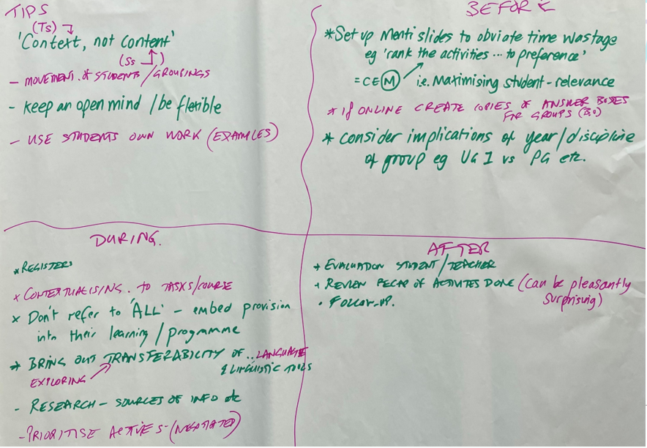
Stage 4: What are the practical implications of our underlying pedagogies?
Group poster presentation
“How to prepare for teaching an ALL”
Notes:
NT & PH

Slide 11
Coordinator Reflections 6 months on
Continuing collaboration post induction
Aligning theory and practice in materials
Reflecting on Lea & Street (1998)
Academic Literacies
Academic Socialisation
Study Skills
Notes:
KH
Need to continue the collaboration from the induction into the year's teaching
Gap in materials re showing the theory – needs to be more transparent – this could come through more collaboration
Study Skills / Academic Socialisation / Academic Literacies – link back to the reading text

Slide 12
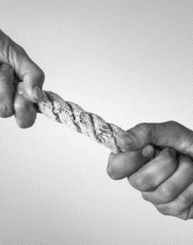
Coordinator Reflections 6 months on
Programme specific or discipline specific
Student needs and Academic Literacies
Avoiding 'them' and 'us'
Notes:
DJ

Slide 13
Definition or Approach?
Definition of Insessional
  What we don't do vs what we do
  Who we work with
  How we work with them
Approach: Principled eclecticism
  Adaptability
  Value
  Collaborative understanding
  Opportunity for development
What is your definition or approach based on and how do you evaluate it?
Notes:
PH/LH

