Slide 1
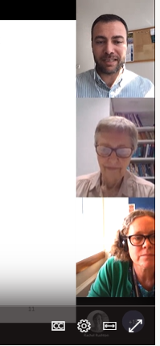


BALEAP Conference, University of Warwick, UK, 19-21 April 2023
Deconstructing grant proposal summaries written by exiled Syrian academics
Genre analysis and pedagogical materials for inexperienced researchers
Mellon Fellowship Program, Columbia Global Centers in Amman.
Maggie Charles, University of Oxford, UK Ahmed Halil, Selçuk University, Konya, Turkey Michael Jenkins, independent researcher Karin Whiteside, University of Reading, UK
Notes:
A participant in the Cara SP who lives in Konya and has been working in teaching Arabic for non native speakers (Turks mainly) for 10 years, and has been working as an assistant professor in the Translation and Interpretation departments for the last two years.

Slide 2
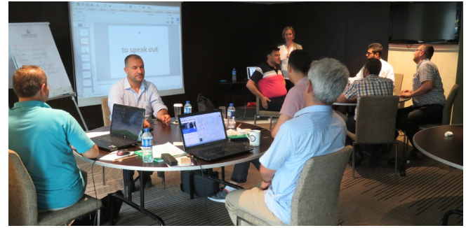

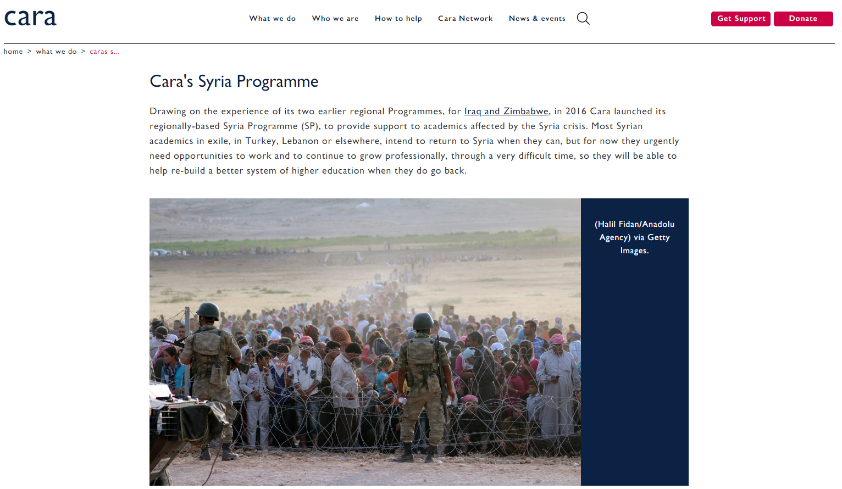
The Cara Syria Programme
‘To strengthen and connect Syrian academics in exile and open up new opportunities to ensure that this major part of Syria’s intellectual and cultural capital will be able to play its vital role in the future of Syria.’
English for Academic Purposes (EAP)
Academic Development
Research Incubation Visits
Cara-Commissioned Research
The Syrian Research Fellowship Scheme

Slide 3
Syria Programme Research Grants
Aim: Rigorous quality research outputs including publication in peer-reviewed journals & international conference presentations
Competitive grants up to £7K for research projects conducted by Syrian participants
9 grant rounds since April 2018, calls go out approx. every 6 months
90+ grants awarded to date
Average 30 applications submitted per grant round
Average 30%+ success rate
Proposals consist of
a proposal summary of 500 words maximum
a detailed proposal about 2,000 - 3,000 words
other documents
Notes:
Why the are research grants important? They are the best vehicle to deliver a central SP aim – the ‘partnering model’ facilitating collaborative research with experienced, mainly UK-based academics as mentors. It also has the function of connecting the displaces Syrian academics to the wider international research community for their field.

Slide 4
Learners: exiled Syrian academics on the Cara Syria Programme. Most based in Turkey.
English level: B2 to C1
Projects: wide range of disciplines (e.g. agriculture, engineering, sociology, archaeology, education)
Need to Teach Proposal Writing
Syrian participants’ lack of experience in applying for research grants
Many unsatisfactory proposals
PROBLEMS
Proposals are an occluded genre (Swales, 1996)
Lack of available teaching materials
Lack of examples for self-made teaching materials
Texts in other genres not appropriate or relevant
Build a corpus of participants’ proposals
Notes:
So, there’s an ongoing need to support the proposal writing process for a no. of reasons.

Slide 5
Corpora: 32 proposals: 12 Funded; 20 Unfunded
Corpus of summaries: 12,292 tokens
2 sub-corpora: funded (4,857 tokens); unfunded (7,435 tokens)
Software: AntConc (Anthony, 2020); AntFileConverter (Anthony, 2021)
Research Questions
RQ1 What is the generic structure of inexperienced learners’ summaries?
RQ2 What are the differences, if any, between the summaries of funded and unfunded proposals?

Slide 6
Moves and Steps for Genre Analysis of Summaries
Adapted from: Feng, H., & Shi, L. (2004). Genre analysis of research grant proposals. LSP and Professional Communication, 4, 8–32.
Move 1 Justifying a research need (violet)
  Step 1 Establishes a real-world or research territory, gives background (pink)
  Step 2 Reports on previous research (orange)
  Step 3 Indicates a niche, a real-world problem, a gap in research, a potential area for further research (turquoise)
Move 2 Describing how to meet the research need (blue-grey)
  Step 4 Presents the current research and/or gives research objectives and/or research questions (blue)
  Step 5 Describes research methods and materials (green)
Move 3 Indicating the value of the research (light brown)
  Step 6 Indicates importance of the research (dark blue)
  Step 7 Describes future research outcomes and outputs (grey)
  Step 8 Describes future real-world benefits (purple)
  Step 9 Establishes team competence (red)
  Step 10 Indicates alignment with Cara aims (dark brown)
Specific to Cara Syria Grants
Notes:
Not a lot of research into proposals, so a little difficult to find a good model for what we wanted to do. We’ve adopted Feng & Shi and adapted it.
So it’s a genre approach and a Moves & Steps approach – both in research and in teaching, we are not seeing this as a prescriptive framework to impose on people, but a flexible framework to be interrogated and to be used to better understand purposes and how to achieve them

Slide 7
Summary 1 All 3 Moves and Steps
Quantifying groundwater level and identifying vulnerable areas in the Azez region (North Syria) using satellite-derived data and smart ground water detection devices
Move 1 Step 1 Territory/ Background
Water is important as the main reason for the existence of life. The decade-long war in Syria has caused the destruction of water sources, the displacement of millions of Syrians from their homes, and they regrouping in places that are not eligible for these gatherings, which led to the emergence of a real crisis in securing water for drinking and agriculture that meets the needs of these communities.
This research will answer the following main question:
At what depth and how much groundwater is available in the Azez area?
The second question: are there different between the data of groundwater collected by devices and Satellites?
We will divide the research into two parts:
The first part is collecting data for the groundwater from satellites.
The second part: We will survey the area with devices, then compare between them.
The importance of this research is due to the fact that it is benefits mainly to the landowners within the studied area, so as to reduce the waste that occurs as a result of random drilling of wells, and save them time as well.
It is also benefits for all living organisms, including humans, animals and plants within this region, when the water needed to sustain life is secured.
Move 1 Step 3
Niche
Move 2 Step 4
Research Questions
Move 2 Step 5
Method
Move 3 Step 8
Real-world Benefits
Notes:
Unfunded proposal

Slide 8
Genre Analysis Procedure (1)
Problems of learner writing
Lack of clear signalling
Incorrect use of language
July 2021 Author 1 analysed all summaries (Feng & Shi, 2004)
Sept 2021 Pilot: Authors 2, 3, 4 analysed 6 summaries
Oct 2021 All discussed and agreed on pilot analyses
Nov 2021 Authors 2, 3, 4 each analysed 8/9 of remaining summaries
Dec 2021 Author 1 compared analyses, noted discrepancies
Dec 2021-Jan 2022 All met weekly to resolve problems, refine coding
Dec 2021 Summaries returned
Jan 2022 All agreed on final genre analyses
May 2022 Analyses used in teaching materials
Notes:
So this was the procedure: I was very much a foot-soldier in this process. Led in a very rigorous, well-organised manner by Maggie.

Slide 9
Results

Slide 10
Funded and Unfunded Summaries: Move Use
Move 3: Indicating the value of the research
More use in funded summaries
Move sequence 1,2,3 Low for both
More use in funded summaries
Notes:
Percentage is the percentage of funded or unfunded summaries that have this feature
Funded M1 83%; M2 100%; M3 92%; Sequence 1,2,3 67%
Unfunded M1 100%; M2 100%: M3 75%; Sequence 1,2,3 50%

Slide 11
Funded and Unfunded Summaries: Move 1 Step Use
Step 2 Previous research
Low for both
More use in funded summaries

Slide 12
Funded and Unfunded Summaries: Move 2 Step Use
Step 5 Methods/Materials
More use in funded summaries

Slide 13
Funded and Unfunded Summaries: Move 3 Step Use
Step 6 Importance
More use needed in both
Step 7 Outcomes/Outputs More use needed in both
Step 8 Real-world Benefits
More use needed in both

Slide 14
So far…
Differences between funded and unfunded summaries
Funded summaries
use all 3 moves in the sequence: Move 1, Move 2, Move 3
include Move 3 Indicating the value of the research
Recommendations for all writers
It is important to include
Move 3 Step 6 Importance of your research
Move 3 Step 7 Research Outcomes and Outputs
Move 3 Step 8 Real-world benefits

Slide 15
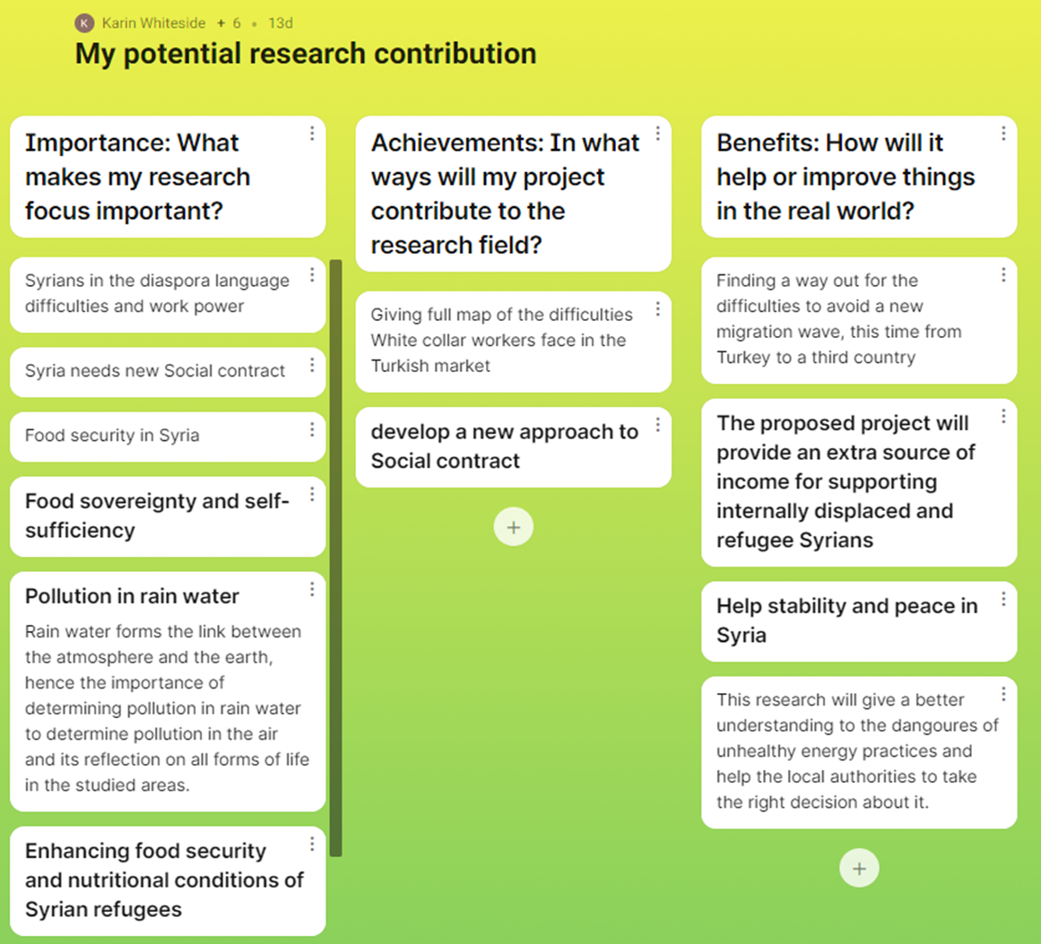
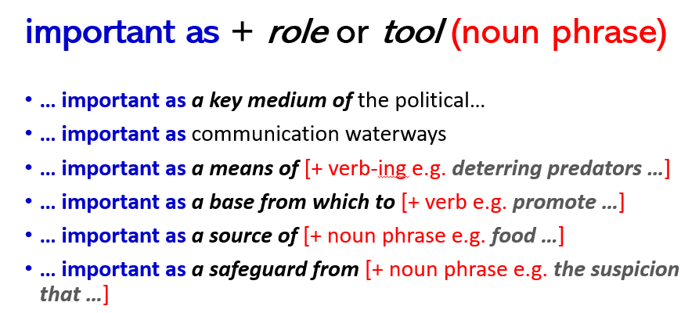
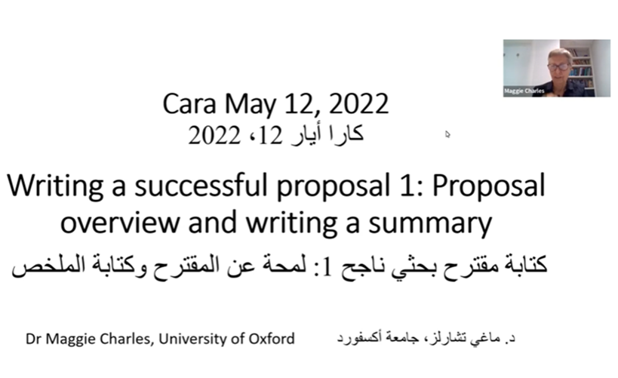
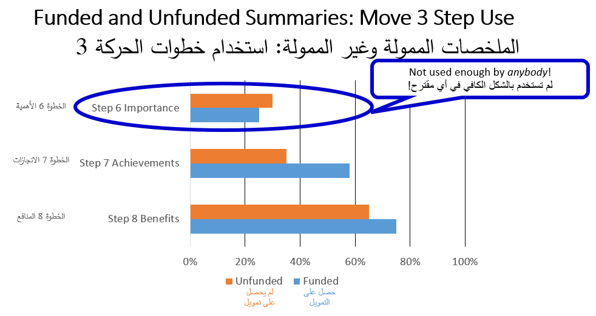
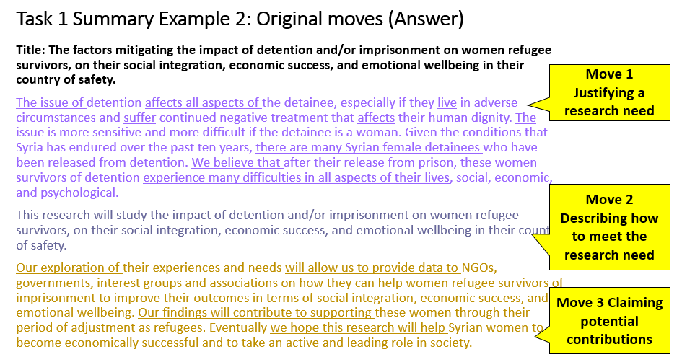
Application - ‘Writing a Successful Proposal’ sessions
May 12 Proposal overview and writing a summary (Maggie Charles)
May 26 Claiming importance, achievements and benefits of the research (Karin Whiteside)

Slide 16

Our Genre Analysis (2)
Top-down approach
32 summaries segmented into communicative/functional units, as seen earlier
Definitions of functional units refined
64 additional summaries functionally analysed (total = 96)
Linguistic analysis of each functional unit, which may be a sentence, clause or phrase
Primary and secondary functions distinguished
Tagging of each functional/linguistic unit
(Biber, Connor & Upton, 2007; Cotos, 2019)

Slide 17
Summary 1 Tagged by Functional/Linguistic Unit
<title> Quantifying groundwater level and identifying vulnerable areas in the Azez region (North Syria) using satellite-derived data and smart ground water detection devices </titel>
Move 1 Step 1 Territory/ Background
<pm1s1> Water is important as the main reason for the existence of life. </pm1s1> <pm1s1> The decade-long war in Syria has caused the destruction of water sources, the displacement of millions of Syrians from their homes, and they regrouping in places that are not eligible for these gatherings, </pm1s1> <sm1s3> which led to the emergence of a real crisis in securing water for drinking and agriculture that meets the needs of these communities. </sm1s3>
<pm2s4> This research will answer the following main question:
At what depth and how much groundwater is available in the Azez area? </pm2s4>
<pm2s4> The second question: are there different between the data of groundwater collected by devices and Satellites? </pm2s4>
<pm2s5> We will divide the research into two parts:
The first part is collecting data for the groundwater from satellites. </pm2s5>
<pm2s5> The second part: We will survey the area with devices, then compare between them. </pm2s5>
<pm3s6> The importance of this research is due to the fact </pm3s6> <sm3s8> that it is benefits mainly to the landowners within the studied area, so as to reduce the waste that occurs as a result of random drilling of wells, and save them time as well. </sm3s8>
<pm3s8> It is also benefits for all living organisms, including humans, animals and plants within this region, when the water needed to sustain life is secured. </pm3s8>
Move 1 Step 3
Niche
Move 2 Step 4
Research Questions
Move 2 Step 5
Method
Move 3 Step 8
Real-world Benefits
Notes:
Unfunded proposal

Slide 18
Issue 1: Signalling
<title> Use of Some Species of Microalgae in Purifying Water from Heavy Metals in Northern Syria </title>
<pm3s6> The importance of the study lies in </pm3s6> <sm1s1> the ability of some types of micro-algae in fresh water to bioaccumulate and remove heavy metals from polluted industrial wastewater allowing for the purpose of using this water in irrigation operations. </sm1s1> <pm2s4> This project will study…
How to analyse?
By the text?
By the assumed intention of the writer?
‘The importance of the study ’ signals Importance (Move 3 step 6), but
‘the ability of some types of micro-algae…’ is factual so belongs to the Background (Move 1 Step 1)

Slide 19
Issue 2: Misleading Signals
<title> Capacity building strategy for local administrative councils in northern Syria </title>
<pm1s1> Local administrative councils (LACs) play important roles in delivering services to citizens in Syrian society, especially in areas beyond the control of the Syrian regime after 2011. </pm1s1>… <pm1s1> …some LACs in the area under control of the opposition no longer receives any support or funding from the Syrian regime government and in the areas of the north devoid of government services. </pm1s1>
<pm1s1> However, in conflict areas, the external environment surrounding the LACs imposes provide the main services such as education, health, water, electricity, sanitation, and security. </pm1s1> <pm1s3> In addition, Lack of strategy contributes to increasing conflict impacts. </pm1s3>
How to analyse?
By the signal?
By the sense?
‘However’ signals a contrast and is usually used for the Niche (Move 1 step 3).
‘In addition’ signals further information of the same type, but here there is a contrast.

Slide 20
Issue 3: Confusion of Functions: Method and Outcome/Output
<title> Islamic political Parties in Syria between 1979-2018. Its origin, development and current role in Syria and its future </title>
<pm2s5> C - Methodology: We will follow the approach of criticism and analysis in the study through: 1- Reading the sources, documents, studies, researches and personal memos of members of political Islamic groups… </pm2s5> <pm3s7> 7. Writing research and scientific article. </pm3s7>
How to analyse?
By the stated function?
By the actual function?
‘Writing research and scientific article.’ is signalled as Method (Move 2 step 5), but is a Research Output (Move 3 Step 7) not a method

Slide 21
Issue 4: Vague Language
<title> The effect of electricity shortage on social well-being in people living in north and northwest Syria </title>
…<pm2s5> The study will be conducted in the same targeted area (northern and northwest Syria), which were greatly affected by the Syrian crisis. </pm2s5> Based on the results from the previous study, social impact will be measured by:
1) Displacement. </pm2s5>
<pm2s5> 2) Access to education. </pm2s5>
<pm2s5> 3) General health, social and psychological well-being. </pm2s5>
<pm2s5> The study will also take into consideration the comparison between the social impact of internally displaced persons (IDPs) and the host communities… </pm2s5> <pm2s5> We will also take into consideration the difference in social impact on male and female and vulnerable groups such as the disabled and pregnant women. </pm2s5>
How to analyse?
Method and Materials (Move 2 step 5)?
or Presents Current Research (Move 2 step 4)?
‘The study will also take into consideration the comparison…’ and
‘We will also take into consideration the difference…’. Unclear what the writer means.

Slide 22

Next steps

Slide 23
Thank you for listening! Any questions?

Slide 24
References
Anthony, L., (2022). AntFileConverter (2.0.2). [computer program] Tokyo, Japan: Waseda University. Available at: http://www.laurenceanthony.net/
Anthony, L. (2020). AntConc (Version 3.5.9) [Computer Software]. Tokyo, Japan: Waseda University. Available at http://www.laurenceanthony.net/
Biber, D., Connor, U., & Upton, T. (2007). Discourse on the Move. Benjamins.
Cotos, E. (2019). Articulating societal benefits in grant proposals: Move analysis of Broader Impacts. English for Specific Purposes, 54, 15–34. https://doi.org/10.1016/j.esp.2018.11.002
Feng, H., & Shi, L. (2004). Genre analysis of research grant proposals. LSP and Professional Communication, 4, 8–32.
Swales, J. M. (1996). Occluded genres in the academy: The case of the submission letter. In E. Ventola & A. Mauranen (Eds.), Academic writing: Intercultural and textual issues (pp. 45–58). John Benjamins.

