Slide 1
Deconstructing communication skills: a competency framework for Foundation healthcare students using CEFR (2020) mediation skills.
Margaret Russell
EAP Lecturer, University of Plymouth

Slide 2
Outline
Why use CEFR (2020) Mediation skills
Context/Process
CEFR (2020) Mediation skills
Creation of Mediation competency framework
Framework in use: self and peer assessment
Using mediation descriptors for various tasks
Usefulness of CEFR Mediation

Slide 3

Why use CEFR (2020) Mediation skills for deconstructing communication?
Mediation skills are special/useful for effective communication because
In mediation one is less concerned with one’s own needs, ideas or expression than with those of the party or parties for whom one is mediating as a ‘social agent’ (Piccardo, North and Goodier, 2019) ie when conveying information. Hence, there is a heightened awareness of the other person in the interaction. So mediation includes skills such as adapting language, intercultural awareness and the use of soft skills such as respect, sensitivity.
And the CEFR (2020) Companion Volume has created Mediation descriptors for these vital (more holistic) skills of successful collaborative communication.
Mediation resonates with an action-oriented approach which emphasizes purposeful, collaborative tasks (Beacco et al, 2016)
Mediation combines language proficiency with transferable skills associated with professional knowledge and future employability (Pavlovskaya and Lankina, 2019)
Notes:
Beacco et al (2016) Guide for the development and implementation of curricula for plurilingual and intercultural education. Strasbourg: Council of Europe.
Pavlovskaya and Lankina, (2019) How new CEFR mediation descriptors can help to assess the discussion skills of management students - Global and analytical scales’,

Slide 4
Context/Process
Foundation stage university healthcare students’ ESAP C1 communication needs identified
Patient:clinician roleplay communicative task
CEFR (2020) Mediation descriptors/skills chosen and adapted to create a mediation competency framework to meet communicative needs and task
Mediation competency framework used as a learning tool to formatively practise/assess communicative performance in roleplay task
TEFL8 2023

Slide 5
Context and students’ communication needs
17 international university Foundation Stage healthcare students (target level C1), 12 nationalities, 8 healthcare professions
Basic need: ability to understand and convey information appropriately in a pluricultural context (academically and professionally)

Slide 6
Patient:clinician roleplay task
Action-oriented activity
Relevant content: learner-generated research/sense of ownership, subject-specific patient case study (this was researched by the students)
Range of skills which could meet students’ communicative needs (ie using appropriate language, encouraging discussion, intercultural awareness/sensitivity)

Slide 7
Create mediation competency framework communication needs
Common European Framework of Reference: CEFR (2020) Mediation skills
tend to reflect
Vygotsky’s (1978) social constructivism theory
sociocultural competence (Hymes, 1972; Canale and Swain, 1980)
interactional competence (Kramsch, 1986; Hall, 1995)
functional competence – ‘can do’ (Savignon, 2002)
Notes:
Sociocultural approach – competence only exists if put into use, esp professionally. Reflects changes in society. CEFR descriptors originate from the field of professional training for nurses to describe competences

Slide 8
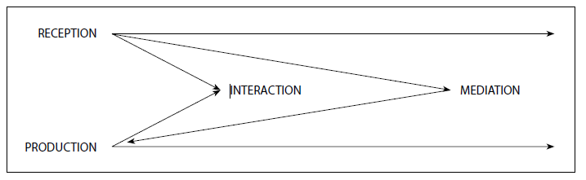
All modes of communication are activated in CEFR Mediation, where a source text/information is (re)formulated for another person (cognitive mediation)(academically ie presentation, professionally ie roleplay) to facilitate understanding and communication through mediation ‘languaging’ (relational mediation) (Piccardo, 2020; Coste and Cavalli, 2015).
The relationship between reception, production, interaction and mediation (CEFR, 2020:34)
Notes:
Coste and Cavalli (2015) providing access to information and competence building (cognitive mediation), contributing to interaction (relational mediation) Coste, D. and Cavalli, M. (2015) Education, Mobility, Otherness the Mediation Functions of Schools. Strasbourg: Council of Europe. https://rm.coe.int/education-mobility-otherness-the-mediation- functions-of-schools/16807367ee

Slide 9
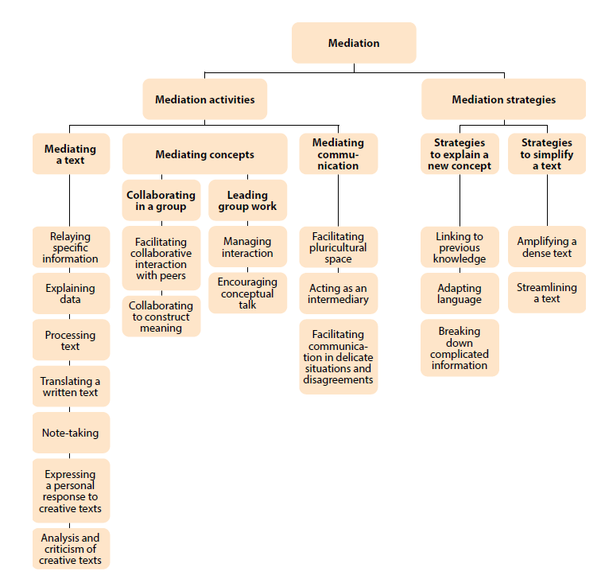
CEFR Mediation skills (2020): a unique and useful interplay of micro skills to be integrated as in real-life communication
Notes:
Some mediation scales are more permanent/Dominant ie Relaying information, Processing text, Adaptation of language. Supplementary scales ie Explaining data
Activities and Strategies should be used simultaneously as they complement each other (Stathopoulou, 2015) Stathopoulou, Maria. 2015. Cross-language mediation in foreign language teaching and testing. Bristol: Multilingual Matters.

Slide 10

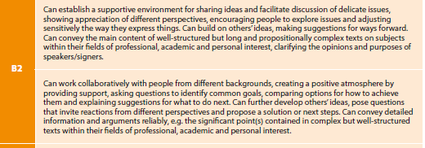
Mediation profiling: look up and down CEFR descriptors to find a profile, use descriptors vertically as well as horizontally (ie B2 mentions useful skills/ideas even for C1 learners = range of competences)
Overall Mediation descriptors for C1 and B2 (CEFR,2020)

Slide 11
Mediation skills | What you think (good, ok, find tricky/improve) | How you did (good, ok, find tricky/improve)
Processing text in speech
Can clearly and confidently sequence, summarise, signpost information
Can adjust use of language to ensure meaning is clear
Can be understood clearly with appropriate use of pace/pauses, word and sentence stress, and tone of voice
Explaining a new concept
Can explain/check understanding of key points/complex details clearly and link to previous knowledge
Collaborative interaction
Can ask appropriate questions for clarification/demonstrate interest (also small talk/personalisation)
Can elicit/encourage patient’s ideas/concerns and use active listening, and appropriate turntaking, to allow patient to speak
Can weigh up different points of view/possibilities using logical reasoning (hypothesising, analysing, inferring, justifying, predicting) + how agreement might be achieved
Facilitating communication
Can maintain positive/respectful interaction and anticipate problems in intercultural encounters
Can demonstrate sensitivity and empathy to patient’s perspectives
Can establish a positive/supportive environment, also with use of appropriate body language
A descriptor you would like to add
Making decisions for future ie treatment plan, family support
Notes:
ie C1 overall mediation: ‘clearly convey and summarise ideas in well-structured language’; confident – expert interviews; ‘sequence and signpost information’- OET. Adapting language – Mediation strategy
Intelligibility – supplementary scales CEFR 2020/ Walker et al (2021). Demonstrate interest: B1. Turntaking: B2. Facilitating communication: NHS, OET, Mediation. Student descriptor: Brown and Kiddle (2019)

Slide 12
Framework in use
4 sections (Processing text in speech, Explaining a new concept, Collaborative interaction, Facilitating communication) to aid ease of use/reuse and recall
The 10 competencies can be used flexibly/sense of ownership ie active listening and sensitivity can be used throughout the task
New CEFR 2020 supporting scales also used ie for phonological control (intelligibility - Walker et al, 2021). Reference was also made to NHS values (ie respect, empathy), and Occupational English Test for healthcare (2018) - many similar skills to CEFR mediation skills.
Notes:
Time to practise/experiment, independent learning, ownership. Liberalism – the individual authentic to themselves, allowing space to express themselves uniquely in different ways (important and possible in HE, esp pluriculturally) albeit guided, which is all part of learning (Find the dancing part of yourself)

Slide 13
Self (pre and post)and peer assessment using competency framework (Criterion-referenced: Good, OK, Improve)
Self assessment
Learners post-task felt they were better at soft skills included in Facilitating communication (inherent in healthcare students?)
….but poorer at Collaborative interaction skills such as turntaking, and adjusting use of language (ie awareness of others’ understanding in the interaction)
Peer assessment
A peer rating index (PRI) determined a 60% agreement between students and teacher on individual’s performance of each mediation skill. This illustrated an ability to mostly recognise the use of the mediation skills. Soft skills, adapting use of language and intelligibility received lower average PRI – skills hard to recognise/judge?
Notes:
Learner-centred

Slide 14
Example of student language in roleplay (some useful language can be fed in for learners with lower levels of language)
It’s completely understandable to be worried. Whenever you’re ready, can you please mention when this problem started to be seen and what were the first steps that you undertook. Shows empathy, sensitivity, gives patient opportunity to speak
Good active listening – nods, yes, ok
Yes, I clearly understand. My question is if you might know what type of strabismo your child has as there are many types of it. Checks patient previous knowledge
Thank you for informing me about the disease history and I also want to ensure that your son gets the best possible treatment so it was a good idea to make another consultation. Confident
It is true what you say, there are many other treatment options, so surgery from my professional knowledge and skill should be the last alternative suggested for a 4 year old child. Confidence and Weighs up different possibilities

Slide 15
Using mediation descriptors for other tasks
Presentations
Processing text in speech | Good | OK | Improve
Can clearly and confidently summarise, signpost information
Can clearly interpret and explain data/details
Can weigh up different points of view/possibilities using logical reasoning (hypothesising, analysing, justifying, predicting)
Can be understood clearly with appropriate use of pace/pauses, word and sentence stress, and tone of voice
Can answer questions clearly, sensitively and confidently

Slide 16
Academic discussion task
Adapted Mediation descriptors from CEFR (2018) | What you think (good, ok, find difficult) | How you did (good, ok, improved)
Processing text in speech
Can identify and summarise clearly key points
Can interpret and describe clearly visual data
Collaborative interaction with peers
Can weigh up different points of view + how agreement might be achieved
Can follow a line of argument
Can ask questions for clarification/demonstrate interest
Can ask questions to stimulate logical reasoning (hypothesising, analysing, inferring, justifying, predicting)
Can make sure everyone is included, no one dominates, a collaborative/positive environment
Facilitate pluricultural communication
Can act as mediator in intercultural encounters, anticipate problems, maintain positive interaction
Can demonstrate sensitivity to different perspectives, formulate any reservations/disagreements in such a way as to avoid offence
Expressing a personal response
Can express clearly reactions and emotions to a text + say why

Slide 17
Tasks Mediation skills
Learners discuss which grammatical options could be correct, and why | Encouraging conceptual talk
Learners discuss what they might already know about a topic | Linking to previous knowledge
Learners sensitively discuss ie dress code or medical choices related to cultures | Facilitating communication in delicate situations and disagreements
One learner explains information from a subject-specific text to another learner in language which other can understand | Adapting language Breaking down complicated information
Learners explain to each other how New Year is celebrated in their country | Relaying specific information
Group discussion task where learners have to decide upon one option | Facilitating collaborative interaction with peers

Slide 18
Usefulness of CEFR Mediation
Language for describing behaviours and labelling, ongoing reference and feedback tool, ‘Can do’ is positive, goal-setting.
Shared/cooperative learning, co-constructing meaning: Transfer/exchange of information is on various levels as in real-life, integrated skills and action-oriented view of language (ie skills in framework come to my mind when I conduct a 1:1 tutorial; can help managers ensure relationships in teams and with individuals are inclusive, positive, supportive and collaborative).
Transferability of skills – academically and professionally, useful for 1st language speakers as not just linguistic skills. Use of soft skills – respect, empathy, sensitivity, Adapting language use (register, speed etc), Critical thinking skills – logical/analytical reasoning, weighing up possibilities (Bloom’s taxonomy)
Heightens awareness of others’ needs and cultures in communication – helps make communication successful and charming ☺
Notes:
Find ‘dancing part’ of oneself

Slide 19
References
Beacco. J, Byram, M., Cavalli, >, Coste, D. Cuenat, M., Goullier, F. and Panthie, J. (2016) Guide for the development and implementation of curricula for plurilingual and intercultural education. Strasbourg: Council of Europe. Available at: https://www.coe.int/en/web/language-policy/guide-for-the-development-and-implementation-of-curricula-for-plurilingual-and-intercultural-education
Canale, M. and Swain, M. (1980) ‘Theoretical bases of communicative approaches to second language teaching and testing’, Applied Linguistics, 1(1), pp. 1-47. Available at: https://academic.oup.com/applij/article/I/1/1/181953?login=true
Common European Framework Companion Volume (2020) Council of Europe. Available at: https://rm.coe.int/common-european-framework-of-reference-for-languages-learning-teaching/16809ea0d4
Coste D. and Cavalli M. (2015) Education, Mobility, Otherness – the mediation functions of schools, Language Policy Unit, Council of Europe, Strasbourg. Available at https://rm.coe.int/16807367ee
Goodier, T. (2019) Focus paper: Mediation in English Language Teaching. Oxford:OUP. Available at: https://www.oup.es/en/EF-mediation-programme
Hall, J. (1995) ‘(Re)creating our worlds with words: A sociohistorical perspective of face-to-face interaction’. Applied Linguistics, 16(2), pp.206–232. Available at: https://pennstate.pure.elsevier.com/en/publications/recreating-our-worlds-with-words-a-sociohistorical-perspective-of
Hymes, D.H. (1972) “On Communicative Competence” in Pride, J.B. and Holmes, J. (eds) Sociolinguistics. Selected Readings. Harmondsworth: Penguin, pp. 269-293
Kiddle, T. (2019) ‘The CEFR Companion Volume Mediation Scales operationalised: Towards English for Professional Purposes in action’, EAQUALS, Krakow. Available at: https://www.eaquals.org/wp-content/uploads/The-CEFR-Companion-Volume-Mediation-scales-operationalised.pdf
Kramsch, C. (1986) ‘From Language Proficiency to Interactional Competence’, The Modern Language Journal, 70(4), pp. 366-372. Available at: https://www.jstor.org/stable/326815
Kurtz, M., Silverman, J. and Draper, J. (2005) Teaching and Learning Communication Skills in Medicine. 2nd edn. Oxford: Radcliffe Publishing
North B. and Piccardo E. (2016), ‘Developing illustrative descriptors of aspects of mediation for the CEFR’, Education Policy Division, Council of Europe, Strasbourg. Available at: https://rm.coe.int/168073ff31
Occupational English Test OET (2018) Available at: https://www.occupationalenglishtest.org/oet-uk/
Pavlovskaya, I. and Lankina, O.(2019) ‘How new CEFR mediation descriptors can help to assess the discussion skills of management students - Global and analytical scales’, CEFR Journal – Research and Practice, pp.33-44
Piccardo, E. (2020) ‘Plurilingual and pluricultural competence in the new CEFR: the mediated nature of language learning and use’. ALTE 2020 Toronto. Available at: https://www.alte.org/resources/Documents/Piccardo_ALTE_plenary_FINAL.pdf
Piccardo, E., North, B. and Goodier, T. (2019) Broadening the scope of language education: plurilingualism, mediation and collaborative learning: the CEFR Companion Volume, Journal of e-Learning and Knowledge Society, 15(1), pp.17-36. Available at: https://www.academia.edu/41323540/Piccardo_E_and_North_B_2019_Broadening_the_scope_of_language_education_plurilingualism_mediation_and_collaborative_learning
Savignon, S. J. (2002) Interpreting communicative language teaching: Contexts and concerns in teacher education. New Haven: Yale University Press.
Walker, R., Low, E., and Setter, J. (2021) Position paper: English pronunciation for a global world. Oxford: Oxford University Press. Available at: Expert advice on… | Oxford University Press (oup.com)
Vygotsky, L. S. (1978) Mind in Society. Cambridge, MA: Harvard University Press

Slide 20


