Slide 1
Deconstructing a writing course through independent, personalised learning
Katrien Deroey
Jennifer Skipp
BALEAP Conference, 20 April 2023

Slide 2
The course
Notes:
’

Slide 3
Research article writing
Credit-bearing → tasks & attendance
PhD students → limited sessions
Multidisciplinary groups → personalisation
10 weeks, 10 participants

Slide 4
Learning outcomes
insight into your writing process
understanding the publication process
creating more coherent, concise and reader-friendly texts
understanding structure and variation in article sections
adapting to disciplinary conventions
using basic corpus search techniques
becoming a more autonomous and reflective writer

Slide 5
Flipped classroom

Slide 6
Task
Workshop
Writing
Reflection
Book
Consultation
Peer
review
Deroey & Skipp (2023)
Skipp & Deroey (2023)

Slide 7
Task
Workshop
Writing
Reflection
Theory reading
Exercises with key
‘Text detective’ work
Corpus exploration
Application to own writing
Book
Consultation
Peer
review
Deroey & Skipp (2023)
Skipp & Deroey (2023)

Slide 8
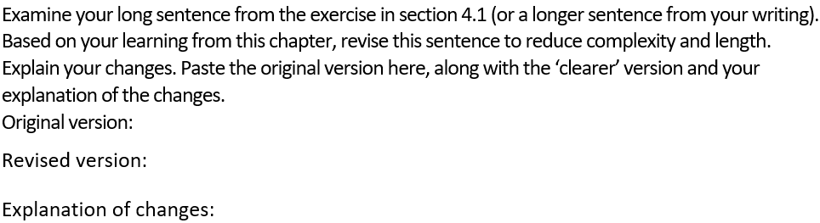
Example: ‘Independent learning’ task
Chapter: crafting clear sentences

Slide 9
Example: ‘Independent learning’ task
Chapter: crafting clear sentences
What question(s) do you still have about crafting clear sentences?

Slide 10
Task
Workshop
Writing
Reflection
Book
Prior student tasks/writing/questions
Illustration main theory points
Consolidation activities
Clarification
Consultation
Peer
review
Deroey & Skipp (2023)
Skipp & Deroey (2023)

Slide 11
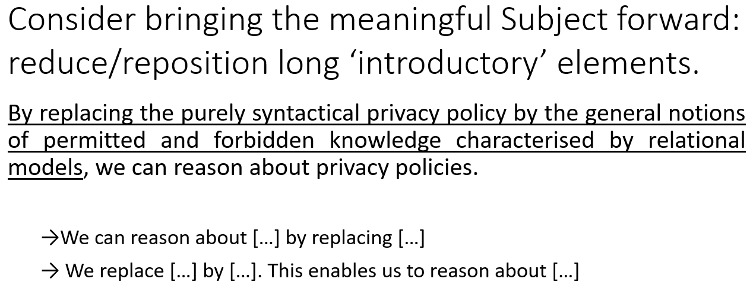
Example: Workshop Crafting clear sentences
Student sentence

Slide 12
Example: Workshop Crafting clear sentences
Student sentence
Consider the following in identifying structural issues that might affect clarity in the sentences below: postponement of Subject and/or verb, interruption of a unit.
[Student sentences]

Slide 13
Task
Workshop
Writing
Reflection
Book
Regular submission
Reflections on applied learning
Consultation
Peer
review
Deroey & Skipp (2023)
Skipp & Deroey (2023)

Slide 14
Task
Workshop
Writing
Reflection
Book
Consultation
Self-organised
Template-based
Report
Peer
review
Deroey & Skipp (2023)
Skipp & Deroey (2023)

Slide 15
Course feedback

Slide 16
Feedback
Student course evaluations –
by transferable skills
92 responses
10 classes over 5 semesters
7 = strongly agree

Slide 17
The flipped classroom
liked that the exercises were given before the lecture so that we had an idea before going into the lectures
It helps a lot by giving enough examples in the E-book and practical exercises in the courses
I benefited the most from the independent learning tasks asking a student to rework his/her initial text.
I liked that the teacher makes personal lectures from the students exercises.
I really like the combination of theoretical work and group-work.

Slide 18
The flipped classroom
liked that the exercises were given before the lecture so that we had an idea before going into the lectures
It helps a lot by giving enough examples in the E-book and practical exercises in the courses
I benefited the most from the independent learning tasks asking a student to rework his/her initial text.
I liked that the teacher makes personal lectures from the students exercises.
I really like the combination of theoretical work and group-work.

Slide 19
The flipped classroom
liked that the exercises were given before the lecture so that we had an idea before going into the lectures
It helps a lot by giving enough examples in the E-book and practical exercises in the courses
I benefited the most from the independent learning tasks asking a student to rework his/her initial text.
I liked that the teacher makes personal lectures from the students exercises.
I really like the combination of theoretical work and group-work.

Slide 20
Flipped approach means maximising class time
I also liked that actual examples from students were used in our class time.
I liked the exchange with students from different doctoral schools, which is not often the case. I really enjoyed the fact the topic "research article writing" was something that we could all work on together without extensive knowledge of the other´s disciplines.
Discussions with the other students about each other’s text submissions

Slide 21
Flipped approach means maximising class time
I also liked that actual examples from students were used in our class time.
I liked the exchange with students from different doctoral schools, which is not often the case. I really enjoyed the fact the topic "research article writing" was something that we could all work on together without extensive knowledge of the other´s disciplines.
Discussions with the other students about each other’s text submissions

Slide 22

Issues with the model
Students
Instructors
Regularity of coursework
Chasing missing work
Time taken to personalise lessons

Slide 23
The flipped classroom outcomes
Independent learning
Personalised
Class time for interaction -> student centred

Slide 24

How could we better manage independent, personalised learning?

Slide 25
References
Deroey, K. L. B., & Skipp, J. (2023). Designing and delivering an online research article writing course for doctoral students in Luxembourg during Covid-19. In B. Fenton-Smith, J. Gimenez, K. Mansfield, M. Percy, & M. Spinillo (Eds.), International perspectives on teaching academic English in turbulent times (pp. 81-94). Routledge. https://doi.org/10.4324/9781003283409-10
Skipp, J. & Deroey, K. L. B. (2023). Designing and managing an online, personalised research writing course for postgraduates. Proceedings of the 2021 BALEAP Conference. Garnet.
katrien.deroey@uni.lu
https://www.researchgate.net/profile/Katrien-Deroey
skipp@ext.uni.lu
https://www.researchgate.net/profile/Jennifer-Skipp

