Slide 1

Deconstructing Pedagogic Practices: Peer Reflections on Using SFL in Doctoral Writing Instruction
Dr Nadya Yakovchuk , University of Surrey, UK
Dr Karin Whiteside , University of Reading, UK

Slide 2
Outline
Our contexts
SFL as an 'appliable' theory
Our reflective process
Examples from our contexts

Slide 3


Our contexts
Doctoral College | ISLI (EAP provision) & Graduate School
Writing Development Programme | Academic English Programme (AEP) & Reading Researcher Development Programme (RRDP)
Focus: doctoral students and early career researchers | Focus: doctoral students and early career researchers
Interdisciplinary groups | Broad disciplinary streams (AEP) & interdisciplinary (RRDP)
Users of English as L1 and L2/EAL | L2 (AEP); L1 & L2 (RRDP)
Stand-alone workshops (usually 2 hrs long) | Courses (AEP); Intensive course & 2-hour sessions (RRDP)

Slide 4
When SFL meets teachers & students ...
Developing theoretically-underpinned practice is an iterative process!
“The table of instantiation looked very different years ago. Several iterations later, and in another setting, the current version is still evolving. While it has achieved the aim of making visible some functional knowledge about language, some elements remain subjective in its design, linked to my own perception of what resources students need and of how ready tutors are to deliver this curriculum. This provides additional reasons to explore recontextualization more systematically. Addressing the concrete and context-tied needs of the students I interact with has been giving meaning to the engagement with the theory. In this way, my engagement with SFL theory is consistent with its purpose to be appliable, dedicated to solving problems and empowering its users.” (Monbec, 2020)
Should we adapt or depart from the theory (and how far) to make things more teachable and/or practically useful?
Or, should we actually be working through a student-friendly way to stay as true as possible to theoretical frameworks?

Slide 5
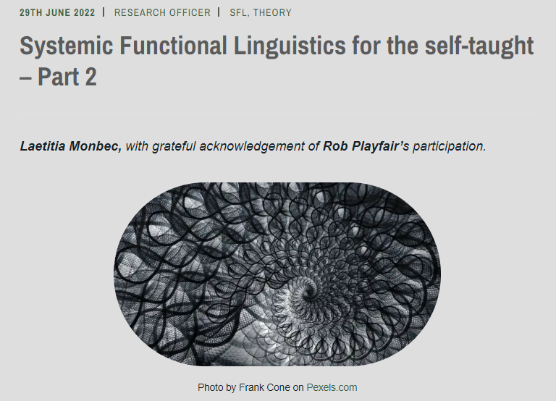
”… The key point in recontextualization is mentioned by Rob when he hopes that it is possible to keep the essence of SFL, a social theory of language conceived as social action, while recontextualizing it to suit our students’ needs. …
One of the aims of the resTES was for SFL practitioners/scholars to present SFL as highly usable in classroom scholarship, disrupt the notion that SFL is intimidating …
An analysis and mapping of different types of SFL recontextualizations in EAP would be very useful for practitioners, but (as far as I know) it has not yet been done. … keeping a critical eye on the discourse surrounding SFL and its theorists, as well as amplifying a welcoming, supportive and inclusive discourse around SFL will be helpful. …”
our contribution to this ongoing discourse – two concrete examples of self-taught practitioner development of SFL-informed materials

Slide 6
Our reflective process
Evolved organically
Protected space to think and to write
A series of structured reflections:
  Why do we want to explore this? (Applied Linguistics into teaching research writing)
  What are the current questions we’re grappling with as applied linguists and practitioners?
  Purpose/motivation for our materials and process of development
Demonstration of teaching materials and critical feedback
Plan: to try out the materials in each other's teaching contexts
Deconstructing our pedagogical practices - making sense of why we do what we do and whether we can do it better

Slide 7

.
"The idea of language as a system of choices in any given act of communication is central to SFL, and this is something that is closely aligned with how I teach academic writing –underscoring the idea of the choices we have to make as academic writers given the stylistic conventions of our disciplines, the rhetorical traditions in which we are writing, what we are trying to achieve and the audiences we want to reach". (NY)

Slide 8
Example 1:
'Genre analysis tool'

Slide 9
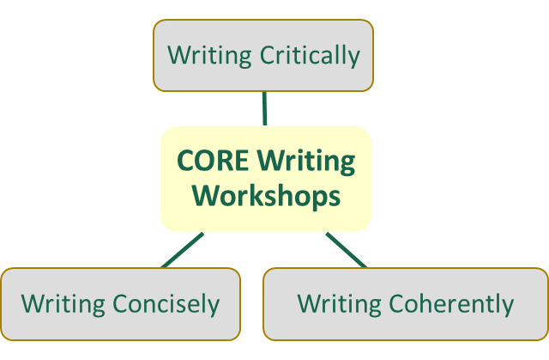
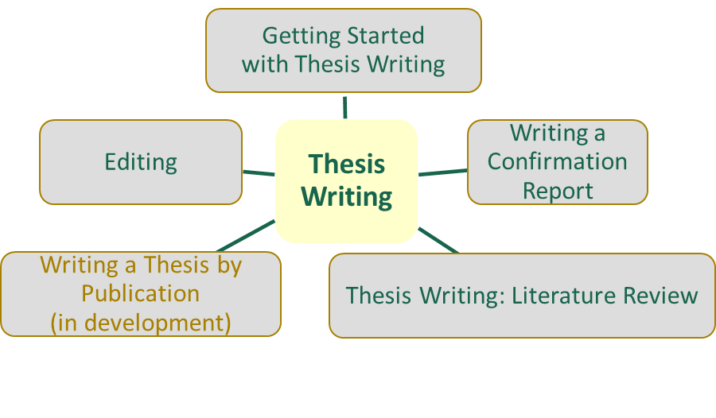
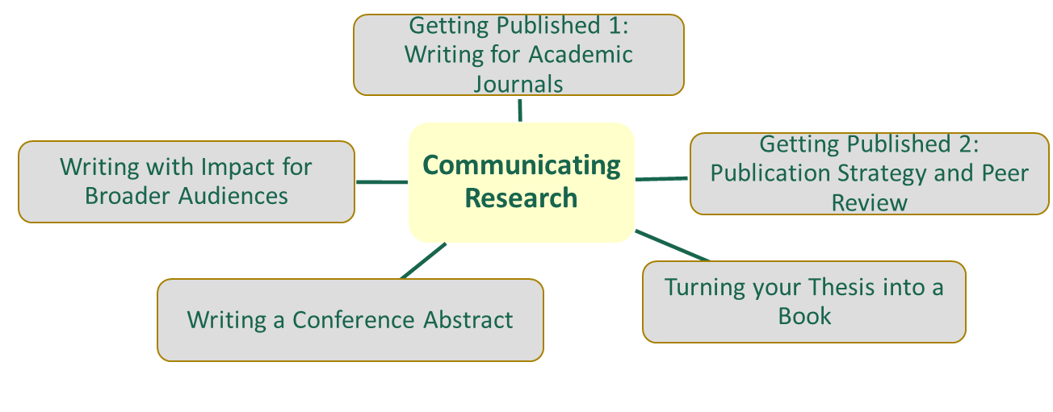
Doctoral College Writing Workshops

Slide 10
Development
Drive for researchers to communicate science to professional audiences and wider society
‘Writing for Public Engagement’ - 'Writing for Professional Audiences' - 'Writing with Impact for Broader Audiences'
A pedagogical tool that would allow researchers to
  Develop their awareness of rhetorical situations
  Develop their ability to analyse the target genre
  Become more confident in writing for the genre

Slide 11
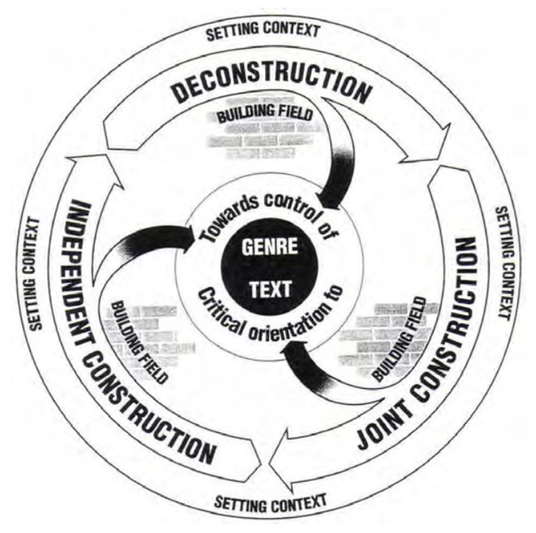
Theoretical underpinnings
Genre teaching / learning cycle (Rothery, 1994)
The Rhetorical Triangle (McGrath, 2020)
SFL (Eggins, 1994; Halliday & Matthiessen, 2014; Thomson, 2014)
Instantiation table (Monbec, 2020)

Slide 12
Teaching sequence
Step 1. Introducing the Rhetorical Triangle
Step 2. Introducing the ‘Genre Analysis Tool’
Step 3. Genre deconstruction
Step 4. Joint / independent construction

Slide 13
The Rhetorical Triangle
Author
Structure
Form
Style
Audience
Purpose

Slide 14
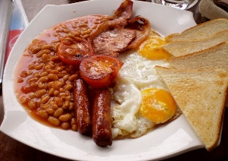
Text 1
Some UK schools have closed, or asked some teachers and pupils to stay home, to stop the spread of the disease - although the official guidance from health bosses is that this is not always necessary.
Here's what you need to know:
Advice if you're upset by the news
What is this virus and where has it come from?
It's a well-known type of a virus called a coronavirus, although this is a new variation of it. It was first spotted in a city called Wuhan in China.
It's called a coronavirus because, under the microscope, it looks like lots of little crowns
The disease was first discovered in Wuhan and initially the majority of cases were there. The virus then spread out across the country.
Text 2
A breakfast, not mine
Maybe it’s the coronavirus, maybe it’s the floods, maybe it’s the excitement around the Prime Minister’s engagement/child-to-be, but we seem to have largely given up talking about Brexit any more.
Sure, there’s debate if you want it, tucked away in the Westminster/Brussels bubble and deep in the inside sections of the paper, but it’s a small fraction of what it was before.
Partly this is about the churn of people that I’ve written about before, but equally it’s about the other stuff that clamours for our attention. Stockpiling for a virus is newer/more engaging than boring old stockpiling for a no-deal.
Text 3
One possibility that would allow for this would be wormholes, hypothetical tubes of space-time that might connect different regions of space and time. The idea is that you step into one mouth of the wormhole and step out of the other in a different place and at a different time. Wormholes, if they exist, would be ideal for rapid space travel. You might go through a wormhole to the other side of the galaxy and be back in time for dinner. However, one can show that if wormholes exist, you could also use them to get back before you set out. One would then think that you could do something like blow up your own spaceship on its original launch pad to prevent you from setting out in the first place. This is a variation of the so-called grandfather paradox: What happens if you go back in time and kill your grandfather before your father was conceived? Would you then exist in the current present? If not, you wouldn’t exist to go back and kill your grandfather. Of course, this is a paradox only if you believe you have the free will to do what you like and change history when you go back in time.

Slide 15
Text 1
Some UK schools have closed, or asked some teachers and pupils to stay home, to stop the spread of the disease - although the official guidance from health bosses is that this is not always necessary.
Here's what you need to know:
Advice if you're upset by the news
What is this virus and where has it come from?
It's a well-known type of a virus called a coronavirus, although this is a new variation of it. It was first spotted in a city called Wuhan in China.
It's called a coronavirus because, under the microscope, it looks like lots of little crowns.
The disease was first discovered in Wuhan and initially the majority of cases were there. The virus then spread out across the country.
Text 2
A breakfast, not mine
Maybe it’s the coronavirus, maybe it’s the floods, maybe it’s the excitement around the Prime Minister’s engagement/child-to-be, but we seem to have largely given up talking about Brexit any more.
Sure, there’s debate if you want it, tucked away in the Westminster/Brussels bubble and deep in the inside sections of the paper, but it’s a small fraction of what it was before.
Partly this is about the churn of people that I’ve written about before, but equally it’s about the other stuff that clamours for our attention. Stockpiling for a virus is newer/more engaging than boring old stockpiling for a no-deal.
Text 3
One possibility that would allow for this would be wormholes, hypothetical tubes of space-time that might connect different regions of space and time. The idea is that you step into one mouth of the wormhole and step out of the other in a different place and at a different time. Wormholes, if they exist, would be ideal for rapid space travel. You might go through a wormhole to the other side of the galaxy and be back in time for dinner. However, one can show that if wormholes exist, you could also use them to get back before you set out. One would then think that you could do something like blow up your own spaceship on its original launch pad to prevent you from setting out in the first place. This is a variation of the so-called grandfather paradox: What happens if you go back in time and kill your grandfather before your father was conceived? Would you then exist in the current present? If not, you wouldn’t exist to go back and kill your grandfather. Of course, this is a paradox only if you believe you have the free will to do what you like and change history when you go back in time.

Slide 16
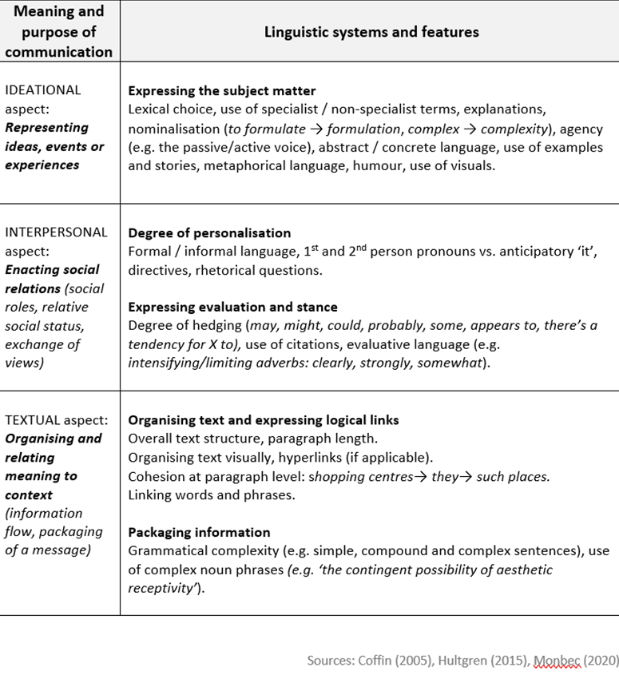
Original table

Slide 17
Teaching sequence
Step 1. Introducing the Rhetorical Triangle
Step 2. Introducing the ‘Genre Analysis Tool’
Step 3. Genre deconstruction
Step 4. Joint / independent construction

Slide 18
IDENTIFY STYLISTIC DIFFERENCES
BETWEEN THESE EXTRACTS
EXTRACT 1 (Scholarly journal)
Sustained attention is a factor in many work environments where operators intervene on a regular basis to ensure the safety and security of a system. Different types of activity during break periods may facilitate different levels of performance following extended periods of attention in these environments. The impact of five different breaks from task activity was assessed against the performance of a no‐break control group during a simulated, high signal probability rail control task. A total of 87 university students were assigned to a no‐break control condition, or one of five break activity conditions that occurred between two, 20‐minute periods of simulated rail control. Post‐break, the analysis revealed that, in comparison to the control condition, performance was greater in all of the five break conditions. Any activity that drew operators' attention from the primary rail control task enabled improvements in performance beyond a no‐break control task.
EXTRACT 2 (Trade magazine)
In our busy-loving modern society, too many of us have had the experience of eating lunch at our desks—or even working straight through the noon hour without sustenance, all in the name of tackling the items on our to-do lists. Unfortunately, powering through without a pause can do more harm than good, psychologists say.
Breaks can improve our moods, overall well-being and performance capacity, says Charlotte Fritz, PhD, an associate professor in industrial/organizational (I/O) psychology at Portland State University in Oregon.
While it might seem obvious that breaks are refreshing, it’s less clear how to maximize their benefit. How frequently you should break from work, how long breaks should last and what activities you should engage in will differ from person to person and job to job. But research is giving us a deeper understanding of breaks, revealing that regularly detaching from your work tasks—both during the workday and in your off-hours—can help restore energy in the short term and prevent burnout in the long term.
Sources: Extract 1: Rees, A., Wiggins, M.W., Helton, W.S., Loveday, T., O’Hare, D. (07 June 2017) https://doi.org/10.1002/acp.3334
Extract 2: https://www.apa.org/monitor/2019/01/break Vol.50, No.1

Slide 19
OUR CHOICES AS WRITERS
How we represent ideas, events or experiences
How we engage with our readers
How we organise and package information

Slide 20
REPRESENTING IDEAS / EVENTS / EXPERIENCES
 | EXTRACT 1 (academic) | EXTRACT 2 (non-academic)
Lexical choices (e.g. use of standard/colloquial language) | Sustained attention is a factor in many work environments where operators intervene on a regular basis to ensure the safety and security of a system. | Powering through without a pause can do more harm than good; tackling the items on our to-do lists; too many of us.
Use of specialist terms | High signal probability rail control task; control condition.
Definitions and explanations
Abstract / concrete language | Impact, performance, safety, security. | Eating lunch at our desks; working straight through the noon hour.
Use of examples, stories, metaphors, humour
Active/Passive Voice | The impact of five different breaks from task activity was assessed; a total of 87 university students were assigned… | Breaks can improve our moods; how frequently you should break from work; research is giving us a deeper understanding of breaks.
Use of visuals

Slide 21
ENGAGING WITH THE READERS
 | EXTRACT 1 (academic) | EXTRACT 2 (non-academic)
SOCIAL DISTANCE:
Formal / informal language | Different types of activity; facilitate different levels of performance; extended periods of attention in these environments. | But research is giving us; it’s less clear how to maximize their benefit; can do more harm than good.
Writing in the 3rd person vs. using 1st /2nd person pronouns (e.g. It is argued that vs. I explore how) | Sustained attention is a factor; Different types of activity during break periods may facilitate | Too many of us have had the experience of eating lunch at our desks; research is giving us a deeper understanding of breaks; how frequently you should break from work.
Use of direct questions, directives
EXPRESSING EVALUATION AND STANCE:
Degree of hedging (e.g. may, can, some, appears to) | Different types of activity during break periods may facilitate different levels of performance | Breaks can improve our moods; while it might seem obvious that breaks are refreshing.
Use of citations |  | Says Charlotte Fritz, PhD, an associate professor in industrial/organizational psychology at Portland State University in Oregon.
Use of evaluative language (e.g. intensifying adverbs clearly, strongly vs. limiting adverbs somewhat) |  | In our busy-loving modern society; unfortunately, powering through without a pause can do more harm than good.

Slide 22
ORGANISING AND PACKAGING INFORMATION
 | EXTRACT 1 (academic) | EXTRACT 2 (non-academic)
ORGANISING TEXT AND EXPRESSING LOGICAL LINKS:
Overall text structure, paragraph length |  | Shorter paragraphs.
Organising text visually, hyperlinks (if applicable)
How ideas are linked |  | …what activities you should engage in will differ from person to person and job to job. But research is giving us a deeper understanding of breaks…
PACKAGING INFORMATION:
Nominalisation (e.g. to formulate → formulation, complex → complexity) | Attention, activity, performance, impact, safety, security. - The impact of five different breaks from task activity was assessed against the performance of a no‐break control group during a simulated, high signal probability rail control task (28 words). | How frequently you should break from work, how long breaks should last and what activities you should engage in will differ from person to person and job to job (29 words).
Complexity of noun phrases (longer or shorter ‘strings’ of nouns). | Different types of activity during break periods; extended periods of attention in these environments; the impact of five different breaks from task activity. | Our desks, the noon hour, their benefit, long breaks.

Slide 23
GENRE ANALYSIS TOOL
Language functions | Language choices
Representing ideas, events or experiences | Expressing the subject matter Lexical choice (e.g. standard / colloquial language), use of specialist / non-specialist terms, explanations, agency (e.g. passive/active voice), abstract / concrete language, use of examples and stories, metaphorical language, humour, use of visuals.
Engaging with the reader | Social distance Formal / informal language, 1st and 2nd person pronouns vs. anticipatory ‘it’ (e.g. it has been argued that), directives, rhetorical questions. Expressing evaluation and stance Degree of hedging (may, might, could, probably, some, appears to, there’s a tendency for X to), use of citations, evaluative language (e.g. intensifying adverbs (clearly, strongly) vs. limiting adverbs (somewhat)).
Organising and packaging information | Organising text and expressing logical links Overall text structure, paragraph length; organising text visually, hyperlinks (if applicable); how ideas are linked. Packaging information Nominalisation (to formulate → formulation, complex → complexity); complexity of noun phrases (longer or shorter ‘strings’ of nouns); sentence complexity.

Slide 24
GENRE DECONSTRUCTION
You’ll be working in groups with different texts.
With others in your group, choose some language features for each of the three aspects from the table that make a particular text effective and impactful.
  What effect do your chosen features have on the intended readership?
  What can you say about the Author, Audience and Purpose of this text?
Variations:
With others in your group, analyse the given text using the ‘Genre Analysis Tool’. How many different features can you identify? How does their use help the writer/s achieve their purposes?
Find several examples of texts in the target genre and, using the ‘Genre Analysis Tool’, come up with some guidance on writing in this genre. How much variation between the texts have you found?

Slide 25
'Writing a Conference Abstract': Abstract Evaluation Table
FUNCTIONS OF COMMUNICATION | LANGUAGE FEATURES
How effectively do the following abstracts communicate the subject matter? | E.g. use of specialist / non-specialist terms, explanations, abstract / concrete language, use of examples, metaphorical language, humour.
How effectively do the following abstracts engage with their reader? | 1st and 2nd person pronouns vs. writing in the 3rd person and using anticipatory ‘it’ (e.g. ‘it has been argued that’), directives (e.g. ‘Think about this’), rhetorical questions, evaluative language.
How effectively is the information organised in the following abstracts? | Overall structure and flow, paragraph length, linking words and phrases, sentence complexity, length of noun phrases.

Slide 26
Reflections / lessons learnt
An ever-evolving tool
Flexibility
Focus: what's helpful to students
Using accessible language

Slide 27
"From the point of legitimising academic writing as a profession and as a field of study, having conceptual and theoretical instruments to define it is crucial. If we want our students, especially PhD students, to be serious about academic writing and not merely see it as ‘formulaic’ - as a skill to learn, as an ‘add-on’ - we need to show them that we’re also serious about it, that we can understand and theorise our field, and that we have a repertoire of instruments, theories and frameworks to help us make sense of it, study it systematically, and help our students make sense of it too. This is where my desire to apply theoretical instruments from writing studies and linguistics comes from – they are useful to us as specialists to understand what’s going on, and hence they’ll be useful to our students to do the same in order to become proficient writers in their disciplines". (NY)
.

Slide 28

Example 2:
Appraisal Framework - Engagement Resources (Martin & White, 2005)

Slide 29


Academic English Programme courses
(enrolment via the Graduate School)
L2 audience
Reading Researcher Development Programme (RRDP)
L1 & L2 audience
Core Language Skills for Research Writing
Language for Voice, Stance & Critical Evaluation (2 hrs)
Doctoral Thesis Writing: Structure & Genre-specific Language Features
(2 x 3 hrs)
Doctoral Thesis Writing: Structure & Language
Language for Reviewing the Literature (2 hrs)
Writing & Editing your Thesis with Corpora (Charles, 2018)
Language for Discussion (2 hrs)

Slide 30
“No recognition of dialogistic alternatives” (Martin & White, 2005, p100)
“Recognition of dialogistic alternatives” (Martin & White, 2005, p100)
e.g. happy, sad
e.g. powerful, weak
moral, immoral
e.g. captivating, boring
e.g. extremely
e.g. reasonably
e.g. a true father
e.g. an apology of sorts
Martin & White (2005, p38)

Slide 31
monogloss
heterogloss
Martin & White (2005, p134)

Slide 32
“Over several iterations I have gone from using the framework ‘raw’ to adapting it slightly, then more so with student-friendlier labels replacing much of the terminology, back to slightly more closely following original terminology, then back further the other way … The expanding/contracting concept has been (over?)simplified in the context of the Literature Review to the idea of ‘developing your position’ either cautiously or more confidently … My ‘student-friendly’ labels have some overlap with the actual Appraisal labels where these make sense to students, and some departures/my own labelling – this needs review – how pedagogically effective is it and have I oversimplified?”(KW)
“I was very interested in exploring its potential, particularly the Engagement Resources strand, when I started teaching doctoral level research writing. I was already in a loose way using the ‘contributing to a debate’/’entering a conversation with your research community’-type metaphor with students to help them understand the purpose of what they were doing within … a research text, but this wasn’t an explicit, concrete part of my teaching materials. The Engagement Resources framework … feels like a fuller … explanation of ‘positioning’ in a text which connects different [linguistic] elements of this … rather than looking at elements as separate, less-fully-connected strands of what is going on. …”(KW)
.

Slide 33
In 2021 …
Appraisal – Engagement Resources label | Label in my materials
Expand → entertain | Make arguments cautiously
Expand → Attribute → Acknowledge | Neutral acknowledgement of others’ findings/ideas (position)
Expand → Attribute → Distance | Distancing yourself from someone else’s position
Contract → Disclaim → Deny Contract → Disclaim → Counter | Dis-alignment with someone else’s position (e.g. disagreeing, rejecting, refuting)
Contract → Proclaim → Concur Contract → Proclaim → Endorse | Positive stance – alignment with or active endorsement of others’ position
Contract → Proclaim → Pronounce | Making arguments strongly/confidently

Slide 34
monogloss
still conflated
… currently!
conflated
argue confidently
a particularly useful focus for the Methods sub-genre
heterogloss
argue cautiously
Martin & White (2005, p134)

Slide 35
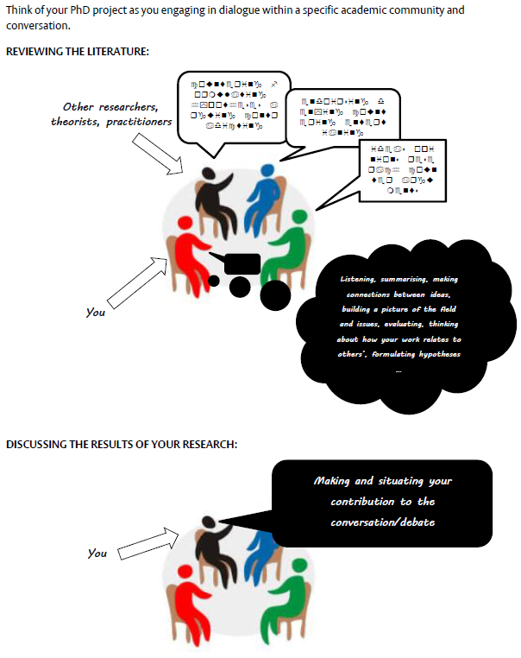

Slide 36
Acknowledgment (neutral) other’s findings/arguments
Smith (2019) finds/states/argues that …
According to Zhu (2019) …
+ A positive stance towards (concurring with) other’s findings and arguments
As Smith (2019) has observed …
Lee (2019) shows/demonstrates that
++ explicit endorsement of others’ findings/arguments
Lee and Smith (2019) are providing promising evidence that ...
The importance of the Lee at al. (2019) study is supported by …
- Distancing yourself from someone else’s position
Smith (2019) claims that …
This assumption goes largely uncontested in the literature …
-- Countering (e.g. disagreeing, rejecting, refuting) someone else’s position
Smith (2019) claims … . However, …
Previous researchers have failed to recognise …
Developing your position by making arguments and expressing opinions cautiously or more strongly
It could be suggested that …
It is clear that …
Adapted from Engagement resources in Martin and White’s (2005) Appraisal Framework

Slide 37
Extract 3 - Gram-Hanseen, K. (2010). Residential heat comfort practices: understanding users. Building Research & Information. 38(2).
Products, ‘things’, technologies
Schatzki explicitly does not consider the material structure, ‘things’ or technologies as important in holding practices together; rather, he considers them a result of social practices. As argued elsewhere (Gram-Hanssen, 2007), this can be problematic. Several socio-technical studies have shown how technology takes part in structuring practices. Warde focuses on ‘things’ (e.g. items of consumption during participation in practices). Reckwitz and Shove and Pantzar use the concept of ‘things’ and technologies as much more important elements for holding practices together.
acknowledging
distancing
countering
concurring
cautiously arguing
other Appraisal resources – Attitude, Graduation

Slide 38
Significantly for this study, Hargreaves et al. (2002) differentiate between two notions: identities in music, and music in identities, each distinct and potentially applicable when considering the musical lives of retired amateurs. The former, identities in music (author’s italics) are considered as being defined by social and cultural roles within music (Hargreaves et al., 2002, p.12), incorporating the ways individuals view themselves in relation to socio-culturally defined roles core to their musical sense-of-self (e.g.: I as music teacher; I as band-member). The second concept, music in identities (author’s italics), explains how music can influence and channel non-musical aspects of a life, as in personal, relational and therapeutic applications of music experience. Relating to this specific aspect, research identifying the positive relationships between music participation and an older individual’s sense of psychological well-being, reduced sense of isolation, lack of social confidence and loneliness (Hallam et al., 2012; Creech et al., 2014a) and a resource for health (Gembris, 2008) provide compelling evidence of this concept of musical influence on non-musical aspects of individual identity.
Viewing lifespan musical trajectories through this dual framework (Hargreaves et al; 2002) could prove analytically enlightening when considering the inter-relationships between the study’s core concepts, deepening understanding of complex identity processes embedded within retiree amateur instrumentalists’ post-school learning pathways.
… Since the confirmation of the existence of 4-mercaptobutyl-GSL (glucosativin), the presence of dimeric GSLs have often been dismissed as products of extraction, and discounted as being naturally produced (Bennett et al., 2002). An excellent paper by Cataldi, Rubino, Lelario, & Bufo (2007) convincingly demonstrated that this was not the case, and that dimeric-4-mercaptobutyl-GSL (DMB) and diglucothiobeinin are in fact naturally occurring within the leaves of rocket species. Despite this significant result, very few research papers have since cited or acknowledged this key outcome. Several subsequent papers disregarded detections of monomeric glucosativin on the basis of previous speculations and assumptions, and potentially missed important details in the variability of GSL profiles between cultivars (Bennett et al., 2007; Chun et al. 2013; D’Antuono et al. 2008; Pasini et al. 2012; Villatoro-Pulido et al., 2013). Some of the aforementioned papers actually cite Cataldi et al. (2007), yet still did not properly quantify the monomer and dimer separately.
The importance of the Cataldi et al. (2007) paper and its findings is supported by many of the results presented in this thesis; …
Distancing
Concuring
Acknowledging
endorsing
Countering
Distancing
countering
endorsing
Concuring
Cautiously arguing
endorsing
Jolly, J. 2016. ‘Never too late’ – life histories of retirement transition amateur instrumentalists: Music education, lifelong learning and identity. EdD Thesis, University of Reading
Bell, L. 2016. Rocket Science: Phytochemical, Postharvest, Shelf-life & Sensory Attributes Of Rocket Species. PhD Thesis, University of Reading

Slide 39
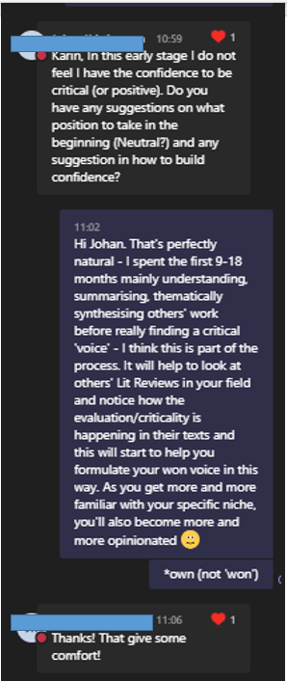

Slide 40
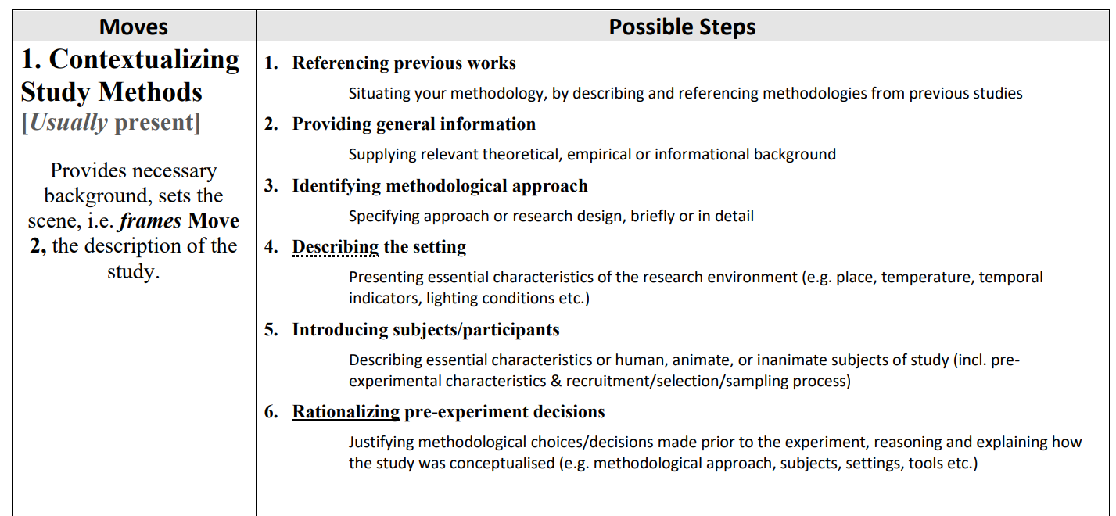

Slide 41
monogloss
a particularly useful focus for Methods sub-genre
heterogloss
Martin & White (2005, p134)

Slide 42
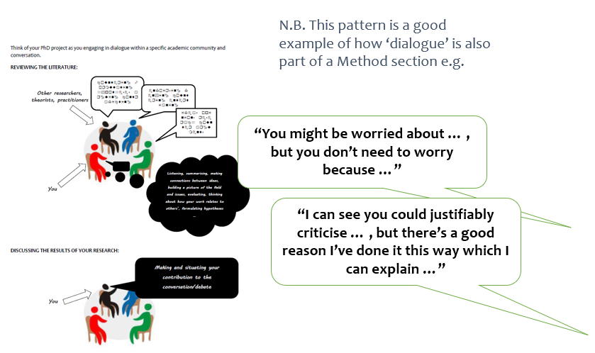
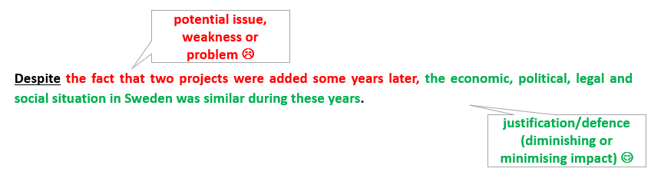

Slide 43
“No recognition of dialogistic alternatives” (Martin & White, 2005, p100)
“Recognition of dialogistic alternatives” (Martin & White, 2005, p100)
e.g. happy, sad
e.g. powerful, weak
moral, immoral
e.g. captivating, boring
e.g. extremely
e.g. reasonably
the next step …
e.g. a true father
e.g. an apology of sorts
Martin & White (2005, p38)

Slide 44
graduation of quantity
graduation of ‘vigour’ of approach
degree of completion
Extract 1 (Wright, 2008)
While many researchers have theorized about the importance of writing, … few have taken an empirical approach to examining the purpose of children’s every day writing practices and written work in school settings. In attempting to fill this gap in research, they show that teachers are the primary audience for students’ writing and that students seek to please the teacher by choosing topics and language that they think will be favoured.
Extract 2 (Yates, 1999)
Green’s study offers a case study exploration of the experiences of ten different students, and in doing so moves on from narrowly defined ‘literacy practices’ to uncover a number of broader issues which make up theses students’ school literacy experiences.
degree of confidence
graduation of scope
graduation of distance
Adapted from Hood, 2012, p. 59

Slide 45

Reflections / lessons learnt …

Slide 46
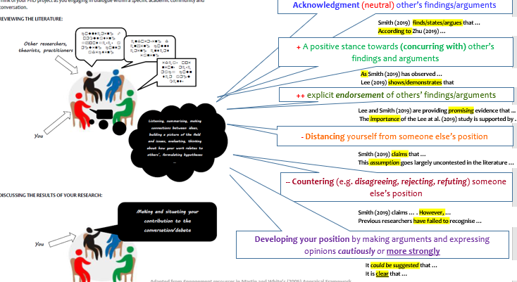
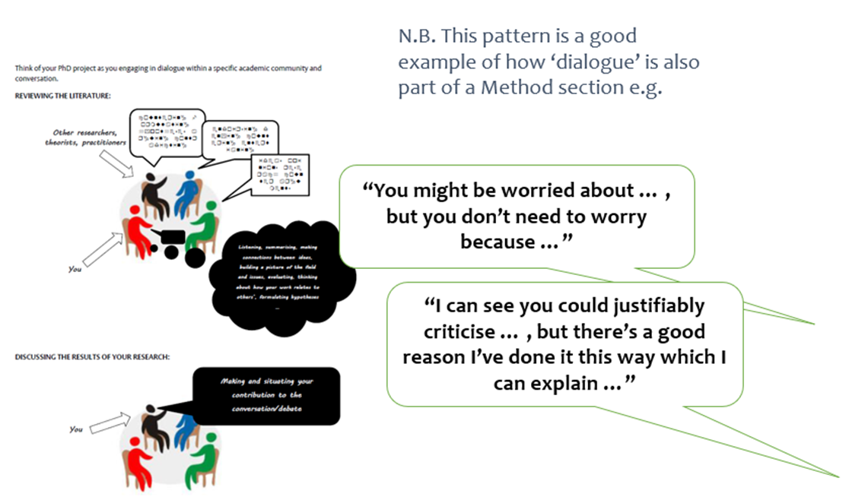
ESP ‘genre’ rhetorical Moves & Steps – a lens for interrogating purposes
N.B. these remain extremely useful!
e.g. Creating a Research Space (CARS) Swales, 1990
e.g. Demonstrating Rigour & Credibility (DRaC)
Cotos et. al., 2019
Introduction
Literature Review
Method
Results & Discussion
Engagement Resources as starting point to prioritise/systematise focus on language for dialogue & criticality …
… ever more consistently a principle of the course’s design, but still a bit top-down - used selectively and adapted
… ongoing journey towards more systematic application, but, pedagogically, the ‘ideal’ still possibly somewhere on a cline between selective and systematic?

Slide 47

Conclusions

Slide 48
References
Charles, M. 2018. Corpus-assisted editing for doctoral students: More than just concordancing. ​Journal of English for Academic Purposes, 36, 15-25.
Cotos, E., Huffman, S., & Link, S. 2017. A move/step model for methods sections: Demonstrating rigour and credibility. English for Speciﬁc Purposes, 46, 90-106.
Eggins, S. 1994. An introduction to Systemic Functional Linguistics. Continuum.
Halliday, M. A. K., & Matthiessen, C. M. I. M. 2014. Introduction to functional grammar (4th ed.). Routledge.
Hood, S. 2012. Voice and Stance as appraisal: Persuading and Positioning in Research Writing across Intellectual Fields. In Hyland & Sancho Guinda (Eds.) Stance and voice in written academic genres. Basingstoke: Palgrave MacMillan, 51-68.
Martin, J. R., & White, P.R.R. (2005). The language of evaluation: Appraisal in English. New York, NY: Palgrave Macmillan.
McGrath, L. 2020. Hidden expectations: Scaffolding subject lecturers' genre knowledge of the assignments they set. Learning Lunch at the University of Surrey.
Monbec, L. 2020. Systemic Functional Linguistics for the EGAP module: Revisiting the common core. Journal of English for Academic Purposes, 43.
Monbec, L. 29th June 2022. Systemic Functional Linguistics for the self-taught – Part 2. BALEAP research & Publications Blog.
Rothery, J. 1994. Exploring Literacy in School English (Write it Right Resources for Literacy and Learning). Sydney: Metropolitan East Disadvantaged Schools Program.
Swales, J. 1990. Genre Analysis: English in academic and research settings. Cambridge University Press.
Thompson, G. 2014. Introducing functional grammar. (3rd ed.). Routledge.

