Slide 1


Deconstructing critical thinking skills provision
The normative and the transformative
Catherine Mitsaki Catherine.Mitsaki@northampton.ac.uk
Dr Qian Zhang Qian.Zhang@northampton.ac.uk

Slide 2


Aims and objectives
Deconstruct current CT provision in UK HE focusing on
  What is available
  How CT is managed in the EAP classroom
  What lessons have been learned
  To what extent student needs are catered for
  How do we move forward

Slide 3

Our preliminary results
Phase 1 – discussion of current provision and challenges we face
Phase 2 – thinking outside the box: new directions

Slide 4
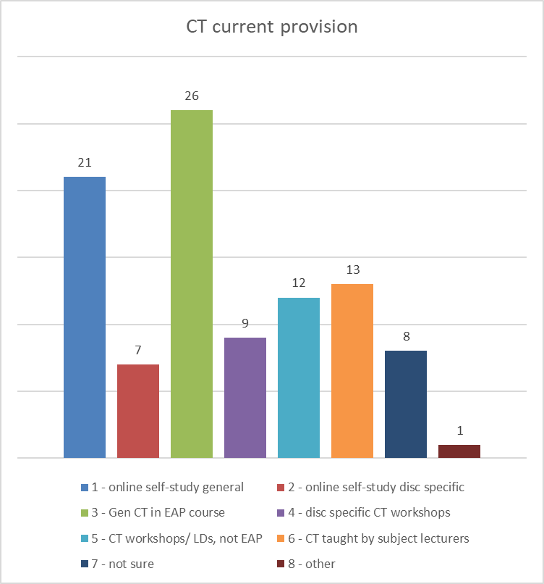
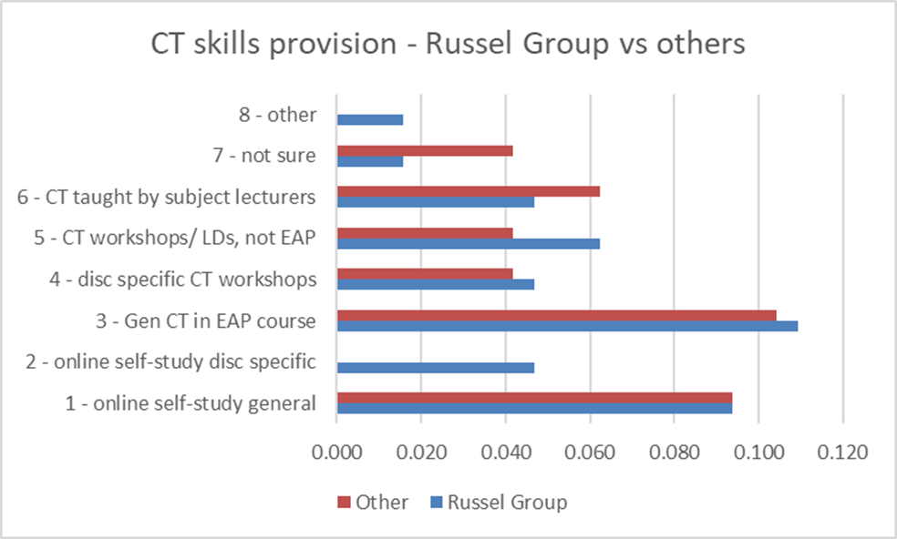
CT skills current provision
Small sample – 30 EAP practitioners
At least 11 different universities – 8 from Russel group, 12 other universities, 10 no reply

Slide 5
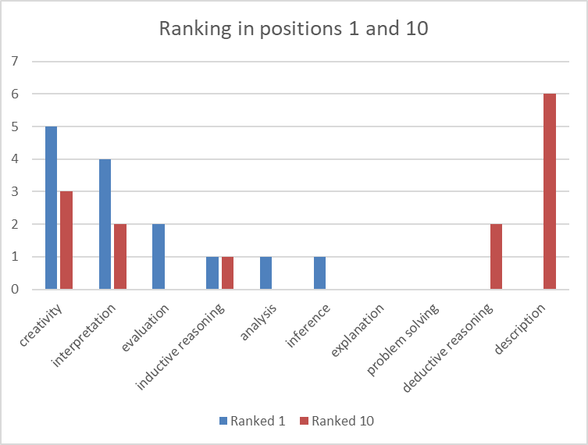
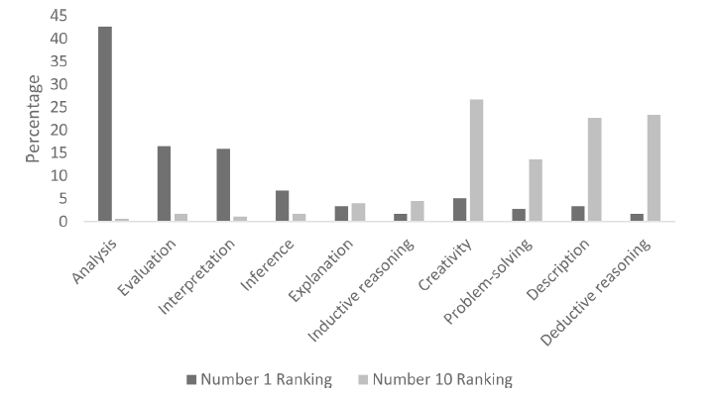

CT skills ranking
Subject instructors – little overlap in the ranking of CT skills in positions 1 and 10
explanation, inference, and inductive reasoning - neither most nor least important
EAP instructors – some overlap in the ranking of CT skills in position 1 but not in position 10
explanation, inference, analysis, problem solving and inductive reasoning - neither most nor least important

Slide 6

CT skills ranking: comments
‘I do not think it is one thing but something that is context dependent [culture of the discipline] & what you are trying to achieve’
‘Different aspects in the above are more/less important depending on level of study (UG, PG, PGR...)’
‘I believe all the above skills are important. I personally wouldn't rank them as they are interconnected.’

Slide 7
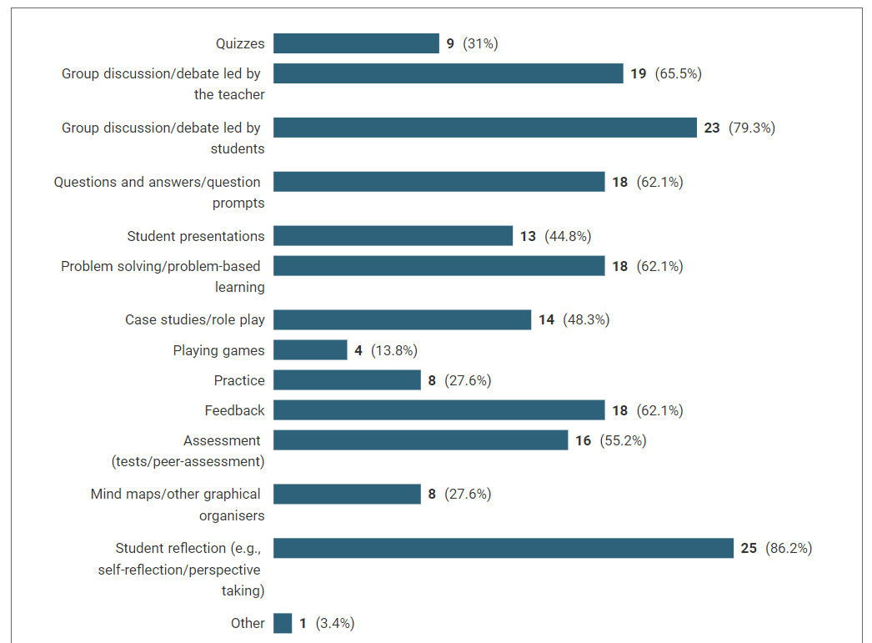

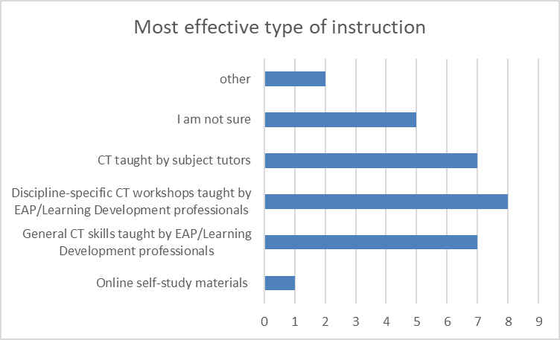
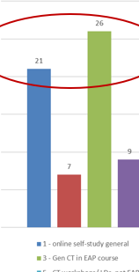
Teaching practices
CT skills taught and practiced in class
Online self-study low compared to second highest in current provision
Teaching techniques used to teach CT skills
Discussions, debates and reflections most popular

Slide 8

What students think
Consistent definitions of CT by both tutors and students – similar understandings (Lloyd and Bahr, 2010)
Different perspectives: students focus on the product while academics focus on the process (Lloyd and Bahr, 2010)
Students struggled to understand the concept of CT and its importance and believe that deep learning is required (Fakunle, Allison and Fordyce, 2012)
A positive or negative event i.e. course feedback may trigger CT skills development (Fakunle, Allison and Fordyce, 2012)
CT was connected to innovative thinking, independent thinking, and a questioning attitude - more strongly associated with dispositions than skills and abilities (Lucas, 2019)
Challenges: lacking background knowledge and differences in educational systems (Lucas, 2019)

Slide 9
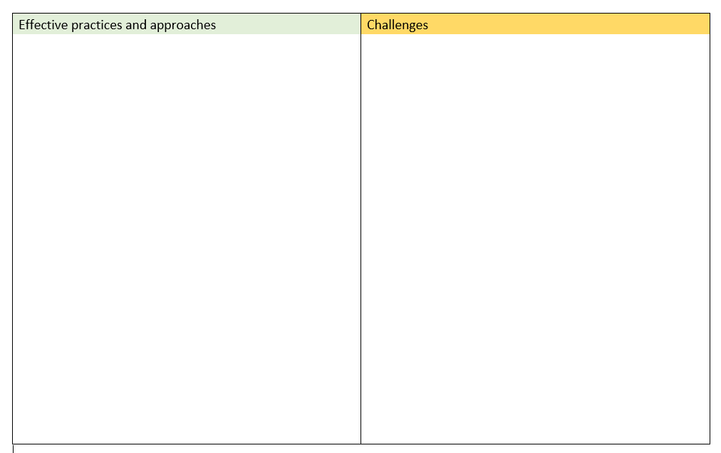


Phase 1
  In 3 mins, introduce yourself and describe what your institution’s provision is regarding Critical Thinking Skills
  To what extent is this provision effective? What are the major issues you are facing both in terms of approach and practice? Write your ideas on post-it notes and stick them on the chart!
  You have 12 mins to do so!

Slide 10

Phase 1
  Take 2 mins and write on a post-it note the ONE thing you would like to discard most
  Bin it!
  Feedback ☺

Slide 11

Phase 2
  Discuss new ideas, innovative practices, new directions, approaches and pedagogies, areas for further research.
  Write your ideas on post-it notes and stick them on the chart!
  You have 15 mins to do so!
  Feedback – go round and check! Which idea(s) would you further pursue?
  Tell us on Mentimeter! ☺

Slide 12
References
Bellaera, L., Weinstein-Jones, Y., Ilie, S. and Baker, S.T., 2021. Critical thinking in practice: The priorities and practices of instructors teaching in higher education. Thinking Skills and Creativity, 41, p. 100856.
Fakunle, L., Allison, P. and Fordyce, K., 2016. Chinese Postgraduate Students' Perspectives on Developing Critical Thinking on a UK Education Masters. Journal of Curriculum and Teaching, 5(1), pp. 27-38.
Lloyd, M. and Bahr, N., 2010. Thinking critically about critical thinking in higher education. International journal for the Scholarship of Teaching and Learning, 4(2), p. 2.
Lucas, K.J., 2019. Chinese Graduate Student Understandings and Struggles with Critical Thinking: A Narrative-Case Study. International Journal for the Scholarship of Teaching and Learning, 13(1), p. 5.

