Slide 1



Critical Inquiry in Canadian EAP:
Political economy, Curricular Breadth,
& Assignment Design
James N. Corcoran Karen Englander & Bruce Russell John McGaughey
Languages, Literature & Linguistics International Foundation Program International Foundation Program
York University, Canada University of Toronto, Canada University of Toronto, Canada
BALEAP, 2023

Slide 2


Diversity, Precarity, and Agency in EAP
A Mixed Methods Study of (De)Constructing EAP Practitioners in Canada
James Corcoran, York University
Julia Williams, University of Waterloo
Kris Pierre Johnston, York University

Slide 3
Overview
Rationale and Objectives
EAP in Canada: Literature
Phase I Findings: Quantitative
Phase II Findings: Qualitative
Discussion
Questions for Researchers, Programs, Institutions and Practitioners
Limitations
Conclusions and Future Avenues

Slide 4

Rationale, Objectives, & Literature

Slide 5
EAP across Canada: Programs and Practitioners
Phase II of ongoing research that seeks to chart landscape of EAP across Canada
This research builds on Phase I findings and attempts to better understand lived experiences of EAP practitioners, focusing on perceptions of professional satisfaction and legitimacy
Aims to add to dearth of work focused on EAP practitioners in Canada
Aims to recognize, validate, and improve the lives of EAP practitioners, an under-research cadre of ELT professionals

Slide 6
EAP across Canada: Programs and Practitioners
EAP Assessment (e.g., Huang, 2018)
EAP Impact (e.g., Fox et al., 2013)
EAP Teacher / student beliefs (e.g., Douglas & Kim, 2014; Douglas et al., 2022)
EAP & L2 Writing Pedagogies (e.g., Bhowmik et al., 2021; Galante, 2020; Marshall & Walsh Marr, 2018; Van Viegen & Zappa-Hollman, 2020)
EAP Programming (Douglas & Landry, 2021; Dyck, 2013)
EAP Practitioners (Breshears, 2019; Valeo & Faez, 2013; MacDonald, 2016)
Notes:
EAP literature very often student-focused and when focused on instructors, often interested in their pedagogical approaches/beliefs etc. Our work focuses on programs and practitioners, looking to chart the Canadian EAP landscape and provide insight into the lived experiences of EAP practitioners.

Slide 7
Critical EAP Lens
In order to better understand the social phenomena associated with EAP programs, and thus advocate for practitioners, we have adopted a critical EAP lens (Author, yr.; Benesch, 2001; Chun, 2019; Harwood & Hadley, 2004; Pennycook, 2021) that “considers hierarchical arrangements within the societies and institutions in which EAP takes place, examining power relations and their reciprocal relationship to the players…involved.” (Benesch, 2009, p. 81)
Notes:
Add Hadley quote

Slide 8
Methodology & RQs

Slide 9
Methodology
Research Design
Sequential mixed methods design, employing both a survey questionnaire and individual interviews
Statistics used as a way of supplementing our understanding of the social world of EAP
Sampling & Participants
EAP directors and instructors from private ESL, college and university contexts drawn from volunteers from a survey (n = 481)
Analytically-driven, randomized invitations were generated and disseminated across groups to 30 directors and 18 instructors, resulting in 18 interviewees
Data collection
60-minute semi-structured interviews conducted with 7 directors (5 University; 1 College; 1 Private) and 11 Instructors (7 University; 3 College; 1 Private)
Data analysis
Multi-level coding of interview data, analytically-informed by survey data (quan & qual)
Mixing of quan & QUAL data sets

Slide 10
Research Questions
RQ #1
Where, how, and by whom is EAP programming delivered across Canadian post-secondary contexts?
RQ #2
What is the self-perceived professional satisfaction of EAP practitioners?

Slide 11
Phase I Findings: Quantitative

Slide 12
Survey Participants
n = 481
Instructors = 75%; Directors = 25%
Universities = 42%; Colleges = 42%; ELIs = 16%
BC = 18%; Prairies = 18%; Ontario = 52%; Québec = 3%; Atlantic = 9%

Slide 13
EAP Across Canada: Salient Findings
Diversity of EAP program types, institution models, students & practitioners
Experienced, well-educated cadre
Salient areas of satisfaction and dissatisfaction across director and instructor groups with significant differences between them
Signs of job precarity as a “lightning rod” issue, particularly among instructors

Slide 14
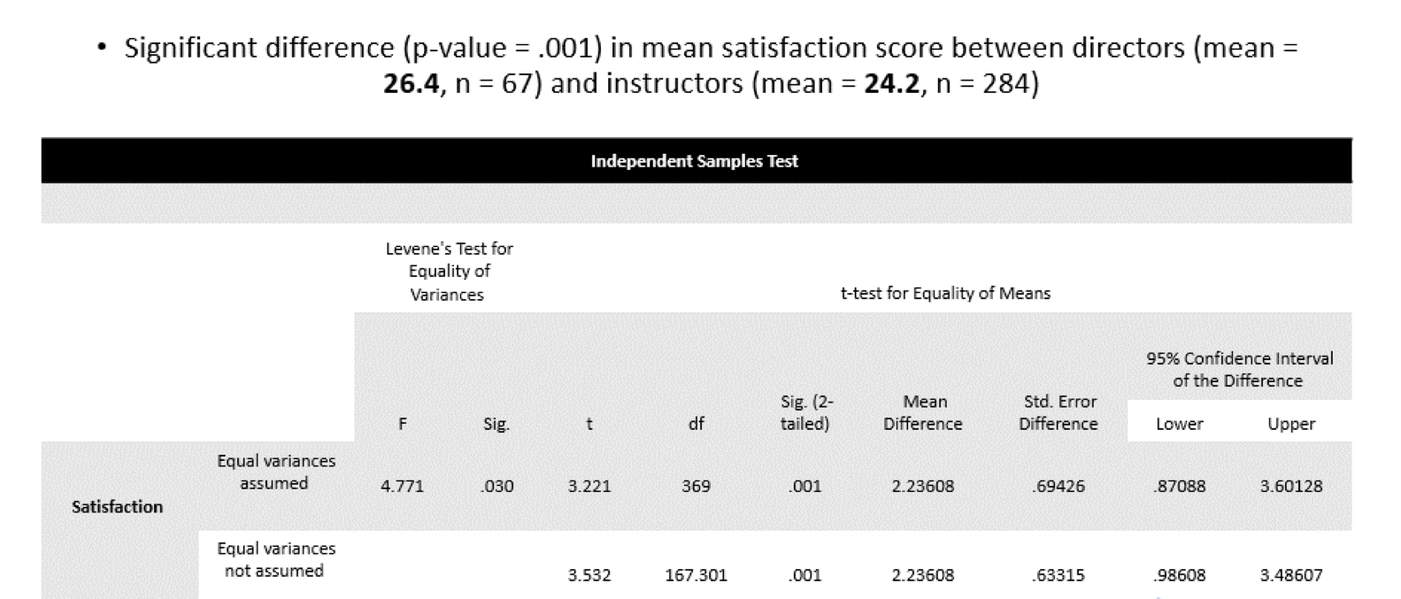
Satisfaction: Directors vs. Instructors

Slide 15
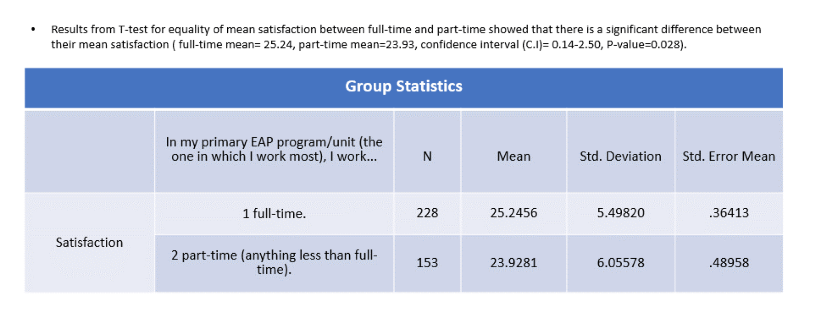
Satisfaction: FT vs. PT Instructors

Slide 16
EAP Across Canada: Open-ended Q
“Am not satisfied with the precariousness of contract teaching. After time, it does take a toll on my mental health. With no job security, I have come to view my [EAP instructor] role as a job rather than a career…[audible sigh] which is disappointing.” (Anonymous EAP instructor)
“Our program is cost recovery, based on enrollments. EAP student numbers are always volatile and this makes us feel insecure and vulnerable to layoffs.” (Anonymous EAP director)

Slide 17
Findings: QUAL (Phase II)
Notes:
Now we will discuss the Phase II Qualitative Findings.
We will focus on Research Questions 2 and 3, ie. directors’ and instructors’ perceptions of being valued within their institutions and programs as well as …
The degree of professional satisfaction, ie. high or low satisfaction with reasons for why they perceive this.

Slide 18
Satisfaction
RQ #3
What is the professional satisfaction of EAP practitioners?
Directors

Slide 19
Respect and Perceived Legitimacy within the Institution and Program
"I think over the 16 years that I've been here there's been a growing awareness that our programs bring in serious money."
Lucy, Director at South Central Canada University
EAP directors have high levels of satisfaction when they feel valued and perceived as important or legitimate members of the institution
Perceived importance and legitimacy often appear connected to EAP as a vital source of revenue for the institution, benefiting departments and programs that recruit internationally
Within EAP programs, high levels of satisfaction stem not only from perceived legitimacy within institutions, but also the sense of collegiality that exists among EAP program staff.

Slide 20
Student Success
"The most satisfying aspect of EAP is any type of learner success, achievement...I like to see the closing ceremony and I always enjoy watching their speeches."
Dave, Director at South Ontario University
EAP directors derive high professional satisfaction from seeing EAL students achieve academic goals.
EAP programs provide vital support for students' immediate and longer-term success, including mental health and academic language development.
EAP directors find great joy in reconnecting with students later in their academic journeys and witnessing their ongoing success.

Slide 21
Facilitating Instructor Professional Development
“I see the work that they do and their research, presenting at conferences...or they're just doing internal research on their own teaching and then reflecting on it. I find that to be very rewarding."
Dave, Director at South Ontario University
Directors expressed high levels of satisfaction with facilitating professional growth among teaching staff
They derived joy from seeing their staff overcome challenges and grow as professionals
Professional development opportunities were valued by directors, and staff who took advantage of them were seen as beneficial to the program by applying and sharing their new knowledge

Slide 22
Dissatisfaction
RQ #3
What is the professional satisfaction of EAP practitioners?
Directors

Slide 23
Lack of Respect from Institution and Program Precarity
"I think for many years ESL professionals have felt that they are sometimes not respected the same way as their other colleagues in the university...It is a profession."
Cheryl, Director at Central Canada University
Low levels of professional satisfaction among directors stem from feelings of frustration due to lack of recognition or standing in the institution
EAP professionals often feel that they are not respected in the same way as their colleagues in other faculties at the university
The perception that "if you can speak English, you can teach it" persists, despite the complexity of teaching a language and working with international students

Slide 24
Unethical Assessment Practices
"There's one student I'm thinking of and everybody in the school knew he wasn't ready. And it didn't matter. He had to go [through to the college program this private institute had an agreement with]."
Amy, Director at Toronto Private Institute
Some directors feel low professional satisfaction when passing students who they believe are unprepared for university studies.
Directors face pressure from various stakeholders, such as parents and agents, to pass unprepared students.
Passing unprepared students creates ethical dilemmas for directors and can lead to feelings of professional dissatisfaction.

Slide 25
Summary of Director Findings
Phase II interview data supported Phase I findings indicating higher levels of professional satisfaction for EAP program directors compared to instructors, largely due to greater job security
Differential satisfaction and agency displayed by those working in universities versus private language institutes, supporting Phase I findings that institution type affects satisfaction levels
University program directors have greater agency and a lesser sense of disarticulation of identity compared to instructors due to their positioning within institutions
Job security is a key differentiator, especially for those working in university settings, but directors also express concern about the future viability of EAP programs if they become unprofitable for the institution
EAP program directors and experienced professionals are a diverse group that have received little empirical attention in existing literature, highlighting the need for further research in this area

Slide 26
Satisfaction
RQ #3
What is the professional satisfaction of EAP practitioners?
Instructors

Slide 27
Connecting with and Supporting Students
Instructors from all institution types derive high levels of professional satisfaction from interacting with and supporting students
Forming bonds with students through interaction and instruction is a significant source of satisfaction for many instructors
Facilitating academic progress and helping students understand conventions of writing also contributes to high levels of satisfaction
Working with students as they navigate their social and academic lives is rewarding and allows instructors to share what they have learned with their students
The emotional, psychological, and professional involvement of teaching contributes to the overall satisfaction of instructors in their roles
"The most satisfactory, hands down, is just the interaction with the students. And watching them progress, I mean, that's why I'm still there."
Antoinette, Instructor at Quebec University

Slide 28
Collegial Relationships, Instructor Autonomy and Professional Development
"I think my co-workers find me really valuable...I think it's a pretty good atmosphere, when we're in the school working together and helping out people."
Tyra, Instructor at Atlantic Canada School
Instructors derive satisfaction from collegial support developed among staff
When instructors are trusted by management, it engenders feelings of professional satisfaction and legitimacy
Professional satisfaction is derived from being "left alone in the classroom" but also given support in terms of curriculum development and free professional development training
Some instructors drew satisfaction from being provided professional development opportunities in their EAP programs, such as attending TESOL through a professional development fund

Slide 29
Dissatisfaction
RQ #3
What is the professional satisfaction of EAP practitioners?
Instructors

Slide 30
Lack of Respect and Legitimacy within the Institution and Program
"It's been interesting to see us focusing very strongly on the recruitment of international students, yet this is not reflected in terms of how the teaching staff are being treated or how the faculty are treated in the academy."
Atun, Instructor at Toronto Technical College
Instructors' value perception comes from being recognized as important service for international students bringing substantial revenue for university
EAP programs are seen as necessary but academically unimportant, with some instructors feeling taken for granted by other faculties
Business-oriented approach to EAP decreases instructors' sense of being valued as professionals and leaves them to fend for themselves after recruitment
Some see EAP programs as illegitimate pipelines for students paying their way into university, leading to concerns about students' academic credibility

Slide 31
Lack of Professional Development Opportunities and Engagement with Research
“There's very little support for the part time instructors or partial load instructors. It really does not give you a feeling like you're appreciated.”
Atun, Instructor at Toronto Technical College
EAP instructors express dissatisfaction with limited professional development opportunities and support, especially for part-time or partial-load instructors
Some university faculty report good support for professional development, but others express discontent with their programs or departments
EAP professionals without research duties also express dissatisfaction with limited opportunities for meaningful academic research
Limited opportunities for professional development and research may contribute to feelings of not being appreciated or seen as legitimate professionals

Slide 32
Conflict with Management, Lack of Autonomy, Stuffed Curriculum, Grading Overload
"There's no autonomy. You do your work and then it just gets revamped in whatever way by a single individual. They don't really trust us to do our own work."
Charlotte, Instructor at North Ontario University
Several instructors reported dissatisfaction stemming from a lack of support, attention, or communication from management
Instructors perceive a lack of autonomy, with top-down administrative decisions and excessive assessment requirements hindering their capacity to innovate
Instructors express frustration with stuffed curricula and grading overload, stating that it leaves no room for discussion, innovation, or relaxation in the classroom
Instructors' perceived lack of autonomy is a marker of their second-class status within neoliberal institutions that prioritize profit over the material conditions of workers

Slide 33
Precarity and Peripheral Participation
"I know that my bosses value me to an extent, but I've also heard my bosses, not necessarily in a threatening manner, suggest that there's more teachers than there are jobs, you know?"
Tyra, Instructor at Atlantic Canada School
Feelings of being expendable are consistent among many EAP instructors, particularly part-time instructors, contributing to professional dissatisfaction
Part-time instructors at universities and colleges perceive unequal treatment compared to full-time staff, with differences in respect, benefits, and salaries
Sessional university and college instructors often express a sense of being second-class employees, with no guarantee of future employment

Slide 34
Summary of Instructor Findings
Qualitative findings support the Phase I survey data regarding lower instructor satisfaction in Canadian EAP
Instructors with less secure employment and those working at private language institutes exhibit greater dissatisfaction
Lower levels of satisfaction stem from reasons often related to employment status and working conditions
Instructors are positioned as second-class employees in many instances
Despite this, there is a consistent dedication to students' learning outcomes and a sense of shared responsibility to attend to their needs
Economic precarity and perceived lack of agency within neoliberal programs and institutions are distinguishing features of Canadian EAP
Social agency appears constricted among instructors, creating differential power relations within the field based on job security

Slide 35
Discussion

Slide 36
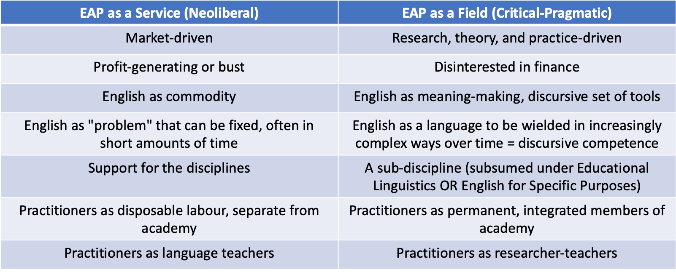
EAP Orientations: Service vs. Field

Slide 37
Discussion
Evidence of conflicting perceptions of EAP instruction (“butler stance” service vs. invaluable support) (Charles & Pecorari, 2016)
Evidence of differential lived experiences and sense of legitimacy/satisfaction between those with and without job stability (Breshears, 2018)
Evidence of contested and constricted practitioner sense of agency within the market of EAP (Bourdieu, 2012; Ding & Bruce, 2017)
Evidence of dedication by EAP practitioners to improving EAL student learning outcomes / lives
Notes:
Adopting a critical lens that considers practitioner agency within the market of EAP, these findings highlight the tensions, juxtapositions, and contestations related to practitioner agency and identity within Canadian EAP.

Slide 38
Discussion
Overwhelming evidence of widespread employment precarity as main factor in practitioners’ sense of dissatisfaction and illegitimacy, adding to body of research from the broader areas of ELT (Breshears, 2018; MacDonald, 2016; Rockwell, 2021; Valeo & Faez, 2013)
In the modern “knowledge economy”, where English language teaching is a form of (real or perceived) abundant, disposable labour for neoliberal institutions of higher education, there is a need for systemic reform that better recognizes and rewards this cadre of workers (Ding & Bruce, 2017; Hadley, 2015)
Findings raise questions as to how we might better equip EAP practitioners for the realities of the “field of battle” (Bourdieu, 2012)
What is to be done? Precarity as a way of life in EAP should be explicitly addressed at a number of levels
Notes:
Adopting a critical lens that considers practitioner agency within the market of EAP, these findings highlight the tensions, juxtapositions, and contestations related to practitioner agency and identity within Canadian EAP.

Slide 39
Questions for Consideration
What is EAP?
How can EAP programs improve the lives of their practitioners given varied institutional constraints?
How might institutions and programs increase a bi-directional flow of knowledge between EAP and other academic programs?
What is the responsibility of language teacher educators in explicitly addressing employment precarity as reality in EAP (and ELT in general)?
How can EAP practitioners advocate for better employment conditions?
How might researchers amplify the voices of ELT practitioners and assist with elevating their status/employment conditions?

Slide 40
Limitations
Self-reporting
Construct validity: operationalization of concepts such as “legitimacy” and “satisfaction”
Limited overall participation from EAP programs and practitioners in Quebec
Limited interviews with those working in the occluded world of private EAP
SARS-2

Slide 41
Conclusions and Future Avenues
Need for greater qualitative (ethnographic) research into lived experiences of EAP practitioners, including highlighting of cases (programs; individuals) where EAP directors and instructors are challenging the potentially coercive relations of power between management and labour
Need for greater research into diverse landscape of EAP programs and practitioners in order to identify ideal (or not) models, pedagogies, etc.
Need for action at several levels in order to provide conditions for greater EAP practitioner agency (Ding, 2019)

Slide 42
Acknowledgements
SSHRC Explore; SSHRC Exchange
York University Liberal Arts & Professional Studies MRG
Renison College - University of Waterloo RG
Contact
James: corcora2@yorku.ca

Slide 43
Selected References

Slide 44
Anthony, L. (2018). Introducing English for specific purposes. Routledge.
Basturkmen, H., & Wette, R. (2016). English for academic purposes. In The Routledge handbook of English language teaching (pp. 164-176). Routledge.
Breshears, S. (2018). The precarious work of English language teaching in Canada. TESL Canada Journal, 36 (2), 26-47. https://doi.org/10.18806/tesl.v36i2.1312
Charles, M. (2013). English for academic purposes. In B. Paltridge and S. Starfield (Eds.) The handbook of English for specific purposes (pp. 137-153). Routledge.
Charles, M., & Pecorari, D. (2016). Introducing English for academic purposes. Routledge.
Ding, A. (2019). EAP practitioner identity. In Specialized English (pp. 63-76). Routledge.
Ding, A., & Bruce, I. (2017). The English for academic purposes practitioner. Cham, Switzerland: Palgrave Macmillan.
Dyck, G.N. (2013). Chinese and Canadian students in undergraduate degree programmes in a Canadian university: A quantitative comparison. In T. Coverdale-Jones (Eds.), Transnational Higher Education in the Asian Context (pp. 216-225). Palgrave Macmillan, London. https://doi.org/10.1057/9781137034946_14
Fox, J., Cheng, L., & Zumbo, B. D. (2014). Do they make a difference? The impact of English language programs on second language students in Canadian universities. TESOL Quarterly, 48(1), 57–85.
Galante, A., Okubo, K., Cole, C., Elkader, N., Carozza, N., Wilkinson, C., Wotton, C., & Vasic, J. (2019). Plurilingualism in Higher Education: A Collaborative Initiative for the Implementation of Plurilingual Pedagogy in an English for Academic Purposes Program at a Canadian University. TESL Canada Journal, 36(1), 121 - 133. https://doi.org/10.18806/tesl.v36i1.1305
Notes:
Add Bourdieu

Slide 45
Huang, L. S. (2018). A call for critical dialogue: EAP Assessment from the Practitioner's Perspective in Canada. Journal of English for Academic Purposes, 35, 70-84.
Hyland, K. & Jiang, F. (2021). A bibliometric study of EAP research: Who is doing what, where and when? Journal of English for Academic Purposes (49), 1-12. https://doi.org/10.1016/j.jeap.2020.100929
Hyland, K. (2018). Sympathy for the devil? A defense of EAP. Language Teaching, 51(3), 383-399.
Hyland, K., & Shaw, P. (Eds.). (2016). The Routledge Handbook of English for Academic Purposes. Routledge.
Hyland, K., & Wong, L. L. (Eds.). (2019). Specialized English: New Directions in ESP and EAP Research and Practice. Routledge.
Marshall, S., & Marr, J. W. (2018). Teaching multilingual learners in Canadian writing-intensive classrooms: Pedagogy, binaries, and conflicting identities. Journal of Second Language Writing, 40, 32-43.
MacDonald, J. (2016). The margins as third space: EAP teacher professionalism in Canadian universities. TESL Canada Journal, 34(1), 106-116.
McKenzie, A. M. (2018). Academic integrity across the Canadian landscape. Canadian Perspectives on Academic Integrity, 1(2), 40-45.
Valeo, A., & Faez, F. (2013). Career development and professional attrition of novice ESL teachers of adults. TESL Canada Journal, 1-1.
Van Viegen, S., & Zappa-Hollman, S. (2020). Plurilingual pedagogies at the post-secondary level: possibilities for intentional engagement with students’ diverse linguistic repertoires. Language, Culture and Curriculum, 33(2), 172-187.

Slide 46

The EAP Intellectual Landscape, and its Implications for Instruction in a Prominent Canadian Pathway Program
Karen Englander & Bruce Russell
International Foundation Program
University of Toronto, Canada
BALEAP, 2023

Slide 47




Context: International Foundation Program (IFP) at the University of Toronto
UofT ranked #1 in Canada and among top 20 globally.
IFP is an EAP pathway program; accepts students with lower IELTS/TOEFL scores
IFP student population ~ 200, most from China
Established in 2009

Slide 48
The University of Toronto study context
New College Vision: to “intentionally promote and foster social responsibility, diversity, equity and global awareness”(2020)
Our concerns
Lack of current review of the EAP field’s theoretical literature.
Such issues may not be well represented in the curriculum.
The university’s Equity, Diversity and Inclusion vision may not be properly met.
Our students may not be fully prepared to enter full-time undergraduate study in the Canadian context.

Slide 49


Three research questions
What have scholars of EAP been writing about in the past 5-(ish) years?
What are the opportunities / challenges that contemporary scholars are posing to the field?
Should, and if so, How can contemporary scholarly insights be transferred to our pathway program?

Slide 50
Method – Collaborative discussion & analysis
Participants
7 instructors
All courses; cis-gender LGBT, hetero; multilingual
Readings (RQ1 – what have scholars been writing about?)
5 broad themes: 2 “obligatory” readings
optional readings, videos, podcasts
Discussions and Analysis
Monthly. 2 hours. Video recorded
17 hours of mtgs plus ancillary materials

Slide 51
RQ1 Literature Inquiry
Translanguaging, plurilingualism
Identity and agency
Anti-racism, anti-Asian, anti-Black, Whiteness
Gender, sexuality, LGBT2SQ
Settlerism and criticality

Slide 52
RQ2: Opportunities and challenges to the field— data emphasized in instructor meetings
The neoliberal agenda underlying EAP and pathways | How English vs plurilingualism is presented | Criticality (EDI, race, queerness, indigenous ways of knowing) within EAP
EAP students perceived or positioned as revenue streams to publicly funded institutions | How to value L1 in pedagogy and assessment while building L2 | Providing varied voices and peoples in materials, content, curriculum
Students must adopt Western academic skills and epistemologies | Valuing experiences, identities and intersectionalities of students and instructors | Tension between “critical” academic skills and “critical” social justice understanding

Slide 53
RQ3: Should, and if so, How to transfer insights to our pathway program?
How should we promote EDI:
Provide multiple voices/faces/perspectives in our “academic skills” content
Move the content from EDI as a “topic” to being “usualized”
Provide students with strategies to recognize and respond to (micro)aggressions
Train instructors to manage “difficult” conversations, e.g. students’ experiences of anti-Asian racism.
Provide instructors with a forum to explore and discuss their own positionality re: race, sexuality, class, religion in relation to classroom openness.
What are the obstacles:
Some instructors feel “unable” to discuss EDI because they don’t identify with a marginalized group.
Program purpose is to promote students’ academic success, not social issues.
International students will return to home country; why learn Canadian social issues?

Slide 54
Resulting programmatic changes
as IFP leadership response
Under-represented voices/perspectives | Learning together programs (instructors) | Learning together programs (students)
1. 50% of all materials (readings, videos, podcasts) from under-represented voices mandated in all courses | 3. Required training: “Micro-aggression”: Tools, Strategies and Discussions | 5. Training: Overcoming the Messaging that Your English “Isn’t Good Enough”
2. Attempt to “usualize” these voices | 4. Required training: Disrupting settler colonial discourses through English language teaching | 6. Training: How Identity Impacts Learning

Slide 55
Implications and Impact
To be determined!
Currently collecting data from each course on EDI content used, plus an anonymized questionnaire to instructors. Planned qualitative study for 2023-24 with students.
Research project reading list and References available
Karen.Englander@utoronto.ca
Bruce.Russell@utoronto.ca

Slide 56
Decolonizing EAP: Raising learners’ awareness of equity and social justice through a research-based writing project on equity and inclusion
John McGaughey
International Foundation Program
University of Toronto, Canada
BALEAP, 2023

Slide 57
Course: Critical Reading and Writing
Fall Term: Reading and research
Winter term: Writing
•
Diverse textual genres of increasing
Diverse written genres for
difficulty
undergraduate programs
Develop in
-
•
depth reading skills via
•
Descriptive essay, annotated
Academic Reading Circles and note
bibliography/literature review;
taking
proposal and outline; argumentative
•
Assessed via 3 quizzes
essay
Begin early stage of independent
research
Assessed through multi
-
•
•
stepped
research paper

Slide 58
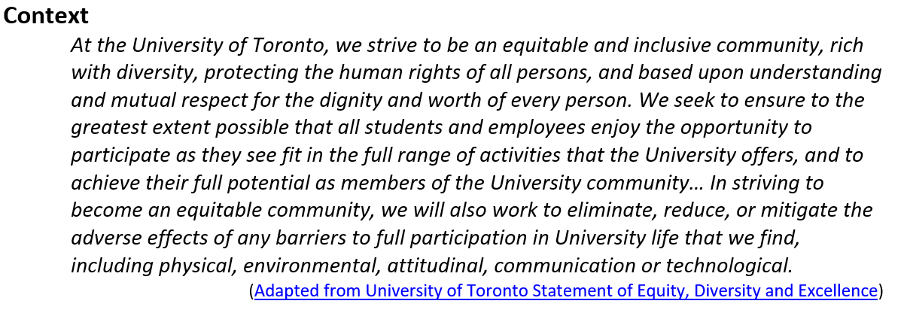
Research paper: EDI statement and research question
Is the University of Toronto’s approach to including your equity-seeking/human rights seeking group representative of other Ontario and international universities?

Slide 59
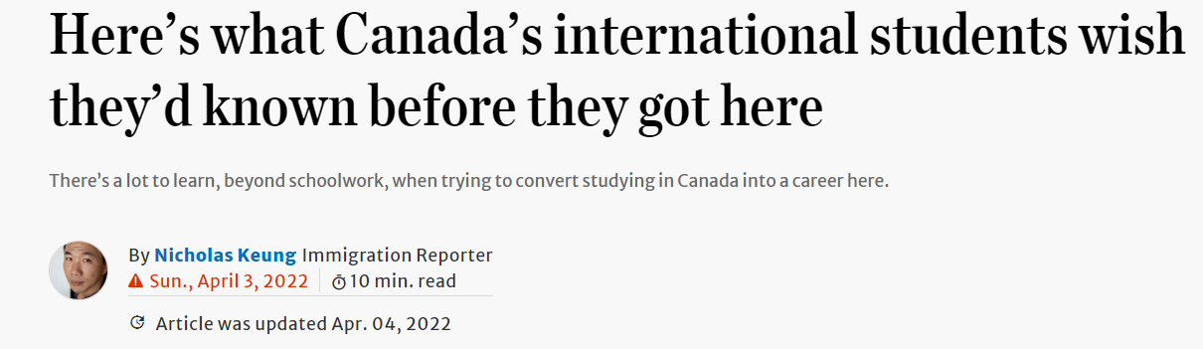
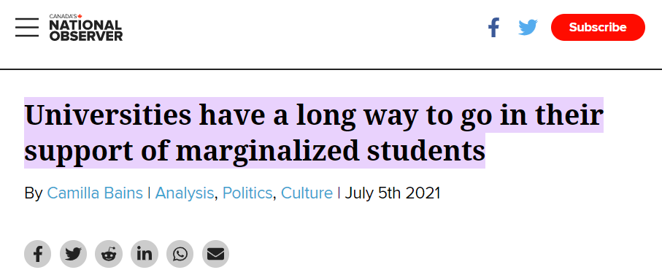
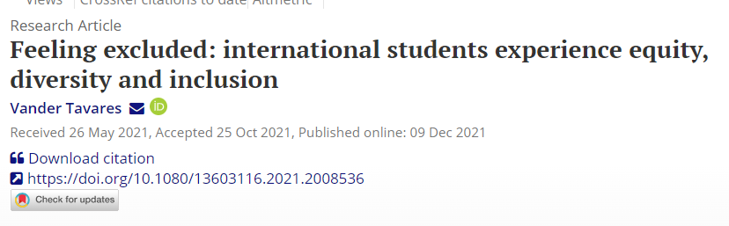
Support through Fall term readings

Slide 60
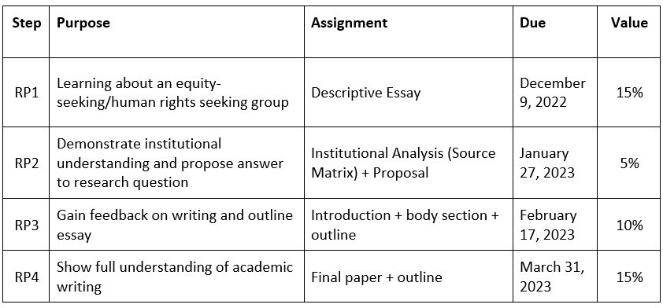
Multi-stepped Research Paper

Slide 61
RP1: Descriptive Essay
Students learned and wrote about the challenges facing one of 5 equity-seeking groups in higher education
  Indigenous students
  Black students
  Asian students
  LGBTQ students
  Refugee students
Findings served as the basis to research how University of Toronto and other universities included their group

Slide 62
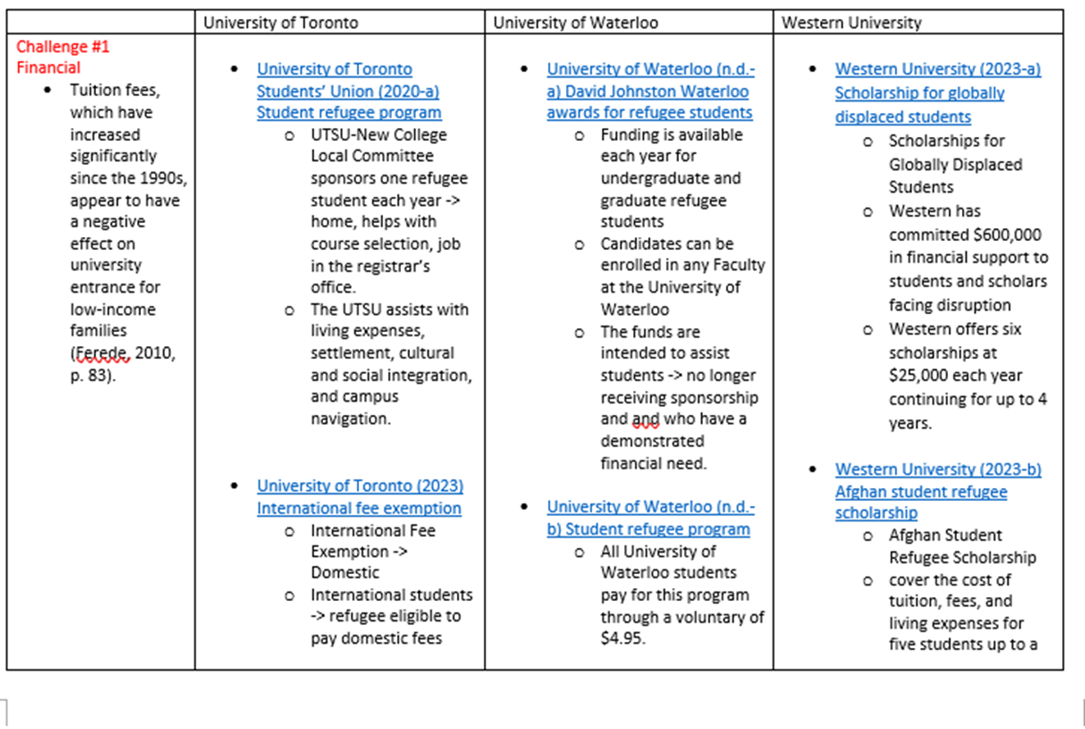
RP2 Institutional analysis (source matrix) + proposal
Focus shifted to learning about universities and how they supported students’ groups and their needs
Recorded research through a source matrix
Wrote a proposal including working thesis statement based on RP1 and their research

Slide 63
RP3/4: Answering the research question through argumentative essay
RQ: Is the University of Toronto’s (UT's) approach to including your equity-seeking/human rights seeking group representative of other Ontario and international universities?
RP2: UT’s approach to the inclusion of refugee students is better than UW and UWO when dealing with financial problems, language barriers, and racism.
RP4: By providing financial resources and Academic English programs, UT is closer to the approach of the inclusion of refugee students than the UW and WU.

Slide 64
RP3/4: Answering the research Q in argumentative essay
RP2: Although UT does not provide as much help as UW, and UBC in dealing with mental health problems faced by LGBTQ2+students, UT’s approach to supporting LGBTQ2+ students is better than UW UBC when dealing with financial insecurity and discrimination.
RP4: UT is more inclusive by offering more financial aid and anti-discrimination resources for LGBTQ2S+ students compared to UW and UBC

Slide 65
RP3/4: Answering the research Q in argumentative essay
RP2: U of T has created a series of programs and offices for LGBTQ+ students, including helping them recognize their identity and providing medical care. But U of T is not representative in supporting LGBTQ students with financial issues.
RP4: While UT is more supportive with financial assistance for LGBTQ+ students, UT is not representative when helping with identity awareness and health care issues as UWO and CC

Slide 66
Limitations
  Limitations
  In-depth independent research study that could not be done at the last minute
    Lack of research on other institutions
    Subject to confirmation bias
  Papers often biased toward UT
    Over-reliance on financial resources
  Difficulty transitioning from problem centered (RP1) to solution centred (RP2-4)

Slide 67
Discussion - Affordances
  Gained awareness of equity in higher education
  Developing ability to critique university EDI statement
  Learned where groups minimally supported
    e.g., Indigenous and refugee students
  Gained awareness of resources that may benefit themselves
    Anti-racism resources
    Mental health resources
    LGBTQIA2S+ resources
Notes:
Through independent research and writing, students were able to:

Slide 68
Q & A
  Thank you for listening!
  If you have any questions or comments, feel free to email me at john.mcgaughey@utoronto.ca
Notes:
Through independent research and writing, students were able to:

