Slide 1
Beyond the Classroom:
Motivating Students to Engage with Academic Texts and Language through a Gamified Web Application
Frank Lauterbach, Tobias Thelen, Ella Dovhaniuk
University of Osnabrück

Slide 2
Situation
subject instruction usually not in English
EAP not immediately relevant
student motivation low

Slide 3
Gamification as Response
→ Gamification as an "eventual translation" of "diverse psychological outcomes into desirable behaviors" (Marc Riar)
focus on game features such as rewards, progress, flow
extrinsic motivational elements as a vehicle
individual usability

Slide 4
Outline
general premises of our iPaca app (Intelligent Personal ACademic Assistant)
basic features of the app
future solutions

Slide 5
Focus of Our Gamified App
reading as a starting point (as most relevant skill)
language structures, (mostly) based on reading
general academic vocabulary as added feature
→ based on an analysis of student needs

Slide 6
Progressions within the Gamified App
increasing complexity of reading genres
gradual addition of academically relevant language structures
step-by-step incorporation of pertinent vocabulary

Slide 7
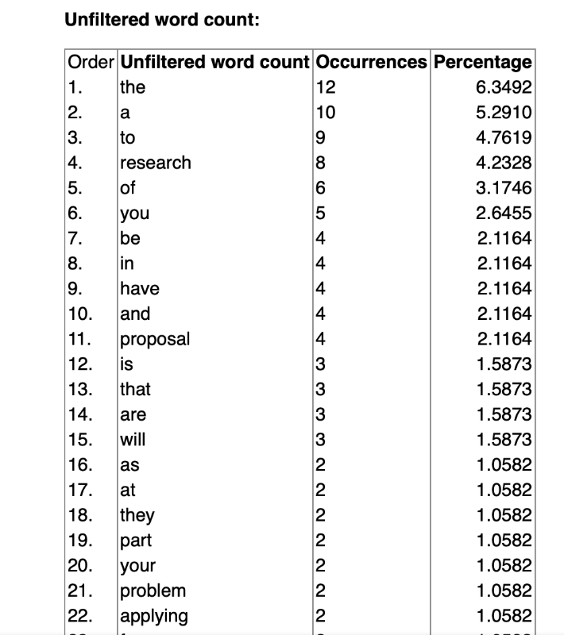
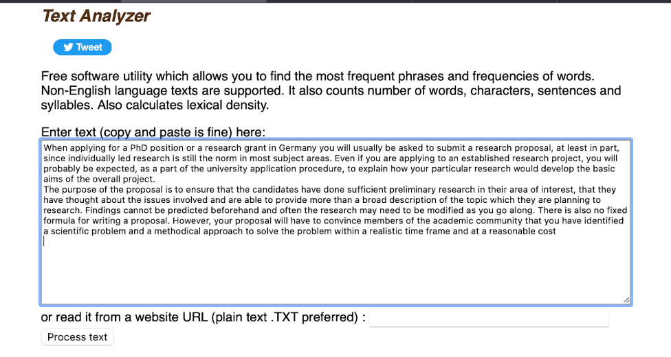
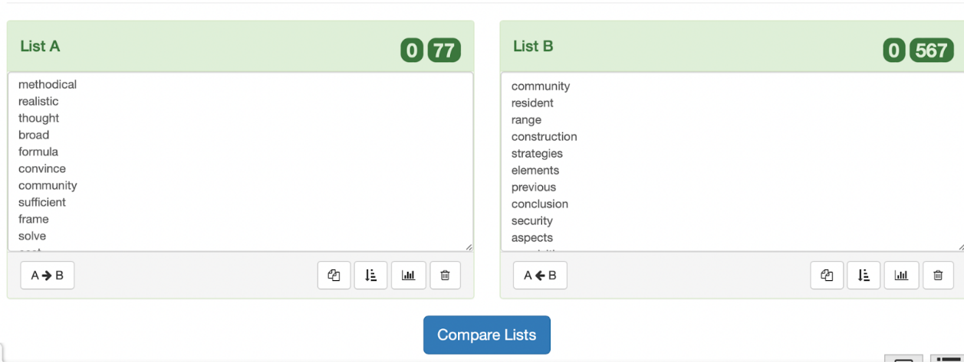

Slide 8
WHAT
WE HAVE NOW:
30 language topics
Text types (3 levels)
Academic and general English
4 interaction modes
Reading, Vocabulary and Grammar&Style tasks
Feedback + links
‘Good to read’ section
Review mistakes
Learner Dashboard
Global Dashboard
“We are our choices.”
― Jean-Paul Sartre

Slide 9
What we are planning to add soon:
Adaptive pre-test
Timing for reading
More writing practice
Extension section (pool)
Badges, bonus tasks
Personalisation
Visual aids (flashcards)

Slide 10
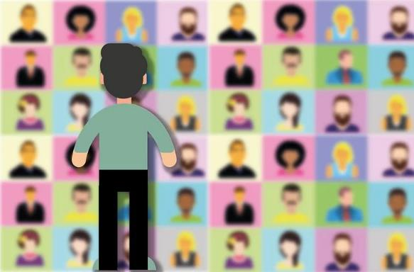
What motivates us or why feedback is important
Unity in diversity: collaboration
Students’ involvement
Ideas are being turned into practice
Ongoing feedback from all the participants
Openness

Slide 11
Thank you for your attention!
https://kommatraining.uni-osnabrueck.de/ipaca/myhome/

Slide 12
iPaca Language Topics
main tenses | adverbial clauses | transitivity | gradability | collocations | link verbs | adverbs in sentences | passive | cohesive devices | parallel structures
articles etc. | conditionals | modal verbs | countability | phrasal verbs | phase verbs | hedging | nomina-lization | connectors | dangling modifiers
use of adverbs | participial phrases | delexical verbs | pronoun usage | position of participles | to-infinitives | reporting | noun clauses | referencing | clefts and pseudo-clefts

Slide 13
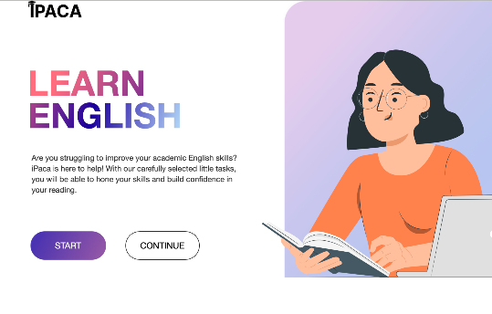
Meet iPaca!

Slide 14
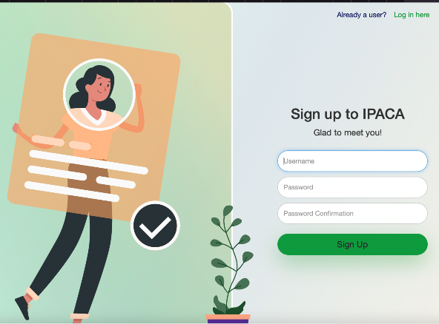
Meet iPaca!

Slide 15
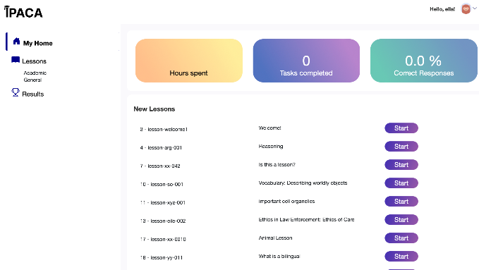
Start page

Slide 16
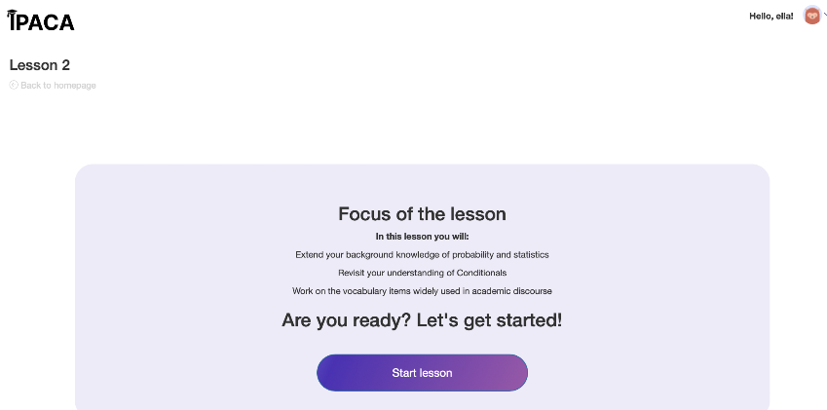
Lesson start

Slide 17
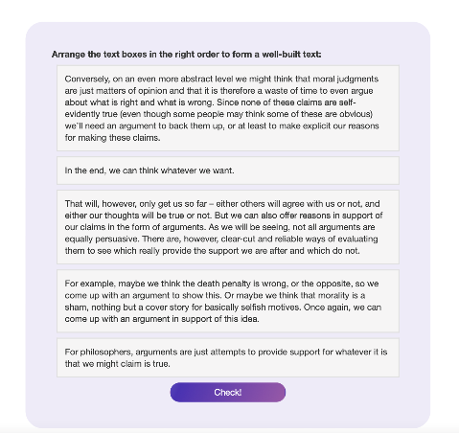
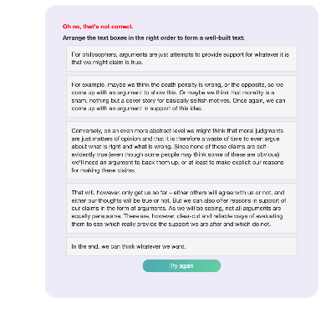
Reading tasks

Slide 18
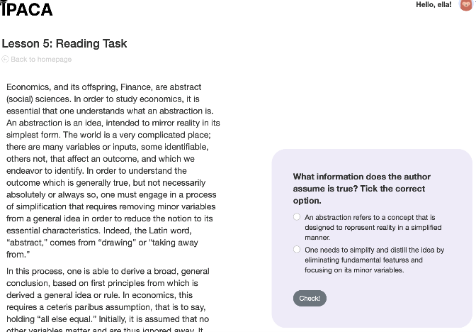
Critical Thinking Questions

Slide 19
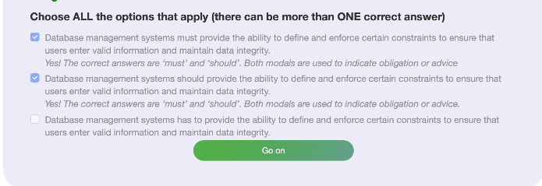
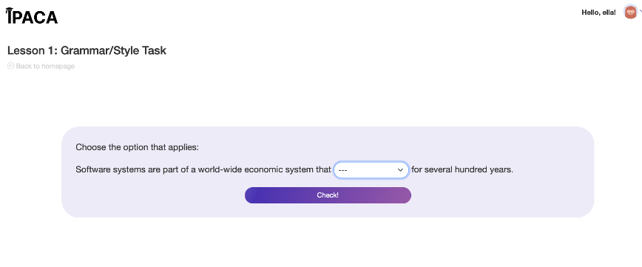
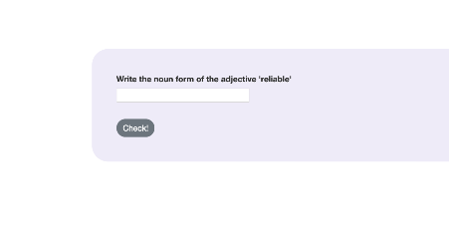
Grammar&Style

Slide 20
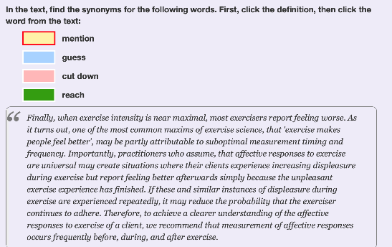
Vocabulary Tasks

Slide 21
Review mistakes

Slide 22
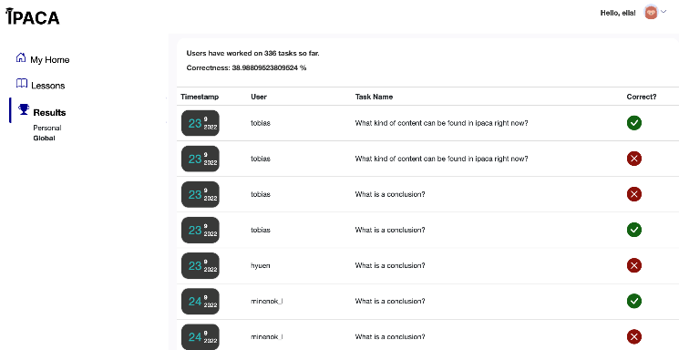
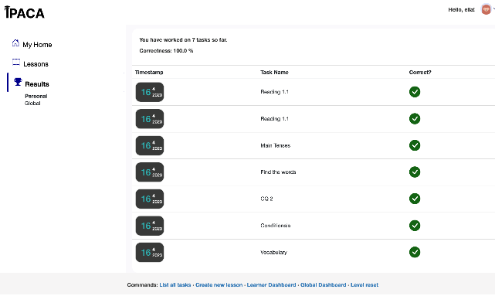
Dashboards
GLOBAL PERSONAL

Slide 23
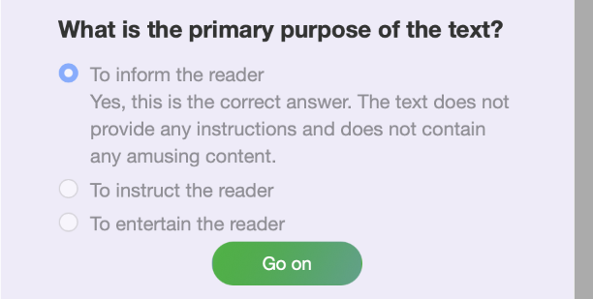
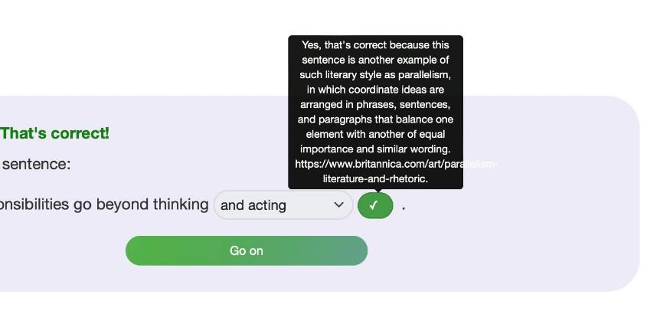
Feedback

Slide 24
Thank you for your attention!
https://kommatraining.uni-osnabrueck.de/ipaca/myhome/

