Slide 1

Beyond the Text: Integrating Tasks and Actions in EAP
Chris Smith
University of Edinburgh
Chris.R.Smith@ed.ac.uk

Slide 2
BALEAP Name Change?
British unnecessary, remove
Association OK
Lecturers exclusive, change
  Professional?
English for Academic Purposes
Change to include academic literacies, but still retain English Language
Professional
Academic
English
Language &
Literacy
Association

Slide 3
Beyond the Text: Integrating Tasks and Actions in EAP
Chris Smith
University of Edinburgh
Chris.R.Smith@ed.ac.uk

Slide 4
Overview
Frameworks
Reception
Mediation
Production
Interaction

Slide 5
Frameworks
Modes and Actions

Slide 6

The 4 skills
Language
Reading
Writing
Listening
Speaking

Slide 7
The 4 Modes of the CEFR
“the CEFR replaces the traditional model of the four skills… which has increasingly proved inadequate to capture the complex reality of communication...
“Activities are presented under four modes of communication: reception, production, interaction and mediation” (CoE, 2018, p. 30).
Language
Reception
Production
Interaction
Mediation

Slide 8

The 4 skills in texts
Reading Research Articles
Writing Essays
Listening Lectures
Speaking Presentations

Slide 9
Bloom’s Taxonomy
Level | Taxon | Actions / Outcome verbs
6 | Create | Produce, develop
5 | Evaluate | Appraise, critique
4 | Analyse | Relate, contrast
3 | Apply | Use, demonstrate
2 | Understand | Identify, describe
1 | Remember | Define, list

Slide 10
Learning Outcomes
In this lesson I will explain how to cook a paella
In this lesson you will make a paella
By the end of this lesson you will be able to make a paella
By the end of the lesson
You will be able to
Prepare ingredients
Sauté
Simmer
Serve

Slide 11
Reception:
Reading and Listening

Slide 12
Text-oriented reading pedagogies
Action-oriented reading pedagogies
Skills approach
  Isolated
Subskills
  Skimming & Scanning
Actions
  Comprehension; language points
Outputs
  Springboard for discussion
Skills approach
  Integrated
Subskills
  Summary, criticality, connections
Actions
  ARCs, seminars
Outputs
  Essays and presentations

Slide 13
Genre Analysis
Actions
Identify genre features (2)
Compare genre features in different texts (4)
Swales (1990)
Very influential
However, may still be text focussed
How do we get learners to engage in the content of the text?
Requires mediation

Slide 14
Academic Reading Circles ARCs
5 roles (Seburn, 2015)
Leader
Contextualiser
Visualiser
Connector
Highlighter
Why are they good?
Student-centred
Focus on content
Employ high level actions

Slide 15
Roles with actions
Role | Actions
Leader | Develop discussion questions (6) Relate contributions (4)
Contextualiser | Compare, contrast & relate (4)
Visualiser | Relate (4), Design (6)
Connector | Evaluate & critique (5)
Highlighter | Identify & explain (2)

Slide 16
Some alternative roles
Role | Actions
Highlighter | Identify & explain (2)
Visualiser (optional) | Difficult for some Ss and texts
Genre analyst | Identify (2) and compare (4)
Summariser | Report (2) and organise (4)

Slide 17
Mediation
Mediation “introduces an additional element: the construction of new meaning, in the sense of new understanding, new knowledge, new concepts” (Piccardo, North, and Goodier 2019, p. 21).

Slide 18
Integrated Reading-into-Writing
More than just
Reading comprehension
  plus
Written production

Slide 19
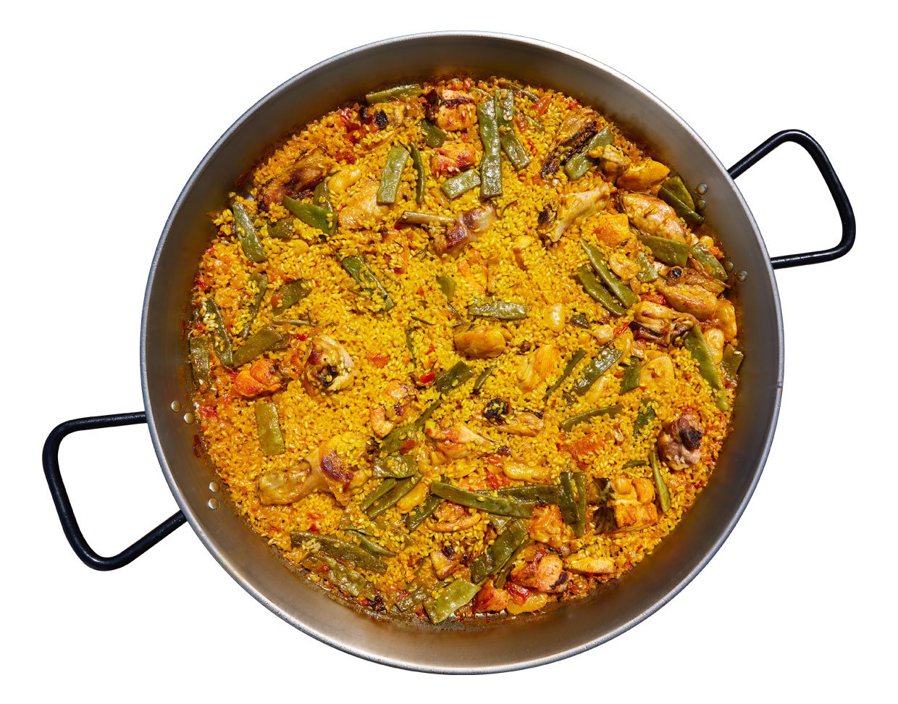
Paella
Ingredients
Finished Dish
Rice
Saffron
Beer/wine
Vegetables
Meat/seafood
Stock

Slide 20
Integrated Reading-into-Writing
More than just
Reading comprehension
  plus
Written production
Summarising, paraphrasing, synthesising
Analysis, critique, comment, comparison
Mediation
Reading-Mediated Writing

Slide 21
Criteria
Reading-Mediated Writing Criteria
Reading
Mediation
Writing
Understanding main ideas
Understanding details
Recognising stance
Paraphrase and summary
Comparison
Criticality
Grammar & Vocabulary
Organisation
Cohesion

Slide 22
Mediation
Modes | Tasks
Reading-Mediated Writing | Essay based on sources Summary of a text
Reading-Mediated Speaking | Presentation Academic Reading Circle
Listening-Mediated Writing | Note-taking task Summary of a lecture
Listening-Mediated Speaking | Oral summary plus Q&A Discussion of a lecture

Slide 23
Production
Product and Process

Slide 24
Generative AI and Writing Tasks
Monitor engagement with process:
Plan
Annotated Bibliography
Evidence of reading
Draft stages
Tutorials
Tutorial focus:
Have you found an article?
Have you read the article?
Can you link it to your essay topic?

Slide 25
Speaking
Presentation
Reading-mediated-speaking
No spontaneity
No interaction
Same mediation as in writing tasks?
Seminars
Group speaking
Based on listening
More than just
listening comprehension plus spoken production:
Listening-mediated-interactional-speaking

Slide 26
Criteria
Listening-Mediated Interactional Speaking Criteria
Listening
Mediation
Interaction
Main ideas
Details
Fact & Opinion
Summary
Criticality
Opinion
Turn-taking
Topic management
Body language
Speaking
Grammar
Vocabulary
Pronunciation

Slide 27
The actions of seminars
By the end of the task cycle, you will be able to
  Identify… of lectures (2)
  Use information from lectures (3)
  Compare your ideas with those of others (4)
  Argue and defend a position (5)
  Critique lecture content (5)
  Construct a position of knowledge (6)

Slide 28
Interaction
Interaction is fundamental to language
Essential part of the EAP construct

Slide 29
Signature Pedagogy
Classroom practices:
  Both genre and process
  But above all action-oriented
Knowledge
  Move away from prescriptivism
Values
  Student-centred

Slide 30
A Framework for
Academic Language and Literacy
Mode | Reception | Production | Mediation | Interaction
Medium
Written | 1. Reading | 3. Writing | 5. of Reading | 7. Written
Spoken | 2. Listening | 4. Speaking | 6. of Listening | 8. Spoken

Slide 31
References
Asención Delaney, Y. (2008). Investigating the reading-to-write construct. Journal of English for Academic Purposes, 7(3), 140–150. https://doi.org/10.1016/j.jeap.2008.04.001
Colina, S., & Lafford, B. A. (2017). Translation in Spanish language teaching: the integration of a “fifth skill” in the second language curriculum. Journal of Spanish Language Teaching, 4(2), 110–123. https://doi.org/10.1080/23247797.2017.1407127
Council of Europe. (2018). Common European Framework Of Reference For Languages: Learning, Teaching, Assessment Companion Volume With New Descriptors. Council of Europe Website. Retrieved from https://rm.coe.int/cefr-companion-volume-with-new-descriptors-2018/1680787989
Galaczi, E., & Taylor, L. (2018). Interactional Competence: Conceptualisations, Operationalisations, and Outstanding Questions. Language Assessment Quarterly, 15(3), 219–236. https://doi.org/10.1080/15434303.2018.1453816
Hinkel, E. (2010). Integrating the four skills: Current and historical perspectives. In R. B. Kaplan (Ed.), The Oxford Handbook of Applied Linguistics (2nd ed., pp. 110–126). Oxford: Oxford University Press.
Piccardo, E., North, B., & Goodier, T. (2019). Broadening the scope of language education: mediation, plurilingualism, and collaborative learning: the cefr companion volume, 17–36. https://doi.org/10.20368/1971-8829/1612
Seedhouse, P., & Walsh, S. (2010). Learning a second language through classroom interaction. In Conceptualising ‘learning’in applied linguistics (pp. 127–146). London: Palgrave Macmillan.

Slide 32
Beyond the Text: Integrating Tasks and Actions in EAP
Chris Smith
University of Edinburgh
Chris.R.Smith@ed.ac.uk

